Slide 1
B.N.C ONLINE CYBER
ALL ARE WELCOMED TO ENJOY THIS ONLINE CYBER SERVICES AT THIS CORONA PERIOD

Slide 2
VISION
TO PROVIDE ONLINE SERVICES TO YOUR HOME AT AFFORDABLE PRICE AND FASTER

Slide 3
SERVICES OFFERED
KRA PIN REGESRATION
HELB/AFYA ELIMU LOAN APPLICATION
NTSA REGESTRATION
NHIF REGESTRATION
TYPESETTING
TSC REGESTRATION
ANY ONLINE APPLICATION
AND ETC

Slide 4
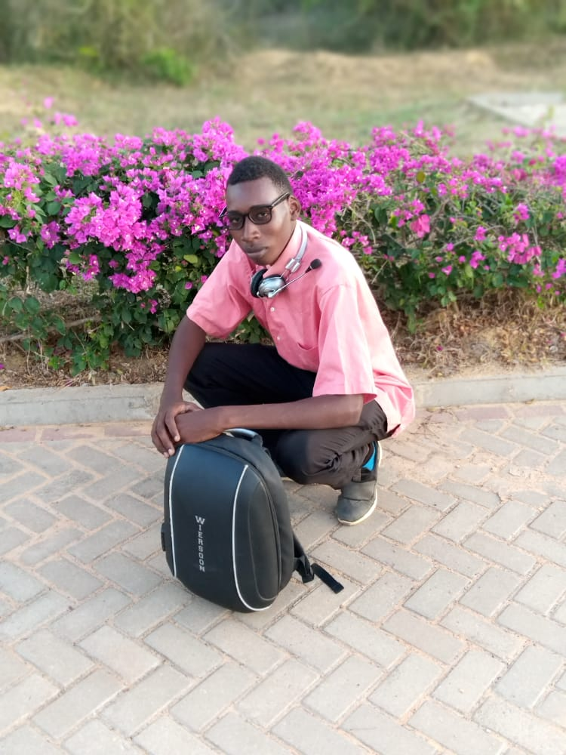
HOW SERVICES ARE OFFERED
ONCE ONLINE SERVICE REQUESTED IS DONE A SOFT COPY IS SENT TO THE CLIENT…
SERVICES ARE OFFERED AT CHEAPPER PRICES COMPARED TO PHYSICAL CYBER
ALL ARE WELCOME TO ENJOY THE WONDERFULL SERVICES
YOUR SERVICE PROVIDER BENSON NDIEMA CHEPKUS

