Slide 1
Radiology and Imaging Orthopedic Plaster Technician and Technologist Students
Patrick M. Githinji
Dept. of M.I.S.
KMTC Nairobi Campus

Slide 2
Learning Objectives
At the conclusion of the lecture (s) learners will be able to:
Understand the scope of Medical Imaging
Understand the source of X-radiation used in Medical Imaging.
Understand the names given to the types of X-ray energies and the application of each in the medical field.
Understand the properties of X-rays
Understand the radiographic image formation
Understand the terminologies used in the description of radiographic projections and positioning.
Understand the techniques used to obtain radiographic images of the bones of the appendicular skeleton
Understand the basic principles of radiographic image interpretation
Understand the cardinal principles of radiation protection.

Slide 3
What is medical imaging?
Medical Imaging is a discipline within the medical field which involves the use of technology to take images of the inside of the human body for the purpose of diagnosis – hence sometimes referred to as diagnostic imaging.
The goal of medical imaging is to provide a picture of the inside of the body in a way which is as non-invasive as possible.
An imaging study can be used to identify unusual things inside the body such as broken bones, tumors, leaking blood vessels, etc.

Slide 4
What is Radiology?
Radiology is the branch of or specialty of medicine that deals with the study and application of imaging technology to diagnosing and treating diseases. The following imaging modalities are used in the field of diagnostic imaging:

Slide 5
Projection (plain-film) radiography
Radiographs are produced by the transmission of X-rays through a patient to a capture device, and then converted into image for diagnosis.
The capture device is an X-ray film which is enclosed in a light tight container- the cassette. Now replacing the X-ray film in digital radiography is a plate of sensors. The X-ray image strike the plate of sensors which then converts the signals generated into digital information and a visible image is generated on computer screen. Plain radiography is usually the first study ordered in evaluation of lungs, heart and skeleton because of its wide availability, speed and relative low cost.

Slide 6
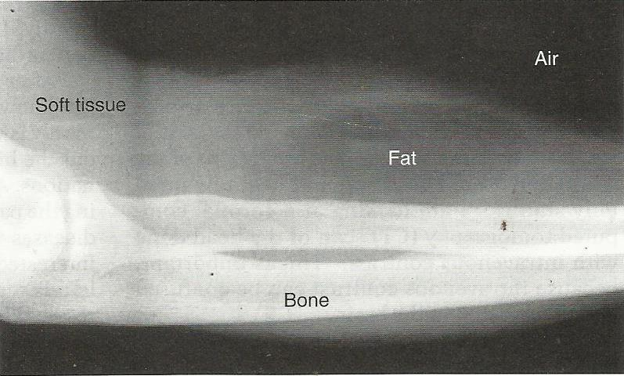
Plain-film radiography
Radiograph of the forearm showing soft tissue, fat, and bone. Air is demonstrated in the background

Slide 7
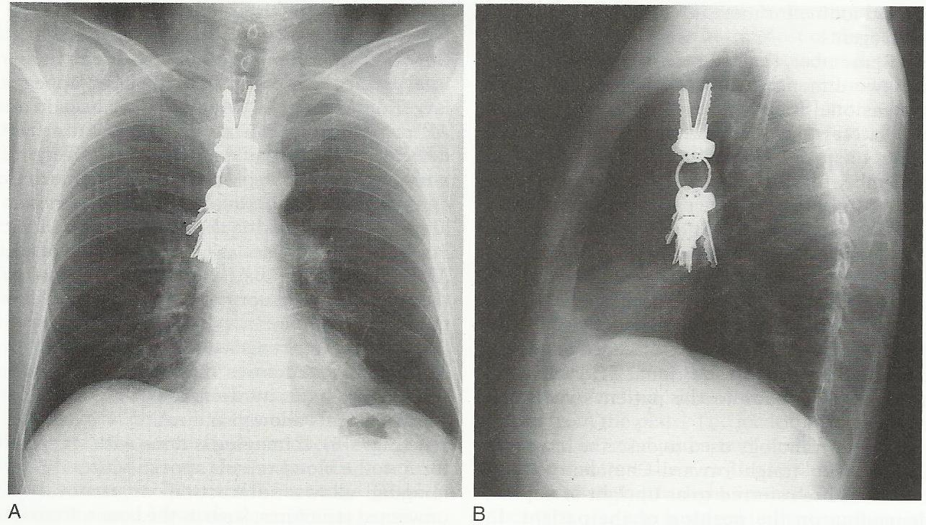
Plain-film radiography
PA and Lateral views of chest x-ray demonstrating foreign body

Slide 8
Fluoroscopy
Fluoroscopy is a special application of X-ray imaging in which a fluorescent screen and image intensifier tube is connected to a closed-circuit television system. This allows real time imaging of structures in motion. During fluoroscopy radiocontrast agents are administered, orally, intravenously or introduced in cavities, to delineate anatomy and functioning of the blood vessels, the genitourinary system or the gastrointestinal tract..

Slide 9
Fluoroscopy
Two radiocontrasts are presently in use;
1. BaSO_{4 _} oral or rectal route for evaluation of the GI tract
2. Iodine – oral, rectal, intra-arterial or intravenous routes
These radiocontrast agents strongly absorb or scatter X-radiation and in conjunction with the real time imaging allows demonstration of dynamic processes e.g. peristalsis in digestive tract or blood flow in arteries and veins, and in the hearts. Iodine contrast may also be concentrated in abnormal areas more or less than in normal tissues and make abnormalities (tumors, cysts, inflammation) more conspicuous. In specific circumstances air can be used as a contrast agent for the gastrointestinal system, in these cases, the contrast agent attenuates the X-ray radiation less than the surrounding tissues

Slide 10
Computed Tomography (CT)
CT imaging uses X-rays in conjunction with computing algorithms to image the body. An X-ray tube rotate around the patient producing a computer generated cross-sectional mage (tomogram) Through reconstruction it is possible to generate 3 D images of carotid, cerebral and coronary arteries. CT scanning has become the test of choice in diagnosing some urgent and emergent conditions such as cerebral hemorrhage, pulmonary embolism, appendicitis, diverticulitis and obstructing kidney stones.

Slide 11
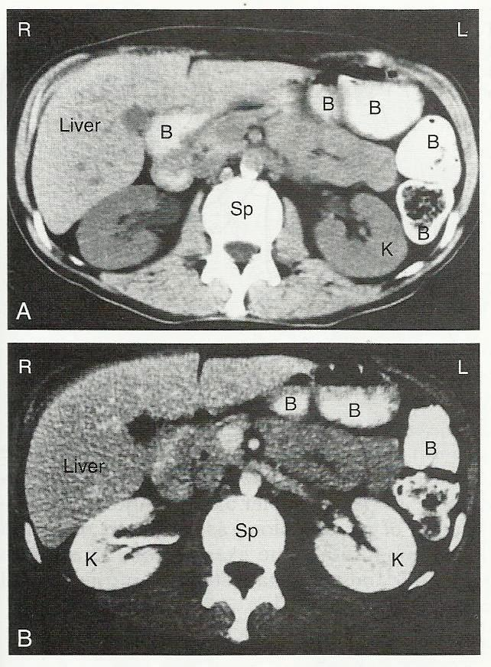
Computed tomography image
CT Images of the abdomen

Slide 12
Ultrasound
Ultrasound uses high frequency sound waves to visualize soft tissue structures in the body in real time. Ultrasound is limited by its inability to image through air (lungs, bowel loops) or bone. Because u/s does not utilize ionizing radiation, unlike radiography, CT and nuclear medicine, it is generally considered safer. Thus this modality plays a vital role in obstetrical imaging. Fetal anatomy development can be thoroughly evaluated allowing early diagnosis of many fetal anomalies. Growth can be assessed over time; this is important in patients with chronic disease or gestation induced disease, and in multiple gestations (twins, triplets, etc).

Slide 13
Ultrasound
Color- Flow Doppler U/S measures the severity of peripheral vascular disease and is used for dynamic evaluation of the heart, heart valves and major vessels. DVT in the legs can be found via u/s before it dislodges and travels to the lungs (pulmonary embolism) – this can be fatal if left untreated. U/S is useful for image–guided interventions like biopsies. U/S is useful in the assessing for the presence of hemorrhage in the peritoneum and the integrity of the major viscera e.g. liver, spleen and kidneys.

Slide 14
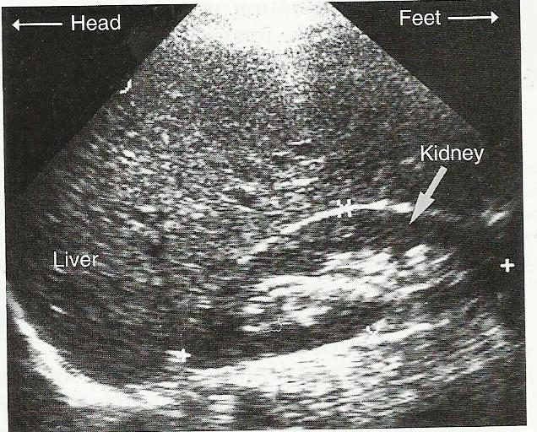
Ultrasound scan
Abdominal u/s scan showing the kidney and the liver

Slide 15
Magnetic Resonance Imaging (MRI)
MRI uses strong magnetic fields to align atomic nuclei (usually hydrogen protons) within the body tissues. Then a radio signal is used to disturb the axis of rotation of these nuclei. The radio signal is removed and the axis of rotation of the nuclei return to normal. As they return to their normal state a radio frequency signal is generated. The radio signals are collected by coils placed near the place of interest, and used to create an image.

Slide 16
Magnetic Resonance Imaging (MRI)
An advantage of MRI is its ability to produce images in axial, coronal, sagittal and multiple oblique planes with ease. MRI scans give the best soft tissue contrast of all the imaging modalities. One disadvantage is that the patient has to remain still for long periods of time in a noisy, space while the image is being performed. Claustrophobia, severe enough to terminate an MRI exam has been reported in 5% of patients. MRI has great benefit in imaging the brain, spine and musculoskeletal system. The modality is contraindicated for patients with pacemakers, cochlear implants, some in dwelling medication pumps, certain types of cerebral aneurysm clips, metal fragments in the eye, and some metallic hardware due to the powerful magnetic fields and strong fluctuating radio signals, the body is exposed to.

Slide 17
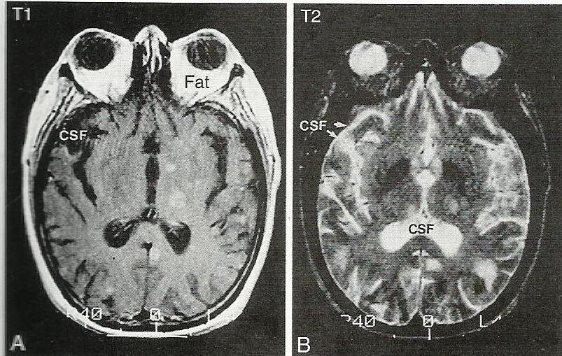

Slide 18
Nuclear medicine
Nuclear Medicine imaging involves the administration into the patient of radiopharmaceuticals consisting of substances with affinity for certain body tissues labeled with radioactive tracer. The most commonly used is Technetium 99m, iodine – 123, iodine -131, gallium – 67 and thallium – 201. The heart, lungs, thyroids, liver, gall bladder, and bones are commonly evaluated for particular conditions using these techniques.
Nuclear medicine is useful in displaying physiological function. The excretory function of the kidneys, iodine concentrating ability of the thyroid, or blood flow to heart muscle, can be measured . The principle imaging device is the gamma camera which detects the radiation emitted by the tracer in the body, and display it as an image.
The application of nuclear medicine can include bone scanning which has been traditionally used in staging of cancers

Slide 19
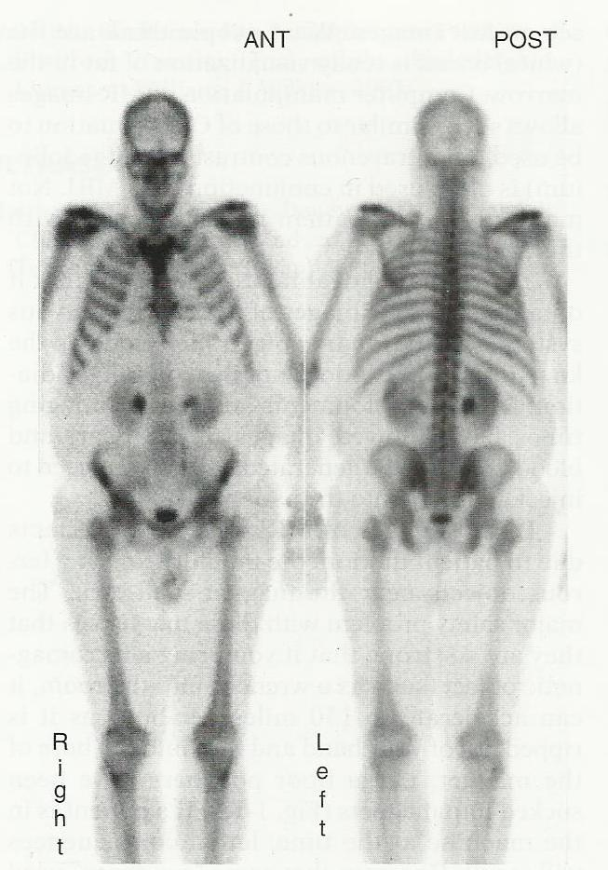

Slide 20
X-rays
Matter can absorb energy from exterior sources e.g. heat. The atoms of the matter becomes excited when they absorbs this energy. As they return to their normal state they shed the energy which they absorbed in a form similar to that which was absorbed. The energy emitted in this manner is called electromagnetic radiation. Examples of electromagnetic radiation include X-rays, heat light. This energy (X-ray, heat or light) radiated is always accompanied by electrical and magnetic field. The two have directions at right angles to the direction in which the radiation is traveling.

Slide 21
X-rays
Electric Field
Radiation (heat, light X-ray)
Magnetic Field

Slide 22
X-rays
Electromagnetic radiations cover a wide band of wave lengths and frequencies. The complete range of wavelengths is called electromagnetic spectrum:
X-rays & Gamma rays
Ultraviolet
Visible light Increasing wavelength
Infra-red
Microwaves
Radio waves

Slide 23
Generation of x-rays
X-rays are generated in a part of the X – ray equipment called X-ray tube. X-ray tube is made up of an evacuated glass tube in which there is a positive electrode (anode) and a negative electrode (cathode). High potential difference is applied between the electrodes. This establishes an electric field in the region between them. The force due to this field causes electrons from the cathode to be accelerated towards the anode at high kinetic energy. The electrons bombard a limited area of the anode surface known as focus. The focus stops the electrons abruptly thereby causing the kinetic energy being converted to heat and X-rays.

Slide 24
Range of X-rays produced and application
Type of X-ray | Approximate energy | Application
Diffraction | < 10 kVp | Research: structural and molecular analysis
Grenz rays | 10-20 kVp | Medicine: Dermatology
Superficial | 50-100 kVp | Medicine: Therapy of Superficial tissues
Diagnostic | 30-150 kVp | Medicine: Imaging anatomical structures and tissues
Orthovoltage | 200-300 kVp | Medicine: Therapy of deep-lying tissues
Super voltage | 300-1000 kVp | Medicine: Therapy of deep-lying tissues
Megavoltage | >1MV | Medicine: Therapy of deep –lying tissues Industry: Checking integrity of welded metals.

Slide 25
Properties of X-rays
Photographic effects
When X-rays are absorbed by a photographic emulsion, the ionization occurs in the crystal whereby silver bromide is produced. During development the silver bromide is reduced to metallic silver thereby rendering the photographic effect visible.

Slide 26
Fluorescent effects
When X-rays fall on certain materials the latter fluoresces i.e. it produces light. Such materials include calcium tungstate, zinc sulphide, cesium iodide. The effect is used in fluoroscopy and intensifying screens.

Slide 27
Ionization and excitations effects
When X-rays pass through air ionization and excitation of the atoms and molecules occur. Ionized air is a good conductor of electricity. The effect is used in the measurement of the quantity and intensity of radiation for personnel monitoring.

Slide 28
Penetrating effects
X-rays penetrate substances which visible light cannot penetrate. However they are gradually absorbed as they pass though the substance. The effect is used in radiotherapy in the calculation of doses of radiation absorbed in the body.

Slide 29
Biological effects
When living cells absorb penetrating radiation, the resulting ionization produces changes which may cause the cells to lose their power of division, or to produce abnormal daughter cells after division. If sufficient radiation is absorbed, the cells may be destroyed.

Slide 30
Radiographic Image formation
The process of image formation is as a result of differential absorption of the X-ray beam as it interacts with the anatomic tissue. Differential absorption is a process whereby some of the X-ray beam is absorbed in the tissue and some passes through the anatomic part. The term differential is used because varying anatomic parts do not absorb the primary beam to the same degree. Anatomic parts composed of bone will absorb more X-ray photons than parts filled with air. Differential absorption of the primary X-ray beam will create an image that structurally represents the anatomic area of interest.

Slide 31
Radiographic Image formation
The areas within the anatomic tissue that absorbs incoming X-ray photons create white or clear areas (low density) on the radiographic image. The incoming X-rays photons that are transmitted create the black areas (high density) on the radiographic image. Anatomic tissues that vary in absorption and transmission create a range of dark and light areas (shades of gray). The exit radiation that interacts with the X-ray film creates a latent or invisible image as explained by the photographic effect of X-rays. The latent image is made visible by processing the film whereby a radiograph is produced.

Slide 32
Radiographic Image formation
The process of converting the latent image to a visible image can be summarized as a three – step process within the emulsion.
The latent image is formed by exposure of silver halide grains
The exposed grain and only the exposed grains are made visible by development
Fixing removes the unexposed grains from the emulsion and makes the image permanent.

Slide 33
Terminologies used for Description of Radiographic projections and positions
AP-Anteroposterior (demonstrate the posterior)
PA-Posteroanterior (demonstrates the anterior)
Lateral -From the side (demonstrates the lat side near the film)
Oblique-Between lateral and AP (or PA)
Decubitus-Lying horizontal
Supine- Lying on the back

Slide 34
Terminologies used for Description of Radiographic projections and positions
Prone -Lying face down
Erect -Standing
Axial -Along the axis (of an anatomic structure)
Cephalic-Towards the head
Caudal -Towards the feet.

Slide 35
RADIOGRAPHIC PROJECTIONS
Extremities
The upper limb consists of the arm, forearm and hand. The term arm refers to that part of the upper limb between the shoulder and the elbow (and not the whole limb).
Bones of the upper limb – humerus, radius, ulna, carpals, metacarpals and phalanges
When examining the upper limb, the whole of the arm should rest on the x-ray couch to bring the adjacent joints level with the area to be radiographed.
In the AP position the arm is supine lying with the palm of the hand facing upward; the elbow is extended and the shoulder well down.
The tube is centered from above the couch

Slide 36
Hand- PA, Lateral and oblique
PA: The forearm is placed on the table with the elbow flexed and the palm of the hand on the cassette.
Fingers are extended but relaxed and slightly separated to bring them into close contact with the cassette.
Centre over the head 3rdmetacarpal bone.

Slide 37
Lateral
The hand and forearm are turned into the lateral position so that the palm of the hand is at 90⁰ to the film (cassette) with the fingers overlapping and the thumb resting on a non-opaque support centre over the head of the second metacarpal bone

Slide 38
Oblique
Hand is rotated forward to mid-way (45⁰) between the postero-anterior and the true lateral.
The fingers are separated and rest on a 45⁰ non-opaque pad for immobilization centre over the head of the fifth metacarpal bone.

Slide 39
Fingers
PA.
The hand is positioned as for the basic view for the hand.
A smaller film is used.
The film should include the finger on each side of the one being examined centre1 over the head of the metacarpal bone of the finger under examination
i.e. over the proximal interpharangeal joint

Slide 40
Lateral
Index or middle finger
The lateral aspect of index finger is brought into contact with the cassette.
The middle finger is supported on a non-opaque pad.
The remaining fingers are flexed to the palm.
Centre over the proximal interphalangeal joint of the index finger

Slide 41
Lateral Ring and Little finger
The hand is in the lateral position.
The medial aspect of the finger is in contact with the film.
The ring finger is supported on a non-opaque pad.
The remaining fingers are flexed to the palm of the hand.
Centre over the proximal interphalangeal joint of the little finger.

Slide 42
Thumb
Lateral
The hand is place downwards.
The ulna aspect is raised on a form pad so that the thumb is in the lateral position centre over first metacarpo-phalangeal joint

Slide 43
AP
The arm is extended along the X-ray table with the palm downwards.
The hand is then rotated until the posterior aspect of the thumb is in contact with the film.
Centre over the metacarpo-phalangeal joint

Slide 44
Wrist Joint
PA
The patient sits beside the X-ray table with the elbow flexed.
The forearm and hand placed palm down centre between the styloid process of radius and ulna

Slide 45
Forearm
The patient sits beside the X-ray table with the elbow extended.
The arm is extended at the elbow so that the shoulder, elbow and wrist are on the same level.
The humeral epicondyles should be equidistant from the film centre to the middle of the forearm.

Slide 46
Lateral
The limb is placed in the lateral position with the elbow flexed; the forearm and the humerus are at right angles and the hand is in lateral position
Centre to the middle of the forearm.

Slide 47
Elbow joint
AP
The patient sits beside the x-ray table.
The elbow is extended and the arm is outstretched with the back of the hand on the table.
The shoulder must be well down so that the arm and forearm are in one plane and the elbow is in true antero-posterior position.
Centre through the joint space i.e. 2.5 cm below (distal to) the epicondyles

Slide 48
Lateral
The arm and the forearm are placed in the usual lateral position with the elbow joint flexed to an angle of approximately 90⁰.
The arm and forearm must be in the same plane such that the epicondyles are superimposed. Centre to the lateral epicondyle (of the humerus)

Slide 49
Humerus
AP
Patient is examined either erect or supine.
The patient faces the x-ray tube.
The elbow is extended, with the palm of the hand facing forwards.
The epicondyles must be equidistance from the cassette
Centre to the mid-shaft of the humerus i.e. between the shoulder and elbow joint

Slide 50
Lateral
From the previous position the forearm is flexed at the elbow to 90⁰.
The arm is abducted to 45⁰ and the forearm is rested on the table in the lateral position with the thumb uppermost.
Centre to the mid-shaft of the humerus i.e.
between the shoulder and elbow joint

Slide 51
Shoulder
AP
The patient is examined either erect or supine.
The patient facing the tube is rotated 30⁰ until the scapula is parallel with the film.
The elbow is flexed and the forearm is directed forward.
Center over the coracoid process (a bony prominence below the outer third of the clavicle)

Slide 52
Axial (supero-inferior)
The patient sits beside the x-ray table with the arms abducted and the elbow flexed at right angles.
A curved cassette is place under the axilla and the shoulder region is as flat as possible
Centre over the head of humerus.

Slide 53
Scapula
AP
The patient faces the x-ray tube and is rotated about 30⁰ to bring the plane of the scapula parallel with the cassette.
A long exposure time is used, with the patient breathing gently, to blur out the lung and rib shadows.
Centre over the head of humerus.

Slide 54
Lateral
The patient faces the cassette with, the elbow of the side being examined flexed and the arm slightly abducted.
The patient is rotated about 60-75⁰ with the side under examination towards the cassette, until the plane of the scapula is at right angle to the cassette.
Centre to the medial border of the scapula.

Slide 55
Clavicle
Postero-anterior
The patient faces the cassette and is rotated slightly so that the long axis of the clavicle is parallel with it. The head is turned away from the affected side to allow the clavicle to make good contact with the cassette.
The arm is rotated medically until the palm of the hand faces upward, and the opposite shoulder is raised and supported on a small sand bag.
Centre to the middle of the clavicle i.e. to the superior angle of the scapula.

Slide 56
The lower limb

Slide 57
The Foot
Dorsi-planter
The patient sits or lies semi-recumbent with the sole of the foot on the cassette.
The leg is angled 45⁰ medially
Centre over the cuboid-navicular region with the central ray perpendicular to the film

Slide 58
Dorsi-plantar oblique
From the dorsi-planter position, the leg is allowed to lean medically until the sole of the foot is at an angle of 45⁰ to the film.
The opposite limb acts as a support to assist immobilization.
Centre to the medial border of the foot, at the level of the navicular.

Slide 59
Lateral (to demonstrate foreign bodies)
The patient is moved into the general lateral position.
The knees are flexed so that the planter aspect of the foot, is at right angles to the table.
Centre to the middle of the foot or to the site of entry of a foreign body.

Slide 60
Calcaneus
Lateral
The foot is placed in the lateral position.
A small aperture is used.
Centre to the calcaneum

Slide 61
Axial
The patient sits with the legs extended.
The foot is dorsi-flexed as much as possible.
The toes are pulled back by a bandage round them and held by the patient.
Centre to the plantar aspect of the calcaneus with the tube angled 30⁰cephalad

Slide 62
Calcaneal Spur
This condition is often bilateral and lateral views of both calcanei are required.
Centre to the calcaneus.

Slide 63
Toes
Dorsi-plantar
The sole of the foot is placed on the table.
A small aperture is used.
Centre to the toe being examined.

Slide 64
Lateral
For 1st (Great), 2nd or 3rd toes:
The foot is placed on this side, with the medial aspect in contact with the film.
The 4th and 5th toes are held out of the way (using patient’s finger of a bandage).

Slide 65
4th or 5th toes
The foot is placed on its side, with the lateral aspect in contact with the film.
The other toes are held out of the way as much as possible.
Centre to the toe being examined.

Slide 66
Oblique
If the toes cannot be separated easily, an oblique view is taken.
The foot is rotated medically 45⁰ and supported.
Centre to the great toe.

Slide 67
Ankle
AP
Patient sits or lies with the limb extended and immobilsed such that the malleoli are equidistant from the film.
Centre between the malleoli.

Slide 68
Lateral
Patient is turned towards the side being examined with the knee flexed.
The position of the ankle is adjusted until the malleoli are superimposed.
Centre to the medial malleolus

Slide 69
Tibia and Fibula
These are the bones of the leg
They articulate with each other at the proximal and distal tibio-fibular joints.

Slide 70
AP
The knee is extended and the leg medially rotated slightly so that the malleoli are equidistant from the cassette.
Both the knee joint and the ankle should be included.
If this is not possible, the joint nearer the site of injury should be included.
Centre to the mid-shaft of the tibia

Slide 71
Lateral
From the AP position the knee is flexed and the leg laterally rotated.
The malleoli should be superimposed and the patella at right angles to the film.
Centre to the mid-shaft of the tibia

Slide 72
Knee
AP
The patient sits or lie with the knee extended and the limb in slight medical rotation so that the patella is parallel with the cassette.
Centre 1 cm distal to the apex of the patella.

Slide 73
Lateral
The patient is turned towards the side being examined. the knee is flexed and its position adjusted until the patella is at right angles to the cassette. The femoral condyles must be superimposed.
Centre to the medial tibial condyle.H

Slide 74
Patella
Pastero-anterior
The patient lies prone.
The cassette is brought into close contact with the patella.
Centre to the crease of the knee.

Slide 75
Infero-superior or ‘Skyline’
The patient sits with the knee flexed at about 135⁰.
The cassette is supported vertically about 15cm proximal to the femoral condyle.
The tube is placed at the level of the foot and is directed upwards at an angle of about 10⁰
Centre to the inferior surface of the patella

Slide 76
Femur
AP
The limb is extended and medially rotated to bring the patella parallel with the table.
The upper border of a 35x43 cm cassette is place at the level of the anterior superior iliac spines so that hip joint is included on the radiograph.
The beam is collimated to the width of the thigh.
Centre to the shaft of the femur.

Slide 77
Lateral
The Patient is rotated towards the side being examined.
The knee isflexed and the leg is allowed to rest on the table such that the femoral condyles are superimposed and the knee is lateral.
The lower border of the 35 x 43 cm cassette is placed at the level of the tibial condyles, so that the knee joint is included on the radiograph.
The beam is collimated to the width of the thigh.
Centre to the shaft of the femur

Slide 78
Pelvis
The patient lies supine with the legs extended.
The pelvis must be positioned symmetrically, with the anterior superior iliac spines equidistant from the cassette.
The feet are separated slightly and internally rotated.
Centre is the midline, 5cm below the anterior superior iliac spine.

Slide 79
Hip Joint
AP is routinely taken after trauma, for congenital abnormalities and arthritis.
The patient lies supine with the fee separated slightly.
The lower limbs are internally rotated 30⁰ and immobilized.
The pelvis must be positioned symmetrically, with the anterior superior iliac spine equidistant from the table.
Centre in the mid-line, 2.5 cm above the symphysis pubis.

Slide 80
Lateral
The patient is rotated towards the side being examined. The knee is flexed and the leg is abducted and allowed to rest on the table.
Centre to the femoral pulse – palpable in the groin.

Slide 81
The Thoracic Cage
Upper Ribs
PA
The patient faces the cassette.
The chin is raised and placed on top, and in the midline of the cassette.
The elbows are flexed and the backs of the hands are placed on hips.
The elbows are pushed forwards
Centre to the cassette.

Slide 82
Oblique
Left ribs – left posterior (L/AP) oblique or
Right anterior (R/PA) oblique view, depending on the site of interest
Right ribs – right posterior (R/AP) oblique or left anterior (L/PA) Oblique.
The patient is rotated 45º from the AP or PA positions as the case may be.
Centre in the mid-clavicular line of the side under examination, at the level of the middle of the cassette.

Slide 83
Lower Ribs
AP
Patient lies supine on the X-ray table.
A cassette is placed transversely with its lower border 5 cm below the lower costal margin.
Centre in the midline at the level of the middle of cassette.

Slide 84
Oblique
The patient is rotated 45⁰ so that the side being examined is nearer the table centre in the mid-clavicular line of the side being examined at the level of the lower costal margin.

Slide 85
Radiographic diagnosis of fracture
The primary aim of extremity radiography is to diagnose the presence of a fracture or dislocation. It also aims at assessing the position of the bone ends before and after treatment. Follow – up radiographs are subsequently needed for bony union and complications.

Slide 86
Radiographic diagnosis of fracture.
The diagnosis of a fracture on a radiograph depends on identifying the features detailed under the classification of fractures.
A fracture is identified by the loss of continuity of the cortex and a dark line traversing the adjacent bone. The fracture line appears dark because the soft tissue, (usually hematoma) between the bone ends is of less density than the bone itself.
A fracture may appear as a dense sclerotic line if the fracture ends are overlapping. At this site there is therefore twice as much bone attenuating the –ray beam e.g. the depressed skull fracture or the overlapping long bone fractures.

Slide 87
Radiographic diagnosis of fracture.
It is important to obtain two views at right angles for all suspected fractures and dislocations. On occasion a fracture or dislocation may only be visible on one projection. Two views are still essential to adequately see the degree of deformity at the fracture site.
It is important that the radiographs always show the joint above and below any suspected long bone fracture, unless it is clinically obvious that the injury is only in the most distal part of the limb. But even then the nearest joint must always be included on the film. It also helps to assess for associated dislocation especially in paired bones e.g. forearm or leg.

Slide 88
In certain circumstances the fracture may not be visible on the radiographs at the time of presentation due to bone resorption, e.g. undisplaced and stress fractures
A fracture line will become visible about 2 weeks after injury. Hence follow-up examinations may be required if clinically suspected but it is not visible immediately after injury
Comparison views of the opposite limb may be required in the immature skeleton before epiphysis closure. This will help to confirm if a bone fragment is an unfused ossified epiphysis, or a fracture.

Slide 89
Fracture healing can be assessed with serial radiographs. There are three phases of healing:
Inflammatory phase: A hematoma (clot) forms at the site of the fracture
Reparative phase: Bone at the fracture margins is deprived of its vascular supply resulting in resorption at the bone ends. On the radiograph, fractures which are difficult to see at first become more easily seen. The cells lining the cortex start to produce immature bone (callus). This is seen as a faint calcification around the fracture
Remodeling phase: The immature callus is replaced by compact (denser) bone in the cortex and cancellous bone within the medullary cavity.

Slide 90
Radiographic diagnosis of fractures
Image interpretation. Refer to separate P.P. Presentation ‘Upper limb trauma’ and ‘lower limb trauma’

Slide 91
Radiation protection
The medical use of ionizing radiations involves diagnosis or therapy. The use results in the radiation of the patient. It may also result in some degree of exposure of the staff-radiologists, radiographers, nurses, porters or even other workers in rooms around the X-ray department. All these people are therefore subject to some degree of radiation hazard. Radiation projection ensures that the doses received are as small as possible, so that the consequent damage never constitutes a significant hazard to the health of the irradiated person.

Slide 92
The biological effects of radiations
Human responses to radiation exposure fall into two types.
Deterministic radiation responses
Stochastic radiation responses
Deterministic These responses result from exposure to high dose of radiation and are an early response. Example is radiation induced skin burns, organ dysfunction, prenatal & neonatal death, congenital malformation, GIT Syndromes, CNS syndrome

Slide 93
Stochastic
These responses results from low dose radiation exposure delivered over a long period and appear as a late radiation response – 5 to 30 years.
Examples - Cancer (Bone cancer, Lung Cancer, Thyroid Cancer, Breast Cancer)
Leukemia,
Genetic effects,
Local tissue damage (Skin, Gonad, eyes)
Shortening of life span
Childhood malignancy
Diminished growth and development

Slide 94
The human response to radiation exposure can bring about either genetic effect or somatic effect.
NB: Genetic effects – those harmful effects to the future generations
Somatic effects - those harmful effects to persons being irradiated.

Slide 95
Maximum Permissible Dose (MPD)
The International Commission on Radiological Protection (ICRP) has defined (MPD) as the maximum dose of radiation that, in the light of present knowledge would be expected to produce no significant radiation effects either somatic or genetic. individuals are divided into two categories. The occupationally exposed (radiation workers) and occasionally exposed.

Slide 96
The MPD for an occupationally exposed individual is 20 mSv per year. That for non-occupationally (occasionally) exposed is 1/10 as much (2 mSv per year). Occupationally exposed individuals work in an area which is under the supervision of a radiation protection supervisor. This area is called controlled area.

Slide 97
. Exposures in controlled areas must be kept at a level that would allow a radiation worker to stay in the area during his entire working day without exceeding the MPD. Areas occupied by occasionally exposed persons are designated as uncontrolled areas e.g. a corridor, waiting room, elevator, parking lot.

Slide 98
Cardinal Principles of Radiation Protection
Radiation exposure to patients, public and radiation workers can be minimized by use of the three cardinal principles of radiation protection- time, distance and shielding.

Slide 99
Minimize Time
If the time during which one is exposed to radiation is doubled the exposure will be doubled. Therefore the time of exposure must be kept as short as possible. Repeat X-ray examinations should be avoided wherever possible.

Slide 100
Maximize distance
As the distance between the source of radiation and the person increases, radiation exposure decreases rapidly. Intensity α 1/d^{2 .} Therefore as large distance as possible should be maintained between the source of radiation and the person.

Slide 101
Use shielding
Lead rubber aprons for staff or relatives
Lead shielding between the radiation source and radiographer
Protective barrier material for the wall and partitioning.
Lead rubber pieces for gonads.

