Slide 1
ORTHOPAEDIC NURSING
Musau

Slide 2
BROAD OBJECTIVE
By the end of the course , the student will be able to nurse patients with orthopedic medical/ surgical disorders.

Slide 3
Specific Objectives
By the end of the unit, the students will be able to:
Define M. S. D
Recognize some M.S.D clinical features
Describe the pathophysiology
Explain nursing interventions in order of priority in each condition
Explain the complications of M.S.D

Slide 4
Course outline
History and trends in orthopedic nursing
Definition and scope of orthopedic nursing
Review anatomy and physiology of musculoskeletal system
Bone injury and repair of bone healing
Assessment of the orthopedic patient
History taking and physical
examination and muscle strength testing
Health assessment

Slide 5
Trauma and injuries
Fractures and polytrauma
Nerve injuries and vascular injuries
Soft tissue injuries - contusion, sprain, strain
sport injuries
Amputation

Slide 6
Orthopedic conditions
Infection of bone and joints
Tuberculosis
Osteomylytis
Arthritis
Bone tomours
Benign and
Malignant and therapies for tumours )
Deformities
scoliosis
khyphosis
lordosis and
congenital disorder)

Slide 7
Disorders of the spine
Intervatebral disc prolapse
pelvic inflammatory disease
fracture of the spine
lower back pain/disorder) Nutritional metabolic disorders
Rickets
Osteomalacia
Osteoporosis
gout

Slide 8
Chronic/ degenerative disease of joints and auto immune disorder
Osteoarthritis
Rheumatoid
arthritis
ankylosing spondylitis

Slide 9
Management and rehabilitation
Care of patients with orthopedic devices
Splints
Braces
plaster casts
types of tractions
the orthopedic bed
ripple mattress

Slide 10
Rehabilitation
Principles of rehabilitation,
Occupational therapy
Counseling and community based rehabilitation,
Challenges in rehabilitation,
Role of nurse in rehabilitation,
National policies regarding persons with physical disabilities.

Slide 11
Review: Skeletal System
Bone types
Bone structure
Bone function
Bone growth and metabolism affected by calcium and phosphorous, calcitonin, vitamin D, parathyroid, growth hormone, glucocorticoids, estrogens and androgens, thyroxine, and insulin.

Slide 12
Bones
Human skeleton has 206 bones
Provide structure and support for soft tissue
Protect vital organs

Slide 13
Bones
Compact bone
Smooth and dense
Forms shaft of long bones and outside layer of other bones
Spongy bone
Contains spaces
Spongy sections contain bone marrow

Slide 14
Bone Marrow
Red bone marrow
Found in flat bones: sternum, ribs,
cranium, pelvis
Produces blood cells and hemoglobin
Yellow bone marrow
Found in shaft of long bones
Contains fat and connective tissue

Slide 15
Types of Bones
Bones are classified as
short(metarcapals),
Irregular(vertebrrae) flat or sesamoid (sternum),
long bones e.g. femur
The bone is the hardest tissue in the body and when fully developed comprises of:
Water 20 %
Organic material 30% to 40%
Inorganic materials 40% to 50%
.

Slide 16
Inorganic material mainly constitutes of mineral salts especially calcium and phosphates.
Organic materials: bone cells and tissues
The cells making up the bone are: osteoblasts, osteoclasts and osteocytes.
There are two types of bone tissue –
compact- harder outer tissue of bones
cancellous.-sponge like tissue inside bones

Slide 17
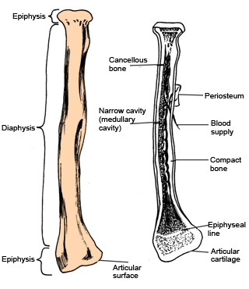
ct

Slide 18
long bones (eg, femur

Slide 19
Joints (Articulations)
Area where two or more bones meet
Holds skeleton together while allowing body to move

Slide 20
Joints
Are points where two or more bones meet or articulate:
Synarthrosis (Fibrous): are fixed and immovable joints. e.g., skull
Amphiarthrosis (Cartilaginous): are slightly movable. They have cartilage between two bones. e.g. joints between the vertebral bones.
Synovial (diarthroses): are freely movable e.g., shoulders, hips). Further subdivided into ball and socket joints, hinge joints, gliding joints, pivot and saddle joints.

Slide 21
Synovial Joints
Found at all limb articulations
Surface covered with cartilage
Joint cavity covered with tough fibrous capsule
Cavity lined with synovial membrane and filled with synovial fluid

Slide 22
Ligaments
Bands of connective tissue that connect bone to bone
Either limit or enhance movement
Provide joint stability
Enhance joint strength

Slide 23
Tendons
Fibrous connective tissue bands that connect bone to muscles
Enable bones to move when muscles contract

Slide 24
Muscles
Skeletal (voluntary)
Allows voluntary movement
Smooth (involuntary)
Muscle movement controlled by internal mechanism
e.g., muscles in bladder wall and GI system
Cardiac (involuntary)
Found in heart

Slide 25
Skeletal Muscle
600 skeletal muscles
Made up of thick bundles of parallel fibers
Each muscle fiber made up of smaller structure myofibrils
Myofibrils are strands of repeating units called sarcomeres

Slide 26
Skeletal Muscle
Skeletal muscles contract with the release of acetylcholine
The more fibers that contract, the stronger the muscle contraction

Slide 27
Changes in Older Adult
Musculoskeletal changes can be due to:
Aging process
Decreased activity
Lifestyle factors

Slide 28
Changes in Older Adult
Loss of bone mass in older women
Joint and disc cartilage dehydrate causing loss of flexibility contributes to degenerative joint disease (osteoarthritis); joints stiffen, lose range of motion

Slide 29
Changes in Older Adult
Cause stooped posture, changing center of gravity
Elderly at greater risk for falls
Endocrine changes cause skeletal muscle atrophy
Muscle tone decreases

Slide 30
In the conditions we shall discuss:
Definition
Pathology
Predisposing factors
Signs/symptoms
Management
Complications

Slide 31
What is Orthopaedics?
Definition:
Field of medicine concerned with study and treatment of musculoskeletal system.
Deals with correction of disorders and deformities related to musculoskeletal system

Slide 32
Functions of Bones
Provide the basic framework of the body
Provide points of attachments to muscles and tendons
Form a reservoir for calcium
Permit movement of the body as a whole - joints
Form boundaries of many cavities, which provides protection to organs within
Contain red bone marrow, which is involved in the production of blood cells

Slide 33
Bone Development
Osteogenesis (before birth to about 25 yrs).
Ossiﬁcation- is a process by which bone matrix is formed and hard minerals calcium & phosphorous are bound to collagen fibres which give it strength.
Long, short and irregular bones develop from cartilage models (endochondral).
Membranous bones such as skull and clavicle (intramembranous).

Slide 34
Bone Maintenance
Bone is a dynamic tissue in a constant state of turnover (resorption and formation)
Regulated by
local stress(weight bearing),
vitamin D(calcitriol),
parathyroid hormone,
calcitonin and
blood supply.

Slide 35
Bone Healing
Fracture healing occurs in 4 areas, including:
Bone marrow: endothelial cells rapidly undergo transformation into osteoblastic bone-forming cells
Bone cortex: new osteons are formed
Periosteum: a hard callus(bone) forms through intramembranous ossification
External soft tissue: where a bridging callus(fibrous tissue) stabilizes the fracture

Slide 36
STAGES IN BONE HEALING.
The process of fracture healing occurs over 5 phases. These include the following:
1. Haematoma formation
A haematoma forms between the ends of bone and in surrounding soft tissues within 48 hrs.
2. Granular tissue formation
Acute inflammation and accumulation of macrophages which phagocytose the haematoma, inflammatory exudates and small fragments of bone without blood supply (this takes about 5 days).
Fibroblasts migrate to the site; granulation tissue and new capillaries develop.

Slide 37
STAGES IN BONE HEALING.
3. Callus formation
New bone forms osteoblasts secrete woven (non-lamellar) bone
non-lamellar) bone is organised into lamellar bone and calcified, resulting callus formation (after about a week).
4. Ossification(consolidation)
Calcium absorbed aid in hardening of bone forming callus.
Osteoblasts and osteoclasts remain active and the callus matures, reuniting the bone ends (after about 3 weeks).

Slide 38
STAGES IN BONE HEALING.
5. Reshaping or Remodeling
Remodeling of the bone continues and gradually the medullary canal is reopened through the callus (in weeks or months).
Osteoclasts become active removing excess callus and opening up a medullary canal in callus.
NB: In time the bone heals completely regaining its original features. Osteoblasts and osteoclasts are no longer present.

Slide 39
Assessment of Musculoskeletal System
Health history taking
Chief complaint
Onset of problem
Effect on ADLs
Precipitating events, e.g., trauma
Examine complaints of pain for location, duration, radiation character (sharp dull), aggravating, or alleviating factors
Inquire about fever, fatigue, weight changes, rash, or swelling
Inquire about exercises, lifestyle, trauma, medication use, concurrent medical conditions etc

Slide 40
Physical Examination
Posture
Gait
Ability to walk with or without assistive devices
Ability to feed, toilet, and dress self
Functional abilities, ROM
Muscle mass and symmetry
Inspect and palpate bone, joints for visible deformities, tenderness or pain, swelling, warmth, and ROM
Assess and compare corresponding joints
Palpate joints knees and shoulder for crepitus

Slide 41
Physical Examination cont’d
Never attempt to move a joint past normal ROM or past point where patient experiences pain
Bulge sign and ballottement sign used to assess for fluid in the knee joint
Thomas test performed when hip flexion contracture suspected
Assess
Pain and tenderness
Neurovascular status
Skin

Slide 42
THOMAS TEST
The Thomas Test is a quick, simple assessment used to examine the length of the muscles involved in hip flexion.
The patient is asked to lie supine. The examiner checks for lordosis which is a predictor of a tight hip flexor.

Slide 43
The examiner then flexes one hip bringing the knee to the chest and asks the patient to hold the knee to help stabilize the pelvis and flatten out the lumbar region.
If the leg that is being tested (the leg on the table) does not have a hip flexion contraction it will remain on the testing table.

Slide 44
If a contracture is present the leg will raise off of the table .
This is often measured if present.
The test can also be performed with the starting position of both knees fully flexed to the chest and slowly lowering the leg being tested to see if the leg makes it to the table.

Slide 45
Lack of Full hip extension with knee flexion less than 45° indicates iliopsoas tightness.
If full extension is reached in this position it would indicates rectus femoris tightness.
If any hip external rotation is observed it may indicate IlioTibial Band tightness.

Slide 46
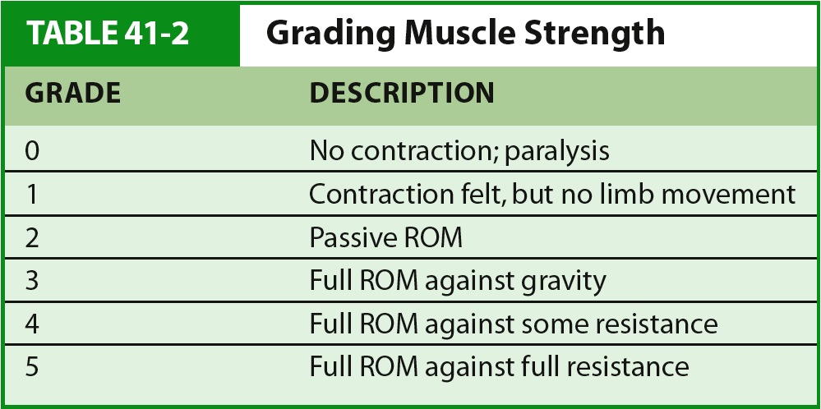

Slide 47
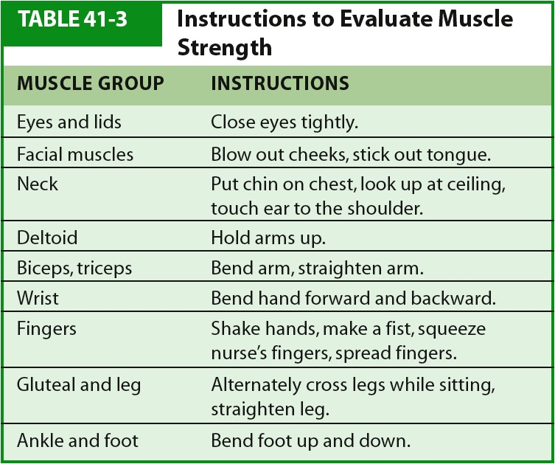

Slide 48
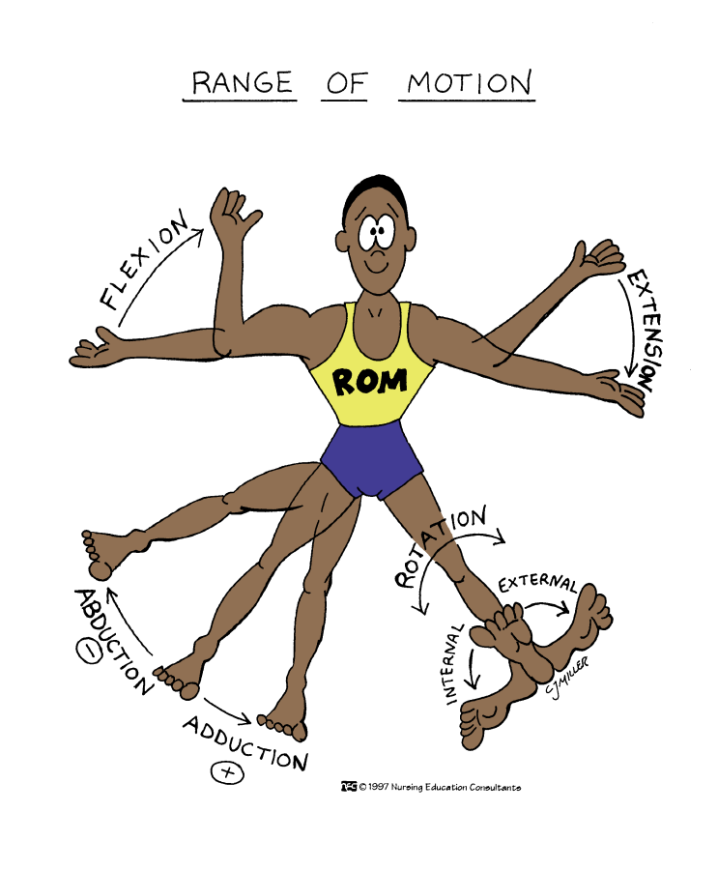
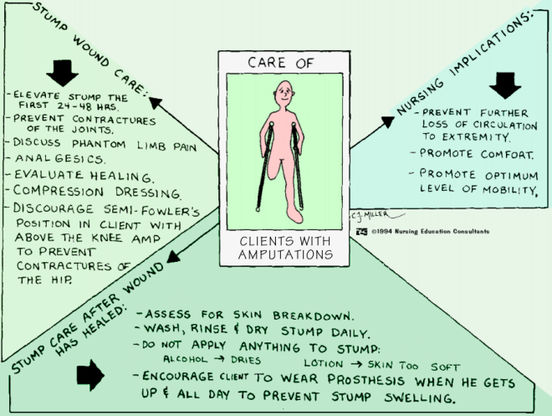

Slide 49
BULGE/BALLOTMENT test
Used to determine the presence of fluid in the knee joint. It is useful when only a little fluid is present in the joint.
The suprapatellar bursa is first emptied of fluid by squeezing distally from about 15 cm above the patella.

Slide 50
The medial compartment of the knee join is emptied by pressing on the side of the joint with the free hand. The hand is then lifted away and then the lateral side is sharply compressed.
If the test is positive, a ripple is seen on the flattened, medial surface.
The test is negative if the effusion is tense - up to 120 ml.

Slide 51
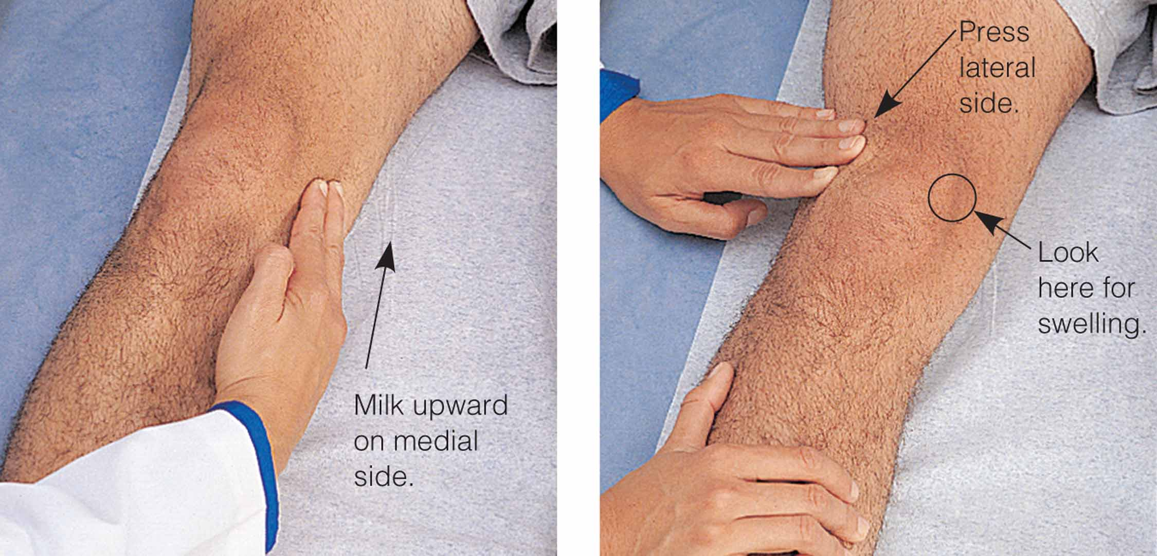
Checking for the bulge sign

Slide 53
Diagnostic Evaluation
Imaging Procedures – CT, Bone Scan, MRI , X-rays, bone density scan, Ultrasound
Nuclear Studies - radioisotope bone density,
Endoscopic Studies –arthrocentesis, arthroscopy
Other Studies –biopsy, synovial fluid, Arthrogram, venogram,
Electromyography
Myelography

Slide 54
Cont’d
Urine Tests –
creatine-creatinine ratio for test presence of muscle disease
Urinary uric acid – gout – 24 hr specimen
Urine deoxypyridinolie – assess bone resorption process
Blood
Serum muscle enzymes – aldolase, C’PK – muscle damage, c-reactive protein,

Slide 55
Cont’d
Erythrocyte Sedimentation Rate (ESR)
Alkaline phosphatase –
bone tumor and infection Fx
Paget’s disease
increase osteoblastic activity
Rheumatoid factor -
latex fixation; certain antibodies indicative rheumatoid condition, Anti-DNA antibody
Le-Prep/Antinuclear antibodies (ANA) – check protein (certain ones) increase, SLE

Slide 56
Arthroscopy
Fiberoptic tube is inserted into a joint for direct visualization.
Client must be able to flex the knee; exercises are prescribed for ROM.
Evaluate the neurovascular status of the affected limb frequently.
Analgesics are prescribed.
Monitor for complications.

Slide 57
Arthroscopy cont’d
Flexible fiberoptic endoscope used to view joint structures and tissues
Used to identify:
Torn tendon and ligaments
Injured meniscus
Inflammatory joint changes
Damaged cartilage

Slide 58
ARTHROSCOPY/ARTHROCENTESIS
Elevate joint to reduce swelling
Monitor and document neurovascular status
Analgesics
Teach patient to report swelling, numbness. Teach extent of activity

Slide 59
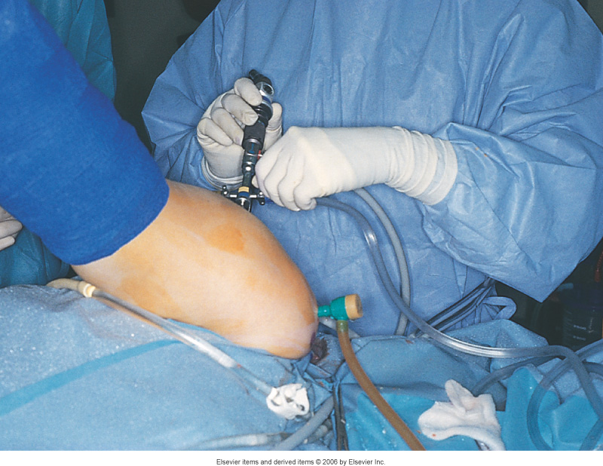

Slide 60
Bone Scan
Nuclear medicine procedure in which amount of radioactive isotope taken up by bones is evaluated
Abnormal bone scans show hot spots due to malignancies or infection
Cold spot uptakes show areas of bone that are ischemic

Slide 61
END

