Slide 1
INFECTION OF BONE AND JOINTS
MUSAU

Slide 2
Orthopedic conditions
Osteomyelitis
Osteo arthritis
Rheumatoid arthritis
Gout
Ankylosing spondylitis

Slide 3
OSTEOMYELITIS

Slide 4
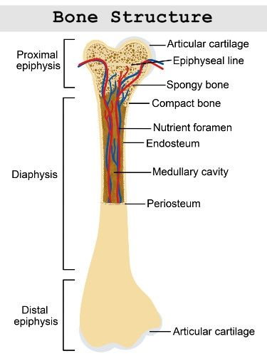

Slide 5
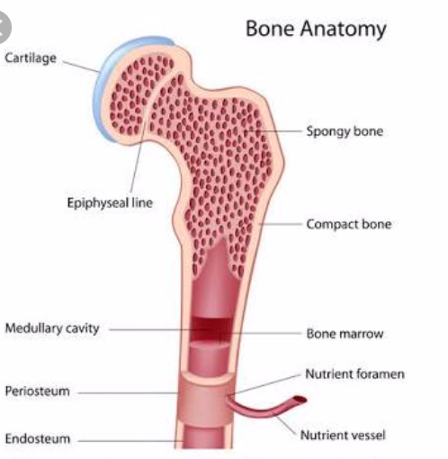

Slide 6
OSTEOMYELITIS
Osteomyelitis is an infection of the bones that results in inflammation, necrosis and formation of new bones.
OR
A condition caused by the invasion by one or more pathogenic microorganisms that stimulates the inflammatory response in bone tissue

Slide 7
Classification
The duration - acute, subacute and chronic
Mechanism of infection – exogenous or haematogenous
The type of host response to the infection- pyogenic or non pyogenic

Slide 8
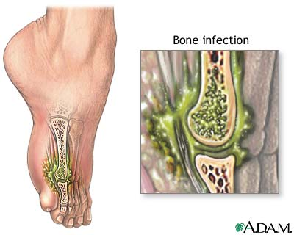
Notes:
What could have caused this infection?
Gunshot?
Open Fracture?
Surgical Wound?
Foot ulcer caused by poor shoe fitting in a client with Diabetes
Puncture wound for client with poor circulation?

Slide 9
Osteomyelitis
causative agent
Staphylococcus aureus (70–80%)
Streptococcus
Proteus and Pseudomonas species
E. coli
Typical signs and symptoms grouped into:
Acute osteomyelitis
Chronic osteomyelitis

Slide 10
Osteomyelitis
Infection of the bone
Occurs due to:
  Extension of soft tissue infection
  Direct bone contamination
  Blood-borne spread from another site of infection
    This typically occur in an area of bone that has been traumatized or has lowered resistance

Slide 11
CAUSES
Direct Contamination- dirty wounds
Surgical Infection-from surgery
Adjacent Soft Tissue Infection
Hematogenous-Originating in the blood
Notes:
Hematogenous: From the blood stream IV drug users are well know for bringing contaminants into the blood stream.
Infected IV site can cause the same series of events in a hospitalized patient!

Slide 12
Acute osteomyelitis include
Fever that may be abrupt
Irritability or lethargy in young children
Pain in the area of the infection
Swelling, warmth and redness over the area of the infection

Slide 13
Chronic osteomyelitis include;
Warmth, swelling and redness over the area of the infection
Pain or tenderness in the affected area
Chronic fatigue
Drainage from an open wound near the area of the infection
Fever,
Treatment – IV antibiotic; long term for 4-6 months

Slide 14
Chronic osteomyelitis include;
Osteomyelitis with vascular insufficiency, seen commonly in patients with:
diabetes and
peripheral vascular disease, most commonly affecting the feet.

Slide 15
CLINICAL MANIFESTATIONS
LOCAL
Redness, warmth
Purulent exudate
constant pulsating pain that intensifies with movement as result of pressure of collecting purulent material (pus).

Slide 16
CLINICAL MANIFESTATIONS
When osteomyelitis occurs from spread of adjacent infections or direct contamination there is signs of sepsis.
The area is swollen, warm, painful and tender to touch.
The patient with chronic osteomyelitis present with non- healing ulcer that overlies the infected bone with a connecting sinus that will intermittently and spontaneously drain pus.

Slide 17
CLINICAL MANIFESTATIONS
SYSTEMIC –
When infection is blood borne
    Fever
    Chills
    Nausea
    general Malaise
    rapid pulse
    Fever
    night sweats
    Restlessness

Slide 18
RISK FACTORS
Trauma
Hemodialysis
Splenectomy
Advanced age - elderly
those who are poorly nourished,
obese,
impaired immune system -↓ Immune function
Poor circulation
Notes:
Spleen is used to control bacteria in the blood stream. Therefore there is a slight increase in the challenge to fight infection if the spleen is missing.
If a spleenectomy is done before the age of 10yrs old the child has a greater risk of fatal septicemia.
The macrophages of the spleen remove pathogens of all kinds from the circulating blood. They also remove old red blood cells from circulation and form bilirubin that will circulat to the liver to be excreted in bile.
Spleen is also a reservoir of blood in time of ER such as hemorrhage.

Slide 19
RISK FACTORS
those with chronic illnesses e.g. Diabetes
those receiving long term corticosteroid therapy
other immunosuppressive agents.

Slide 20
Bone infections are difficult to eradicate because:
the infected bone is mostly avascular and
not accessible to body’s natural immune response and there is decreased penetration by antibiotics.
Osteomyelitis can become chronic and affects patient’s quality of life

Slide 21
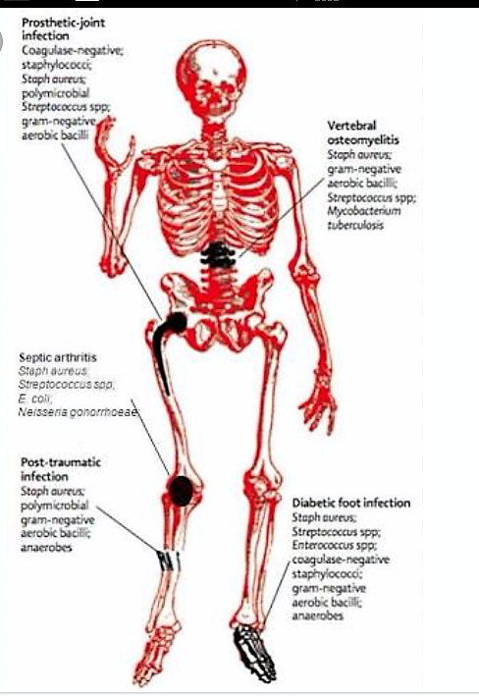

Slide 22
pathophysiology
Most of bone infections is caused staphylococcus aureus.
Other pathogens include streptococci , enterococci and pseudonomas species.
The initial response to infection is inflammation, increased vascularity and edema. After 2 to 3 days thrombosis of the local blood vessels occurs resulting in ischemia with bone necrosis.

Slide 23
pathophysiology
The infection extends into the medullary cavity and under the periosteum and
may spread into adjacent tissues or joints.
If the infective process is treated promptly, a bone abscess forms.
The resulting abscess cavity contains bone dead tissue(sequestrum), which does not easily liquefy and drain.

Slide 24
pathophysiology
Therefore, the cavity cannot collapse and heal as it does in soft tissue abscesses.
New bone growth( the involucrum) forms and surrounds the sequestrum.
Although healing appears to take place, a chronically infected sequestrum remains and produces recurring abscesses throughout patient’s life leading to chronic osteomyelitis.

Slide 25
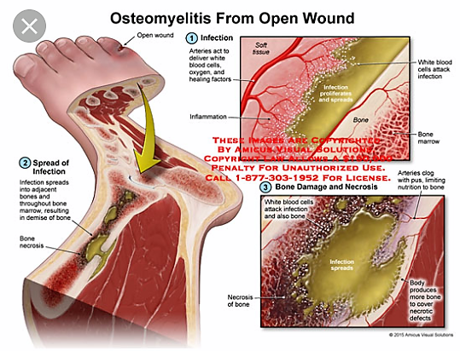

Slide 26
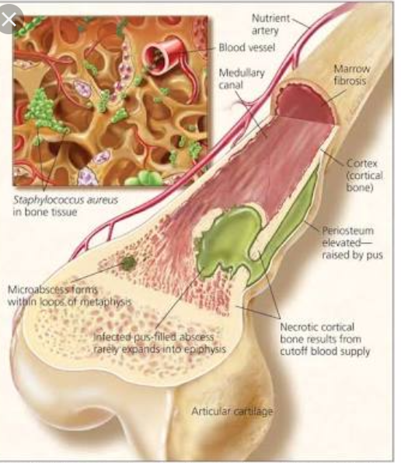

Slide 27
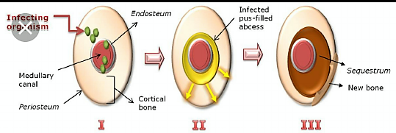

Slide 28
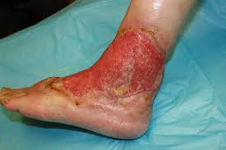
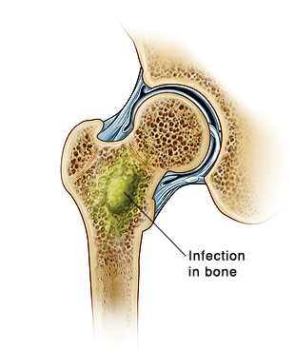
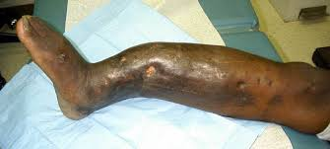

Slide 29
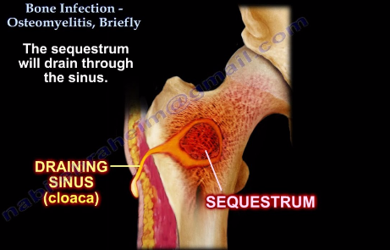

Slide 30
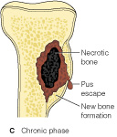
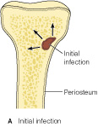
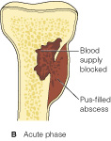
STAGES OF OSTEOMYELITIS
Notes:
PAGE 1268 Lemone
Stages of Osteomyeletis
Initial Infection
Infection: Organism enters the bone. And multiplies
Inflamation, immune system response
Phagocytes attempt to contain the infection, releasing enxymes in to the process that destroys bone tissue
Acute Phase:
Pus forms, edema forms vascular congestion
Haversian canals in the marrow of the bone allow the infection to travel to other segments of the bone.
If the infection reaches the outer margin of the bone, the periosteum of the bone is raised. The infections spreads on the surface of the bone.
Bolood and antibiotics can not reach the bone tissue once the pressure of compromises the vaxcular arteriolare system
Bacteria adheres to damange bone coating the underlying bone with protective film that impedes host defenses
Chronic Phase:
Necrotic bone separates, new layer of bone forms, sinus develops to allow the wound to drain.
Chronic involvement includes the presence of new bone formation

Slide 31
DIAGNOSTIC STUDIES
MRI
CT
Bone Scan
Ultrasound
Labs:
    Sed Rate
    WBC’s
    Cultures
Notes:
MRI can show abssesses
CT can show sinus tracks and abscesses
Bone Scans: Infections in the active stage can be ID’d. Also can see if noninflammatory changes in the bone have occurred
Ultrasound: Can show fluid
ERS and WBC are elevated in acute infections
Clutures of blood and tissue will help ID what organism has invaded and will set the path to correct antibiotic treatment

Slide 32
Diagnosis
In acute osteomyelitis early x-ray findings demonstrate
soft tissue edema.
In about 2-3 weeks areas of periosteal elevation and bone necrosis are evident.
Radioisotope bone scans particularly the isotope- labeled white blood cell scan and MRI help with early definitive diagnosis.
Blood studies reveal leukocytosis and elevated ESR.

Slide 33
Wound and blood culture studies are performed although they are only positive in 50% of cases.
In chronic osteomyelitis large, irregular cavities, raised periosteum; sequestra; or dense bone formation are seen on x-ray.
Bone scans to identify infections.
ERS and WBCs count are usually normal.
Anemia ; associated with chronic infections maybe present.

Slide 34
Prevention
Elective orthopedic surgery should be postponed if a person has current infection (UTI or sore throat) or a recent history of infection.
During orthopedic surgery, careful attention is paid to surgical environment and equipments to decrease direct bone contamination.
Treatment of focal infections diminishes hematogenous spead.

Slide 35
Medical management
Initial goal is to control and halt the infective process.
immobilize the body part to prevent pathological fractures and to decrease discomfort
Antibiotic therapy depends on blood and wound cultures.

Slide 36
General supportive measures;
hydration,
diet high in Vit and proteins
correction of anemia) should be instituted.
Warm wet soaks for 20 minutes several times a day may be prescribed to increase circulation

Slide 37
Pharmacological therapy
As soon as the culture specimens are obtained IV antibiotics is administered, should be sensitive to the causative organism, given for 3-6 weeks.
If infections is controlled antibiotic is given orally for up to 3 months.
To enhance the absorption of antibiotics taken orally should not be administered with food.

Slide 38
Surgical management
Wound debrindment: The infected bone is surgically exposed and purulent and necrotic material removed, the area is irrigated with saline solution.
Antibiotic-impregnated beads may be placed in the wound for direct application of antibiotic for 2-4 weeks.
In chronic osteomyelitis antibiotics are adjunctive therapy to surgical debridement.
I.V antibiotics continued

Slide 39
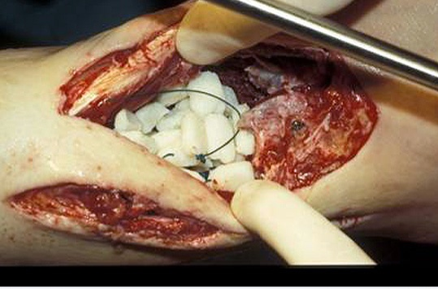

Slide 40
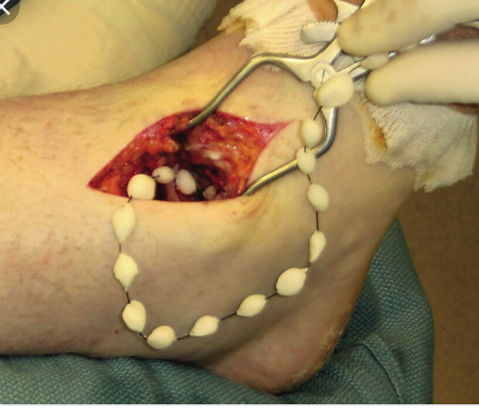

Slide 41
A sequestrectomy ( removal of enough involucrum to enable the surgeon to remove the sequestrum) is performed.
Sufficient bone is removed to convert a deep cavity to shallow saucer( saucertration).
All dead, infected bone and cartilage must be removed before permanent healing can occur.
A closed suction irrigation system maybe used to remove debris.
Wound irrigation using sterile physiologic saline solution maybe performed for 7-8 days.

Slide 42
The wound is either closed tight to obliterate the dead space or packed and closed later by granulation or possibly by grafting.
If wound is too big, bone graft may be done
Since surgical debridement weakens the bone internal fixation or external supportive devices may be needed to stabilize or support the bone to prevent pathologic fracture.

Slide 43
Amputation for osteomyelitis
Amputation indications include
  Arterial insufficiency
  Major nerve paralysis
  Non functional limb-stiffness, contracture
  Malignant change
Prevalence of maliganacy arising from COM reported as 0.2 to 1.6% of cases.
Most are squamous cell carcinoma, also reticulum cell carcinoma,fibrosarcoma

Slide 44
NURSING
Assessment before surgery
Wound dressing
Diet
Manage fever
Avoid pressure and movement of the area, so assist in ADL
Exploit allowed mobility to promote general well being
Teach patient self care

Slide 45
Nursing diagnosis
Acute pain related to inflammation
Impaired physical mobility related to weakened bone structure.
Risk for extension of infection
Knowledge deficit related to the treatment regimen
Hyperthermia
Anxiety
Body Image
Self Esteem

Slide 46
Goals
Relief pain.
Improved physical mobility within therapeutic limitations.
Control and eradication of infection.
Knowledge on treatment regimen.

Slide 47
interventions
The affected area maybe immobilized with splints to relieve pain. Administration of prescribed analgesics.
The joints above and below the affected part should be gently moved through their range of motion.
Participation in ADLS within the physical limitations to encourage well-being.

Slide 48
Promoting Home and Community- Based Care.
The patient and family are taught about the strict:
Adhering to the therapeutic regimen of antibiotics
preventing falls/ injuries that could result in bone fracture.
Maintenance and management of the IV access and IV administration equipment in the home.

Slide 49
Pt Teaching includes:
medication name
medication dosage,
medication frequency
administration route,
safe storage and handling,
adverse reactions, and
necessary laboratory monitoring.

Slide 50
Pt Teaching cont.……..:
Aseptic dressing
warm compress techniques
Monitoring of the patient for the development of :
  Additional sites that are painful or
  Sudden increases in body temperature.
Instruct the patient and family to observe for and report:
Elevated temperature,
Drainage/ odor from the wound
signs of increased inflammation,
adverse reactions of drugs , and
signs of super-infection.

Slide 51
CONTINUING CARE. Management of osteomyelitis, including wound care and IV antibiotic therapy, is usually performed at home.
The patient must be medically stable and physically able and motivated to adhere strictly to the therapeutic regimen of antibiotic therapy.
The home care environment needs to be conducive to the promotion of health and to the requirements of the therapeutic regimen.

Slide 52
Assessment to determine the patient’s and family’s abilities regarding continuation of the therapeutic regimen at home is done.
If the patient lives alone, a home care nurse may be needed to assist with IV administration of the antibiotics.
The nurse monitors the patient for
response to the treatment,
signs and symptoms of superinfections, and
adverse drug reactions.
The nurse stresses the importance of follow – up care.

Slide 53
JOINT
DISORDERS

Slide 54
Arthritis

Slide 55
Arthritis
Inflammation of a joint accompanied by pain, swelling and changes in structure in bone
Etiology/types of arthritis
  Degenerative Joint Disease
    Osteoarthritis
    Rheumatoid arthritis
  Metabolic disturbances
    Gout
  Infection- Gonococcus, TB, Pneumonia
  septic arthritis
  Sero-negative arthritis
  Ankylosing spondylitis
Notes:
When a patient tests negative for RF and anti-CCP antibodies, yet they still display strong symptoms consistent with rheumatoid arthritis, they are given a diagnosis of seronegative rheumatoid arthritis. The term seronegative means they don't possess the antibodies that seropositive patients do

Slide 56
Arthritis
Joints can become infected through:
spread of infection from other parts of the body
directly through trauma or
surgical instrumentation.
Previous trauma to joints, joint replacement, coexisting arthritis, and diminished host resistance contribute to the development of an infected joint.
S. aureus causes 50% of all joint infections rheumatoid arthritis

Slide 57
The knee is the joint that is most commonly infected (50% of cases), followed by the hip and the shoulder
Prompt recognition and treatment of an infected joint are important because accumulating purulent material results in chondrolysis (destruction of hyaline cartilage).

Slide 58
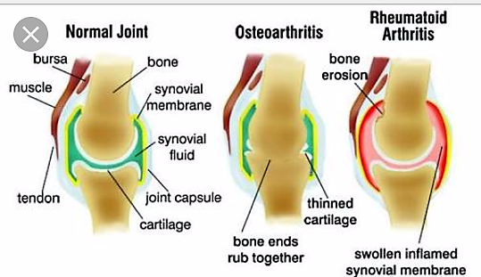

Slide 59
Clinical manifestations
Acute septic arthritis usually presents with:
a warm joint
painful joint
swollen joint with decreased range of motion.
Systemic chills,
fever
leukocytosis

Slide 60
Risk factors include:
advanced age,
diabetes,
rheumatoid arthritis, and
preexisting joint disease or
joint replacement
patients taking corticosteroids
immunosuppressive medications

Slide 61
Risk factors include:
NB:
patients taking corticosteroids or immunosuppressive medications require ongoing assessment to detect infection as early as possible in the infectious process.

Slide 62
diagnosis
An assessment for the source and cause of infection is performed.
Diagnostic studies include aspiration, examination, and culture of the synovial fluid.
Computed tomography (CT) and MRI may reveal damage to the joint lining.
Radioisotope scanning may be useful in localizing the infectious process.

Slide 63
Medical management
Broad-spectrum IV antibiotics are started promptly and then changed to organism-specific antibiotics after culture results are available.
The IV antibiotics are continued until symptoms resolve.
The synovial fluid is aspirated and analyzed periodically for sterility and decrease in WBCs.

Slide 64
physician may aspirate the joint with a needle to remove excessive joint fluid, exudate, and debris.
This promotes comfort and decreases joint destruction caused by the action of proteolytic enzymes in the purulent fluid.
Arthrotomy or arthroscopy is used to drain the joint and remove dead tissue.

Slide 65
The inflamed joint is supported and immobilized in a functional position by a splint that increases the patient’s comfort.
Analgesic such as codeine, prescribed to relieve pain.
After the infection has responded to antibiotic therapy, NSAIDs are prescribed to limit joint damage.
The patient’s nutrition and fluid status is monitored.

Slide 66
Nursing management
The nurse describes the septic arthritis physiologic process to the patient and teaches the patient how to relieve pain using pharmacologic and non pharmacologic interventions.
The nurse also explains the importance of supporting the affected joint, adhering to the prescribed antibiotic regimen, and observing weight-bearing and activity restrictions.

Slide 67
The nurse demonstrates and encourages the patient to practice safe use of ambulatory aids and assistive devices.
The nurse teaches the patient strategies to promote healing through aseptic dressing changes and proper wound care.
The patient is then encouraged to perform range-of motion exercises after the infection subsides.

Slide 68
Chronic/ degenerative disease of joints and auto immune disorder
Rheumatoid arthritis
Osteoarthritis
Ankylosing spondylitis

Slide 69
RHEUMATOID ARTHRITIS
Rheumatoid Arthritis is a systemic inflammatory disease affecting synovial joints.
OR
Rheumatoid arthritis (RA) is a chronic, progressive, systemic inflammatory disease that destroys synovial joints and other connective tissues, including major organs.

Slide 70
Pathophysiology
The autoimmune reaction within synovial membrane leads to an inflammatory process, that damages or irritates the joint tissues.
Inflammatory cells and chemicals cause synovitis, an inflammation of the synovium (the lining of the joint capsule).

Slide 71
Pathophysiology
As the inflammation progresses, the synovium becomes thick and fluid accumulation causes joint swelling and pain.
A destructive pannus (new synovial tissue growth infiltrated with inflammatory cells) erodes the joint cartilage and eventually destroys the bone within the joint

Slide 72
Cont’d…
At this point, fibrin develops into a granulation tissue known as pannus which destroys cartilage and erodes the bones.
This leads to adhesions between joint surfaces (ankylosis) resulting in loss of mobility.
Pain occurs as a result of cartilage degeneration due to erosion.
Joint deformity and bone loss are common in late RA

Slide 73
Synovial joints are not the only connective tissues involved in RA
Other connective tissue may be affected, including blood vessels, nerves, kidneys, pericardium, lungs, and subcutaneous tissue.
The result of body system involvement is malfunction or failure of the organ or system.
Death can occur if the disease does not respond to treatment.

Slide 74
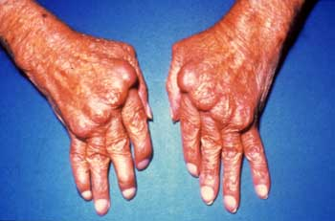
Rheumatoid Arthritis

Slide 75
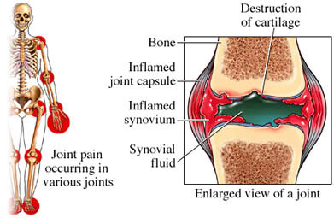
Sites affected

Slide 76
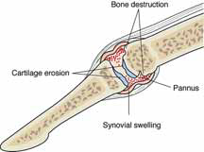

Slide 77
Clinical Features
Early Signs | Late Signs | Other Signs
Warm, swollen and painful joints | Joint deformities | Increasing pain
Morning stiffness lasting 30 minutes | Contractures, rheumatoid nodules | Paraesthesia
Pain at rest and with movement |  | Dislocation
Fatigue, malaise

Slide 78
Manifestations of RA
Joint symptoms
  Pain, swelling, stiffness (↑in morning)
  Deformity and muscle atrophy
  Limited ROM
Other Symptoms
  Fatigue
  Anorexia
  Low-grade fever
  Inflammatory changes of heart and lungs

Slide 79
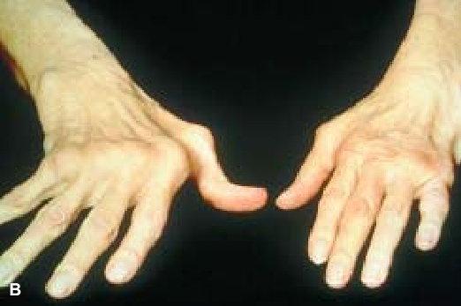
Arthritis Assessment
Inspection and palpation of the same joints on both sides of the body for asymmetry, skin color, size, shape, tenderness, swelling
Limitation of active joint movement

Slide 80
Diagnosis
No specific diagnostic test confirms RA, but several laboratory tests help support the diagnosis.
An increase in white blood cells and platelets.
A group of immunologic tests are include the following:
Presence of rheumatoid factor (RF) in serum
Decreased red blood cell (RBC) count

Slide 81
Diagnosis
This is made from the history and presence of :
  Stifness, joint pain and swelling
  Narrowing of the joint spaces seen on x-ray
  Increased erythrocyte sedimentation rate (ESR)
  Mild leukocytosis
  Synovial fluid exam
  CD4 complement component are decreased

Slide 82
Increased erythrocyte sedimentation rate (ESR)
Positive antinuclear antibody (ANA) test
Positive C-reactive protein (CRP) test

Slide 83
RF can indicate the aggressiveness of the disease.
The ESR is obtained to evaluate the effectiveness of treatment.
If the disease responds to treatment, the ESR decreases.
The higher the ESR, the more active the disease process.

Slide 84
LEARNING TIP ON ESR
ESR is a general screening test for inflammation.
It measures the amount of time it takes for
RBCs to settle to the bottom of a test tube.
In the presence of inflammation, RBCs settle faster in the tube.
Therefore, the ESR increases with the presence of inflammation.

Slide 85
X-ray examination and MRI detect joint damage and bone loss, especially in the vertebral column.
A bone or joint scan assesses the extent of joint involvement throughout the body.
For some patients, an arthrocentesis may be performed
The synovial fluid is cloudy, milky, or dark yellow with inflammatory cells present.

Slide 86
Functional Presentation and Disability of RA
In the initial stages of each joint involvement, there is warmth, pain, and redness, with corresponding decrease of range of motion of the affected joint
Progression of the disease results in reducible and later fixed deformities
Muscle weakness and atrophy develop early in the course of the disease in many people

Slide 87
Complications of Rheumatoid Arthritis
Complications include: Several associated syndromes with rheumatoid arthritis are:
  Carpal tunnel syndrome(median nerve compression)
  Baker’s cyst,
  vasculitis,
  subcutaneous nodules,
  Sjögren’s syndrome- white blood cells attack the moisture-producing glands,
  peripheral neuropathy,
  cardiac and pulmonary involvement,
  Felty’s syndrome, and
  anemia
Notes:
Sjögren's ("SHOW-grins") syndrome is a chronic disease in which white blood cells attack the moisture-producing glands. The hallmark symptoms are dry eyes and dry mouth, but it is a systemic disease, affecting many organs and may cause fatigue. It is one of the most prevalent autoimmune disorders, striking as many as four million Americans.

Slide 88
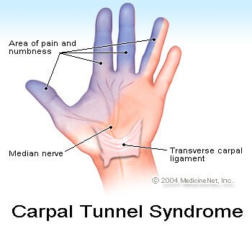
Carpal tunnel syndrome,( median nerve compression)

Slide 89
Felty's syndrome is a complication of long-standing rheumatoid arthritis.
Felty's syndrome is defined by the presence of three conditions: rheumatoid arthritis, an enlarged spleen (splenomegaly), and an abnormally low white blood cell count.
Sjögren's (pronounced Show-grin's) syndrome is a condition that affects parts of the body that produce fluids like tears and saliva becoming dry.

Slide 90
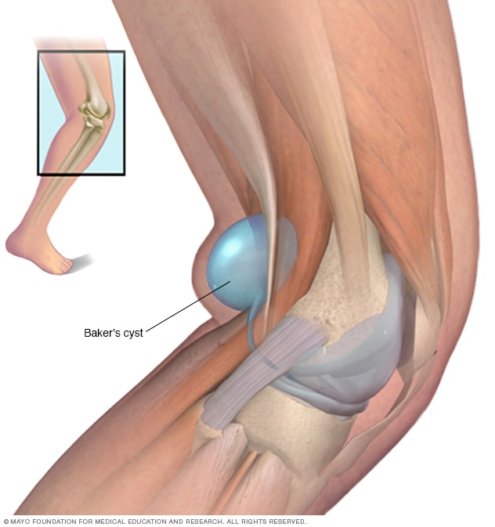
A popliteal cyst, also known as a Baker’s cyst, is a fluid-filled swelling that causes a lump at the back of the knee, leading to tightness and restricted movement. Discovered by William Bakers.

Slide 91
MANAGEMENT
NO CURE
Goals of Treatment
  Relieve pain -NSAIDs
  Reduce inflammation- corticosteroids
  Stop or slow joint damage and deformity
  Improve well-being and ability to function

Slide 92
Medical management
Pharmacotherapy: Treatment for RA includes disease modifying
  NSAIDS- Analgesics ie indocid 50-75mg tds, brufen 400mg and aspirin for pain and stiffness
  Steroids (p.o or intra-articular)i.e. prednisolone reduce inflammation (used to induce disease remission).
Disease modifying anti-rheumatoid drugs (DMARDs), i.e. methotrexate, sulfasalzine slow disease progression
Immunosupressants i.e cyclosporine

Slide 93
Medical management
Leflunomide taken orally has antiproliferative
and anti-inflammatory properties.
Etanercept inhibits tumor necrosis factor, which is involved in the inflammatory process, and is given subcutaneously twice a week.
Low-dose methotrexate (MTX) or gold therapy is given to induce disease remission.
Newer DMARDs such as leflunomide
(Arava) and etanercept (Enbrel) are used to slow the progression of RA.

Slide 94
Medical management
  Modify the autoimmune and inflammatory response
    Enbrel- Tumor necrosis factor blocker
    Kineret- Interleukin 1 receptor antagonist
Many of these medications have potentially serious side effects that must be monitored carefully.

Slide 95
Complementary therapies that decrease inflammation or pain include:-
capsaicin cream
fish oil
magnetic therapy
antioxidants such as vitamin C, vitamin E,
beta carotene

Slide 96
HEAT AND COLD.
Heat applications or hot showers help decrease joint stiffness and make exercise easier for the patient.
For acutely inflamed, or “hot,” joints, cold applications are preferred.
Program that balances rest and exercise later in the day is most beneficial for the patient.

Slide 97
Surgical
If nonsurgical approaches are not effective
  synovectomy (excision of the synovial membrane)
  tenorrhaphy (suturing a tendon), Tendon reconstruction
  arthrodesis (surgical fusion of the joint)
  arthroplasty (surgical repair
  replacement of the joint with a prosthesis).

Slide 98
Nursing Interventions
1) Comfort/ Pain relief
Adminster prescribed analgesics i.e NSAIDS
Providing heat or cold treatments on the affected joints to reduce inflamation/pain
Encouraging the use of splints,braces on ambulation
2) Independence
Assist in activities of daily living as needed
Encourage use of supportive devices e.g. trapeze to move up the bed.

Slide 99
Cont’d…
3) Reducing fatigue by: providing frequent rest periods, Instruct patient on how to conserve energy.
4) Nutrition-
with emphasis on foods high in vitamins, protein, and iron for tissue building and repair. For the extremely anorexic patient, small, frequent feedings
5) patient education on the disease
6) monitoring and managing potential complications

Slide 100
Cont’d…
7) Mobility and prevention of injury by:
Assessing all joints for signs of inflammation and deformity; Avoiding positions that can lead to formation of contractures; Active range-of-motion exercises are encouraged because they prevent joint stiffness; Use of assistive devices for ambulation
8) Improving body image and communication by encouraging pt & family to verbalize the feeling &perceptions. Encourage commitment to medications.

Slide 101
Degenerative Joint Disorder(Osteoarthritis)

Slide 102
Degenerative Joint Disorder(Osteoarthritis)
DEF: A chronic non-inflammatory joint disorder in which there is progressive softening and disintegration of articular cartilage accompanied by new growth of cartilage and bone at the joint margins (osteophytes) and capsular fibrosis

Slide 103
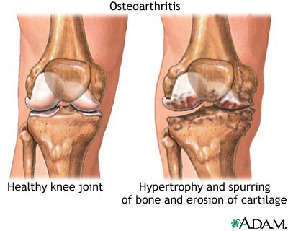
Osteoarthritis
Notes:
Page 1239 Lemone
Osteoarthritis also labeled degenerative joint disease
Most commonly occuring form of arthritis
Loss of articular cartilage and hypertrophy of the bone!
Degenerative Joint Disease

Slide 104
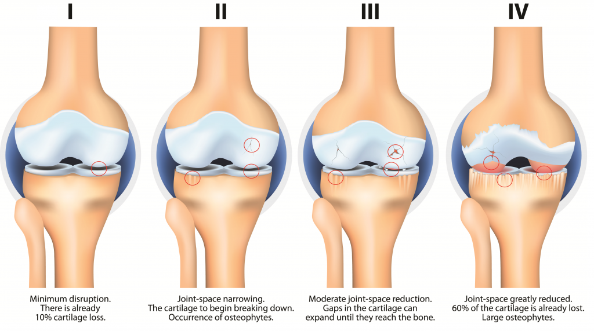
Osteoarthritis

Slide 105
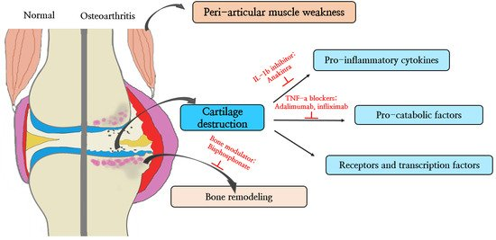
Osteoarthritis

Slide 106
classification of Osteo-arthritis
Primary OA
Common-in elders where there is no previous pathology.
Its mainly due to wear and tear changes occurring in old ages mainly in weight bearing joints.
Secondary OA
Due to a predisposing cause such as:
1. Injury to the joint
2. Previous infection

Slide 107
Cont’d
3. RA
4. Deformity
5. Obesity
6. Hyperthyroidism

Slide 108
Pathophysiology
OA is a degenerative condition primarily affecting the articular cartilage
1. Articular cartilage
2. Bone
3. Synovial membrane
4. Capsule
5. Ligament
6. Muscle

Slide 109
Pathophysiology
The pathogenesis of OA involves a slow onset of :
degradation of cartilage (erosion of articular cartilage and
Remodeling of bone) due to an active response of chondrocytes in the articular cartilage and the inflammatory cells in the surrounding tissues.
The release of enzymes from these cells break down collagen and proteoglycans, destroying the articular cartilage (erosion of articular cartilage).
The area of the cartilage becomes soft and the surface becomes rough and cracks.
Notes:
Proteoglycans are proteins that are heavily glycosylated. The basic proteoglycan unit consists of a "core protein" with one or more covalently attached glycosaminoglycan (GAG) chain(s).

Slide 110
Pathophysiology
The exposure of the underlying subchondral bone results in sclerosis( hardening), followed by reactive remodeling changes
This lead to the formation of osteophytes or bone spurs appear and subchondral bone cysts at the joint margin at the sites of attachment.
The joint space is progressively lost over time.
osteophytes or bone spurs appear may break off and appear in the joints as joint mice (intra-articular loose bodies=fragments).
These flakes of cartilage break off and may be impacted b/w the joint surfaces causing locking and inflammation.

Slide 111
Risk factors
Increased age
Obesity
Previous joint damage/injury
Repetitive use (occupational or recreational)
Anatomic deformity
Female gender
Genetic susceptibility
Diagnosis
Based on evaluation and history
X-ray films show narrowing of joint space

Slide 112
Clinical Features
Pain in affected joint
Stiffness (morning or on awakening)
tenderness
Loss of flexibility,
Grating sensation
Joint deformity, S
hortening ligaments
Functional impairment

Slide 113
Characteristic bony nodes, spurs may be present; usually painless, unless inflammation is present.
Muscle spasms
Redness
Swelling
Knee effusions
Crepitus

Slide 114
Management
NOTE: No treatment halts the degenerative process, certain preventive measures can slow the progress if undertaken early enough. These include
  weight reduction,
  prevention of injuries,
  perinatal screening for congenital hip disease, and
  ergonomic modifications.
Occupational and physical therapy can help the patient adopt self-management strategies.

Slide 115
Conservative treatment measures include
  use of heat or cold compressions,
  weight reduction,
  joint rest and
  avoidance of joint overuse,
  orthotic devices to support inflamed joints (splints, braces),
  Isometric exercise - static contraction of a muscle without any visible movement in the angle of the joint.
  postural exercises, and
  Aerobic exercise.
Notes:
Aerobic exercise is physical exercise of low to high intensity that depends primarily on the aerobic energy-generating process. "Aerobic" is defined as "relating to, involving, or requiring free oxygen", and refers to the use of oxygen to adequately meet energy demands during exercise via aerobic metabolism.

Slide 116
Pharmacologic Management
Directed toward symptom management and pain control.
Use of analgesics, opioids and intra-articular corticosteroids.
Newer approaches include glucosamine and chondroitin, thought to improve tissue function and retard breakdown of cartilage
Viscosupplementation, the intra-articular injection of hyaluronic acid, to improve cartilage function and retard degradation; it may also have some anti-inflammatory effects

Slide 117
Surgical Management
  Osteotomy (to alter the force distribution in the joint by realigning the bone away from the worn out.
  Arthroplasty. Joint replacement surgery.
  Viscosupplementation Lubrication injections/ (the reconstitution of synovial fluid viscosity).
  Tidal irrigation (lavage) of the knee.
  Cortisone shots/injections into joint.

Slide 118
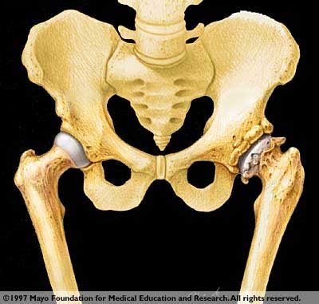
Surgical Treatment
Joint Arthroplasty (Reconstruction or Replacement)

Slide 119
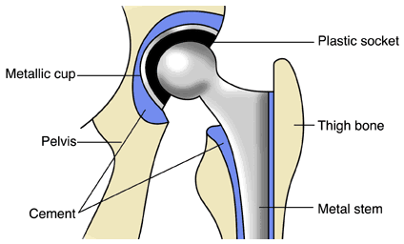
HIP REPLACEMENT

Slide 120
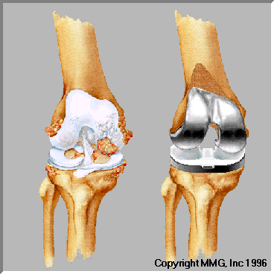
Total Knee Replacement

Slide 121
Total Joint Replacement
Candidate selection
Several devices available
Significant relief of pain
Good return to ADL
OOB in 1 -2 days with PT help
Best results with PT program for re-strengthening muscles
Post op CPM
  Continuous Passive Motion – see next slide

Slide 122
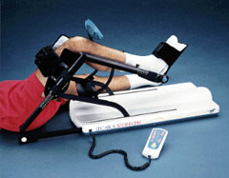
Continuous Passive Motion

Slide 123
Post Op Care
Joint Replacement
  Monitor incision for bleeding
  Cough, turn, deep breath
  OOB as ordered
  Neurovascular checks hourly 12-24 hours (color, temp, pulses, capillary refill, movement, sensation)
  Pain management
  Prevent new hip displacement

Slide 124
Post-Op Joint Replacement
Nursing Care Plan
  Pain assessment
  Position changing with Trapeze
  Sequential compression
  Incentive spirometer
  OOB
  Abduction pillow for hip replacement
  Monitor temperature and other VS
  Surgical site assessment
  Quadriceps and foot exercises
Notes:
Page 1246
Nursing care

Slide 125
Discharge Teaching
Hazards assessment
Chronic disease
ROM
Prevent Overuse/Overstess
Pain Management

Slide 126
Ankylosing spondylitis
Make notes on Ankylosing spondylitis

Slide 127
Ankylosis
Fixation or immobility of a joint
Ankylosing spondylitis affects the cartilaginous joints of the spine and surrounding tissues.
Occasionally, the large synovial joints, such as hips, knees, or shoulders, may be involved.
Ankylosing spondylitis is usually diagnosed in the second or third decade of life.
The disease is not usually as severe in females as in males, in whom the disease is more prevalent and likely to include significant systemic involvement.
Back pain is the characteristic feature.
As the disease progresses, ankylosis of the entire spine may occur, leading to respiratory compromise and complications.

Slide 128
TUBERCULOSIS
DISCUSS AND MAKE NOTES.

Slide 129
THANK YOU

Slide 130
Metabolic Bone Disorders
Osteoporosis
Osteomalacia
Paget’s Disease

Slide 131
Osteoporosis
A disease in which loss of bone exceeds rate of bone formation; usually increase in older women, white race, nulliparity.
Clinical Manifestations – bone pain, decrease movement.
Treatment – Calcium, Vit. D, estrogen replacement, Calcitonin, fluoride, estrogen with progestin, SERM (Selective Oestrogen Receptor Modulator) with anti-estrogens, exercise.
Pathologic fracture-safety.
Notes:
Metabolic disease, in which bone demineralization results in decreased density and subsequent fractures.
Osteopenia (low bone mass, which occurs when there is a disruption in the bone remodeling process.
Bone density scan altered, decrease density.
Bone resorption exceeds bone formation.
SERM – Selective Estrogen Receptor Modulators.

Slide 132
Classification of Osteoporosis
Generalized osteoporosis occurs most commonly in postmenopausal women and men in their 60s and 70s.
Secondary osteoporosis results from an associated medical condition such as hyperparathyroidism, long-term drug therapy, long-term immobility.
Regional osteoporosis occurs when a limb is immobilized.

Slide 133
Health Promotion/Illness Prevention - Osteoporosis
Ensure adequate calcium intake.
Avoid sedentary life style (a type of lifestyle with a lack of physical exercise) .
Continue program of weight-bearing exercises.
Notes:
S&P

Slide 134
Osteoporosis - Assessment
Physical assessment
Psychosocial assessment
Laboratory assessment
Radiographic assessment

Slide 135
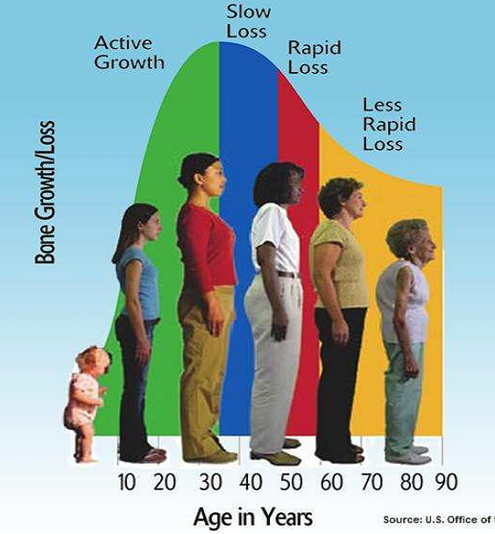
Loss of bone mass with age(female)

Slide 136
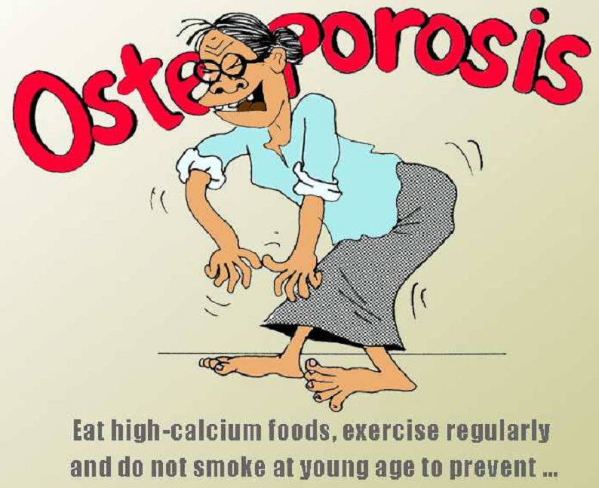
Cont’d…
Nutrition and lifestyle changes

Slide 137
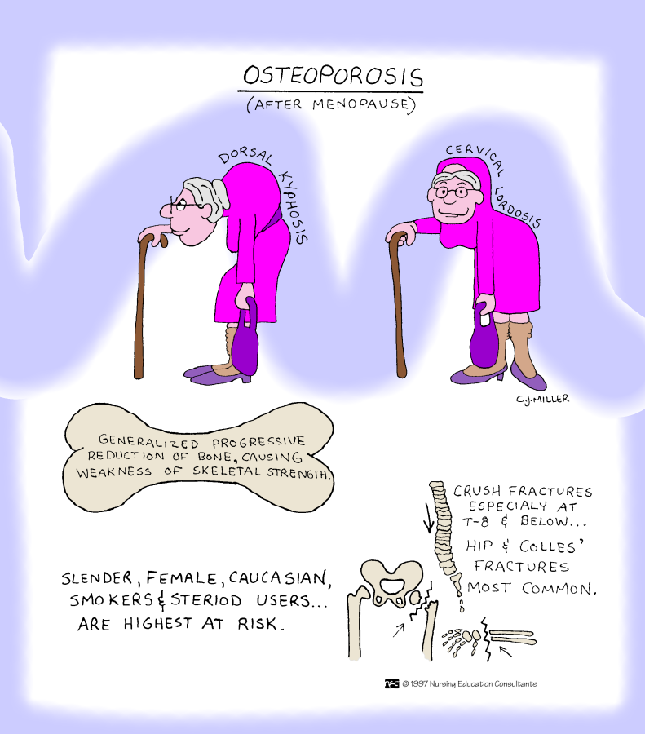

Slide 138
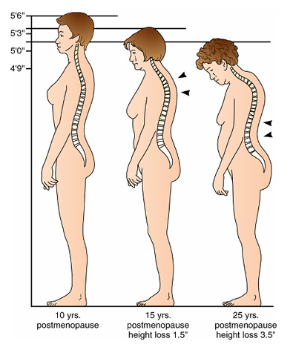
Osteoprosis
Os

Slide 139
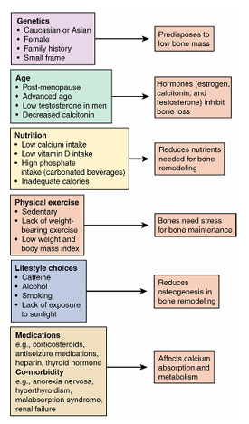
Osteoprorsis

Slide 140
Drug Therapy
Osteoporosis
Hormone replacement therapy
Parathyroid hormone
Calcium and vitamin D
Bisphosphonates
Selective estrogen receptor modulators
Calcitonin
Other agents used with varying results

Slide 141
Diet Therapy - Osteoporosis
Protein
Magnesium
Vitamin K
Trace minerals
Calcium and vitamin D
Avoid alcohol and caffeine

Slide 142
Fall Prevention - Osteoporosis
Hazard-free environment
High-risk assessment through programs such as Falling Star protocol
Hip protectors that prevent hip fracture in case of a fall
Notes:
S&P

Slide 143
Others - Osteoporosis
Exercise
Pain management
Orthotic devices

Slide 144
Osteomalacia/ rickets
Softening of the bone tissue characterized by inadequate mineralization of osteoid
Vitamin D deficiency, lack of sunlight exposure
Similar, but not the same as osteoporosis
Major treatment:
Vitamin D from exposure to sun and certain foods
Notes:
S&P

Slide 145
Pathophysiology
The primary defect in osteomalacia is a deficiency of activated vitamin D (calcitriol), which promotes calcium absorption from the gastrointestinal tract and facilitates mineralization of bone.
The supply of calcium and phosphate in the extracellular fluid is low.
Without adequate vitamin D, calcium and phosphate are not moved to calcification sites in bones.

Slide 146
Cont’d pathophysiology
It may result from failed calcium absorption (e.g. malabsorption syndrome) or from excessive loss of calcium from the body.
Gastrointestinal disorders (e.g. coeliac disease, chronic biliary tract obstruction, chronic pancreatitis, small bowel resection) in which fats are inadequately absorbed are likely to produce osteomalacia through loss of vitamin D (along with other fat soluble vitamins) and calcium, the latter being excreted in the feces with fatty acids.

Slide 147
Cont’d pathophysiology
In addition, liver and kidney diseases can produce a lack of vitamin D because these are the organs that convert vitamin D to its active form.
Severe renal insufficiency results in acidosis.
The body uses available calcium to combat the acidosis, and PTH stimulates the release of skeletal calcium in an attempt to reestablish a physiologic pH.
During this continual drain of skeletal calcium, bony fibrosis occurs and bony cysts form.

Slide 148
Cont’d pathophysiology
Chronic glomerulonephritis, obstructive uropathies, and heavy-metal poisoning result in a reduced serum phosphate level and demineralization of bone.
Hyperparathyroidism leads to skeletal decalcification and thus
Prolonged use of antiseizure medication (e.g. phenytoin, Phenobarbital) poses a risk for osteomalacia, as does insufficient vitamin D (dietary, sunlight).
The malnutrition type of osteomalacia (deficiency in vitamin D often associated with poor intake of calcium) is a result of poverty, food faddism, and lack of knowledge about nutrition.
It occurs most frequently in parts of the world where vitamin D is not added to food, where dietary deficiencies exist, and where sunlight is rare.

Slide 149
N.B.
A nutritious diet is particularly important in elderly people.
Adequate intake of calcium and vitamin D is promoted.
Because sunlight is necessary for synthesizing vitamin D, people should be encouraged to spend some time in the sun.
Prevention, identification, and management of osteomalacia in the elderly are essential to reduce the incidence of fractures.
When osteomalacia is combined with osteoporosis, the incidence of fracture increases.

Slide 150
Assessment and Diagnostic Findings
X-ray shows;
generalized demineralization of bone is evident.
Studies of the vertebrae may show;
A compression fracture with indistinct vertebral end-plates.
Laboratory studies show;
low serum calcium and phosphorus levels and a moderately elevated alkaline phosphatase concentration.
Urine excretion of calcium and creatinine is low.
Bone biopsy demonstrates;
an increased amount of osteoid.

Slide 151
Medical Management
The underlying cause of osteomalacia is corrected if possible.
If osteomalacia is caused by malabsorption, increased doses of vitamin D, along with supplemental calcium, are usually prescribed.
Exposure to sunlight for ultraviolet radiation to transform a cholesterol substance (7-dehydrocholesterol) present in the skin into vitamin D may be recommended.

Slide 152
Cont’d management
If osteomalacia is dietary in origin, a diet with adequate protein and increased calcium and vitamin D is provided.
The patient is instructed about dietary sources of calcium and vitamin D (e.g, fortified milk and cereals, eggs, chicken livers)
The safe use of supplements is reviewed.
Because high doses of vitamin D are toxic and enhance the risk of hypercalcaemia, the importance of monitoring serum calcium levels is stressed.

Slide 153
Cont’d management
Vitamin D raises the concentrations of calcium and phosphorus in the extracellular fluid and thus makes these ions available for mineralization of bone.
Physical, psychological, and pharmaceutical measures are used to reduce the patient’s discomfort and pain.
When assisting the patient to change positions, the nurse handles the patient gently, and pillows are used to support the body.

Slide 154
Cont’d management
As the patient responds to therapy, the skeletal discomforts diminish.
Frequently, skeletal problems associated with osteomalacia resolve themselves when the underlying nutritional deficiency or pathologic process is adequately treated.
Long-term monitoring of the patient is appropriate to ensure stabilization or reversal of osteomalacia.
Some persistent orthopedic deformities may need to be treated with braces or surgery (e.g. osteotomy may be performed to correct long bone deformity).

Slide 155
Common Problems of the Upper Extremity
Bursitis and tendinitis
Loose bodies
Impingement syndrome
Ganglion
carpal tunnel syndrome

Slide 157
GOUT
Gout is a heterogeneous group of conditions related to a genetic defect of purine metabolism resulting in hyperuricemia.
Oversecretion of uric acid or a renal defect resulting in decreased excretion of uric acid, or a combination of both, occurs.
The prevalence of gout is reported to be 1.6 to 13.6 per thousand.
The incidence increases with age and body mass index.
It occurs more commonly in males than females

Slide 158
Cont’d
In primary hyperuricemia, elevated serum urate levels or manifestations of urate deposition appear to be consequences of faulty uric acid metabolism.
Primary hyperuricemia may be due to severe dieting or starvation, excessive intake of foods that are high in purines (shellfish, organ meats), or heredity.

Slide 159
Cont’d
In secondary hyperuricemia, gout is a clinical feature secondary to any of a number of genetic or acquired processes, including conditions in which there is an increase in cell turnover (leukemia, multiple myeloma, some types of anemias, psoriasis) and an increase in cell breakdown.
Altered renal tubular function, either as a major action or as an unintended side effect of certain pharmacologic agents (diuretics such as thiazides and furosemide), low-dose salicylates, and ethanol can contribute to uric acid under excretion.

Slide 160
Pathophysiology
Hyperuricemia (serum concentration greater than 7 mg/dL [0.4 fmol/L]) can but does not always cause monosodium urate crystal deposition.
However, as uric acid levels rise, risk increases
Attacks of gout appear to be related to sudden increases or decreases of serum uric acid levels.

Slide 161
Cont’d
When the urate crystals precipitate within a joint, an inflammatory response occurs and an attack of gout begins.
With repeated attacks, accumulations of sodium urate crystals, called tophi, are deposited in peripheral areas of the body, such as the great toe, the hands, and the ear.
Renal urate lithiasis (kidney stones) with chronic renal disease secondary to urate deposition may develop

Slide 162
Cont’d
The finding of urate crystals in the synovial fluid of asymptomatic joints suggests that factors other than crystals may be related to the inflammatory reaction.
Recovered monosodium urate crystals are coated with immunoglobulins that are mainly immunoglobulin G (IgG).
IgG enhances crystal phagocytosis, thereby demonstrating immunologic activity.

Slide 163
Clinical Manifestations
Manifestations of the gout syndrome include acute gouty arthritis (recurrent attacks of severe articular and periarticular inflammation), tophi (crystalline deposits accumulating in articular tissue, osseous tissue, soft tissue, and cartilage), gouty nephropathy (renal impairment), and uric acid urinary calculi.

Slide 164
Cont’d
Four stages of gout can be identified:
Asymptomatic hyperuricemia, acute gouty arthritis, inter-critical gout, and chronic tophaceous gout.
The subsequent development of gout is directly related to the duration and magnitude of the hyperuricemia.
Therefore, the commitment to lifelong pharmacologic treatment of hyperuricemia is deferred until there is an initial attack of gout.

Slide 165
Cont’d
For hyperuricemic people who are going to develop gout, acute arthritis is the most common early clinical manifestation.
The metatarso-phalangeal joint of the big toe is the most commonly affected (75% of patients).
The tarsal area, ankle, or knee may also be affected.
Less commonly, the wrists, fingers, and elbows may be affected.
The acute attack may be triggered by trauma, alcohol ingestion, dieting, medications, surgical stress, or illness.

Slide 166
Cont’d
The abrupt onset often occurs at night, awakening the patient with severe pain, redness, swelling, and warmth of the affected joint.
Early attacks tend to subside spontaneously over 3 to 10 days even without treatment.
The attack is followed by a symptom-free period (the inter-critical stage) until the next attack, which may not come for months or years.
With time, however, attacks tend to occur more frequently, involve more joints, and last longer.

Slide 167
Cont’d
Tophi are generally associated with more frequent and severe inflammatory episodes.
Higher serum concentrations of uric acid are also associated with more extensive tophus formation.
Tophi most commonly occur in the synovium, olecranon bursa, subchondral bone, infrapatellar and Achilles tendons, subcutaneous tissue on the extensor surface of the forearms, and overlying joints.
They have also been found in the aortic walls, heart valves, nasal and ear cartilage, eyelids, cornea, and sclerae.
Joint enlargement may cause a loss of joint motion. Uric acid deposits may cause renal stones and kidney damage.

Slide 168
Medical Management
A definitive diagnosis of gouty arthritis is established by polarized light microscopy of the synovial fluid of the involved joint.
Uric acid crystals are seen within the polymorphonuclear leukocytes within the fluid.
Colchicine (oral or parenteral) or an NSAID such as indomethacin is used to relieve an acute attack of gout.
Management of hyperuricemia, tophi, joint destruction, and renal disorders is usually initiated after the acute inflammatory process has subsided.
Uricosuric agents, such as probenecid, correct
hyperuricemia and dissolve deposited urate.
Allopurinol is also effective, but its use is limited because of the risk for toxicity.

Slide 169
Cont’d
When reduction of the serum urate level is indicated, the uricosuric agents are the medications of choice.
When the patient has, or is at risk for, renal insufficiency or renal calculi (kidney stones), allopurinol is the medication of choice.
Corticosteroids may be used in resistant cases.
If the individual experiences several acute episodes or there is evidence of tophi formation, prophylactic treatment is considered.
Specific treatment is based on serum uric acid level, 24-hour urinary uric acid excretion, and renal function

Slide 170
Nursing Management
Historically, gouty arthritis was thought to be a condition of the
royalty and the very rich, with the disease attributed to “high
living.”
This has not been shown to be entirely true.
While severe dietary restriction is not necessary, patients should be encouraged to restrict consumption of foods high in purines, especially organ meats, and to limit alcohol intake.

Slide 171
Cont’d
Maintenance of normal body weight should be encouraged. In an acute episode of gouty arthritis, pain management is essential.
During the inter-critical period, the patient feels well and may abandon preventive behaviors, which may result in an acute attack.
Acute attacks are most effectively treated if therapy is begun early in the course.

Slide 172
Medications Used to Treat Gout
Colchicine
Probenecid (Benemid)
Allopurinol (Zyloprim)
Lowers the deposition of uric acid and interferes with leukocytes and kinin formation, thus reducing inflammation, does not alter serum or urine levels of uric acid, used in acute and chronic management

Slide 173
Cont’d
Uricosuric agent;
Inhibits renal reabsorption of urates and increases the urinary excretion of uric acid
prevents tophi formation
Xanthine oxidase inhibitor;
interrupts the breakdown of purines before uric acid is formed;
inhibits xanthinoxidase because it blocks uric acid formation

Slide 174
NURSING IMPLICATIONS
Acute management:
Administer when attack begins;
dosage increased until pain relieved or diarrhea develops
Chronic management:
Prolonged use may decrease vitamin
B12 absorption; causes GI upset in most patients
Be alert for nausea, rash, and constipation.
Monitor for side effects, including bone marrow depression, vomiting, and abdominal pain.

Slide 176
End

