Slide 1
MOSORIOT KMTC ORTHOPAEDICS 18 HRS
SEPTEMBER 2019

Slide 2
MAIN OBJECTIVE/PURPOSE
To enable the learner acquire knowledge, skills & attitudes in order to promote health, diagnose, manage & coordinate rehabilitation of infants, children & adults suffering from common orthopedic conditions.

Slide 3
LEARNING OBJECTIVES
Recall anatomy & physiology of the skeletal muscular system
Describe the process of bone healing
Describe common orthopedic diseases/conditions
Demonstrate the ability to share health messages with a pt. following application of POP.
Demonstrate how to position the leg following application of skeletal traction

Slide 4
HISTORY AND TRENDS IN ORTHOPEDIC NURSING
Orthopaedic Nursing stems from Victorian England. The specialty’s matriarch, Dame Agnes Hunt, devoted her entire nursing career to improving the lives of crippled children and those injured by the ravages of war.

Slide 5
She lived between December 31, 1866 – July 24, 1948.
Dame Agnes Hunt, from Shropshire, England, is considered by most to be the first orthopaedic nurse. Born in Baschurch, she suffered from osteomyelitis as a child, which left her disabled. Despite this, she trained as a nurse and eventually opened her own convalescent home for disabled children.

Slide 6
After the outbreak of World War I, wounded soldiers were sent to Baschurch, and many disabled people were treated by this special orthopaedic nurse.
Dame Agnes Hunt's memorial reads: “Reared in suffering thou shalt know how to solace others’ woe. The reward of pain doth lie in the gift of sympathy.”

Slide 7
Traditionally, orthopaedic nurses practiced in hospital settings in either dedicated orthopaedic units or in the operating room. Within the past few years, we’ve seen changes in our field; many orthopaedic units have evolved into mixed units caring for a diverse patient population and orthopaedic nurses have expanded to take on a variety of professional roles.

Slide 8
With these shift, you now find orthopaedic nurses in diverse roles in an endless array of practice settings. These settings encompass the entire continuum of care, from birth until death; from acute care in an intensive care unit to outpatient rehab and home care.

Slide 9
It is important that nurses caring for patients with musculoskeletal injuries and conditions have the appropriate knowledge and skills specific to the orthopaedic specialty.

Slide 10
Introduction
Orthopedic nursing is a specialty that focuses on musculoskeletal diseases and disorders. These orthopedic issues include conditions like arthritis, bone fractures, joint replacements, genetic malformations, arthritis, and osteoporosis. Orthopedic nurses are familiar with traction, casting, mobility devices, and pain management.
Notes:
Orthopedic nursing probably got its start in England. Agnes Hunt (1862–1948)

Slide 11
INTRODUCTION
Orthopedic nursing is a specialty that focuses on the nursing care of patients who have injury, diseases or disorders of bones, joints & muscles.
Orthopedic issues range from acute problems such as fractures or hospitalization for joint replacement to chronic systemic disorders such as loss of bone density or lupus erythematosus.

Slide 12
REVIEW OF ANATOMY & PHYSIOLOGY
Individual assignment.
Revise the A & P of musculoskeletal system.
Bone healing
Connective tissues

Slide 13
Types of tissues
Although there are many types of cells in the human body, they are organized into four broad categories of tissues: epithelial, connective, muscle, and nervous. Each of these categories is characterized by specific functions that contribute to the overall health and maintenance of the body.

Slide 14
Connective tissue
Connective tissues perform many functions in the body, but most importantly, they support and connect other tissues; from the connective tissue sheath that surrounds muscle cells, to the tendons that attach muscles to bones, and to the skeleton that supports the positions of the body.

Slide 15
Cont.
Protection is another major function of connective tissue, in the form of fibrous capsules and bones that protect delicate organs and, of course, the skeletal system. Specialized cells in connective tissue defend the body from microorganisms that enter the body.

Slide 16
BONE HEALING
Fracture healing can be described in three conceptual stages. An understanding of the timing and mechanisms associated with each stage is important in planning fracture treatment. The stages are:

Slide 17
1. INFLAMMATION
This begins immediately after bone injury with the formation of a local hematoma or fibrin clot. There is local cell death where vessel disruption has resulted in ischemia - usually at the very ends of the fractured bone. Over the course of the next few days, this area becomes infiltrated by inflammatory cells and is characterized by local swelling and warmth.

Slide 18
Cont.
The inflammatory cells release lysosomal enzymes and other mediators that attract pluripotent cells to the area; they also act to remove necrotic tissue. Fibroblasts, mesenchymal cells and osteoprogenitor cells appear and may transform nearby tissues. The fracture is tender and may be grossly mobile to physical examination at this stage. Inflammation is at its peak 48 hours after a fracture.

Slide 19
2.REPAIR
The reparative phase begins a few days after the injury with the arrival of mesenchymal cells able to differentiate into fibroblasts, chondroblasts and osteoblasts. The repair phase persists for several months; it can be divided into two distinct phases: soft and hard callus formation.

Slide 20
Cont.
"Soft callus" formation lasts for approximately six weeks from the time of injury. During this preliminary stage of repair, pain and swelling subside and bony fragments become united by fibrous and cartilagenous tissue. Woven bone is formed.

Slide 21
Cont.
While this creates some stability, the fracture may still angulate at this stage if not held with stable external support, such as a cast or external fixator, or internal support provided by plates, screws or intramedullary devices.

Slide 22
Cont.
"Hard callus" formation - During this second stage of repair, woven bone is transformed into lamellar bone. This takes approximately three months

Slide 23
3.REMODELING
Remodeling is the process by which bone is removed in tiny increments and then replaced by new bone. After a fracture, remodeling may continue for months or even years. The adult human skeleton continuously replaces itself at rate of 10-18% per year.

Slide 24
Cont.
The rate of remodeling is accelerated in children and during fracture repair. In addition to being an essential part of fracture healing, remodeling plays an important role in calcium homeostasis. During the remodeling phase the woven bone is converted to lamellar bone and the medullary canal is reconstituted.

Slide 25
ASSESSMENT.
As a healthcare professional, providing care to a victim of orthopedic trauma, as with any patient, begins with the ABCs (airway, breathing and circulation) and a primary assessment. The most effective type of patient assessment is comprised of several phases, and includes:
• A primary assessment, including focus on the system(s) affected
• A secondary assessment

Slide 26
The most important factor to remember is that as a healthcare professional, you must prioritize patient care (within your scope of practice) with the intent of preventing a life-threatening condition from developing or progressing.

Slide 27
In addition to providing a patient’s care, you may also be involved in the decision-making process as to whether an individual requires an accelerated intervention such as an immediate transfer to the operating room.

Slide 28
The Primary Assessment
The primary assessment of an individual who has sustained a traumatic injury is similar to that of any patient. What differentiates the type of care that is delivered is when caring for trauma victims, the goal is to quickly identify and initiate treatment of any potentially life-threatening problems before continuing with the remainder of the assessment

Slide 29
Securing a patient’s airway, for example, while protecting their cervical spine is essential and should always occur prior to examining a wound. Some care might occur concurrently, such as, maintaining the cervical spine while applying pressure to a wound with pulsatile bleeding (arterial bleeding or other related circulation problems). This condition can also be life-threatening and will require immediate intervention.

Slide 30
A primary assessment should include:
1.• Complete set of vital signs (blood pressure, heart rate, respiratory rate and temperature)
2.• Immediate pain level. Use the acronym “PQRST” for quick pain assessment:

Slide 31
P = Provoking factors (What brought on the pain?)
Q = Quality (Describe the pain - i.e. stabbing, throbbing, burning)
R = Radiation (Does the pain radiate anywhere?)
S = Severity/symptoms (How bad is the pain - rate it; Are there other symptoms with the pain?)
T = Timing (Is it constant? What makes it better/worse?)

Slide 32
3.• Level of consciousness
When performing a primary patient assessment, the information you collect should contain subjective and objective information about the injury (such as open or closed fracture), the mechanism of injury, medical history, and clinical signs and symptoms.

Slide 33
Subjective assessment factors are those that are reported by the patient. Objective assessment data includes that which is observable and measurable (Jarvis, 2011). Assessment questions for consideration include the “Six P’s” (Mistovich et al., 2011). The six P's of assessment data include:

Slide 34
• Pain: Is there pain at the injured area? Is there pain with palpation or movement?
• Pallor: Is the color pale at the site of injury or distal to the injury? This can indicate circulatory compromise.
• Paresthesia: Is there numbness and/or tingling at the affected area or with the affected limb? This can indicate neurological compromise.

Slide 35
• Pulses: If a limb is injured, is the pulse to all extremities equal to palpation?
• Paralysis: Can the patient move the affected area or limb?
• Pressure: Is there a feeling of pressure at the affected area or limb?

Slide 36
The Secondary Assessment
The secondary assessment should include:
• Complete set of vital signs (blood pressure, heart rate, respiratory rate and temperature)
• Glasgow coma scale
• Trauma score
• Additional assessment gathering tools such as pulse oximetry, carbon dioxide detection
device, nasogastric tube, urinary catheter (when indicated), imaging and lab studies

Slide 37
• Pain assessment and comfort measures
• Pre-hospital information, past medical history
• A head-to-toe assessment that includes posterior surfaces
• Family involvement
• Administration of medications, wound care, splints and other treatments should be initiated as well

Slide 38
Assessment of orthopedic patient
Present History
Allowed to narrate history
Date of onset of symptoms
Mechanism of injury
Mode of onset
Condition – Improved, Stationary, Deteriorated
Muscular weakness

Slide 39
Pain History
Duration of symptoms
Type of pain
Aggravating and Relieving factors

Slide 40
Past History
Any history of Tuberculosis
Bronchial Asthma
Blood Pressure
Diabetes
Cardiac Problems
Enquiry made for any accidental injury

Slide 41
Family History
Hereditary?
Consanguinity?

Slide 42
Personal History
Cigarettes – Number/day, How long?
Alcoholic – Amount/day, Duration
Socio-economic History
Medical History
Present medication patient is on

Slide 43
General Orthopaedic Examination
Systematic approach each time you see patient
General Observation on meeting patient
Appearance
Posture
Gait
Ambulation, Use of any aids
Undress & position patient

Slide 44
Look
Skin
scars, pigmentation, vascular status
colour changes – cyanosis, inflammation, erythema oedema & trophic change
Shape
swelling, wasting, definite lump, deformity
Position

Slide 45
FEEL
Feel for landmarks
Skin,warm or cold, moist or dry, sensation
Soft Tissues, characteristics of lump
Pulses
Bones & Joints, deformity, synovial thickening, effusion
Tenderness, Look at patient’s face & palpate specific structures

Slide 46
MOVE
Active,Passive
Record Degree of movement
Feel for crepitus
Unstable movement
Provocative / apprehension tests

Slide 47
Joint Stiffness
Arthrodesis: surgical fusion
Ankylosis: pathological fusion
Joint Laxity
Persistent generalized joint hypermobility
5% of population
Autosomal dominant

Slide 48
Features
Hyperextension of knees
Hyperextension of elbow
MCP joints pass 90deg
Thumb able to touch forearm
Also look for connective tissue disorders
Marfan’s, Ehlers-Danlos, Larsen’s, Osteogenesis imperfecta

Slide 49
DeformityVarus
part distal to joint is displaced towards midline
Valgus
away from it
Joint Deformity
Causes
contracture of overlying soft tissues
muscle imbalance
dislocation
joint destruction

Slide 50
Bony Lumps
Features
size
shape
site
margin
consistency
tenderness
multiplicity

Slide 51
How to Assess Muscle Strength
Patients who report weakness may mean fatigue, clumsiness, or true muscle weakness. Thus, the examiner must define the precise character of symptoms, including exact location, time of occurrence, precipitating and ameliorating factors, and associated symptoms and signs.

Slide 52
Limbs are inspected for weakness (when extended, a weak limb drifts downward), tremor, and other involuntary movements. The strength of specific muscle groups is tested against resistance, and one side of the body is compared with the other. However, pain may preclude a full effort during strength testing.

Slide 53
GRADING OF STRENGHT.
Strength should be graded. The following scale, originally developed by The Medical Research Council of the United Kingdom, is now used universally:

Slide 54
0: No visible muscle contraction
1: Visible muscle contraction with no or trace movement
2: Limb movement, but not against gravity
3: Movement against gravity but not resistance
4: Movement against at least some resistance supplied by the examiner
5: Full strength

Slide 55
TRAUMA AND INJURIES
A bone fracture is a medical condition where the continuity of the bone is broken.
A significant percentage of bone fractures occur because of high force impact or stress.
However, a fracture may also be the result of some medical conditions which weaken the bones, for example osteoporosis, some cancers, or osteogenesis imperfecta (also known as brittle bone diseases).
A fracture caused by a medical condition is known as a pathological fracture.

Slide 56
Polytrauma
Polytrauma and multiple trauma are medical terms describing the condition of a person who has been subjected to multiple traumatic injuries, such as a serious head injury in addition to a serious burn.

Slide 57
we have to deal with many trauma patient in our hospital every day. Fracture of limbs are most commonly found damage which occurs from high velocity injury. Patients of younger age group are most common sufferers from road traffic accidents. Head injury are commonly associated findings we frequently deal with. Emergency team has to stabilize the patients once they enter the hospital.

Slide 58
Nerve injuries
Nerves are fragile and can be damaged by pressure, stretching, or cutting. Injury to a nerve can stop signals to and from the brain, causing muscles not to work properly, and a loss of feeling in the injured area.

Slide 59
Signs and symptoms
Numbness: Some nerves only transmit sensation, so a nerve injury to these nerves would cause some amount of numbness.
Weakness: In addition to sensory nerves, some nerves give you the ability to move, and other nerves do both of these things. Injury to nerves that carry motor signals causes some amount of weakness.
Pain: This is frequently a symptom after nerve injury. The pain present after a nerve injury can be anywhere along the course of the nerve, but it is typically at the injury site.

Slide 60
If the nerve is thought to be repairable, surgical treatment may consist of:
Nerve decompression
Nerve repair
Nerve graft

Slide 61
Vascular injuries
The term "vascular trauma" refers to injury to a blood vessel—an artery, which carries blood to an extremity or an organ, or a vein, which returns blood to the heart. Vascular Surgeons categorize these injuries by the type of trauma that caused them: blunt or penetrating injury.

Slide 62
A blunt injury can occur when a blood vessel is crushed or stretched.
A penetrating injury can occur when a blood vessel is punctured, torn or severed.
Either type of vascular trauma can cause the blood vessel to clot (thrombosis) and interrupt blood flow to an organ or extremity, or cause bleeding which can lead to life-threatening hemorrhage.

Slide 63
Vascular trauma causes
Vascular trauma can result from a wide range of causes, including:
Injury (accidents, falls, cuts, etc.).
Violence.
Pinching of a vein or artery (internal or external).
Dislocation of a bone.
Piercing of a vein, such as with insertion of an IV.

Slide 64
Vascular trauma complications
Vascular trauma can lead to a number of complications, including:
Loss of blood, sometimes a large amount.
Formation of a blood clot (thrombosis).
Bruising and swelling.
Soreness or pain.
Scarring.

Slide 65
soft tissue injury
A soft tissue injury (STI) is the damage of muscles, ligaments and tendons throughout the body. Common soft tissue injuries usually occur from a sprain, strain, a one off blow resulting in a contusion or overuse of a particular part of the body. Soft tissue injuries can result in pain, swelling, bruising and loss of function.

Slide 66
What are the most common soft tissue injuries?
Ankle Spain (see exercise routine below)
Back Strain (see article on back pain)
Calf Strain
Golfers/Tennis elbow
Hamstring strain

Slide 67
Amputation
Amputation is the surgical removal of all or part of a limb or extremity such as an arm, leg, foot, hand, toe, or finger.

Slide 68
What causes the need for amputations?
The causes for amputation may include any of the following:
Diseases, such as blood vessel disease (called peripheral vascular disease or PVD), diabetes, blood clots, or osteomyelitis (an infection in the bones).
Injuries, especially of the arms. Seventy-five percent of upper extremity amputations are related to trauma.
Surgery to remove tumors from bones and muscles.

Slide 69
Rehabilitation
Loss of a limb produces a permanent disability that can impact a patient's self-image, self-care, and mobility (movement). Rehabilitation of the patient with an amputation begins after surgery during the acute treatment phase. As the patient's condition improves, a more extensive rehabilitation program is often begun.

Slide 70
Disorders
Skeletal dysplasias and malformations
Hip dysplasia
Scoliosis
Deco-generative
Inflammatory & rheumatic disorders
Arthritis
Rheumatoid arthritis
Osteoarthritis
Gout
Ankylosis & Ankylosing sponylitis
Systemic Lupus Erythematosus
Scleroderma
Metabolic/endocrine bone disorders:
Paget’s dx
Osteoporosis
Osteomalacia
Bone tumors:
Osteosarcoma
Bone infections
Osteomyelitis
Tuberculosis of spine

Slide 71
SKELETAL DYSPLASIAS AND MALFORMATIONS
Talipes/ club foot
Osteogenesis imperfecta
Hip dysplasia
Scoliosis, kyphosis, Lordosis

Slide 72
Skeletal Dysplasia
Skeletal dysplasias are a complex group of bone and cartilage disorders that may affect the fetal skeleton as it develops in utero. As a whole, skeletal dysplasias are not common.

Slide 73
Skeletal Dysplasia
They affect one in every 4,000-5,000 births, although the incidence may be higher since the symptoms may not manifest until early childhood, when short stature, joint abnormalities or other complications arise.

Slide 74
common symptoms
Shortening in the bones of the legs and/or arms
Bowed or fractured bones
A small thorax
Abnormal ribs
Absence of a limb
Asymmetric bone growth (e.g., one leg is longer than the other)

Slide 75
Common symtoms
Duplication of fingers or toes
Irregular, thickened or thin bones
Demineralization

Slide 76
Cont.
Distinct skeletal disorders are identified by a common grouping of symptoms and characteristics. Common skeletal dysplasias and associated symptoms include:

Slide 77
Thanatophoric dysplasia
severe skeletal disorder characterized by extremely short limbs and folds of extra (redundant) skin on the arms and legs. Other features of this condition include a narrow chest, short ribs, underdeveloped lungs, and an enlarged head with a large forehead and prominent, wide-spaced eyes.

Slide 78
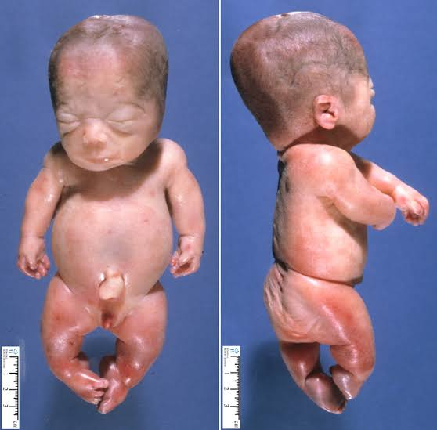

Slide 79
management
Inpatient care is something that is needed for newborns with thanatophoric dysplasia. Intubation may be needed as a form of aggressive treatment for respiratory distress; admission to a neonatal unit is required.

Slide 80
Cont.
If aggressive treatment is deferred, palliative treatment is something that consists of keeping the newborn comfortable, warm, and nourished.

Slide 81
Cont.
At this time, medication therapy is not a part of the care provided in association with thanatophoric dysplasia directly, although medications might be indicated for treatment of concurrent medical conditions that are associated with the disorder.

Slide 82
Campomelic dysplasia
severe disorder that affects development of the skeleton, reproductive system, and other parts of the body. This condition is often life-threatening in the newborn period. The term "campomelic" comes from the Greek words for "bent limb." Affected individuals are typically born with bowing of the long bones in the legs, and occasionally, bowing in the arms.

Slide 83
campomelic dysplasia
People with campomelic dysplasia usually have short legs, dislocated hips, underdeveloped shoulder blades, 11 pairs of ribs instead of 12, bone abnormalities in the neck, and inward- and upward-turning feet (clubfeet). These skeletal abnormalities begin developing before birth and can often be seen on ultrasound

Slide 84
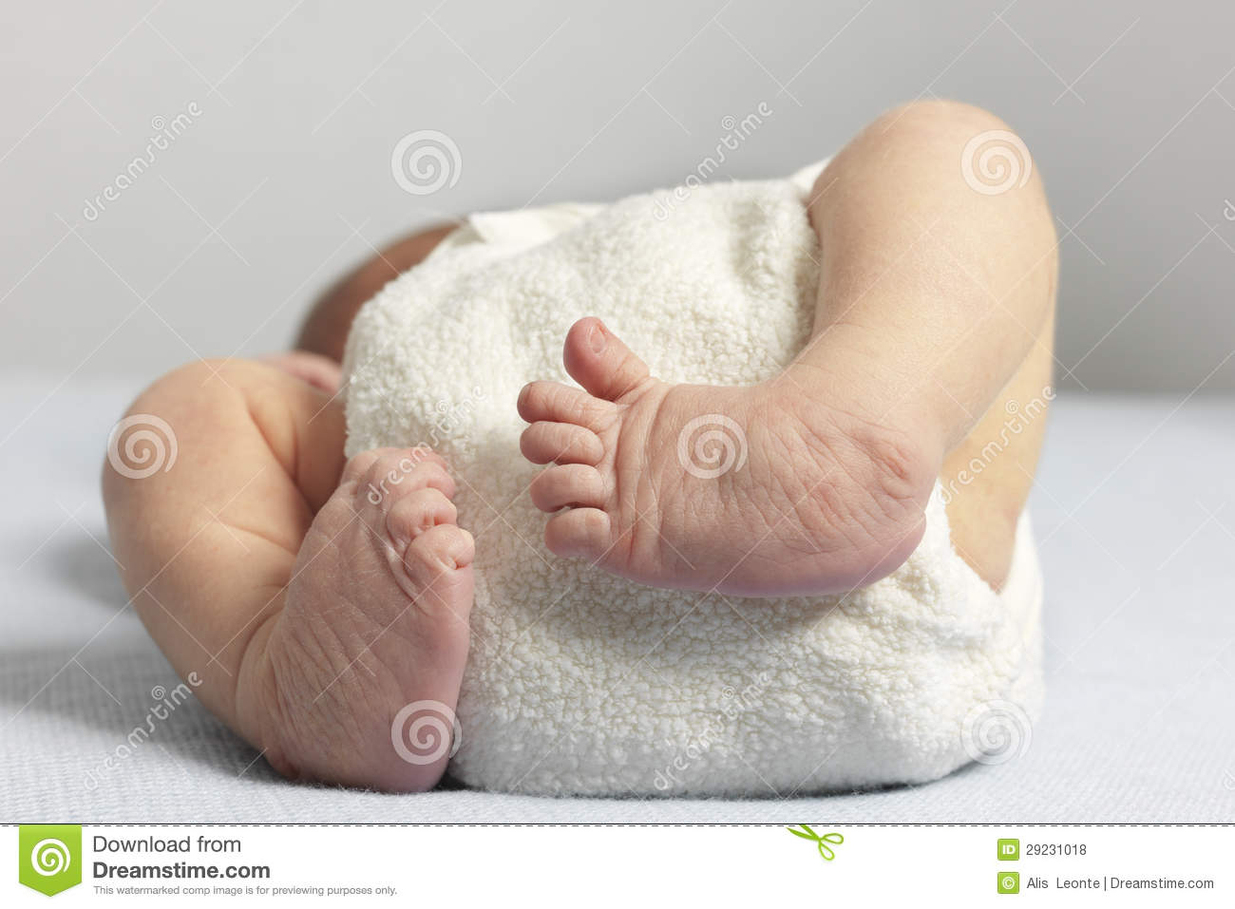
Cont.

Slide 85
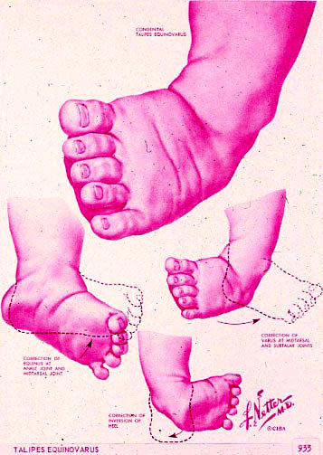
CLINICAL PRESENTATION

Slide 86
TALIPES/ CLUB FOOT
DEF.
A congenitally inverted foot in which adduction, plantar flexion & inversion of the foot occur in varying degrees of severity.
The unilateral form occur commonly than the bilateral form.
RISK FACTORS
Intrauterine compression –faulty posture of the fetus in the uterus
Decreased growth of distal tibia
Family history of talipes
Poor muscular development-poor muscles allow the bone to dislocate.

Slide 87
Management of club foot/telipes
DIAGNOSIS
Clinical manifestation
TREATMENT
Treatment is began immediately & most often requires three stages for correction.
Correction of deformity: Casts are applied in series for gradual stretching & strengthening;
Massages accompanied by special bandaging may be used.
Maintenance of correction: Orthopaedic shoes.
Follow-up observations to prevent recurrence of the deformity.

Slide 88
NURSING INTERVENTION
To assist parents to understand mechanism of treatment to achieve correction.
Appropriate care of cast or brace at home
Follow-up care & importance of frequent cast changes.
To facilitate developmental progress & adapt nurturing activities.
Provide appropriate stimuli & activity for developmental level.
Encourage parents to hold & cuddle the baby.
Maintain normal home routine.

Slide 89
COMPLICATIONS
Pressure sores due to tight casts.
Rocker bottom deformity of the foot
Failure to achieve correction.

Slide 90
Achondroplasia
a genetic disorder that results in dwarfism.[3] In those with the condition, the arms and legs are short, while the torso is typically of normal length. Those affected have an average adult height of 131 centimetres (4 ft 4 in) for males and 123 centimetres (4 ft) for females. Other features include an enlarged head and prominent forehead. It does not affect intelligence.

Slide 91
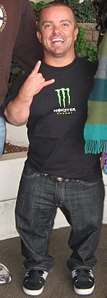

Slide 92
Management of achondroplasia
Currently, there is no way to prevent or treat achondroplasia, since the majority of cases result from unexpected new mutations. Treatment with growth hormone does not substantially affect the height of an individual with achondroplasia. Leg-lengthening surgeries may be considered in some very specialized cases.

Slide 93
Cont.
Detection of bone abnormalities, particularly in the back, are important to prevent breathing difficulties and leg pain or loss of function.

Slide 94
Cont.
Kyphosis (or hunch-back) may need to be surgically corrected if it does not disappear when the child begins walking. Surgery may also help bowing of the legs. Ear infections need to be treated immediately to avoid the risk of hearing loss.

Slide 95
Cont.
Dental problems may need to be addressed by an orthodontist (dentist with special training in the alignment of teeth).

Slide 96
Achondrogenesis
Achondrogenesis is a group of severe disorders that affect cartilage and bone development. These conditions are characterized by a small body, short limbs, and other skeletal abnormalities.

Slide 97
Achondrogenesis
As a result of serious health problems, infants with achondrogenesis usually die before birth, are stillborn, or die soon after birth from respiratory failure. However, some infants have lived for a short time with intensive medical support.

Slide 98
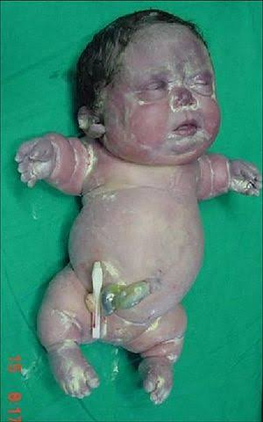

Slide 99
Management of achondrogenesis
Treatment of achondrogenesis is symptomatic and supportive and involves palliative care, in which physicians attempt to reduce or minimize pain, stress and specific symptoms associated with the disorder. Genetic counseling is recommended for families with an affected child. Psychosocial support for the entire family is essential as well.

Slide 100
OSTEOGENESIS IMPERFECTA

Slide 101
OSTEOGENESIS IMPERFECTA
Also called brittle bone disease.
Is a defect in the production of collagen resulting in repeated fractures with minor trauma.
Spontaneous fractures occur in utero (osteogenesis congenita) or during birth or childhood (osteogenesis imperfecta tarda)
Healing of the bone fractures progresses normally.

Slide 102
OSTEOGENESIS IMPERFECTA
Later in life the tendency to fracture decrease & often disappears.
Vast majority of cases are transmitted as autosomal dorminant traits although a small percentage of congenital cases are transmitted as autosomal recessive

Slide 103
OSTEOGENESIS IMPERFECTA
PRESENTATION
Trauma during delivery may lead to intracranial hemorrhage & stillbirth.
At birth the skull is soft & feels like a “bag of bones”.
Infants born alive may die suddenly during the first few days or week.
Survivors develop shortened extremities & other bony deformities.

Slide 104
OSTEOGENESIS IMPERFECTA
5. Mental development is normal unless CNS injury occurs.
6. The sclerae is thin, translucent & appear blue.
7. Hearing loss from otosclerosis may occur.
8. Joint instability.

Slide 105
OSTEOGENESIS IMPERFECTA
MANAGEMENT
To prevent fractures & increase function
Orthopedic treatment
Physiotherapy & occupational therapy
Treatment with biphosphonate pamidronate given iv has been shown to increase bone mineral density & motor function & may decrease bone pain & resorption.
Notes:
physical and occupational therapy to increase your child’s mobility and muscle strength
bisphosphonate medications to strengthen your child’s bones
medicine to reduce any pain
low-impact exercise to help build bone
surgery to place rods in your child’s bones
reconstructive surgery to correct bone deformities
mental health counseling to help treat issues with body image

Slide 106
OSTEOGENESIS IMPERFECTA
COMPLICATION
Failure to gain weight
Bone deformities & dwarfism

Slide 107
HIP DYSPLASIA
Is a malformation of the hip as a result of imperfect development of the femoral head or the acetabulum or both.
The structures that support the hip joint & holds the joint together are too loose, or the joint cavity is too shallow.
RISK FACTORS
Frequently associated with other congenital deformities.
Prenatal factors e.g. maternal hormonal secretion, intrauterine posture especially frank breech position
Notes:
MEDICAL CNX IN WHICH THE HIP SOCKET DOESN’T FULLLY COVER THE BALL PORTION OF THE UPPER THIGHBONE
THIS ALLOWA THE HIP JOINT TO BECOME PARTIALLY OR COMPLETELY DISLOCATED
MOST PPLE ARE BORN WITH IT

Slide 110
HIP DYSPLASIA
CLINICAL MANIFESTATIONS (NEWBORN)
Ortolani’s sign: Infant supine, knees flexed, hips fully abducted, a click is heard or felt as the hip is reduced by the abduction.
Asymmetrical gluteal & thigh folds.
Shortening of the leg on the affected side, one knee is lower than the other (Galeazzi sign)
Notes:
ORTOLANI- CLUNK

Slide 111
HIP DYSPLASIA
DIAGNOSIS
X-ray film
CT Scan
TREATMENT
Is initiated as soon as condition is identified
For newborn, the dislocated hip is securely held in a full abduction position. This keeps the femur in the acetabulum & stabilizes the area

Slide 112
HIP DYSPLASIA
Abduction devices
Pavlik harness: a fabric, strap harness that is secured around the infant’s shoulders & chest & is connected to straps around the lower leg. The harness maintains the legs in a flexed, abducted position at the hip. The harness maybe removed for bathing, but the infant will wear it full time until the hip is stable.

Slide 117
HIP DYSPLASIA
b) Hip spica cast, most often used when adduction contracture is present. After the removal of the cast, a protective abduction brace is fitted.
c) Closed reduction: Performed in older children, 6-8 months old.
d) Open reduction: becomes increasingly difficult after the age of 4 years.

Slide 118
HIP DYSPLASIA-PAVLIK HARNESS

Slide 119
HIP DYSPLASIA
NURSING INTERVENTION
To identify hip dysplasia in the newborn before discharge.
To assist parents to understand mechanisms to maintain reduction
(a) Pavlik brace: Teach parents the application of brace, undershirts should be worn beneath the brace. Check skin under brace for irritation or pressure areas, no lotions or oils should be applied to the skin that will be under brace.

Slide 120
HIP DYSPLASIA
(b) Teach parents cast care if hip spica cast is applied.
3. To facilitate developmental progress.
Provide appropriate stimuli & activity for developmental level.
Encourage parents to hold & cuddle child.
Maintain normal home routine.

Slide 121
SCOLIOSIS
Is a lateral S-shaped curvature of the thoracic & lumbar spine.
If allowed to progress without treatment, it will severely affect the shape of the thoracic cavity & impair ventilation.
Could be structural or postural (non-structural).
Structural: classifications are idiopathic, congenital, neuromuscular & syndromic or miscellaneous (infection).

Slide 122
SCOLIOSIS

Slide 123
CLINICAL MANIFESTATIONS
Uneven hips & shoulders
Visible curvature of the spinal column; head & hip are not in alignment.
When a child bends forward from the waist, there is visible asymmetry of the shoulders.
Waistline is uneven. One hip is more prominent.

Slide 124
DIAGNOSTICS
Clinical manifestations
X-ray film- AP & lateral spine
MRI – especially for those with neurological deficit.
Straight-leg-raising test is performed by the nurse on the pt on a supine position & will complain of sciatica or leg pain

Slide 125
TREATMENT
Observation & monitoring for curvature less than 20 degrees.
Brace if curvature shows progression 20-40 degrees. Maintain the size of deformity.
Surgery if the curvature is 40-50 degrees. Spinal fusion & placement of a rod to prevent destruction of the fused segment. The rod may be left in place permanently unless it becomes displaced or causes discomfort.

Slide 126
NURSING INTERVENTION
Promote health programs in school to identify condition early.
Assist pt & parents to properly use braces.
Make sure brace is properly fitted & does not inadventently rub bony prominences.
May put light T-shirt under brace for comfort.
Initially, the brace is worn 20-23 hrs/day till skeleton mature.

Slide 127
d) Brace is regularly adjusted to promote correction.
e) If progress is good, child is weaned from the brace during the daytime & wears it only at night.
f) Supplemental exercises.
3. Support normal growth & development & to develop a positive self-image.
a) Encourage peer socialization.

Slide 128
b) Encourage independence
c) Encourage child to participate in & be independent in scheduling of activities & other aspects of care.
d) Emphasize positive long-term outcome.
4. Maintain spinal alignment after surgical correction. (care of pt after laminectomy & fusion).
5. Maintain homeostasis & assess for complications after surgical correction.

Slide 129
OSTEOPOROSIS (POROUS BONE)

Slide 130
OSTEOPOROSIS (POROUS BONE)
A metabolic bone disease that involves an imbalance between new bone formation & bone resorption.
Primary osteoporosis is the most common type, often in women after menopause because low levels of estrogen are associated with an increase in bone resorption.
Bone loss occurs predominantly in the vertebral bodies of the spine, femoral neck in the hip, & the distal radius of the arm. Bone mass declines, leaving the bones brittle & weak.

Slide 131
OSTEOPOROSIS (POROUS BONE)
RISK FACTORS
Increased incidence in women after the age of 50 yrs.
Early menopouse
Low peak bone mass (maximum amount of bone a person achieves)
Excessive alcohol intake-act on bone cells to reduce remodeling by increasing the parathyroid hormone
Sedentary lifestyle
N/B OESTROGEN MAINTAINS BONE MASS IN ADULT WOMEN

Slide 132
OSTEOPOROSIS
6. Endocrine disorders of the thyroid & parathyroid glands.
7. Eating disorders
8. Cigarette smoking
9. Insufficient dietary calcium
10. Long term use of corticosteroids (decreases collagen synthesis & increase collagen breakdown).

Slide 133
OSTEOPOROSIS
CLINICAL MANIFESTATIONS
Maybe asymptomatic until x-ray films demonstrate skeletal weakening.
Spinal deformity & dowager’s hump resulting from repeated pathological, spinal vertebral fractures.
Spinal fractures may occur spontaneously or as a result of minimal trauma.

Slide 134
OSTEOPOROSIS
4. Chronic low thoracic & midline back pain
5. Height loss may precipitate thoracic problems, decrease in abdominal capacity, & decrease in exercise tolerance.
6. Hip fractures & vertebral column collapse are the most debilitating problems.
DIAGNOSTICS
Serum calcium, phosphorus, & alkaline phosphatase & PTH are usually normal

Slide 135
OSTEOPORISIS
2. CT Scan or bone density scan to evaluate bone loss.
MEDICAL MANAGEMENT
Medications: calcium supplements, vit. D supplements, estrogen replacement therapy & medications that facilitate increased bone density.
Dietary: increased intake of protein, calcium & vit. D.

Slide 136
OSTEOPOROSIS
3. Exercise: activities that put moderate stress on bones working them against gravity (walking, racquet sports, jogging).
4. Compression fractures of the vertebrae usually heal with surgical intervention.
NURSING INTERVENTION
pain relief; bedrest; firm mattress & narcotic analgesic initially, followed by non steroidal antiinflammatory drugs.

Slide 137
OSTEOPOROSIS
2. Assess bowel & bladder function, patient will be prone to constipation & paralytic ileus if vertebrae are involved.
3. Regular daily exercise; encourage outdoor exercise (to increase the utilization of vit. D)
4. Increased calcium intake & estrogen therapy.
5. Education:-decrease falls & injury by maintaining safe home environment

Slide 138
OSTEOPOROSIS
- understand the need to continue taking medication even if they do not make the patient feel better, they prevent further damage.
- do not exercise if pain occurs.
- avoid heavy lifting, stooping & bending. Review & demonstrate good body mechanics with the client.

Slide 139
OSTEOPOROSIS
PREVENTION
Diet adequate in protein, calories, calcium & vit. D.
Calcium & vit. D supplements & exercise for those at risk.
Consider hormonal replacement for hypogonadal men & women.
Consider biphosphate if pt is on corticosteroids for more than 2 weeks & for prevention of osteoporosis.

Slide 140
OSTEOPOROSIS
5. Give calcium supplement with meals to reduce risk of calcium oxalate nephrolithiasis.
COMPLICATION
Bone fracture occurring in the vertebral bodies, distal radius or hip.

Slide 141
BONE TUMOR-BONE CYST

Slide 142
BONE TUMOURS
TUMOR-abnormal swelling due to rapid growth of tissue which may be benign or malignant
TYPES
Osteogenic- of bone origin
Chondronic- of cartilage origin
Fibrogenic- from fibrous tissue
Rhabdomyogenic- of muscular origin
Others are marrow (reticulum), nerve, vascular & fatty cell tumors.
Could be primary or metastatic tumor.

Slide 143
BONE TUMOURS
BENIGN BONE TUMOURS-
They do not metastasize to other tissues.Are more common than malignant primary bone tumours.
Generally are slow growing & well circumscribed, present few symptoms, & are not a cause of death.
Examples:- osteochondroma, bone cyst, fibroma.
Some benign tumors such as giant cell tumors (osteoclastoma) have the potential of undergoing malignant transformation.

Slide 144
BONE TUMOUR
MALIGNANT BONE TUMOURS
Primary malignant musculoskeletal tumours are relatively rare & arise from connective & supportive tissue cells (sarcomas) or bone marrow elements (myelomas).
Malignant primary musculoskeletal tumours include osteosarcoma, chondrosarcoma, Ewing’s sarcoma & fibrosarcoma.

Slide 145
BONE TUMOURS
Soft tissue sarcomas include liposarcoma, fibrosarcoma.
Osteogenic sarcoma (osteosarcoma) is the most common & most often fatal malignant bone tumour. The tumour carries a high mortality rate because the sarcoma often has spread to the lungs by the time pt seeks healthcare. Long bone is often affected.

Slide 146
BONE TUMOURS
METASTATIC BONE DISEASE
More common than any primary bone tumour.
From elsewhere the most common primary sites of tumors that metastasize to bone include the kidney, prostate, lung, breast, ovary & thyroid.

Slide 147
BONE TUMOURS
RISK FACTORS
Male between 10-25 years
Older people with paget’s disease
A result of radiation exposure
PATHOPHYSIOLOGY
A tumour causes normal bone tissue to react by osteolytic response (bone destruction) or osteoblastic response (bone formation). Primary tumours cause bone destruction, which

Slide 148
BONE TUMOURS
Weakens the bone, resulting in bone fractures. The bones surface changes & the contour enlarges in the tumor area.
Malignant bone tumors spreads in blood along the walls of the veins. This invade & destroy adjacent bone tissue & benign bone tumors place pressure on adjacent bone tissue. This weakens the structure of the bone until it can no longer withstand the stress of ordinary use. Pathologic fractures commonly result.

Slide 149
BONE TUMOURS
CLINICAL MANIFESTATION
Varying degrees of disability
Weight loss
Malaise
Fever
Spinal cord compression (spinal metastasis)
Palpable, tender, & fixed bone mass.

Slide 150
BONE TUMOURS
DIAGNOSTICS
History & physical examination
Diagnostic studies: CT Scan, bone scan, myelogram, arteriography, MRI, biopsy, & CXR.
TREATMENT
Amputation of extremity &/or extensive surgical resection of bone & surrounding tissue.

Slide 151
BONE TUMOURS
2. Chemotherapy
3. Radiotherapy
NURSING INTERVENTION (post excision of tumor)
Pain relieve: pharmacologic & non-pharmacologic pain mx. Work with pt for effective pain mx regime increasing pt control.

Slide 152
BONE TUMOURS
2. Wound care as healing maybe delayed because of surgery & radiotherapy. Minimize pressure on wound.
3. Adequate nutrition, address anorexia, nausea & vomiting post chemotherapy & radiotherapy.
4. Prevent wound infection- antibiotics & aseptic wound dressing techniques. If pt is on chemotherapy monitor WBC.

Slide 153
BONE TUMOUR
5. Give psychological care.
6. physiotherapy.
7. Teach on meds, dressing, treatment regimen, physical & occupational therapy programs, & complications.

Slide 154
SKELETAL TUBERCULOSIS
It is caused by dissemination of bacilli via the blood stream early in the course of the initial infection.
In some cases spread to bone appears to result from lymphatic drainage from another infected area such as the pleura or kidney.
May smolder for years before being discovered.

Slide 155
SKELETAL TUBERCULOSIS
Basic lesions almost always is a combination of osteomyelitis & athritis.
In adults, skeletal tuberculosis usually occurs in weight- bearing joints; spine, hip & knees.
PATHOPHYSIOLOGY
An inflammatory reaction is followed by formation of granulation tissue that begins to erode & destroy cartilage & eventually cancellous bone, ultimately leading to demineralization &

Slide 156
SKELETAL TUBERCULOSIS
Necrosis. The healing process involves deposition of fibrous tissue.
PRESENTATION
Multiple osteolytic lesions.
Pain
Slight narrowing of vertebral space.
Later vertebral body destruction with collapse & formation of kyphosis & scoliosis

Slide 157
SKELETAL TUBERCULOSIS
POTT’S DISEASE (TUBERCULOSIS SPONDULOSIS)
This is TB of the spine.
Half of the cases of skeletal tuberculosis occur in the spine.
Infectious process begins in the anterior part of a vertebral body.
The disk space between two involved vertebrae is usually destroyed, producing the characteristic anterior wedging of two involved vertebrae with loss of intervening disk space.

Slide 158
SKELETAL TUBERCULOSIS
The resulting deformity may produce a characteristic posterior prominence of the spine
Thoracic spine is involved most frequently
Lumber spine is next, & cervical & sacral spines least often.
POTT’S ABSCESS & SINUS FORMATION
Pus from a vertebral focus ruptures anteriorly, enveloping the spine & producing a paraspinal abscess

Slide 159
SKELETAL TUBERCULOSIS
Since it is confined by tight ligamentous investments, it can develop higher pressure, dissect along tissue planes for long distance, & present as a mass in the supraclavicular space, above the posterior iliac crest in the petit’s triangle the groin, the buttock, or even the popliteal fossa.
Cases of Pott’s abcess perforating into the bowel have been reported, resulting in a gas-filled psoas

Slide 160
SKELETAL TUBERCULOSIS
visible on x-ray films.
Rupture into adjacent lung has been observed.
The abscess can spread infection to other vertebral bodies, sometimes with intervening normal spine.
POTT’S PARAPLEGIA
Paralysis of lower extremities can develop in several ways.

Slide 161
SKELETAL TUBERCULOSIS
Pressure in a paraspinal abscess can produce ischemic changes in the subjacent cord.
In such cases neurologic symptoms are promptly relieved by drainage of the abscess.
Caseous or granulating tissue may extrude from the posterior aspect of the vertebral body & impinge on the anterior aspect of the cord.
Inflammatory thrombosis of the anterior spine artery can occur.

Slide 162
SKELETAL TUBERCULOSIS
Sudden cord transections(injury) may result from serious loss of structural integrity.
INVESTIGATIONS
Tuberculin test: precise intracutaneous injection producing a raised, blanched wheal. The reaction is read in 48-72 hrs, a positive test defined as greater than 10mm of induration.

Slide 163
SKELETAL TUBERCULOSIS
2. Tissue or pus culture & specify of micro-organism.
3. CT spine, MRI, x-ray
TREATMENT
Bed rest to relief pain
Drainage or debridement of large paraspinal abscesses if they are causing paraplegia or paraparesis

Slide 164
SKELETAL TUBERCULOSIS
3. Prolonged treatment (2 years) with an INH (isoniazid)- containing regimen is indicated & many advise including RMP (rifampicin) for 9 months.
4. Advanced neurologic defects & severe anatomic instability of the spine require more radical orthopedic approaches.

Slide 165
ATHRITIC HAND

Slide 166
ARTHRITIC KNEE

Slide 167
ARTHRITIS
It is the inflammation of a joint, usually accompanied by pain, swelling & changes in structure.
Occurs in many forms e.g
Acute secondary arthritis: arthritis caused by osteitis.
Acute suppurative purulent distention of synovial sac: a serious form usually due to bacterial infection.
Allergic arthritis: arthritis following ingestion of food allergens or occurring in serum sickness
Palindromic arthritis: transient recurrent arthritis, of unknown etiology of the large joints.

Slide 168
ARTHRITIS
ETIOLOGY
Infection; gonococcus, tuberculous, pneumococcal.
Rheumatic fever
Ulcerative colitis
Trauma

Slide 169
ARTHRITIS
5.Degerative joint disease e.g. osteoarthritis.
6. Metabolic disturbances such as gout.
7. Neoplasms e.g synovioma.
8. para- or peri-articular conditions eg fibromyositis
9. Psoriasis
Notes:
Fibro-chronic inflammations of a muscle and fibrous tissues which surrounds the muscle
Psoriatic arthritis-inflammatory arthritis which affects pple with auto immune dz

Slide 170
ARTHRITIS
SIGNS & SYMPTOMS
Joint inflammation; redness, swelling, pain & reduced mobility
TREATMENT
Treat underlying cause.
Pts often benefit from referal to occupational or physiotherapy or both.
Notes:
50% involve the knees
Systemic- fever chills leukocytosis
Vi abx
Aspirate the joint with a needle to remove excessivefluids, exudate and debris- comfort and descrease joint destruction
Immobilize the inflamed joint with a splint
analgesics
Nutrition n fluid states
Rom
Nrsg mnx
Educate about cnx importance of supporting limb, adherence, inspecting skin under splint

Slide 171
MANAGEMENT.
3. Physical exercise: During pain, exercise seems to be the last option but muscle strengthening and stretching exercises have proved to be very helpful.
4.To relieve pain: Pain relievers like NSAIDs (non-steroidal anti inflammatory drugs). NSAIDs generally interfere with chemicals called prostaglandins in the body, which trigger pain, inflammation, and fever.

Slide 172
MANAGEMENT.
5. Surgery: Joint replacement surgery is often performed for those who are not able to walk or have lot of difficulty in walking.
6. Disease-modifying anti rheumatic drugs (DMARDs): Often used to treat rheumatoid arthritis; DMARDs slow or stop immune system that attack joints. Examples include methotrexate (Trexall) and hydroxychloroquine (Plaquenil).

Slide 173
MANAGEMENT.
7. Intra-articular injection-A hypodermic needle is injected into the affected joint where it delivers a dose of any one of many anti-inflammatory agents, the most common of which are corticosteroids.

Slide 174
OSTEOARTHRITIS (O.A)
Also known as joint degenerative disease or osteoarthritis.
It occurs when the protective cartilage that cushions the end of your bones wears down over time.
It is a progressive nonsystemic, noninflammatory disease that causes a progressive degeneration of synovial joints of weight- bearing long bones.
Notes:
It doesnot involve auto immunity or inflmation but it can occur as a end result of auto immnunity e=where there was joint destruction
It is limited to affected joint not systemic

Slide 175
OSTEOARTHRITIS (O.A)
OA has been classified as primary (idiopathic, with no prior event or disease related to the AO) or secondary. Distinction is always not clear between primary & secondary OA.
Osteoarthritis symptoms can usually be managed although the damage to joints is irreversible.

Slide 176
OSTEOARTHRITIS
RISK FACTORS
Increased age
Genetic predisposition
Gender & hormonal factors
Obesity
Mechanical factors/repeated stress on the joint.
Prior inflammatory disease
Notes:
Age – change in weight bearing joints

Slide 177
RISK FACTORS
7. Joint injuries
8. Genetics
9.Bone deformity/ defective cartilage
10. Certain metabolic diseases e.g diabetes

Slide 178
OSTEOARTHRITIS
CLINICAL MANIFESTATIONS
Pain, swelling, tenderness
Crepitus: a grating sound or feeling with movement.
Instability; stiffness & immobility.
Pain increases with motion & weight bearing.
Herberdens nodes: bony nodules on the distal finger joints.
Notes:
Weight baring joint-hip,knees, cervical and lumber spine
Functional impairment
Pain is aggreavated by exercise and relieved by rest
Affected limb is enlarged with descresed rom

Slide 179
OSTEOARTHRITIS
DIAGNOSTICS
Synovial joint analysis
Bone scan
X-ray films/MRI
TREATMENT
Medication to relieve pain, NSAIDS eg acetaminophen
Activity balanced with adequate rest
Weight reduction, if appropriate
Notes:
Blood test and synovial fluid analysis is not needed but its orded to rule out auto immune causes of joint pain
Xr- to show joint space, osteophyte formation

Slide 180
OSTEOARTHRITIS
4. Physical therapy & exercise
5. Joint rest & avoidance of joint overuse.
6. Use of orthotic device to support inflamed joints ( splints, braces).
7. Occupational therapy- helps to discover ways of doing everyday tasks without putting extra stress on your already painful joint.
8. Corticosteroid injection in the site.
9. Lubrication injection on the site.

Slide 181
OSTEOARTHRITIS
10. joint replacement with plastic and metallic part after removal of damaged joint surfaces.

Slide 182
OSTEOARTHRITIS
NURSING MANAGEMENT
1. Acute inflamed joint should be immobilized with splint or brace.
2. Plan ADLs to prevent stress on involved joints & promote rest.
3. Heat compresses to relief pain & cold compresses for inflamed joints
4. Maintenance of regular exercise
Notes:
Pharm and non-pharm plus education for pain mnx e.g wt loss and exercise
Assistive devices like cane

Slide 183
assignment
Read and make short notes on
Rheumatoid arthritis
Gout arthritis

Slide 184
ANKYLOSING SPONDYLITIS

Slide 185
ANKYLOSING SPONDYLITIS
It is a type of arthritis that affect the spine.
Ankylosis is fixation or immobility of a joint.
Ankylosing spondylitis affects the cartilaginous joints of the spine & surrounding tissues. Occasionally, the large synovial joints, such as hips, knees or shoulders, maybe involved.
It is usually diagnosed in the second or third decade of life.
Notes:
Inflamatory dz of the spine
It affect the cartilaginous joints of the spine and surrounding tissues making them rigid, descresing mobility and leading to kyphosis which leads to descresed mobility and stability
More prevalent in male than women

Slide 186
ANKYLOSING SPONDYLITIS
The disease is not usually as severe in females as in males, in whom the disease is more prevalent & likely to have significant systemic involvement.
CLINICAL MANIFESTATION
Low back pain which improves with exercise.
Early morning stiffness or stiffness after immobility.
Notes:
Back pain- mask cervical # which can lead to neurological disorders if left un treated
Stiffness from the neck down the lower back

Slide 187
ANKYLOSING SPONDYLITIS
3. Enthesitis (inflammation at points of insertion of ligaments & tendons) & occurs as heel, plantar
4. Bony fusion- it can cause an overgrowth of the bones which leads to abnormal joining of the bones
5. Bent posture. If AS has gone undiagnosed and untreated, you might have a stooped posture from changes to your vertebrae.

Slide 188
A.S
6.Breathing problems. Changes in posture can lead to changes in your lungs that make it hard to breathe.
7.Fatigue. You could feel run down because of lack of sleep due to pain or as a part of the disease process itself.
8.Psoriasis. About 10% of people with AS have this immune system disease that causes scaly, itchy red patches on their skin.

Slide 189
A.S
9.Inflammatory bowel disease. The inflammation can also affect your digestive system.
10. Eye and heart can be affected
11.fever

Slide 190
A.S
DIAGNOSTICS
Diagnosis is too often delayed by 8-10 yrs because of increased prevalence of back pain in community.

Slide 191
ANKYLOSING SPONDYLITIS
ESR & CRP not always elevated, radiographs will be normal in early disease.
CT-scan: shows erosive changes
MRI enhanced: most sensitive technique to detect joint & lumbar-spine inflammation.
TEATMENT
The goal of treatment is to relieve your pain and stiffness, and prevent or delay complications and spinal deformity. Ankylosing spondylitis treatment is most successful before the disease causes irreversible damage to your joints.
Notes:
C-reactive protein

Slide 192
TREATMENT
Regular exercise to maintain ROM by physiotherapy.
Regular follow-up
Increased doses of NSAIDS.
Surgery- artificial joint replacement

Slide 193
OSTEOMYELITIS

Slide 194
OSTEOMYELITIS
An infection of the bone, bone marrow & surrounding soft tissue.
Causation organisms are staph. Aureus (70-80 %), Proteus, psuedomonas & E. Coli.
Notes:
Hematogenous-due to blood borne
Contiguous – from contaminated bone surgery, open fracture, traumatic trauma e,g gun shot
With vascular insufficiency like in diabetes

Slide 195
OSTEOMYELITIS
RISK FACTORS.
Indirect entry of organism
Hematogenic
Injury & infection of adjacent soft tissue as in cellulitis.
Direct injury to bone:
Trauma
Surgical procedures.

Slide 196
OSTEOMYELITIS
PATHOPHYSIOLOGY
Inflammatory response occurs initially, with increased vascularization & edema. After 2 or 3 days, thrombosis of the blood vessels occurs resulting in ischemia with bone necrosis. The infection extends into the medullary cavity & under the periosteum & may spread into adjacent soft tissues & joints. Without prompt

Slide 197
OSTEOMYELITIS
treatment bone abscesses form which contains dead bone tissue (sequestrum) that does not easily liquify & drain. New bone growth (involucrum) forms & surrounds the sequestrum. Although healing appears to take place, achronically infected sequestrum remains & produces recurring abscesses throughout the the pt’s life. This is referred to as chronic osteomyelitis.

Slide 198
OSTEOMYELITIS
CLASSIFICATION
Acute osteomyelitis: sudden onset, may heal in 2 to 3 weeks or progress to chronic status.
Chronic osteomyelitis: a continuous, persistent problem or exacerbation of previous problem.

Slide 199
OSTEOMYELITIS
CLINICAL MANIFESTATION
Acute
Tenderness, swelling & warmth in affected area.
Drainage from infected site.
Fever, chills
Constant pain in affected area.
Circulatory impairment

Slide 200
OSTEOMYELITIS
Chronic
Drainage from wound or sinus tract
Recurrent episodes of bone pain
Low grade fever
Remission & exacerbation of problem.

Slide 201
OSTEOMYELITIS
DIAGNOSTICS
Wound culture, blood culture to identify appropriate antibiotic therapy.
Radionuclide bone scan , MRI for early definitive diagnosis.
X-ray plate only shows soft tissue swelling till after 2 weeks.
Bone or soft tissue biopsy.

Slide 202
OSTEOMYELITIS
TREATMENT
Intensive IV antibiotics therapy 3 to 6 weeks.
Immobilization of the affected area.
Surgical debridement may be necessary with antibiotic beads impregnated i.e sequestrectomy (removal of enough involucrum to enable removal of sequestrum)

Slide 203
OSTEOMYELITIS
NURSING INTERVENTION
Administration of antibiotics, analgesics
Prevent contractures especially of the affected extremity.
Care of open wounds & some pts are isolated
Education on drug compliance because they are going to take antibiotics for a long time, infection control measures & keeping follow-up appointments.

Slide 204
OSTEOMYELITIS
PREVENTION
Treatment of focal infections diminishes hematogenous spread.
Post pone elective orthopedic surgery if pt has recurrent infection e.g UTI, sore throat or history of a recent infection.
Prophylactic antibiotics with invasive procedures on pts with joint replacement surgery.

Slide 205
OSTEOMYELITIS
Asepsis during orthopedic surgery.
Aseptic post op wound care.

Slide 206
CONTUSION
Is a soft tissue injury produced by blunt force e.g a blow, kick or fall. Many small blood vessels rupture & bleed into soft tissues (ecchymosis/ bruising). A hematoma develops when the bleeding is sufficient to cause an appreciable collection of blood.
Local symptoms (pain, swelling & discoloration) are controlled with intermittent application of cold.
Most contusions resolve in 1-2 weeks.

Slide 207
STRAIN
Is a “muscle pull” from over use, overstretching, or excessive stress.
Strains are microscopic, incomplete muscle tears with some bleeding into the tissue.
Patient experiences soreness or sudden pain with local tenderness upon muscle use & isometric contraction

Slide 208
SPRAIN

Slide 209
SPRAIN
Is an injury to ligaments surrounding a joint, caused by a wrenching or twisting motion.
The function of a ligament is to maintain stability while permitting mobility.
A torn ligament loses stabilizing ability.
Blood vessels rupture & edema occurs, the joint is tender & movement becomes painful.
The degree of disability & pain increases during the first 2-3 hrs after the injury because of the associated swelling & bleeding.

Slide 210
SPRAIN
The patient should have an x-ray to evaluate for bone injury.
Avulsion fracture (a bone fragment is pulled away by a ligament or tendon) may be associated with a sprain.

Slide 211
TREATMENT (CONTUSION, STRAIN & SPRAIN)
Resting (prevent further injury & promote healing) & elevating the affected part (control swelling)
Apply cold (ice) (produces vasoconstriction which reduces bleeding & edema)
Note: acronyme RICE- Rest, Ice, Compression, Elevation.
Monitor neurovascular status (circulation, motion, sensation).

Slide 212
TREAMENT
After the first 48 hrs of acute inflammation stage heat may be applied to promote vasodilation, absorption & repair.
Exercise after 2 or more days depending on the severity of injury.

Slide 213
JOINT DISLOCATION
Is a condition in which the articulate surfaces of bones forming the joint are no longer in anatomic contact.
The bones are literally “out of joint”.
A subluxation is a partial dislocation of the articulating surfaces.
Traumatic dislocations are orthopedic emergency. Otherwise vascular necrosis & nerve palsy may occur.
Dislocations may be congenital (hip), spontaneous or pathological or traumatic.

Slide 214
JOINT DISLOCATION
SIGNS & SYMPTOMS OF A TRAUMATIC DISLOCATION
Pain
Change in contour of the joint
Change in the length of extremity
Loss of normal mobility
Change in axis of the dislocated bones.

Slide 215
JOINT DISLOCATION
DIAGNOSIS
X-ray confirms diagnosis & demonstrates possible associated fractures.
MEDICAL MANAGEMENT
Immobilization of the joint while pt is transported to hospital.
Prompt reduction to preserve joint function
Joint immobilization by bandages, splints, casts or traction.

Slide 216
JOINT DISLOCATION
Monitor neurovascular status.
After several days to weeks passive & active movement 3-4 times a day is began to preserve ROM. Support joint between the exercise.
NURSING MANAGEMENT
Promote comfort, evaluate neurovascular status, & protecting joint during healing.
Teach pt to manage immobilizing devices & how to protect joint from injury.

Slide 217
FRACTURES
A.S

Slide 218
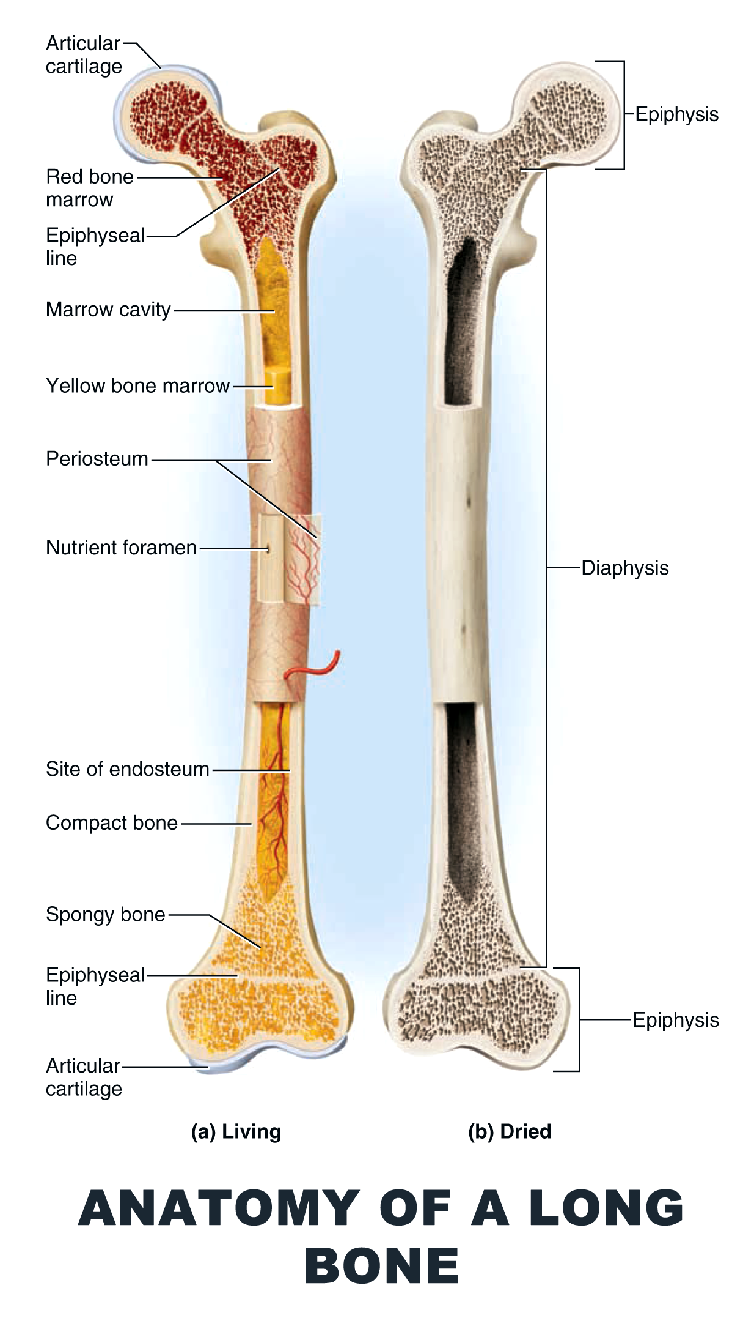

Slide 219
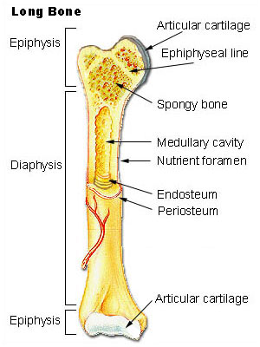

Slide 220
DEFINITION
A disruption or break in the continuity of the bone.
Usually as a result of a traumatic injury
Characteristics of bones in children affecting fracture & fracture healing.
Presence of epiphyseal plate; if damaged, may affect the growth of the long bone.
Periosteum is thicker & stronger & has an increased blood supply; therefore healing is more rapid.
Bones are more porous & allow for greater flexibility.

Slide 221
CLASSIFICATION OF FRACTURES
According to pattern of fracture
Complete: fracture line extends through the entire bone; the periosteum is disrupted on both sides of the bone.
Incomplete: fracture line extends only partially through the bone (greenstick, hairline).
Comminuted: fracture with multiple bone fragments; more common in adults.
Impacted: complete fracture in which bone fragments are driven into each other.

Slide 222
FRACTURES

Slide 223
According to location of the fracture
Proximal
Middle
Distal
Stable vs Unstable fractures.
Stable: a portion of the periosteum remains intact; frequently transverse, spiral or greenstick fractures.
Unstable: bones are displaced at the time of injury, with poor approximation; frequently comminuted or impacted.

Slide 224
Simple vs Complex fractures.
Simple, closed fracture: does not produce a break in the skin.
Complex, open or compound fracture: involves an open wound through which the bone has protruded
Anatomic location (colles & potts fractures)
Colles’: fracture within the last inch of the distal radius, distal fragment is displaced in a position of dorsal & medial deviation.
Potts’: fracture of distal fibula, seriously disrupting the tibio-fibular articulation, a piece of medial melleolus may be chipped off as a result of rupture of internal ligaments.

Slide 225
FRACTURE

Slide 226
RISK FACTORS
Pathological fractures: osteoporosis, multiple myeloma, osteogenic sarcoma, metabolic diseases.
Trauma
Congenital conditions
Spontaneous

Slide 227
CLINICAL MANIFESTATIONS
Edema around the injured site.
Severe pain
Abnormal positioning of the extremity
Loss of normal function
False movement; movement occurs at the fracture site, bone should not move except at joints.
Crepitation: palpable or audible crunching as the ends of the bone rub together.
Discolouration of the skin around the affected area.
Sensation may be impaired if there is nerve damage.

Slide 228
DIAGNOSTICS
Clinical manifestations & history
X-ray film of involved area.

Slide 229
MANAGEMENT
IMMEDIATE IMMOBILIZATION
Suspected fracture area restricted from moving.
FRACTURE REDUCTION
Closed reduction: nonsurgical, manual realignment of the bones, then injured extremity is placed in a cast for continued immobilization until healing occurs.
Open reduction: surgical correction of alignment.

Slide 230
FIXATION DEVICES
External fixation- application of a rigid external device consisting of pins placed through the bone & held in place by a metalic frame, requires meticulous care of pin insertion site.
Internal fixation (ORIF open reduction, internal fixation): done through an open incision, & a hardware (pins, plates, rods, screws) is placed in the bone.
Both methods

Slide 231
INTERNAL FIXATION DEVICES

Slide 232
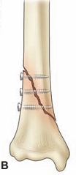
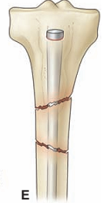
INTERNAL FIXATION DEVICES
B, Screws:-oblique/spiral
D, Plate and six screws
E, Medullary nail.

Slide 233
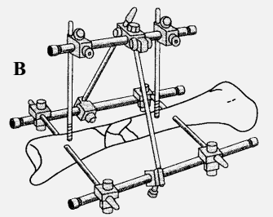
EXTERNAL FIXATION DEVISES

Slide 234
CAST APPLICATION
To maintain immobility of the injured area.
Type of cast applications
Short arm cast: extends from below the elbow to the palmar crease, secured around the base of the thumb. If the thumb is included, it is known as a thumb spica or gauntlet cast.
Long-arm cast: extends from the axillary fold to the palmer crease. The elbow usually is immobilized at a right angle.
Long leg cast: extends from the junction of the upper & middle third of the thigh base to the toes. The knee maybe slightly flexed

Slide 235
Short-leg cast: extends below the knee to the base of the toes. The foot is flexed at a right angle in a neutral position.
Walking cast: a short- or long- leg reinforced for strength.
Body cast: encircles the trunk.
Shoulder spica cast: a body jacket that encloses the trunk & the shoulder & elbow.
Hip spica cast: encloses the trunk & a lower extremity. A double hip spica cast includes both legs.

Slide 236
ARM CASTS

Slide 237
LEG CASTS

Slide 238
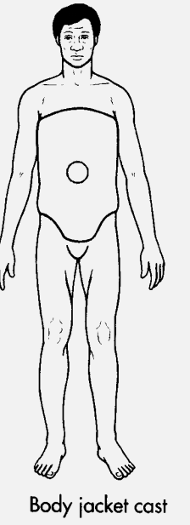
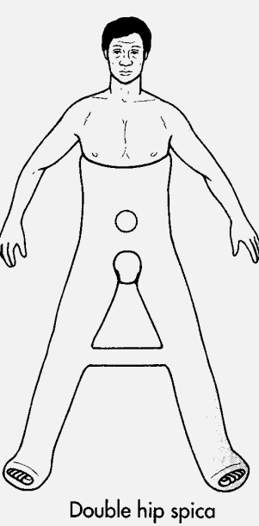
BODY CAST and HIP SPICA

Slide 239
SPLINTS
Devises used to keep fractured bones, dislocated bones and broken bones immobile during the healing process.
Splints can be used underneath casts or alone.
Can be used for injuries of tissues attached to bones, such as muscles, ligaments or tendons.
Occasionally, splints support joints afflicted with arthritis.
Can be fashioned by using a stiff material as the foundation of the orthopedic splint and cloth, ropes or tape to hold the splint in place.

Slide 240
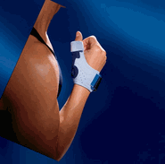
ARM SPLINT and THUMB SUPPORT SPLINT

Slide 241
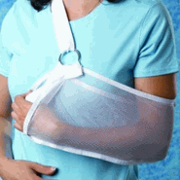
RESTING ARM SPLINT and ARM SLING

Slide 242
LEG NIGHT SPLINT and KNEE BRACES

Slide 243
BACK SPLINT

Slide 244
Taking Care of Your Splint or Cast
Keep your splint or cast dry. Moisture weakens plaster and damp padding next to the skin can cause irritation. Use two layers of plastic or purchase waterproof shields to keep your splint or cast dry while you shower or bathe.
Walking casts. Do not walk on a "walking cast" until it is completely dry and hard. It takes about one hour for fiberglass, and two to three days for plaster to become hard enough to walk on.

Slide 245
Cont.
Avoid dirt. Keep dirt, sand, and powder away from the inside of your splint or cast.
Padding. Do not pull out the padding from your splint or cast.
Itching. Do not stick objects such as coat hangers inside the splint or cast to scratch itching skin. Do not apply powders or deodorants to itching skin. If itching persists, contact your doctor.

Slide 246
Cont.
Trimming. Do not break off rough edges of the cast or trim the cast before asking your doctor.
Skin. Inspect the skin around the cast. If your skin becomes red or raw around the cast, contact your doctor.
Inspect the cast regularly. If it becomes cracked or develops soft spots, contact your doctor's office.

Slide 247
Warning Signs
Increased pain and the feeling that the splint or cast is too tight. This may be caused by swelling.
Numbness and tingling in your hand or foot. This may be caused by too much pressure on the nerves.
Burning and stinging. This may be caused by too much pressure on the skin.

Slide 248
Warning.
Excessive swelling below the cast. This may mean the cast is slowing your blood circulation.
Loss of active movement of toes or fingers. This requires an urgent evaluation by your doctor.

Slide 249
ON CAST and TRACTION

Slide 250
TRACTION
The application of a pulling force to an injured body part or extremity while a countertraction pulls in the opposite direction.
Purpose
Reduce, realign & promote healing of fractured bones
Decrease muscle spasms that may accompany fractures or follow surgical reduction .
Prevent soft tissue damage through immobilization
Treat deformities
Rest an inflamed, diseased, or painful joint.
Reduce & treat dislocations/subluxations
Prevent the development of contractures
Reduce muscle spasms associated with low back pain or cervical whiplash.
Expand a joint space during arthroscopy or prior to major joint reconstruction.

Slide 251
Types of Traction
Skin traction: application of a pulling force directly to the skin through the use of traction boot, traction strip, halters, or belts. For temporary use because of skin breakdown.
Skeletal traction: force applied directly to a metal pin (Steinmann pin) or wire (Kirschner wire) inserted through the bone. Sites include distal femur, proximal ulna.
Note: Traction could be static (continuous) or dynamic (intermittent).

Slide 252
Traction.
c) Cervical traction- Cervical traction might be used in two different situations. First, it may be done to gently stretch the neck muscles so muscle spasms can be relieved or prevented. It may also be performed to immobilize the spine after a neck injury.

Slide 253
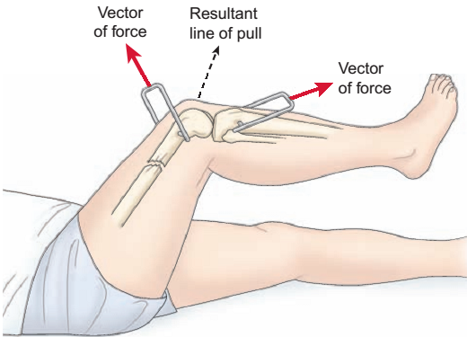
SKELETAL TRACTION
Balanced suspension
skeletal traction with Thomas leg splint.

Slide 254
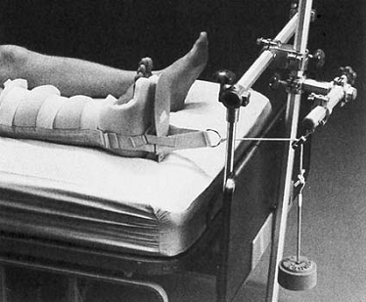
SKIN TRACTION
RUSSELL TRACTION (SKIN)
BUCK’S EXTENSION TRACTION (SKIN)

Slide 255
OTHER EXAMPLES

Slide 256
NURSING MANAGEMENT
Immobilize fractured extremity & provide emergency care before transporting victim.
Evaluate circulation distal to injury
If pulses are not present or if the extremity must be realigned to apply splint for transfer, apply just enough traction to support & immobilize the fractured extremity in a position of the proper alignment.
Splint & immobilize extremity before transfer.
Note: traction to compound fractures may cause more damage.
Elevate the affected extremity, if possible, to decrease edema.

Slide 257
Identify complications early
Perform frequent peripheral nerve & vascular assessments distal to the area of injury or cast.
Impaired blood flow:
pulselessness, pale skin & cool to touch, pain, swelling, edema distal to injury or cast, capillary refill >3 sec.
Compartment syndrome.
Significant increase in pain not responding to analgesic.
Loss of movement & sensation distal to cast.
Skin is pale & cool to touch.
Edema distal to injury or cast.
Pulses may be present initially.
Notify physician immediately.

Slide 258
Nerve damage from excess pressure.
Paresthesia; numbness distal to injury or cast.
Motor paralysis of previously functioning muscles.
Feeling of deep pain & pressure.
Infection:
May occur within the cast i.e unpleasant odor, purulent drainage, fever, & increased warmth over cast.

Slide 259
Immobilize by cast (intermediate- Long-term).
Plaster cast: allow cast to dry adequately before handling or moving the pt i.e
Do not cover the cast with a blanket
Encourage drying of casts using funs & maintaining adequate circulation.
Avoid handling wet cast to prevent indentations in the cast, which may precipitate pressure areas inside the cast
Reposition pt every 2 hrs to increase drying on all cast surfaces.
“petaling” the cast is done to cover the rough edges & prevent crumbling of the plaster cast; edges are covered with small strips of waterproof adhesive
Do not allow cast to become wet or excessively damp
Note: do not apply any form of heat to dry the cast.

Slide 260
Synthetic casts (fiberglass, polyester cotton knit) are lighter & require a minimal amount of drying time.
Frequently used for upper body cast
Preferable for infants or children.
Cast does not crumble around the edges & does not soil as easily.
Cast dries rapidly when it gets dump, & it does not disintergrate in water; some synthetic casts can be immersed for bathing.
Body jacket cast & hip spica cast.
Evaluate abdominal discomfort caused by cast compression of mesenteric artery against duodenum.
Relief of abdominal pressure can be achieved by means of NGT suction or cast removal & reapplication.
Evaluate for pressure areas over iliac crest.

Slide 261
Immobilization via traction.
Assume that traction is continuous unless otherwise ordered.
Carefully assess for skin breakdown especially under the pt.
Do not change or remove traction weight on a pt with continuous traction.
The traction ropes & weights should hang free from any obstruction
Traction applied in one direction requires an equal counter-traction to be effective
Do not let the pt’s feet touch the edge of the bed, this will cause the counter traction to be lost.
Do not allow the traction weights to rest on anything
Carefully assess the pin sites (skeletal traction) for early recognition of complications e.g Osteomyelitis

Slide 262
Remember!!
PRINCIPLES OF TRACTION
Patient must be in correct body alignment at center of bed
Traction is maintained continuously, unless otherwise specified
Continuously maintain counter traction
All ropes must move freely on the pulley at all times
Rope knots should never touch the pulley
Ropes should be kept clear of bed linens/other objects
Weights must always hang freely
Skeletal traction must never be released

Slide 263
Prevent complications
From of immobility e.g venous stasis, thrombosis, pneumonia, contipation, UTI, decubitus ulcers, increased blood calcium leading to renal stones.
From internal or external fixation.
Inspect exposed skin & pin sites for infection
Cleanse around pin sites
Perform wound care on incision area or area of trauma.
Observe carefully for development of an infection
Evaluate for circulatory & neurosensory impairment.

Slide 264
Education
Patient should not:
Bear weight on the affected extremity until allowed
Allow the cast to get wet.
Insert anything under or in the cast
Move or manipulate pins on an external fixator device.
Patient should:
Assess pin sites for evidence of infection.
Report symptoms associated with swelling or an increase in pain—unrelieved by analgesic.

Slide 265
Orthopedic mattress
The name says it all. An orthopaedic mattress is a firm mattress designed to support the muscles, bones and joints. This makes the orthopaedic mattress suitable for people suffering from back pains and aches, osteoporosis, arthritis and other similar conditions. Here are some of Orthopaedic mattress benefits.

Slide 266
1. Improved posture
An orthopaedic bed prevents your body from sinking and curling when you are sleeping, and promotes a better posture. There are endless benefits to improving your posture. These benefits include reduced stress and strain on your spine, as well as increased energy levels during the day.

Slide 267
2.Increased Support
Orthopaedic mattresses conform to the contours of your body, giving optimal support to all its pressure points. This reduces the potential of pain build ups.

Slide 268
3.Better Sleep
An orthopaedic mattress provides increased comfort and support for those suffering with back aches and pains, arthritis, and joint problems. Extra support helps improve the posture during sleep, reducing the odds of the discomforts of pains and aches waking you up.

Slide 269
Ripple Mattress
Ripple Mattresses also known as air mattresses are at the top of the pressure relief range. They work by inflating a section of the cells inside the mattress at different intervals so as to alternate the pressure on ones body.

Slide 271
SPECIFIC SITE FRACTURES
RIBS
HUMERAL NECK
HUMERAL SHAFT
PELVIS
HIP
FEMORAL SHAFT
TIBIA-FIBULAR
THORACOLUMBAR SPINE

Slide 272
FRACTURE RIBS
FRACTURE RIBS
Uncomplicated fractures heal 3 to 6 weeks without residue impairment
Painful respirations cause pts breathing to be more shallow & coughing to be restrained, this precipitates building up of secretions & decreased ventilation.
Multiple rib fractures may cause pnuemothorax.

Slide 273
FRACTURE RIBS
Nurse assists the pt to splint chest while coughing & deep breathing to prevent pneumonia & atelectasis.
Occasionally intercostal nerve blocks may be administered to relieve pain & permit productive coughing.
Chest taping or strapping is not usually done because it decreases thoracic excursion.

Slide 274
FRACTURE HUMERAL NECK
FRACTURE HUMERAL NECK
May occur through anatomical or the surgical neck of the humerus.
Impact fractures common in the elderly after a fall.
Are essentially nondisplaced fractures.
Active middle aged pts may suffer severely displaced humeral neck fractures with associated rotator calf muscle damage.

Slide 275
FRACTURE HUMERAL NECK
MANAGEMENT FRACTURE HUMERAL NECK
Nondisplaced fracture is supported & immobilized by a sling & swathe that secure the supported arm to the trunk.
Require 6-10 wks to heal & pt should avoid vigorous activity for another 4 wks.
Residual stiffness, aching & some limitation of ROM may persist for 6 or more months.
Displaced humeral neck fracture may need closed reduction, ORIF, or humeral head prosthesis.
Limitation of motion & stiffness of the shoulder occur from disuse.
Pendulum or circumduction exercises are done after period of immobilization (Pt. leans forward & allows affected arm to abduct & rotate).

Slide 276
FRACTURE HUMERAL SHAFT
FRACTURE HUMERAL SHAFT
Frequently caused by:
Direct trauma resulting in transverse, oblique or comminuted fracture.
Indirect twisting force that results in a spiral fracture. The nerves & brachial blood vessels may be injured with these fractures. Wrist drop indicates radial nerve injury.

Slide 278
FRACTURE HUMERAL SHAFT
MANAGEMENT
Hanging cast
Provides traction to the arm when the pt is upright hence reducing & immobilizing the fracture.
Must be independent (free from support)
Sleep in upright position so that traction is maintained.
Watch out for complication—non-union.
Finger & pendulum shoulder exercise start as soon as possible
Need 10 weeks to heal with hanging cast.
After cast removal, a sling is applied & exercise of wrist, elbow, & shoulder started.

Slide 281
FRACTURE HUMERAL SHAFT
Functional bracing.
A contoured thermoplastic sleeve is secured in place with interlocking fabric closures around the upper arm immobilizing the reduced fracture.
Shoulder spica cast: may be used during early treatment of unstable humerus fracture.
Skeletal traction: may be used for pts who must remain in bed because of their injuries.
Open fractures are treated by external fixators.
ORIF is necessary with nerve palsy or pathologic fractures

Slide 282
Functional arm brace.

Slide 283
FRACTURE PELVIS
FRACTURE PELVIS
The sacrum, ilium, pubis, & ischium bones form the pelvic bone, a fused, stable, bony ring in adults.

Slide 285
PELVIC BONES
FRACTURE PELVIS

Slide 287
FRACTURE PELVIS
CAUSES OF PELVIC FRACTURE
Falls, crush injuries
At least $2/3$are associated with multiple injuries.
High mortality rate associated with hemorrhage, pulmonary complications, fat emboli, intravascular coagulation, thromboembolic complications, & infection.

Slide 288
FRACTURE PELVIS
MANIFESTATIONS OF PELVIC FRACTURE
Ecchymosis
Tenderness over the symphysis pubis, anterior iliac spine, iliac crest, sacrum or coccyx.
Local swelling
Numbness or tingling of pubis, genitalia, & proximal thighs.
Inability to bear weight without discomfort.

Slide 289
FRACTURE PELVIS
TYPES OF PELVIC FRACTURES
Stable pelvic fractures
May include fractures of a single pubic or ischial ramus; ipsilateral pubic & ischial rami; pelvic wing of ilium (Duverney’s fracture); or fracture of the sacrum or coccyx.
Treated with a few days of bed rest & symptom management until the pain & discomfort are controlled.
Most heal rapidly because the hip is made up mostly of cancellous bone, with rich blood supply.
Ambulation is resumed using ambulatory aids for protected weight bearing.

Slide 290
FRACTURE PELVIS
Unstable pelvic fractures
May be any of three (3) types
Rotationally unstable: from lateral or AP compression. e.g. open book type (separation at the symphysis pubis)
Vertically unstable e.g. vertical shear type (superior-inferior displacement of the pelvic sides).
A combination of both.
Treatment: External fixation or ORIF

Slide 291
FRACTURE PELVIS
Vertical shear pelvic fractures
Involves the anterior & posterior pelvic ring with vertical displacement, usually through the sacro-iliac joint with disruption of ligaments.
Management: External fixation with or without skeletal traction & ORIF.
Fracture acetabulum
Often seen after motor vehicle crashes in which the femur is jammed into the dashboard.
Management: depends on the pattern of fractures; (traction, open reduction, orthoplasty).

Slide 292
FRACTURE PELVIS
DIAGNOSIS
Clinical manifestations
X-ray
CT-scan: sacroiliac joint disruption, soft tissue trauma, hematoma, & fractures.

Slide 293
FRACTURE PELVIS
MANAGEMENT
Check for possible hemorrhage from torn iliac artery & shock occurance- palpate pulses.
Peritoneal lavage may be done to detect intra-abdominal hemorrhage.
Assess for injuries to the bladder, rectum, intestines, other abdominal organs, & pelvic vessels & nerves.
Assess injury to urinary tract by urinalysis.

Slide 294
FRACTURE PELVIS
Avoid urethral catheter till status of the urethra is known.
Exercises (ROM, & strengthening), elastic stockings & elevation of the foot of the bed to aid venous return and diminish the effects of bed rest.
Pt. may be mobilized with progressive weight bearing, usually with crutches.

Slide 295
FRACTURE PELVIS
LONGTERM COMPLICATIONS
Malunion
Nonunion
Residual gait disturbances
Back pain from ligament injury

Slide 296
FRACTURE HIP
FRACTURE HIP
RISK FACTORS (COMMOBIDITIES)
Osteoporosis especially in elderly women.
Weak quadriceps muscles also age related
Conditions that produce decreased cerebral arterial perfusion ( anemia, emboli, cardiovascular disease, effects of medications).
All attribute to incidence of falls in elderly people.

Slide 297
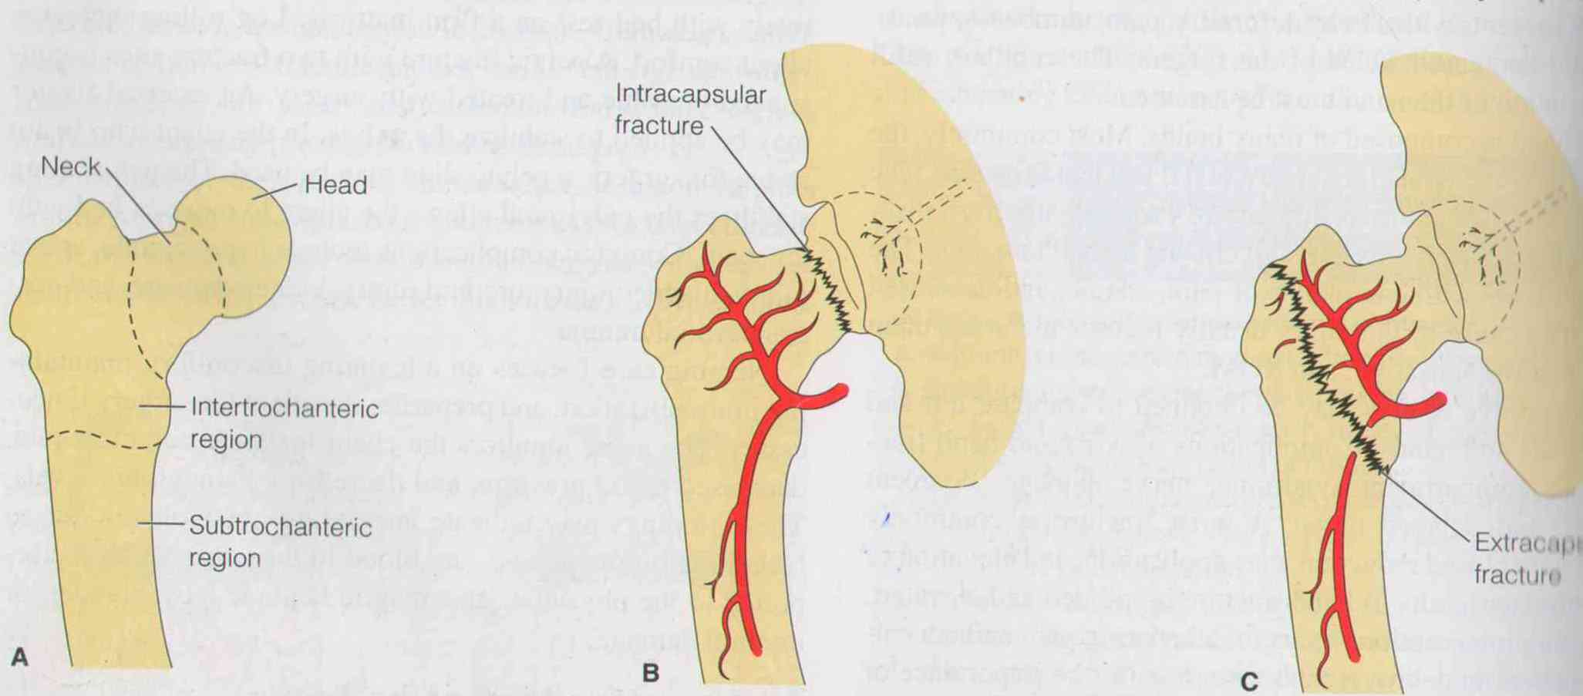
FRACTURE HIP
There are two (2) types of hip fractures.
Intracapsular fractures: head and neck of the femur.
May damage the vascular system denying nutrient supply & bone may die
Nonunion or aseptic necrosis is common
Extracapsular fractures: trochanteric region & subtrochanteric region.
Have an excellent blood supply & heal readily.

Slide 298
FRACTURE HIP
CLINICAL MANIFESTATION
With fractures of the femoral neck: leg is shortened, adducted, & externally rotated. Pt most comfortable with leg slightly flexed in external rotation.
Impacted femoral neck fractures: moderate discomfort even on movement, may allow Pt. to bear weight, no obvious shortening or rotational changes.
Extracapsular femoral fractures: significantly shortened extremity, greater external rotation, muscle spasms, large hematoma or ecchymosis.

Slide 299
FRACTURE HIP
DIAGNOSIS
X-ray.
CT scan
MEDICAL MANAGEMENT
Temporary skin traction (Buck’s extension)
ORIF
Replacement of the femoral head with a prosthesis (hemiarthroplasty).

Slide 300
HIP REPLACEMENT/ FEMORAL-HEAD PROSTHESIS

Slide 301
FRACTURE HIP
POST-OP NURSING CARE
Like all pts undergoing orthopedic surgery.
1st 24-48 hrs, relieving pain & preventing complications are priorities.
Deep breathing, coughing (incentive spirometry) & foot flexion exercises every 1-2 hrs.
Prophylactic antibiotics, analgesics, anticoagulants

Slide 302
FRACTURE HIP
Home modification e.g putting a toilet raiser on the toilet sit, use walker, sleep down-stairs.
Thigh high elastic compression stockings.
A pillow between legs to maintain abduction & alignment even when turning.
Progressive assisted walking as indicated by therapist.

Slide 303
SELF-CARE AFTER FEMORAL-HEAD PROSTHESIS
FRACTURE HIP

Slide 304
FRACTURE HIP
COMPLICATIONS
Neurovascular complications
Direct injury to nerves & blood vessels or tissues (pressure).
DVT
Pulmonary complications: pneumonia
Skin breakdown: blisters from tape, pressure ulcer.
Infection
Nonunion
Avascular necrosis
Fixation device problem (protrusion of the fixation device through the acetabulum; loosening of hardware.

Slide 305
FRACTURE HIP

Slide 306
FRACTURE FEMURAL SHAFT
FRACTURE FEMURAL SHAFT
Great force is required in adults for this fracture to occur.
May be transverse, oblique, spiral or comminuted.
Massive blood loss common leading to shock.
SIGNS AND SYMPTOMS
Enlarged, deformed, painful thigh.
Can not move hip or knee.

Slide 307
FRACTURE FEMURAL SHAFT
ASSESSMENT & DIAGNOSIS
Neurovascular status check
Doppler ultrasound to assess blood flow
X-rays: associated dislocation of the hip & knee.

Slide 308
FRACTURE FEMURAL SHAFT
MANAGEMENT
Neurovascular monitoring.
Skin traction for comfort & immobilization of the fracture to minimize soft tissue injury.
Generally, skeletal traction for muscle relaxation & alignment of the fracture fragments before ORIF.
In ORIF: intramedullary nailing devices, interlocking nail, or compression plate & screws provide adequate internal fixation.

Slide 309
FRACTURE FEMURAL SHAFT
Active muscle movement enhances healing.
Fractures of the middle & distal shaft (supracondylar). May be managed with skeletal traction after 2-4 weeks.
When pain & swelling have subsided skeletal traction is removed & a cast brace placed
Complication: Restriction of knee motion due to lack of early exercise.

Slide 310
FRACTURE TIBIA & FIBULA
FRACTURE TIBIA & FIBULA
Results from a direct blow, falls with foot in a flexed position or a violent twisting.
Usually occur in association with each other.
ASSESSMENT & DIAGNOSTIC FINDINGS
Assess nerve damage: inability to dorsiflex great toe with diminished sensation in the first web space.
Tibial artery damage: assess skin colour, temperature & capillary refill.
Monitor anterior compartment syndrome: pain unrelieved by analgesics & increasing with plantar flexion, & paresthesia.

Slide 311
FRACTURE TIBIA & FIBULA
MANAGEMENT
Pins-in-plaster technique.
Closed tibial fractures: closed reduction in long leg-walking or patellar-tendon-bearing cast.
Partial weight bearing after 7-10 days.
Cast changed to short leg cast or brace in 3-4 wks to allow knee motion.
Healing takes 6-10 wks.
Comminuted fractures may need skeletal traction or fixation (internal/external).
Continue neurovascular assessment and limb elevation.

Slide 312
FRACTURE THORACOLUMBAR SPINE
FRACTURE THORACOLUMBAR SPINE
May involve
Vertebral body
Lamina & articulating process
Spinous process or transverse processes
T₁₂ – L₂ are most vulnerable to fractures.
Generally due to indirect trauma caused by excessive loading, sudden muscle contraction, or excessive motion beyond physiologic limits.
Osteoporosis contributes to vertebral body collapse.

Slide 313
FRACTURE THORACOLUMBAR SPINE
SIGNS & SYMPTOMS
Acute tenderness
Swelling
Paravertebral muscle spasm
Change in normal curves or gaps btn. spinous processes.
Note: Immobilization is essential till initial determination of spinal cord injury & fracture stability.

Slide 314
FRACTURE THORACOLUMBAR SPINE
Stable fractures are due to flexion, extension, lateral bending, or vertical loading.
Few spinal fractures are associated neurologic deficit which require immediate surgery (laminectomy with spinal fusion) to decompress the spinal cord
Unstable fractures occur with fracture dislocation & exhibit disruption of both anterior & posterior structural columns. The potential for neural damage exists.

Slide 315
MED-SURG MANAGEMENT
Stable: conservative mgt. with limited bedrest, with the head of bed <30⁰, till acute pain subsides
Pain management; Analgesics
Assess for paralytic ilius because of associated retroperitoneal haemorrhage
Begin ambulation early slowly
Avoid having Pt. bend, stoop, twist, sit, or lift.

Slide 316
FRACTURE THORACOLUMBAR SPINE
A spinal brace or thoracolumbar orthosis may be applied for support during progressive ambulation & resumption of activities.
Weigh reduction
With unstable fracture, maintain bed rest with special turning device (eg stryker frame) to maintain spinal alignment.
Neurological observation
Unstable fractures: open reduction, decompression & fixation with spinal fusion & instrument stabilization.

Slide 317
FRACTURE THORACOLUMBAR SPINE
PRE-OPERATIVE NURSING CARE
Perform pre-op general nursing care
Practice log rolling & voiding from supine position.
Discuss post-op pain & methods to decrease pain.
Evaluate specific pain characteristics for post-op reference.
Evaluate bowel & bladder function.
Establish a baseline neurological assessment for post-op reference.

Slide 318
FRACTURE THORACOLUMBAR SPINE
POST-OP CARE (LAMINECTOMY) Laminectomy: surgical removal of the herniated portion of the disk.
Keep the bed in a flat position.
Log rolling pt when turning
Keep pillows between the legs when client is positioned on the side.
Pt post microlaminectomy has fewer mobility, often they may assume a position of comfort.
Maintain homeostasis & assess for complications post laminectomy.
Assess incision area for leakage of CSF & bleeding.
Analgesic via PCA pump or epidural catheter
Start mobilization with assistance of physiotherapist

Slide 319
REHABILITATION

Slide 320
REHABILITATION(W.H.O)
Rehabilitation is a set of interventions needed when a person is experiencing or is likely to experience limitations in everyday functioning due to ageing or a health condition, including chronic diseases or disorders, injuries or traumas.

Slide 321
Rehabilitation is care that can help you get back, keep, or improve abilities that you need for daily life. These abilities may be physical, mental, and/or cognitive (thinking and learning). You may have lost them because of a disease or injury, or as a side effect from a medical treatment. Rehabilitation can improve your daily life and functioning.

Slide 322
Examples of limitations in functioning are difficulties in thinking, seeing, hearing, communicating, moving around, having relationships or keeping a job.

Slide 323
At present the subsequent need for rehabilitation is largely unmet. For example, in many low- and middle-income countries, there is a lack of trained professionals to provide rehabilitation services, with less than 10 skilled practitioners per 1 million population.

Slide 324
In orthopedics, an example of rehabilitation can be Interventions that optimize surgical outcomes after a hip fracture, including exercise prescription, provision of a walking aid and education about hip movements to avoid during the recovery process.

Slide 325
The benefits of rehabilitation
Rehabilitation can reduce the impact of a broad range of health conditions, including diseases (acute or chronic), disorders, injuries or trauma. It is a highly integrated form of health care that complements other health interventions, such as medical and surgical interventions, helping to achieve the best outcome possible.

Slide 326
For example, rehabilitation can help to prevent complications associated with many health conditions, such as spinal cord injury, stroke, or a fracture. Rehabilitation can also help to minimize or slow down the disabling effects of chronic health conditions, such as cardiovascular disease, cancer and diabetes by equipping people with self-management strategies and the assistive products they require, or by addressing pain or other complications.

Slide 327
Rehabilitation is an investment, with cost benefits for both the individuals and society. It can help to avoid costly hospitalization, reduce hospital length of stay, and prevent re-admissions. Rehabilitation also enables individuals to participate in education and gainful employment, remain independent at home, and minimize the need for financial or caregiver support.

Slide 328
Reabilitation Principles
There are seven principles of rehabilitation; principles are the foundation upon which rehabilitation is based. This mnemonic may help you remember the principles of rehabilitation: ATC IS IT.
Avoid aggravation
Timing
Compliance
Individualization
Specific sequencing
Intensity
Total patient

Slide 329
A: Avoid aggravation. It is important not to aggravate the injury during the rehabilitation process. The primary concern of the therapeutic exercise program is to advance the injured individual gradually and steadily and to keep setbacks to a minimum.

Slide 330
T: Timing. The therapeutic exercise portion of the rehabilitation program should begin as soon as possible—that is, as soon as it can occur without causing aggravation. The sooner patients can begin the exercise portion of the rehabilitation program, the sooner they can return to full activity.

Slide 331
C: Compliance. Without a compliant patient, the rehabilitation program will not be successful. To ensure compliance, it is important to inform the patient of the content of the program and the expected course of rehabilitation.

Slide 332
I: Individualization. Each person responds differently to an injury and to the subsequent rehabilitation program. Expecting a patient to progress in the same way as the last patient you had with a similar injury will be frustrating for both you and the patient. It is first necessary to recognize that each person is different.

Slide 333
S: Specific sequencing. A therapeutic exercise program should follow a specific sequence of events. This specific sequence is determined by the body's physiological healing response and is briefly addressed in the next section of this chapter.

Slide 334
I: Intensity. The intensity level of the therapeutic exercise program must challenge the patient and the injured area but at the same time must not cause aggravation. Knowing when to increase intensity without overtaxing the injury requires observation of the patient's response and consideration of the healing process.

Slide 335
T: Total patient. You must consider the total patient in the rehabilitation process. It is important for the unaffected areas of the body to stay finely tuned. The whole body must be the focus of the rehabilitation program, not just the injured area.

Slide 336
Occupational therapy
Occupational therapists provide occupational therapy (OT) treatments to help individuals who require specialized assistance to participate in everyday activities, or “occupations.” Occupations don’t just refer to work or your job, but can also refer to self-care practices, everyday tasks and recreational activities.

Slide 337
The goal of occupational therapy is to help individuals participate in the things they want and need to do to live an independent and satisfying lifestyle.

Slide 338
Occupational therapists help by making changes to things that hinder someone's ability to complete tasks such as eating, dressing, brushing one’s teeth, completing school activities and working.

Slide 339
Children with physical disabilities may need a therapist to help them develop the coordination needed to feed themselves, use a computer or improve their handwriting.

Slide 340
An individual who has lost the ability to hold a fork due to an injury may work with a therapist to regain grip strength and modify movements so that they can feed themselves independently.

Slide 341
Those who have suffered a spinal cord injury may require therapist intervention to help them avoid movements or behaviors that may worsen their injuries.

Slide 342
Rehabilitation counseling
Rehabilitation counseling is focused on helping people who have disabilities achieve their personal, career, and independent living goals through a counseling process.

Slide 343
Rehabilitation Counseling is a profession whose goal is to assist people with disabilities to achieve the fullest, physical, mental, social, vocational, and economic independence of which they are capable.

Slide 344
Rehabilitation counseling is a specific practice of counseling within the discipline where professionals work to help people who have emotional and physical disabilities so that they are able to live more independently.

Slide 345
The belief in the worth and dignity of all people, including people with disabilities, is particularly important. Following from the belief in the worth of all people, rehabilitation counseling practice is dedicated to facilitating full access to opportunities for participation in all aspects of community life and to the pursuit of individually determined goals, consistent with the opportunities available to others in society.

Slide 346
Following from the belief in the dignity of all people, rehabilitation counseling attempts to empower people with disabilities in achieving control over their own lives and the opportunities and goals that they choose to pursue.

Slide 347
Consistent with this value is an emphasis on informed choice in rehabilitation counseling practice, viewing people with disabilities as equal collaborators in the rehabilitation counseling process and assisting them in obtaining and processing the information that they need to make their own decisions regarding services, interventions, and goals.

Slide 348
Also similar to counseling in general, rehabilitation counseling has a long tradition of going beyond limitations and problems to focus on the strengths of individuals with disabilities and helping them to build on those strengths in overcoming the difficulties that they face in accomplishing their goals and living high-quality lives.

Slide 349
Community-Based Rehabilitation

Slide 350
Community-Based Rehabilitation
Community Based Rehabilitation (CBR) is a community development strategy that aims at enhancing the lives of persons with disabilities (PWDs) within their community. Community-based rehabilitation (CBR) was initiated by WHO following the Declaration of Alma-Ata in 1978 in an effort to enhance the quality of life for people with disabilities and their families; meet their basic needs; and ensure their inclusion and participation.

Slide 351
CBR is implemented through the combined efforts of people with disabilities, their families and communities, and relevant government and non-government health, education, vocational, social and other services(WHO).

Slide 352
According to the UN Convention on the Rights of Persons with Disabilities, comprehensive rehabilitation services focusing on health, employment, education and social services are needed to enable PWDs/CWDs attain and maintain maximum independence, full physical, mental, social and vocational ability, and full inclusion and participation in all aspects of life (UN, 2006).

Slide 353
CBR gets parents, neighbors, friends, teachers, and employers involved in an attempt to drive disability-inclusive development using whatever infrastructure there is.
Health services, school, vocational training, employment, political participation: Community-Based Rehabilitation connects the dots which make a happier society.

Slide 354
CBR is implemented through the combined efforts of people with disabilities, their families and communities, and relevant government and non-government health, education, vocational, social and other services.

Slide 355
Challenges in rehabilitation.
1. Poor knowledge
1.1 Poor knowledge of PWD and their families
1.2 Poor knowledge of providers

Slide 356
2. Negative attitude to disability
2.1 Negative attitude of society
2.2 Negative attitude of PWD and their families
2.3 Negative attitude of providers

Slide 357
3. Insufficient support of PWD
3.1 Shortage of admission and Insufficient
support for PWD
3.2 Releasing and ignoring of PWD

Slide 358
4. Accessibility problems to rehabilitation
4.1 Problem of environmental accessibility
4.2 Problem of access to centers of rehabilitation services
4.3 Problem of transportation

Slide 359
5. Individual problems of providers
5.1 Lack of communication ability
5.2 Problems of professional ethics
5.3 Lack of interest and motivation

Slide 360
6. Cost problems in rehabilitation
6.1 High cost of rehabilitation
6.2 Lack of insurance coverage
6.3 Emphasize of therapists on financial issues

Slide 361
Role of rehabilitating nurse
Possesses the specialized knowledge and clinical skills necessary to provide care for people with physical disability and chronic illness
Coordinates educational activities and uses appropriate resources to develop and implement an individualized teaching and discharge plan with clients and their families
Performs hands-on nursing care by utilizing the nursing process to achieve quality outcomes for clients

Slide 362
Possesses the specialized knowledge and clinical skills necessary to provide care for people with physical disability and chronic illness
Coordinates educational activities and uses appropriate resources to develop and implement an individualized teaching and discharge plan with clients and their families
Performs hands-on nursing care by utilizing the nursing process to achieve quality outcomes for clients

Slide 363
Demonstrates effective oral and written communication skills to develop a rapport with clients, their families, and health team members and to ensure the fulfilment of requirements for legal documentation and reimbursement
Acts as a resource and a role model for nursing staff and students and participates in activities such as nursing committees and professional organizations that promote the improvement of nursing care and the advancement of professional rehabilitation nursing

Slide 364
Encourages others to obtain advance degrees, participate on committees, and/or join professional organizations
Facilitates community education regarding acceptance of people with disabilities

Slide 365
Actively engages in legislative Initiatives affecting the practice of rehabilitation nursing or the people in their care
Applies nursing research to clinical practice and participates in nursing research studies

Slide 366
NATIONAL POLICIES ON PWD
As stipulated in article 24 State parties recognize the right of persons with disabilities to quality education without discrimination and on an equal basis with others.

Slide 367
Efforts to enhance equal opportunities to education for persons with disabilities are also embedded in: (i)Recently promulgated Constitution of Kenya (ii)Kenya Vision 2030 and
(iii) The National Special Needs Education Policy framework 2010.

Slide 368
The number of school programmes that provide for education of children with disabilities have increased steadily to over 1882 with more than 50,744 Children with disabilities enrolled in primary and secondary schools.

Slide 369
Curriculum materials have been adapted or adopted to meet the needs of learners with disabilities in primary and secondary schools.
The Kenya national Examination Council (KNEC) has also ensured appropriate measures to cater for the needs of different disability groups when setting and administering national examinations.

Slide 370
The Kenya government through the ministry of health has a component of Community Based Rehabilitation included among the 12 elements of primary health care where issues of medical rehabilitation are addressed.

Slide 371
Tax exemption on assistive devices including modi]ied cars
Collaboration with partners including the private sector to ensure PWDs access assistive devices and are not isolated or segregated in the community

Slide 372
Improved networking by the government and partners in service provision to PWDs
General tax exemption on some income to mitigate disability costs

Slide 373
The Kenya government has recently introduced recruitment of persons with disabilities into National Youth Services (NYS) for various disciplines and skills training which is an area that has been reserved for those seen to be fit physically in the past.

Slide 374
Additionally in an effort to promote inclusion, the Government of Kenya has set up a disability specific fund, (the National Development Fund (NDF) for PWDs) which is aimed at promoting business entrepreneurship for Persons with Disabilities, access to assistive devices and training

Slide 375
The Govt. has recently introduced Access to Government Procurement Opportunities (AGPO), which is targeting the vulnerable groups, that is Women, Youth and PWDs as away of empowering them financially.

Slide 376
The latest Government directive of 15th January 2015 on AGPO through The Nationa l Treasury on Implementation of the 30% Public Procurement Reservation and Preference for Youth, Women and Persons with Disabilities demands that at least 2% be reserved for PWDs ( as Minimum)

