Slide 1
CONGENITAL AND DEVELOPMENTAL ABNORMALITIES

Slide 2
OSTEOGENESIS IMPERFECTA (Flaggilus osium/Brittle bone disease)

Slide 3
DEFINITION:
Hereditary disease characterized by generalized osteopaenia with slender bones and increased flagility.

Slide 4
AETIOLOGY
Abnormal synthesis and structural defect of Type I Collagen.
Results in abnormalities of the bones, teeth ligaments ,sclerae and skin.

Slide 5
PATHOLOGY
Deficit in synthesis of all connective tissues including the organic matrix of the bone.

Slide 6
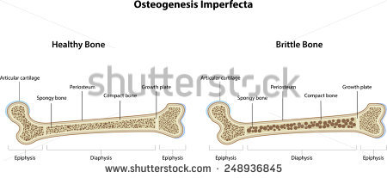

Slide 7
TYPES
1. Osteogenesis Imperfecta Congenita:
Develops during intrauterine period
Severe and fatal
Leads to
- intrauterine fractures
- still births due to fractures and intracranial
haemorrhages during labour
Survivors often develop:
- Deformities of the limbs, spine and rib cage
- Disproportionately large skulls
- Mental retardation

Slide 8
Types cont…
2.Osteogenesis Imperfecta Tarda:
Inherited as autosomal dominant
Presents in older children and young adults
Presents with multiple fractures resulting from minor trauma
Frequency of fractures lessens near adulthood but re-occurs in females after menopause due to osteoporosis

Slide 9
CLINICAL FEATURES
Multiple bone deformities
Laxity of ligaments-hyper-mobility of the joints
Multiple fractures
Crumbling of teeth( dentinogenesis Imperfecta)
Kyphoscoliosis-due to vertebral compression fractures
Loose thin skin
Blue sclerae
Deafness-due to osteoscrelosis
Mental retardation

Slide 10
INVESTIGATIONS
X-RAYS:
Generalized osteopaenia-reduced bone density
cortical thinning
Widening of medullary cavity
Multiple fractures at different healing stages
Spinal deformities and fractures
Skull enlargement with presence of wormian bones{areas of vicarious ossification in the calvarium}

Slide 11
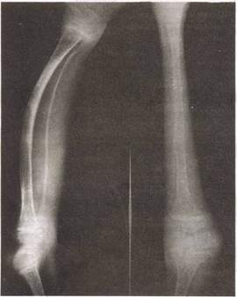

Slide 12
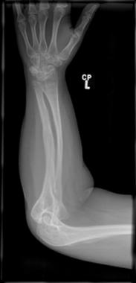

Slide 13
DIFFERENTIAL DIAGNOSIS
Battered Baby Syndrome.
-Differentiated from Osteogenesis Imperfecta by the following:
{i} Guardian denies having assaulted the child.
{ii}Presence of multiple bruises and scars

Slide 14
TREATMENT
1) No definitive treatment.
2) Treat specific fractures as they occur.
3) Prophylactic internal fixation with intramedullary rods to reduce the frequency of fractures.

Slide 15
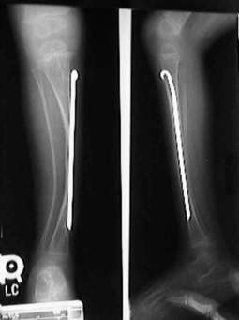
Intramedullary rods

