Slide 1
Occupational health safety
Kmtc voi
March 2020
Community health 3

Slide 2
objectives
Definition of terms
Historical background of OHS
Principles of OHS
Classification of occupational hazards
Control and prevention
Occupational related diseases
OHS regulations.

Slide 3
terms
OHS-its a discipline with the prevention of work- related injuries and diseases as well as protection and promotion of health of workers. It aims at the improvement of working conditions and environment.
Hazard- a physical or psychological condition, object or agent that has the potential to cause harm o a worker or cause damage to property
Accident- an unplanned event that results in harm to people, property or loss
Acute effect- a change that occurs in the body within relatively short time
Occupational ergonomics- an applied science that studies interaction between people and the work environment.it focuses on matching the job to the worker to ensure a healthy and productive worker
Risk assessment- is a thorough look in the workplace to identify things, situations, processes that may cause harm, particular to people.

Slide 6
Historical background of OHS
The origins of OHS can be traced back to the industrial revolution(late 18- to 19th century) which was marked with innovations like cotton spinning, coal and steam engines.
Men and women were exposed to toxins, toxic gases, extreme heat, light, sound that had an impact on their health, both physical and psychological. The injuries, diseases and hazards faced by workers As a result of the industrial revolution attracted scholars and scientists of that period, who felt industrial health and hygiene must be addressed.
Annie Hamilton, an American toxicologist, physician studied the impact of industrial chemicals on human beings. She became a pioneer in industrial diseases and hygiene and contributed immensely to the discipline.

Slide 7
In kenya
The history of Occupational Health and Safety (OSH) in Kenya dates back to the 1950s when the need to have a legal instrument to manage the safety, health and welfare of factory employees became indispensable. The then British government adopted the British Factories Act of 1937. The Act was later amended in 1990 to Factories and Other Places of Work Act to widen its scope of coverage to additional workplaces initially not included under the Factories Act of 1937. Kenya has ratified and adopted 49 ILO Conventions out of which ten are OSH-related. The country compiled its first national profile on OSH in 2004, while the most recent one was compiled in 2013 (ILO, 2013). The profile provides labour market insights necessary for creating a safe and healthy workplace ecosystem in the country.
In 2007, the Factories and Other Places of Work Act was repealed and replaced by the Occupational Safety and Health Act (2007), [3] commonly known as OSHA 2007. In the same year, the Work Injury Benefits Act (WIBA) [4] was enacted. The Occupational Safety and Health Act promotes safety at workplace, preventing work-related injuries and sickness, while protecting third party individuals from being predisposed to higher risk of injury and sickness associated with activities of people at places of work.

Slide 8
.
The Work Injury Benefits Act was enacted to ensure that workers who sustain work-related injuries and contract diseases that are work-related get compensated. Inspection and enforcement systems exist with a bearing to occupational safety, health, and labour inspections. Inspections related to environment at work, such as safety of workplaces, general health and basic welfare of workers are executed by the Directorate of Occupational Health and Safety Services – DOSHS – to ensure compliance with OSHA (2007). Specifically, the core roles of DOSHS include: inspection of workplaces to foster compliance with safety and health law; measurement of workplace pollutants for purposes of their control; investigation of occupational accidents and diseases and aiming to prevent recurrence; examination and testing of steam boilers, steam and air receivers, lifts, gas cylinders, cranes chains among other lifting equipment; training on OSH, first aid and fire safety; approving of architectural plans of buildings intended to serve as workplaces; medical examinations of workers; and dissemination of information on OSH to employers, workers, other key stakeholders and the general public.

Slide 9
Cont..
Further, there are other laws and regulations touching on OSH and are issued and enforced by other ministries and state departments. Such laws and regulations include: the Mining Act, Cap. 306, No. 2, 2009; the Biosafety Act, the Food, Drugs and Chemical Substances Act, Cap. 254; the Environmental Management and Coordination Act, No. 8, 1999; the Public Health Act, Cap. 242; the Employment Act, No. 11, 2007; the Energy Act, No. 12, 2006; the Radiation and Protection Act, Cap. 243 and the Standards Act, Cap. 496; the Pest Control and Product Act, Cap. 346; the Petroleum (Exploration and Production) Act, Cap. 308. In addition, the National Occupation Safety and Health Policy (2012) established national occupation safety and health systems and programmes designed to improve workplace environment.
DOSHS outlines that occupational accidents should be reported by an employer to the Director of Occupational Health and Safety Services on a prescribed form within 7 days following receipt of accident notice or on learning that an employee has been injured at work. In case of fatal accidents, the accident should be reported within 24 hours by fastest means possible and thereafter in writing to DOSHS within seven days.
The total number of workplaces that are supposed to be inspected by the Directorate is estimated at 140,000, but only around 4,000 (2.9%) workplaces are inspected annually (ILO, 2013). Kenya has a population of 47.5 million people (KPHC, 2019), with a total working population of 18 million. About 3 million are employed in the formal sector and 15 million in the informal sector across the country (KNBS, 2020). DOSHS had 71 professional OSH officers (ILO, 2013). This is only 29 per cent technical capacity, and not sufficient to effectively inspect approximately 140,000 workplaces. This, therefore, leaves most workers exposed to OSH hazards. DOSHS has limited representation in the counties, with only 29 counties covered by the 43 technical staff members. The remaining 18 counties have no officers.

Slide 10
source
https://kippra.or.ke/an-overview-of-workplace-safety-and-health-in-kenya/
https://www.ilo.org/global/topics/safety-and-health-at-work/lang--en/index.htm

Slide 11
Problem statement
Magnitude of the problem/disease
The difficulty of obtaining accurate estimates of the frequency of work-related diseases is due to several factors.
1. Many problems do not come to the attention of health professionals and employers and, therefore, are not included in data collection systems.
2. Many occupational medical problems that do come to the attention of physicians and employers are not recognized as work related.
3. Some medical problems recognized by health professionals or employers as work- related are not reported bcoz reporting is not strict.
4. Many of the occupational medical problems are preventive, so it means in their presence and high numbers there is an individual or group responsible.

Slide 12
statistics
UN estimates 10,000,000 occupational disease cases occur each year globally, severity and frequency is greatest in developing countries.
1.2 million working peoples die of work related accident and
diseases every year
More than 160 million workers fall ill each year due to
workplace hazards

Slide 13
objectives OF OHS
According to global strategy on OHS for all.
Strengthening international and national policies for OHS at work
Development of healthy work practices and promotion of health at work places
Strengthening OHS
Establishing support for services of OH
Development of occupational health standards based on scientific risk assessment
Development of Human resources for occupational health
Establishment of registration and data sytems, IT for effective public awareness
Strengthening of research in OHS
Development of collaboration in OHS with other services

Slide 14
Principles of OHs
1.All workers have rights. Workers, as well as employees and government, must ensure ;that these rights are protected and foster decent conditions of labor. As the International Labor Conference stated in 1984:
- Work should take place in a safe healthy environment;
- Conditions of work should be consistent with workers‟ well-being and human dignity;
2. Occupational health and safety policies must be established. Such policies must be
implemented at both the governmental and enterprise levels. They must be effectively
communicated to all parties concerned

Slide 15
Cont.
3. Prevention and protection must be the aim of occupational health and safety programs and policies. Efforts must be focused on primary prevention at the workplace level. Workplaces and working environment should be planned and designed to be safe and healthy.
4. Information is vital for the development and implementation of effective programs and policies. The collection and dissemination of accurate information on hazards and hazardous materials, surveillance of workplaces, monitoring of compliance with policies and good practices, and other related activities are central to the and the enforcement of effective policies.

Slide 16
..
5. Health promotion is a central element of occupational health practice. Efforts must be made to enhance workers‟ physical, mental and social well- being.
6. Occupational health services covering all workers should be established. Ideally all workers in all categories of economic activity should have access to such services.
7. Compensation, rehabilitation and curative services must be made available to
workers who suffer occupational injuries, accidents and work related diseases. Action
must be taken to minimize the consequences of occupational hazards.

Slide 17
.
8.Education and training are vital components of safe, healthy working environments.
Workers and employers must be made aware of the importance and the means of establishing safe working procedures. Trainers must be trained in areas of special
relevance to different industries, which have specific OHS concerns.
9. Workers, employers and competent authorities have certain responsibilities, duties
and obligations. For example, workers must follow established safety procedures; employers must provide safe workplaces and ensure access to first aid; and the competent authorities must devise, communicate and periodically review and update occupational health and safety policies.
10.Policies must be enforced. A system of inspection must be in place to secure compliance with occupational health and safety and other labour legislation.

Slide 18
Questions??
WHAT ARE THE RIGHTS OF WORKERS?? (10 MARKS)
LIST AND EXPLAIN 5 EMPLOYERSS RESPONSIBILITIES (10 MARKS)
LIST AND EXPLAIN GOVERNMENT RESPONSIBILITIES/DUTIES??(10 MARKS)

Slide 19
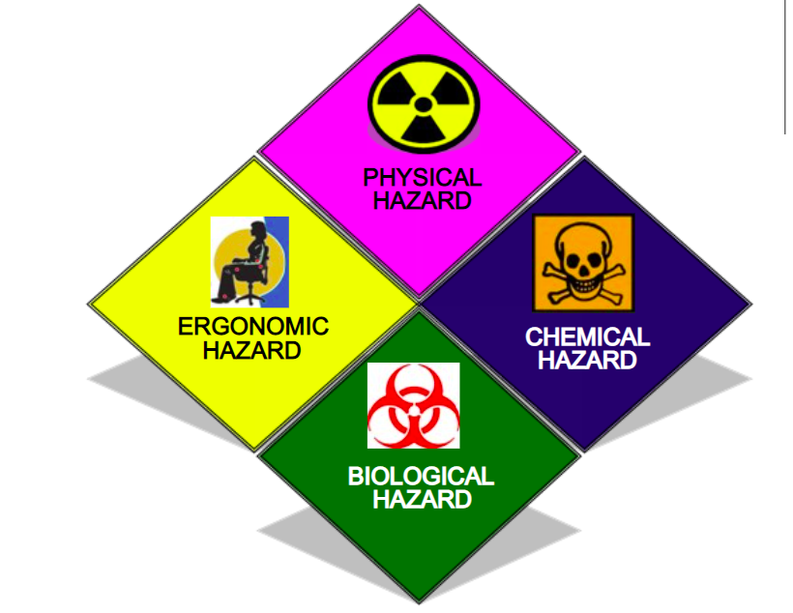
Classifications of Occupational hazards

Slide 20
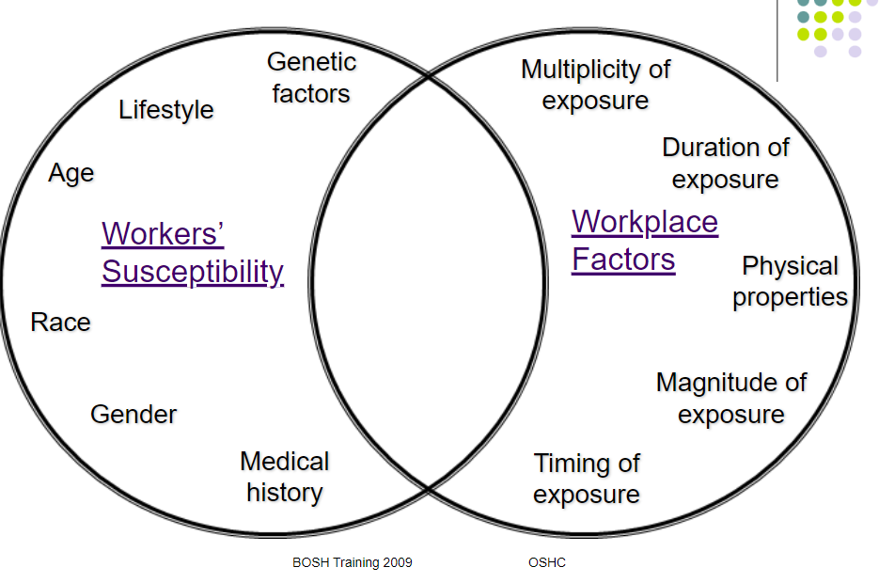
HAZARD VS RISK
HAZARD- is any source of potential damage, harm or adverse health effects on something, someone under certain conditions at work.
RISK-the CHANCE or probability that a person will be harmed or experience an adverse health effect if exposed to a hazard.

Slide 21
classification
Occupational hazards are classified as the following;
Chemical hazards
Physical hazards
Biological
Ergonomic hazards

Slide 22
Chemical hazards
This are all toxic substances that pose a wide range of health effects(irritation, sensitization and carcinogenicity)
Examples; CO, Ammonia, Clorine, HCL, sulphuric acid-carcinogens i.e benzene, lead.
Toxicity occurs at the point where the bodies ability to detoxify or repair injury have been exceeded.
Question; what are some of the ways humans can be exposed to chemicals??
Toxic effects are classified into; Local toxicity; systemic, acute toxicity and chronic toxicity.

Slide 23
Health effects of chemical hazards
Renal diseases
Respiratory diseases
Skin diseases
Heamatologic
Cvs
Neurologic
Carcinogenic
teratogenic

Slide 26
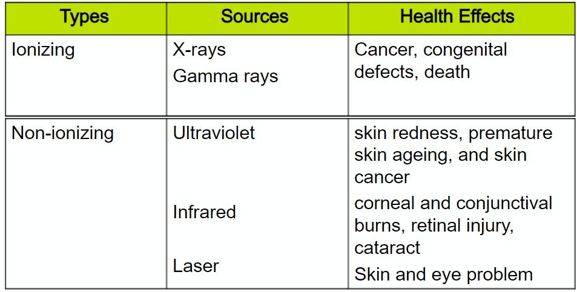
Physical hazards
Noise- temporary or permanent deafness, hypertension, hyperacidity, palpitations and disturbs sleep and relaxation
Vibrations- cause hands and arm vibration syndrome, pain,fatigue,spine disorders
Extreme temperatures-burns, rush, exhaustion, heat stroke, frost bite, pneumonia
Illumination- inadequate illumination can cause accidents
Radiation

Slide 27
Biological hazards- TOP-HIV

Slide 28
..

Slide 31
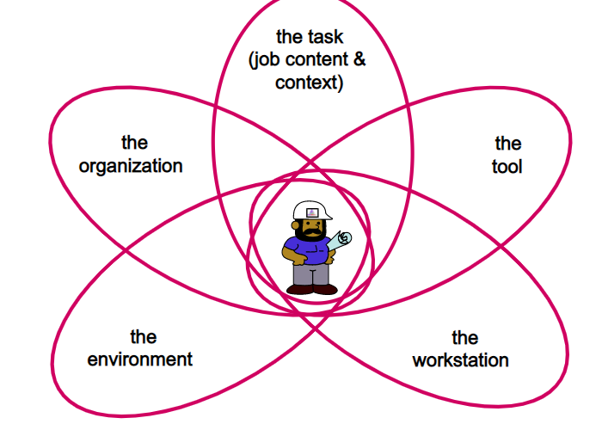
ERGONOMIC HAZARDS
This are all risk factors in the workplace that cause wear and tear on the body and mind and can cause harm.
Risk factors;- repetition, awkward posture, forceful motion, stationary position, direct pressure, vibration and work stress. All causing MSDs-(musculoskeletal disorders

Slide 32
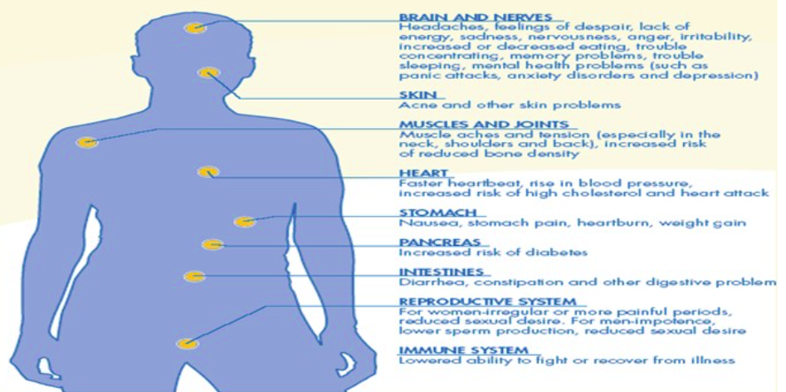
.
STRESS- the harmful and emotional responses that occur when the requirements on the job do not match the capabilities, resources or needs of the worker. Effects as in diagram below

Slide 34
Questions
Discuss How is monitoring and surveillance of occupational hazards done? (20 marks)
Discuss the control and prevention measures established in a work place?? ( 20 marks)
Discuss occupational related diseases, mentioning the causative factor and exposure environment/ means, effects, affected system, treatment/ management (20 marks)

Slide 35
Monitoring sample;

Slide 42
Occupational health safety regulations
OHS Act, 2007.
Management of Health and Safety at Work Regulations 1999: the main set of regulations
Manual Handling Operations Regulations: covering handling of heavy or awkward loads
Display Screen Equipment (DSE) Regulations: covering the safe use of computer screens and keyboards
Workplace (Health, Safety and Welfare) Regulations: covering the environments people are asked to work in
Provision and Use of Work Equipment Regulations: covering the suitability of equipment in the workplace
Personal Protective Equipment (PPE) Regulations: covering the use of protective equipment

Slide 43
end
In groups, discuss and make notes in the questions provided.
Read the materials provided.
Work injury benefit act 2007
Occupational health safety Act 2007
Next session on demography…
(make time and decide on online sessions)

Slide 44
kibwagizoo
Successful and unsuccessful people do not vary greatly in their abilities. They vary in their desires to reach their potential. – John Maxwell

