Slide 1
General PATHOLOGY
By Kate.

Slide 2
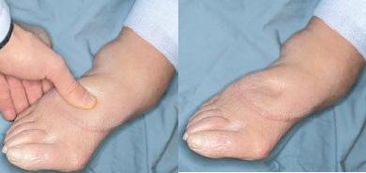

Slide 3
DEFINITION
This is the excess accumulation of fluid in the tissue.
Usually body cells and tissue are bathed by about 12 liters of tissue fluid which is in constant exchange with intra-cellular fluid and blood.

Slide 4
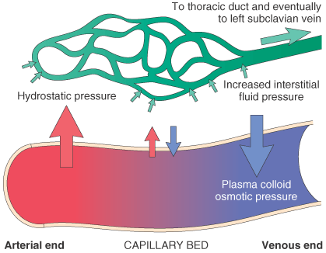
Factors involved in the formation and removal of tissue fluid (physiology)
Capillary blood pressure
The pressure is 25-30 mmHg at the arterial end and 7-12 mmHg at the venous end. The pressure gradient results in out flow of the fluid into the tissues at the arterial end and the removal of tissue fluid into the capillaries at the venous end.

Slide 5
b) Capillary permeability
Injured capillary endothelial becomes more permeable thus allowing excess fluid to enter the tissue e.g. inflammation exudates
c) Blood osmotic pressure
Blood protein particularly albumin exerts an osmotic pressure of about 25 mmHg. This attract tissue fluid back into the capillaries at the veins end where the net pressure is high.
d) Osmotic pressure of fluid
Trace amounts of albumin exerts an osmotic pressure of 2-3mmHg mostly attracting fluid from blood to tissues
e) Lymphatic pressure
Lymphatic vessels drain excess tissue fluid

Slide 6
These fore-factors ensure constant circulation of tissue fluid. In oedema one or more of these becomes deranged to result in tissue fluid accumulation.

Slide 7
BASIC CAUSES OF OEDEMA
Increased hydrostatic pressure
Local- mechanical obstruction to venous drainage e.g. gravid uterus compressing on pelvic veins to cause leg oedema
General- passive venous congestion due to heart failure
2) Decreased blood osmotic pressure
This is due to decreased plasma protein i.e. less than 4g/100ml of blood. This is hypoprotenaemia which may be due to
Inadequate intake of protein in diet as in starvation
Malabsorption syndrome
Excess loss of serum proteins through the kidneys as in nephrotic syndrome or in sever extensive burns or tapped ascites
Under synthesis as in severe liver disease

Slide 8
3) Increased capillary permeability
Angioneurotic oedema secondary to hypersensitivity inflammatory exudates usually localized in lips, face and tongue
Bacterial and chemical toxins causes increased capillary permeability
Acute inflammation
4) Lymphatic obstruction results in severe oedema
Congenital obstruction as in congenital Milroy disease
Parasitic infections like filariasis caused by Wuchereria Bancrofti
Scaring following severe or Chronic bacterial infections
Surgical removal of any set of regional lymphnodes e.g. inguinal or axillary
Neoplasm- lymphatic blockage by tumour cells.
5) Sodium and Water retention
Excessive retention of water and sodium via renal and extra-renal ADH mechanism

Slide 9
CLINICAL TYPES OF OEDEMA
Cardiac- CCF, constructive Pericarditis.
Renal- Glomerulonephritis and nephrotic syndrome
Hepatic -due to liver cirrhosis
Nutritional-hypoproteinaemia (kwashiorkor, beriberi)
Infections that result into blocking of lymphatic vessels (bacterial parasitic)
Neoplastic oedema- mechanical effects brought about by emboli of cancer cells

Slide 10
Effects of oedema on health
Chronic leg oedema- elephantiasis
Pulmonary oedema- dyspnoea and death
Frequent infections of the affected tissues
Electrolyte imbalance

Slide 11
Questions

Slide 12
Merci

