Slide 1
Olecranon fractures
MAINA

Slide 2
Epidemiology
  bimodal distribution
    high energy injuries in the young
    low energy falls in the elderly
Pathophysiology
  mechanism
    direct blow
      usually results in comminuted fracture
    indirect blow
      fall onto outstretched upper extremity
      usually results in transverse or oblique fracture

Slide 3
Mechanism
Direct blow: This can happen in a fall (landing directly on the elbow) or by being struck by a hard object (baseball bat, dashboard of a car during a crash).
Indirect fracture: This can happen by landing on an outstretched arm. The person lands on the wrist with the elbow locked out straight. The triceps muscle on the back of the upper arm help "pull" the olecranon off of the ulna.

Slide 4
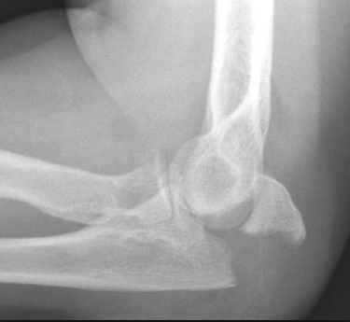
Image

Slide 5
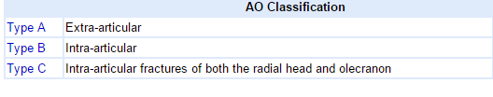
Classification

Slide 6
Other classifications
Mayo: Based on fracture displacement, comminution and dislocation
Colton: fracture type, comminution and dislocation
Schatzker: classified according to simplicity or complexity

Slide 7
Clinical features
Symptoms
  pain well localized to posterior elbow
Physical exam
  palpable defect
    indicates displaced fracture or severe comminution
  inability to extend elbow
    indicates discontinuity of triceps (extensor) mechanism

Slide 8
Clinical features
Sudden, intense pain
Inability to straighten elbow
Swelling over the bone site
Bruising around the elbow
Tenderness to the touch
Numbness in one or more fingers
Pain with movement of the joint

Slide 9
Imaging
Radiographs
  recommended views
    AP/lateral radiographs
      true lateral essential for determination of fracture pattern
  additional views
    radiocapitellar may be helpful for
      radial head fracture
      capitellar shear fracture
CT
  may be useful for preoperative planning in comminuted fractures

Slide 10
Treatment
Nonoperative
immobilization
  indications
    nondisplaced fractures
    displaced fracture is low demand, elderly individuals
  technique
    immobilization in 45-90 degrees of flexion for 3-4 weeks
    begin motion at 3-4 weeks

Slide 11
Treatment: operative
tension band technique
  indications
    transverse fracture with no comminution
  outcomes
    excellent results with appropriate indications
intramedullary fixation
  indications
    transverse fracture with no comminution (same as tension band technique)
plate and screw fixation
  indications
    comminuted fractures
    Monteggia fractures
    fracture-dislocations
    oblique fractures that extend distal to coronoid

Slide 12
Operative treatment
excision and triceps advancement
  indications
    elderly patients with osteoporotic bone
    fracture must involve <50% of joint surface
    nonunions
  outcomes
    salvage procedure that leads to decreased extension strength
    may result in instability if ligamentous injury is not diagnosed before operation

Slide 13
Complications
Symptomatic hardware
  most frequent reported complication
Stiffness
  occurs in ~50% of patients
  usually doesn't alter functional capabilities
Heterotopic ossification
  more common with associated head injury
Posttraumatic arthritis
Nonunion
  rare
Ulnar nerve symptoms
Anterior interosseous nerve injury
Loss of extension strength

