Slide 1
Anatomy notes Presenter Ruth T Wambua

Slide 2
Omentum
The omenta are the fused (two-layered)peritoneal folds that attach the abdominal organs with one another.
There are two omenta:
the greater omentum
the lesser omentum

Slide 4
Greater omentum
It attaches the greater curvature of stomach to transverse colon
It is the largest peritoneal fold and contains some adipose tissue
It consists of a double sheet of peritoneum folded on itself so that it is made up of four layers (anterior 2 layers + posterior 2 layers)

Slide 5
Ct,
The two layers descend from greater curvature of stomach to the transverse colon where they separate and enclose it
The left border of the greater omentum is continuous with the gastrosplenic ligament (extends to the spleen, overlying the kidney);its right border extends as far as the beginning of the duodenum.

Slide 6
Ct,
Gastrophrenic ligament extends to the underside of the left dome of the diaphragm
The upper part of the greater omentum which extends from stomach to transverse colon is termed the gastrocolic ligament

Slide 7
Contents of greater omentum
Gastroepiploic/ gastro-omental vessels(Right and left gastroepiploic vessels)
Lymph nodes and lymphatic vessels
Fat
Autonomic nervous system- sympathetic+ parasympathetic (vagus nerve)

Slide 8
Functions of greater omentum
Protective function- it contains numerous fixed macrophages which perform an important protective function
Storehouse for fat- the greater omentum is usually thin and presents a cribriform appearance but always contain some adipose tissue which insulates the abdominal organs

Slide 9
Ct
3. Migration and limitation- the greater omentum may limit spread of infection in the peritoneal cavity. Because it will migrate to the site of any inflammation in the peritoneal cavity and wrap itself around such a site, the greater omentum is commonly referred to as the “policeman “ of the peritoneal cavity

Slide 10
Lesser omentum
Smaller of the omenta
Two-layered fold of peritoneum
Extends from the lesser curvature of the stomach and duodenal bulb (first part of duodenum) to the liver
Divided into hepatogastric and hepatoduodenal ligaments
Hepatogastric ligaments extends from porta hepatis to lesser curvature of stomach
Hepatoduodenal ligament extends from porta hepatis to superior part of duodenum

Slide 11
Ct,
Forms anterior border of the epiploic foramen
One of its roles is to separate the greater sac from the omental bursa
Contents of lesser omentum
Blood vessels- Right and left gastric vessels
Lymph nodes and lymphatic vessels
Fat
Autonomic N.S – sympathetic+parasympathetic (vagus nerve)

Slide 12
MESENTERY
The mesentery is a large, fan-shaped, double-layered fold of peritoneum that suspends small intestine and large intestine from posterior abdominal wall
Is a continuation of visceral and parietal peritoneum
Mesenteries are peritoneal folds that attach viscera to the posterior abdominal wall

Slide 13
Ct,
Mesentery allow some movement and provide a conduit for vessels, nerves, and lymphatics to reach the viscera and include (allow communication between organ and body wall )
Contain lymph nodes and variable amount of fat.

Slide 14
Ct,
The mesentery is the mesentery of small intestine (jejunum and ileum)
The mesocolon is the mesentery of the large intestine
the transverse mesocolon — associated with the transverse colon
the sigmoid mesocolon — associated with the sigmoid colon.
All of these are derivatives of the dorsal mesentery.

Slide 15
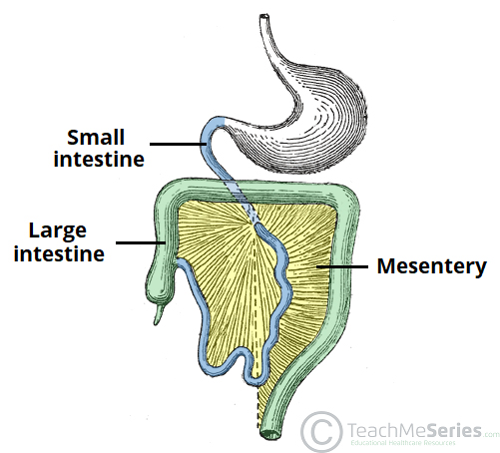
Overview of mesentery

Slide 16
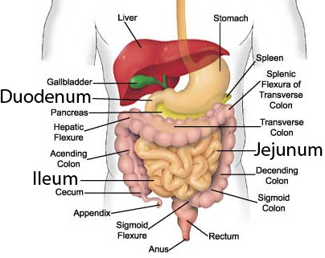
Overview of small and large intestine

Slide 17
Mesentery of small intestines
Suspends small intestines(jejunum and ileum) from the posterior abdominal wall
Is broad and fan-shaped
Contents of the mesentery
The jejunal and ileal branches of superior mesenteric arteries and veins
Nerve plexus
Lymphatic vessels

Slide 18
Ct,
Lymphatic nodes
Connective tissue
Fat
Transverse mesocolon
Is a broad fold
Connects the transverse colon to posterior abdominal wall
Its two layers of peritoneum leave the posterior abdominal wall across the anterior surface of the head and body of the pancreas and pass outward to surround the transverse colon

Slide 19
Contents of transverse mesocolon
The blood vessels
Nerves
Lymphatic vessels
Lymphatic nodes

Slide 20
Sigmoid mesocolon
Is a fold of peritoneum
Attaches sigmoid colon to the pelvic wall
Contents
Sigmoid vessels
Lymphatic vessels
Nerves
The left ureter descends into pelvis behind its apex

Slide 21
Mesoappendix
Triangular mesentery- extends from terminal part of ileum to appendix
Appendicular artery run in free margin of mesoappendix

Slide 22
Functions of mesentery
The mesentery attaches the small and large intestines to the posterior abdominal wall, anchoring them while still allowing some movement
Helps storing the fat
Provides conduit (passageway) for the blood and lymph vessels, as well as the nerves, to supply the intestines.
Postulated to play a pathological role in inflammatory disease such as Crohn’s disease

