Slide 1
Oncology
Cancer nursing

Slide 2
Epidemiology
All age groups
However:
  M>F
  Elderly>young
  >in industrialiazed countries

Slide 3
Pathophysiology of the Malignant Process
Abnormal cell is transformed by the genetic mutation of the cellular DNA.
Abnormal cell forms a clone and begins to proliferate abnormally, ignoring growth-regulating signals

Slide 4
Pathophysiology…
The cells acquire invasive characteristics, and
changes occur in surrounding tissues.
The cells infiltrate these tissues and gain access to lymph and blood vessels, which carry the cells to other areas of the body {metastasis}

Slide 5
PROLIFERATIVE PATTERNS
Several patterns of cell growth exist: hyperplasia, metaplasia, dysplasia, anaplasia, and neoplasia
Cancerous cells are described as malignant neoplasms

Slide 6
anaplasia:
  cells that lack normal cellular characteristics and differ in shape and organization with respect to their cells of origin; usually, anaplastic cells are malignant.

Slide 7
Dysplasia :
  bizarre cell growth resulting in cells that differ in size, shape, or arrangement from other cells of the same type of tissue

Slide 8
Hyperplasia:
Increase in the number of cells of a tissue; most often associated with periods of rapid body growth

Slide 9
Malignant
Having cells or processes that are characteristic of cancer

Slide 10
Metaplasia
Conversion of one type of mature cell into another type of cell
Metastasis: spread of cancer cells from the primary tumor to distant sites
Neoplasia: uncontrolled cell growth that follows no physiologic demand
Staging: process of determining the size and spread, or metastasis, of a tumor

Slide 11
CHARACTERISTICS
OF MALIGNANT CELLS
The cell membranes are altered in cancer cells, which affects fluid movement in and out of the cell.
The cell membrane of malignant cells also contains proteins called tumor-specific antigens

Slide 12
Typically, nuclei of cancer cells are large and irregularly shaped (pleomorphism).

Slide 13
INVASION AND METASTASIS
Malignant disease processes have the ability to allow the spread or transfer of cancerous cells from one organ or body part to another by invasion and metastasis

Slide 14
Characteristics of Benign and Malignant Neoplasms
Cell characteristics | Well-differentiated | Cells are undifferentiated
Mode of growth | Tumor grows by expansion usually encapsulated | Grows at the periphery and sends out processes that infiltrate and destroy the surrounding tissues
Rate of growth | slow | variable
Metastasis | no | Yes: blood/lymphatics
General effects | Localized effects | Generalized effects
Tissue destruction | No | Yes
Ability to cause death | ? | Usu fatal

Slide 15
Metastatic mechanisms
Hematogeneous spread
Lymphatic spread
Angiogenesis

Slide 16
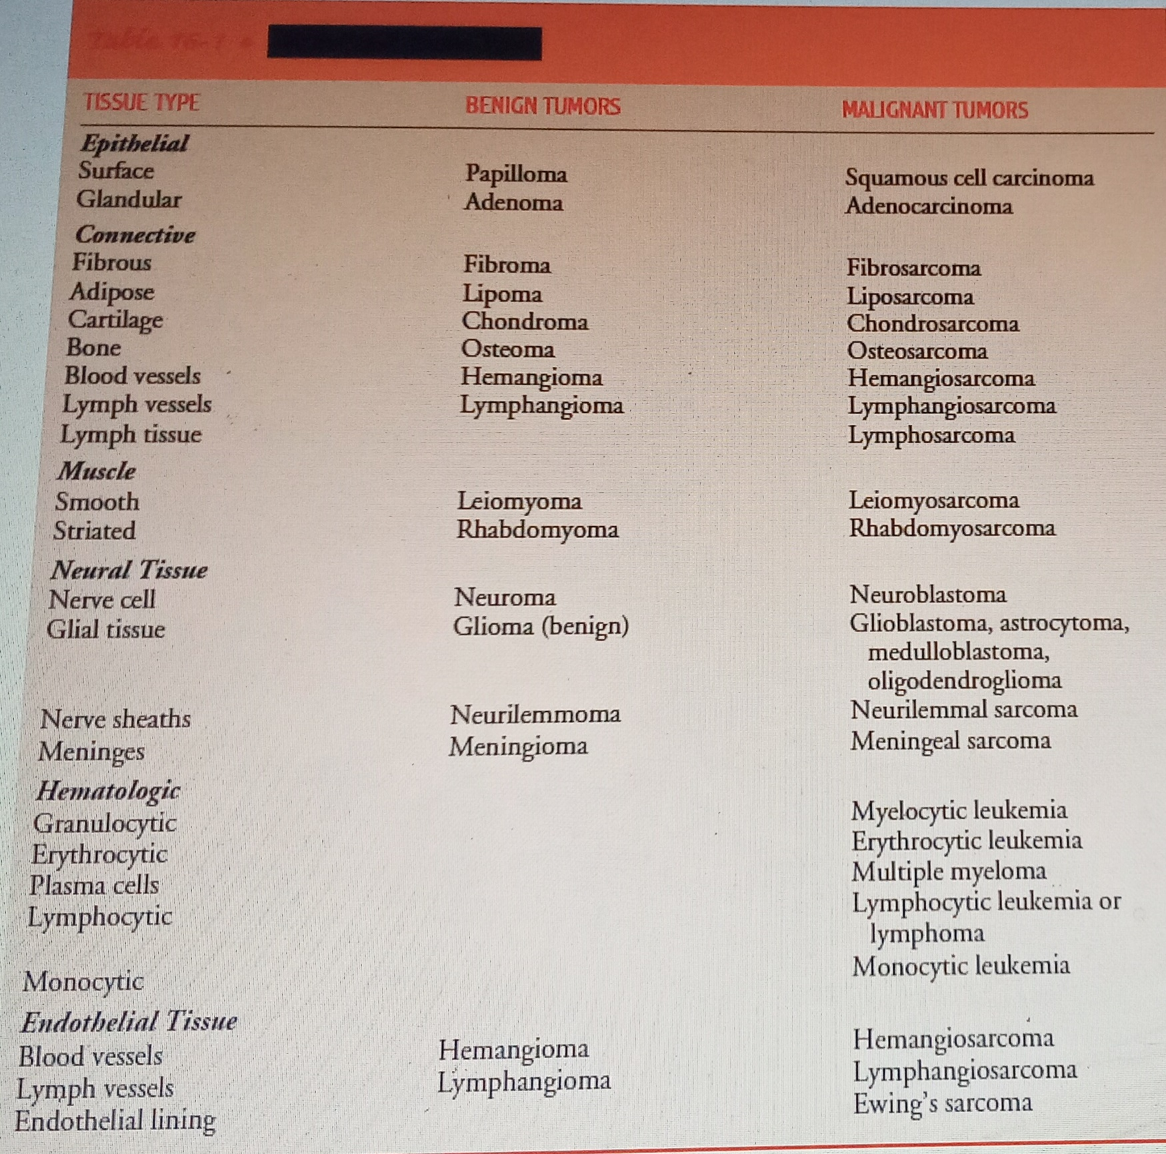
Tumors and Tissue Types

Slide 17
Responsibilities of the Nurse in Cancer Care
• Support the idea that cancer is a chronic illness that has acute exacerbations rather than one that is synonymous with death and suffering.
• Assess own level of knowledge relative to the pathophysiology of the disease process.
• Make use of current research findings and practices in the care of the patient with cancer and his or her family.
• Identify patients at high risk for cancer.
• Participate in primary and secondary prevention efforts.
• Assess the nursing care needs of the patient with cancer.
• Assess the learning needs, desires, and capabilities of the patient with cancer.
• Identify nursing problems of the patient and the family.
.

Slide 18
Responsibilities…
• Assess the social support networks available to the patient.
• Plan appropriate interventions with the patient and the family.
• Assist the patient to identify strengths and limitations.
• Assist the patient to design short-term and long-term goals for care.
• Implement a nursing care plan that interfaces with the medical care regimen and that is consistent with the established goals.
• Collaborate with members of a multidisciplinary team to foster continuity of care.
• Evaluate the goals and resultant outcomes of care with the patient, the family, and members of the multidisciplinary team.
• Reassess and redesign the direction of the care as determined by the evaluation

Slide 19
Carcinogenesis
Malignant transformation, or carcinogenesis, has three-steps:
  Initiation,
  Promotion, and
  Progression.

Slide 20
Initiation
.
The first step.
  Initiators (carcinogens), such as chemicals, physical factors, and biologic agents, escape normal enzymatic mechanisms and alter the genetic structure of the cellular DNA. [Mutation]

Slide 21
Promotion
repeated exposure to promoting agents (co-carcinogens) causes the expression of abnormal or mutant genetic information even after long latency periods

Slide 22
Progression
Third step of cellular carcinogenesis.
The cellular changes formed during initiation and promotion now exhibit increased malignant behavior
These cells now show a propensity to invade adjacent tissues and to metastasize.
Agents that initiate or promote cellular transformation are referred to as carcinogens.

Slide 23
ETIOLOGY
Viruses and Bacteria: HPV
Physical Agents: UV rays
Chemical Agents: Tobacco
Genetic and Familial Factors: Burkitt’s lymphoma/CML
Dietary Factors: Fats/alcohol
Hormonal Agents: Diethylstilbestrol

Slide 24
Detection and Prevention of Cancer
Primary prevention
Secondary prevention

Slide 25
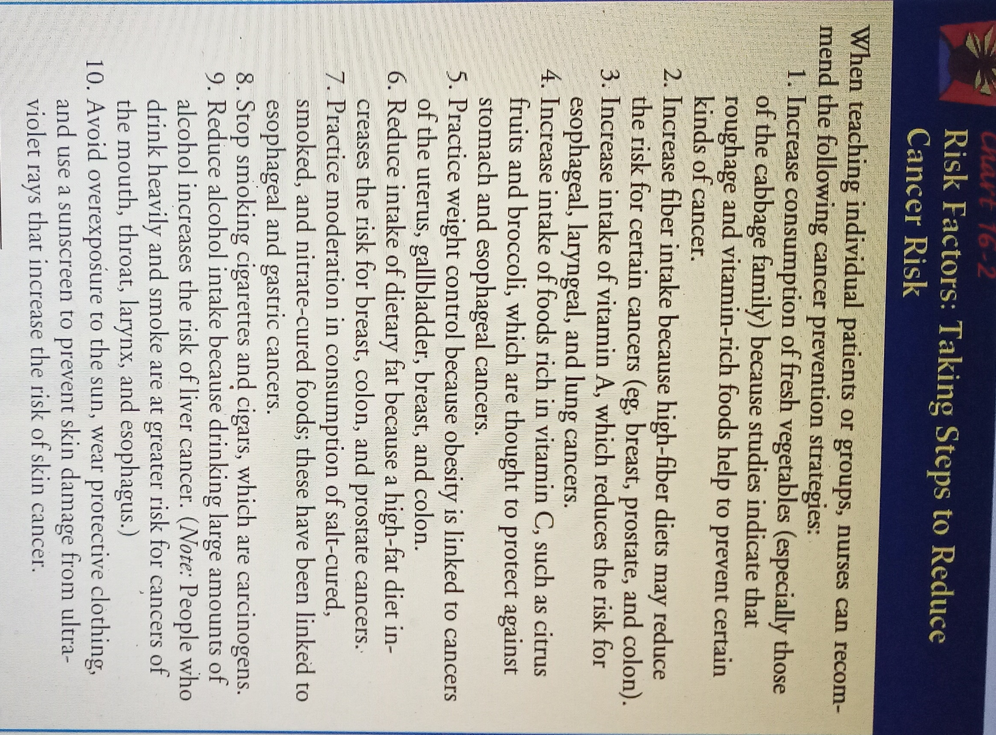

Slide 26
TUMOR STAGING AND GRADING
Staging determines the size of the tumor and the existence of metastasis.
  Several systems exist for classifying the anatomic extent of disease.
    The TNM system is frequently used.
      T refers to the extent of the primary tumor,
      N refers to lymph node involvement, and
      M refers to the extent of metastasis

Slide 27
Grading refers to the classification of the tumor cells.
  Grading systems seek to define the type of tissue from which the tumor originated and the degree to which the tumor cells retain the functional and histologic characteristics of the tissue of origin

Slide 28
Management of Cancer
The range of possible treatment goals may include:
  Complete eradication of malignant disease (cure),
  Prolonged survival and containmentof cancer cell growth (control), or
  Relief of symptoms associated with the disease (palliation).

Slide 29
Management
Surgery
Radiotherapy
Chemotherapy
BMT
Cancer Rehabilitation

Slide 30
assignment
Nursing Management in:
  Chemotherapy
  Radiotherapy
  BMT
  Surgery

