Slide 1
Open fractures
P.J. Okoth

Slide 2
Open fractures
Definition:
A fracture is open or compound when there is a wound of the skin surface leading down to the site of fracture.
A fracture is classed as open only when a direct communication exists between the body surface and the fractured bone ends.

Slide 3
Gustilo - Anderson Classification of open fractures
The Gustilo – Anderson classification divides open fractures into three types – I, II & III.
Type I:
  Clean wound smaller than 1cm in diameter,
  appears clean,
  simple fracture pattern,
  no skin crushing.

Slide 4
Classification…
Type II:
  A laceration larger than 1cm but without significant soft tissue crushing:
    No flaps,
    No degloving,
    No contusion [a bruise]
  Simple fracture pattern

Slide 5
Classification…
Type III:
  High-energy injury with extensive soft tissue damage
  Or An open segmental fracture or multifragmentary fracture, or bone loss irrespective of the size of skin wound
  Or Severe crush injuries
  Or Vascular injury requiring repair
  Also included are injuries older than 8 hours or severe contamination.

Slide 6
Classification…
Type III injuries are subdivided into three types:
Type III A:
  Adequate soft tissue coverage of the fracture despite high energy trauma or extensive laceration or skin flaps.
Type III B:
  Inadequate soft tissue coverage with periosteal stripping.
  Soft tissue reconstruction is necessary.
Type III C:
  Any open fracture that is associated with vascular injury that requires repair.

Slide 7
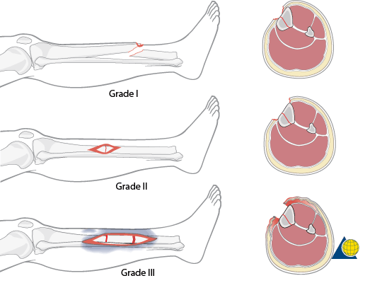
Classification…

Slide 8
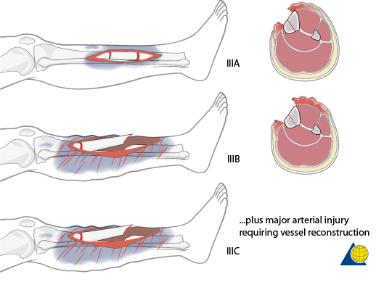
Classification…

Slide 9
treatment of open fractures
An open fracture requires urgent attention
The sooner the wound can be dealt with, the smaller is the risk of infection arising from contaminating organisms.

Slide 10
Treatment…
Do primary survey – ABC
AIRWAY
  Ensure airway is clear
BREATHING
  Make sure the patient is ventilating and if not assist (Ambu bag, oxygen)
CIRCULATION
  Assess for bleeding – inspect, pulse, BP
  Start an IV line
  Give IV fluids to restore volume
  Stop obvious bleeding
  Blood for grouping and cross-match, Hb, haematocrit, blood gases.

Slide 11
TREATMENT..
Ever seen an open fracture?
How was it?
How was it managed?

Slide 12
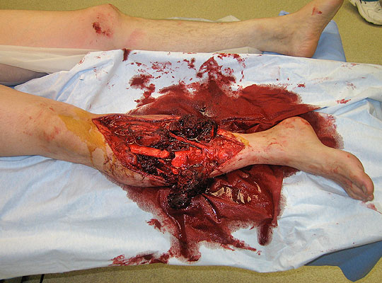
Treatment of open fractures

Slide 13
Principles of treatment
Clean the wound by performing a thorough surgical toilet.
  Remove all dead and devitalized tissue
  Remove all extraneous material
  Aim at leaving healthy, well-vascularized tissues that are able to fight infection from any remaining contaminating organisms.
The wound should not be subjected to repeated examination, but should be covered with sterile dressing.
Avoid immediate skin closure.

Slide 14
Technique of operation for major wounds
Enlarge the skin wound to display clearly the extent of the underlying damage
Flush the wound with copious quantities of water or saline to remove all contaminating dirt.
Pick out with forceps any foreign matter e.g. shreds (pieces) of clothing.
Excise any tissues that are obviously dead
Remove dead or devascularised muscle in order to reduce the risk of gas gangrene.

Slide 15
Operation for major wounds…
Remove bone fragments that are small and completely detached.
Large bone fragments, which usually retain some soft tissue attachments, should be preserved.
The bone ends must be inspected.
When debriding bone, the fracture edges are curetted and all dirt and non-viable bone are removed.

Slide 16
Operation for major wounds…
Damage to major blood vessels is dealt with by:
  Ligation
  Suture
  Or vein grafting
The ends of severed nerve trunks may be tucked lightly together with one or two sutures to facilitate later definitive repair.

Slide 17
Operation for major wounds…
Tourniquets should be avoided when possible to prevent additional ischemic injury to the soft tissues.
Necrotic tissue is removed and only viable tissue is left behind. The exception is skin, where none is removed unless obviously necrotic.
The quality of the muscle tissue is assessed using the classic 4 C’s:
  Color (red or brown)
  Consistency (how does the muscle feel)
  Capillary Circulation (does it bleed?)
  Contractility (responds to pinch or electro-cautery)

Slide 18
Skin closure
The wound should be left unsutured after surgical toilet and dressed with sterile covering.
Delayed closure should be done as soon as infection has been aborted or overcome (delayed primary suture).

Slide 19
Methods of skin closure
Direct suture of the skin edges if feasible, depending upon the amount of skin destroyed and lost in the injury.
  If the skin loss is negligible and the skin edges can be brought together without tension, direct suture should be done.
A free split-skin graft is used if the skin edges will not come together easily.
Full-thickness skin graft
soft-tissue flaps

Slide 20
Treatment of the fracture
Once the wound has been dealt with, the fracture itself should be treated following the general principles of managing closed fractures.
There should be greater reluctance to resort to operative methods of fixation, due to increased risk of infection.
If the fracture is unstable and unsuitable for treatment by traction or by simple splintage, external fixation should be done.

Slide 21
External fixation…
Provides temporary stabilization
Minimizes additional soft-tissue injury.
This fixation facilitates access to the wound for inspection between debridements.
Once the wound has healed, the fracture can be immobilized in plaster for the remaining duration of treatment.

Slide 22
Other treatment
Antibiotics:
  A course of treatment with a broad-spectrum antibiotic, such as a third generation cephalosporin, should be begun immediately and continued until the danger of infection is past.
  Antibiotics should be given intravenously.
Prophylaxis against tetanus:
  Tetanus toxoid should be given and repeated 6 weeks later or a booster should be given if the patient was already immunized previously.
Analgesics
Monitor vital signs

Slide 23
The end!
Thanks

