Slide 1
Orthopaedic nursing
By Jane Osumba

Slide 2
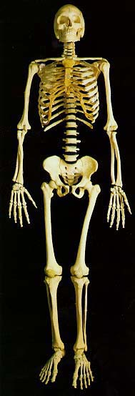
Aim
To understand principles applied in orthopedic nursing in order to be able to care for patients presenting with orthopaedic conditions/ diseases

Slide 3
objectives
To review A &P of the bones
To discuss fractures and the principles of fracture management.
To discuss indications and care of patients done amputation of a limb
To describe causes and management of orthopaedic diseases
Identify congenital malformations related to orthopaedics and discuss their management
Apply knowledge of orthopaedic management in nursing patients presenting with orthopaedic conditions.

Slide 4
Contents
Anatomy and physiology of the bones
Assessment to include:- Hx, physical exam, neurovascular assessment, and investigations
Minor injuries:- Contusion, Lacerations, Strains, Sprains & dislocations/subluxation
Fractures:- Definition, types/classification, clinical features, general principles of management
Amputation and its management(definition, indications, management)

Slide 5
Contents
orthopedic diseases (osteomyelitis;arthritis;osteoporosis & osteomalacia
Congenital abnormalities:- Talipes, Congenital hip dislocation & osteogenesis imperfecta
Tumors i.e. benign and malignant
Gout and pagets’ disease

Slide 6
Anatomy and physiology of the bones
Bones are connective tissue.
Bones have a soft center that is full of bone marrow, where blood cells are made.
Bones support the body, help with movement, and offer protection to vital organs

Slide 7
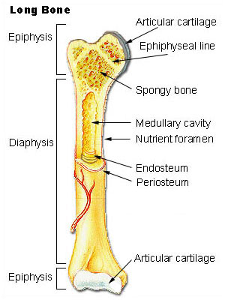
Types of bones
There are 5 main types of bones
  Long bones- characterized by a long shaft, like a femur
  Short bones- roughly cubed shaped and found in wrist
  Flat bones-are thin and curved bones with two hard bones sandwiching a soft tissue, the skull bones
  Irregular bones- bones that do not fit in the above categories, like hip or spine bones
  Sesamoid bones- bones that are embedded in tendons, like the patella

Slide 8
Assessment of orthopaedic patients
History taking
Physical examination
Radiological exams

Slide 9
History taking
Health Hx:- i.e.
Initial interview
Onset, management approach, pt’s perceptions & expectations related to health.
Concurrent health conditions(e.g. chronic illnesses) & related problems (e.g. familial tendencies/genetics)
HX of medication use & response to pain drugs
Any allergies
Substance use & abuse e.g. tobacco, alcohol
Information on pt’s learning ability, economic status & current occupation for rehabilitation & discharge planning
Any other useful data as the nurse interacts with the patient

Slide 10
Assessment data
Assess & document the following
Pain:-
bone pain - dull deep pain
Muscle pain - soreness or aching/muscle cramps
# pain - sharp and piercing pain relieved by immobilization
NB: Sharp pain can also be due to bone infection or pressure on a sensory nerve
Pain increasing with activity may indicate joint /muscle sprain,
Steadily increasing pain- progression of an infectious process, malignant tumors or neurovascular condition
Radiating pain- pressure on a nerve.

Slide 11
Assessment data
2. Altered sensation
Paresthesias -burning, tingling sensations or numbness due to pressure on nerves, or circulatory impairment.
Assess the neurovascular function

Slide 12
Physical examination
Posture
Gait
Bone integrity
Joint function
Muscle strength and size
Skin integrity and condition
Neurovascular status

Slide 13
Radiological studies
Imaging studies - x-ray studies, C.T scanning, M.R.I’s, arthrography, bone densitometry
Nuclear studies:- bone scan, arthroscopy,
Other studies:- arthrocentesis, Electromyography, Biopsy
Lab studies:- blood & urine tests
Assignment
Read on each of the above
Notes:
a

Slide 14
Fractures
Objectives: to
Define the terms fracture, dislocation and Subluxation
Identify the general causes, signs & symptoms of fractures
Classify the different types of fractures
Discus the general principles of the management of fractures
Describe the role of radiography in the management of fractures
Explain the process of fracture healing
State the local and general complications of fractures

Slide 15
Definition
A break in the continuity of the structure of bone
It can be partial or complete
A medical condition where the bone is either cracked or broken
Traumatic injuries account for the majority of fractures

Slide 16
Causes
Direct force- the force is applied direct to the bone
Indirect force –the force is transmitted along other parts of the body
Muscular violence –violent contraction of muscles in order to avoid falling e.g. quadriceps causing fracture patella
Muscle fatigue –deprives the bones of necessary support
Pathological – due to
-disuse of muscles leading to atrophy
-bone demineralizing diseases
-local disease
Notes:
e.g. a fall on outstretched hand may cause # of the clavicle

Slide 17
classification
5 factors taken into account when fractures are classified.
  The name of the bone
  The location on the bone
  The type of fracture
  The group/ shape (Like a spiral fracture)
  The subgroups, which looks at factors like the displacement or if there is shortening
  Classification can also either be orthopedics or anatomical

Slide 18
Anatomical classification
Based on the body part affected.
Humerus
Radius/ulna
spine
femur
Titbia

Slide 19

Anatomical classification-according to fracture specification
Comminuted # :
The bone is broken into more than two fragments.
Stellate fracture:
Fracture lines run in various directions from one point e .g. # of flat bones of the skull and the patella

Slide 20
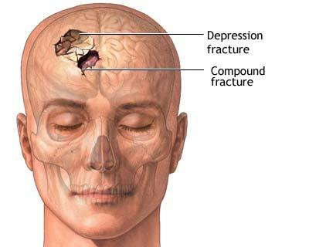
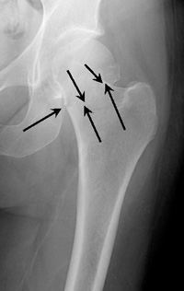
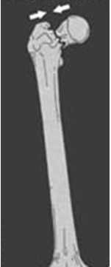
Anatomical classification-according to fracture specification
Impacted fracture:
This # where a vertical force drives the distal fragment of the fracture into the proximal fragment.
Depressed fracture:
This # occurs in the skull where a segment of bone gets depressed into the cranium
Notes:
Impacted also known as telescope fracture

Slide 21
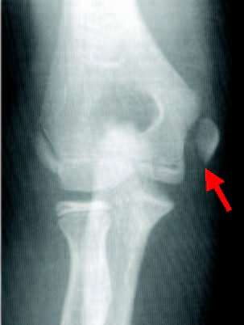
Anatomical classification-according to fracture specification
Avulsion fracture:
This is one, where a chip of bone is separated by the sudden and unexpected contraction of a powerful muscle from its point of insertion e.g.
1. The supra spinatus muscle avulsing the greater tuberosity of the humerus.
2. Avulsion fracture of the tibial tuberosity

Slide 22
Orthopedic classification
Communication with external environment
Closed (simple) - fracture hematoma does not communicate with the outside
Open ( compound) - fracture hematoma communicates with the outside through an open wound.

Slide 23
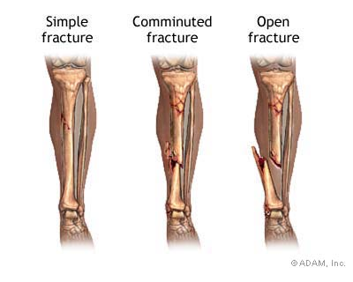
Types of fractures

Slide 24
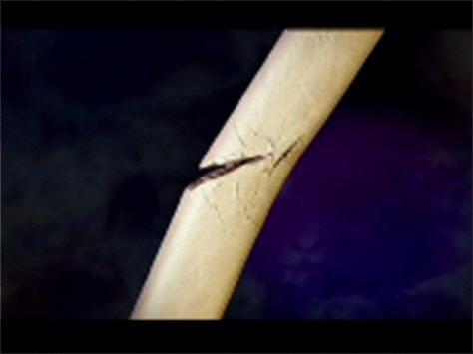
Orthopedic classification
Complete fracture –periosteum is tone separating the two bone fragments
Incomplete fracture -
Continuity of the bone is not completely disrupted e.g. green stick fractures in children

Slide 25
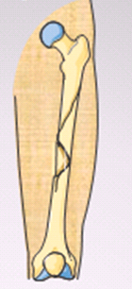

According to the Path of the # Line
Spiral Fracture
A severe form of oblique fracture in which the # plane rotates along the long axis of the bone. These #s occur secondary to rotational force.
Longitudinal Fracture
A fracture in which the # line runs nearly parallel to the long axis of the bone. A longitudinal fracture can be considered a long oblique fracture.

Slide 26


According to the Path of the # Line
Transverse Fracture
A fracture in which the # line is perpendicular to the long axis of the bone .
Oblique Fracture
A fracture in which the # line is at oblique angle to the long axis of the bone.

Slide 27
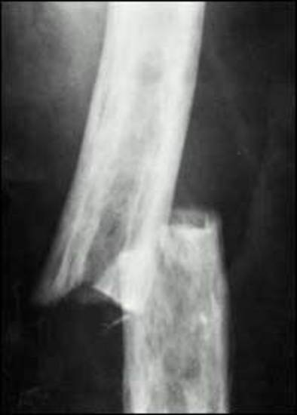
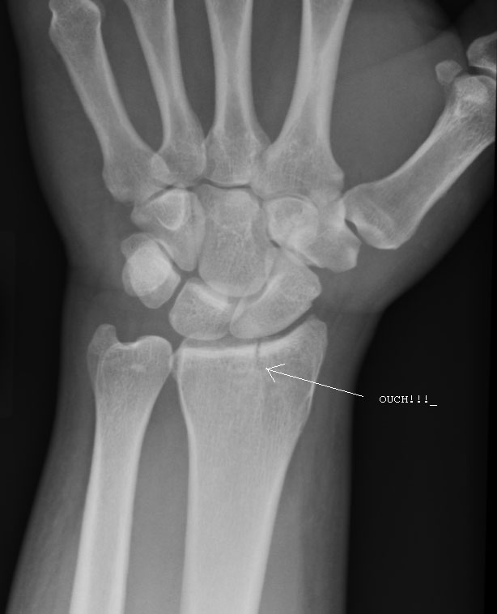
According to the Path of the # Line
Displaced fracture –bone ends are pulled apart from each other.
Non displaced –crack without a change in the normal alignment of the bone.

Slide 28
Pathological fractures
It is a fracture occurring after a trivial violence in a bone weakened by some pathological lesion. This lesion may be :
- Localized disorder (e.g. secondary malignant deposit)
- Generalized disorder (e.g. osteoporosis)

Slide 29
Summary of types of fracture
Simple little or no bone displacement
Compound fracture ruptures the skin & bone protrudes
Green stick occurs mostly in children whose bones have not calcified or hardened
Transverse crack perpendicular to long axis of the bone - displacement may occur
Oblique diagonal crack across the long axis of the bone
Spiral diagonal crack involving a "twisting" of the bone about the longitudinal axis
Comminuted "crushing" fracture - more common in elderly
Impacted one end of bone is driven up into the other

Slide 30
Summary of fracture types
Depressed broken bone is pressed inward (skull fracture)
Avulsion fragment of bone is pulled away by tendon
Simple little or no bone displacement
Compound fracture ruptures the skin & bone protrudes

Slide 31
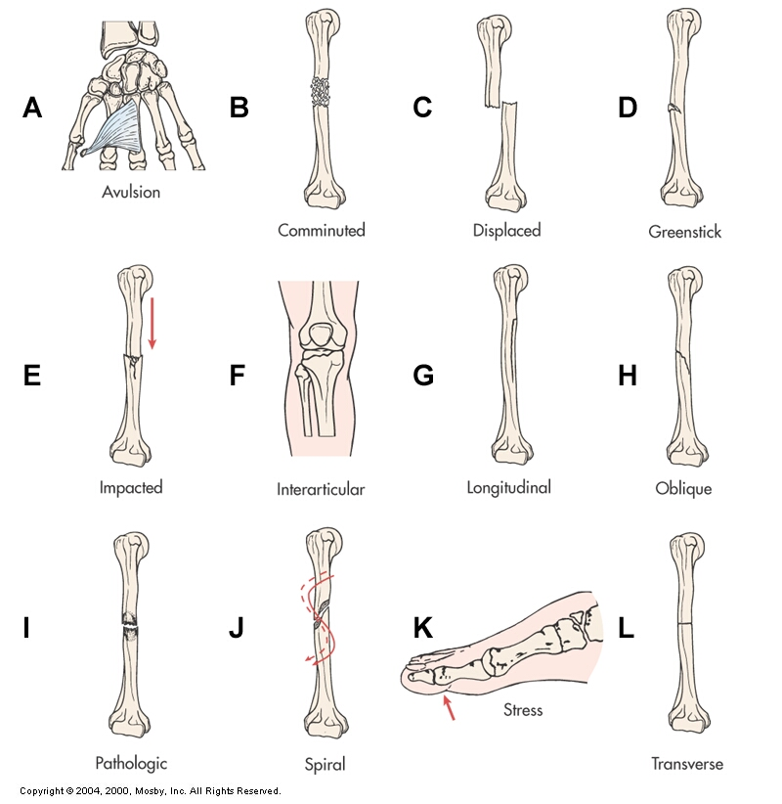
Types of fractures

Slide 32
Clinical features
Local injuries
Pain due to :-
break in the continuity of the periosteum, with or without similar discontinuity in endosteum, as both contain multiple nociceptors.
Edema of nearby soft tissues caused by bleeding of torn periosteal blood vessels evokes pressure pain.
Muscle spasms trying to hold bone fragments in place
Damage to adjacent structures such as nerves or vessels; spinal cord and nerve roots

Slide 33
Clinical features
Abnormal mobility
Deformity –caused by contraction of surrounding muscles
Loss of function of the affected limb
Shortening of the bone
Crepitus or grunting of the fragments- caused by bone edges rubbing against each other
Hemorrhage –either internal or external
Paralysis due nerve damage
Paraesthesia due to impaired sensation
Shock
Notes:
Paraesthesia -Sensation of burning, pricking, itching or tingling of the skin

Slide 34
Fracture healing
Is bone self healing process/ repair/union that has the following processes
Inflammatory Phase.
Stage of hematoma formation- after #, bleeding & edema precede a hematoma surrounding the fragment
There is swelling, edema & pain
The fracture fragments become devascularized
Injured bone is invaded by microphages which debride the area

Slide 35
Fracture healing
Reparative Phase.
Fibrin strands form within the # hematoma
Revascularization begins
Fibroblasts & osteoblasts produce collagen matrix at the # site.
Cartilage and fibrous connective tissue develops.

Slide 36
Fracture healing
  A) Formation of fibro cartilaginous callus.
The phagocytic cells absorbs the products of local necrosis.
The hematoma changes to into Granulation tissue constituting of young blood vessels, fibroblasts, osteoblasts (the bone osteoid)
  B) Formation bony callus (woven bone become calcified)).
Osteoid mineralization to form a network of cartilage, osteoblasts & minerals
Begins to appear by the 1st week of # and can be confirmed by X-ray

Slide 37
Fracture healing
Ossification:- calcification of callous into bone mass that prevent movement @ the # site
Begins 2-3 wks after # until # is healed
However, the # is still evident in the x-ray
Pt can be converted from skeletal traction to cast or cast can be removed & the pt mobilized
Consolidation:- distance between bone continues to diminish & eventually closes & x-ray can confirm # union

Slide 38
Fracture healing
  Remodeling Phase.
  Excess material inside bone shaft is replaced by more compact bone
Excess cells are absorbed & union is completed.
Return of bone to its pre-injury structure, shape & strength
Bone remodeling enhanced by exercises & later weight bearing exercises
New bone is deposited @ site of #

Slide 39
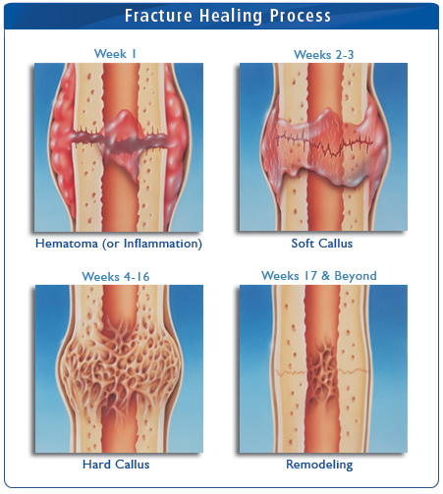
Fracture healing

Slide 40
Factors affecting bone healing
Enhancing
Early Immobilization of fracture fragments
Bone fragments contact
Adequate blood supply
Proper Nutrition
Exercise- wt. bearing for long bones
Adequate hormones –Growth hormone, Thyroxin, Calcitonin
Electric potential across the #
Inhibiting
Extensive local trauma
Bone loss due to the severity of the fracture
Inadequate immobilization
Infection
Avascular Necrosis
Local malignancy
dernarvation
Age
Notes:
A

Slide 41
Management protocol
Aims : 3s (A)- safe life (B)-save the limb
(C)-save the function
Efficient First Aid: This relieves the pain and prevents complications.
Safe transport: This help to minimize complications in injures to the spine, fracture of the lower limbs, ribs(immediate immobilization of all # ) .
Assessment of condition of the patients for shock & other injuries.

Slide 42
Management protocol
4.Assessment of local condition of the injured limb for complications like nerve, vascular& neighboring joints injuries
5.Resuscitation - manage shock if present
6.Radiography of the part
X-ray before plaster ( to determine site and degree of displacement)
Post Reduction films ( wet plaster) - insurance of good alignment
Follow up films - assess healing
Before removal of plaster - confirm complete healing

Slide 43
Management protocol
7.Reduction of the fracture- correction of displacement of fragments done by :
  closed Manipulation
  open reduction
8.Immobilization of the fragments.
External fixation
  -Cast (plaster)
  Internal fixation
  -Screws
  -Plates
  -intramedullary nails and rod
  -wires & pins

Slide 44
Management protocol
9. Rehabilitation
Restoration of full muscle power and joint movements to make the limb fit for his original function.
. Early physiotherapy : for the preservation of function of the limb (local complication such as ischemia ,nerve damage ,joint stiffness ,infection etc. may endanger the function of the limb.

Slide 45
Principles of fracture treatment
Three main principles of treatment
Reduction
Immobilization
Rehabilitation

Slide 46
1.Reduction
Getting the bone fragments into an anatomical rotation & alignment accomplished through ;-
Closed reduction
Obtained by manual manipulation
Performed under L/A to reduce pain; muscle spasms and relax muscles pulling bone fragments out of position.
Open reduction
Involves surgical interventions
Used where muscles attached to the bones are numerous and powerful
In open wounds after surgical toilet

Slide 47
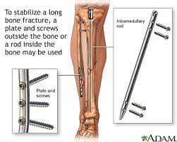
2. Immobilization
keeping fragmented ends of bones still & stable until healing takes place.
The means by which reduction is maintained achieved through:-
External splintage e.g. P.O.P, traction , splints
Internal splintage e.g. internal or external fixation

Slide 48
External fixation
The fracture is reduced & aligned & immobilized by a series of pins inserted into bone fragments
The pins are maintained in position through attachment to a rigid portable frame
The device facilitates :-
Rx of soft tissue in complex #
Patient comfort
Early mobility
Active exercise of the uninvolved joint

Slide 49
External fixation
Prevents complications related to disuse & immobility
Shortens hospital stay
Pre-insertion care
Prepare the patient psychologically –reassure about the apparatus
Post application care
Elevate the extremity to reduce swelling
Drainage of serous fluid is expected
Monitor neurovascular status of injured extremity daily
Be alert for potential problems that may arise due to pressure of the device on the skin, blood vessels & nerves.

Slide 50
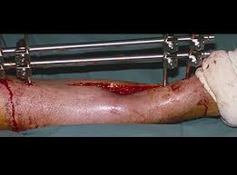
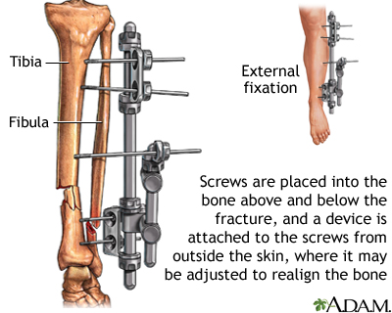
External fixation

Slide 51
External fixation
Cover the sharp ends of the fixator and pins to prevent device induced injury.
Assess each the pin site for swelling , redness , hotness , tenderness , drainage & loosening of the pins indicative of infection
Provide pin care as appropriate
Advice the patient to maintain fixation site clean
Encourage active exercises within the limit of tissue damage
Never adjust clamps on the external fixator frame
Notes:
Signs of infection-redness, drainage ,tenderness, pain & loosening of the pin

Slide 52
Internal fixation
Internal fixation devices e.g. pins , wires, screws, plates, nails or rods are used to hold the bone fragments in position until solid bone healing occurs.
The devices can be:-
attached to the sides of the bone
inserted through the bony fragments
Inserted directly into medullary cavity of the bone
The devices ensure firm fixation of the bony fragments

Slide 53
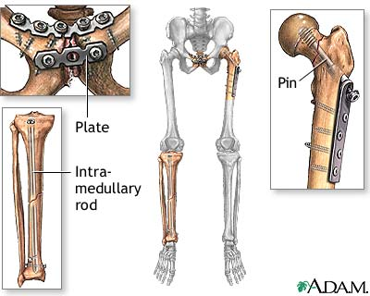
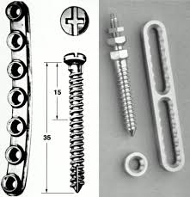
Internal fixation

Slide 54
Internal fixation
Post operative care
Same as any post operative patient
Give strong opioid analgesics for pain
Observe site for bleeding & shock
Observe for signs of infection
Encourage mobility as prescribed by the sergeon
Psychotherapy

Slide 55
Internal fixation
Internal fixation devices may be removed after the bone union
For majority of pts the device is not removed unless there is complications such as pain and decreased function which is indicative of:-
Mechanical failure
Material failure
Corrosion of devices
Allergic response to metallic alloys used
Osteoporotic remodeling

Slide 56
Traction
A pulling force applied in a specific direction to a body part by manual or mechanical means.
Exertion of a pulling force to reduce & immobilize a #
Purpose of traction
To overcome muscle spasms
To stretch muscles and tendons
To permit joint exercise
To hold the extremity in position
To prevent further injury
Reduce pain
Maintain bone alignment

Slide 57
Types of traction
Fixed traction
Traction attached to stationary point e.g. Thomas splint
Pulp traction
Used in Rx of # figures and toes;
to correct shape of fingers
Suture passes through a pulp(bone) of the fingers then fastened to an extension piece in cooperated in the P.O.P applied to a hand or foot

Slide 58
Balanced traction
Composed of two opposing forces that are separated by a raised structure e.g. elevated bed to balance the forces.
Weights hung from cords which pass over pulleys in the edges of the bed then are attached to pt’s limb.
The opposing force is called counter- traction and is equal to that of traction but pulls in the opposite direction.
Counter-traction is provided by pt’s own body weight and raised foot of the bed so that the weight of the body counteracts pull on the limb.

Slide 59
Balanced traction
Advantages
Allows pt to move freely in bed without interfering with fracture site thus reducing complications of immobility
Precautions
Pulleys should run smoothly without any interference
Cords should be in straight line without nodes
The weights should hang freely
Bed elevators should never be removed even for a few seconds

Slide 60
Types of balanced traction
Skin traction
The traction is applied to the skin from which the force is transmitted to the muscles then to the bones.
Special type of strapping is used.
Skin does not tolerate large weights hence 2.7 – 3.6 kgs used
Indications
Pts with arthritis
# of lower limbs
Dislocation of the spine

Slide 61
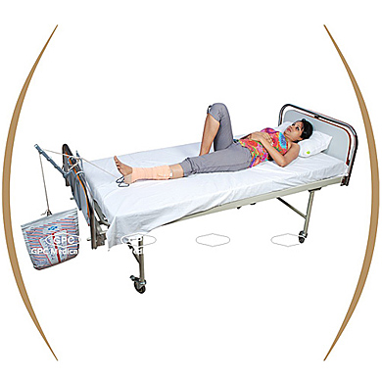
Skin traction

Slide 62
Types of skin traction
Cervical skin traction
Relieves muscle spasms and compression in the upper extremities and neck.
Uses a head halter and a chin pad to attach to the traction
The head of the bed is elevated at 30- 40 degrees and weights are attached to a pulley system over the head of the bed.
Use powder to protect the ears.

Slide 63
Types of skin traction
Buck’s skin traction
Longitudinal skin traction applied to one or both limbs
Pelvic skin traction
Used to relieve low back, hip & leg pain
Traction is applied over the pelvis & illiac crest & weights are attached.
Russell´s traction
Horizontal pulling force applied to lower leg
Used to Rx # of the tibial plateau
Supports the flex knee in a sling

Slide 64
N/care of patient on skin traction
Ensure effective traction- maintain counter traction: observe for wrinkling & slipping of traction bandage
Adhesive tapes adhere to the skin and has potential for causing skin breakdown thus observe the skin for redness and swelling
Inspect the limb for signs of circulatory compromise
Assess for sensation & motion of the limb
Assess for dorsiflexation of foot-pressure on common perianal nerve.
Planter flexion of the foot(foot drop)- pressure on tibial nerve
Notes:
Peripheral pulses, color, capillary refill & temp

Slide 65
N/care of patient on skin traction
Change the bed from top to bottom as the pt lifts self with aid of trapeze
Turn pt at 45 degrees to either side to accomplish back care or linen change.
Buck’s skin traction released 8 hourly then rewrapped to prevent long term pressure over the nerves & circulatory constriction; provides opportunity to assess the skin.
Observe pts on Buck’s skin traction for perianal palsy due to pressure from the elastic straps on the foot over the fibula head leading to perianal nerve ischemia.

Slide 66
Skin traction –N/care cont´d
If traction boot is used, it must be removed 8 hourly for inspection of the heals.
Provide a pillow underneath calf muscles to keep heels off the bed.
Message heals 4 hourly to increase circulation
Neuromuscular observations done hrly for the 1st 24hrs then 4 hrly if findings are within normal
Observe the foot for edema which denotes that elastic strap is too tight
Maintain intact neurovascular status while the pt is on traction

Slide 67
Types of balanced traction
Skeletal traction
Traction applied direct to skeletal structure or bone using pins , wires or tongs
Indications
When continuous force is needed
When heavier weights are required to overcome traction e.g.11-18kgs
Types
Balanced skeletal traction
Overhead arm traction
Skull traction –used in spinal cord injuries
Cervical traction with tongs

Slide 68
Balanced skeletal traction
Indication
–Rx of long bone and cervical spine #
Pin placement done under G/A or L/A and parental analgesia using aseptic technique.
Prepare patient for insertion to allay anxiety, ensure pt.'s comfort and cooperation
A pull is exerted direct on the bones by means of Steinman's pin, Kirchner wire or Denham’s pin then balance suspension is applied such that the limb is supported off the bed by ropes, pulleys and eights.

Slide 69
Skeletal traction
Thomas splint with Pearson attachment used to suspend the leg in # of femur
Traction is continuous once applied
May take 3-4 months
Advantages
Permits pt to move easily and comfortably in bed
Enables the pt to lift self off the bed for skin care, bedpan use without discomfort or motion at the fracture site.

Slide 70
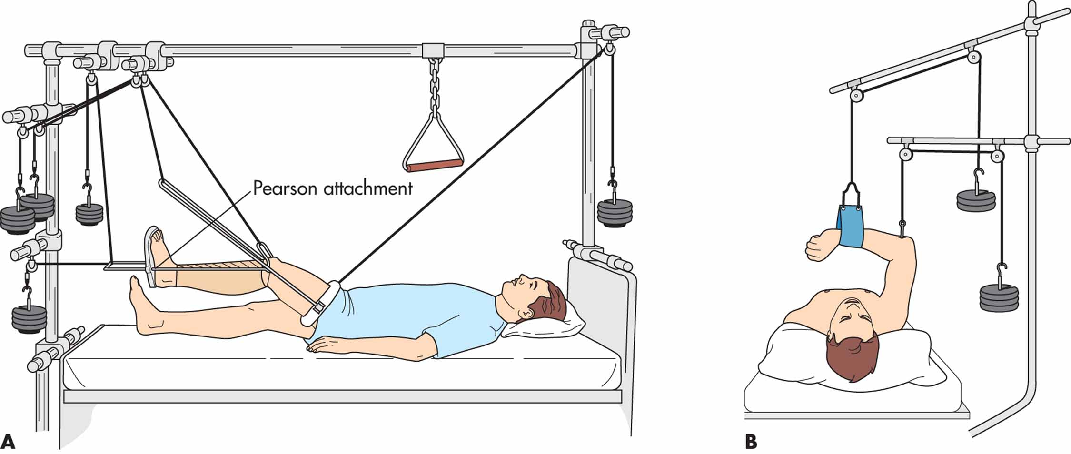
Skeletal traction

Slide 71
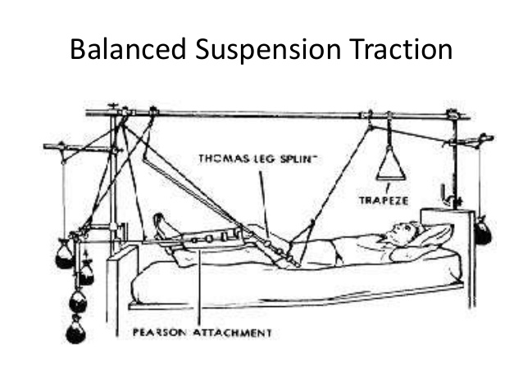
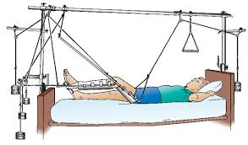

Slide 72
Nursing care
Ensure pt maintains correct position to prevent pain
Ensure that effective traction is maintained
Ensure skin care to prevent skin break down
Clean the pin site with sterile normal saline
Ensure that established pull is maintained without interruption
Traction set must be free from friction
Bed must be equipped with trapeze to aid pt in movement
Remove wrinkles in the splint or Pearson’s attachment to avoid pressure

Slide 73
Nursing care
Check and reposition the splint frequently
Observe for pressure caused by the metal part suspending the splint
If counter-traction is insufficient the pt will lean towards the traction and the half ring will cause pressure on the groin hence observe the pt’s position and report so that weight can be added.
Active movement of unaffected limb maintained by range of motions exercises 4 hourly.
When the presence of callus is demonstrated on x-ray then skeletal traction is discontinued.

Slide 74
Cast
Is rigid external immobilizing device that is molded to the contours of the affected limb
Casting material –plaster or non-plaster materials(fiberglass cast)
Casts permit immobilization of the pt while restricting movement of the casted part
Purpose
Immobilize the body part
Apply uniform pressure on the encased soft tissue
Immobilize a reduced fracture
Correct deformity
Provide support and stability for weakened joints

Slide 75
Types of casts
Short arm cast –extends from below the elbow to the proximal creases secured around the thumb. If the thumb is included then it is called thumb spica
Long arm cast –extends from the upper level of axillary folds to the proximal palmer creases.
long leg cast –extends fro the upper thigh to the base of the toes.
Body cast –encircles the trunk
Spica cast –incorporates a portion of the trunk and one or two of the extremities
Shoulder spica cast –body jacket that encloses the trunk, shoulder & elbows
Hip spica cast –encloses the trunk & the lower extremities

Slide 76
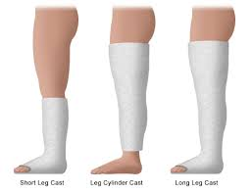
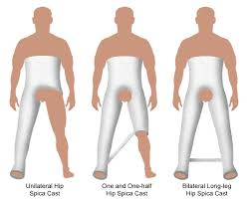
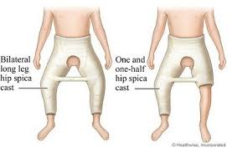
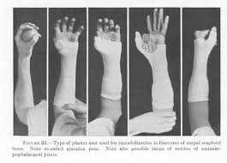
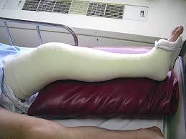
Plaster casts
rd

Slide 77
Cast care
Monitor pt for pain, swelling, discoloration, tingling or numbness, diminished or absent pulses, paralysis and coldness of the extremity.
Assess the casted limb for signs of circulatory compromise
Handle moist cast with palm of the hand and it should not rest on a hard surface or sharp edge
Elevate the affected limb using a pillow to reduce swelling
Do not ignore complains of pain, pins and needles from a pt with casted limb as this could indicate circulatory complications or pressure on the nerves

Slide 78
Cast care
Inspect the cast at regular interval for any complications
Observe for signs of infection
Symptoms of pain, pallor, pulselessness, paraesthesia, paralysis (5 Ps) or coolness denote circulatory changes or neurological disturbances.
Report to the orthopedist immediately if noted so that dressings may be loosened or cast bivalved to relieve pressure
Hematoma drainage - fasciotomy may be done to improve circulation
Observe pts with extensive casts for cast syndrome

Slide 79
Patient education
Avoid excessive use of the injured limb
Elevate the casted limb above the heart –prevent swelling
Keep the cast dry
Report to the hospital if the cast breaks and not to attempt fixing of the cast
To keep the cast clean
To immediately report any oduor from cast, stains, warmth or pressure & decreased ability to move the limb
To report any persistent swelling, pain, that does not respond to elevation ; changes in sensation, skin & temperature

Slide 80
Complication
Cast syndrome
–occurs in pts immobilized with large casts
Psychological component
Pt exhibits acute anxiety reaction characterized by behavioral changes and autonomic responses e.g. increased respiratory rate, heart rate, BP, diaphoresis, dilated pupils
Observe pt for these reactions
Reassure assure
Provide an environment in which pt feels secure

Slide 81
Cast syndrome
Physiological component
Are associated with imposed immobility
GIT motility decreases; accumulation of intestinal gases cause increased pressure resulting in paralytic ileus
Clinical presentation
Abdominal discomfort & distension
Nausea & vomiting
Rx –conservatively with
Decompression(NGT drainage)
IVF therapy until motility is restored
Window cut over the abdomen in casts restricting the abdomen
Complete obstruction or bowel gangrene –surgical intervention

Slide 82
Management of specific fractures
Upper limb fractures
Lower limb fractures
Fracture pelvis
Fracture vertebral column

Slide 83
Upper limb fractures
# of humeral neck
non-displaced #
RX – support the arm with a sling
Pt to avoid vigorous exercise for 6-8 weeks
Displaced #
Closed reduction or open reduction
Replacement of humeral head with prosthesis

Slide 84
Fracture of upper limb
Fracture shaft of Humerus
Causes
Direct violence
Indirect twisting force
S /S – nerves and brachial blood vessels may be injured.
Wrist drop is indication of radial nerve injury
Rx
Oblique, spiral, displaced # resulting in shortening of the humeral shaft - a hanging cast
Skeletal traction

Slide 85
Upper limb fractures
Fractures of radial head
Caused by a fall on outstretched hand with elbow in extension
Rx
Undisplaced # -immobilized by a sling
Displaced # -open operation with excision of radial head
Fracture of the shaft of radius and ulna
Displacement occurs when both bones are broken
Rx
Non displaced #- immobilized for 12 weeks; last 6 wks arm put in a functional brace
Displaced #- internal fixation done

Slide 86
Upper limb fractures
Fracture of the wrist (Colle’s # )
# of the distal radius as result of a fall on open dorsal-flexed hand
Common in elderly pt with osteoporotic disease
Pt presents with deformed wrist with radial deviation; pain; swelling; weakness; limited finger range motion and numbness
Rx
Closed reduction and immobilization with the cast
Internal fixation with Kirchner wire or external device for severe #
Wrist & arm elevated for 48hrs after reduction by suspending the arm from an overhead frame or IV pole.

Slide 87
Fracture lower limbs
Fibula tibia #
Commonest below knee fracture
Causes
Direct blow
Falls with the foot in dorsiflexed position
Violent twisting motion
Clinical presentation
Pain
Deformity
Obvious hematoma
Edema
Soft tissue damage

Slide 88
# tibia fibula
Management
Assess the pt for perineal nerve damage indicated by inability to dorsiflex the great toe & diminished sensation between in the first web
Assess capillary refill time to R/O tibial artery damage
Observe for signs of anterior compartment syndrome e.g. pain, paraesthesia, diminished capillary refill time
Rx
Closed reduction and immobilization with long leg cast initially
Short leg cast after 3-4 weeks which allow knee motion
Fracture healing takes 16-24 weeks

Slide 89
# tibia fibula
Open and comminuted #
Rx
Traction with external fixation
Pt is not allowed to bear weight for about 6 weeks
Intermedullary nails and compression plates may used with external plaster support.
Compression plates allows for anatomical reduction, early foot and knee motion & weight bearing.
Elevate the leg to control edema

Slide 90
Fracture lower limbs
Hip #
Common in the elderly due to osteoporotic bones; weak quadriceps muscles
Can be:-
Intracapsular i.e. # neck of femur or
Extracapsular- # of trochantric region
Rx
Temporary skin traction with Buck’s extension may be applied to immobilize the limb, reduce muscle spasms & relieve pain
Internal fixation

Slide 91
The femur
Femur(thigh) bone is the longest & heaviest bone in the body
The head is spherical and fits into acetabulum of the hip bone to form hip joint.
The neck form the head of the shaft of femur
The posterior surface forms the flat triangular area, the popleteal
Distal surface has two articulatar condyles with tibia and patella ; forms knee joint
Function –to transmit body weight through the bones below to the knees.

Slide 92
Fracture of femur
# clinically open with focal pain, swelling & deformity
Can result in blood loss >1L in the thigh
# head of femur
Associated with hip dislocation caused by high energy force
Rx -surgical fixation & hemiathroplasty
# neck of femur
Usually non displaced
Occurs as a result of stress
Common in athletics
Pt usually ambulant
Notes:
Hemiathroplasty-plastic surgery to reorganize the joint, ½ of the hip is exercised.

Slide 93
Fracture of femur
Rx –young pts; non-weight bearing for 6 -12 weeks
-Old pts –surgical fixation
# femoral shaft
Usually caused by direct or indirect force
Management
Long leg splint applied while awaiting definitive management
Immobilize with Thomas splint or Buck’s traction
surgical Rx with medullary nailing
Open # -wound debridement with delayed medullary nailing.

Slide 94
Nursing care
Priority
Immobilization; fluid replacement; pain control
Assess vital signs and intervene accordingly
Control bleeding in open # with direct pressure; cover wound with sterile dressings
DO NOT CLEAN THE WOUN AS IT IS DONE DURING SURGICAL TOILET TO PREVENT INFECTION.
Measure circumference of both femur to assess edema
Avoid I.M injection if pt has circulatory compromise
Assess neurovascular status
Elevate the leg to control edema

Slide 95
Nursing care
Give broad-spectrum antibiotic in open #
Assess circulatory status distal to the #
Assess for perianal and tibial compromise
Tibial nerve damage –decrease or loss of sensation in the lateral aspect of the sole of the foot
Perianal nerve damage - decrease or loss of sensitivity across the top of the foot
Sciatic nerve damage –signs of both tibial & perianal nerve damage
Prepare pt for theatre

Slide 96
The pelvis
Formed by three hip bones(innominate bones ) – Ileum, ischium & pubis
On the lateral side is the depression known as acetabulum which forms the hip joint with head of the femur
Note
The pelvis protects lower urinary tract; blood & nerve vessels of lower extremities.
Pelvic trauma may result into life threatening haemorrhage, urologic & neurologic dysfunction
Up to 4L of blood can accumulate in the peritoneum after severe pelvic fracture.

Slide 97
Fracture pelvis
Causes
Blunt trauma
A fall > 12 feet
colliding or crashing accidents
S/S
Perineal ecchymoses
Crepitation
Pain , local swelling & tenderness
Lower limb paresis; inability to bear weight
Haematuria
Shortening of lower limbs

Slide 98
Classification of pelvic #
Open #- Open wound with direct communication to the vagina, rectum or perineum
Mortality high due to haemorrhage
Closed # -bleeds into peritoneum
Stable # -no further pathologic displacement of the pelvis can occur with physical turning or moving
Unstable # -further pathologic displacement can occur with turning or moving

Slide 99
Diagnosis
Plain abdominal x –ray
CT scan or MRI indicated when
Acetabular # is seen or suspected
Intra- abdominal or retroperitoneal injuries are suspected & the pt is haemodynamically unstable
Retrograde urethrography indicated when :-
urethral injuries are present or suspected
Diastases of symphysis pubis
Injury to pelvic structures

Slide 100
Management
Hx taking to determine the cause
Physical exam
Observe for blood at the scrotum or perineal ecchymoses
Check femoral pulses
Abdominal palpation to R/O liver, spleen or bowel injuries
Gently perform manual pelvic compression once to determine whether the pelvis is stable or not
Exam the urethra for blood at the penile meatus
Rectal exam to R/O lacerations or palpable fragments
Bimanual V.E to R/O lacerations, tenderness, bleeding

Slide 101
Medical intervention
Priority : prevention & control of haemorrhage
Open #- pt taken directly to OR for aggressive resuscitation, ligation and packing to control haemorrhage
May also require exploratory laparotomy to Rx intra-abdominal injuries
No obvious abdominal injuries
pelvis is stabilized
Immobilization done with hip spica cast
Stable # - conservative bed rest or internal fixation within 2-3 days after injury

Slide 102
Surgical intervention
Open #
Placement of internal or external fixation devices
Closed #
Immediate external fixation of the pelvis done as primary method of controlling haemorrhage
Unstable #
External pelvic clamps used to reduce and compress posterior pelvic fragments & internal fixation done later when the pt is stable
Pt haemodynamically unstable despite resuscitative measures angiography done to R/O emboli.

Slide 103
Nursing interventions
Ensure pt is stated on IVF
Control pain by giving analgesia
Observe vital signs
Maintain correct position
Ensure blood is taken for GXM, CBC, hematocrit
Give supplemental oxygen
Prepare pt for theatre
Psychotherapy to pt/family

Slide 104
A &P the bony vertebrae
7 cervical vertebrae
12 thoracic
5 lumber
5 sacral (fused)
4coccyx ( fused)
The vertebrae have similar structures but:
The first cervical vertebra( Atlas) is unique –a ring like structure that articulates with occiput and provides for normal flexion extension of the head
2nd cervical vertebra (Axis) articulates with odontoid process of C1 and allows rotation movement of the head

Slide 105
Spinal cord
Cylindrical structure that passes through the bony spinal column
It begins at the level of foramen magnum to L2
The spinal cord is covered by the meninges which protects it.
Function of the vertebral column
Protection of the spinal cord
Provide vertical stability

Slide 106
Spinal cord injuries
Injuries occurring to bony vertebrae that may involve the spinal cord.
Spinal cord injuries result in neurological deficit that affect pt, family & society :-
Physical
Psychological
Social
Spinal cord injuries more in males (80%) with majority (60%) victims are between 15-30 years of age.
Most injuries are associated with MV accidents, falls, sports & assaults.

Slide 107
Classification of spinal cord injuries
Simple # -occurs without neurologic compromise and affects the spinous or transverse process
Compression # -occurs when vertebral body is compressed as a result of hyperextension injuries
Burst /comminuted # -shattering of vertebral body where the bones may be driven into spinal cord resulting in neurological deficit
Dislocation-occurs where one vertebra overrides the other
Subluxation –occurs where there is partial or complete dislocation
Herniation –protrusion of the annulus causing compression

Slide 108
Classification of spinal cord injuries
Fractures & dislocation of the spine are series injuries due to spinal cord involvement
# appear commonly in C5 –C7 and T12 –L2 due to range of mobility in these areas
Causes of fracture
Trauma
Infections
Previous laminectomy
Excessive motion beyond physiologic limit
osteoporosis

Slide 109
Cervical fractures
Clinical manifestations
Severe pain radiating to the radius
Inability to move both upper & lower limbs
Loss of sensation
Respiratory compromise
Rx
Minor injury –immobilized with cervical collar for 6-8 wks
Major injuries –realignment & immobilization with skeletal traction, series of x-ray taken at intervals to assess bony healing
Once the bone is healed traction is removed and pt wears cervical collar for some time

Slide 110
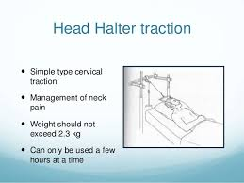
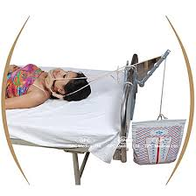
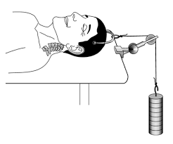
Cervical traction

Slide 111
Thoracic injuries
# may involve ;-
The vertebral body
The lamina & articulating processes
The spinous processes
Clinical presentation
pain
difficulty in breathing
Rx –immobilization of the # for 4-6wks, followed by plaster jacket worn for 3months then extension brace worn for 3-4 months.

Slide 112
Lumber injuries
Clinical presentation
Severe pain radiating to the back
pt may present with paralytic ileus; intestinal obstruction
Difficulty in voiding
Rx
Uncomplicated # – bed rest on firm bed for 3-4 wks
Support the fracture region with a full length brace; support used when ambulatory & is removed when in bed

Slide 113
Lumber injuries
Moderate to severe fracture
Pt put on hyperextension brace in order to achieve hyperextension of the spine to reduce comprehension of the affected vertebral bodies, then bed rest for 6-8 wks or
Plaster jacket for 2 months, followed by extension brace for 3 months

Slide 114
Surgical management
Indications
Progressive neurological deficit despite reduction & spine immobilization
When there is good chance that neurological deficit can be improved by removal of the compression element
Operations done
Laminectomy – removal of the vertebral ring to allow decompression, removal of bony fragments or disk material from spinal cord.

Slide 115
Surgical management
Laminotomy – division of lamina of the spinal cord
Spinal fusion – surgical fusion of 2-6 vertebrae elements to provide stability and prevent motion. Accomplished through use of bony parts or chips taken from iliac crest; use of wires or acyclic glue
Diskectomy – removal of herniated disk tissue and related mater
Disketomy with fusion – removal of vertebra with bone graft
chemolysis – injection to dissolve the affected disk

Slide 116
Complications of fractures
Fat embolism
May occur following # long bones, Pelvis, multiple # or crush injuries.
Mechanism
Fat globules may move into blood at the time of # because bone marrow pressure is > than capillary pressure.
Injury cause stress which increase production of catecholamine resulting in use of fatty acids and development of fat globules in the blood stream
The fat globules combine with platelet to form emboli which can occlude the small blood vessels that supply brain, lungs, kidneys

Slide 117
Complications of fractures
Onset of symptoms is rapid and usually occur within 48hrs but can also occur a few hrs to a wk after injury
Clinical manifestations vary according to the site of the emboli
Mnx
Strong opioid( morphine) to control the pain
This is an emergency thus observe pt for
-respiratory compromise
-Change in mental status
Transfer to CCU for further management

Slide 118
Compartment syndrome
Occurs due to diminished tissue perfusion less than required
Causes
Reduction of the muscle compartment size due to tightness of enclosing muscle facia due to too tight cast or dressing .
An increase in muscle compartment content as result of edema or hemorrhage
Most affected sites are forearm and the leg muscles
Myoneural ischemia can set in if the condition persists for 6-8hrs causing loss of function

Slide 119
Compartment syndrome
Presentation
Deep throbbing pain unresponsive to analgesics
Swelling
Diminished capillary refill
Cyanosis
Paralysis
Management
Elevate the injured limb
Apply ice after injury
Release restrictive dressings
Fasciotomy if conservative measures fail to restore circulation

Slide 120
Compartment syndrome
Extremity is splinted in functional position
Passive range of motion exercises done every 4-6hrs when the edema has resolved and tissue perfusion is restored.
Other complications
Thromboembolism
Infection
Disseminated intravascular coagulation

Slide 121
Delayed complications
Delayed union - healing does not occur at the expected healing time for location & type of #
Nonunion - failure of the bone ends to unite
Avascular necrosis

Slide 122
The end
questions
thank you

