Slide 1
ORTHOPAEDIC
NURSING
Rachael simeka

Slide 2
Course Outline
Review of Anatomy and Physiology of musculoskeletal system: bone, joints, muscles
Disorders of the spine; scoliosis, kyphosis, lumbar lordosis
Metabolic disorders of the bone: Osteoporosis, Osteomalacia
Infections; Osteomylitis
Bone tumors; benign and malignant
Fractures; types, modalities of care
Soft tissue and joint injuries.

Slide 3
Cont’d…
Bone tumors; benign and malignant
Fractures
Definition, classification,
specific types of fractures
Factors enhancing & hindering bone healing
Principles of fracture management
Traction; Definition, types, indication,
principles of effective traction
Specific care of patient on traction

Slide 4
Cont’d…
Cast and splints; definition, purpose
Nursing management of a patient on cast and splints
Complications of fracture; early and delayed
Soft tissue injuries; contusion, sprain, strain
Joint disorders
Rheumatoid arthritis, osteoarthritis, joint dislocation, Gout
Amputation, Definition, indication, levels,
Pre-operative and post-operative care

Slide 5
What is Orthopaedics?
Definition:
Field of medicine concerned with study and treatment of musculoskeletal system. Deals with correction of disorders and deformities related to musculoskeletal system

Slide 6
Review of A & P
The musculoskeletal system includes the:
  bones,
  joints,
  muscles,
  tendons,
  ligaments, and
  bursae of the body (plural located next to tendons near the large joint)

Slide 7
Types of Bones
Bones are classified as short(metarcapals), irregular(vertebrrae) flat or sesamoid (sternum), long bones e.g. femur
The bone is the hardest tissue in the body and when fully developed comprises of:
  Water 20 %
  Organic material 30% to 40%
  Inorganic materials 40% to 50%
.

Slide 8
Inorganic material mainly constitutes of mineral salts especially calcium and phosphates.
Organic materials: bone cells and tissues
The cells making up the bone are: osteoblasts, osteoclasts and osteocytes.
There are two types of bone tissue –
compact- harder outer tissue of bones
cancellous.-sponge like tissue inside bones

Slide 9
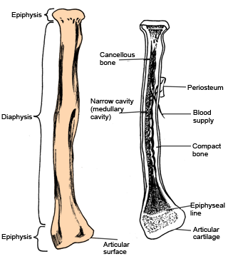
ct

Slide 10
Functions of Bones
Provide the basic framework of the body
Provide points of attachments to muscles and tendons
Form a reservoir for calcium
Permit movement of the body as a whole - joints
Form boundaries of many cavities, which provides protection to organs within
Contain red bone marrow, which is involved in the production of blood cells

Slide 11
Bone Development
Osteogenesis (before birth to about 25 yrs).
Ossiﬁcation- is a process by which bone matrix is formed and hard minerals calcium & phosphorous are bound to collagen fibres which give it strength.
Long, short and irregular bones develop from cartilage models (endochondral). Membranous bones such as skull and clavicle (intramembranous).

Slide 12
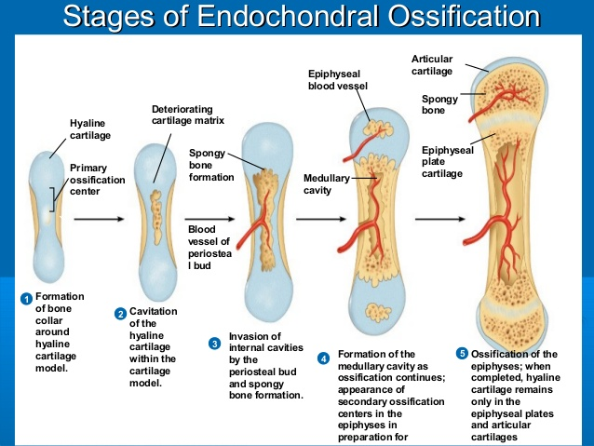

Slide 13
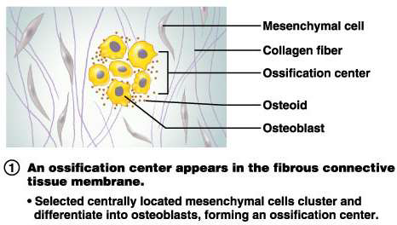
1.Stages of Intramembranous
Ossification

Slide 14
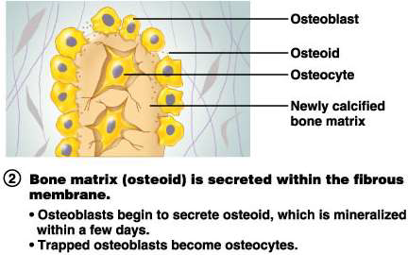
2.Stages of Intramembranous
Ossification

Slide 15
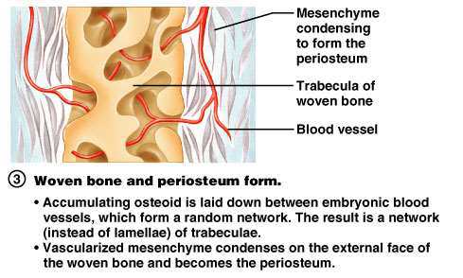
3.Stages of Intramembranous
Ossification

Slide 16
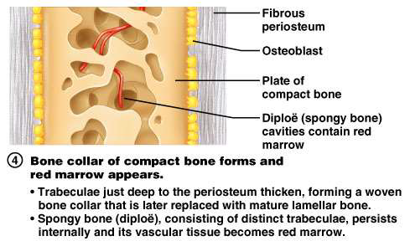
4.Stages of Intramembranous
Ossification

Slide 18
Bone Maintenance
Bone is a dynamic tissue in a constant state of turnover(resorption and formation)
Regulated by
  local stress(weight bearing),
  vitamin D(calcitriol),
  parathyroid hormone,
  calcitonin and
  blood supply.

Slide 19
Bone Healing
Fracture healing occurs in 4 areas, including:
Bone marrow: endothelial cells rapidly undergo transformation into osteoblastic bone-forming cells
Bone cortex: new osteons are formed
Periosteum: a hard callus(bone) is forms through intramembranous ossification
External soft tissue: where a bridging callus(fibrous tissue) stabilizes the fracture

Slide 20
Process of Fracture Healing
Hematoma and inflammation: After injury there is bleeding into the injured tissue (hematoma). Macrophages invade then debride the area causing inflammation, swelling, and pain.
Angiogenesis and cartilage formation: Under the influence of signaling molecules, cell proliferation and differentiation occur. Blood vessels and cartilage overlie the fracture.

Slide 21
Cont’d…
c. Cartilage calcification: Chondrocytes in the cartilage callus form matrix vesicles, which regulate calcification of the cartilage through the enzymes in them.
d. Cartilage removal: The calcified cartilage is invaded by blood vessels and becomes resorbed by chondroblasts and osteoclasts and it is replaced by woven bone.

Slide 22
Cont’d…
e. Bone formation: Minerals continue to be deposited until the bone is firmly reunited. With major adult long bone fractures, ossification takes about 3 to 4 months.
f. Remodeling: consists of modifying the new bone into its former structural arrangement. May take months to years.

Slide 23
Factors that Delay Healing of Bones:
Tissue fragments between the ends of bone.
Deficient blood supply.
Poor alignment or continued mobility of bone ends.
Infection.
Systemic illness.
Malnutrition.
Drugs.
Ageing.

Slide 24
Muscles
More than 600 muscles in the human body that are anchored firmly to bones by tendons and aponeuroses.
Origin and insertion of muscles
Muscle arrangements and muscle actions
  Prime movers
  Antagonistics
  Synergistics
  Fixators

Slide 25
Joints
Are points where two or more bones meet or articulate:
Fibrous: are fixed and immovable joints.
Cartilaginous: are slightly movable. They have cartilage between two bones. e.g. joints between the vertebral bones.
Synovial (diarthroses): are freely movable. Further subdivided into ball and socket joints, hinge joints, gliding joints, pivot and saddle joints.

Slide 26
Assessment of Musculoskeletal System
History: exercises, lifestyle, trauma, medication use, concurrent medical conditions etc
Physical exam: Assess
  Pain and tenderness
  Neurovascular status
  Functional abilities, ROM
  Muscle tone, size
  Gait and posture
  Skin

Slide 28
General symptoms
Bones: Pain
  Focal in infections and tumours
  Diffuse Generalized disorders
  Sharp and piercing in fractures
  Joints: pain, swelling, crepitus, locking
  Muscles: pain, stiffness, weakness, wasting, cramping etc.

Slide 29

Acute low back pain

Slide 30
Causes
Acute lumbosacral strain
Unstable lumbosacral ligaments and weak muscles
Osteoarthritis of the spine
Spinal stenosis
Intervertebral disk problems
Bone metastasis.
Unequal leg length.
Osteoporotic vertebral fractures
Kidney disorders
Pelvic problems
Retroperitoneal tumors
Abdominal aneurysms
Psychosomatic problems.

Slide 31
Predisposing Factors
Obesity
Occupational
Age
Alcohol and Drug Abuse
Family History
Gender
Sports
Poor Posture and Alignment
Previous Back Injury
Psychological, Social and Spiritual Factors
Smoking
Other diseases
Level of Activity (Physical Fitness)

Slide 32
Pathophysiology
The spinal column is supported by complex facet joints, multiple ligaments, and paravertebral muscles.
Trunk muscles help to stabilize the spine.
Abdominal and thoracic muscles aid in lifting activities.
Obesity, postural problems, structural problems, and overstretching of the spinal supports may result in back pain.
Herniation of disks can compress nerve roots leading to pain.

Slide 33
Clinical Features
Acute or chronic back pain
Fatigue
Pain radiating down the leg
Alteration in gait, spinal mobility, reflexes, leg
Length, leg motor strength and sensory perception
Paravertebral muscle spasm
Loss of the normal lumbar curve and possible spinal deformity

Slide 34
Diagnosis
Initial assessment
General observation of the patient
Back examination
Neurologic testing (reflexes, sensations, muscle strength, and muscle atrophy).
More tests
X-ray of the spine—fracture, dislocation, infection or deformity.
Bone scan and blood studies—infections, tumors and bone marrow abnormalities

Slide 35
Cont’d…
Computed tomography (CT scan)-identifying underlying problems, such as obscure soft tissue lesions adjacent to the vertebral column and problems of vertebral disks
Magnetic resonance imaging (MRI)—permits visualization of the nature and location of spinal pathology.
Electromyogram (EMG) and nerve conduction studies—spinal nerve root disorders (radiculopathies)

Slide 36
Management
Most back pain is self-limited and resolves within 4 weeks with analgesics, rest, stress reduction, and relaxation.
Focus of management:-
  Relief of pain
  Comfort
  Activity modification
  Patient education.

Slide 37
Therapies
Analgesics
Muscle relaxants
Heat or cold treatment
Massage
Traction
Diathermy,
Ultrasound
Cutaneous laser treatment
Transcutaneous Electrical nerve stimulation
Acupuncture

Slide 38
Patient education
Pain Management-Limit bed rest; keep knees flexed to decrease strain on back etc
Body Mechanics
  • Practice good posture
  • Avoid twisting body
  • Push objects rather than pull them
  • Keep load close to body when lifting
  • Bend knees and tighten abdominal muscles when lifting
  Avoid overreaching
  • Use wide base of support
  • Use back brace to protect back

Slide 39
Work Modifications
  Adjust work area to avoid stress on back
  Adjust height of chair or work table
  Use lumbar support in chair
  Avoid prolonged standing and repetitive tasks
  Avoid bending, twisting, and lifting heavy objects
  Avoid work involving continuous vibrations

Slide 40
Exercise
Stretch to enhance flexibility
Do muscle strengthening exercises
Perform prescribed back exercises to increase function
Emphasize gradual increases in time and repetitions

Slide 41
Stress Reduction
Discuss with patient the interdependence of stress and anxiety on muscle tension and pain.
Explore effective coping mechanisms
Teach stress reduction techniques
Refer patient to back clinic

Slide 42
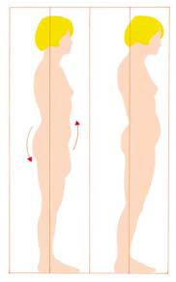
Health promotion strategies
Standing
Avoid prolonged standing and walking.
When standing for any length of time, rest one foot on a small stool or box to relieve lumbar lordosis.
Avoid forward flexion work positions.
Avoid high heels.

Slide 43
Sitting
Avoid sitting for prolonged periods.
Sit in a straight-back chair with back well supported and arm rests to support some of the body weight; use a footstool to position knees higher than hips if necessary.
Maintain back support; use a soft support.
Avoid knee and hip extension. E.g. when driving
Guard against extension strains—reaching, pushing, sitting with legs straight out.
Alternate periods of sitting with walking.

Slide 44
Lying
Rest at intervals; fatigue contributes to spasm of the back muscles.
Place a firm bed board under the mattress.
Avoid sleeping in a prone position.
When lying on the side, place a pillow under the head and one between the legs, with the legs flexed at the hips and knees.
When supine, use a pillow under the knees to decrease lordosis.

Slide 45
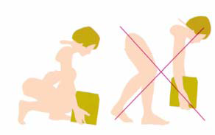
Lifting
When lifting, keep the back straight and hold the load as close to the body as possible.
Lift with the large leg muscles, not the back muscles.
Use trunk muscles to stabilize the spine.
Squat while keeping the back straight when it is necessary to pick something off the floor.
Avoid twisting the trunk of the body, lifting above waist level, and reaching up for any length of time.

Slide 46
Exercising
Daily exercise is important in the prevention of back problems.
Walking and gradually increasing the distance and pace of walking is recommended.
Perform prescribed back exercises twice daily, increasing exercise gradually.
Avoid jumping and jarring activities.

Slide 47
BONE
DISORDERS

Slide 48
Disorders of Bones
Results from
  Altered growth and development i.e. femoral ante-version, is an inward twisting of the thigh bone, also known as the femur (the bone that is located between the hip and the knee)
  Disordered metabolism can happen when abnormal chemical reactions in the body alter the normal metabolic process.
  Neoplasm,
  Injuries and their complications.

Slide 49
Spine Curvature Abnormalities
Scoliosis: is lateral deviation of the spinal column. Causes: Idiopathic, certain diseases e.g. poliomyelitis.
Kyphosis : an exaggeration in the curvature of the thoracic spine thus affecting the functional lung capacities.
Lumbar lordosis: an exaggeration in the curvature of the lumbar spine (swayback).

Slide 50
Gibbus deformity
is a form of structural kyphosis typically found in the upper lumbar and lower thoracic vertebrae, where one or more adjacent vertebrae become wedged

Slide 51
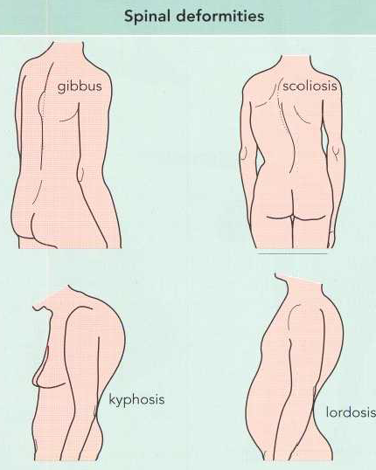

Slide 52
OSTOEPOROSIS
Disorder in which the rate of bone resorption is greater than the rate of formation leading to a loss of organic matrix and mineral content.
The bone then becomes brittle, fragile and fractures easily.

Slide 53
The manifestations include:
pain and spontaneous fractures, loss of height overtime. It may also lead to kyphosis.
Pathophysiology
There is rapid bone loss. This leads to thinning of the lamellar with deformity and later collapse. The bone may easily fracture.

Slide 54
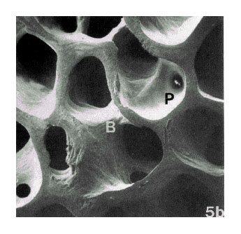
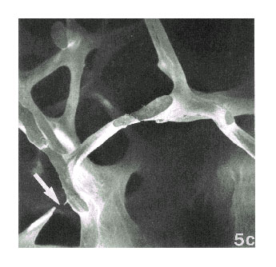
Normal & Osteoporotic Bone Architecture
Diagnosis:
  Hx and clinical features
  X-ray
  Quantitative US studies(QUS) of the heel

Slide 55
Risk factors
Genetics: Female, Caucasian, or Asian
Low weight and body mass index/obesity
Estrogen deficiency or menopause
Contributing, coexisting medical conditions (e.g., celiac disease Celiac disease - a disorder in which eating gluten triggers an immune response in the body, causing inflammation and damage to the small intestine) and medications (e.g., corticosteroids, antiseizure medications)
Diets low in calcium and vitamin D
Cigarette smoking, use of alcohol and/or caffeine
Lack of weight-bearing exercise

Slide 56
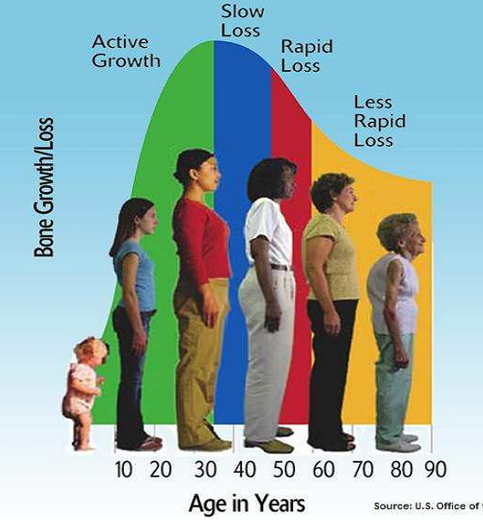
Loss of bone mass with age(female)

Slide 57
Management
Prevention: early administration of calcium supplements, vitamin D, Fluoride to encourage bone strengthening.
Give health messages about risk factors.
Hormone replacement therapy.
Pharmacotherapy: e.g. etidionate disodium, calcitonin (Calcimar) to decrease bone loss and increase strength
Surgical intervention of fractures

Slide 58
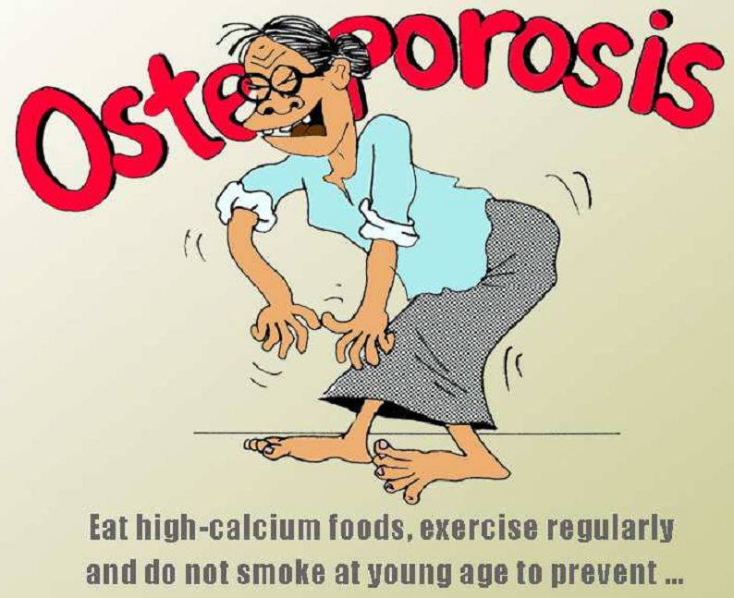
Cont’d…
Nutrition and lifestyle changes

Slide 59
OSTEOMALACIA and RICKETS
Results from deficiency of vitamin D. characterized by inadequate mineralization of bone.
If the deficiency occurs before fusion of the epiphyseal plates then the bones get deformed, but if fusion has already occurred, then the bones will bend easily.

Slide 60
Pathophysiology
Vit. D facilitates calcium absorption from the gastrointestinal tract and mineralization of bone.
Thus with a deficiency of activated vitamin D (calcitriol), the supply of calcium and phosphate in the extracellular fluid becomes low depriving the calcification sites in bones with these minerals.

Slide 61
Clinical Manifestation
  pain, tenderness to touch
  bowing of the bones
  pathologic fractures
  Wadding or limping gait due to skeletal deformities
  Muscle weakness, and unsteadiness.

Slide 62
Tests and Diagnosis
Blood and urine tests- abnormal levels of phosphorus, calcium and vitamin D, high levels of alkaline phosphotase isoenzymes
X-ray- slight cracks on bones
Bone biopsy

Slide 63
Management
Correct or treat the underlying cause of deficiency of calcium and vitamin D:
  Supplemental vitamin D or Calcium.
  Exposure to sunlight.
  Diet with adequate protein and increased calcium and vitamin D is provided. i.e. milk, cereals
Some persistent orthopedic deformities may need to be treated with braces or surgery
Physical, psychological, and pharmaceutical measures to reduce discomfort and pain

Slide 64
OSTEOMYELITIS
An inflammation and infection of the bone.
Through:
  Extension of soft tissue infection
  Direct bone contamination from bone surgery,
  Hematogenous (blood borne) spread from other sites of infection

Slide 65
Pathophysiology
Majorly by Staphylococcus aureus (70% to 80%). Others include Proteus and Pseudomonas species and E. coli.
Inflammation, increased vascularity, and edema occurs following an infection.
After 2 or 3 days, thrombosis of the blood vessels occurs in the area, resulting in ischemia with bone necrosis.
The infection extends into the medullary cavity and under the periosteum and may spread into adjacent soft tissues and joints.

Slide 66
Cont’d…
Without prompt treatment, a bone abscess forms. The resulting abscess cavity contains dead bone tissue (the sequestrum), which does not easily liquefy and drain.
New bone growth (the involucrum) forms and surrounds the sequestrum.
Although healing appears to take place, a chronically infected sequestrum remains and produces recurring abscesses. This is referred to as chronic osteomyelitis.

Slide 67
Clinical manifestations
  septicemia symptoms
  painful, swollen, and extremely tender infected area
  constant, pulsating pain that intensifies with movement as a result of the pressure of the collecting pus.
Chronic osteomyelitis presents with a continuously draining sinus or recurrent periods of pain, inflammation, swelling, and drainage

Slide 68
Diagnosis
X-ray
Magnetic resonance imaging
Blood studies(elevated leukocyte levels and an elevated sedimentation rate)
Wound and blood culture studies

Slide 69
Management
Antibiotic therapy (I.V antibiotics 3- 6 wks, oral for 2months)
Analgesics for pain.
General supportive measures. e.g., hydration, diet high in vitamins and protein, correction of anemia.
The area affected with osteomyelitis is immobilized to decrease discomfort and to prevent pathologic fracture of the weakened bone.

Slide 70
Cont’d…
Warm wet soaks for 20 minutes several times a day to increase circulation.
Surgically:
Surgical debridement.
Antibiotic-impregnated beads may be placed in the wound for direct application of antibiotics.
A sequestrectomy.
Wound irrigation using sterile saline for 7 to 8 days.

Slide 71
ASSIGNMENT
Explain measures that should be taken to prevent bone infections.
Using the nursing process, describe the management of a patient with osteoporosis.

Slide 72
Prevention
Elective orthopedic surgery should be postponed if the patient has a current infection (e.g., urinary tract infection, sore throat) or a recent history of infection.
During orthopedic surgery, careful attention is paid to the surgical environment and to techniques to decrease direct bone contamination.
Prophylactic antibiotics, administered to achieve adequate tissue levels at the time of surgery and for 24 hours after surgery.
Urinary catheters and drains are removed as soon as possible to decrease the incidence of hematogenous spread of infection.

Slide 73
Aseptic postoperative wound care reduces the incidence of superficial infections and osteomyelitis.
Prompt management of soft tissue infections reduces extension of infection to the bone.
When patients who have had joint replacement surgery undergo dental procedures or other invasive procedures (e.g., cystoscopy), prophylactic antibiotics are recommended.

Slide 74
Specific Nursing Interventions
Assesses the patient for risk factors (e.g. older age, diabetes, long-term corticosteroid therapy) and for a history of previous injury, infection, or orthopedic surgery
RELIEVING PAIN
  The affected part may be immobilized with a splint to decrease pain and muscle spasm.
  Elevation reduces swelling and associated discomfort
  Administer prescribed analgesics
  IMPROVING PHYSICAL MOBILITY
  Use of assistive devices such as crutches,
  The joints above and below the affected part should be gently placed through their range of motion.

Slide 75
Cont’d...
  CONTROLLING THE INFECTIOUS PROCESS
  close monitoring of the patient,
  promotion of drainage,
  use of antibiotics,.
  changes dressings using aseptic technique
  use of fluids,
  good nutrition to the patient diet high in protein and vitamin
  PATIENT EDUCATION
Patient and family must learn and recognize the importance of strictly adhering to the therapeutic regimen of antibiotics and preventing falls or other injuries.

Slide 76
BENIGN TUMORS
Most common, slow growing and well circumscribed and present few symptoms.
  osteochondroma, the most common, occuring as a large projection of bone at the end of long bones
  echondroma,
  bone cyst.e.g, aneurysmal bone cyst),
  osteoid osteoma; in early ages of life, painful
  rhabdomyoma, and
  ﬁbroma.

Slide 77
MALIGNANT TUMORS
Relatively rare and arise from connective and supportive tissue cells (sarcomas) or bone marrow elements.they include multiple myeloma, osteosarcoma, chondrosarcoma,, and ﬁbrosarcoma.
The usual tumor sites include the pelvis, femur, humerus, spine, scapula, and tibia.

Slide 78
Soft tissue sarcomas include liposarcoma, ﬁbrosarcoma, and rhabdomyo-sarcoma.
Metastatic bone disease (secondary bone tumor) is more common than any primary bone tumors.

Slide 79
Diagnosis
  Bone scan
  Computerized tomography
  Magnetic resonance imaging
  Positron emission tomography x-ray
  Angiogram
  Biopses
Risk Factors include: Family history, Pagets disease, Radiation therapy, Bone marrow transplant, Bone infections,

Slide 80
Clinical Manifestations
Manifestations of bone tumors include
  bone pain that lasts over a week
  unexplained swelling and warm skin over the affected bones
  Joint swelling and stiffness.
  prominent veins.
  Weight loss, malaise, anemia and fever may be present.
  With spinal metastasis, spinal cord compression may occur.

Slide 81
Management
Surgical excision, Chemotherapy, used to suppress plasma cell growth in the bone marrow.
Administration of Steroids.
Good infection prevention and control.
The treatment of metastatic bone cancer is palliative.
Structural support and stabilization are needed to prevent pathologic fracture and pain by prophylactic internal ﬁxation.

Slide 82
Cont’d...
Pain assessment and management with adequate and appropriate analgesics.
Hydration with IV administration of normal saline solution, diuresis, mobilization, and medications such as bisphosphonates, and calcitonin to rx hypercalcemia.
Assist the patient to increase activity and ambulation.
Blood product transfusions restore hematologic factors.

Slide 83
Specific Nursing Interventions.
Ensuring satisfactory pain relief
Decreasing the possibility of injury
Because loss of appetite, nausea, and vomiting are frequent side effects of chemotherapy and radiation therapy, it is necessary to provide adequate nutrition for healing and health promotion.
Adequate hydration is essential

Slide 84
Cont’d…
Promote self esteem by encouraging the patient to accept body image changes resulting from chemotherapy radiation and surgery
Educating the patient on disease progression and prognosis treatment regimen, diagnostic procedures & changes
Enabling the patient to maintain preferred activities

Slide 85
Cont’d…
monitoring and managing potential complications such as delayed wound healing, wound Infections, hypercalcemia, DVT, PE.
promoting coping skills The nurse encourages the patient and family to verbalize their fears, concerns, and feelings. They need to be supported as they deal with the impact of the malignant bone tumor.

Slide 86
JOINT
DISORDERS

Slide 87
RHEUMATOID ARTHRITIS
Rheumatoid Arthritis is a systemic inflammatory disease affecting synovial joints.
Pathophysiology
The autoimmune reaction within synovial membrane leads to an inflammatory process, that damages or irritates the joint tissues.

Slide 88
Cont’d…
Continued inflammation leads to thickening of the synovium especially where it joins the articular cartilage.
At this point, fibrin develops into a granulation tissue known as pannus which destroys cartilage and erodes the bones. This leads to adhesions between joint surfaces (ankylosis).
Pain occurs as a result of cartilage degeneration due to erosion.

Slide 89
Clinical Features
Early Signs | Late Signs | Other Signs
Warm, swollen and painful joints | Joint deformities | Increasing pain
Morning stiffness lasting 30 minutes | Contractures, rheumatoid nodules | Paraesthesia
Pain at rest and with movement |  | Dislocation
Fatigue, malaise

Slide 90
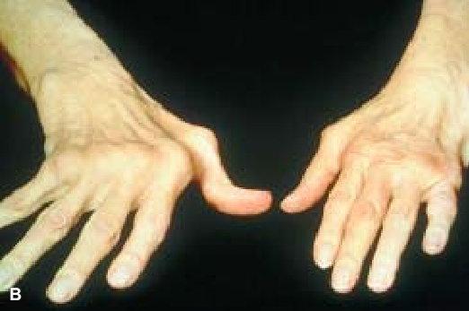
Arthritis Assessment
Inspection and palpation of the same joints on both sides of the body for asymmetry, skin color, size, shape, tenderness, swelling
Limitation of active joint movement

Slide 91
Diagnosis
This is made from the history and presence of :
  Stifness, joint pain and swelling
  Narrowing of the joint spaces seen on x-ray
  Increased erythrocyte sedimentation rate
  Mild leukocytosis
  Rheumatoid factor
  The red blood cell count and CD4 complement component are decreased

Slide 92
Medical management
Pharmacotherapy: indocid 50-75mg tds, naprosyn 100mg bd, brufen 400mg
Steroids i.e predinisolone reduce inflammation
Disease modifying anti-rheumatoid drugs i.e methotrexate, sulfasalzine slow disease progression
Immunosupressants i.e cyclosporine
Surgical: synovectomy (excision of the synovial membrane), tenorrhaphy (suturing a tendon), arthrodesis (surgical fusion of the joint), and arthroplasty (surgical repair and replacement of the joint with a prosthesis).

Slide 93
Nursing Interventions
1) Comfort/ Pain relief
Adminster prescribed analgesics i.e NSAIDS
Providing heat or cold treatments on the affected joints to reduce inflamation/pain
Encouraging the use of splints,braces on ambulation
2) Independence
Assist in activities of daily living as needed
Encourage use of supportive devices e.g. trapeze to move up the bed.

Slide 94
Cont’d…
3) Reducing fatigue by: providing frequent rest periods, Instruct patient on how to conserve energy.
4) Nutrition-
with emphasis on foods high in vitamins, protein, and iron for tissue building and repair. For the extremely anorexic patient, small, frequent feedings
5) patient education on the disease
6) monitoring and managing potential complications

Slide 95
Cont’d…
7) Mobility and prevention of injury by:
Assessing all joints for signs of inflammation and deformity; Avoiding positions that can lead to formation of contractures; Active range-of-motion exercises are encouraged because they prevent joint stiffness; Use of assistive devices for ambulation
8) Improving body image and communication by encouraging pt & family to verbalize the feeling &perceptions. Encourage commitment to medications.

Slide 96
Degenerative Joint Disorder(Osteoarthritis)
Def: A condition affecting one or more joints characterised by degeneration of joint tissue or a non-inflammatory condition of the joint characterised by degeneration of joint tissue.
Classification
Primary (idiopathic)…no prior event or disease related to the OA, and
Secondary….resulting from previous joint injury or inflammatory disease.

Slide 97
Pathophysiology
The onset is slow with erosion of articular cartilage, thickening of sub-chondral bone and formation of osteophytes or bone spurs.
The area of the cartilage becomes soft and the surface becomes rough and cracks. Eventually the cartilage is destroyed and the underlying bone goes through a remodeling process.
Osteophytes or bone spurs appear at the joint margin at the sites of attachment. These may break off and appear in the joints as joint mice.

Slide 98
Risk factors
Increased age
Obesity
Previous joint damage/injury
Repetitive use (occupational or recreational)
Anatomic deformity
Female gender
Genetic susceptibility
Diagnosis
Based on evaluation and history
X-ray films show narrowing of joint space

Slide 99
Clinical Features
Pain in affected joint
Stiffness (morning or on awakening)
tenderness
Loss of flexibility, Grating sensation
Joint deformity, Shortening ligaments
Functional impairment
Characteristic bony nodes, spurs may be present; usually painless, unless inflammation is present.
Muscle spasms

Slide 100
Medical Management
NOTE: no treatment halts the degenerative process, certain preventive measures can slow the progress if undertaken early enough. These include
  weight reduction,
  prevention of injuries,
  perinatal screening for congenital hip disease, and
  ergonomic modifications.
Occupational and physical therapy can help the patient adopt self-management strategies.

Slide 101
Cont’d…
Conservative treatment measures include the
  use of heat or cold compressions,
  weight reduction,
  joint rest and
  avoidance of joint overuse,
  orthotic devices to support inflamed joints (splints, braces),
  isometric and postural exercises, and aerobic exercise.

Slide 102
Pharmacologic Management
Directed toward symptom management and pain control.
Use of analgesics, opioids and intra-articular corticosteroids.
Newer approaches include glucosamine and chondroitin, thought to improve tissue function and retard breakdown of cartilage
Viscosupplementation, the intra-articular injection of hyaluronic acid, to improve cartilage function and retard degradation; it may also have some anti-inflammatory effects

Slide 103
Surgical Management
  Osteotomy (to alter the force distribution in the joint by realigning the bone away from the worn out.
  Arthroplasty. Joint replacement surgery.
  Viscosupplementation Lubrication injections/ (the reconstitution of synovial fluid viscosity).
  Tidal irrigation (lavage) of the knee.
  Cortisone shots/injections into joint.

Slide 104
GOUT
Def: heterogeneous group of conditions related to a genetic defect of purine metabolism resulting in hyperuricemia and deposition of monosodium urate crystalsuric acid/ in joints or soft tissue causing inflammation.
Normal blood uric acid concentrations are 3.6 to 8.3 mg/dL
Affects the foot, knee, ankle, elbow, wrist, hands, or nearly any joint in the body.
When gout is more severe, multiple joints may be affected at the same time. The affected joint is often more sensitive to touch.

Slide 105
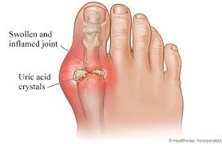
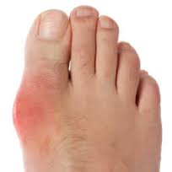

Slide 106
Clinical manifestations
Joint pain attack starting with distal joints and swelling, stiffness, redness, warmth: big toe is mostly affected.
Tophi (crystalline deposits accumulating in articular tissue,
Saturation of uric acid in the human blood stream may result in one form of kidney stones.
Aggravated by infections, cold weather and consumption of meals rich in purines, dehydration, trauma, after surgery

Slide 107
Risk Factors
High intake of purine rich food: red meat, shell fish.
High alcohol intake particularly beer and wine can increase uric acid levels in the body.
Genetics
Obesity- contributory factor to gout.
Chronic conditions i.e. High blood pressure, kidney disease, DM, ateriosclerosis, hyperlipidemia
Drugs or medications- e.g. Diuretics, aspirin & chemotherapy treatment for cancer can lead to increase in uric acid levels
Gender: more common in men
Notes:
.

Slide 108
Management
Advice on how to avoid acute gout attacks.
Anti-gout medication include.
  Pain-controlling medication such as
  indocid, diclofenac and aspirin at a high dose.
  Colechine used in acute attack
  Medication that acts to decrease the production of uric acid e.g. allopurinol,
  Medications that improves uric acid removal probencid.

Slide 109
Lifestyle modification
Drink 8 to 16 cups (about 2 to 4 liters) of fluid each day, with at least half being water.
Avoid alcohol.
Eat a moderate amount of protein, preferably from healthy sources, such as low-fat or fat-free dairy, tofu, eggs, and nut butters.
Limit your daily intake of meat, fish and poultry to 4 to 6 ounces (113 to 170 grams).

Slide 110
Paget’s Disease (Osteitis deformans)
It’s a disorder that involves an abnormal breakdown of bone tissue, followed by abnormal bone formation.
The new bone is bigger, but weakened and filled with new blood vessels.
Etiology unknown
Usually affects the axial skeleton, vertebrae and skull, although the pelvis, tibia, femur are the other common sites of disease.

Slide 111
Signs and Symptoms
Bone pain (may be severe and persistent)
Bowing of the legs and other visible deformities
Enlarged head/skull deformities
Fracture
Headache
Hearing loss
Joint pain or stiffness
Reduced height
Warmth of skin over the affected bone
N/B: Most patients may be asymptomatic.

Slide 112
Management
Goals of the treatment- to relieve pain & prevent fracture & deformities
Bisphosphonates & calcitonin: decrease bone pain & bone warmth & also relieve neural decompression, joint pain & lytic lesions.
Use of analgesics & NSAIDs.
Assistive devices, including cane, walker.
Deformities may be corrected by surgical intervention (osteotomy).

Slide 113
Cont’d…
Local application of ice or heat may help alleviate pain.
A regular exercise should be maintained; walking is best.
Avoid extended periods of immobility to avoid hypercalcemia.
A nutritionally adequate diet is recommended.
Assistance in learning to use canes or other ambulatory aids.

Slide 114
JOINT DISLOCATION
Def: a condition in which the articular surfaces of the bones forming the joint are no longer in anatomic contact.
A sub - luxation is a partial dislocation of the articulating surfaces.
Traumatic dislocations are orthopedic emergencies because the associated joint structures, blood supply, and nerves are distorted and severely stressed.

Slide 115
Cont’d…
Signs and symptoms of a traumatic dislocation are
  pain,
  change in contour of the joint,
  change in the length of the extremity,
  loss of normal mobility, and
  change in the axis of the dislocated bones.
X-rays confirm the diagnosis

Slide 116
Cont’d…
If the dislocation is not treated promptly, avascular necrosis and nerve palsy may occur.
Dislocations may be
  congenital, or present at birth (mostly the hip)
  spontaneous or pathologic,
  caused by disease of the articular or peri-articular structures;
  traumatic, resulting from injury in which the joint is disrupted by force.

Slide 117
Management
Immobilization of the joint by bandages, splits etc and maintained in a stable position
Prompt reduction to preserve joint function.
Analgesia, muscle relaxants, and possibly anesthesia are used to facilitate closed reduction.
Neurovascular status is monitored.
If the joint is stable, gentle, progressive, active and passive movement is begun to preserve ROM and restore strength while supporting the joint.

Slide 118
Nursing Management
Providing comfort,
Evaluating the patient’s neurovascular status,
Protecting the joint during healing.
Teaching the patient how to manage the immobilizing devices and how to protect the joint from re-injury.

Slide 119
FRACTURES

Slide 120
FRACTURES
Fractures are classified according to:
  Location i.e. proximal, midshaft, distal
  Communication to the environment i.e. open or closed
  Degree of break in continuity of the bone i.e. complete/incomplete
  Character of fracture i.e. comminuted, impacted, segmental
  Pattern of fracture line i.e. transverse, oblique

Slide 121
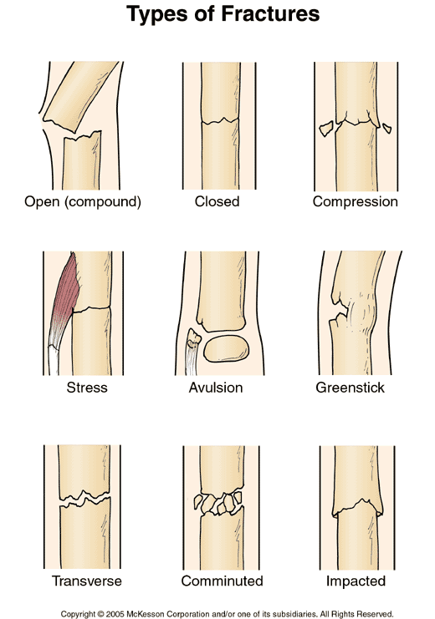

Slide 122
Clinical Features of Fractures
  Pain at site of injury due to muscle spasm
  Discoloration of the skin (echymosis) due to bleeding into tissues
  Swelling due to hematoma formation
  Loss of function due to pain and deformity
  Deformity depending on force and muscle tissue surrounding muscles e.g. angulation, shortening of extremity.

Slide 123
Cont’d…
  Crepitus: When the extremity is examined with the hands, a grating sensation can be felt. It is caused by the rubbing of the bone fragments against each other.
Diagnosis
  History of fall or trauma in road traffic accidents.
  An x-ray examination confirms diagnosis.

Slide 124
Factors enhancing fracture healing:
  Adequate nutrition
  Adequate blood supply
  Absence of infection
  Immobilization of fracture fragments
  Exercise: weight bearing for long bones
  Hormones: growth hormone calcitonin, vitamin D

Slide 125
Factors hindering fracture healing:
  Presence of infective organisms e.g. streptococci
  Fat embolism in medullary canal
  Excessive bone tissue fragments
  Deficient blood supply
  Continued mobility (lack of proper reduction and immobilization)
  Age - old age due to slowing
  Metabolic bone disease (e.g. Paget’s disease)

Slide 126
Emergency Management
The emergency management of a fracture:
  Immobilization by use of splints
  Assess circulation, airway and breathing.
  Assess any bleeding sites and control bleeding
  Treatment of any life threatening injury.
  Applying cold compresses and elevating the extremity
  Monitoring the patient closely

Slide 127
Principles of Management
The principle management of fractures includes:
a) Fracture reduction
b) Immobilisation
c) Rehabilitation

Slide 128
Reduction
Restoration of the fracture fragments to anatomic alignment and rotation.
Open Reduction.
Through a surgical approach, internal fixation devices (metallic pins, wires, screws, plates, nails, or rods) may be used.
Closed Reduction
Manipulation without viewing the fracture however confirmation must be done through x-ray.

Slide 129
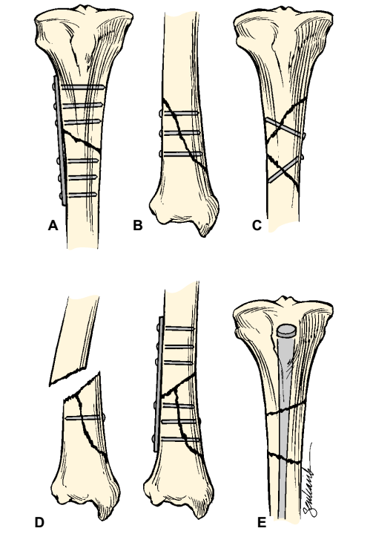
Cont’d…
A:plate and screws
B,C&D: screws
E: medullary nail

Slide 130
Immobilization
The aim is to prevent movement of injured parts already reduced hence ensuring the parts are held in correct position and alignment, until union occurs.
It is accomplished through the use of:
  External devices e.g. splints, plaster casts, external fixation devices or traction.
  Internal devices inserted during open reduction e.g. screws, nails, plates.

Slide 131
Rehabilitation
Restoring the bone back to function normally through
Ensuring appropriate fracture healing,
Controlling swelling by elevating the injured extremity and applying ice as prescribed.
Neurovascular status (circulation, movement, sensation) is monitored to include: pain, paresthesia, pulse, pallor, paralysis.

Slide 132
Cont’d…
Restlessness, anxiety, and discomfort are controlled.
Participation in activities of daily living (ADLs) and gradual resumption of activities as per therapeutic prescription.
Isometric and muscle-setting exercises are encouraged to minimize disuse atrophy and to promote circulation.

Slide 133
Nursing Interventions:
Patients with Closed Fractures
Encourage patients with closed (simple) fractures to return to their usual activities as rapidly as possible within the limits of the fracture immobilization..
Control swelling and pain associated with the fracture and with soft tissue trauma by elevation.
Encouraging them to be active
Teach on self-care, medication information, monitoring for potential complications.

Slide 134
Cont’d…
Teaching exercises to maintain the health of unaffected muscles and to increase the strength of muscles needed for transferring and for using assistive devices.
Teaching patients how to use assistive devices safely.
Making plans to help patients modify their home environment as needed and to secure personal assistance if necessary.

Slide 135
Patients with Open Fractures
The objectives of management are to
  prevent infection of the wound, soft tissue, and bone and
  to promote healing of soft tissue and bone.
Administration of tetanus prophylaxis if indicated.
Serial irrigation and debridement to remove anaerobic organisms.
Intravenous antibiotics are prescribed to prevent or treat infection.

Slide 136
Cont’d…
Prompt, thorough wound irrigation and debridement in the operating room are necessary.
Devitalized bone fragments are removed.
Any damage to blood vessels, soft tissue, muscles, nerves, and tendons is treated.
Heavily contaminated wounds are left unsutured and dressed with sterile gauze to permit swelling and wound drainage.

Slide 137
After it has been determined that infection is not present, the wound is closed in 5 to 7 days, and all dead space is obliterated by grafting of autogenous skin or a flap.
Elevation the extremity to minimize edema.
Assessing neurovascular status frequently.
Measuring the patient’s temperature at regular intervals and monitoring the patient for signs of infection.

Slide 138
Complications of Fractures
Early complications include
  shock,
  fat embolism,
  compartment syndrome
  deep vein thrombosis,
  Thrombo-embolism(pulmonary embolism),
  disseminated intravascular coagulopathy,
  infection.

Slide 139
Cont’d...
Delayed complications include:
  delayed union and nonunion,
  avascular necrosis of bone,
  reaction to internal fixation devices,
  complex regional pain syndrome (formerly called reflex sympathetic dystrophy), and
  heterotrophic ossification

Slide 140
MUSCULOSKELETAL
CARE MODALITIES

Slide 141
TRACTION
Traction is pulling bones directly or indirectly in order to reduce and hold fractures.
This is used to maintain fractures apart but allowing sufficient contact for healing.

Slide 142
Uses:
to minimize muscle spasms
to reduce a fracture
To align bones in the right planes
To immobilize fractures
to reduce deformity
to increase space between opposing surfaces.

Slide 143
Cont’d…
Used primarily as a short-term intervention until other modalities, such as external or internal fixation, are possible.
This reduces the risk of disuse syndrome and minimizes the length of hospitalization, often allowing the patient to be cared for in the home setting.

Slide 144
Principles of Effective Traction
There must be a counter traction
Must be continuous to be effective in reducing and immobilizing fractures.
Skeletal traction is never interrupted.
Weights are not removed unless intermittent traction is prescribed.
Any factor that might reduce the effective pull or alter its resultant line of pull must be eliminated

Slide 145
Eliminated by:
Placing patient in good body alignment in the center of the bed when traction is applied.
Ensuring that ropes are unobstructed.
Weights hanging freely and not resting on the bed or floor.
Ensuring that knots in the rope or the footplate do not touch the pulley or the foot of the bed.

Slide 146
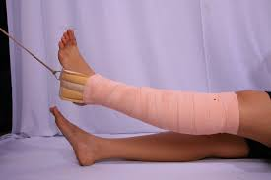
Methods of applying Traction
1. Skin traction. The force is exerted tangentially along the skin by using adhesive strapping to attach the cord and weight e.g. Buck’s Extension

Slide 147
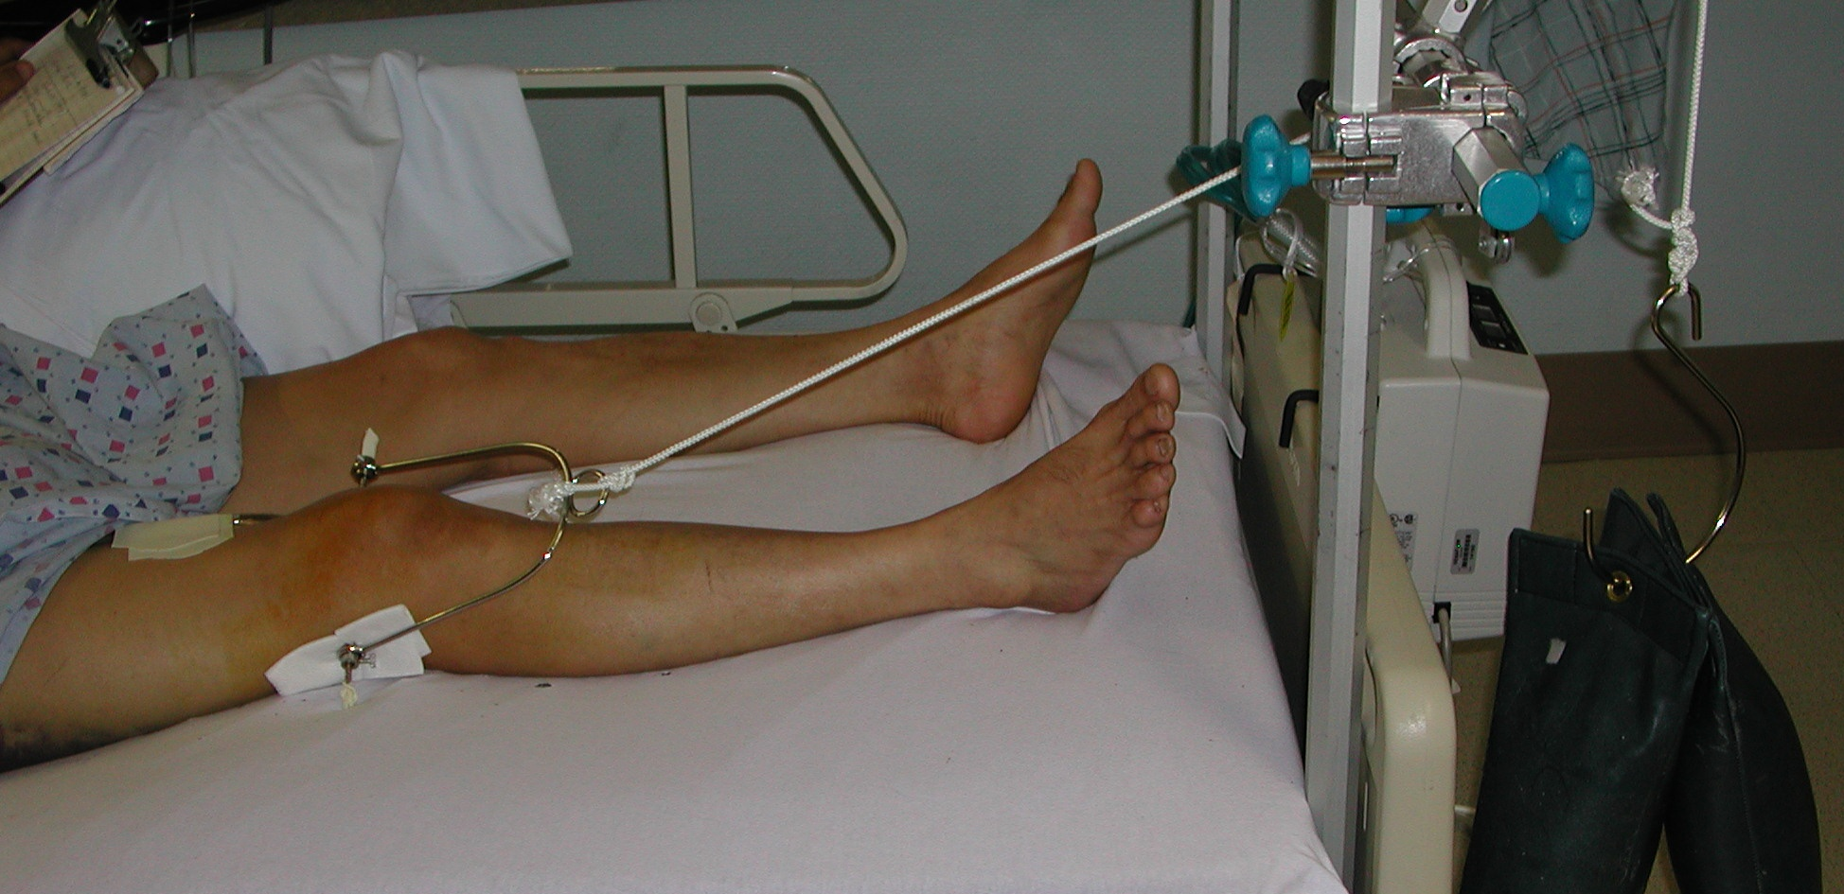
Skeletal Traction.
This is applied by means of a pin (Steinmann pin) or wires (Kirschner wire) or screws applied directly through bone. It enables greater force to be used, but may allow infection into the bone.

Slide 148
Types
Balanced / sliding traction
The patient’s weight is balanced against an applied load, utilizing frictional and gravitational forces to counterbalance the applied traction.
It allows the patient to move about the bed or to move the limb whilst the traction continues to act in the desired line.
Fixed Traction: The pull is exerted against a fixed point; e.g., the tapes are tied to the crosspiece of a Thomas splint and pull the leg down

Slide 149
Types of balanced traction
Simple traction: applied usually to the skin especially for conditions affecting the hip.
Longitudinal traction: Used for fractures of the femur. An alternative to the use of the Thomas ’ splint as a fixed traction.
Hamilton – Russell traction: designed to apply a traction force in line with the shaft of the femur whilst allowing movement of the hip and knee.
Gallows traction (Bryant) : longitudinal traction to the femur in a child up to the age of 2 years.
B öhler – Braun frame. Useful to a tibial or femoral fracture. The leg is supported in good alignment on slings stretched across the frame

Slide 150
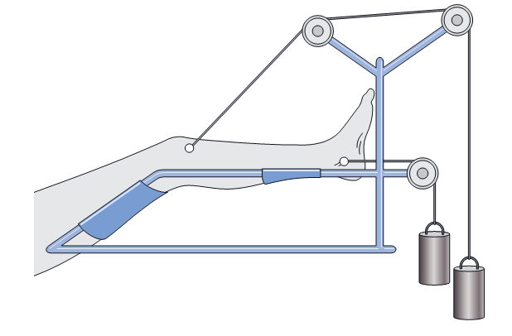
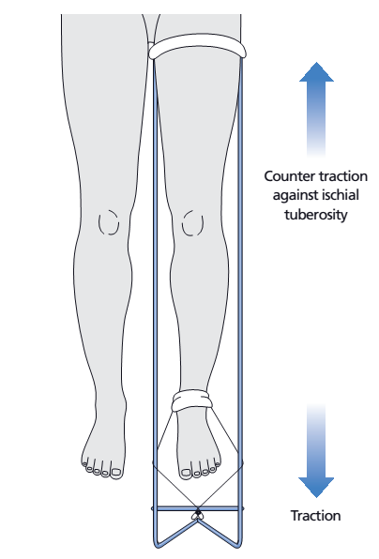
Thomas’ splint with fixed traction.
Böhler − Braun frame

Slide 151
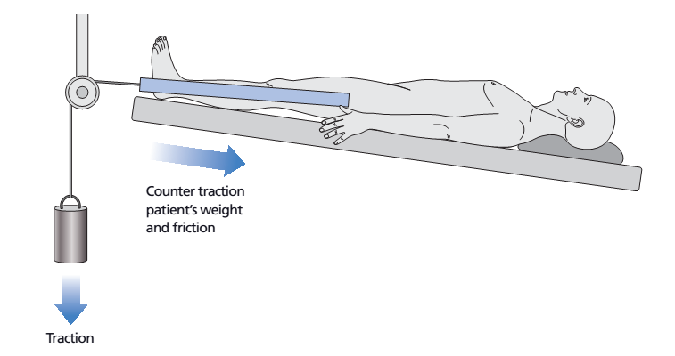
Sliding traction.

Slide 152
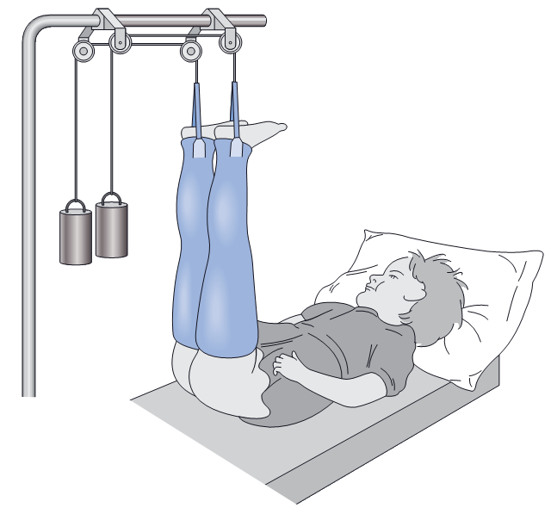
Gallows traction

Slide 153
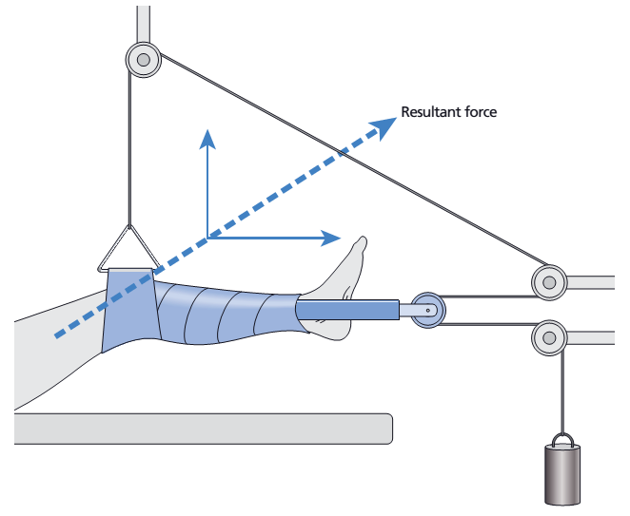
Hamilton − Russell traction

Slide 154
Indications for Skin Traction
Temporary management of # of fructures
Management of femoral shaft fracture
Undisplaced # of acetabulum
After reduction of dislocation of hip
To correct minor fixed flexion deformity of hip and knee.

Slide 155
Contraindications for Skin T.
Abrasion and lacerations of skin in the are at which traction is to be applied
Disturbance in blood circulation such as varicose vein or impending gangrene
Dermatitis

Slide 156
Indications for Skeletal Traction
Adults requiring > 5kg traction
Skin damage requiring dressings
Long term
Patients with external fixator in situ

Slide 157
Manual Traction
Accomplished by a persons hands exerting a pulling force. This is temporary traction that may be used when
  applying a cast,
  giving skin care under a Buck’s extension foam boot, or
  adjusting the traction apparatus.

Slide 158
N/B:
At times, traction needs to be applied in more than one direction to achieve the desired line of pull. When this is done, one of the lines of pull counteracts the other. These lines of pull are known as the vectors of force. The actual resultant pulling force is somewhere between the two lines of pull.
The effects of traction are evaluated with x-ray studies, and adjustments are made if necessary.

Slide 159
Complications
Complications of skin traction: Skin breakdown, nerve pressure, and circulatory impairment
Complications of skeletal traction:
  Pressure ulcer
  Pneumonia
  Constipation
  Anorexia
  Urinary stasis and infection
  Venous stasis with DVT

Slide 160
SPECIFIC CARE FOR A PATIENT ON TRACTION
Maintain continuous traction and avoid adding weight.
Ensure effective traction by proper position to maintain leg in neutral position
Pain management though administration of analgesics
Skin care
Monitor the skin in contact with tape or foam, palpate area of traction tape daily to detect underlying tenderness

Slide 161
Cont’d…
Provide back care every 2hrs to avoid pressure ulcer
Keep the skin clean around pin sites in skeletal traction to avoid infections.
Nerve Pressure ( peroneal nerve) care by
Regularly assess sensation and motion.
Immediately investigate any complaint of burning sensation under the traction bandage or boot.
Promptly report altered sensation or motor function.

Slide 162
Cont’d...
Assess peripheral pulses, color, capillary reﬁll, and temperature of the ﬁngers or toe, Indicators of DVT
Promoting Exercise
Within the therapeutic limits of the traction, assist in maintaining muscle strength and tone and in promoting circulation: pulling up on the trapeze, ﬂexing and extending the feet, and Isometric exercises of the immobilized extremity
promoting understanding of the treatment regimen aids in active participation
Assist the patient in activities of daily living

Slide 163
Cont’d...
Reducing Anxiety
Inform patient about procedures, purpose, and its implications. Encourages the patient to participate in decisions that affect care.
Achieving a maximum level of comfort: provide firm mattress and frequent positioning, dry & wrinkle-free bed linens.
Improve tissue perfusion by anticoagulant therapy,deep breathing and ROM excercises.
Monitoring and managing potential complications i.e DVT,pneumonia, constipation ,urinary stasis, foot drop

Slide 164
CASTS
A cast is a rigid external immobilizing device that is molded to the contours of the body to:
  immobilize and reduce fracture,
  correct a deformity,
  apply uniform pressure to underlying soft tissue, or
  support and stabilize weakened joints.
Casts permit mobilization of the patient while restricting movement of a body part.
Applied after closed reduction.

Slide 165
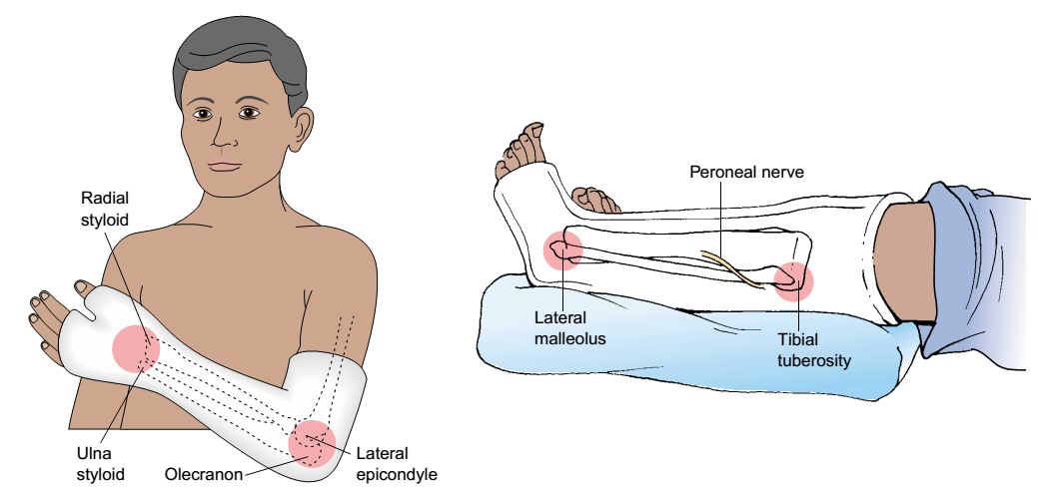
casts and pressure areas

Slide 166
Types of Casts
Short arm cast: Extends from below the elbow to the palmar crease.
Long arm cast: Extends from the upper level of the axillary fold to the proximal palmar crease. The elbow usually is immobilized at a right angle.
Short leg cast: Extends from below the knee to the base of the toes.
The Long leg cast: Extends from the junction of the upper and middle third of the thigh to the base of the toes. The knee may be slightly ﬂexed.

Slide 167
Cont’d…
Walking cast: A short or long leg cast reinforced for strength.
Body cast: Encircles the trunk.
Shoulder spica cast: A body jacket that encloses the trunk and the shoulder and elbow.
Hip space cast :Encloses the trunk and a lower extremity.

Slide 168
Casting Materials
1) Non-plaster: fiberglass casts
They are water-activated polyurethane materials having the versatility of plaster but are lighter in weight, stronger, water resistant, and durable.:
  Are porous and therefore diminish skin problems.
  They do not soften when wet, which allows for hydrotherapy when appropriate.
  When wet, they are dried with a hair drier on a cool setting;
  They are used for non-displaced fractures with minimal swelling and for long-term wear.

Slide 169
2) Plaster (the traditional cast)
Rolls of plaster bandage are wet in cool water and applied smoothly to the body. A crystallizing reaction occurs, and heat is given off producing a rigid dressing when dry.
Avoid denting the cast.
Takes about 24 to 72 hours to dry completely, depending on its thickness and the environmental drying conditions

Slide 170
Management of Patient in a Cast
Physical assessment of the part to be immobilized including assessment of the neurovascular status of the body part, degree and location of swelling, bruising, and skin abrasions.
Explain treatment regimen and procedure.
Relieving pain by immobilization, elevating, applying cold as prescribed, and analgesics.

Slide 171
Cont’d…
Every joint not immobilized should be exercised and moved through its range of motion to maintain function.
Treat skin lacerations and abrasions to promote healing before cast application.
Observe for signs of infection, odors from the cast, and purulent drainage staining the cast.

Slide 172
Cont’d…
encourages the patient to move fingers or toes hourly when awake to stimulate circulation.
Perform frequent, regular assessments of neurovascular status
Use of a sling or crutches during ambulation
Encouraging the patient to assist in repositioning, if not contraindicated, by use of the trapeze or bed rail.

Slide 173
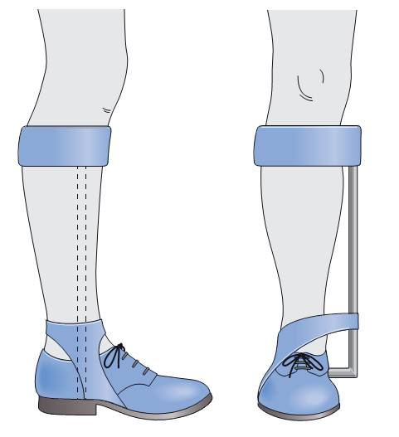
T-strap and inside iron

Slide 174
INTERNAL FIXATION
An operation in orthopedics that involves the surgical implementation of implants for the purpose of repairing a bone
      Screws
      Plates
      Compression plates
      Intramedullary nails
      Kirschner wires (k-wires)

Slide 175
Advantages of internal fixation
Allows accurate reduction and maintenance of position
Allows the patient and his/her joints more mobility, thus encouraging rehabilitation and avoiding joint stiffness
May encourage union, but only if sufficiently strong
Diminishes time spent in hospital

Slide 176
Disadvantages
May introduce infection
Is technically exacting and operative complications may occur
If it is inadequate or infection occurs, union may be long delayed or may not occur
May not be sufficiently strong to allow the advantages of full mobilization
Excessively rigid fixation and periosteal stripping may delay union
Further surgery may be needed to remove the device

Slide 177
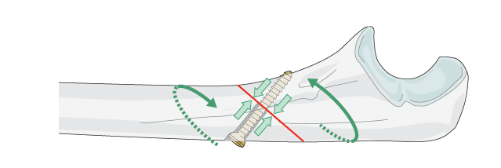
Techniques of internal fixation
Screw fixation
Simple screw fixation is usually used to attach small bony fragments, e.g. the malleoli.

Slide 178
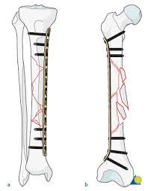
Plate fixation
Many sizes and shapes of plate are used to hold fractures. The plate can be designed to apply compression to the fracture in order to give firmer fixation.

Slide 179
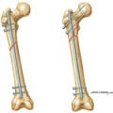
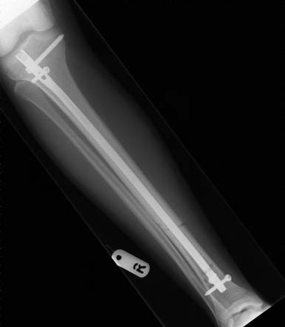
Intramedullary nail
This technique involves the passage of a rod into the medullary canal of a long bone and across the fracture site, thus stabilizing it in bending.

Slide 180
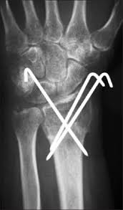

Wires
These are occasionally used to hold bone fragments in position, e.g. stiff Kirschner wires for Colles fractures or as a figure of 8 tension band wire in olecranon or patella fractures

Slide 181
EXTERNAL FIXATORS
Used to manage open fractures with soft tissue damage.
They provide stable support for severe comminuted
(Crushed or splintered) fractures while permitting active treatment of damaged soft tissues,complicated fractures of the humerus, forearm, femur, tibia, and pelvis are managed with external skeletal fixators.

Slide 182
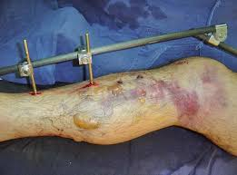
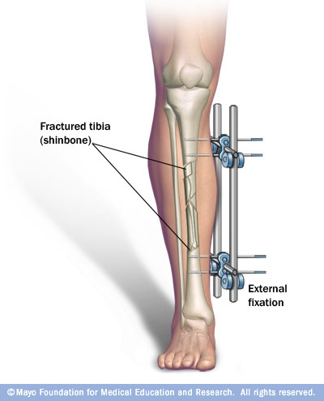

Slide 183
Nursing interventions
prepare the patient psychologically for application of the external ﬁxator and Reassurance that the discomfort associated with the device is minimal and that early mobility is anticipated promotes acceptance of the device
the extremity is elevated to reduce swelling.

Slide 184
Cont’d…
sharp points on the ﬁxator or pins, are covered to prevent device-induced injuries.
monitor the neurovascular status of the extremity every 2 to 4 hours and assesses each pin site for redness, drainage, tenderness, pain, and loosening of the pin
pin care as prescribed to prevent pin tract infection
Encourage isometric exercise as prescribed

Slide 185
SPLINTS & BRACES
Contoured splints of plaster or pliable thermoplastic may be used for conditions
  that do not require rigid immobilization,
  for those in which swelling may be anticipated, and
  for those that require special skin care.
  They are commonly used in emergency situations to immobilize a fracture

Slide 186
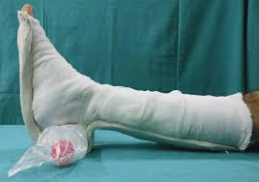
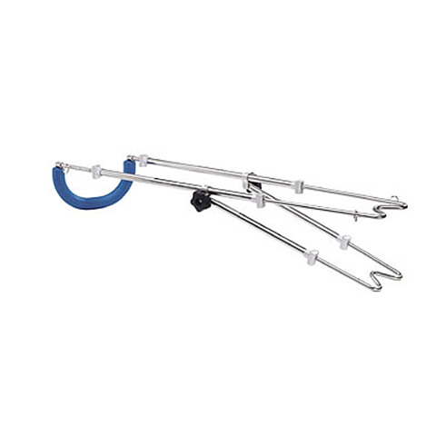
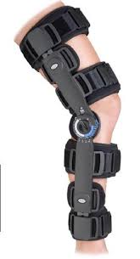
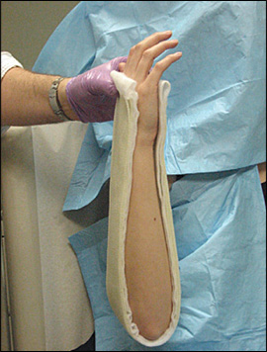
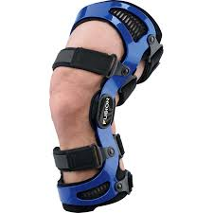
Examples of splints and braces

Slide 187
Cont’d…
The splint must be well padded to prevent pressure, skin abrasion, and skin breakdown.
The splint is overwrapped with an elastic bandage applied in a spiral fashion and with pressure uniformly distributed so that the circulation is not restricted.
Assessment of the neurovascular status and skin integrity of the splinted extremity should be done frequently.

Slide 188
For long-term use, braces (orthoses) are used to
  provide support,
  control movement, and
  prevent additional injury.
Braces may be constructed of plastic materials, canvas, leather, or metal.
The orthotist adjusts the brace for fit, positioning, and motion.

Slide 189
The nurse
  helps the patient learn to apply the brace and to protect the skin from irritation and breakdown.
  assesses neurovascular integrity and comfort when the patient is wearing the brace,
  encourages the patient to wear the brace as prescribed, and
  reassures the patient that minor adjustments of the brace by the orthotist will increase comfort and minimize problems associated with its long-term use.

Slide 190
AMPUTATION
Removal of a body part, usually a limb or part of a limb.
Amputation is used to
  relieve symptoms,
  improve function,
  save patient’s life
  improve the patient’s quality of life.

Slide 191
Necessity for Amputation!
  Progressive peripheral vascular disease (often a sequelae of DM)
  Severe burns
  Severe congenital deformities
  malignant tumours
  Chronic osteomyelitis
  fulminating gas gangrene,
  trauma (crushing injuries, frostbite, electrical burns)

Slide 192
Levels of Amputation
Amputation is performed at the most distal point that will heal successfully.
The site of amputation is determined by two factors:
  circulation in the part, and
  functional usefulness (i.e., meets the requirements for the use of the prosthesis).

Slide 193
Cont’d…
The circulatory status of the extremity is evaluated through
  physical examination
  Doppler flow-metry,
  Segmental blood pressure determinations
  Transcutaneous partial pressure of oxygen
  Angiography

Slide 194
Cont’d…
The objective of surgery is to conserve as much extremity length as possible. Preservation of knee and elbow joints is desired.
Most people who have a hip disarticulation amputation must rely on a wheelchair for mobility.
A staged amputation may be used when gangrene and infection exist

Slide 195
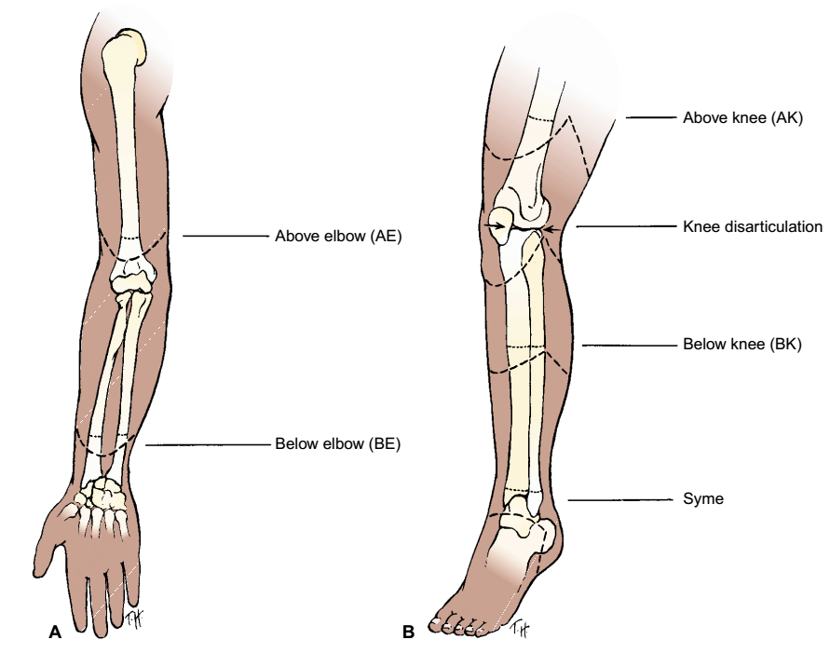
Levels of Amputation

Slide 196
Pre-operative Care
Evaluate the neurovascular and functional status of the extremity, the nutritional status.
Any concurrent health problems e.g, cardiac insufficiency, chronic respiratory problems, diabetes mellitus.
Assist the patient to undergo investigations, i.e blood grouping and cross-matching, blood culture

Slide 197
Cont’d…
Assesses the patient’s psychological status: emotional reaction, change in body image.
Always give good nutrition, high in vitamins and proteins
Correct and monitor Hb
Teach the patient how to use assistive devices such as crutches
Involve the patient in exercise programs.

Slide 198
Post-operative Care
Control surgical pain with opioid analgesics i.e. pethidine
Closely monitor pt for hemorrhages, vital signs fluctuations
Ensure good wound drainage, proper wound dressing
Administration of antibiotics to decrease sepsis
Physiotherapy to prevent the development of contractures.

Slide 199
Cont’d…
Care of the skin at the stump area,
Enhance physical mobility by muscle strengthening and ROM exercise, position changes, elevation.
Enhance healing: gentle handling of the residual limb, control of residual limb edema(rigid or soft compression dressings), and use of aseptic technique in wound care to avoid infection.
Education on use of prostheses.

Slide 200
Cont’d…
Monitor for potential complication i.e. infections
Rehabilitation of the patient
  psychological support in accepting the sudden change in body image
  The patient is encouraged to be an active participant in self-care.
  dealing with the stresses of hospitalization,
  Modification of lifestyle.

Slide 201
Complications:
They include
  hemorrhage,
  infection,
  skin breakdown,
  phantom limb pain, and
  joint contracture

Slide 202
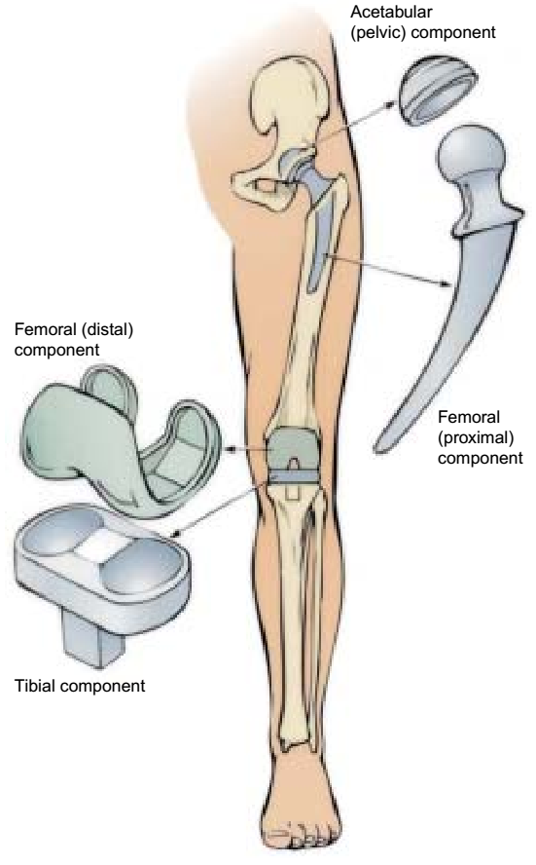
TOTAL HIP REPLACEMENT
Total hip replacement is the replacement of a severely damaged hip with an artificial joint.

Slide 203
Indications
Arthritis (degenerative joint disease)
Femoral neck fractures
Failure of previous reconstructive surgeries (failed prosthesis, osteotomy)
Problems resulting from congenital hip disease.

Slide 204
Nursing Considerations
Promoting ambulation
Preventing hip prosthesis dislocation
Monitoring wound drainage
Preventing DVT
Preventing infection

Slide 205
Complications
Dislocation of the hip prosthesis
Excessive wound drainage
Thromboembolism
Infection
Heel pressure ulcer
Avascular necrosis
Loosening of the prosthesis.

Slide 206
ASSIGNMENT
Identify indicators of a dislocated hip prosthesis
Using the nursing process describe the preoperative and postoperative care of a patient undergoing an orthopedic surgery.

Slide 207
SOFT TISSUE INJURIES
Contusion
- by blunt force, such as a blow, kick, or fall.
Many small blood vessels rupture and bleed into soft tissues (ecchymosis, or bruising). A hematoma may develop.
Local symptoms (pain, swelling, and discoloration) are controlled with intermittent application of cold.
Most resolve in 1 to 2 weeks.

Slide 208
Cont’d…
A strain
A “muscle pull” caused by overuse, overstretching, or excessive stress.
Strains are microscopic, incomplete muscle tears with some bleeding into the tissue.
The patient experiences soreness or sudden pain, with local tenderness on muscle use and isometric contraction.

Slide 209
Cont’d…
A sprain
- injury to the ligaments surrounding a joint caused by a wrenching or twisting motion.
A torn ligament loses its stabilizing ability.
Blood vessels rupture and edema occurs; the joint is tender, and movement of the joint becomes painful.

Slide 210
Cont’d…
The degree of disability and pain increases during the first 2 to 3 hours after the injury because of the associated swelling and bleeding.
An x-ray should be obtained to rule out bone injury.
Avulsion fracture (in which a bone fragment is pulled away by a ligament or tendon) may be associated with a sprain.

Slide 211
Management
Treatment of contusions, strains, and sprains consists of the acronym RICE—Rest, Ice, Compression, Elevation)
  Rest prevents additional injury and promotes healing.
  Moist or dry cold applied intermittently for 20 -30 minutes during the first 24 to 48 hours after injury produces vasoconstriction, which decreases bleeding, edema, and discomfort. Care must be taken to avoid skin and tissue damage from excessive cold.

Slide 212
Cont’d…
  An elastic compression bandage controls bleeding, reduces edema, and provides support for the injured tissues.
  Elevation controls the swelling.
If the sprain is severe, surgical repair or cast immobilization may be necessary so that the joint will not lose its stability.

Slide 213
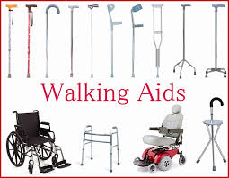
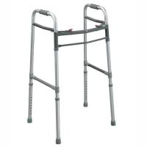
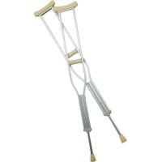
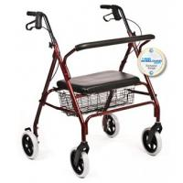
Ambulatory Devices

Slide 214
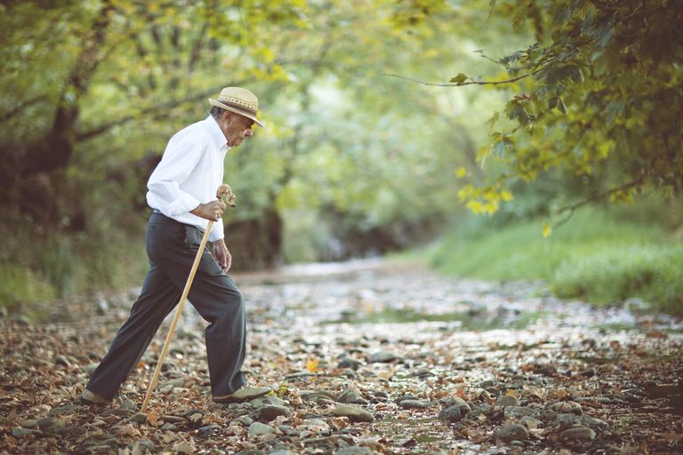
Thank You

