Slide 1
OSTEOGENESIS IMPERFECTA
(fragilitas ossium, brittle bone syndrome)
PRESENTERS;
COLLINS WAHOME
RISPER GITARI

Slide 2
To be a blue-eyed boy is great but to virtually have blue eyes is a misery. We are going to find out why in this presentation.

Slide 3
OUTLINE
Overview of the anatomy of the bone.
Definition
Etiology
Incidence
Pathogenesis and pathology
Classification
Clinical features
Investigations
Treatment

Slide 4
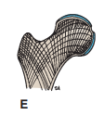
Overview of the anatomy of the bone
Bone is a living tissue capable of changing its structure as the result of the stresses to which it is subjected. Like other connective tissues, bone consists of cells, fibers, and matrix. It is hard because of the calcification of its extracellular matrix and possesses a degree of elasticity because of the presence of organic fibers .
Bone exists in two forms: compact and cancellous. Compact bone appears as a solid mass; cancellous bone consists of a branching network of trabeculae. The trabeculae are arranged in such a manner as to resist the stresses and strains to which the bone is exposed.
Note arrangement of trabeculae to act as struts to resist both compression and tension forces in the upper end of the femur

Slide 5
CONT’D
Bones may be classified regionally (axial and appendicular) or according to their general shape.
Bones are grouped as follows based on their general shape: long bones (humerus, femur), short bones (bones on the hand and the foot-> calcaneus, scaphoid), flat bones (frontal and parietal bones), irregular bones (pelvic bones and the vertebrae), and sesamoid bones (patella).
For the long bones, their length is greater than their breadth and they have the following characteristics;
They have a tubular shaft, the diaphysis and epiphysis at each end.
An epiphyseal cartilage separates the diaphysis from the epiphysis during the growing phase and the part of the diaphysis lying adjacent to the epiphyseal cartilage is known as the metaphysis.
The shaft has a central marrow cavity that contains the bone marrow.
The outer part of the shaft is composed of compact bone that is covered by a connective tissue sheath, the periosteum.
All bone surfaces, other than the articulating surfaces, are covered by a thick layer of fibrous tissue called the periosteum.

Slide 6
CONT’D
Bone is developed by two processes: membranous and endochondral. In the first process, the bone is developed directly from a connective tissue membrane; in the second, a cartilaginous model is first laid down and is later replaced by bone.
The bones develop from the paraxial mesoderm.
The bones have cells, the osteogenic cells, that are found in both the periosteum and the endosteum (a vascular membrane that lines the inner surface of long bones).

Slide 7
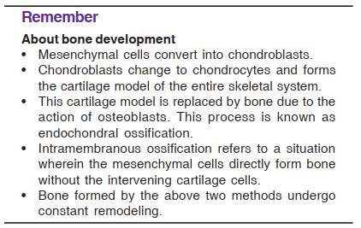
CONT’D
Clinical relevance; The osteoblasts synthesize and secrete the organic intercellular substance called the osteoid tissue. The intercellular substance so formed is a mixture of matrix with type-I collagen as its main constituent, inorganic salts consisting mainly of calcium in the form of hydroxyapatite and water. The process of the formation of organic intercellular substance by osteoblasts is known as ossification.

Slide 8
CONT’D
Bone dysplasias can occur due to disturbance of growth and development of either bone or the cartilages and genetics has a role in dysplasias where the inheritance can be dominant, recessive, X-linked or multifactorial.
Among the bone dysplasias, osteogenesis imperfecta falls in the heterogeneous group of mainly autosomally dominant inherited disorders with mutations in COL1A1, COL1A2 genes that are responsible for the synthesis of type I collagen.

Slide 9
Definition
Osteogenesis imperfect (OI) is an autosomal dominant or recessive disorder of synthesis of type I collagen that constitutes 90­-95% of bone matrix. The disorder, thus, involves not only the skeleton but other extra­skeletal tissues as well containing type I collagen such as sclera, eyes, joints, ligaments, teeth and skin.
It is a hereditary condition characterized by fragility of bones, deafness, blue sclera, laxity of joints and a tendency to improve with age.
Osteogenesis imperfecta (OI) is the name given to a group of disorders characterised by severe osteoporosis and multiple fractures in infancy and childhood.

Slide 10
Etiology
The etiological factors could be heredity, Mendelian recessive—in prenatal cases, and Mendelian dominant—in postnatal cases.
Most cases are caused by mutations in the COL1A1 and COL1A2 genes, which encode the proteins that make type I collagen. These result in reduced collagen production (in mild OI) or in formation of abnormal collagen chains that are rapidly degraded (in severe OI).
Mutations in several other genes have been described that can cause OI, some of which affect post-translational modification of collagen and others that affect bone formation.

Slide 11
Incidence
Type I OI has a frequency of about 1 in 15,000-20,000 births.
Type II OI has a reported incidence of about 1 in 60,000 births.
Only a limited number of patients with the severe forms of OI have been reported and the combined incidence of the severe forms that are recognizable at birth (types II, III, and IV) maybe higher than 1 in 60,000 births.
The disorder is equally common in males and in females.

Slide 12
Pathogenesis and pathophysiology
Mutations in the COL1A1 and COL1A2 genes result in the production of reduced or abnormal chains of the type I collagen fibres.
Since type I collagen is not only localized in the skeleton, the manifestations of the defect can be seen in other tissues containing the type I collagen including the sclera, eyes, joints, ligaments, teeth and skin.
With mutations in these genes, there occurs reduced formation of hydrogen and disulfide bonds between type I preprocollagen molecules that results in decreased triple helix formation that causes decreased synthesis of normal type I collagen thus impaired bone matrix formation.

Slide 13
Classification
Initially, OI was classified into two subtypes of congenita (at birth) and tarda (during adolescence) and this was based depending on the age of onset of symptoms.
Then, there came Sillence classification that mainly assessed the severity.
FALVO’S CLASSIFICATION
Osteogenesis imperfecta tarda type I; this type has presence of bowing at long bones.
Osteogenesis imperfect tarda type II; no bowing of long bones in this type.
NB; fractures maybe present in both but are rare in type II.

Slide 14
Classification based on clinical presentation

Slide 15
Clinical features
Pathological features include;
Periosteum is thick but the cambium layer is thin
Bone is short and thin and the epiphysis is bulbous.
Cortex is thin and medullary contents are fatty and fibrous.
Bones break easily but heal well with abundant callus. Fracture is usually subperiosteal and heals by periosteal bone formation.
Deformity results from bending and fractures.
Vertebral bodies are biconcave.
Scoliosis.
Skull is thin and globular.

Slide 16
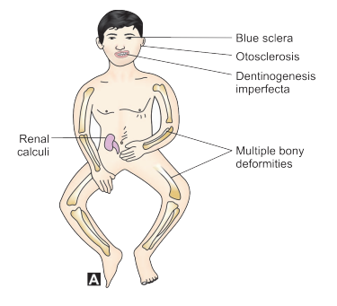
CONT’D
Clinical features are summarized by the following diagram;
Patient presents with;
-blue sclera (92% of the cases),
-dentinogenesis imperfecta & generalized osteoporosis (almost in all cases).
Osteoporosis will lead to bowing and multiple fractures.
Other features:
-> deafness due to otosclerosis
-> laxity of joints
-> dwarfism
-> broad skull
-> poorly calcified decidual teeth with the permanent teeth being normal and same as the blood chemistry.
-> cardiovascular manifestations such as aortic regurgitation, floppy mitral valves, mitral incompetence, and fragility of large blood vessels. -> thin skin that scars extensively.

Slide 17
CONT’D

Slide 18
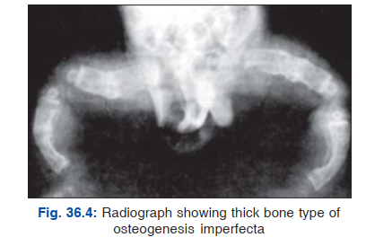
CONT’D

Slide 19
Diagnosis
OI is usually diagnosed on the basis of clinical criteria.
The presence of fractures together with blue sclerae, dentinogenesis imperfecta or family history of the disease is usually sufficient to make the diagnosis.
However, other causes of pathologic fractures must be excluded， including battered child syndrome, nutritional deficiencies, malignancies, and other inherited disorders such as chondrodysplasias and hypophosphatasia that can have overlapping presentations.

Slide 20
CONT’D

Slide 21
Investigations
Bone microscopy
Will reveal the pathological features.
X-rays
Usually reveal a decrease in bone density that can be verified by photon or x-ray absorptiometry.
Inorganic pyrophosphate assay
Prenatal determination of the probability of osteogenesis imperfecta on the fetus can be achieved by amniocentesis and estimation of inorganic pyrophosphate. This compound is elevated 3-4 times the normal value.
Prenatal Ultrasonography
Will detect severely affected fetuses at about 16 weeks of pregnancy.

Slide 22
Treatment
Treatment is multidisciplinary.
The surgical team will be involved in reduction and fixation of fractures and correction of limb deformities.
Physiotherapy and occupational therapy for rehabilitation of patients with bone deformity.
Bisphosphonates, especially intravenous pamidronate in children is used to reduce bone loss.
For severe hearing loss, stapedectomy or replacement of the stapes with a prosthesis may be successful.
Intravenous infusion of cells from bone marrow referred to as mesenchymal stem cells or multipotential stromal cells can also be used.
Counseling and emotional support are important for patients and their parents
Principles of treatment include; protection and operation.
In protection, administration of vitamins, estrogens, and androgens is done to protect the child until the tendency of the fracture lessens as age advances.

Slide 23
CONT’D
Operation is done in infantile type as the tendency to fracture is much higher and hence the treatment of choice is multiple osteotomies with intramedullary nailing.
Surgical Methods
Sofield’s method consists of multiple osteotomies and realignment and IM nail fixation. It is useful for long bones and is indicated for fresh fractures and correction of bowing. There are no growth disturbances in this technique.
In Bailey and Duboy’s, a telescopic medullary rod is used which elongates as growth occurs.
In William’s, retrograde nailing is done by fixing an extension to the distal end of the rod and driving the nail through the heel.

Slide 24
References
Dennis, L., Stephen, L., Larry, J., Anthony, S., Dan, L. & Joseph, L. (2015) Harrison’s Principles of Internal Medicine 19th Ed. ISBN: 978-0-07-1 8021 6-1
Parveen, K., &Michael, C. (2012) Kumar and Clark‘s Clinical Medicine 8th Ed. ISBN 978-0-7020-4499-1
Ivan, D. (2015) Textbook of Pathology 7th Ed. ISBN: 978-93-5152-369-7
John, E. (2010) Textbook of Orthopedics 4th Ed. ISBN 978-81-8448-744-2
Stuart, H., Ian, D., Mark, W., & Richard, P. (ed) (2018) Davidson’s Principles and Practice of Medicine 23rd Ed. ISBN 978-0-7020-7028-0
Richard, S. (2012) Clinical Anatomy by Regions 9th Ed. ISBN 978-1-60913-446- 4

Slide 25
THANK YOU

