Slide 1
PAEDIATRICS

Slide 3
OBJECTIVE
Acquire skills that will enable learner to manage effectively infants and children

Slide 4
SPECIFIC OBJECTIVES
review normal growth and development
effects of illness and hospitalization to children
congenital abnormalities
common childhood diseases
malignancy in children
pediatiric emergencies

Slide 5
TEACHING METHODOLOGY
lecture
group presentations
assignments
self directed studies
case studies
reflections
brainstorming

Slide 6
COURSE EXPECTATIONS
Active participation
Group presentation, attendance and assignment 10%
CAT 20%
Final exam 70%

Slide 7
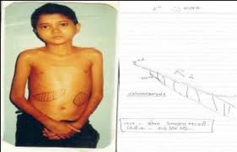
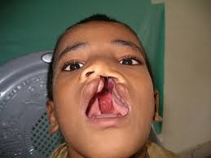
Group work
Group I:
Anaemia in children
Cleft palate

Slide 8
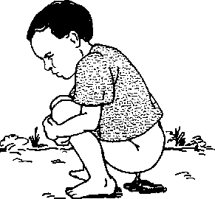
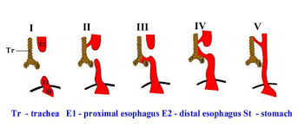
Group II
Diarrhoea in children
Esophageal atresia

Slide 9
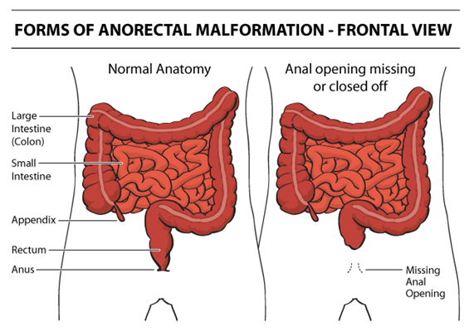
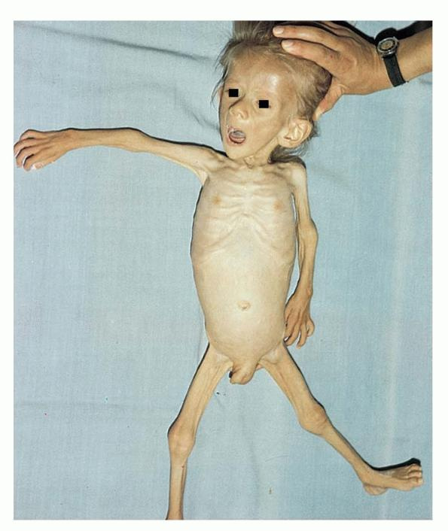
Group III
Malnutrition in children
Imperforate anus

Slide 10
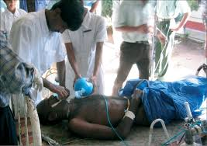
Group IV
Organophosphate poisoning
Ambiguous genitalia

Slide 11
Presentation format
Definition
Incidence
Pathophysiology
Signs and symptoms
Diagnosis
Management: medical/nursing
complications

Slide 12
Individual assignment
Outline effects of illness and hospitalization on children
(physiological, psychological, social and spiritual)
Not more than 2 pages; if typed must be double spaced, font 12, Times New Roman

Slide 13
GROWTH, MATURATION AND DEVELOPMENT
GROWTH: physiological increase in size through cell multiplication or differentiation. Seen in w/h changes
MATURATION: Changes that are due to genetic inheritance rather than life experiences, illness or injury.
DEVELOPMENT: physiological, psychosocial and cognitive changes occurring over ones’ lifespan due to growth, maturation and learning, and assumes that orderly and specific situations that lead to new activities and behavior patterns

Slide 14
Principles of growth and development
1. Development is orderly and sequential
- Maturation follows a predictable and universal timetable i.e. children learn to crawl before walking
2. Development is directional:- 2 pattern observed
a) cephalocaudal – head downwards
b) proximal distal – inside out i.e. fingers to entire hand
3. Development is unique for each child i.e. naming of colors, walking and teething
4. Development is interrelated

Slide 15
5. Development becomes increasingly differentiated
- Responses become more specific and skillful as the child grows ex. Pain response is more generalized in infants
6. Development becomes increasingly integrated and complex
- As new skills are gained, more complex tasks are learned i.e. children start by babbling before comprehensible speech
7. Children are competent
8. New skills predominate

Slide 16
Principles of Growth and Development
Growth is an orderly process, occurring in systematic fashion.
Rates and patterns of growth are specific to certain parts of the body.
Wide individual differences exist in growth rates.
Growth and development are influences by are influences by a multiple factors.

Slide 17
Principles Continued
Development proceeds from the simple to the complex and from the general to the specific.
Development occurs in a cephalocaudal and a proximodistal progression.
There are critical periods for growth and development.
Rates in development vary.
Development continues throughout the individual's life span.

Slide 18
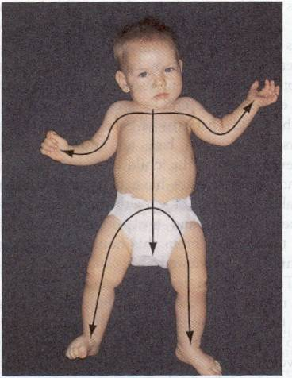
Growth Pattern

Slide 19
Growth Patterns
The child’s pattern of growth is in a head-to-toe direction, or cephalocaudal, and in an inward to outward pattern called proximodistal.

Slide 20
Factors Influencing G&D
Genetic
Environment
Nutritional
Socioeconomic
Environmental & seasonal
Chronic disease
Growth potential
Emotional
Notes:
Nutrition begins prenatally
Folic acid prevents spina bifida 400 mcg/day

Slide 21
Theories of human development
We shall discuss the following theories
Psychoanalytic theory
Behavioral theory
Cognitive theory
Ecological theory

Slide 22
Why developmental assessment?
Early detection of deviation in child’s pattern of development
Simple and time efficient mechanism to ensure adequate surveillance of developmental progress
Domains assessed: cognitive, motor, language, social / behavioral and adaptive

Slide 23
Psychoanalytic perspective
Focuses on the emotional forces reflected in the individual’s personality
Divided into:
Psychosexual (Freud)
Psychosocial or epigenetic (Erickson)
Interpersonal (Sullivan)

Slide 24
PSYCHOSEXUAL DEVELOPMENT: FREUD
Originated by Sigmund Freud
Described two basic instincts that motivate behavior (life and death)
LIFE instincts aims for survival and is responsible for life sustaining activities i.e. eating, breathing, copulation
DEATH instincts are destructive forces expressed as hate, aggression and destructive conduct
The drive has three components: ID,EGO and SUPERGO

Slide 25
ID is oriented towards maximizing pleasure and immediately satisfying needs
It is manifest as irrational, selfish and impulsive
EGO is rational, operates on reality principle
Ego development is continous throughout lifespan
SUPEREGO: conscience, strives for perfection rather than pleasure or reality
Freud described five sex instincts that a child passes through before adulthood

Slide 26
STAGE I: ORAL (BIRTH – 1YR)
Children are occupied with activities associated with the mouth i.e. sucking, biting, chewing and satisfying anger
Children receive satisfaction and enjoyment from these oral behaviors
Later development will be affected by how well oral needs are met
If not well met, will develop thumb sucking, nail biting, pencil chewing, compulsive eating, smokers, esp. those weaned too early

Slide 27
STAGE II: ANAL (1-3YRS)
Children learn how to defecate – toileting
Train children to use toilet at this stage
Those who do not successfully pass through this stage will manifest with obsessive compulsive behavior, hoarding objects, use material objects to demonstrate love

Slide 28
STAGE III: PHALIC (3-6 YRS)
Phallus = penis
Children are curious about childbirth
Fascinated with anatomical differences
Find pleasure in their own genitals’

Slide 29
Phalic …
Girls wish they had penis or had a penis once that was removed by a jealousy mother
Develop strong incestuous desire for the care giver of opposite gender
Oedepus complex: attachment of boy to mother
Electra complex: attachment of girl to father

Slide 30
STAGE IV: LATENCY (6-11YRS)
Children realize a sexual relationship with caregivers is impossible
Sexual drives are submerged
Appropriate gender roles are adopted
Oedipal/electra conflicts are resolved
Children learn rapidly about society
Identifies with same gender
Energies are directed to play, school and problem solving abilities

Slide 31
STAGE V: GENITAL (12YS ABOVE)
Sexual desires emerge die to psychological changes, hormones
The adolescent vacillidates between dependence and independence
Learns how to form loving relationships
Manages sexual urges in societally appropriate ways

Slide 32
B) PSYCHOSOCIAL DEVELOPMENT ERIC ERICKSON
STAGE I: TRUST VS MISTRUST (1M – 11/2YRS)
Basic task is to establish trust rather than mistrust in relation to oneself and others
Infants learn that the world is not only predictable but safe, reliable and can be trusted

Slide 33
If caregivers are unpredictable, inconsistent or inadequate, or convey a sense of confusion or chaos, the child learns to view the environment with mistrust or wariness, demonstrated by: restlessness, crying, whining, sleep disturbances, vomiting and diarrhea

Slide 34
STAGE II: AUTONOMY VS SHAME AND DOUBT (11/2 – 3YRS)
Children develop/discover new mental and physical attributes
Learn competencies i.e. bathing, eating, toileting, dressing
Shame occurs if assertiveness and independence are considered unacceptable by care givers
Doubt occurs if children learn to mistrust not only themselves but also others in the immediate environment

Slide 35
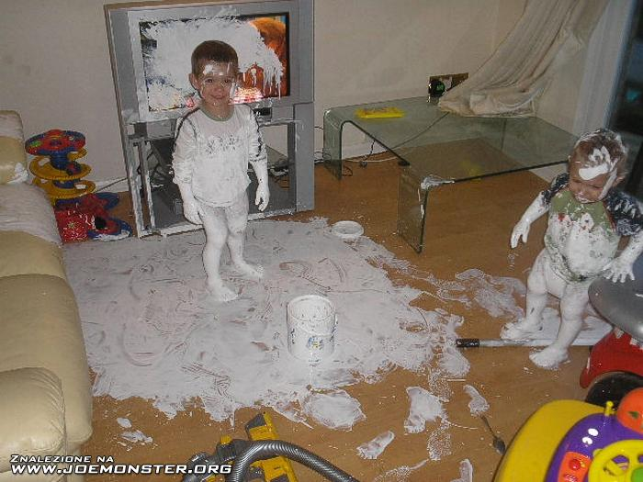
Autonomy VS. Doubt & Shame???

Slide 36
STAGE III: INITATIVE VS GUILT (3-6YRS)
Initiative refers to a person’s independently beginning an activity rather than merely responding to or imitating others
Child invents creative ways to use skill
Takes responsibility of one’s own actions
Guilt occurs when care giver frequently reprimand behaviors reflecting initiative
Such children may become passive, reluctant and refuse to participate in activities

Slide 37
STAGE IV: INDUSTRY VS INFERIORITY (6-11YRS)
Industry involves mastery of social, physical, and intellectual skills and orientation toward and competition with peers
Children are interested in being first, fastest and smartest
Energies are turned to learning academic skills and social roles
Inferiority develops when school aged children are ridiculed by peers, don’t measure up with adult expectations and lack specific skills

Slide 38
STAGE V: IDENTITY VS ROLE CONFUSION (12-18YRS)
Identity involves achieving a sense of who one is intellectually, cognitively or emotionally
Sexual maturity is integrated with already existing skills and abilities
Ability to identify ones’ own political, social, economic ad religious ideologies

Slide 39
Considered a crucial stage in development
Identity formation affects commitments and decisions made late in life
Role confusion occurs when the adolescent is unable to acquire a sense of direction, self or place within the world

Slide 40
c) INTERPERSONAL DEVELOPMENT HARRY STACK SULLIVAN
Described seven steps of interpersonal development but only six relate specifically to infants – adolescents

Slide 41
STAGE | AGE | CHARACTERISTICS
INFANT | Birth – 18months | learns to rely on others especially mothers
EARLY CHILDHOOD | 18m-6yrs | learns to clarify communications recognizes approval and disapproval delays gratification
LATE CHILDHOOD | 6-9yrs | - increasing intellectual abilities - learns to control behavior - own place in the world
PREADOLESCENT | 9-12 yrs | - Vulnerable to teasing
EARLY ADOLESCENT | 12-15yrs | - Mastering independence - develop relationships with person of opposite gender
LATE ADOLESCENT | 15-19 yrs | - Masters expression of sexual impulses - forms responsible and satisfying relationships with others

Slide 42
BEHAVIORAL PERSPECTIVE
Posits that human action and interactions come from learned responses to environmental stimuli

Slide 43
CLASSICAL CONDITIONING
Described by Ivan Pavlov, Russian psychologist
Studied dogs’ response to food
Learned that dogs would salivate not only when he saw food (unconditional) but also when he saw the person who fed him or heard a bell ring just before food appeared (conditional)
An infant, seeing the spoon used for feeding becomes exited because the spoon is associated with being fed

Slide 44
OPERANT CONIDITIONING
Described by B F Skinner
Involves behavior change due to either negative (punishment) or positive (reinforces) consequences
If the behavior is rewarded, the likelihood of it recurring increases
If it is punished, chances are that it will not reccur

Slide 45
SOCIAL LEARNING
Proposed by Albert Bandura
Children learn by observing or imitating others
Behavior is influenced by the environment and learned through various experiences

Slide 46
COGNITIVE STRUCTURAL PERSPECTIVE
Concerned with how children learn to reason, use language and thinks

Slide 47
THEORY OF COGNITIVE DEVELOPMENT
Developed by Jean Piaget
Believed that intellectual growth followed an orderly progression based on child’s maturational level
Stages of piagets theory of cognitive development
Sensorimotor
Preoperational
Concrete operations
Formal operations
(READ MORE ON THE ABOVE)

Slide 48
Theories of Child Development
Piaget- Theory of Intellectual Development
Sensoriomotor Thought 0-2 yrs
Preoperational Thought 2-7 yrs
(Egocentrism, Transductive reasoning,
Centration, Animism, Magical Thinking)
Concrete Operations 7-11 yrs
Formal Operations >11 yrs
Notes:
0 – 2 reflexes: swallow, blink, repitition,
2-7
egocentrism: self centered,
Transductive reasoning: connect two events together as cause and effect
Centration: focus on one aspect of the situation only: allow them to do it.
Animism: giving lifelike qualities to inanimate objects.
so show a procedure on a doll will alleviate stress
7-11 Concrete
>11 intilectual thought,

Slide 49
B) KOLBERG THEORY OF MORAL DEVELOPMENT
1. PRECONVENTIONAL LEVEL (BIRTH – 7YRS)
- Premorals stage
- Punishment and obedience orientation stage
- Instrumental realistic orientation stage

Slide 50
2. CONVENTIONAL LEVEL (7-12YRS)
- Interpersonal concordance orientation stage
- Authority and social order
- Maintaining orientation stage

Slide 51
POST CONVENTIONAL LEVEL (12YRS- OLDER)
- Social contract/legalistic orientation stage
- Universal ethical principles orientation stage

Slide 52
CONTEXTUAL PERSPECTIVE – ECOLOGICAL THEORY
READ AND MAKE NOTES ON THIS SECTION

Slide 53
AGE SPECIFIC GROWTH AND DEVELOPMENT
Neonate/ New born 0 -28 days
Infant 1month – 1yr
Toddler 1-3yrs
pre-school 4-6 yrs
School age 6 – 12 yrs
Adolescent 12 – 21yrs

Slide 54
PHYSIOLOGICLA DEVELOPMENT INFANCY 0-12MONTHS
Children grow in cephalocaudal and proximaldistal fashion
Growth is influenced by genetics, environment, ethnic background and biology
Physical growth includes height, weight and head circumference, which are plotted on growth chart

Slide 55
Weight and height
weight doubles at 6 months
At 12 months, infants birth wt triples
Height increases at 1 inch per month in the first 6 months
6-12 months, growth in height is at 0.5inch per month

Slide 56
Head growth
Head changes reflect rapid brain growth
At 12 months, brain will be 2/3 the size of adult
Head circumference increases at 1.3cm per month in the first six moths
6-12 months, head circumference = 0.6cm per month

Slide 57
As the head grows fontanels gradually close
Posterior fontanel closes at 2 months
Anterior fontanel closes at 12-18months
Gross motor development
The ability to use large muscles groups to maintain balance, postural control or locomotion
Major task is to maintain head control

Slide 58
2-3 months
- Head lag when pulled to sitting position
- Rolls from abdomen to back
- Moro reflex disappearing
- Tonic neck disappears
4-6 months
- Good head control
- No head lag
- Sits with support
- Rolls from back to abdomen
- Bears weight in standing position with support

Slide 59
7-8 months
- sits alone without support
- bears weight with some support
9-12 months
Moves from prone to sitting position to standing position without assistance
Stands alone without support
Attempts to walk alone

Slide 60
FINE MOTOR DEVELOPMENT
Includes utilization of hands and eyes and manipulate environment
Ability to co-ordinate head eye movement in orderly and progressive manner
2-3 months
Follows objects past midline
Holds hands open
Places hand in the mouth
Briefly reaches at dangling objects
Grasps objects with the whole hand before dropping

Slide 61
4-5 months
Reaches for objects beyond grasp
Looks from object to hand and back again
Places objects in the mouth
Uses whole hand to grasp objects
Plays actively with hand and feet

Slide 62
6-7 months
Holds objects securely and bangs them together
Actively drops objects
Transfers objects between hands
8-9 months
Pincer grip beginning
Dorminant hand preferences emerging

Slide 63
10-12 months
True pincer grip present
Can self feed finger foods
Can place and remove objects from a container
Can turn multiple pages in a book

Slide 64
VISION
Visual development is demonstrated by the infants ability to follow objects
Infants prefer human face
By 6 months, the infant can recognize familiar faces and may experience stranger anxiety
Ability to easily find and pick up small toys is a good indicator of good vision in children

Slide 65
INDICATORS OF VISUAL PROBLEMS
Absence of blink
Does not fixate on objects
Does not follow objects at one month
Does not watch own hands and feet at 4 months
Does not reach objects at 5 months
Poor hand-eye coordination at 7 months

Slide 66
DENTAL
Tooth development and eruption are affected by genetics, gender, race, and growth pattern
Deciduous teeth (primary/baby teeth/ milk teeth) are first to develop
Eruption of teeth varies among children
Begins around 3-4 months

Slide 67
The first teeth to erupt are lower central incisors followed by upper central incisors 4-8 months later
During teething, periodontal membrane becomes slightly swollen, red, and tender
Child has mild anorexia, fussiness and increased desire to bite
Low grade fewer, vomiting, diarrhea have also been attributed to teething

Slide 68
NUTRITION
constitutes to rapid growth and development
first six months exclusive breastfeeding is recommended
weaning is the process of giving up one method of feeding for another
weaning too early could lead to iron deficiency anaemia
colic is a common health problem seen in infants
occurs 1st 2 weeks and diminishes progressively. Colic is caused by excessive air swallowing, improper feeding techniques, food allergies and parental factors

Slide 69
Management of colic
avoid eating foods that may attribute to gas formation
vibrate the baby gently
rock the infant while applying gently pressure on the abdomen
gently massage the infant’s back while the infant is lying down

Slide 70
TODDLERS 12 MONTHS -36 MONTHS
(prominent wide legged gait)
Neurologic changes
Anterior fontanels close
Brain grows reaching 80-90% of adult size
Rapidly expanding vocabulary
Control gained over most reflexes
Myelinization completed around 24 months
Spinal cord ends at L3-4 (adult ends at L1)

Slide 71
Musculoskeletal changes
Walks without support
Walks upstairs with support
Walks and pulls toys
Able to remove shoes/socks
Unzips zippers
Turns door knobs
Kicks ball
Rides tricycle
Brushes teeth

Slide 72
GI changes
Drinks from cup without spilling
Weight 14-15kg
Primary dentition completed (20 deciduous teeth)
Sphincter control enables bladder and bowel training

Slide 73
Psychosocial development
Tolerates separation from care giver (stay in day care)
Walking well and seeking new experiences
Temper tantrums develop
Toddlers most often play alongside but not with other children “parallel play”

Slide 74
III: PRESCHOOLER 3-6 YRS
Weight increases at 1.8-2.7kg/year
Height average 37.5inches 95cm
Color is fully intact
Achieved night time control of bladder and bowel
Walking, jumping, balances on one foot
Dresses and undresses self
Knows own and others gender
Uses longer sentences
Vocabulary (900-2100 words)
Feeds self completely
Learns play and initiation of adult behavior

Slide 75
IV: SCHOOL AGE 6-12YRS
FINE/GROSS MOTOR SKILLS
legibly prints letters
Uses knife, fork, spoon
Rides 2 wheel bike
Cuts pastes and folds papers
Ties shoe laces
Walks on a straight line
Develops eye-hand coordination
Plays team sports
Dresses self completely
Jumps, skips
Catches a fly ball

Slide 76
Social development
Learns to tell time
Can read from memory
Understands right from left
Knows value of currency
Enjoys work and spelling games
Knows date and time
Enjoys helping hand around the house
Spends time in quiet play
Modest
Learns from experience
Punctual

Slide 77
10-12 yrs
Able to write stories
Interests in opposite sex
Quarrelsome with siblings
Drawings are detailed
Obedient
Easy to please
Respects parents
Likes to discuss and debate
Knows death is irreversible
Truthful
Increased interest in family
Boys become bully

Slide 78
V: ADOLESCENT (12-21YRS)
Interest in body image
Appetite increases
Muscle mass increases
Permanent teeth present,
dentition complete
Physical endurance increases
Sweat glands function
Acne
More conflict with care givers

Slide 79
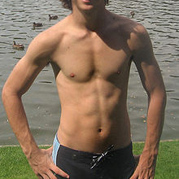
BOYS:
Testes, scrotum and penis growing
Pubic hair
Facial hair
Axillary hair present
Gynaecomastia
Mature sperm production
Voice changes
Skeletal growth ends at 21 years
Peer influence
Form groups of 3-9 buddies
Homosexuality tendencies

Slide 80
GIRLS
Breast development occurs
Menarche
Ovulation
Pubic hair develops
Heavier than males
Skeletal growth ends at 17 years
Sexual maturation achieved
Friends are considered to be of central importance
Most teenage pregnancies and abortions occurs
Lesbianism tendencies

Slide 81
Red Flags in infant development
Unable to sit alone by age 9 months
Unable to transfer objects from hand to hand by age 1 year
Abnormal pincer grip or grasp by age 15 months
Unable to walk alone by 18 months
Failure to speak recognizable words by 2 years.

Slide 82
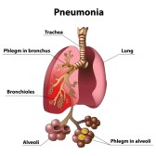
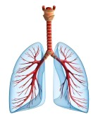
COMMON CHILDHOOD DISEASES
PNEUMONIA
Defn: acute inflammation of the pulmonary parenchyma associated with alveolar consolidation

Slide 83
Incidence:
Frequently seen in childhood
Occurs mostly in infancy and early childhood
Most bacteria type are preceded by viral URTI
Etiology
Virus: cytomegalovirus, respiratory syncitial virus, influenza and adenovirus
Bacteria: streptococcus, haemophillus
Streptococcus pneumoniae is the most common cause

Slide 84
RISK FACTORS
Bacterial or viral URTI
Prematurity
Inborn lung or heart disease
Impaired immune system
Cystic fibrosis
Sickle cell disease

Slide 85
Pathophysiology
Pathogen invade lung tissues
Produce endotoxins which produce the accumulation of debris and exudates in the airways
Reduction in ventilation and perfusion occurs
Classified as lobar, interstitial or bronchial
LOBAR: involves a major portion of one or more lobes of the lung
INTERSTITIAL includes alveolar walls, peribronchial and inter lobular tissues
BRONCHIAL diffuse, involves the bronchi and lung fields

Slide 86
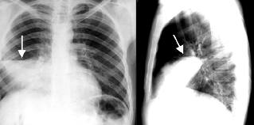
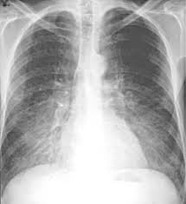

Slide 87
Clinical presentation
Cough with and without sputum -tachypnea
Malaise - Wheezing
Pleuritic pain aggravated by deep breathing and coughing
Fever - Anorexia
Headache
Dyspnea
Cyanosis in severe
Reduced breath sounds and crackles,
Dullness On percussion
Diagnosis:
physical examination
sputum culture
WBC count – increased neutrophils
CXR

Slide 88
Treatment
Depends on the etiology
Viral – supportive
Bacterial – antibiotics X-pen and gentamycin
Oxygen therapy
Iv fluids
Antipyretics
Antipyretics and analgesicsi.e parecetamol, diclofenac
Antihistamines and nasal decongestants may be administered
In severe cases nebulise with salbutamol

Slide 89
Nursing management
Assessment
assess respiratory system
assess for fever and pain
check hydration status
Nrsg Dx
impaired gaseous exchange
ineffective airway clearance
ineffective breathing pattern

Slide 90
Interventions
Administer prescribed antibiotics
administer intravenous fluids
ensure adequate hydration
chest physiotherapy
pain assessment and intervention – use analgesics
administer O2 as prescribed via mask or nasal catheter
Improve breathing pattern by proper positioning in a semi fowlers position
Continually monitor for signs of improvement by assessing respirations, breathing patterns, presence of secretions, use of accessory muscles, any abnormalities in VS, and auscultations of breath sounds
Adminster antipyretics incase of fever and analgesics for pain
care giver teaching
Suction mucus from the infant to maintain a patent airway if infant is unable

Slide 91
COMPLICATIONS
Shock and respiratory failure
Atelectasis and pleural effusion
Super infection
meningitis

Slide 92
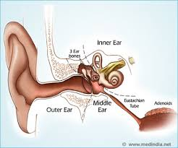
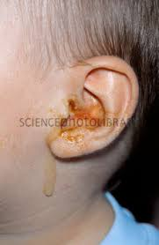
OTITIS MEDIA

Slide 93
OTITIS MEDIA
Defn: inflammation of the middle ear
Can be acute or chronic
Can occur with or without effusion
Bilateral involvement occurs in 50% of diagnosed cases
Classified as: acute OM, OM with effusion and Chronic OM

Slide 94
Classification of Otitis Media
Acute Otitis Media: presents with fever, otalgia, and hearing loss
Otitis Media with Effusion: evidence of middle ear effusion on pneumatic otoscopy
Recurrent Otitis Media: inability to clear middle ear effusions
Chronic Serous Otitis Media: presents as ‘fullness in the ear’, tinnitus, or another acute disease.

Slide 95
ACUTE OM
Infectious process caused by pathogen invasion through the Eustachian tube and the middle ear with a sudden onset and short duration
Otitis media with Effusion
Inflammation of the middle ear with fluid behind tympanic membrane without signs of infection
Chronic OM:
Persists for more than 3 months, may have or may not have effusion

Slide 96
RISK FACTORS
Upper Respiratory Infections
Allergies
Craniofacial abnormalities (cleft palate)
Down’s Syndrome
Passive smoking

Slide 97
Incidence
More common in childhood
More than 24 million case diagnosed annually in the US
20-40%of opd cases are OM
Peak incidence 6-18 months
Etiology
Streptococcus pneumonia
Hemophilus influenzae
Moraxella catarrhalies
RSV
Follows URTI
Also affects children with allergy symptoms, cleft palate, and HIV
Common in malnourished children

Slide 98
Pathophysiology
Children less than 3 years have short, wider and straight Eustachian tube
These allows microorganisms and nasopharyngeal secretions access middle ear
They cause inflammation leading to accumulation of secretions in the middle ear
Fluid impedes sound transmission
Blockage of connection between pharynx and Eustachian tube occurs
Interrupts pressure equalization function
This increases pressure in the middle ear hence can lead to rapture of tympanic membrane

Slide 99
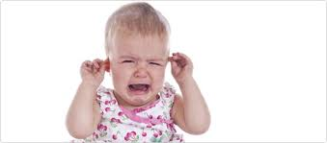
Clinical manifestations
Ear pain
Tugging and pulling of the ear
Fever
Irritability
Diarrhea
Vomiting ‘
Partial deafness
URTI

Slide 100
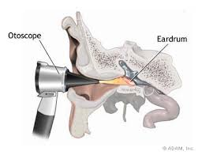
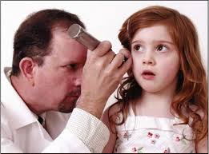
Diagnosis
otoscopic examination: tympanic membrane will be red and bulging
visible serous fluid
culture and sensitivity
history

Slide 101
Treatment:
Antibiotics: amoxil, ceftriaxone, cotrimoxazole, erythromycin and cofactor
Effusion takes longer to dissolve following antibiotic therapy
Tympanostomy – in case OM persists for 3-4 months
Refer to ENT for further evaluation and management

Slide 102
TREATMENT
Amoxicillin: 20-40 mg/kg/day tid for 10-14 days or,
Augmentin: 45 mg/kg/day po bid for 10-14 days
Auralgan: analgesic/adjunct for ear pain 2-4 drops tid

Slide 103
Nursing Management
Assessment
Take proper history
Physical examination
Assess for pain and fever
Do otoscopic examination
Nrsg Dx
Acute pain
Ineffective thermoregulation

Slide 104
Interventions
Admit the patient
Treat pain with prescribed analgesics and antipyretics
Administer prescribed antibiotics full course
Ensure adequate hydration
Family education on risk for OM and avoid bottle feeding
Assess hearing
Discharge and follow up book clinic appointments

Slide 105
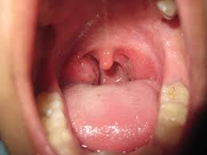
PHARYNGOTONSILITIS
Defn: Pharyngitis and tonsillitis are common comorbidity of childhood
Mostly are caused by viruses
Bacterial infection s are common and if left untreated can cause serious health problems

Slide 106
Incidence/etiology
Group A beta hemolytic streptococcus (GABHS) commonest cause
Others include S. aureus, mycoplasma pneumonia, corynebacterium diptheriae
If left untreated can lead to scarlet fever, OM and abscess, airway obstruction
Serious complications include AGN, RF, Meningitis

Slide 107
Pathophysiology
Tonsils are lymphoid tissues located at the nasopharynx
Serve to protect the body from invading organisms
Adenotonsilitis is the infection of both palatine and pharyngeal tonsils
Children are more prone because they have a large amount of lymphoid tissue in the pharyngeal cavity, have frequent URTI and are exposed during play

Slide 108
Signs and symptoms
Dryness of the mucous membranes
difficult in swallowing (odynophagia)
pain
Fever
headache
nasal congestion
obstruction of the upper airway – snoring
nausea
vomiting
diarrhea
cervical adenopathy
malaise
inflamed tonsils and oropharynx with coupious debris

Slide 109
Chronic infection
Halitosis
Chronic sore throat
Foreign body sensations
History of expelling foul smelling debris
Diagnosis:
Physical examination
Throat cultures
Signs and symptoms

Slide 110
Treatment:
viral treatment is supportive
warm saline gargles
analgesics for pain – use non aspirin
antibiotics: penicillin, cephalosporins, clindamycin
cauterization of tonsils using silver nitrate
tonsiloadenoidectomy for recurrent infections or obstructions
note: surgery is not performed to the very young below the age of 2 years

Slide 111
Nursing Management:
Assessment:
history taking about the disease, admit the patient
assess childs tonsils and adenoids
assess sleeping, swallowing and breathing
complete physical examination
check temperature
Nrsg Dx:
acute pain
risk for injury
risk for deficient fluid volume
impaired airway clearance

Slide 112
Interventions:
Administer prescribed antibiotics
Pre-op care in case of surgery
Ensure patient safety
Position the patient to allow postural drainage
Post op care following surgery
Assess for bleeding post op
Treat pain and fever
Hydrate the patient
Involve care givers in care of the patient
Ensure adequate rest
On discharge, book patient for appointments

Slide 113
RHEUMATIC FEVER
Is an inflammatory disease related to streptococcal infection, affecting mostly the heart and the joints but also other tissues including the brain and skin.
It occurs mostly in children between 5 and 15 years.

Slide 114
Pathophsiology
Rheumatic fever usually follows about 2 weeks after an infection of the throat or skin with beta- haemolytic streptococci.
This is due to specific distant reaction of the tissues, mainly the heart and the joints, to these streptococci.
All layers of the heart i.e. endocardium, myocardium and pericardium can be involved so called pancarditis.

Slide 115
Signs and symptoms
Jones criteria: It has 5 Major and 4 minor manifestations.
NB: Patients are diagnosed with rheumatic fever if they develop at least 2 of the manifestations.

Slide 116
Cont’d
Major Manifestations:
1. Migratory polyarthritis- arthritis occurs in about 75% of patients with acute rheumatic fever and typically involves larger joints, particularly the knees, ankles, wrists and elbows. Rheumatic joints are hot, red, swollen and tender.

Slide 117
Cont’d
2. Carditis- rheumatic carditis is characterized by pancarditis with active inflammation of myocardium, pericardium and endocardium.
3. Chorea- Sydenham chorea presents as an isolated neurologic behavior disorder. Emotional lability, incoordination, poor school performance, uncontrollable movements and facial grimacing, exacerbated by stress and disappearing by sleep.

Slide 118
Cont’d
4. Erythema marginatum ( a non itchy rash on the trunk and proximal extremities)- is a rare characteristic rash of acute rheumatic fever. It consists of erythematous, macular lesions with pale centers that are not pruritic.
5. Subcutaneous nodules- it consists of firm nodules approximately 1cm in diameter.

Slide 119
Cont’d
Minor manifestations
Clinical:
a. Arthralgia
b. Fever
Laboratory:
a. Elevated ESR
a. Prolonged PR interval

Slide 120
Medical management
Antibiotic therapy e.g. penicillin or erythromycin.
Anti-inflammatory therapy: Aspirin- high doses is begun at 100mg/kg/day for 2 days then decreased to 70mg/kg/day until ESR returns to normal.

Slide 121
Cont’d
Patients with carditis should receive corticosteroids: Prednisolone 2mg/kg/day in 4 divided doses for 2-3 weeks.
Supportive therapy- digoxin, fluid, and salt restriction, diuretics and oxygen.
Sedatives for sydenham chorea: Phenobarbital 16-32mg q6-8hours PO.

Slide 122
Nursing management
Rheumatic fever is managed in the OPD unless the child is in severe heart failure.
Initially the child should be placed on bed rest until inflammation has resolved – done in OPD.
They can be allowed to ambulate as soon as the signs of acute inflammation have subsided.

Slide 123
Cont’d
Administer prescribed medications.
Administer fluids as a supportive therapy.
Manage pain and fever.
Family teaching on disease process and proper diet ( restrict salt intake).

Slide 124
Complication
Infective endocarditis
Prevention
Control infections of the upper respiratory tract.
Individuals susceptible to recurrence of rheumatic fever should receive continuous antibiotic therapy i.e. benzathine penicillin G (1.2 MIU) every 4th week. For those allergic to penicillin erythromycin is given twice daily.

Slide 125
RHEUMATIC HEART DISEASE
Patients with rheumatic fever may develop rheumatic heart disease as evidenced by a new heart murmur, cardiomegaly, pericarditis and heart failure.
Prompt treatment of streptococcal throat infection with antibiotics can prevent the development of rheumatic fever.

Slide 126
Pathophysiology
All the three layers of the heart gradually become affected, especially the endocardium.
This is known as endocarditis of the left side of the heart. The infection may also progress to affect the mitral valve or other valves in the heart. The flaps, which form the valve, become swollen and edematous with small and firmly attached vegetable like deposits.

Slide 127
Cont’d
In the acute stage, the valve becomes incompetent, resulting in subsequent fibrosis and thickening. The tendonous cords (cordae tendineae) become shortened. This causes stenosis, with or without incompetence.

Slide 128
Clinical manifestations
The child complains of headache, vomiting, moderate fever of 37.2 degrees Celsius to 37.8 degrees Celsius but can be higher, sweating and occasionally constipation. These are signs of emerging toxemia.
Pulse rate is elevated, corresponding to temperature.

Slide 129
Cont’d
On examination, the patient has a severely painful moveable joint, which begins with one and spreads to others. Normally the knees, elbows, wrists, ankles are affected.
Occasionally these joints are reddened, swollen and warm to the touch. There may be nodules over these joints

Slide 130
When the child has been ill for a prolonged period of time, anemia will develop, indicating danger of permanent heart damage.
Some patients may occasionally faint and develop slightly pinkish rash appearing on the chest. This may occur intermittently for several months.

Slide 131
Diagnosis
History taking
Throat cultures to diagnose the presence of a group A beta- hemolytic streptococcal infection.
ECG may show sinus tachycardia, sinus bradycardia and sinus dysrhythmia.
ESR will be elevated.

Slide 132
Cont’d
During assessment of the rheumatic heart disease, the nurse should keep in mind that no diagnostic studies are specific for rheumatic endocarditis and that symptoms may not develop until years after the rheumatic fever . The symptoms depend on which side of the heart is involved.

Slide 133
Medical management
Drugs: Calcium channel blockers e.g. nifedipine to improve symptoms; Diuretics to remove excess extracellular fluids; Beta blockers to prevent onset of symptoms of heart failure.
Treat the rheumatic fever.

Slide 134
Cont’d
Good nursing care is the most significant remedy for this patient. However, several drugs may be given, mainly to control pain and for prophylaxis.
Antibiotics, such as penicillin V, or amoxil as prophylactic, are commonly used..

Slide 135
Analgesics, such as aspirin or brufen, may be the alternative choice. The doses depend on the age and individual patient’s needs

Slide 136
Nursing management
Nurse the child in recumbent position in a well ventilated room, with minimal disturbances.
Vital signs observations of temperature, pulse and respiration should be taken and recorded every two hours, and any abnormalities immediately reported to the doctor.

Slide 137
Cont’d
Take particular interest in the painful joints. Small soft pillows should be used to support the affected limb providing comfort. You should ensure that bed cradle is in place to keep beddings off the lower limbs.
The child should be on complete bed rest with all activities carried out by the nurses. You should explain to older children and their parents why such steps are being taken.

Slide 138
Cont’d
The child should be given light well balanced meals, you should assign one nurse to feed them if they are too ill to do it for themselves or if they are in pain.
Slowly progressive passive exercise in bed and occupational therapy is advised. As the child’s condition improves, they will be mobilized within the ward.

Slide 139
Cont’d
Involve the family in the child’s care, as this care will have to continue at home. Reassure the parents that the child with rheumatic heart disease should be encouraged to continue with normal activities as far as possible and emphasize that over protection will not facilitate recovery.

Slide 140
Cont’d
Administer medications and assess patient’s response to the pharmacologic regimen.
Assess fluid balance including input and output with a goal of optimizing fluid status.
Restrict sodium diet and avoidance of excess amounts of fluid.

Slide 141
Cont’d
Weigh the patient daily at the same time and on the same scale; usually in the morning after urination.
Identify and evaluate the severity of dependent edema.

Slide 142
Complications
These include:
Heart failure,
Mitral stenosis,
Aortic valve incompetence and
Pericarditis.

Slide 143
Prevention
Early and adequate treatment of streptococcal infection.
Control of epidemics in the community.

Slide 144
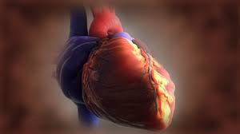
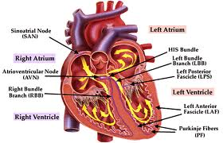
RHEUMATIC HEART DISEASE
Acquired heart diseases
Leading cause of heart diseases in developing countries

Slide 145
Incidence:
10-20 Million cases occur yearly in developing countries
Common in children 5-15years
Follows untreated or partially treated streptococcus type A infection (sore throat)
With the advent of antibiotics therapy, the mortality has reduced

Slide 146
Pathophysiology:
streptococcus enters the blood stream following a URTI infection to the heart, causing pericarditis, myocarditis and valvulitis
RHD affects the valves, especially mitral valve leading to regurgitation; aortic valve can also be involved
Vegetations form on the valves – leading to valvular stenosis warranting replacement

Slide 147
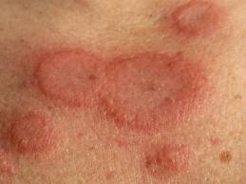
Signs and symptoms
throat infection
fever
pharyngitis
systolic muirmur
silent regurtitation murmur on ECG
migratory polyarthritis: tender, swelling
erythema marginatum: rash on the trunk and extremeties, never on the face

Slide 148
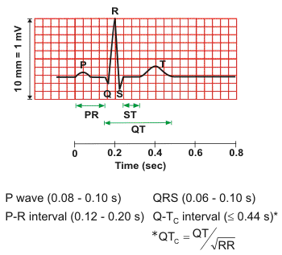
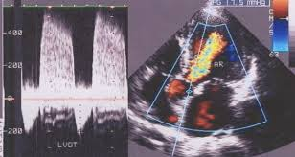
Diagnosis:
Clinical manifestations
Lab: ASOT,RF
Throat swabs for culture and sensitivity
ECG – PR prolongation
Echocardiogram
Cardiac examination

Slide 149
Treatment
Goal: Eliminate the organism and relieve the inflammation
Aspirin is the drug of choice 100mg/kgbwt x2/7 then 75mg/bwt/day x 7/7
Polyarthritis does not respond to paracetamol or brufen
Bed rest
Penicillin therapy up to 22 years
Valvotomy
Valvular replacement

Slide 150
Nursing management
Admit the patient
Teach the family on the importance of antibiotic therapy
Teach on the side effects of the aspirin therapy
Compliance with activity restricts
Prompt treatment of throat infections
Monitor for complications: CCF and infective endocarditis

Slide 151
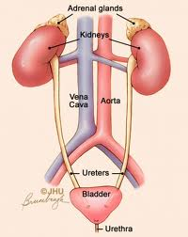
URINARY TRACT INFECTION
DEFN: An infection of one or more structures of urinary tract
Classified as lower UTI (cystitis, urethritis) or upper UTI (pyelonephritis)
Pyelonephritis is more severe
DRAW AND LABEL URINARY SYSTEM

Slide 152
Incidence:
UTI in newborns is approximately 10%
More frequent in males, later girls incidence overtakes that of boys
Common in African, Caucasians than whites
Uncircumcised boys more likely to develop UTI than circumcised

Slide 153
Etiology:
E. coli. Is the commonest cause
Less common are Klebsiella pneumonia
Pseudomonas
Enterobacter
Candida spp

Slide 154
Pathophysiology
In infancy bacteria enter urinary tract through blood and cause infection
After infancy infections are ascending through the urethra
Women are more prone due to short urethra
Other predisposition include:
urethra catheter
congenital anomalies in the urinary tract
urinary stasis
obstruction in the urinary tract

Slide 155
Signs and Symptoms
maladous urine
dysuria
urinary frequency
fever
irritability
poor feeding
loss of apetite
Fever with chills
Back pain/flank pain

Slide 156
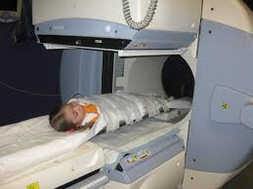
Diagnosis:
urinalysis
urine C/S
FHG – elevated WBC
ESR increased
Renal scan

Slide 157
Treatment:
Goal:
Eradicate infection
prevent reinfection
correct underlying causes of infection
preserving renal function
Administer prescribed oral antibiotics e.g. bactrim, amoxil, cephalosporin, nitrofurantoin
Hydration
Prevent complications i.e. renal scarring, kidney stones, hypertension, and end stage renal disease

Slide 158
Nursing management
Assessment:
Admit the patient
Take complete history on urine elimination pattern, pain in urination, change in urine odor, frequency, hesitancy, urgency and bed wetting
Assess knowledge of care giver
Assess hydration level
Pulse rate - tarchycardia
Skin turgor – reduced recoil > 3sec
Dry mucous membranes

Slide 159
Sunken fontanels – infants
Hemoconcentrations – increased hematocrit
Reduced peripheral perfusion
Perform urine specific gravity
Assess level of comfort
Measure weight
Nursing Dx:
risk for injury
risk for deficient fluid volume
acute pain
deficient knowledge

Slide 160
Interventions
Administer prescribed antibiotics
Correct dehydration
Manage fever/pain pharmacologically and non-pharmacologically
Document/maintain input and output charts

Slide 161
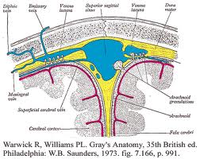
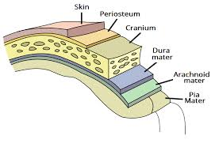
MENINGITIS
DEFN: Inflammation of the meninges secondary to bacterial or viral infections

Slide 162
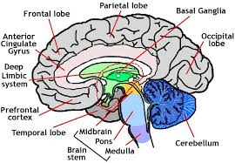
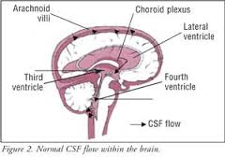

Slide 163
Etiology:
Neonates: Adolescents
E. Coli - N. Meningitidis
H. Influenzae - Strep. Pneumoniae
Strep. Type B - herpes
Herpes - Adenovirus
Arbovirus

Slide 164
Infants/Children
H. Influenzae
Naiserria Meningitidis
Strep. Pneumonae
Enterovirus
Adenovirus
Mumps virus

Slide 165
Incidence:
affects mostly children below 5 years
caused by infectious agents
can also be due to penetrating trauma, neurosurgery, secondary to otitis media, sinusitis, pharyngitis, cellulites, pneumonia, septic arthritis and dental carries

Slide 166
Pathophysiology
Bacteria enter the blood and are disseminated throughout the body including the brain
They are then seeded in the CSF and spread into the subarachnoid space
Inflammatory response then follows
Brain then becomes hyperemic and oedematous leading to increased intracranial pressure

Slide 167
Hydrocephalus occurs if ventricles are blocked and obstructed
Prognosis depends on age and organisms, how antibiotics are quickly administered
Most children develop a sequel of hearing loss, blindness, paresis of facial muscles and intellectual impairment

Slide 168
Signs and symptoms
Mostly depend on age and organism
Infants > 3 months and Toddlers
Lethargy
Fussy
Irritable
Paradoxic irritability: a state in which activities that normally soothe a baby i.e. cuddling, rocking activate the infant further
Fever +/-

Slide 169
Hypothermia
Alteration in feeding and sleeping
Vomiting or diarrhea
Weight loss
Bulging anterior fontanel
Seizure
Reduced level of consciousness
Depressed respiratory state
Apnoea

Slide 170
Children >2 years
GI upset
Chills
Fever
CNS symptoms, lethargy, irritability, agitations, confusion, headache
Nausea
Projectile vomiting
Photophobia
Diplopia
Tinnitus
Nuchal rigidity
Joint pain

Slide 171
Increased heart rate
Reduced blood pressure
Cold extremities
Reduced level of consiousness
Increased intracranial pressure
Hyperactive reflexes
Positive kernigs sign
Brudezinski’s sign positive

Slide 172
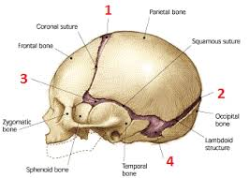
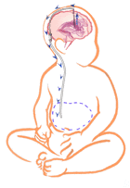
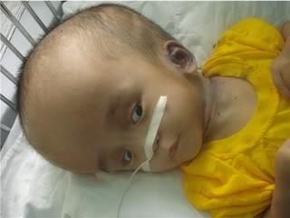
Complications:
Sepsis
Seizure
Brain abscess
Hydrocephalus
DIC

Slide 173
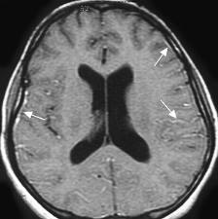
Diagnosis
Detailed history
Lab test: CSF, culture
Physical examination
Clotting studies
LP
CT scan
MRI

Slide 174
Treatment
this child may be critically ill
place the child in a cardiorespiratory monitor
oxygen therapy
fluid replacement
transfuse child if needed
admninster benzodiazepam for convulsions
phenobarbitone can also be admininstered
dexamethasone for inflammatory process
antibiotics for 7-10 days

Slide 175
Nursing management:
Protective/barrier nursing should be used
Check vital signs frequently
Do neurologic examination
Assess level of consiousness
Assess fontanels
Do head circumference measurements

Slide 176
Observe for seizure activity and report
Administer antibiotics as prescribed
Maintain body temperature within normal range
Monitor urine input output charting
Nurse in quiet environment
Monitor signs and symptoms of arthritis
Incorporate play in care

Slide 177
ASTHMA
Chronic inflammatory disorder of the airways
Many cells play a role: mast cells, eosinophils, and T-lymphocytes
Inflammation causes: wheezing, breathlessness, chest tightness and cough that occurs mostly at night and early morning
Result in airflow limitation and obstruction which is reversible with treatment
Asthma prevalence, morbidity, and mortality is increasing

Slide 178
This is due to:
Air pollution
Poor access to medical care
Underdiagnosis
Under treatment
Asthma is the most common chronic disease of childhood
Primary cause of school absences
Major cause of admission of pediatric emergency admission
Common in children 4-5 years but can occur at any age
Boys are affected more than girls, till adolescence when the trend reverses

Slide 179
CLASSIFICATION
 | Mild intermittent asthma | Symptoms less than 2 times a week Night symptoms less than 2 times
 | Mild persistent asthma | Symptoms more or equal to 2 times a week May affect activity
 | Moderate persistent asthma | Daily symptoms Daily use of inhaled β-agonists May affect activity
 | Severe persistent asthma | Continued symptoms Frequent exacerbations Frequent night time symptoms Limited physical activities

Slide 180
PATHOPHYSIOLOGY
Exposure to allergen
Release of inflammatory mediators
Alteration in epithelial integrity and autonomic neural control of airway tone
Increase in the airway smooth muscle responsiveness resulting in :
Wheezing
Dyspnea
Obstruction of mucous membranes
Bronchospasms
Edema
Accumulation of tenacious secretions
Muscle spasm of the bronchioles and bronchi

Slide 181
SIGNS AND SYMPTOMS
Dyspnoea Wheezing
Coughing esp. at night Bronchoconstriction
Prodromal itching Restlessness
Course sonorous crackles Rhonchi –course
Chest tightness Non productive coug
Anxious facial expressions
Substernal retractions
Hyperresonance on percussion

Slide 182
DIAGNOSIS
History
Physical examinations
X-ray
Pulmonary function tests: spirometry

Slide 183
MANAGEMENT
- Prevent disability
- minimize physical and psychological morbidity
- assist the child in living normal and happy life
- Allergen control: airborne and irritants i.e. house dust mites, coacroaches
- drug therapy: corticosteroids, vasodilators, anticholinergics, antihistamines and nebulizations
- inhaled meds:
Chest physiotherapy
Hyposensitization – still controversial

Slide 184
NURSING CARE ASSESSMENT
Do physical assessment, assess
Physical characteristics
Chest configuration (barrel chest)
Posturing
History of previous episodes
Do pulmonary functional tests – collaborative
Assess drug adherence
Assess family support level

Slide 185
Nursing diagnosis
Risk for suffocation
Ineffective airway clearance
Activity intolerance
Impaired family processes

Slide 186
INTERVENTIONS
Teach patient/family to avoid allergens
Recognition and respond to symptoms
Teach how to use inhalers
Avoid foods that provoke attack
Administer prescribed medications, nebulization
Administer oxygen prn
To report oral candida – complication of steroids
Teach patient breathing exercises
Promote activity as tolerated
Perform other nursing care

Slide 187
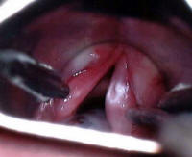
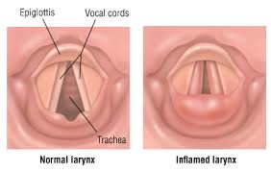
CROUP SYNDROME Definition
Symptoms complex characterized by hoarseness, a resonant cough, varying degrees of respiratory distress resulting from swelling or obstruction in the region of larynx

Slide 188
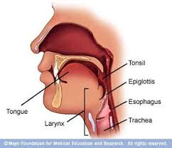
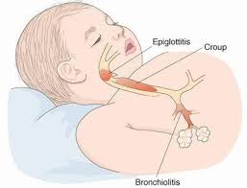
Common respiratory disease of childhood are:
Acute epiglotitis
Acute laryngitis
LTB
Tracheitis

Slide 189
LARYNGOTRACHEABRONCHITIS
The most common type of croup experienced by children
Affects children less than five years
Etiology
Parainfluenza virus
RSV
Influenza A and B
Disease preceded by URTI
Causes narrowing of airways
Child struggles to inhale past the obstruction

Slide 190
SIGNS AND SYMPTOMS
Inspiratory stridor
Suprasternal retractions
Cough – barking in nature
Hoarseness
Coryza
Low grade fever
Respiratory distress
Hypoxia symptoms
Respiratory acidosis
Respiratory failure

Slide 191
MANAGEMENT GOAL: Maintain patent airway
Mild forms of LTB are managed at home
Oxygen therapy
Nebulizer with epinephrine
Adequate hydration
Corticosteroids

Slide 192
NURSING CONSIDERATIONS
Close observation
Accurate assessment of resp. status
Assess response to allergy
Place intubation set at bed side
Promote adequate rest
Administer oxygen as prescribed
Nebulizer prn
Infants nursed in oxygen tents
Irritated children should be nursed on mother’s lap
Teach family

Slide 193
BRONCHIOLITIS
Definition
Is an acute, typically viral infection of the bronchioles. The causative microorganisms include: Respiratory Syncytial Virus (RSV), adenovirus, parainfluenza and influenza viruses.
It occurs most often in children, the infection causes inflammation in the bronchioles.

Slide 194
Pathophysiology
The inflammation created by the infectious process leads to airway edema and the accumulation of mucous and cellular debris. These effects result in a narrowing or occlusion of the bronchioles.

Slide 195
Cont’d
These occlusion causes air trapping which leads to hyperinflation of some alveoli and atelectasis (collapse of lung tissue) in others. The overall effect is hypoventilation of the affected child.

Slide 196
Signs and symptoms
Initially children with bronchiolitis exhibit symptoms of an URTI such as rhinorrhea, sneezing, decreased appetite, a low grade fever and coughing.
There’s wheezing and tachypnea
Poor feeding

Slide 197
Cont’d
Nasal flaring
Prolonged expiratory phase
Retraction of subcostal and intercostal areas
Cyanosis
Crackles

Slide 198
Diagnosis
Physical exam and history are the main diagnostic tools for bronchiolitis.
Nasopharyngeal secretions may be obtained for culture to determine the etiologic agent.

Slide 199
Treatment
Home management:
Promoting rest, ensuring adequate fluid intake and manage child’s fever.
Children who demonstrate signs of respiratory distress or become dehydrated require hospitalization.

Slide 200
Cont’d
Hospital management:
Drugs: bronchodilators, steroids, humidified oxygen and intravenous fluids.
Ribavirin (Virazole), the only specific drug for RSV bronchiolitis, is an aerosol antiviral medication reserved for severely ill children.

Slide 201
Cont’d
Mechanical ventilation is indicated for children in respiratory failure. Antibiotics are used when a secondary infection or pneumonia is present.

Slide 202
Nursing management
Ensure effective airway clearance through suctioning of secretions.
Supplemental oxygen is administered through a nasal cannula. Other strategies include raising the head of bed, consolidating care and encouraging caregiver involvement in the child’s care.

Slide 203
Cont’d
Promote fluid balance by administering intravenous fluids until the child can drink adequate amounts of oral fluids.
Administer antipyretics to reduce fever.
Ensure nebulized pulmonary medications have been given and chest physiotherapy has been done.
Family teaching on home management during discharge.

Slide 204
Complications
Apnea (cessation of breathing)
Atelectasis
Secondary bacterial infections e.g. pneumonia
Respiratory failure

Slide 226
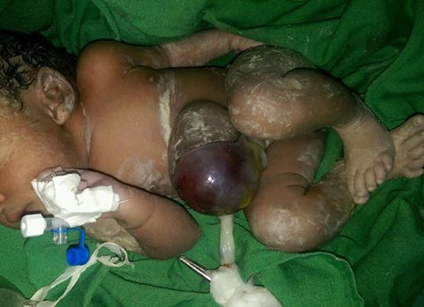
TETANUS (LOCK JAW)
Is an acute preventable and often fatal disease caused by exotoxin produced by the anaerobic spore forming gram positive bacillus clostridium tetani
Characterized by painful muscular rigidity

Slide 227
Requirements for developing tetanus
Presence of tetanus spores or vegetative forms of the bacillus
Injury to the tissues
Wound conditions that encourage multiplication of the organism
Susceptible host
Tetanus spores are found in the soil, dust and intestinal tract of animal esp. herbivorous
Prevalent in rural areas
Enters the body by way of wounds esp. puncture wound, burn or crash wounds
Infants – umbilical cord
Incidence peak during outdoor activities

Slide 228
PATHOPHYSIOLOGY
Wound – dirty, not clean and exposed to dust
Exotoxins reach the CNS by neuron axons or vascular system
Toxins become fixed on nerve cells of the brain stem and the anterior horn of the spinal cord
Toxins act as myoneural junction to produce muscular stiffness and to lower the threshhold for reflex excitability
Incubation period 3 days to 3 wk, average 8 days
Neonates 5 – 14 days
More heavily contaminated wounds have a shorter incubation period

Slide 229
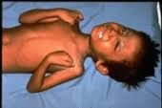
SIGNS AND SYMPTOMS
Rigidity of the muscles Difficult in suckling
Excessive crying
Irritability
Nuchal rigidity
Difficult in opening of the mouth (trismus)
Devil’s grin (risus sardonicus)
Photophobia
Laryngospasms - atelectasis, respiratory failure
Fever +/- fever has a poor prognosis
Survival beyond four days indicates recovery

Slide 230
Management
Best treated in ICU
Quiet environment preferred
Maintain external environment (incubator)
Control electrolyte imbalance
Feed using NGT or oral GT
TIG to neutralize toxins

Slide 231
Antibiotics for bacterial infection
Local care of the wound i.e. debridement and cleaning with antiseptic solution
Sedatives/muscle relaxants – to prevent spasms and convulsions (diazepam)
In severe forms, intubate

Slide 232
NURSING MANAGEMENT
Control and eliminate stimulation from sound and light, and touch
Nurse in sufficient light
Handle child as little as possible
Administer prescribed medications
Monitor and report muscle spasms
Monitor respiratory status for signs of distress

Slide 233
Place intubation set next to the patient
Monitor oxygen saturation
Adequate hydration and nutrition
Check iv sites and NGT patency
Suction prn
Allay anxiety
Allow parents to stay with the child
Perform other nursing care

Slide 234
NEPHROTIC SYNDROME
This is a disorder of the kidneys common in children and characterized by:
Generalized edema
Severe loss of protein in urine (proteinuria)
Low plasma- protein (albumin) levels- hypoalbuminaemia.
High blood cholesterol (hyperlipidaemia)

Slide 235
Nephrotic syndrome can develop during the course of renal or systemic disease and can be classified as:
1. Primary or idiopathic-results from glomerular disease of the kidney.

Slide 236
Cont’d
2. Secondary nephrotic syndrome- results in renal malfunctioning as a result of a systemic disease, drugs or toxins or other diseases that put a stress on the renal system e.g. hepatitis, childhood cancer or its therapies .

Slide 237
Incidence
It is more common in males than females with a ratio of 2:1. It usually affects children between the ages of 2 and 6 years.

Slide 238
Pathophysiology
It results when there’s a threat to the immune system and an inflammatory response is evoked. The glomeruli becomes increasingly permeable to plasma protein resulting in massive urinary protein loss or proteinuria. When protein is lost, fluids shift from the intravascular to the interstitial spaces.

Slide 239
Cont’d
The result is tissue edema, ascitis or accumulation of fluid in the abdominal cavity and hypovolemia. Once the volume diminishes in the vascular spaces then renal blood flow declines. Renin production is stimulated to maintain volume and systemic pressure.

Slide 240
Cont’d
The result is excretion of aldosterone and tubular reabsorption of sodium. Water follows the sodium leading to edema. Serum cholesterol and triglycerides levels rise from the stimulation of lipoprotein production in the face of hypovolemia and falling serum protein levels (this is an attempt to make up for the lost proteins).

Slide 241
Cont’d
Immunoglobulin levels are diminished (Ig G). As blood volume falls, red blood cells and platelets concentration are increased. The net result is a slowing of the blood flow and ultimately the clumping or clotting of red blood cells and platelets.

Slide 242
Signs and symptoms
Edema (generalized with gradual onset)
Abdominal swelling, anorexia
Abdominal pain or tenderness, fatigue
Proteinuria, hypoalbuminaemia
Hyperlipidaemia, increased weight

Slide 243
Diagnosis
Urinalysis- reveals 3+ or 4+ proteinuria
Laboratory evaluation- serum albumin levels are diminished (hypoalbuminaemia); Cholesterol, triglycerides levels are increased. The rise in serum cholesterol, triglycerides, hematocrit and platelet count indicate some problem with hypoproteinemia in the serum.
BUN and creatinine rise as kidney function falls.

Slide 244
Medical management
Antidiuretics e.g. furosemide 1-2mg/kg/dose IV q12hrs for severe edema.
Steroids: Prednisolone – decrease the inflammation and the loss of proteins.
Albumin- may be given if the edema is marked and causes the child to have decreased mobility, poor oral intake or decreased urine output (Albumin help restore normal plasma pressure and promote the movement of the interstitial fluid back into the intravascular compartments).

Slide 245
Cont’d
The albumin is followed by furosemide to reduce potential for fluid volume overload and to enhance diuresis.
A high protein diet is required.
Restrict salt intake to control edema and also restrict the fluid intake.

Slide 246
Nursing management
Maintain fluid and electrolyte balance.
Administer medications (diuretics, steroids etc.)
Prevent infection and skin breakdown.
Monitor the child’s vital signs q4hrs (decreased BP and tachycardia are signs of hypovolemia).

Slide 247
Cont’d
Monitor input and output.
Assess for signs of edema and dehydration.
Daily weighing at the same time of day and on same scale.
Family teaching on disease process, the need for daily weights, protection of their children from infection and the drugs.

Slide 248
Complications
Infection- peritonitis, sepsis, cellulitis, UTI.
Thrombosis- due to increased prothrombotic factors e.g. fibrinogen and decreased fibrinolytic factors (urinary losses of antithrombin III and proteins).
Cardiovascular disease e.g. myocardial infarction due to hyperlipidaemia.

Slide 249
CONGENITAL MALFORMATIONS CLEFT LIP AND CLEFT PALATE
Cleft is a fussure or elongated opening
A cleft of the lip, palate or both is one of the most common congenital anomalies of the newborn
Any type of cleft interferes with development of the normal anatomic structures of the nose, muscles and palate

Slide 250
Incidence/etiology
Occurs in 1.5/1000 live births
Highest in Asia and Caucasians
Cleft lip and palate in common in males
Cleft palate alone is common in females
Genetic and positive family history forms the etiology
Environmental factors i.e. parent age, alcohol intake by mother, drugs i.e. phenyltoin/ diazepam
Dietary intake i.e. low in folic acid and vitamin deficiencies

Slide 251
Pathophysiology
Cleft kip is caused by failure of nasal and maxillary processes to fuse between 5th and 8th week of gestation
Cleft palate is caused by failure of the palatine plates to fuse between the 7th and 12th week of gestation

Slide 252
Signs and Symptoms
Separation of the lip extending into the nostril
Cleft palate fissure in the hard and soft palate
Diagnosis
Visual inspection
Palpation of the palate
In utero ultrasonography
Feeding coming through the nose

Slide 253
Treatment
involves multidisciplinary approach i.e. plastic surgeons, neurosurgeons, paediatrician, orthodontist, nurse and audiologist
surgical repair: closure of the lip done at 3 months left palate is corrected at 1 year

Slide 254
Long term complications:
Speech difficulties
Malocclusion (abnormal tooth eruptions)
Hearing problems
Recurrent otitis media secondary to abnormalities of the Eustachian tube

Slide 255
Nursing management
Assessment;
Assess status of the lip and palate at birth
Document description of the abnormality
Note nenates’ability to suck and swallow
Assess caregiver reaction at birth of a baby with cleft palate, cleft lip

Slide 256
Nursing diagnosis:
Imbalanced nutrition: less than body requirement
Ineffective parenting’
Risk of aspiration
Deficient knowledge (caregiver)

Slide 257
Interventions
Perform pre-op care
Ensure adequate nutrition
Foster attachment and bonding between mother and baby
Perform other nursing care and nursing care as required

Slide 258
HIRSCHSPRUNG DISORDER
Also called congenital aganglionic megacolon
It is a motility disorder of the bowel caused by absence of parasympathetic ganglion cells in the large intestine
This prevents peristalsis and causes feaces to accumulate proximal to the defect leading to obstruction
Sometimes it is never diagnosed until infancy and childhood

Slide 259
Incidence
0.2/1000 live births
Affects males fourfold than girls
Etiology
Positive family history
Child with other congenital abnormality i.e. imperforate anus, UT anomaly, seizure disorders, cardiac defects or down’s syndrome

Slide 260
Pathophysiology
disease is due to absence of parasympathetic ganglion cells in the colon
Commonly at rectosigmoid area
Hence there is uncoordinated peristaltic motion
Affected segment becomes dilated
Common cause of obstruction in newborns

Slide 261
Signs and symptoms
failure to pass meconium in 48hrs
abdominal distension
bile vomiting
refusal to feed
intestinal obstruction
chronic constipation
inadequate weight gain
fever

Slide 262
Complications
enterocolitis
sepsis
Death
Diagnosis
history of not passing meconium > 48 hrs
rectal exam: absence of fecal matter
barium enema
rectal biopsy – absence of ganglion cells

Slide 263
Treatment
2- stage surgery: immediately – colostomy then resectioning and anastomosis between 6 – 15 months
Laparascopy

Slide 264
Nursing care
Admit the patient
Pre-op care: fluid replacement
Enema
Put pt on NPO
Pass NGT
Pre-op care
Care of the colostomy
Family teaching
Do other relevant nursing care

Slide 265
HYDROCEPHALUS
Caused by increased production, impaired absorption or block in the flow of CSF that results in an excessive amount of cerebral spinal fluid within the cerebral ventricles
Incidence:
3 -4/1000 live births

Slide 266
Etiology:
may be acquired or unknown
are of two types: communicating and non-communicating/obstructive
In communicating, obstruction is outside the ventricular system causing decreased absorption of CSF

Slide 267
In non-communicating/obstructive:
Responsible for 99% of cases
Obstruction is within the ventricles
Often due to congenital malformation i.e. aqueduct stenosis, meningomyolocele etc
Other causes are brain tumors, meningitis

Slide 268
Signs and symptoms:
increased intracranial pressure
Increasing head circumferences
Protrusion of forehead
Widened sutures
Wide bridge between the eyes
Sun-setting sign
Bulging anterior fontanel
Hollow and cracked sound on percussion of the skull
Fuss, irritability and restless
Reduced level of conscious
Poor feeding
High pitched cat like cry
Caridiopulmonary depression
Absent gag reflex
Upper extremity weakness
Headache
Nausea, vomiting etc

Slide 269
Diagnosis
Head circumference
CT scan
MRI
Physical exam
History – delay growth and development
Electroencephalography
Skull x-ray

Slide 270
Treatment:
surgical – removal of the SOL, insertion of the shunt
complications of the shunt include infection which occurs in 2 months of insertion in 30% of cases and shunt malfunction i.e. kinking, plugging or separation of tubbing

Slide 271
Nursing management
Admit the patient
Do head circumference measurement daily
Monitor for signs of increased ICP
Assess respiratory status 4 hourly
Assess sleep patterns
Do neurological examination 2 hourly post operatively
Do vital signs monitoring 4 hourly

Slide 272
Check for sign of shunt infection
Position the child appropriately
Promote hydration of the patient
Maintain skin integrity
Monitor and report the following:
Fever
Increased heart rate
Increased respiratory rate
Poor feeding
‘vomiting

Slide 273
Altered mental status
Seizure
Teach family on local support structures available
Allay family anxiety
Book patient for follow up

Slide 274
NEURAL TUBE DEFECTS SPINAL BIFIDA
DEFN: is a neural tube defect where there is incomplete closure of the vertebral and neural tube
Incidence
develops during 1st 28 days of gestation
Occurs in 0.4/1000 live births
Mostly affects females
Runs in families

Slide 275
Etiology/pathophysiology
Can occur anywhere along the spine
Due to a) failure of closure of neural tube in the first 4 weeks or b) increased CSF pressure
Cause is unknown, but attributed to the following:
a) exposure to chemicals
b) medications in early pregnancy
c) maternal lack of folic acid

Slide 276
Clinical manifestations
Ancephaly: Absence of cranial vault, cerebral hemisphere completely missing
Cranioschisis: skull defect through which neural tissue protrudes
Exacephaly: Malformation where the brain is totally exposed or herniates through the skull defects
Encephalocele: a protrusion of the brain and meninges into a fluid filled sac through a skull defect

Slide 277
Spina bifida occluta: Failure of posterior verterbral arches to fuse. There is no herniation of spinal cord or menenges
Spinal bifida cystica: defect of the spine leading to:
Meningocele: sac like herniation through the borny malformation containing meninges and CSF
Myelomeningocele: Just like a meningocele, but CSF is leaking,nerve present

Slide 278
Paralysis – depending on the location of the defect
Renal impairment
Talipes
Hydrocephalus
UTI
Kyphosis/scoliosis
Back pain
Tethering: abnormal fusion of bones
Skin breakdown

Slide 279
Diagnosis
prenatally – Ultrasound
Amniocentesi – Increased alpha fetal proteins
CT scan
MRI

Slide 280
Treatment:
corrective surgery
infant placed in prone position, normal saline dressing applied over the defect
isolate the patient
prevent contamination with urine and stool
catheterize the patient

Slide 281
Nursing care
Admit the patient
Continuously monitoring of the patient
Monitor signs and symptoms of increased ICP: fever, irritability, lethargy, nuchal rigidity
Daily head circumference measurement and recording
Nurse patient in prone position – preop and post operatively
Ensure adequate feeding

Slide 282
Note: breastfeeding may be contraindicated before surgery
Do neurological examination
Do vital signs
Observe surgical site for leakage of CSF post operatively
Observe for urine retention
Maintain skin integrity
Refer patient appropriately
Plan for discharge
Family education on: feeding, skin care, catheter care, follow up etc

Slide 283
HYPERTROPHIC PYLORIC STENOSIS (HPS)
Most common intra-abdominal condition requiring surgery during neonatal period
Incidence
1-3/1000 live births
Affects males 4-5 times more than female
Cause unknown but attributed to :
Environmental factors
Allergens
Pylorospam
Genetics

Slide 284
Pathophysiology
There is hypertrophy of the muscles of the pyloric sphincter 4 -5 times its normal resulting in a narrowed opening and gastric outlet obstruction.

Slide 285
Signs and symptoms
Non-bilous vomiting – projectile
Infant is hungry
Dehydration
Metabolic alkalosis
Hypokalemia
Irritability
Lethargy

Slide 286
Diagnosis
History and physical assessment
Barium meal
Abdominal ultrasound

Slide 287
Treatment
Surgical – pyloromyotomy
NGT for decompression – pre-op
Correct fluid and electrolyte in 24-48hrs prior to surgery
Remove NGT post operatively

Slide 288
Nursing Management
Admit the patient
Determine vomiting in terms of frequency, color and amount
Strict input and output is essential
Assess for hydration status
Skin turgor
Tearing
Mucous membranes
Depressed anterior fontanel
Decreased urine output
Dropping blood pressure
Assess and treat pain

Slide 289
Daily weighing
Do pre-op care
Record NGT contents, color and amount
Monitor IVF post op
Administer prescribed drugs
Feed the patient as prescribed
Family teaching
Do discharge and follow up

Slide 290
PEADIATRIC EMERGENCIES
FOREIGN BODIES IN THE EYE
Objects i.e. grit, loose eyelash, or contact that are floating on the surface of the eye can easily be rinsed out
DO NOT attempt to remove anything that sticks to the eye or penetrates the eyeball because they may damage the eye

Slide 291
Signs and symptoms
Blurred vision
Pain
Discomfort
Redness (eechymosis)
Tearing

Slide 292
Management
Advise casualty not to rub the eye
Ask patient to sit down facing a light
Gently separate eyelids with your fingers
Ask patient to look up, down, left, right, as you inspect the affected eye
Wash out the foreign body by pouring clean water from a glass
You can also use a moist swab, moist handkerchief or tissue
If the object is not removed, refer to ophthalmology department

Slide 293
FOREIGN BODY EAR
Objects in the ear may cause temporary deafness by blocking the ear canal
Foreign body at times damage the tympanic membrane
Common in children
Insects too crawl in the ears

Slide 294
Management
Reassure the casualty and ask him to sit down
Support the head with the affected ear upper most
Gently flood the ear with tepid water: the object should float out
If it fails, refer to ENT department
DO NOT attempt to insert instruments in the ear in attempt to remove the object because it may lodge the FB even deeper and cause damages to the ear drum

Slide 295
FOREIGN BODY NOSE
Young children push small objects up their noses
Objects block the nose and cause infection
If objects are sharp, can cause bleeding
DO NOT remove FB, you may cause injury or push it further into the airway

Slide 296
Signs and symptoms
Difficult or noisy breathing through the nose
Swelling of the nose
Smelling or blood stained discharges
Management
Keep casualty calm
Advice them to breath through the mouth
Advice patient not to poke inside the nose in bid to remove the object
Refer to hospital – ENT immediately

Slide 297
SALICYLATE POISONING IN CHILDREN
Salicylate poisoning can cause vomiting, tinnitus, confusion, hyperthermia, respiratory alkalosis, metabolic acidosis, and multiple organ failure.
Acute ingestion of > 150 mg/kg can cause severe toxicity

Slide 298
Pathophysiology
Salicylates impair cellular respiration by uncoupling oxidative phosphorylation.
They stimulate respiratory centers in the medulla, causing primary respiratory alkalosis, which is often unrecognized in young children.
Salicylates simultaneously and independently cause primary metabolic acidosis.
Eventually, as salicylates disappear from the blood, enter the cells, and poison mitochondria, metabolic acidosis becomes the primary acid-base abnormality.

Slide 299
Signs and symptoms
nausea,
vomiting,
tinnitus, and
hyperventilation.
Later symptoms include hyperactivity,
fever, confusion, and
seizures.
Rhabdomyolysis, acute renal failure, and respiratory failure may eventually develop.

Slide 300
Salicylate poisoning is suspected in patients with any of the following:
History of a single acute overdose
Repeated ingestions of therapeutic doses
Unexplained metabolic acidosis
Unexplained confusion and fever (in elderly patients)
Other findings compatible with sepsis (eg, fever, hypoxia, noncardiogenic pulmonary edema, dehydration, hypotension)

Slide 301
Treatment
Activated charcoal
Alkaline diuresis with extra KCl
Treat fever with antipyretics
Seizures with benzodiazepines
hemodyalisis

Slide 302
Key Points
Salicylate poisoning causes respiratory alkalosis and, by an independent mechanism, metabolic acidosis.
Consider salicylate toxicity in patients with nonspecific findings (eg, alteration in mental status, metabolic acidosis, noncardiogenic pulmonary edema, fever), even when a history of ingestion is lacking.
Estimate the severity of toxicity by the salicylate level and ABGs.
Treat with activated charcoal and alkaline diuresis with extra KCl.
Consider hemodialysis if poisoning is severe.

Slide 303
Alcohol poisoning

Slide 304
Signs of alcohol poisoning in young children are far more dangerous than in adults. A small amount can cause a child's blood sugar to drop to a dangerous level. Alcohol also depresses the central nervous system which is responsible for our coordination.

Slide 305
Signs of alcohol poisoning in young children are
The child may smell of alcohol
The face of the child may be red and sweating
Confusion, stupor
Vomiting
Noisy and slow breathing
Fast and strong pulse

Slide 306
In more severe cases the symptoms are:
Blue or pale skin
Hypothermia (low body temperature)
Hypoglycemia (low blood sugar)
Respiratory depression
Seizures
Coma

Slide 307
First aid to give to a child with signs of alcohol poisoning
What you can do while help is on the way.
Monitor and try to maintain the child’s breathing. Resuscitation may be needed if the breathing stops completely.
Place the child in the recovery position (on his side) so he doesn’t choke in his own vomit.
Cover with a blanket to reduce the risk of hypothermia (low body temperature).

Slide 308
How can children get alcohol poisoning?
People give children alcohol to make them sleep
Household products i.e. hand sanitizers, antiseptic mouthwash, window cleaners
Handrub, disinfectants – vodka
[INSERT; nursing intervention for a child with alcoholic poisoning]

Slide 309
Febrile seizures
A febrile seizure is a convulsion in a child triggered by a fever.
A febrile seizure can be very frightening for any parent or caregiver.
However, most of the time, they do not cause any harm and does not mean the child has a more serious long-term health problem.

Slide 310
Causes
Febrile seizures occur most often in otherwise healthy children between ages 9 months and 5 years.
Toddlers are most commonly affected.
Febrile seizures often run in families.
Most febrile seizures occur in the first 24 hours of an illness and may not occur when the fever is highest.
Ear infections or any cold or viral illness may trigger a febrile seizure.

Slide 311
Symptoms
The child may cry or moan.
The muscle tightening may last for several seconds, or longer.
The child will fall, if standing, and may pass urine.
The child may vomit or bite the tongue.
Sometimes children do not breathe, and may begin to turn blue.
The child's body may then begin to jerk rhythmically.
The child will not respond to the parent's voice.

Slide 312
Exams and Tests
History
Exams and Tests
Further testing may be needed if:
The child is younger than 9 months or older than 5 years
The child has a brain, nerve, or developmental disorder.
The seizure was confined to one part of the body.
The seizure lasted longer than 15 minutes.
The child had more than one febrile seizure in 24 hours.
The child has abnormal findings when examined

Slide 313
Treatment
You may want to slide a blanket under the child if the floor is hard.
Move the child only if in a dangerous location.
Remove objects that may cause injury.
Loosen any tight clothing, especially around the neck. If possible, open or remove clothes from the waist up.
If the child vomits, or if saliva and mucus build up in the mouth, turn the child to the side or on the stomach

Slide 314
Do NOT try to force anything into the child's mouth to prevent biting the tongue, as this increases the risk of injury.
Do NOT try to restrain your child or try to stop the seizure movements.

Slide 315
Focus your attention on bringing the fever down:
Insert an acetaminophen suppository (if you have some) into the child's rectum.
Do NOT try to give anything by mouth.
Apply cool washcloths to the forehead and neck. Sponge the rest of the body with lukewarm (not cold) water.
Cold water or alcohol may make the fever worse.
After the seizure is over and your child is awake, give the normal dose of ibuprofen or acetaminophen.

Slide 316
Diarrhea in Children: Common Causes and Treatments
Diarrhea is the body's way of ridding itself of germs,
Some of the most common reasons kids get diarrhea include:
Infection from viruses like rotavirus, bacteria like salmonella and, rarely, parasites like giardia.
Medications like laxatives or antibiotics
Food poisoning
Other causes of diarrhea include irritable bowel disease, Crohn's disease, food allergies, and celiac disease

Slide 317
Malnutrition
Malnutrition is a state in which the body is not getting enough of the required nutrients. Starvation is a severe form of malnutrition.

Slide 318
Causes and Development
an inadequate, poor, unbalanced diet – or, not so obvious. Other causes include digestive problems, nutrient absorption problems, or certain disease conditions.

Slide 319
Signs and Symptoms
weight loss / being very underweight
stunted growth
water retention (edema), which often hides muscle loss
tight skin caused by edema
unhealthy skin
unhealthy hair that looks wiry, stiff, unkempt, can come out easily, and looks lighter than normal due to depigmentation
hair loss
liver enlargement
abdominal swelling
unusually bright or dull eyes
fatigue

Slide 320
dizziness
weak immune system
inflamed or swollen eyelids
eye color, softness, thickness changes
wrinkles radiating out from the mouth which may lead to scarring
protruding soft inner mucous membrane of the mouth that becomes visible with the lips
reddened lips woth sores
cracks at the sides of the mouth
a scaly, yellow coating between the top lip and the nose
a swollen thyroid gland at the front of the neck beneath the Adams apple (goiter)

Slide 321
enlarged saliva glands in the mouth
disappearing tastebuds on the tongue
redder sides and top of inside mouth, often with sores, making eating painful
white fungal growth on the tongue
losing muscle tone and muscle wasting, making the muscles feel jelly-like
in severe cases, a 'skeletal' look to the body
becoming unresponsive, disinterested in what is happening
listlessness, tiredness, apathy, dull spirit
irritability

Slide 322
poor memory
dull yellow skin
skin color loss
pale fingernails
follicular hyperkeratosis – 'goose bumps' that don't disappear when you warm up
tooth decay (including brown stains and pitting)
white areas on the teeth – from spots to the whole tooth
red and swollen gums
pus oozing from the gums
tooth loss due to the jawbone breaking down and thinning

Slide 323
Diagnosis and Tests
If malnutrition is suspected, analysis of a blood sample can identify various protein, vitamin and mineral deficiencies.
Complications
Specific deficiencies create specific signs, symptoms and disease conditions.

Slide 324
Scurvy
is caused by a lack of vitamin C. Symptoms include fatigue, skin spots, and bleeding from the mucous membranes. It used to occur mainly among sailors and in areas of famine, but can occur nowadays when people eat too many processed foods that lack nutrients.

Slide 325
Rickets
usually occurs due to vitamin D deficiency but may also be caused by insufficient calcium intake. It usually affects children and causes softening of the bones, which leads to fractures and deformites such as bowed legs.

Slide 326
Kwashiorkor
usually affects children under 5 years old living in famine-stricken regions. It is a disorder that occurs when the body has an adequate calorie intake but doesn't receive enough protein and required nutrients. Symptoms include edema, anemia, stunted growth, diarrhea, and skin spots.

Slide 327
Marasmus
usually affects the elderly and involves protein and calorie deficiency. Symptoms include diarrhea, severe loss of fat and muscle, slowed metabolism, slowed pulse, and low blood pressure.

Slide 328
PEADIATRIC TUMORS:WILMS TUMOR
Definition
a rare kidney cancer that primarily affects children.
Also known as nephroblastoma,
the most common cancer of the kidneys in children.
most often affects children ages 3 to 4 and becomes much less common after age 5.
often occurs in just one kidney, though it can sometimes be found in both kidneys at the same time.
Improvements in the diagnosis and treatment of Wilms' tumor have improved the

Slide 329
Causes
It's not clear what causes Wilms' tumor.
In a small number of cases, the errors in DNA that lead to Wilms' tumor are passed from parents to children.
In most cases, there is no known connection between parents and children that may lead to cancer.

Slide 330
Symptoms
Wilms' tumor doesn't always cause signs and symptoms. Children with Wilms' tumor may appear healthy, or they may experience:
Abdominal swelling
An abdominal mass you can feel
Abdominal pain
Fever
Blood in the urine=hematuria
Hypertension?

Slide 331
Risk factors
Being female. Girls are slightly more likely to develop Wilms' tumor than are boys.
Being black. Black children have a slightly higher risk of developing Wilms' tumor than do children of other races. Children of Asian descent appear to have a lower risk than do children of other races.
Having a family history of Wilms' tumor

Slide 332
Wilms' tumor occurs more frequently in children with certain abnormalities present at birth, including:
Aniridia. In this condition the iris — the colored portion of the eye — forms only partially or not at all.
Hemihypertrophy. A condition that occurs when one side of the body is noticeably larger than the other side.
Undescended testicles. One or both testicles fail to descend into the scrotum (cryptorchidism).
Hypospadias. The urinary (urethral) opening is not at the tip of the penis, but is on the underside.

Slide 333
To diagnose Wilms' tumor, your child's doctor may recommend:
A physical examination
Blood and urine tests.
Imaging tests: Imaging tests may include ultrasound, computerized tomography (CT) and magnetic resonance imaging (MRI).
Surgery: biopsy

Slide 334
Staging
Stage I. The cancer is found only in one kidney, and generally can be completely removed with surgery.
Stage II. The cancer has spread to the tissues and structures near the affected kidney, such as fat or blood vessels, but it can still be completely removed by surgery.
Stage III. The cancer has spread beyond the kidney area to nearby lymph nodes or other structures within the abdomen, and it may not be completely removed by surgery.
Stage IV. The cancer has spread to distant structures, such as the lungs, liver, bones or brain.
Stage V. Cancer cells are found in both kidneys.

Slide 335
Treatments and drugs
Surgery
Surgical removal of kidney tissue is called nephrectomy. The various types of nephrectomy include:
Simple nephrectomy. In this surgery, the surgeon removes the entire kidney. The remaining kidney can increase its capacity and take over the entire job of filtering the blood.
Partial nephrectomy. This involves removal of the tumor and part of the kidney tissue surrounding it. It's usually performed when the other kidney is damaged or has already been removed.
Radical nephrectomy. In this type of surgery, doctors remove the kidney and surrounding tissues, including the ureter and adrenal gland. Neighboring lymph nodes also may be removed.

Slide 336
Burkitt Lymphoma
Burkitt lymphoma is a form of non-Hodgkin's lymphoma in which cancer starts in immune cells called B-cells. Recognized as the fastest growing human tumor, Burkitt lymphoma is associated

Slide 337
Types of Burkitt Lymphoma
Endemic (African). Endemic Burkitt lymphoma primarily affects African children ages 4 to 7 and is twice as common in boys as in girls.
Sporadic (non-African). Sporadic Burkitt lymphoma occurs worldwide. Globally, it accounts for 1% to 2% of adult lymphoma cases. In the U.S. and Western Europe, it accounts for up to 40% of pediatric lymphoma cases.
Immunodeficiency-associated. This variant of Burkitt lymphoma is most common in people with HIV/AIDS.

Slide 338
Causes
The African type of Burkitt lymphoma is closely associated with the Epstein-Barr virus (EBV), the main cause of infectious mononucleosis. The North American form of Burkitt lymphoma is not linked to EBV.
People with HIV have an increased risk for this condition. Burkitt lymphoma is most often seen

Slide 339
Symptoms include:
Fever
Night sweats
Unexplained swollen lymph nodes
Unexplained weight loss

Slide 340
Exams and Tests
Bone marrow biopsy
Chest x-ray
CT scan of the chest, abdomen, and pelvis
Complete blood count (CBC)
Examination of the spinal fluid
Lymph node biopsy
PET scan

Slide 341
Treatment
Chemotherapy is used to treat this type of cancer. Commonly used medicines include prednisone, cyclophosphamide, ifosfamide, vincristine, cytarabine, doxorubicin, methotrexate, and etoposide.
Possible Complications
Complications of treatment (radiation therapy or chemotherapy)
Spread of the cancer
Alternative Names
B-cell lymphoma; High-grade B-cell lymphoma

