Slide 1
PEPTIC ULCER DISEASE
Samuel Ngigi K.
GIT DISORDERS

Slide 2
REFLECTION!!!
To repeat what others have said, requires education ………… to challenge it, requires brains!!!
  MARY PETTIBONE POOLE

Slide 3
EPIDEMIOLOGY
Duodenal ulcers occur more frequently than gastric ulcers. This is probably due to the likelihood of gastric ulcers being silent and presenting only after complications.
Peptic ulcer disease occurs more commonly in males than females.
Gastric ulcers occur later in life than duodenal ulcers (peak is in the sixth decade).
About 90 -100% of duodenal ulcers and 75 - 85% of gastric ulcers are associated with H. pylori infection.
About 15 - 20% of patients have both gastric and duodenal ulcers.
Patients with gastric ulcers have a 33% chance of developing subsequent duodenal ulcers.

Slide 4
PEPTIC ULCER
An ulcer is a break in the mucosal surface, bigger than 5mm in size with depth to sub- mucosa.
Peptic ulcer is caused by discrete tissue destruction caused by acid and pepsin.
Ulcers occur most commonly in the stomach (GU) and proximal duodenum (DU), and less commonly in the esophagus, and rarely on the other portions of small intestine

Slide 5
PATHOPHYSIOLOGY
Peptic ulcers develop as a result of an imbalance between protective mucosal defensive factors and aggressive factors
Defensive factors include
  Prostaglandins
  Mucus
  Bicarbonates
  Mucosal blood flow
Aggressive factors
  Pepsin
  Hydrochloric acid.

Slide 6
PATHOPHYSIOLOGY
Prostaglandins produce mucous and HCO3 ions which protect the tissue in the stomach by being destroyed with hydrochloric acid and pepsin.
Dyspepsia is the imbalance between the protective mucosa and acid/pepsin.
Peptic ulcer which is a defect beyond muscularis mucosa will develop if there is an imbalance.
NB -stress ulcers do not extent through the muscularis mucosa.

Slide 7
PATHOPHYSIOLOGY
Two types of peptic ulcers
1) Duodenal ulcers which occur in the first portion of the duodenum.
2) Gastric ulcers which usually occur in the lesser curvature of the stomach.

Slide 8
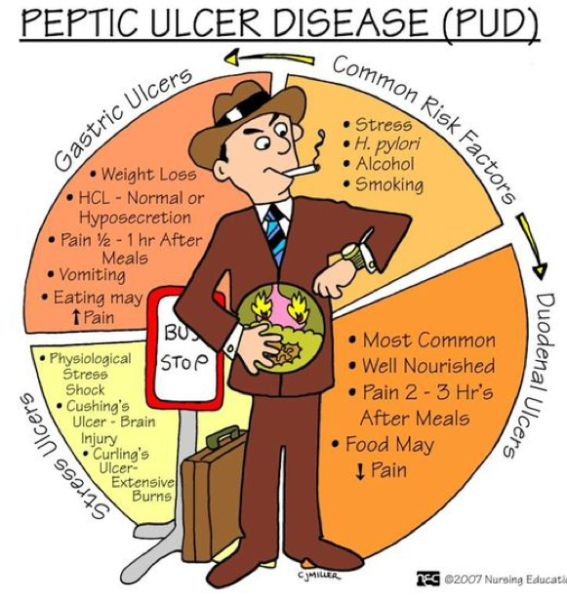

Slide 9
CAUSES
H. pylori - a spiral, urease producing flagellated bacterium which lives between the mucus gel and mucosa.
The bacterium produces lots of factors, which enable its existence in the acidic environment that include:
  Urease: which splits urea to CO2 and ammonia, and alkalinize the acidic environment
disturb the gel and increase tissue exposure to acid and pepsin.
H. pylori is seen in 95% of pts with duodenal ulcers and 80% of gastric ulcers.

Slide 10
CAUSES
The prevalence of H. pylori infection varies throughout the world and depends to a great extent on the overall standard of living.
In developing countries 80% of the population may be infected by age 20.
Transmission of H. pylori occurs from person to person following an oral-oral or fecal-oral route
NB: only 10-20% of pts who are infected with H. pylori will develop ulcers.

Slide 11
CAUSES
Pathophysiology:
H. pylori infection is virtually associated with chronic active gastritis, but only 10 - 15% of the infected individuals develop frank peptic ulcerations. The basis for this difference is unknown.
The end results are dependent upon the interplay between bacterial and host factors.
The end results of H. pylori infection are:-
  Gastritis
  Mucosa associated lymphoid tissue Lymphoma (MALT lymphoma)
  peptic ulcer diseases
  Gastric cancer

Slide 12
CAUSES
NSAID’s - inhibit prostaglandins which in turn increases tissue exposure to acid and pepsin.
These drugs inhibit prostaglandin synthesis, which maintains gastro- duodenal mucosal integrity and repair.
Gastric ulcers occur at somewhat higher frequency than duodenal ulcers.

Slide 13
CAUSES
Zollinger-Ellison syndrome - is a gastrin secreting tumor which creates such a high acid level it over rides the protective gel.
Cigarette smoking - inhibits bicarbonate ion production and increases gastric emptying.

Slide 14
CAUSES
Bile salts
Emotional stress
Type O blood
Prolonged use of corticosteriods
Caffeinated beverages
NB: diet and alcohol alone are not predisposing factors to the development of peptic ulcers.

Slide 15
CLINICAL FEATURES
Epigastric pain - (gnawing, aching or burning) .
Gastric ulcer
Symptoms often do not follow a consistent pattern, especially when ulcer is located in pyloric channel, where symptoms of obstruction may predominate (bloating, nausea, vomiting due to edema and scarring).
Duodenal ulcer
Pain tends to be consistent, usually absent when patient wakes up but appears in midmorning, and relieved by food but recurs again 2 - 3 hours after a meal.
Pain may be severe enough to awaken patient at night.
Physical exam of uncomplicated PUD, there may be a finding of epigastric tenderness.

Slide 16
CLINICAL FEATURES
Change in the character of pain may herald development of complications:
Duodenal ulcer pain that becomes constant, is no longer relieved by food or antacids, or radiates to the back or to either upper quadrant, may signal penetration of the ulcer to the pancreas.
Duodenal ulcer pain accentuated rather than relieved by food, and/or accompanied by vomiting often indicates gastric outlet obstruction (G.O.O).
Abrupt, severe or generalized abdominal pain is characteristic of free ulcer perforation into the peritoneal cavity.

Slide 17
CLINICAL FEATURES
Physical finding
Epigastric tenderness is most frequent finding.
Signs of peritonitis may be found in ulcer perforation.
Succussion splash is often detected in gastric outlet obstruction.

Slide 18
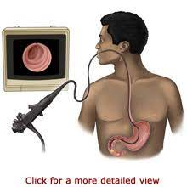
DIAGNOSIS
Definite diagnosis can only be made by visualization with an upper GI endoscopy.
Endoscopy:
  a biopsy which is definitely needed for gastric ulcers to rule out malignancy.
  H.Pylori testing

Slide 19
DIAGNOSIS
Several ways to determine H. pylori infection
1) invasive
a) during endoscopy a rapid urease test, histologic
study, or culture can be done.
2) noninvasive
a) serologic studies which can not be done as a
follow up for cure due to antibodies being
positive for several years after eradication of
infection.
b) urea breath test can be used to confirm cure.
c) stool antigens test can also be used to confirm
cure.

Slide 20
DIAGNOSIS OF PUD
1) Barium examination of the upper gastrointestinal tract: sensitivity of this investigation to detect ulcers ranges from 70 – 90%
2) Endoscopy: is most sensitive and specific method for the diagnosis of PUD.
Advantages
  Direct visualization and photographic documentation of the ulcer is possible.
  Permits mucosal biopsy for detection of H. pylori infection.
  Provides baseline reference for the assessment of ulcer healing.
3) Tests for H. pylori There are two categories of tests for the diagnosis of this bacterium:
i) Invasive tests (endoscopy required)
  Rapid urease test
  Histology
  Culture
ii) Non invasive tests
  Urea breath test - simple, rapid; useful for early follow up, false negative with recent therapy.
  Serology – inexpensive, convenient, not useful for early follow-up
  Stool antigen test

Slide 21
TREATMENT
Objectives of treatment:
Relief of symptoms (pain, dyspepsia)
Eradication of H. pylori to prevent recurrence
Promote ulcer healing

Slide 22
TREATMENT
Stop any offending agents such as NSAID’s.
Restriction of certain diets with frequent feedings has not been shown to be effective.

Slide 23
TREATMENT
Antacids – neutralize gastric acids.
a) good for acute pain relief and healing ulcers.
b) poor compliance due frequency of doses.
c) inhibit absorption of some drugs such as warfarin,
digoxin, some anticonvulsants and antibiotics.
d) aluminum causes constipation and should not be
given with renal failure pts due to
accumulation which can cause osteoporosis and
encephalopathy.
e) magnesium causes diarrhea.

Slide 24
TREATMENT
H2- Antagonists – inhibit gastric acid secretion
a) equally as effective as antacids with better
compliance due to decreased frequency of
doses.
b) cimetidine inhibits cytochrome p450 system
greater than other H2-antagonists which
will cause an increase in drugs such as
warfarin, phenytoin, diazepam, propranolol,
etc.
c) renal excretion and therefore must adjust doses in
patients with renal disease.

Slide 25
TREATMENT
Proton Pump Inhibitors - inhibit gastric acid secretion
a) heal ulcers faster then H2-antagonists and
antacids.
b) omeprazole has also been shown to affect
the cytochrome p450 system.
c) lansoprazole does not affect other drug
metabolism.
d) esomeprazole has been shown to decrease
bleeding from peptic ulcers.

Slide 26
TREATMENT
Sulcralfate – locally binds to the base of the ulcer and therefore protects it from acid
a) Also has been shown to absorb bile acids,
inhibit pepsin activity, and increase
prostaglandin production.
b) Needs an acidic environment to work
therefore not beneficial to give antacids
c) Causes constipation, dry mouth and inhibits
the absorption of many medications.

Slide 27
TREATMENT
Misoprostol – prostaglandin E1 analogue which acts as natural prostaglandin in the body
a) Only indicated for prevention of NSAID
-induced gastric ulcers in high risk patients.
b) contraindicated in pregnant women and
women in childbearing age because it
causes spontaneous abortion.
c) can cause diarrhea and crampy abdominal
pain.

Slide 28
TREATMENT
Bismuth compounds – decrease pepsin activity, increase mucus secretion, form a barrier protection on ulcers, augment prostaglandin synthesis, slow hydrogen ion diffusion across mucosal barrier, and H. pylori bactericidal effect.
a) Used in triple drug combinations for
the treatment of H. pylori.

Slide 29
TREATMENT
If H. pylori positive then must be given antibiotics to prevent recurrence of ulcer.
Usually done with triple or quadruple treatment regimens.
Some antibiotics in regimens are metronidazole, tetracycline, amoxicillin, clarithromycin plus a PPI
A Cochrane meta-analysis of 55 studies concluded that 14 days is the optimal duration of triple therapy, achieving an H pylori eradication rate of 81.9%, whereas 7 days attains an eradication rate of only 72.9%.

Slide 30
TREATMENT
First line therapy
Proton pump inhibitor (PPI)
EX: omeprazole 20 mg BID, lansoprazole 30 mg BID, esomeprazole 40 mg BD, pantoprazole 40 mg BD, rabeprazole 20 mg BID
plus
Clarithromycin 500 mg BID (first-line and continues to be recommended in areas where H pylori clarithromycin resistance is less than 15% and in patients without previous macrolide exposure or metronidazole 500 mg BID (when clarithromycin resistance is increasing)
plus
Amoxicillin 1000 mg BID or metronidazole 500 mg BID (if not already selected)

Slide 31
TREATMENT
Second-line therapy
Second-line therapy should avoid repeating first-line regimens that were already used, and should incorporate at least one different antibiotic.
Bismuth-based therapy or levofloxacin-containing triple therapy can be used.

Slide 32
TREATMENT
Esomeprazole 20 mg BID
plus
Levofloxacin 500 mg BID
plus
Bismuth 220 mg BID
plus
Amoxicillin 1000 mg BID OR cefuroxime 500 mg BID
PPI or H2 receptor antagonist lansoprazole 30 mg BID or ranitidine 150 mg BID
plus
Bismuth subsalicylate 525 mg QID or bismuth tripotassium dicitrate 300 mg QID
plus
Metronidazole 250 mg QID or 500 mg TID (or levofloxacin)
plus
Tetracycline 500 mg QID

Slide 33
TREATMENT
Third-line therapy
PPI (lansoprazole 30 mg BID)
plus
Bismuth potassium citrate 220 mg BID
plus
Tetracycline 500 mg QID or amoxicillin 1 g TID
plus
Furazolidone 100 mg TID or tetracycline 500 mg QID (if not already selected) or metronidazole 400 mg QID

Slide 34
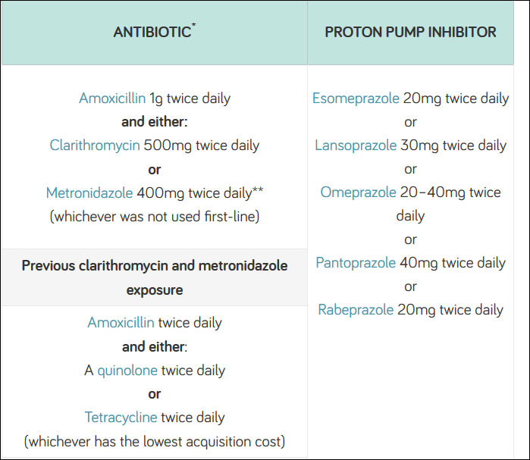

Slide 35
COMPLICATIONS OF PUD
GI bleeding is the most common complication of PUD
PUD most common cause of upper GI bleeding.

Slide 36
COMPLICATIONS OF PUD
GI Bleeding
Is the most common complication of PUD
patients present with hematemesis, passage of tarry stools, weakness, hypotension, syncope, thirst and sweating resulting from associated blood loss.

Slide 37
COMPLICATIONS OF PUD
Perforation
Initially a chemical peritonitis develops which then progresses to a bacterial peritonitis.
Anterior perforation - patients will have sudden abdominal pain with guarding and rebound.
60-70% will demonstrate free air on x-rays.
Posterior perforation - patients will develop back pain with no free air on x-ray
may mimic pancreatitis but lipase will be normal or only slightly elevated.
No free air on x-rays cannot rule our perforation.
IV fluids, electrolyte corrections, NG tube, broad spectrum antibiotics and surgery.

Slide 38
COMPLICATIONS OF PUD
Gastric outlet obstruction
Scaring from healed ulcers or edema from active ulcer with development of obstruction.
Obstruction will cause gastric dilation, vomiting, dehydration, metabolic alkalosis.
Pts will develop upper abdominal pain with vomiting, early satiety, weight loss, succussion splash.
Abdominal x-ray will show dilated stomach shadow with large air-fluid level.
IV fluids, electrolyte corrections, NG tube, and surgery.

Slide 39
CA STOMACH
MEDICINE 2
GIT DISORDERS

Slide 40
INTRODUCTION
Ambition is never content, even on the summit of greatness .
He conquered the larger part of Europe, but he could not conquer gastric cancer
Napoleon‘s gastric cancer tumor was found on the lesser curvature of the stomach

Slide 41
Why Napoleon died of GC?
Diet
“full of salt-preserved foods but sparse in fruits and vegetables- common fare for long military”
H. pylori
The new study suggest he was chronically infected with the bacteria Helicobacter pylori.”
Genetic factors
“his father had also died of stomach cancer which led to the theory that he had inherited the disease.”
Precancerous changes
chronic atrophic gastritis?

Slide 42
GASTRIC CANCER
Early gastric cancer
Defined as a tumor confined to the mucosal or submucosal layer, with or without lymph node metastasis

Slide 43
GASTRIC CANCER
Advanced gastric cancer
invasion depth beyond submucosal layer

Slide 44
BORMANN CLASSIFICATIONS
Gross classification
phymatoid type
ulcerative type
infiltrative ulcerative
diffuse infiltrative type

Slide 45
HISTOLOGY CLASSIFICATION
Adenocarcinoma occupy 95%
Lymphomas 2%
Carcinoids 1%
Adenocathomas 1%
Squamous cell 1%

Slide 46
SPREAD PATTERNS
Direct invasion
Lymph node dissemination
Blood spread
Intraperitoneal colonization

Slide 47
HISTORY TAKING
Epigastric Discomfort, Dyspepsia
Dysphagia
Wt loss
Anorexia and early satiety
Haemetemesis
Malena
Altered Bowel habits
Bleeding P/R
Shortness of breath
Jaundice
Smoking
Past history
Family history

Slide 48
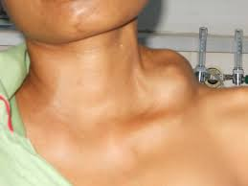
PHYSICAL EXAMINATION
Pallor
Lymph nodes
  Lt Supraclavicular (virchow)
  Ant Axillary (irish nodes)
  Cervical lymph nodes

Slide 49
PHYSICAL EXAMINATION
Trousseau,s sign
  Thrombophelbitis
Acanthosis Nigricanus
  Hyperpigmentation

Slide 50
PHYSICAL EXAMINATION
Abdomen
Mass epigastrium moves with respiration
  hard
  non tender
  irregular
  Separate from liver
Succussion splash
Periumblical metastasis
  Sister Mary Joseph nodule
Hepatomegaly
Pelvic Masses
  Krukenberg tumor
Ascites

Slide 51
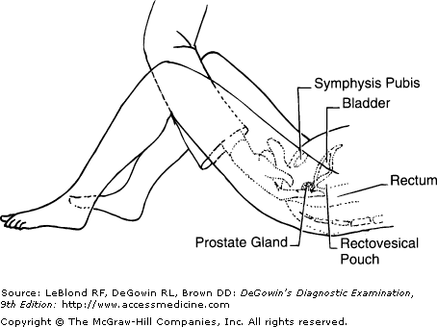
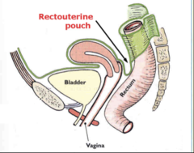
PHYSICAL EXAMINATION
DRE
Blumer shelf
Hard nodularity extraluminaly and anteriorly also called, Drop metastasis

Slide 52
CLINICAL MANIFESTATIONS
Early symptoms
Asymptomatic or silent 80%
Peptic ulcer symptoms 10%
Nausea or vomiting 8%
Anorexia 8%
Early satiety 5%
Abdominal pain 2%
Gastrointestinal blood loss <2%
Weight loss <2%
Dysphagia<1%

Slide 53
CLINICAL MANIFESTATIONS
Advanced Gastric Cancer
Weight loss 60%
Abdominal pain 50%
Nausea or vomiting 30%
Anorexia 30%
Dysphagia 25%
Gastrointestinal blood loss 20%
Early satiety 20%
Peptic ulcer symptoms 20%
Abdominal mass or fullness 5%
Asymptomatic or silent <5%

Slide 54
CLINICAL MANIFESTATION
Linitis plastic→ diffusely infiltrating with a rigid stomach
Virchow’s node→ left supraclavicular lymph node
Sister Mary Joseph’s node→ umbilical lymph node
Prerectal pouch mass (Blumer shelf)→ seeding metastasis

Slide 55
DIAGNOSTIC WORKUP
Laboratory tests
Assists in determining optimal therapy.
CBC identifies anemia, with may be caused by bleeding, liver dysfunction, or poor nutrition.
30% have anemia.
Tumor markers
  CEA:carcino-embryonic antigen
  CA19-9:carbohydrate antigen
  CA724:carbohydrate antigen

Slide 56
DIAGNOSTIC WORKUP
Upper GI endoscopy 95 % accuracy
Tissue diagnosis
Ulcerated lesion (take 6 biopsies around the lesion)

Slide 57
DIAGNOSTIC WORKUP
Double contrast upper GI series and Barium swallow 75% accuracy for obstructive lesions only

Slide 58
DIAGNOSTIC WORKUP
Chest X ray
  lung mets
  plurel effusion
U/S abdomen
  liver mets
CT scan Abdomen and Pelvis
  loccaly advanced disease
  Metastasis
  Extra regional lymphadenopathy

Slide 59
TREATMENT
Surgery is the only curative treatment for gastric cancer.
It is the best palliation
provides the most accurate staging.
Exceptions
patients who cannot tolerate an abdominal operation
patients with overwhelming metastatic disease.

Slide 60
TREATMENT
1. Early staged carcinoma
reduced radical resection
laparoscopic surgery
endoscopic mucosal resection (EMR)
endoscopic submucosal dissection (ESD)
2. Advanced carcinoma
Radical resection
Palliative surgery

Slide 61
TREATMENT
Chemotherapy
the most widely used regimen is 5-FU(S1/Xeloda), DDP, Oxaliplatin and Taxol
Radiotherapy
provides relief from bleeding, obstruction and pain in 50-75%.
Median duration of palliation is 4-18 months

Slide 62


