Slide 1
PERIOPERATIVE CARE AND ANAESTHETIC NURSING
C. MACHARIA

Slide 2
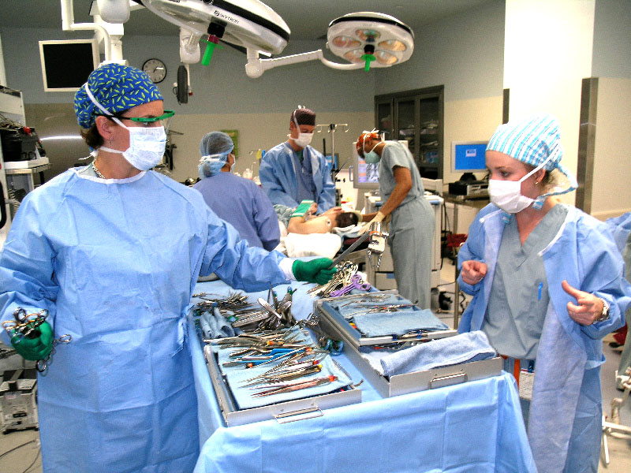

Slide 3
Module Objectives
By the end of this unit you will be able to;
Describe the historical background of theatre nursing;
Explain the legal requirements to be met by an
operating theatre;
Describe the general layout of the operating theatre;
Describe the instruments used in a theatre;
Describe the methods of ensuring safety and infection prevention in the theatre;
Explain the Roles and functions of the theatre Nurse in the care of a patient while in theatre;

Slide 4
HISTORY OF THEATRE NURSING
Theatre nursing has developed alongside the history of surgery
Surgery is an old form of treatment that can be traced back through the history of man.
In the past, there were no theatres, no trained personnel, no anaesthesia and no equipment.
Operations were performed at home.
Problems during this time included infection, bleeding and pain. However, with time, efforts were made to solve these problems.
For example, in 17 BC, alcohol and opium were used to relieve pain by Napoleon who performed an amputation while the patient slept for 24 hours.

Slide 5
By 1772, Joseph Priestly discovered the use of nitrous oxide as anaesthesia,
In 1842, Dr Crawford discovered the use of ether.
In 1847 James Young began to use chloroform.
In the 18th century a great breakthrough was made with the use of trilene, thiopentone, clytopopaine and curare, which are muscle relaxants.
By the end of 19th century, pain relief was an integral part
of surgery.
In order to control haemorrhaging, the ancient Greeks and Romans as far back as the 16th century BC, used strings as ligatures. Later on, during the Middle Ages, they came up with the use of hot iron
This idea has been developed into the use of cautery to control bleeding.

Slide 6
By the beginning of the 20th century, many types of ligatures were available, prepared from metal, nylon and cotton.
The control of infection dates back to the efforts of Louis Pasteur, who proved that bacteria caused infections.
In 1865, Joseph Lister used carbonic acid to reduce the growth of bacteria in wounds.
In 1886 Von Bergemen introduced sterilisation of dressings.
Gloves were introduced in surgery in 1890.

Slide 7
Theatre nursing
Theatre nursing is as old as nursing
A theatre nurse is a member of a bigger team, all of whom work together to provide a safe passage through the operating theatre for every patient.
Theatre team includes ( the nurse, anaesthetist, surgeon, theatre assistant)
However small or insignificant the task to be performed, the theatre nurse is responsible for the success of the procedure.
They must, therefore, be highly skilled and trained, in order to be able to ensure a successful outcome for the patient.

Slide 8
Aims of theatre nursing
To prepare conscientiously by study to adapt to the changing world of medicine,
To allay the fears of the patient,
To integrate the patient care during their period in theatre,
To become highly skilled in theatre techniques,
To be able to impart knowledge to others,

Slide 9
Surgical team
Consists of:
The patient
The surgeon
The anesthetist/anesthesiologist
The theatre technicians
The nurses(pre-op, intra-op, PACU and post-op ward nurses)

Slide 10
.
  Perioperative nursing - term used to describe the nursing care provided during the total surgical experience of the patient: i.e. during preoperative, intraoperative, and postoperative periods.
  Preoperative period - from the time the decision is made for surgical intervention to the transfer of the patient to the operation.

Slide 11
Intraoperative period - from the time the patient is received in the operating room until admitted to the post anesthesia care unit (PACU).
Postoperative period - from the time of admission to the PACU to the follow-up evaluation.

Slide 12
Anesthesia care provider - a professional who can administer and monitor anesthesia during a surgical procedure; may be a doctor (anesthesiologist) or a certified registered nurse anesthetist (CRNA), or a clinical officer anesthetist.

Slide 13
Indications for Surgery
Diagnosis – e.g. biopsy or exploratory laparotomy.
Curative – e.g. excision of a tumor or an inflamed appendix.
Reparative – e.g. multiple wound repair.
Reconstructive or cosmetic – e.g. mammoplasty or a facelift.
Palliative – e.g. to relieve pain/symptoms

Slide 14
Types of Surgery
Elective – not an emergency; scheduled time for surgery convenience of the pt; e.g. a planed C/S for a pregnant mother.
Required – (cold cases); the condition requires surgery within a few wks.
Emergency - the situation requires immediate surgical attention without delay.

Slide 15
Ambulatory Surgery
Same-day surgery, outpatient surgery.
The surgical outpatient clinic (SOPC) nurse is in a key position to assess pt status; plan the perioperative experience; and monitor, instruct, and evaluate the pt.

Slide 16
Advantages of Day Cases
    Reduced cost to the facility, and insuring and governmental agencies
    Reduced psychological stress to the pt
    Less incidence of hospital-acquired infection
    Less time lost from work by the pt; minimal disruption of the pt's activities and family life

Slide 17
Disadvantages of Day Cases
    Less time to assess the pt and perform preoperative teaching
    Less time to establish rapport between the pt and health care personnel
    Less opportunity to assess for late postoperative complications

Slide 18
Preoperative Care
Preoperative evaluation
Complete history and Proper documentation; .menstrual , reproductive, allergies, chronic conditions etc
Clinical examination-general head to toe, vital signs, weight, height ,and systems review.
Investigations Full haemogram, Urea and electrolyte ,LFT’S GXM,RBS, as the baseline and other relevant test particular to the patient..

Slide 19
You should make sure that the surgeon explains clearly to the patient what will happen to them.
The surgeon should obtain an informed consent from the patient or parent/guardian/next of kin for those under age 18 in Kenya or not in a position to sign (e.g. unconscious person, mentally ill ).
The nurse ensures that the patient has signed an informed consent, after the surgeon has explained the advantages and outcomes of the operation.
Make sure that the patient observes a ‘Nil by oral’ rule.

Slide 20
Pre-operative care
The fasting should usually start six hours before the operation-consider the diabetics.
Blood works: All should be within the acceptable ranges e.g. full haemogram including HB, urea, electrolytes and creatinine.
The patient should be counselled and reassured especially those receiving operations such as amputation, or mastectomy
The site to be operated on should marked be shaved 30min before operation and cleaned with warm soapy water, to reduce the bacteria on the patients skin. The area shaved should be larger than the incision site.

Slide 21
ct
Catheterisation may be necessary depending on the surgery.
Observations of vital signs, urine testing for sugars, proteins and acetone should be done, some of the requirements form some of the legal aspects before surgery.

Slide 22
Remember….
Manage and treat/stabilize any patient with pre existing medical condition
Give up smoking 6/52 or at least over 48 hours.
Pre-anaesthetic review
Drug history
Preoperative counseling
Patient has a right to know the extent and risks of any intended surgery,
An outline of the immediate postoperative recovery

Slide 23
Assessment of Health Factors that affect Patients Preoperatively
  Nutritional and fluid Status
  Drug or alcohol use
  Respiratory status
  Cardiovascular status
  Hepatic and renal function
  Endocrine function
  Immune function
  Previous medical experience
  Psychosocial factors

Slide 24
Nutritional and Fluid Status
Optimal nutrition - essential factor in promoting healing and resisting infection
Assess of a pt’s nutritional status provides info on obesity, undernutrition, wgt loss and malnutrition
Dehydration, hypovolemia, and electrolyte imbalances can lead to significant problems in pts

Slide 25
Drug or Alcohol Use
Acutely intoxicated persons are susceptible to injury – surgery postponed if possible.
To prevent vomiting and potential aspiration, an NG tube is inserted b4 administering GA.
Pts with a history of chronic alcoholism often suffers from malnutrition and other systemic problems that increase the surgical risk

Slide 26
Alcohol withdrawal delirium –
  May be anticipated up to 72 hrs after alcohol withdrawal
  In postop period, its associated with significant mortality rate
  Alcoholics may end up needing a higher dosage of anesthesia during operation

Slide 27
Respiratory Status
Goal for potential surgical pts is optimal respiratory function
Pts who smoke urged to stop before surgery
Because adequate ventilation is potentially compromised during all phases of surgical treatment, surgery is usually postponed when the pt has a respiratory infection

Slide 28
Cardiovascular Status
The goal in preparing any pt for surgery is to ensure a well functioning cardiovascular system to meet the oxygen, fluid, and nutritional needs of the perioperative period.
Cardiovascular disease increases the risk for complications.

Slide 29
Hepatic and Renal Function
The presurgical goal is optimal function of the liver and urinary systems so that meds, anesthetic agents, body wastes, and toxins are adequately processed and removed from the body.
Liver - important in the biotransformation of anesthetic compounds.
Kidney - involved in excreting anesthetic drugs and their metabolites.

Slide 30
Endocrine Function
DM pts - at risk for hypo and hyperglycemia.
Hyperglycemia -
  May ↑ the risk for surgical wound infection
  May result from the stress of surgery - which may trigger ↑ levels of catecholamine.
Other risks are acidosis and glucosuria.
Pts who have received corticosteroids are at risk for adrenal insufficiency.

Slide 31
Pts with uncontrolled thyroid disorders are at risk for thyrotoxicosis (with hyperthyroid disorders) and respiratory failure (with hypothyroid disorders).

Slide 32
Immune Function
Preop assess – determine the existence of allergies, including the nature of previous allergic reactions.
Document sensitivity to meds and past adverse reactions (boldly and clearly)
Immunosupression - pts who are immunosuppressed are highly susceptible to infection, great care taken to ensure strict asepsis.

Slide 33
Current & Previous Medication Use
Obtained due to possible effects of meds on the pt’s perioperative and perianesthesia course and the possibility of drug interactions.

Slide 34
Psychosocial Factors
All pts have some type of emotional stress before any surgical procedure.
Psychological distress directly influences body functioning.
It is imperative to identify any anxiety the pt is experiencing.

Slide 35
General pre-op patient teachings
Incentive spirometry
Coughing
Turning
Foot and leg exercises
Pain management

Slide 36
Principles of Perioperative Asepsis
    Rigorous adherence to the principles of surgical asepsis is the foundation of preventing surgical site infections
    All surgical supplies, instruments, needles, sutures, dressings, gloves, covers, and solns that may come in contact with the surgical wound and exposed tissues, must be sterilized b4 use

Slide 37
Surgical team members wear long-sleeved sterile gowns and gloves
Head and hair are covered with a cap
Mask is worn over the nose and mouth to minimize the possibility that bacteria from the Respiratory Tract will enter the wound
The gloved and gowned scrubbed personnel only touch sterilized objects

Slide 38
Nonscrubbed personnel refrain from touching or contaminating anything sterile
An area of the pt’s skin considerably larger than that requiring exposure during the surgery is meticulously cleansed, and an antimicrobial agent is applied
If hair needs to be removed, it is done immediately prior to the procedure to minimize the risk of wound infection

Slide 39
The remainder of the pt’s body is covered with sterile drapes
Surgical asepsis requires meticulous cleaning and maintenance of the OR environment : -
  Floors and horizontal surfaces are cleaned frequently with detergent, soap, and water
  Sterilizing equipment is inspected regularly to ensure optimal operation and performance.

Slide 40
  All equipment that comes into direct contact with the pt must be sterile
  Instruments are cleaned and sterilized in a unit near the OR
  Airborne bacteria are a concern - to decrease the amount of bacteria in the air, standard OR ventilation provides 15 air exchanges per hour

Slide 41
Legal Aspects in Theatre Nursing
‘legal’. The dictionary defines the word legal as 'required’ or 'permitted by law'.
Therefore, when we talk of legal aspects in theatre nursing, we are referring to what the law requires us to do in the theatre before, during and after the operation.

Slide 42
Important considerations
    Right to life/principle of justice
    Respect of autonomy-respect to ones opinion
    Principle of non maleficence –do no harm (beneficence)
COMMON ENCOUNTERED LEGAL ISSUES
Consent, Negligence, inadequate documentation, inexperience, clinical errors, confidentiality, patients security.
Consent:
Consent must be:
    Legally valid e.g. given by a person above 18 years, of sound mind and voluntary not coerced
    Administered by a competent doctor
    Must be informed

Slide 43
Negligence: clinician not providing adequate /reasonable information about risks of proposed treatment.
Inadequate documentation: improper and incomplete notes, lack of documentation.
Inexperience /inadequate experience/lack of experience: No clinician is an expert of everything, clinician should seek appropriate guide,/supervision and refuse to proceed.
Clinical errors (not negligence) clinician need to be honest and apologetic for their mistakes ,this is not admitting negligence. Patients accept apologies but not explanations.

Slide 44
The importance of confidentiality in nursing practice was stressed. This is another legal requirement.
In the definition of legal, the term ‘permitted by law’ implies that you can only carry out patient care within what the law permits you to do.
Therefore, the law gives the patient seeking medical, surgical and nursing care, rights under which they are to be managed.

Slide 45
7. Security/Safety of the patient before, during and after operation is vested in the theatre team.
    It has already been implied earlier that by signing the consent form, the patient takes some responsibility for the whole loss of life or part of their body.
    However, this does not take away the responsibility of the theatre team to ensure the security of the patient's life during the operation.

Slide 46
It is on this basis that those below the legal age of adulthood (18 years in Kenya) are not legally bound to sign the consent form.
It is signed by the parents/guardians on their behalf. In the same way, consent for the mentally ill is sought from their parents/guardians/relatives.
It is also important to note that consent for an operation should be obtained from the patient before they are pre-medicated, as pre-medication drugs have the potential of affecting their reasoning capacity, hence making consent signed not legally binding.

Slide 47
The legal aspect in theatre nursing involves the care of the patient from the time the patient is accepted in theatre, until they are handed over back to the ward.
For these reasons, the following procedure should be adhered to:
    Any patient going to theatre must be properly prepared preoperatively.
    The patient must be well labelled.
    The patient must sign an informed consent, obtained by the surgeon.
    The patient must be protected from any harm, falls or eventuality, during the stay in theatre.
    Confidentiality must be observed regarding the patient.

Slide 48
    Measures must be taken to ensure that the patient taken to theatre is the right one for the intended operation.
    The items to be used for the operation must be counted and recorded before and after operation to prevent loss of swabs, tubes, blades, forceps, abdominal packs and any instrumented.
    Theatre nurses must know where the exits are, for use in case of an emergency.
    Sockets in theatre should be covered during scrubbing to prevent risk of conducting currents. They should also be one meter or more above the floor level.
    All electrical machines must be checked to ascertain optimum function before use on the patient.

Slide 49
INTRAOPERATIVE CARE
Involves:
The surgical team and the individual roles
Theatre layout and the restricted areas
Common body positions during surgery
Potential intra-operative complications
Anesthesia

Slide 50
Theatre design considerations
The design depends on the :
  Number, type and length of the surgical procedure to be carried out.
  Type and distribution of specialties of the surgical team and the equipment required by each.
  Staff, patients and other personnel safety during construction and renovation.
  Equipment’s and surgical specialty
  Scheduling policy
  Volumes- patients and size of the hospital.
  Planned technology.
  Future plans expansion.

Slide 51
Design consideration
Systems and procedures for efficient patient, staff and supplies flow
Scheduling policies related to the number of hours per day and days per week the suit will be in use.
Design , ventilation and control of pollution and traffic all need to be considered in the design of the operating room.
A proper design of the operating theatre allows a one way flow of traffic and prevents the return flow of contaminants in to the clean area.
Operated patient should not meet with the unoperated patient

Slide 52
12. separate areas should be allocated for use
    Anesthetic room
    Scrub area
    Sterile supply area
    Dirty utility area
    Sterilizing room
    Unsterile stock and heavy equipment area
    Plaster room
    Receiving area
    Recovery area/pacu
    Staff lounge
    Dark rooms for x-ray
    Changing room and cleaners room
    Laboratory
    Operating suite
    Clean corridors
    Separation between restricted and semi restricted areas

Slide 53
Design - Theatre light
Fluorescent lighting is best for general illumination, with provision for emergency back up (portable light)
In patients areas , white light is preferred as blue light will make the patient look cyanosed
Over head lights should be shadow less and made of tungsten lamps and incandescent bulbs with heat filters that act as reflectors to prevent over heating of patients and theatre staff.
The lights should be dimmed and increased by turning a knob
The lights should have an autoclavable handle covers so that the surgeon can adjust the position of the light on the operating site.

Slide 54
size
Theatres should be of equal sizes if possible.
They should measure 20 by 20 by 10 ft. (L W H, or 400 sq.ft
Larger rooms for complicated procedures like cardiac surgery

Slide 55
Wall and ceiling
Walls and ceilings should be solid without windows,
Finishes of all surface material should be hard, non porous, fire resistant, waterproof, stain proof, seamless, non reflective and easy to clean .
The ceiling should be a minimum of 10 feet high and have seamless construction
The ceiling colour should be white to reflect at least 90% of the light in even dispersion.
Walls should be pastel colour (soft, neutral e.g. baby blue) with paneling made of hard vinyl materials that is easy to clean and maintain.
The walls should have stainless cuffs at collision corner to prevent damage.

Slide 56
Floors
The floor should be made of antistatic materials.
It should be probably made of terrazzo or seamless polyvinyl chloride that is continued up the sides of the wall for about six inches.
The material should not degrade or wear out with aging and cleaning.
They should be slip-proof when wet
It should be easy to clean by flooding or wet vacuum cleaning.

Slide 57
Doors and ventilation
Doors:
    Should about 4ft wide
    Sliding doors, that can be swung open when necessary
    They should not remain open during surgical procedures
Ventilation:
    Air movement and air conditioning in the operating theatre are regulated so that the patient and theatre staff are comfortable.
    Air flow in the operating room is directed clean to less clean areas.
    Relative humidity is maintained at between 50-55%
    Heat and water loss can occur in small babies during prolonged operations in cool air conditioning, hence humidity needs to be adjusted

Slide 58
Recirculating air
A certain amount of the exhaust air is filtered to remove bacteria and is then re introduced to the operating room.
Control of pollution and traffic
Anesthetic gases are scavenged from the expiratory valve of the anesthetic machine to the atmosphere via tubing
Traffic of personnel is restricted in the operating room
A limited number of staffs should be present

Slide 59
Traffic flow
Unrestricted area:
    personnel may wear street cloths, and traffic is not limited.
In semi-restricted area:
    such as processing and storage areas for instruments and supplies, as well as corridors leading to the restricted areas of the surgical suite, personnel must wear surgical attire and patients must wear gowns and hair coverings
Restricted area:
    This includes operating room and clean core and scrub sink areas.
    Surgical attire and mask are required in these areas when there are open sterile supplies or scrubbed persons in the area.

Slide 60
The flow of supplies should from clean core area through the operating rooms to the peripheral corridor.
Soiled materials should not re-enter the clean core area

Slide 61
Location
1. Theater should be located in an area accessible to the;
      Critical Care Unit,
      Sterile Supplies Area
      Laboratory Department
      The Radiology Department
2. A terminal location is necessary to prevent un related traffic from passing through the suite.

Slide 62
Traffic patterns
In the restricted areas there are:
    Open sterile supplies
    Scrubbed personnel
    All personnel should wear masks and caps
    Sterile procedures
Semi restricted area:
    Personnel to wear scrubs/theatre attire, and caps
    Patients hair should be covered
    Only authorized personnel

Slide 63
Members Of The Surgical Team
The surgeon
Anaesthesiologist
Nurse manager
Receiving area nurse
Circulating nurse
Scrub nurse

Slide 64
Theatre equipment’s
The operating table
The operating lights
The anaesthetic machines
The anaesthetic cart
Sterile instruments
Electronic monitor
The pulse oximeter machine
Automated blood pressure machine
An electrocautery machine (Diathermy machine)
heart-lung machine
Diagnostic imaging systems such as MRI and cardiac catheterization
Instruments and patients trolleys
Drip stands
Laryngoscopes
Suction machines
autoclave

Slide 65
Basic general instruments
Cutting instrument’s- scalpel, scissors
Holding instrument’s- dissecting forceps, sponge holding forceps, towel clips, babcock’s tissue holding forceps, tissue forceps, kockers.
Clamping instruments- artery forceps.
Exposing instruments- Retractors.
Suturing instruments- needle holders, suturing forceps toothed and non toothed and ligature scissors.

Slide 66
Maintaining a sterile field/Principles of aseptic technique
Placing sterile items within sterile field and only sterile items are used within sterile field
Opening, dispensing or transferring sterile items without contaminating them.
Not allowing sterile personnel to reach across unsterile areas and touch unsterile items
Not allowing unsterile personnel to reach across the sterile field or to touch sterile items.

Slide 67
Whatever is sterile for one patient can only be used for that patient.
You must pour sterile fluids from a point high enough to prevent accidental touching of the receptacle, but this should not produce splashing.
If there is any doubt about the sterility of an article or area, it is considered unsterile
Sterile objects become unsterile when touched by unsterile objects.
Sterile items that are out of vision or below the waist level of the nurse are considered unsterile.
Sterile objects can become unsterile by prolong exposure to airborne microorganisms.
The edges of a sterile field are considered unsterile.

Slide 68
Gowns of the surgical team are considered sterile in front from the chest to the level of the sterile field. The sleeves are also considered sterile from 2 inches above the elbow to the stockinette cup.
Sterile drapes are used to create a sterile field. Only the top surface of a draped table is considered sterile. During draping of a table or patient, the sterile drape is held well above the surface to be covered and is positioned from front to back.
A tear or puncture of the drape permitting access to an unsterile surface underneath renders the area unsterile. Such a drape must be replaced.
Sterile fields should be prepared as close as possible to the time of use.

Slide 69
The movements of the surgical team are from sterile to sterile areas and from unsterile to unsterile areas.
Scrubbed persons and sterile items contact only sterile areas;
Circulating nurses and unsterile items contact only unsterile areas.
Movement around a sterile field must not cause contamination of the field.
Sterile areas must be kept in view during movement around the area. At least a 1-foot distance from the sterile field must be maintained to prevent inadvertent contamination.
Whenever a sterile barrier is breached, the area must be considered contaminated.

Slide 70
SAFETY AND INFECTION PREVENTION IN THEATRE
Safety and infection prevention are of utmost importance in the operating theatre. To ensure this, in this section you will consider the:
    preparation of the operating theatre,
    theatre nurse and the gen surgical team,
    patient and equipment.
    The equipment used in theatre and types of anaesthesia.

Slide 71
1. Preparation of the operating room
The theatre and equipment must be cleaned thoroughly every morning to minimise the number of micro-organisms.
Ensure high dusting of walls and clean trolleys, drip stand, operating tables and all equipment there in.
You should also ensure that the floor is scrubbed with soapy water to remove dirt and then mopped with a disinfectant recommended by the hospital.
After cleaning and drying the theatre floor, all the equipment must be returned to its proper place and ensure they are working.
Prepare the operating table by drying it after cleaning and placing it in the right position directly below the overhead operating lights.

Slide 72
    Theatre table should then be draped with a clean sheet ready to receive the patient.
    You should then set the anaesthetic tray ready
    Check the diathermy machine to ensure it is in working order for use to cauterise any bleeding vessel during operation.
    The operating lights should be checked to ensure they are in good working order.
    The required operating set of equipment should be ordered from the theatre sterilising room/unit.
    After the operation has been completed you should:

Slide 73
After the operation you should ensure:
    Clean all fitments and equipment thoroughly
    Do high and low level dusting using the disinfectant
    Clean the floor and drains with the disinfectant
    Wipe the operating lights with a clean damp towel

Slide 74
2. Preparation Of The Nurse
After entering the theatre unit, you should go straight to the changing rooms.
Take a shower and change into your theatre suit and boots. Personal clothes should be locked in a locker within the changing room.
Your head should be covered with a clean, sterile theatre cap.
If you have any respiratory infection you are advised not to enter the operating room.
A very high standard of personal hygiene should be maintained.
You should avoid movement in and out of the theatre and any time that happens you should change into another clean theatre suit before re-entering the operating room.

Slide 75
It is advisable for you to visit the toilet to empty your bowels and bladder before taking a shower and putting on the sterile theatre suit to minimise the need of using this facility later during the theatre activities.
However, this is just a precautionary measure and you should change your theatre suit any time the toilet facilities are used if you are to go back to the operating room.

Slide 76
3. scrubbing
This is done to remove micro-organisms from the forearm and arms by mechanical washing and chemical disinfections before taking part in surgical procedure.
This helps prevent the possibility of the patient being contaminated by bacteria from the hands and arms.
Preparation for this procedure involves the following:
    The theatre suit should have the top/shirt tidily tucked in. Roll the sleeves up to at least three inches above the elbow.
    A cap should be worn to cover all the hair, tie the tape at
    the back.

Slide 77
    A mask should be worn with the short side above the nose and the long side under the chin.
    Remove all jewellery, wedding rings, dress rings, watches, earrings and necklaces.
    Finger nails must be short and clean without nail varnish.
    No cut wounds or septic wound on fingers. No upper respiratory tract infection.
    No gastroenteritis.
    Wear a mackintosh apron to protect your scrub suit. Regulate temperature and flow of water to suit you.
    Scrubbing time varies according to the type of soap or chemical used.
    For example, if using gamophen soap, which contains hexachlorophene disinfectants, you should scrub for five minutes; if using hibiscrub, two minutes; ordinary soap, ten to fifteen minutes.
    for the procedure refer to the nursing council procedure manual which you covered in the introductory block.

Slide 78
Drying / gowning and gloving
Drying :
    Pick up the towel and step back.
    Start with the left hand and blot dry the fingers, the webs of the hand and the palm well, then move to the back of the hand, and the forearm, using a circular movement to the elbows.
    Change the towel to the left hand with the wet part against the left palm. Using the dry part of the towel, repeat the same procedure on the other arm.
    When you get to the elbow, discard the used towel in the dispenser provided.

Slide 79
2. Gowning
The following procedure should be followed when gowning:
    Pick a gown and step back.
    Hold the neck-band and let the bottom hem drop.
    Open the gown and slide both hands in through the
    arm holes.
    Do not touch the outside of the gown with your bare hands.
    The Runner Nurse will first tie the neck and shoulder bands then wristbands without touching the gown.

Slide 80
3. Gloving
The following procedure should be adhered to:
Arrange gloves on the trolley with glove finger portion away from you.
Pick the glove with left hand holding at the folded part and slip in your right hand. Fold the tip of the sleeve on right hand and pass the glove over.
Using the gloved hand slip your fingers beneath the folded area of the remaining glove and slip in the left hand into
the glove.
Unroll the cuff of the glove covering the cuff of the sleeve.
Do the same for the opposite hand using the same technique.
Ensure you do not contaminate any area that will come in contact with the sterile field.

Slide 81
Patients preparation
  Skin preparation depends on the area being operated.
  Preparation of the skin includes vigorous sponging of the skin with a sponge soaked in strong disinfectant held in a sponge
  holding forceps.
  Disinfectants used include centrimide and hibitine in spirit, After sponging, the area is swabbed once with iodine in spirit or hibitine 5% in 70% alcohol.
After skin preparation the patient is draped:
  The purpose of draping is to maintain an adequate sterile field for the surgical procedure.
  The scrub nurse gives the surgeon the sterile towel to cover the area above the operation site and below and the sides.
  After draping, the scrub nurse brings the operation trolley and instrument trolley next to the table.

Slide 82
Setting Up A Sterile Trolleys
Done by a theatre nurse after scrubbing, putting on the required operating room attire
The runner nurse/circulating nurse assists the scrub nurse in setting up the trolley e.g. opening the green towels drum, sterile gloves
Several trolleys and packs are required while setting the trolleys for specific operations
Instruments, , drapes ,extra instruments are arranged according to the order of use
Counts must be maintained
When the trolley is fully set it should be covered with sterile towel till the operation starts
Extra materials e.g. consumables may be added according to the need by the circulating nurse

Slide 83
Positioning Patient In Theatre
Positioning is done by the other team members who have not scrubbed up and worn sterile gowns and gloves.
Patients are positioned before the skin preparation and draping described previously.

Slide 84
Goals of proper positioning
  To maintain patients airway and avoid constriction or pressure on the chest cavity
  To maintain circulation
  To prevent nerve damage
  To prevent bed sores
  To provide comfort and safety to the patient during the operation.
  To allow the procedure to be done on the patient
  The nurse must be aware of the anatomic and physiological changes associated with patient positioning, and any procedure being done.

Slide 85
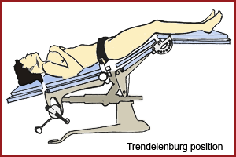
POSITION USED IN SURGERY
1. Trendelenburg Position
Trendelenburg, which is most commonly used in pelvic operations, where the patient is placed supine while the table is modified to a head tilt of 30-45 degrees and the table is broken at the knee joint to lower the lower section slightly to flex the patient’s knees.

Slide 86
2. Reverse trendelenburg
the entire bed is tilted so the head is higher than the feet.
Used for head and neck procedures. Facilitates exposure, aids in breathing and decrease blood supply to the area.

Slide 87
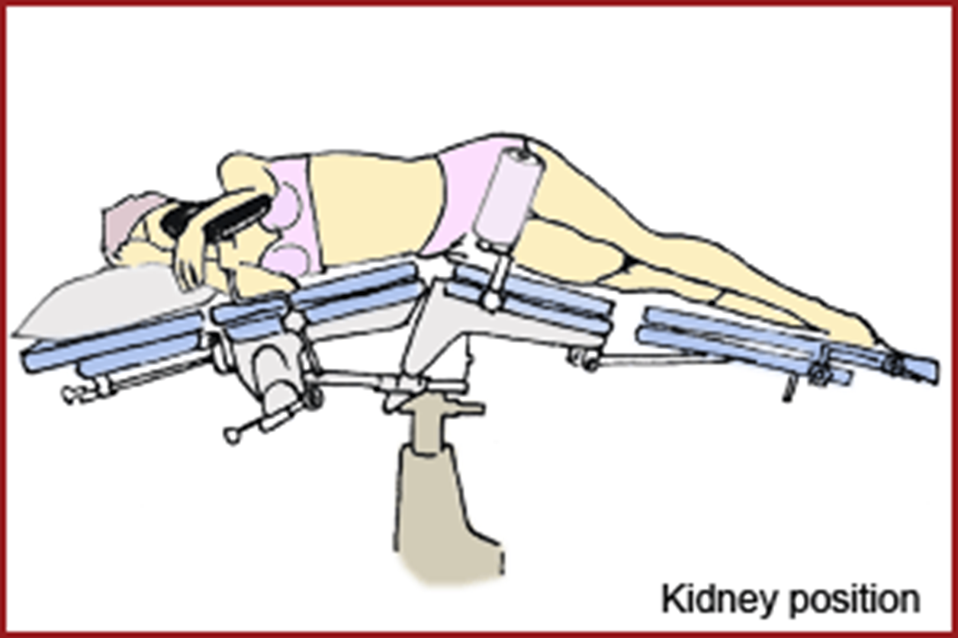
Kidney position
Kidney position, where the bridge of the table is raised to elevate the loins between the lower limbs and the iliac crest.

Slide 88
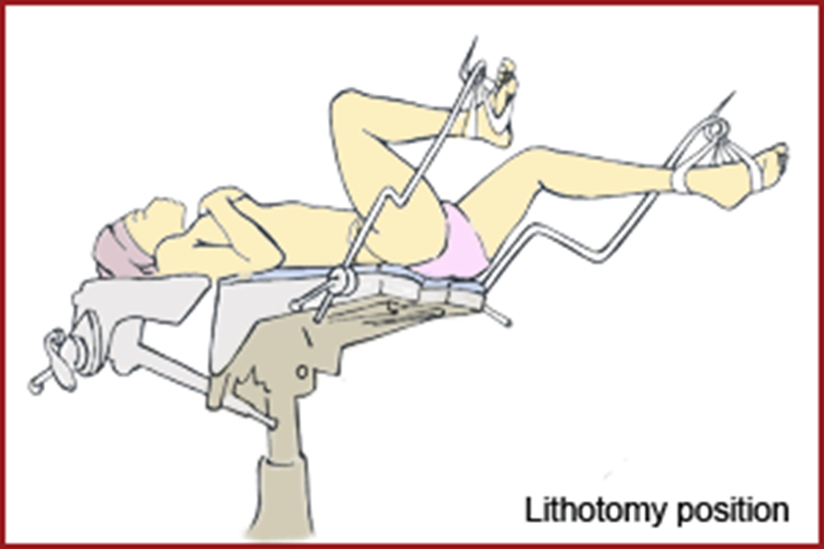
Lithotomy
Lithotomy, which is used in perineum operation. The patient lies supine position and the lower limbs are raised and abducted to expose perineum, the legs and feet are on stirrups that support the lower extremities, they should at even height. Both legs must be raised simultaneously to avoid injury. The knees are flexed.

Slide 89
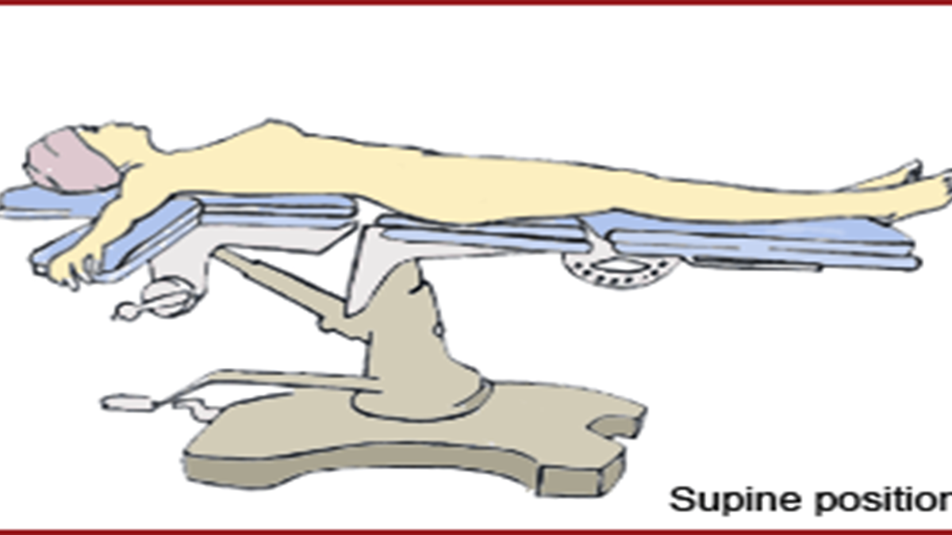
Supine or laparotomy position
Supine (laparotomy position), where the patient lies on the back spinal column should be in a alignment with the legs parallel to the bed, head in line with spin and face is upward, with arms on the sides on arm boards.

Slide 90
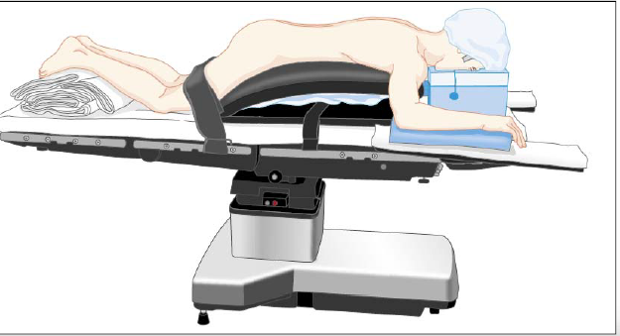
Prone position
Anesthetized supine, usually on the stretcher prior to turning, Face down, resting on the abdomen and chest, Head is turned to one side with accessible airway, Forehead, eyes and chin are protected Access to the posterior fossa of the skull, the posterior spine, the buttocks and perirectal area, and the lower extremities

Slide 91
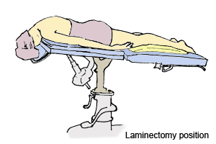
Laminectomy Position
Laminectomy position, where the patient is put in the prone position with the head beyond the end of the table with the forehead resting and supported on a horseshoe fixed six inches below the level of the table.

Slide 92
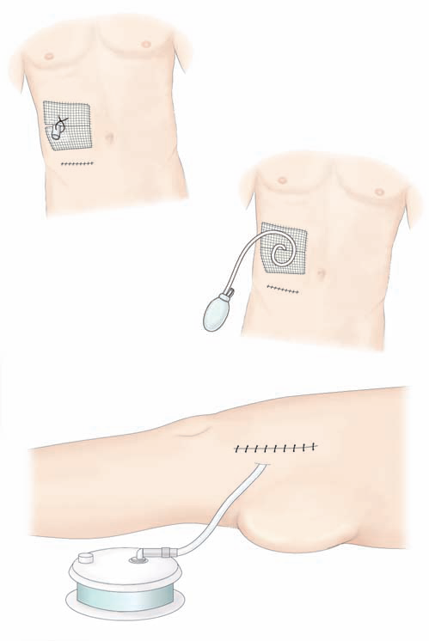
Surgical Drains
Drains may be inserted near the operative site if significant wound drainage is anticipated.
Some drains are attached to suction, some have self-suction, and some will drain due to gravity

Slide 93
Potential Intraoperative Complications
  Nausea and vomiting
  Anaphylaxis
  Hypoxia
  Hypothermia
  Malignant hyperthermia-drug of choice in managing is dantrolene sodium

Slide 94
Sutures And Ligatures
A suture is a medical device used to hold skin, internal organs, blood vessels or other tissues of a human body together after they have been severed by injury or surgery until healing takes place.
A ligature is a suture used for tying blood vessels to a or another hollow organ to shut it off.
Classification of sutures:
Absorbable they are broken down in the tissue after some time
Non Absorbable the body tissues cannot digest the material used thus they are removable.
The above suture can further be classified as :
      Natural or synthetic
      Monofilament or multifilament
      multistranded

Slide 95
1. Natural absorbable suture e.g. catgut
Natural absorbable suture are defined by the loss of most of their tensile strength within 6o days after placement
They are of materials that are degraded by the body tissues
Originally they were made from sheep’s intestines
Gut sutures are made of specially prepared beef and gut intestines and packaged in alcohol to prevent it from dying and breaking
It is multifilament
Examples:
    Plain catgut – untreated
    Chromic catgut turned with chromium salts to increase their persistent in the body
    Chromic catgut tensile strength 10-21 days

Slide 96
2. Synthetic absorbable suture
Examples are:
Polyglycolic acid (DEXON) synthetic multifilament
Polyglatin (VICRYL) synthetic multifilament
Polydioxanone
Poliglecaprone Monocryl
Polyconate (MAXOM )
Poly trimethylene carbonate suture synthetic monofilament
Advantage to catgut is that it takes longer time in tissues than chromic catgut

Slide 97
Non absorbable sutures
They are resistant to degradation by living tissue
Uses:
Skin or wound closure where the sutures can be removed after a period
Can be used In inner tissues in which absorbable sutures are not adequate e.g. heart and blood vessels who rhythmic movements requires a suture which stays longer than three weeks to give wound enough time to heal
Non absorbable sutures can be permanently implanted in the body or can be removed after few days of surgery depending on the kind of surgery

Slide 98
Natural non absorbable sutures
      Stainless steel
      Silk
      Cotton
      Linen
Synthetic non absorbable sutures
Synthetic monofilament sutures are commonly used in cutaneous procedures and include
      Nylon
      Polypropylene
      Polyester

Slide 99
Characteristics of sutures
Main characteristics to be considered in the selection of suture material :
    Tensile strength
    Elasticity
    Plasticity
    memory
    Ease of passage through tissue
    Knot security
    Pull of tissue by suture
    Short and long term reactions of tissue
    Handling, ease of use of suture and Packing property ensuring suture getting out of package with minimum memory.

Slide 100
Characteristic of sutures
1. Elasticity:
It is a term describing elongation of suture material by means of pulling method then returning to its original length when left free, in short its flexibility.
Elasticity is a preferred characteristic sutures. Because after implanting the suture to the wound, suture is expected to keep two parts of scar together in suitable position by elongating without stressing, cutting tissues due to edema developed in the scar and then, upon retraction of wound after re-absorption of edema to return to original length.
2. Plasticity:
Plasticity is a term defined as the capacity of a suture to retain its length and strength after stretching.
Sutures with high plasticity do not hinder circulation on the tissue by elongating without stressing or cutting tissues due to developing edema on the wound. However, elongated suture upon retraction of wound after re-absorption of edema cannot ensure correct approximation of wound edges.

Slide 101
3. Memory:
It is a term defining incapability of suture to change shape easily. Sutures with strong memory tend to return their former, packing form when they are removed from their packing, during and after manipulation. This is because of their rigidity. Sutures with strong memory is hard to manipulate and thread, at the same time they have poor thread safety.
4. Friction Surface:
It defines slipperiness of suture. Suture surface should be smooth and uniform. However, very slippery and smooth sutures are not preferred due to their unsecure knotting.
Uneven surface of sutures is a desired characteristic for knot security.
Disadvantages of these types of sutures (uneven sutures) are their leading trauma while passing through tissue and to thrombosis by scratching vein surface. Such disadvantages are tried to be eliminated by coating such sutures with materials such as silicone. Multifilament sutures have larger friction surfaces compared to monofilament sutures and they cause more trauma while passing through tissues.

Slide 102
5. Tensile Strength :
It defines the force needed to break the suture. Tensile strength of suture reduces after implantation.
Tensile strength is related with the diameter of suture and tensile strength increases as the diameter of suture increases.
Weakest point of suture is knot. Therefore tensile strength of sutures are measured in knotted condition. Knotted suture has 2/3 strength of unknotted suture. Each applied knot reduces tensile strength of suture by 30-40% and causes to leave more foreign substance on the tissue.

Slide 103
6. Capillarity:
It defines wicking of fluids by the suture and transmission of fluid wicked throughout the suture.
Sutures with capillarity property carry the serum and bacteria in the region of implantation they have absorbed throughout the suture. Generally, capillarity of multifilament sutures are higher than monofilament ones.
Sutures with capillary characteristic used on skin allow passage of microorganisms between external medium and internal medium and lead contamination.
Capillarity characteristics of sutures are minimized by coating with materials such as silicone, Teflon or resin.

Slide 104
Factors impacting suture selection
    Field of specialism,
    Clinical tissue regeneration experiences,
    Surgery experience,
    Knowledge gained on healing process of tissue,
    Knowledge on biological and physical characteristics of various suture materials,
    Patient factors (age, weight, general health status, existence of infection)
    Usage Characteristics:
It defines usage quality comprehensively. It includes all physical characteristics of suture such as handling, knot security, friction coefficient and memory.

Slide 105
Size of sutures
Suture sizes are classified according to USA Pharmacopoeia (USP) and European Pharmacopoeia (EP) which is also called as metric system.
Suture sizes commonly classified according to USP. USP classification is made according to diameter, tensile strength and knot security of the suture.
    12/0 – 7/0 = Microsurgery (smallest in diameter, weaker)
    6/0 = Face and Blood Vessels
    5/0= Face, neck and blood vessels
    4/0 = Mucosa, neck, hands, arms, legs, tendon, blood vessels,
    3/0 = arm, legs, body, intestine, blood vessel,
    2/0 = Body, fascia, stomach, internal organs, blood vessel
    0-1 = Abdominal wall, strong fascia surfaces. ( largest in diameter, Strongest)

Slide 106
SURGICAL NEEDLE
Needles are necessary for placement of suture material in the wound.
They should be:
    Made of high quality stainless steel
    As slim as possible without compromising strength
    Sharp enough to penetrate tissue with no trauma
    Be rigid enough to resist bending
    Malleable (flexible) enough to bend before breaking.
    Sterile and corrosion resistant to prevent introduction of microorganism or foreign bodies into the wound.

Slide 107
Needle construction
The needle has 3 sections:
The point: this is the sharpest portion and used to penetrate the tissue.
The body: this represents the mid portion of the needle.
The swage: this is the thickest portion of the needle and the portion to which the suture material is attached

Slide 108
Types of needles
Round bodied needles, which are round and smooth, cause less damage and make a puncture. They are used in delicate tissues and organs e.g. uterus , intestines, ( all the internal organs)
Atraumatic needles, which are either cutting or round bodied whose traumatising chance is minimal. These needles have no eye. Suture and needles are made joined-together.
Cutting needles, which have a sharp edge, cut a crack as they pass, and are used on strong tissues, for example, skin, tendon, muscles.

Slide 109
swabs
Swabs are resources used for absorbing blood and fluids, protecting tissues, applying pressure or traction and dissecting tissue during a surgical intervention.
A radio-opaque thread or marker is incorporated into commercially manufactured swabs.
There are different types of swabs:
    Gauze swabs 3" X 3" (7.6 x 7.6) cm which are used for small. incisions;
    4" x 4" (10 x 10) cm; raytec swabs or dissecting swabs.

Slide 110
Other type of swabs are:
large abdominal swabs; with attached tapes
small abdominal swabs; usually used in the bladder
Peanut swabs or lahey swabs; small round gauze sponges used for blunt dissections or to absorb fluid in delicate procedures e.g. thyroidectomy
Large and small tonsil swabs which are cotton filled gauze with cotton thread attached.
Neuro - patties made of compressed rayon of cotton, used moist on delicate structures such as the brain or spinal cord

Slide 111
Care of swabs, instruments and needles
a) Prior To Sterilization
Use clean, uncontaminated, new swabs.
Check all swabs and shake well before folding and packing; no wool, threads or pieces of lint should adhere to the swab.
Swabs must be X-Ray opaque and abdominal swabs must have 25cm tapes.
The first and second checker must do a simultaneous check.
Each bundle must contain five swabs, abdominal, raytec and tonsil swabs are kept together with tape or a rubber band.
Point balls are sewn together and each bundle must contain a signed document.

Slide 112
Before the operation
The scrub nurse holds the bundle up and checks that each swab has a
    secured tape and a opaque indicator.
    He/she checks each swab separately into a bowl while counting audibly and must not count one bundle on top of another.
    The scrub nurse must count audibly with the circulating nurse.
    If extra swabs are required during the operation, the same procedure is to be followed with number added on, e.g. 5 + 5 + 5 or according to hospital policy.

Slide 113
Small dissecting swabs (laheys) are counted by holding one secure between fingers, counting that one and then pointing with the finger to the remaining four which are then placed in a gallipot.
Ensure that each has an X-Ray opaque indicator.
If any bundle of swabs opened is found to be incorrect, the swabs and document must be removed from the theatre to prevent later confusion.
The incorrect swabs must be given to the unit manager who must follow up this occurrence.
No opened swabs are to be allowed in theatre if they are not counted. Swabs may not be used for cleaning theatres.
Before closure of the cavity, an audible check is done of the remaining swabs on the rack and those in use on the trolley and operating field.

Slide 114
Rules for counting swabs intra-operative
The rules for counting swabs in theatre is according to the scrub nurse's specific preference, complying with at least the following:
There should be a minimum of three (3) counts of swabs, though this is not fixed. If the scrub nurse is doing a long difficult procedure using many swabs she can do five to six counts.
It is up to the individual but the first swab count must be done before;
    The peritoneum is closed, the next count is done before fascia is closed and the last count before the skin is sutured.
Lahey swabs are not removed from the trolley, but checked into a gallipot / receiver.
It is important that the correct swab count is reported to the surgeon who must acknowledge this.

Slide 115
Procedure for lost swabs
If the count is incorrect, inform the surgeon and do a recount.
The missing item must be looked for in the surgical cavity as well as in the theatre.
In the event of the missing article not being found, the scrub nurse must inform the registered nurse in charge. X-Rays, must be taken and if the article is seen, the surgeon must re-open the cavity.
If no article shows on X-Ray the surgeon records on the patient's file stating the missing article does not show on X-Ray.
The scrub nurse will endorse the facts about missing items in red on the operative form and in the operation register.
The scrub nurse and check (circulating) nurse must write a statement and hand it to the nurse in charge.
The original statements are photo copied to distribute to the following significant supervisors; Chief Nursing Service Manager, Clinical Manager, Theatre Nursing Service Manager, Scrub Nurse and Floor Nurse.

Slide 116
ROLE OF VARIOUS NURSES IN THE OPERATING ROOM
Receiving area nurse
Scrub nurse
Anesthetic nurse
Circulating nurse
Role of the PACU (post anaesthetic unit) nurse

Slide 117
1. Role of receiving area nurse
Receive reports
Ensure cleanliness-floor, wall, furniture
Ensure availability of documentation charts preoperative check list, consent form
Ensure resuscitation drugs are available and ready
Avail screens for patients
Ensure availability of patients trolley
Ensure that all the theatre list are available
Confirm about patients readiness for surgery
Send for patient from the award

Slide 118
10. Receive the patient from the ward and check for;
    Identification ( name tag, file, theatre list)
    Consent, investigation, blood, items ordered, premedication, dentures, jewelry, nail polish (cutex), hygiene, theatre attire, covering of hair, other documents.
Confirm surgical site
Transfer patient to theatre
Indicate in the theatre list
Inform concerned theatre, care for the patient till collection
Compile report.

Slide 119
2. Role of a scrub nurse
Checks the following day’s theatre list and makes the necessary orders for sterile packs and other surgical supplies.
Ensures that the patients are ready for the operation.
Prepares the theatre for the days operation by:
      ensuring that the theatre necessary supplies are available
      Ensuring that the theatre is clean
      Checking the machines are in working order
      Checking the operating light
Receives the patient at the receiving area and confirms the right patient is received
Confirms the operation site
Scrubs, gowns and gloves and sets up the sterile field

Slide 120
Checks the instruments for correctness, and working conditions
Counts instruments, swabs and sharps, audibly which are then recorded by the circulating nurse
Receives all the other items that are to be used during the operation
Wheels the trolley to the operating room and positions self and trolleys creating a sterile field
Maintains the sterile field and anticipates the needs of the surgical teem.
Maintain count of items used in the sterile field
Communicates with the surgical team members on the condition of the patient.
Receives specimen from the surgeon and hands them over to the circulating nurse.
Assists during the closure of the incision.

Slide 121
Remains sterile until the patient is out of the operating room
Moves the trolley and hands over patient to the circulating nurse.
Checks patient for diathermy burns,
Clears theatre, hands over instruments, and other items used in the procedure to the sluice room attendant.
Un gowns, ungloves, washes hands and signs name in the register
Ensures that patients notes are written
Follows patient to the recovery ward

Slide 122
3. Role of the anaesthetic nurse
To prepare the anaesthetic machine
Tests machine and avails other anaesthetic equipment’s:
    Laryngoscope,
    Magillss forcep and
    endotracheal tubes
Avails all the necessary anaesthetic drugs
Ensures that the patient is ready at the receiving area
Assist the anaesthetist during :
    wheeling patient to theatre
    Induction
    Maintenance
    Reversal
    Wheeling the patient to PACU

Slide 123
Participates during resuscitation
Assists in clearance of theatre and preparation for the next patient.

Slide 124
4. Role of the circulating nurse
Prepares theatre for the days operations together with the theatre nurse
Assist is assembling needed supplies
Admits patients to the operating room
Assists in positioning the patient
Assists during induction
Assist the surgical team during scrubbing
Performs catheterization and skin preparation
Assist during draping and connecting of machines
Maintains orderly in the operating room
Co ordinates the activities of the operating room, anticipating the needs of the surgical team

Slide 125
Maintains records and supplies during the operation
Receives specimen and other body tissues from the scrub nurse and labels accordingly
Continuously monitors the aseptic technique and patients needs
Counts the swabs with the scrub nurse at intervals
Finalizes records and changing
Assist in applying tape on dressing
After surgery, removes drapes and puts them under the instruments trolley
Removes diathermy plate and checks area for burns
Assist in clearing the theatre after surgery
Assist in transfer of patient from the operating table, room to the recovery room

Slide 126
Disposes specimen and other body tissues accordingly
Assist in clearing theatre
Avails supplies for the next operation
Ensures that the next patient is ready and available
Reports to the charge nurse for the next assignment.

Slide 127
5. Role of the PACU ( post anaesthetic care unit) nurse
Reports on duty
Changes from home clothes into theatre attires
Receives report from the night staff on machines, drugs, patients, records, incidences.
Ensure cleanliness of environment and equipment’s
Ensures all equipment’s , anaesthetic machines, suction machines, defibrillator, and monitors are in good working conditions.
Ensures that the resuscitation trolley is complete
Arranges machines at their respective areas

Slide 128
Ensures that the anaesthetic drugs are available
Prepares all the relevant documents, charts and request forms.
Recieves the patient to PACU
Perform initial assessment for fitness to admit at PACU
Monitor vitals signs and consciousness levels
Administer analgesics
Handle any emergencies
¼ hourly observations of vital signs
Maintain fluid and input and output
Document vital signs and any other relevant information
While fully awake hand over patient to the ward nurse
Document time and patient state on exit.

Slide 129
6. Role of nurse manager
Ensures that all staff have reported on duty
Ensures that theatre is clean
Ensures that all the machines are in good working order
Ensures that all the necessary supplies are available
Liaises with the overall in charge for smooth running of theatre
Ensure that the patients are ready.
Ensures all the surgical team members are ready
Ensures that documentation is carried out.
Performs all the activities aimed at promoting patient safety
Maintains a conducive working environment among surgical team members.

Slide 130
7. Role of sluice room attendant
Ensures cleanliness of the sluice room
Ensures availability of cleaning materials
Ensures availability of disinfectants and decontamination solutions
Receives instruments from the scrub nurse
decontaminates, cleans, dries the instrument and assembles them ready for sterilization
Hands over instruments to the sterilization staff
Updates all the records in the sluice room
Prepares other waste for disposal

Slide 131
ANAESTHESIA
Anaesthesia ( Greek word meaning “ without sensation”)
It is a state of temporary induced loss of sensation
It includes, analgesia, paralysis, amnesia and/or unconsciousness
A patient under the effects of anesthetic drugs is referred to as being anaesthetized

Slide 132
Types of anesthesia
Local anesthesia: Used for minor procedures such as skin surgery and tooth extraction. The person remains conscious (awake) but should not feel pain in the area being worked on.
Regional anesthesia: These are similar to local anesthesia but cover a wider or deeper part of the body by targeting specific nerves
      epidural anesthesia -anaesthsia delivered to the lower spine to numb the lower half of the body. It is given through a tube that is left in place, so can be topped up over a period of time if necessary.
      Spinal anesthesia like epidural it targets the nerves of the spine and is given as a single dose used to numb the lower part of the body.
3. General anesthetic: used for major operations and when a patient needs to be unconscious.

Slide 133
Goals of anaesthesia
    Provide analgesia
    Reduce the level of anxiety and discomfort
    Control the autonomic nervous system
    Muscle relaxation appropriate for the type of operative procedure

Slide 134
Clinical manifestation of pain
AUTONOMIC
    Elevation of BP,
    Increase in heart and pulse rate
    Rapid and irregular respiration-persistent
    Increase in perspiration
Skeletal muscle
    Increase in muscle tension or activity
Psychological
    Irritability , apprehension
    Increased anxiety , attention focused on pain

Slide 135
Local / regional anesthesia
Local anaesthesia induces analgesia in the region where it is administered, for example, lignocaine, procaine hydrochloride, xylocaine and lidocaine.
The local anaesthesia last for forty five minutes to three hours depending on the type and dosage of anaesthesia used.
It is given locally to the affected part of the body by one of the following methods:
Infiltration, nerve block, field block, refrigeration analgesia (local), & spinal analgesia and epidural anaesthesia(regional).

Slide 136
Local anesthesia –
  Provide a reversible regional loss of sensation.
  Reduce pain, facilitating surgical procedures.
  Safer than general anesthesia; used whenever possible.

Slide 137
Local anaesthetic methods
Local Anaesthesia Methods
Infiltration:
The drug is injected on and around (in various points of) the affected area.
Nerve Block:
  The nerve supplying of the affected area is infiltrated by the anaesthetic drugs, inducing loss of sensation on the affected area supplied by that specific nerve.
Field Block:
  Similar to nerve block but cover a larger area and may involve more than one nerve.

Slide 138
Refrigeration Analgesia
    It is administered by use of a vapouriser. Drugs used include: Ethyl chloride or Diethyl ether.
Spinal Anesthesia
    Used for operations from the abdomen and below, e.g. caesarean section. A lumbar puncture is done and the local anaesthesia introduced through the spine (sub-acrachnoid space). The drug paralyses the area below the puncture.
Epidural Anaesthesia
    The drug is injected in the dura mater space of the spinal cord. Used for operations of the abdomen and below.

Slide 139
General anesthesia
General anaesthesia causes the patient to lose consciousness, for example, thiopentone, ketalar and halothane.
Anaesthesia can be categorised into: pre-medication, preoperative and postoperative procedures.
General anesthesia Classification:
Parenteral e.g. ketamine
Inhalation e.g. sevoflurane, isoflurane, desflurane, halothane (among the first to be invented but it is still in use in 3rd world countries)

Slide 140
GA
The state produced when a patient receives medications for amnesia, analgesia, muscle paralysis, and sedation
The combination of anesthetic agents used for GA often leaves a pt with the following clinical features:
  Unarousable even secondary to painful stimuli
  Unable to remember what happened (amnesia)
  Unable to maintain adequate airway protection or spontaneous ventilation as a result of muscle paralysis
  Cardiovascular changes secondary to stimulant/depressant effects of anesthetic agents

Slide 141
GA agents are used to render pts unaware of, and unresponsive to painful stimulation during surgical procedures.
They are given systemically and exert their main effects on the CNS.
The modern practice of anesthesiology involves the use of combinations of intravenous and inhaled drugs (balanced anesthesia technique).

Slide 142
Advantages of GA
  Reduces intraoperative patient awareness and recall
  Allows proper muscle relaxation for prolonged periods of time
  Facilitates complete control of the airway, breathing, and circulation
  Can be used in cases of sensitivity to local anesthetic agent
  Can be administered without moving the patient from the supine position
  Can be adapted easily to procedures of unpredictable duration or extent
  Can be administered rapidly and is reversible

Slide 143
Disadvantages of GA
  Requires increased complexity of care and associated costs
  Requires some degree of preoperative pt preparation
  Can induce physiologic fluctuations that require active intervention
  Associated with less serious complications such as nausea or vomiting, sore throat, headache, shivering, and delayed return to normal mental functioning
  Associated with malignant hyperthermia –use Dantrolene sodium

Slide 144
Stages of anesthesia
Anesthetic effects on the brain is divided into 4 stages of increasing depth of CNS depression:
1st - Stage of analgesia: The pt initially experiences analgesia without amnesia. Later on, both analgesia and amnesia are produced.
2nd - Stage of excitement: Pt often delirious, may vocalize but is definitely amnesic. Resp irregular and retching/vomiting may occur. Efforts are made to limit the duration and severity of the 2nd stage – by rapidly increasing the concentration of the agent. 2nd stage ends with the reestablishment of regular breathing.

Slide 145
3rd -Stage of surgical anesthesia: Begins with the recurrence of regular respiration and extends to complete cessation of spontaneous respiration (apnea). has 1st plane(loss of swallowing reflex) and 2nd plane(loss of eyelids reflex), 3rd plane( paralysing of the diaphram, pupils are dilated). The 3rd plane is the most suitable for starting the surgery, 4th ( patient is in apnoea) and now the patient is hooked up to the ventilator, otherwise the patient dies.
4th - Stage of medullary depression: includes severe depression of the CNS, including the vital centers in the brain stem. Without circulatory and respiratory support, death rapidly ensues.

Slide 146
Premedication
The following procedures should be adhered to prior to the operation:
Atropine 0.6mg intramuscular (for adults) administered one hour before the operation to reduce Respiratory Secretion (RS) and to prevent bradycardia; Children should be given 0.3mg.
Pethidine 50 - 100mg intramuscular for adults, which has an analgesic effect on the patient; and 25 - 50mg for children depending on age and weight.
Diaepam can be given one night before to a very nervous patient,adjuvant for anaesthesia.
Hyoscine 0.4mg for adults, which can also be given for pre-medication although it has the potential side effect of amnesia. It is antispasmodic.
Morphine 10 - 15mg intramuscular can also be used. Oral pre-medication is the best for children and should be administered two hours before operation. Analgesic and adjuvant for anaesthesia.
Remember to make the patient observe nil by mouth for six hours prior to operation.

Slide 147
Induction agents
1. Volatile inhalation agents include:
  Ether, which is highly inflammable in the presence of diathermy and irritates the respiratory tract. On the other hand, it has the advantage of being cheap to administer.
  Halothane is very good as an induction agent but can cause halothane hepatitis.
  Trilene is not a very good induction agent but is a good maintenance anaesthetic agent. Its side effects include tachypnoea and vomiting. However it has a good analgesic effect postoperatively and it is cheap.
  A mixture of Oxygen and Nitrous Oxide and one of the volatile anaesthetic agents, is the best way of maintaining anaesthesia.

Slide 148
Parenteral anesthetic agents
Intravenous agents include barbiturates sodium thiopental (STP), which causes sleep very quickly.
Methohexitone can be used as an induction agent but cannot be used without equipment for resuscitation and is contraindicated in epilepsy. These are mainly sedative drugs thus they do not have any analgesic effect.
Ketamine can be given IV or IM. It has an analgesic effect and can be used alone in minor surgeries. Side effects include bad dreams and elevated blood pressure. Ketamine is also used with diazepam. It is contraindicated in hypertension.
Diprivan (propofol, (milk of anaesthesia) best for short procedures and hypertensive patient contraindicated in shock.

Slide 149
Muscle relaxants
Muscle relaxants can be divided into categories.
Short acting (depolarising) relaxants include suxamethonium (scoline), which is mainly used for intubation. Its main side effect is that it causes bradycardia.
Intermediate vecuronium and rohocuronium
Long acting (non-depolarising) relaxants include curare, flaxedil and pancuronium.
The action of these agents has to be reversed to revive the patient by neostigmine & atropine.
Analgesics
Analgesics are used to relieve pain and include pethidine, sosagen, morphine and fentanyl.
The postoperative patient is given a drug for pain relief, for example, pethidine or valium, and an anti-emetic for instance, plasil (metoclopromide), stemetil or phenergan.

Slide 150
nursing care of the anaesthetized patient
GA –a reversible state consisting of complete loss of consciousness that provides analgesia ,muscle relaxation and sedation
Protective reflexes are lost
Consists of 3 major phases
1) induction
2) maintenance
3) emergence.
others are pre anaesthetic and recovery

Slide 151
Phases Of Anaesthesia
Pre anesthetic phase: This period start from the time decision of operation is made up to the time of induction, history taking, physical examination, investigations are done FBC, GXM, premedication counselling, observation of vital signs, the patient is prepared for a safe operation.
Induction phase: This is done in theatre it involves giving patient anesthetic medication as per the operation . Patient is given oxygen, parenteral or inhalation anesthetics, muscle relaxants and adjuvant anesthetics.
Maintenance phase: This is done to prolong unconsciousness for the duration required. this is the phase during the operation where by the patient remains anaesthetized till the operation is over. The drugs used include e.g. oxygen , nitrous oxide, halothane, anesthetics drugs like propofol, opioid such as morphine and sedative.

Slide 152
Emergence / reversal: This is the period following completion of surgery and anaesthesia is no longer needed and there’s need to return to basic physiological functions of all organ and systems. Drug commonly used are 1.2mgs atropine mixed with neostigmine in 1 syringe counteracts the effects of neuromuscular blocking agents and oxygen. Atropine counteracts Muscarinic effects of neostigmine i.e. bradycardia and hypersecretions (parasymphathetic effect)
Recovery phase: This is the period after reversal when the patients regains wakefulness, spontaneous respiration and mobility. Patients is on post operative treatment.

Slide 153
Nursing responsibilities - pre operatively (before surgery)
Monitor blood loss ,urine output
Obtaining fluids drugs and blood products as requested
Sending blood specimen to the lab
Identity and the relevant documents and charts and notes are validated
Check bedside rails, catheters, intravenous lines, check for drug allergies
Position patient well,
Apply padding to all pressure areas in cases of a long operation
Maintain patent and clear airway-ensure adequate ventilation
Continue physiological monitoring

Slide 154
Intraoperatively (during the operation)
Depends on type of surgery ,type and amount of anesthesia
The circulating nurse:
    Transfer of patient to operating room table
    Positions the patient in the operating table
    Maintains functional alignment
    Exposure of surgical site
    Observe patient critically for effects of;
    Excessive fluid loss or gain ,watch for inflicted injuries
    Distinguishes normal from abnormal cardiopulmonary data
    Reports changes in patients vital signs
    Institutes measures to promote normothermia
    Mnx of bleeding ,reaction to anesthesia

Slide 155
Discharge Of Patient From Post Anaesthesia Care Unit (PACU)
Each facility may have an individual checklist or scoring guide to include:
    Stable vital signs
    Adequate urine output (at least 30mls/hour)
    Orientation to person , place and time
    Satisfactory response to commands
    Movement of extremities after regional anesthesia
    Control of pain –minimal/tolerable
    Control or absence of vomiting

Slide 156
General principle in post operative care
(after operation)
The general principles in postoperative care include:
    Ensuring clear airway
    Supporting circulation
    Controlling bleeding
    Preventing infection
    Monitoring any complications
    Controlling pain
    Ensuring return of gastro intestinal motility
    Ensuring early ambulation
    Preparing the patient for discharge and home-based care

Slide 157
Ensuring a clear air way:
    You should place the patient in recovery position (three-quarters prone, or left-lateral).
    This allows secretions from the lungs and mouth to drain out.
    Suck the secretions using a suction machine if they are excessive.
2. Supporting Circulation
    This is done in order to maintain the functions of the lungs, the heart and the kidney.
    This is achieved through adequate blood volume.
    You should maintain the infusion running at the required rates.
    Monitor input and output

Slide 158
3. Controlling Bleeding and Wound Care
    Monitor the wound for any signs of bleeding.
    Should this occur, apply a firm dressing and inform the surgeon.
    After 24 hours, check for signs of infection, these include redness, tenderness, oedema and low grade fever.
    If this occurs the sutures are removed to allow the pus to drain and the wound cleaned three times a day with antiseptic lotion.
4. Preventing Infection
    Septicaemia is likely following an operation, due to peritonitis.
    Pneumonia may follow bed confinement.
    This is indicated by a rise in body temperature and should this occur, you will need to administer antibiotic without delay.
    In some hospitals it is a common practice to cover the patient with antibiotics following surgery, where septicaemia is likely.

Slide 159
5. Monitoring for complication:
    You should monitor pulse, blood pressure, and respiration rate and body temperature until they are stable and within the normal ranges for the age and sex of the patient.
    The recommended frequency is to observe the patient every 15 minutes for the first two hours, followed by every 30 minutes for the next two hours, then four hourly if they appear to be stable.
    Other important observations to make at the same time are level of consciousness, and urine output.
6. Controlling Pain
    This is achieved by the administration of pain relief drugs once the patient is conscious.
    You should administer an intermittent bolus of pethidine 50-100mg intramuscularly or morphine 10-15mg for adult.
    Other measures include correct positioning of the patient.

Slide 160
7. Ensuring return to normal gastrointestinal motility
    This is indicated by the return of bowel sounds and passing of flatus.
    Following abdominal surgery (laparotomy), gastro intestinal motility returns to normal in three to four days.
    The patient should not take food orally before this period is over.
    The stomach is decompressed through nasal gastric tube suction. This should be removed when the aspirate falls bellow 400mls per day.
    Should postoperative diarrhoea occur, reassure the patient, as this clears in two to three days, but ensure adequate hydration.
    When bowel sounds are back give oral sips, fluid diet, light diet, then resume normal diet.

Slide 161
Ensure return to normal gastro intestinal motility
    This is done by ensuring Early Ambulation
    Encourage the patient to move out of bed as soon as their condition allows.
    This will prevent deep venous thrombosis (the development of a blood clot in a vein), which can complicate to pulmonary embolism (a circulating blood clot in the veins of the lungs).
    The signs of thrombosis include, warm swollen painful limbs and low-grade fever.
    If noticed, the affected limb should be elevated until the swelling subsides. Heparin in a dose of 5000units, eight hourly, is administered subcutaneously when the diagnosis is confirmed.
    The postoperative care should start from the recovery area of a theatre, and continue in the postoperative ward where the patient is rehabilitated then discharged.

Slide 162
Preparing patient for discharge and home based care
    The postoperative patient needs to be made aware of the expected outcome of the surgery as well as the medical and nursing care that they will require at home.
    This will reduce the possibility of last minute crises on the day of discharge.
    The patient should be given an opportunity to get ready to cope at home and in the community as they ask you how to deal with a changed body image.
    Home based care concepts will be covered in another unit

Slide 163
Record keeping in theatre
Record your work clearly, accurately and legibly
Surgeons must ensure that accurate, comprehensive, legible and contemporaneous records are maintained of all their interactions with patients.
In meeting the standards of Good Medical Practice you should:
Be fully versed in the use of the electronic health record system used in your organization and record clinical information in a way that can be shared with colleagues and patients and reused safely in an electronic environment.
Take part in the mandatory training on information governance offered by your organization, including training on data protection and access to health records.
Ensure that all medical records are accurate, clear, legible, comprehensive and contemporaneous and have the patient’s identification details on them.
Ensure that when members of the surgical team make case note entries these are legibly signed and show the date, and, in cases where the clinical condition is changing, the correct time.

Slide 164
Ensure that a record is made of the name of the most senior surgeon seeing the patient at each postoperative visit.
Ensure that a record is made by a member of the surgical team of important events and communications with the patient or supporter (for example, prognosis or potential complication). Any change in the treatment plan should be recorded.
Ensure that there are clear (preferably typed) operative notes for every procedure.
The notes should accompany the patient into recovery and to the ward and should give sufficient detail to enable continuity of care by another doctor.
Ensure that sufficiently detailed follow-up notes and discharge summaries are completed to allow another doctor to assess the care of the patient at any time.

Slide 165
Patients records should include
Date and time
Elective/emergency procedure
Names of the operating surgeon and assistant
Name of the theatre anaesthetists
Name of the scrub nurse and circulating nurse
Operative procedure carried out
Incision type
Operative diagnosis
Operative findings
Any problems/complications
Any extra procedure performed and the reason why it was performed
Any extra procedure performed and the reason why it was performed.
Details of tissue removed, added or altered.
Identification of any prosthesis used, including the serial numbers of prostheses and other implanted materials
Details of closure technique
Anticipated blood loss
Antibiotic prophylaxis (where applicable)
DVT prophylaxis (where applicable)
Detailed postoperative care instructions
NAME AND SIGNATURE

Slide 166
Record keeping/supplies
  Sort to make best use of available space
  Set out on clearly labeled shelves
  Should be standardized for all store rooms
  Stocks should be regularly audited
  Should be matched to demand
  Avoid unnecessary building up of large stocks

