Slide 1
PERI-OPERATIVE NURSING
BY
WAMBUGU. J

Slide 2
OBJECTIVES
By the end of the module the learner should:
Introduction to peri-operative nursing
Understand the theatre design
Apply guidelines of aseptic technique( scrubbing, gowning, gloving, donning)
Understand the roles & responsibilities of peri-op nurse
Care for patients pre, intra and post-operatively
Position patients for surgery
Know basic surgical instruments
Know the types of anesthetic agents
Understand the Ethical and Legal aspect in surgery
Manage anesthetic emergencies

Slide 3
What is peri-operative nursing?
It is the care offered to patients scheduled for surgery before, during and after the invasive procedure.
Peri-op nurses participate in planning, execution/carry out and monitor treatment of patients undergoing surgery.
The identification of physiological & sociological needs of the client, the implementation of an individualized program of nursing care geared to restore/maintain the health and welfare of patient before during and after surgical intervention.

Slide 4
Theatre Design
The theatre should be located in a terminal location to prevent unrelated traffic from passing through or next to the suit.
It should be in the most quiet area of the hospital away from environmental contamination.
It should be located close to a CCU for ease of transfer of critical patients.
Proper design of theatre allows one way flow of traffic and prevents the return flow of contaminants to clean areas.

Slide 5
Sub-divisions in theatre include;
Receiving area
Anesthetic room
Scrub up room
Sterile supply room
Dirty utility area
OR
PACU
Changing rooms
Staff lounge

Slide 6
Design
The floor should be made of anti static materials eg. seamless PVC or terrazzo continued up the sides of the wall up to 6 inches.
Floor should be slip proof and easy to clean through flooding or wet vacuum
The ceiling should be a minimum of 10 ft high and of seamless material
Walls should be made of hard vinyl material that is east to clean an have collision corners to prevent damage
Doors should be >4ft wide either swinging or sliding

Slide 7
O.R equipment
Operating Table with adjuncts
Overhead LED adjustable lights
Anesthetic machine
Physiological monitor
Electro-surgical unit
Suction machine
Air conditioner
Sterilizer

Slide 8
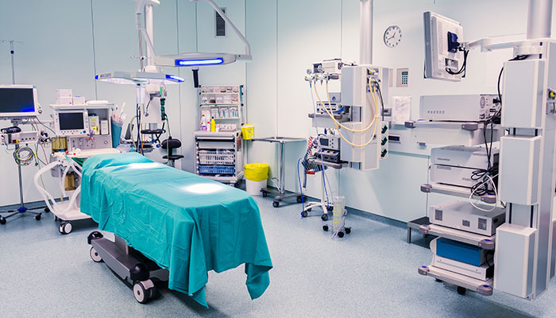

Slide 9
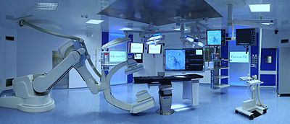

Slide 10
Electro Surgical Unit

Slide 11
Anesthetic Machine

Slide 12
Physiological monitor

Slide 13
Guidelines of surgical asepsis
Unrestricted zone-street apparel allowed
Semi restricted zone- scrub clothes, boots and caps. Only authorized personnel allowed
Restricted zone- Where scrub clothes, boots, caps, sterile gown &masks are worn. Only surgical team allowed
All materials in contact with wound within the sterile field must be sterile.
Gowns are sterile in the front from chest to level of sterile field
Only the top of the drape is considered sterile

Slide 14
Guidelines of surgical asepsis
Items dispensed by methods to preserve sterility
Movt around sterile field must not cause contamination of field. 1 foot from sterile area must be maintained.
Whenever sterile barrier is breached then the area is considered contaminated.
Sterile field is constantly maintained and monitored closely.
Sterile field is establishes as close as possible to the “time out”.

Slide 15
SURGICAL ASEPTIC TECHNIQUE
BEFORE AN OPERATION, it is necessary to sterilize and keep sterile all Instruments, materials, and supplies that come in contact with surgical site. Every item handled by the scrubbed team must be sterile.
The patient’s skin and the hands of the members of the surgical team must be thoroughly scrubbed, prepared, and kept as aseptic as possible.

Slide 16
DURING THE OPERATION, the surgeon, surgeon’s assistants, and scrub nurses must wear sterile gowns and gloves and must not touch anything that is not sterile.
Maintaining sterile technique is a cooperative responsibility of the entire surgical team.
Each member must develop a surgical conscience, a willingness to supervise and be supervised by others regarding the adherence to standards.

Slide 17
BASIC PRINCIPLES OF SURGICAL ASEPSIS
All personnel assigned to the operating room must practice good personal hygiene. This includes daily bathing and clothing change.
Those personnel having colds, sore throats, open sores, and/or other infections should not be permitted in the operating room.
Operating room attire (which includes scrub suits, gowns, head coverings, and face masks) should not be worn outside the operating room suite. If such occurs, change all attire before re-entering the clean area. (The operating room and adjacent supporting areas are classified as “clean areas”)
All members of the surgical team having direct contact with the surgical site must perform the surgical hand scrub before operation.

Slide 18
All materials and instruments used in contact with the site must be sterile.
The gowns worn by scrubbed personnel are considered sterile from shoulder to waist (in the front only), including the gown sleeves.
If sterile surgical gowns are torn, punctured, or have touched an unsterile surface or item, they are considered contaminated.

Slide 19
The safest, most practical method of sterilization for most articles is steam under pressure.
Label all prepared, packaged, and sterilized items with an expiration date.
Use articles packaged and sterilized in cotton muslin wrappers within 28 calendar days.
Use articles sterilized in cotton muslin wrappers and sealed in plastic within 180 calendar days.
Unsterile articles must not come in contact with sterile articles.
Take every precaution to prevent contamination of sterile areas or supplies by airborne organisms.

Slide 20
HANDLING STERILE ARTICLES
When you are changing a dressing, removing sutures, or preparing the patient for a surgical procedure, it will be necessary to establish a sterile field from which to work. The field should be established on a stable, flat, dry surface.
An article is either sterile or unsterile; there is no in-between. If there is doubt about the sterility of an item, consider it unsterile.
Any time the sterility of a field has been compromised, replace the contaminated filed and setup.
Do not open sterile articles until they are ready for use.
Do not leave sterile article unattended once they are opened and placed on a sterile field.

Slide 21
Cont..
Do not return sterile articles to a container once they have been removed from the container.
Never reach over a sterile field.
When pouring sterile solutions into sterile containers or basins, do not touch the sterile container with the solution bottle. Once opened and first poured, use bottles of liquid entirely. If any liquid is left in the bottle, discard it.
Never use an outdated article. Unwrap it, inspect it, and, if reusable, rewrap it in a new wrapper for sterilization.

Slide 22
A surgical set is considered unsterile when:
Its more than 28 calendar days since it was sterilized
The sterility indicators have not turned from pink to black
If the muslin wrapper is torn
If the muslin wrapper or the instruments are wet
Any dirt particles or debris visible on the instruments
When the autoclaving tape has not reacted

