Slide 1
PERIOPERATIVE NURSING
FELLY M
KRPoN/BScN

Slide 2
Objectives
By the end of this presentation the students should be able to:-
Outline at least 5 important areas of perioperative nursing assessment
Describe the 3 habits associated with tolerance to anesthesia
Describe the 3 peri-operative phases
Describe the 5 types of surgery according to purpose

Slide 3
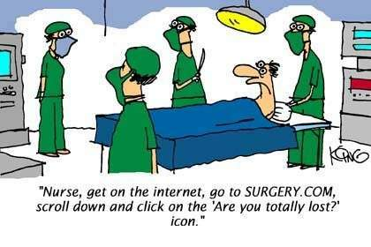

Slide 4
Introduction
Perioperative nursing is the term used to describe the nursing responsibilities associated with the preoperative, intraoperative, postanesthesia recovery, and postoperative surgical phases.
Throughout the perioperative period, the nurse applies the nursing process to identify the client’s positive functioning, altered functioning, and potential for altered functioning.
Nursing responsibilities focus on specific actual or potential health problems.

Slide 5
Preoperative nursing assessment
Age
Allergies
Vital Signs
Nutritional Status
Habits affecting tolerance to anesthesia
Presence of Infections
Use of drugs that are contraindicated prior to surgery
Physiological Status
Psychological state of the patient

Slide 6
Age:
Elderly are at risk >65 years of age
obtain a detailed medical history and health assessment
assess for sensory deficits
assess for overall functional status
understand that there is a decreased physiological reserve
Allergies:
known drug, food and substance allergies
reaction to the drug or substance is (is it a true allergy, hives or anaphylaxis?)
clearly note on the chart

Slide 7
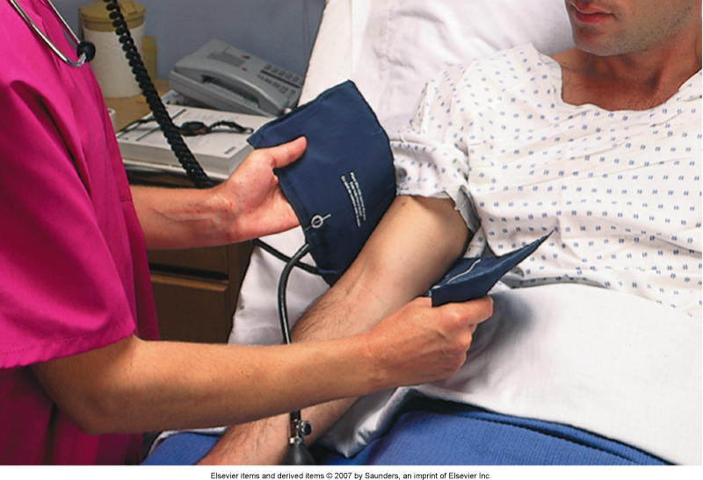
Vital Signs

Slide 8
Nutritional Status
Can be a deficit or excess
Assess for individuals who are prone to general nutritional deficiencies:
Aged
Cancer patients
Gastrointestinal problems
Chronic illness
Alcoholics
Also assess for excess (Obesity):
Poor wound healing because of decreased blood supply
Hard to access surgical site
Decreased lung capacity

Slide 9
Habits affecting tolerance to anesthesia
Smoking:
alters platelet function...hypercoagulable
reduces the amount of functional hemoglobin
carboxyhemoglobin
cilia in the lung are damaged, more difficult to mobilize secretions in the patient that smokes
retards wound healing (especially because of the decreased functional hemoglobin)
Alcoholism:
can have impaired liver function
B-vitamin deficiencies
Opioid Addiction
have a high tolerance for pain meds

Slide 10
Presence of Infections
Indicator is presence of fever above 38C
If infection is present, likely surgery will need to be delayed because the risks to the patient are too great.
Goal will be to find and treat the infection, and then reattempt surgery once the infection is cleared

Slide 11
Use of drugs that are contraindicated prior to surgery
Drugs like aspirin, heparin, warfarin (Coumadin) should be stopped prior to surgery
affect bleeding time
Some drugs/herbs can interact with the anesthesia
Check about antihypertensives the morning of surgery need to be clear about home meds (dose, frequency, timing) so that any necessary meds are in the postoperative order as per the prescription
Reinforce if the patient is to take meds the morning of surgery

Slide 12
Physiological Status
Preoperative nurse that all labs, xrays and necessary tests are done and in the chart
Notify the physician if there is anything abnormal
Psychological Status
Common behaviors are
Fear patient knows what they are scared of
Anxiety don't tangibly know what is scaring you

Slide 13
Psychological States
Common Fears:
Fear of death
Fear of pain and discomfort
Fear of mutilation or alteration in body image
Fear of anesthesia
Fear of disruption of life functioning or patterns
Fear due to lack of knowledge regarding the proposed surgery
Fear related to previous surgical experiences
Fear due to the influence of significant others

Slide 14
Psychological States cont’d….
Preoperative fear and anxiety can lead to:
Need for increased anesthesia
Need for increased postoperative pain management
Speed of recovery is decreased
Preoperative education of what to expect in clear, common English can alleviate some fear and anxiety

Slide 15
Patient preparation for surgery
Operative consent
Preoperative learning needs
Interventions the day or evening prior to surgery
Interventions the day of surgery

Slide 16
Informed consent
Gaining of consent should be treated as a process, rather than a one-off event.
For major operations, it should be considered good practice where possible to look for a personal consent to the proposed procedure well in advance, when there is time to respond to the personal questions and provide adequate information.
Before the procedure starts, the clinician should check that the person still consents.

Slide 17
Informed consent cont’d…
Voluntary and written informed consent from the patient is necessary before non emergent surgery can be performed.
Such written consent protects the patient from unsanctioned surgery and protects the surgeon from claims of an unauthorized operation.
In the best interests of all parties concerned, sound medical, ethical, and legal principles are followed.
The nurse asks the patient to sign the form and witnesses the patient’s signature.
It is the physician’s responsibility to provide appropriate information.

Slide 18
Informed consent cont’d…
Criteria for informed consent
Voluntary Consent= must be freely given, without coercion.
Done by a competent Patient - Legal definition: individual who is not autonomous and cannot give or withhold consent (eg, individuals who are mentally retarded, mentally ill, or comatose)
Informed Subject Informed consent should be in writing.

Slide 19
Informed consent cont’d…
It should contain the following:
Explanation of procedure and its risks
Description of benefits and alternatives
An offer to answer questions about procedure
Instructions that the patient may withdraw consent
Patient Able to Comprehend
Information written and delivered in language understandable to the patient.
Questions must be answered to facilitate comprehension

Slide 20
Informed consent cont’d…
The patient must have capacity to understand and retain the information provided, especially around the consequences of having or not having the procedure.
Consent must be given willingly, without pressure or undue influence to either undertake or not undertake treatment.
Has sufficient information been provided? This is so the patient has a understanding of the procedure and the purpose behind it.

Slide 21
Phases of the peri-operative period
Preoperative
Intraoperative
Postoperative
Each phase begins and ends at a particular point in the sequence of events that constitutes the surgical experience, and each includes a wide range of activities the nurse performs using the nursing process and based on the standards of practice

Slide 22
Preoperative phase
Begins when the decision to proceed with surgical intervention is made and ends with the transfer of the patient onto the operating room table.
Scope of nursing activities:
Establishing a baseline evaluation of the patient before the day of surgery
Physical exam, Previous anesthetic history , Identification of known allergies, Tests arranging appropriate, Health education

Slide 23
Preoperative phase cont’d…
On the surgery day
Review patient teaching
Informed consent is confirmed
Intravenous infusion is started
Responding to any concerns by the family

Slide 24
Intraoperative phase
Begins when the patient is transferred onto the operating room table and ends when he or she is admitted to the post anesthesia care unit (PACU).
Scope of nursing:
Providing for the patient’s safety
Maintaining an aseptic environment
Ensuring proper function of equipment
Providing the surgeon with specific instruments and supplies for the surgical field

Slide 25
Intraoperative phase cont’d…
Scope of nursing care cont’d…
Completing appropriate documentation
Providing emotional support by holding the patient’s hand during general anesthesia induction
Assisting in positioning the patient on the operating room table using basic principles of body alignment
Acting as scrub nurse, circulating nurse, or nurse first assistant

Slide 26
Postoperative phase
Begins with the admission of the patient to the PACU and ends with a follow-up evaluation in the clinical setting or at home.
Scope of nursing care :
Maintaining the patient’s airway
Monitoring vital signs
Assessing the effects of the anesthetic agents

Slide 27
Postoperative phase cont’d…
Scope of nursing care cont’d…
Assessing the patient for complications
Providing comfort and pain relief
Promoting the patient’s recovery
Initiating health teaching
Follow-up care and referrals essential for recovery
Rehabilitation after discharge.

Slide 29
Types of surgery based on purpose
Diagnostic
Therapeutic
Palliative
Preventive
Cosmetic

Slide 30
Diagnostic
Determination of the presence and or extent of the pathology i.e. lymph node , bronchoscopy, exploratory laparatomy

Slide 31
Therapeutic
Elimination or repair of the pathology e.g. Removal of the appendix when it's inflammed, removal of a localized cancer

Slide 32
Palliative
Alleviation of symptoms without curing the underlying disease e.g. Rhizotomy to decrease pain, colostomy placement to bypass an obstructing colon tumor

Slide 33
Preventive
Surgery to remove tissue that has the potential to become pathologic (may not already express a pathologic problem) e.g. Total abdominal hysterectomy

Slide 34
Cosmetic
The surgery is preformed for aesthetic reasons e.g. Repair of scars from burns or injuries, minor cleft palate repairs, face lifts, breast augmentation

