Slide 1
PERIOPERATIVE NURSING

Slide 2
Objectives
By the end of this presentation the students should be able to:-
Define operative theatre
Describe the 3 areas in an operative theatre
Describe the 5 members of a surgical team
Outline at least 2 roles of the different theatre nurses
Outline at least 5 principles of basic aseptic technique in an operating room
Describe important aspects of anaesthesia care
Describe at least 5 possible complications of anaesthesia

Slide 3
OPERATING THEATRE
Is a controlled surgical environment designed to minimize the spread of infectious organisms and allow a smooth flow of patients, personnel, and the instruments and equipment.

Slide 4
Operating theatre cont’d…
Unrestricted Area: area in the operating room that interfaces with other departments; includes patient reception area and holding area: where personnel in normal clothes can interact with those in scrubs
Semi restricted Area: area in the operating room where scrub attire is required; may include areas where surgical instruments are processed :peripheral support areas and corridors, all individuals need to be surgical scrubs
Restricted Area: area in the operating room where scrub attire and surgical masks are required; includes operating room and sterile core areas.

Slide 5
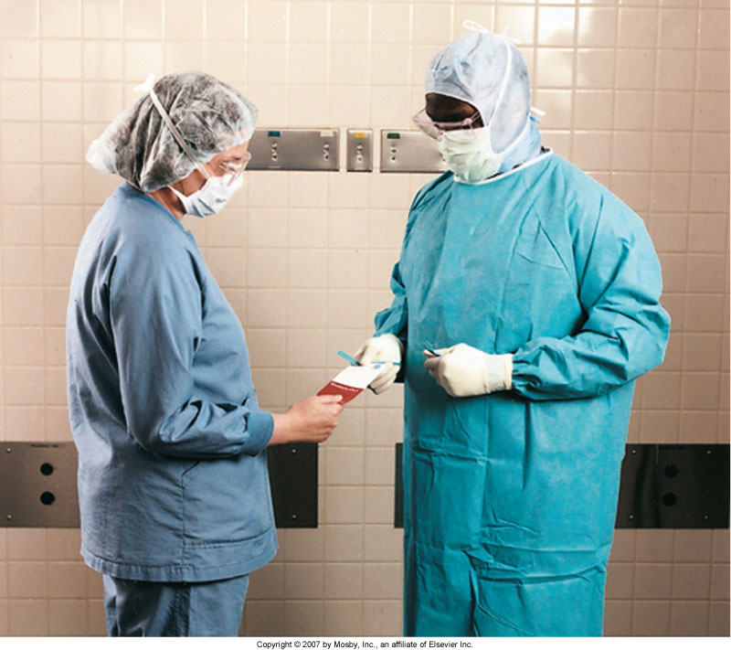
Operating theatre cont’d…

Slide 6
Surgical team
The patient
The anesthesiologist or anesthetist
The surgeon
The intraoperative nurses
The surgical technologists.

Slide 7
Theatre nurses roles
Circulating nurse
Manages the operating room and protects the patient’s safety and health by monitoring the activities of the surgical team, checking the operating room conditions, and continually assessing the patient for signs of injury and implementing appropriate interventions.
Main responsibilities
Verifying consent
Coordinating the team
Ensuring cleanliness
Humidity

Slide 8
theatre nurses roles cont’d…
Circulating nurse functions cont’d
Lighting
Safe functioning of equipment
Availability of supplies and materials.
The circulating nurse monitors aseptic practices to avoid breaks in technique while coordinating the movement of related personnel
Nursing activities directly relate to preventing complications and achieving and maintaining optimal patient outcomes.
Send tissue specimen to the laboratory

Slide 9
Scrub nurse
Performing a surgical hand scrub
Setting up the sterile tables - preparing sutures, ligatures, and special equipment (such as a laparoscope)
Assisting the surgeon and the surgical assistants during the procedure by anticipating the instruments that will be required
Together with the circulating nurse conduct a sponge count (accounted for and not retained as a foreign body in the patient)
Label tissue specimens obtained during surgery

Slide 10
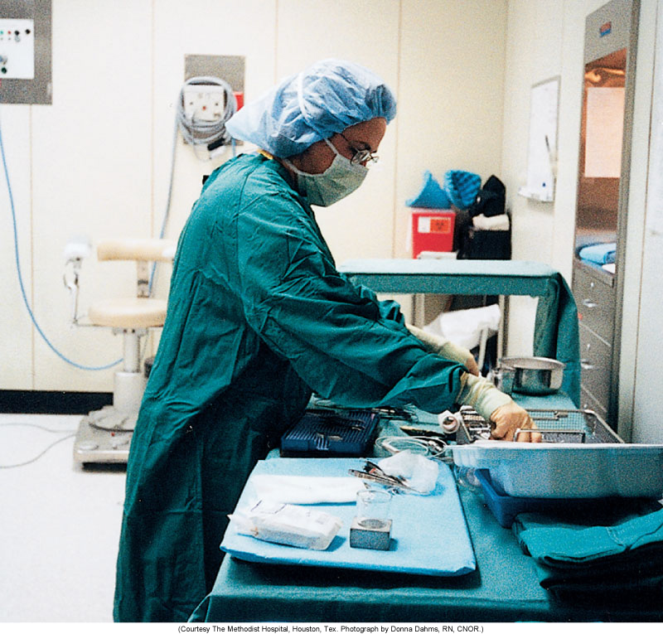
Scrub nurse cont’d…

Slide 11
First assistant nurse
Practices under the direct supervision of the surgeon.
Responsibilities
Handling tissue
Providing exposure at the operative field, suturing, and providing hemostasis.
The entire process requires a thorough understanding of anatomy and
physiology, tissue handling, and the principles of surgical asepsis.
Needs to be able to handle any emergency situation in the operating room

Slide 12
First assistant nurse cont’d…

Slide 13
Surgeon
Performs the surgical procedure and heads the surgical team.
He or she is a licensed physician (MD) is specially trained and qualified.

Slide 14
Anesthesiologist or anesthetist
An anesthesiologist is a physician specifically trained in the art and science of anesthesiology.
An anesthetist is a qualified health care professional who administers anesthetics. Most anesthetists are nurses who have graduated from an accredited nurse anesthesia
Responsibilities
Assesses the patient prior to surgery
Selects the anesthesia, administers it, intubates the patient if necessary, manages any technical problems related to the administration of the anesthetic agent, and supervises the patient’s condition throughout the surgical procedure.

Slide 15
Anesthesiologist or anesthetist cont’d…

Slide 16
Anesthesiologist or anesthetist cont’d…
Before the patient enters the operating room, often at preadmission testing, the anesthesiologist or anesthetist visits the patient to provide information and answer questions.
The type of anesthetic to be administered, previous reactions to anesthetics, and known anatomic abnormalities that would make airway management difficult are identified.
During surgery, monitors the patient’s blood pressure, pulse, and respirations as well as the electrocardiogram (ECG), blood oxygen saturation level, tidal volume, blood gas levels, blood pH, alveolar gas concentrations, and body temperature and communicates to the surgical team.

Slide 17
Surgical Asepsis
Defined as absence of microorganisms in the surgical environment to reduce the risk for infection
Surgical asepsis prevents the contamination of surgical wounds.

Slide 18
Medical asepsis versus surgical asepsis

Slide 19
Scrubbing technique
  First wash you hands and forearms thoroughly with soap and water
  Rinse then scrub the fingers and hands with progression to the forearm and elbows.
  The hands should be held up once clean so that no bacteria can drift down onto the clean area
  Then you can enter the surgical area and dry the hands and put on the surgical gown and gloves

Slide 20
Principles of basic aseptic technique in an operating room
All materials entering the sterile field must be sterile.
All surgical supplies, any instruments, needles, sutures, dressings, gloves, covers, and solutions that may come in contact with the surgical wound and exposed tissues, must be sterilized before use.
If a sterile item comes in contact with an unsterile item, it is contaminated.
Contaminated items should be removed immediately from the sterile field

Slide 21
Principles of basic aseptic technique in an operating room cont’d….
Sterile team members must wear only sterile gowns and gloves: once dressed for the procedure , they should recognize that the only parts of the gown considered sterile are the front from the chest to table level and the sleeves to 2 inches above the elbow.
A wide margin of safety must be maintained between the sterile and unsterile fields.

Slide 22
Principles of basic aseptic technique in an operating room cont’d….
Tables are considered sterile only at tabletop level , items extending beneath this level re considered contaminated.
The edges of a sterile package are considered contaminated once the package has been opened.

Slide 23
Principles of basic aseptic technique in an operating room cont’d….
Bacteria travel through moist fabrics and contamination occurs, they also harbor on the patient’s and the team member’s hair, skin, and respiratory tracts and so must be confined by appropriate attire.
An area of the patient’s skin considerably larger than that requiring exposure during the surgery is meticulously cleansed, and an antimicrobial agent is applied. The remainder of the patient’s body is covered with sterile drapes

Slide 24
Anaesthesia
Anaesthesia refers to a reversible local or general loss of bodily sensation, especially of touch, as the result of nerve damage or other abnormality or loss of sensation, especially of pain, induced by drugs with or without loss of consciousness
Anaesthetics are the drugs given to induce or maintain the loss of sensation

Slide 25
Types of anaesthesia
1. Local anaesthesia
Temporary interruption of the transmission of nerveimpulses to and from specific area or region of the body;
Applied locally to a limited area of the body
Achieved by injecting local anesthetics in close proximity to appropriate nerves.
Reduce all painful sensation in one region of the bodywithout inducing unconsciousness
Agents used are lidocaine and bupivacaine.

Slide 26
Types of anaesthesia cont’d…
General anaesthesia
Reversible state consisting of complete loss of consciousness and sensation.
Protective reflexes such as cough and gag are lost
Provides analgesia, muscle relaxation and sedation.
Produces amnesia and hypnosis .
Administered systemically by inhalation or by intravenous injection

Slide 27
Types of anaesthesia cont’d…
General anaesthesia is defined as a state of unconsciousness, analgesia, amnesia, skeletal muscle relaxation, and inhibition of sensory and autonomic reflexes
Analgesia - A state of decreased awareness of pain, sometimes with amnesia
Amnesia - Impairment of memory anaesthetics cause short-term amnesia, i.e. experiences occurring during the influence of the drug are not recalled later, even though the person was responsive at the time.

Slide 28
Techniques used in General Anesthesia
A. Intravenous Anesthesia
This is being administered intravenously and extremely rapid.
Its effect will immediately take place after thirty minutes of introduction.
It prepares the client for smooth transition to the surgical anesthesia.
B. Inhalation Anesthesia
This comprises of volatile liquids or gas and oxygen.
Administered through a mask or endotracheal tube.

Slide 29
Course of general anesthesia
The intra-operative period for GA is normally broken down into 3 phases:
Induction
Maintenance
Recovery
Induction of anesthesia
The period of time from onset of administration of the anesthetic to the establishment of a depth of anaesthesia adequate for surgery in the patient.

Slide 30
Course of general anesthesia cont’d…
Maintenance
Period during the surgical anesthesia stage
Recovery
It is the time from discontinuation of administration of anesthesia until consciousness is regained .
Induction of anaesthesia depends on how fast effective concentrations of the anesthetic drug reach the brain
Recovery from anaesthesia depends on how fast the anaesthetic drug is removed from the brain

Slide 31
Pre anesthetic medication
Preliminary drug given to facilitate induction of GA
Administation of drugs prior to anesthesia to allay apprehension, produce sedation, and facilitate the administration of anesthesia to the patient.
Drugs include:
Anticholinergic drugs
Drugs that reduce acidity and volume of gastric contents
Sedative-hypnotics & anxiolytics
Opioids

Slide 32
Stages of general anesthesia
Stage of analgesia
Patient initially experiences analgesia without amnesia.
Later in stage I, both analgesia and amnesia are produced

Slide 33
Stages of general anesthesia cont’d..
II. Stage of excitement
Patient often appears to be delirious and may vocalize but is definitely amnesic.
Respiration is irregular both in volume and rate, and vomiting may occur if the patient is stimulated.
Efforts should be made to limit the duration and severity of this light stage of anesthesia by rapidly increasing the concentration of the agent.
This stage ends with the reestablishment of regular breathing.

Slide 34
Stages of general anesthesia cont’d..
III. Stage of surgical anaesthesia
Begins with the recurrence of regular respiration and extends to complete cessation of spontaneous respiration (apnea).
Four planes of stage III have been described in terms of changes in ocular movements, eye reflexes, and pupil size, which may represent signs of increasing depth of anaesthesia

Slide 35
Stages of general anesthesia cont’d..
Planes of stage III
Plane 1: From the return of regular respirations to the cessation of random eye movement.
Plane 2: The Surgical Plane -From the cessation of random eye movement to the onset of paralysis of the intercostal muscles
Plane 3: From the onset to the complete paralysis of the intercostal muscles
Plane 4: From the paralysis of the intercostal muscles to the paralysis of the diaphragm - at the end

Slide 36
Stages of general anesthesia cont’d..
IV. Stage of medullary depression
Includes severe depression of the CNS, including the vasomotor center in the medulla, as well as the respiratory center in the brain stem.
Without circulatory and respiratory support, death rapidly ensues.

Slide 37
Anesthetic drugs

Slide 44
Techniques used in anaesthesia
Intravenous Anesthesia
This is being administered intravenously and extremely rapid.
Its effect will immediately take place after thirty minutes of introduction.
It prepares the client for smooth transition to the surgical anesthesia.

Slide 45
Techniques used in anaesthesia cont’d…
Inhalation Anesthesia
This comprises of volatile liquids or gas and oxygen.
Administered through a mask or endotracheal tube.

Slide 46
Techniques used in anaesthesia cont’d…
Topical Anesthesia
Applied directly to the skin and mucous membrane, open skin surfaces, wounds and burns.
Readily absorbed and act rapidly
Used topical agents are lidocaine and benzocaine

Slide 47
Techniques used in anaesthesia cont’d…
Spinal Anesthesia ( Subarachnoid block )
Local anesthetic is injected through lumbar puncture between L2 and S1
Anesthetic agent is injected into subarachoid space surrounding the spinal cord.
Low spinal, for perineal/rectal areas
Mid spinal T10 ( below level of umbilicus)for hernia repair and appendectomy.
High spinal T4 ( nipple line ), for CS
Agents used are procaine, tetracaine, lidocaine and bupivacaine

Slide 48
Techniques used in anaesthesia cont’d…
Epidural Anesthesia
Achieved by injecting local anesthetic into epidural space by way of a lumbar puncture.
Result similar to spinal analgesiaｷagents use are chloroprocaine, lidocaine and bupivacaine

Slide 49
Injection sites for spinal and epidural anesthesia

Slide 50
Injection sites for spinal and epidural anesthesia

Slide 51
Cross sectional injection sites

Slide 52
Complications and Discomforts of Anesthesia
Hypoventilation - inadequate ventilatory support after paralysis of respiratory muscles.
Oral Trauma
Malignant Hyperthermia - uncontrolled skeletal muscle contraction
Hypotension - due to preoperative hypovolemia or untoward reactions to anesthetic agents.
Cardiac Dysrhythmia - due to preexisting cardiovascular compromise, electrolyte imbalance or untoward reaction to anesthesia.

Slide 53
Complications and discomforts of anesthesia cont’d…
Hypothermia - due to exposure to a cool ambient in the oprerating theartre environment and loss of thermoregulation capacity from anesthesia.
Peripheral Nerve Damage - due to improper positioning of patient or use of restraints.
Nausea and Vomiting
Headaches

Slide 54
