Slide 1
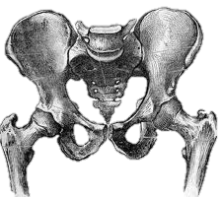
Legg Calve Perthes Disease
Synonyms
Perthes Disease
Osteochondritis Deformans Juvenilis
Childhood Aseptic Necrosis of Femoral Head

Slide 2
Definition
Perthes’ disease is a self-limiting form of osteochondrosis of the capital femoral epiphysis of unknown aetiology that develops in children commonly between the ages of 5 – 12 years.
It is a condition of immature hip caused by necrosis of the femoral epiphysis; the femoral head subsequently deforms as necrotic bone is replaced by living bone.
It is Hip disease occurring during early childhood and caused by impaired circulation in the femoral head.

Slide 3
Historical background
The disease was described almost simultaneously, in 1910, by –
G. C. Perthes in Germany,
J. Calve in France
A.T. Legg in America.
Hence name – “Legg Calve Perthes Disease”
The newly discovered x-ray technique allowed doctors to differentiate it from inflammatory forms of hip disease.

Slide 4
Etiological Factors that play a role in development of illness
Vascular supply
Increased intra-articular pressure
Intraosseous pressure
Coagulation disorder
Growth hormones
Growth
Social conditions
Genetic factors

Slide 5
To sum up –
Genetic factors play an important role in the etiology of Perthes disease.
The illness develops as a result of impaired circulation in the medial circumflex artery in association with a skeletal maturation disorder with delayed growth in children aged from 3–5 years.

Slide 6
Occurrence
In white population is 10.8 per 1,000,000 children & adolescents aged from 0–15 year
In Asians is 3.8 per 1,000,000
In Mixed-race populations is 1.7 per 1,000,000
In Blacks is 0.45 per 1,000,000
The highest reported incidence was in city of Liverpool (UK) early 1980’s, with 15.6 per 1,00,000 individuals under 15 years of age.

Slide 7
Epidemiology
Disorder of hip in young children
Usually ages 4-8yr
As early as 2yr, as late as teenager
Boys: Girls – 4/5:1
Bilateral – 10-12%
No evidence of inheritance
Notes:
-incidence of positive family hx ranges from 1.6% to 20%, but no hard evidence of predisposition
-is more common in certain geographic areas (urban>rural)=nutritional?, later born children, strong association with ADHD (33%)

Slide 8
Classification
All known classifications of Legg-Calvé-Perthes disease are based on the morphological findings on x-rays.

Slide 9
Morphological classifications of the extent of the lesion
Classification according to Catterall (Common)
Classification according to Salter & Thompson
Classification according to Herring

Slide 10
Classification of extent of lesion - (Acc to Catterall)
Grade | Characteristics
I | Only anterolateral quadrant affected
II | Anterior third or half of the femoral head
III | Up to 3/4 of the femoral head affected, only the most dorsal section is intact
IV | Whole femoral head affected

Slide 11
Grade – I
Only anterolateral quadrant affected

Slide 12
Grade - II
Anterior third or half of the femoral head

Slide 13
Grade – III
Up to 3/4 of the femoral head affected,
only the most dorsal section is intact

Slide 14
Grade – IV
Whole femoral head affected

Slide 15
Classification according to Herring
Group | Characteristics
A | Lateral pillar not affected
B | >50% of height of lateral pillar preserved
C | <50% of height of lateral pillar preserved

Slide 16
Classification according to Herring
“A”
Lateral pillar not affected

Slide 17
Classification according to Herring
“B”
>50% of height of lateral pillar preserved

Slide 18
Classification according to Herring
“C”
<50% of height of lateral pillar preserved

Slide 19
Deformation of the femoral head
Children femoral head becomes deformed during revascularization of the epiphysis.
There is evidence to suggest that irreversible deformation occurs either in the latter part of the stage of fragmentation or very early in the stage of regeneration.

Slide 20
Enlargement of the femoral head –
The femoral head becomes enlarged as the disease progresses.
The extent of enlargement is proportional to the degree of its deformation.

Slide 21
Secondary degenerative arthritis of the hip –
All 3 morphological changes in the proximal femur listed above can contribute independently or collectively to the development of secondary degenerative arthritis.
However, the most important factor that predisposes to the development of degenerative arthritis is deformation of the shape of the femoral head.

Slide 22
Stages of Perthe’s Disease (Waldenström Staging)
Fragmentation stage
Re-ossification stage
Healed stage
Avascular stage
These stages can occur over a period of 3-4 years

Slide 23
Stage and Characteristics
Avascular stage.
The femoral head appears slightly flattened & denser than normal on the x-ray.
The joint space is widened (Waldenström sign).
Lateralisation of the femoral head.

Slide 24
Stage and Characteristics cont…
Stage of resorption (Fragmentation)
Femoral head breaks up into fragments
Lucent areas appear in the femoral head
Increased density resolves
Acetabular contour is more irregular

Slide 25
Stage and Characteristics cont…
Stage of Re-ossification
The femoral head is rebuilt
New bone formation occurs in the femoral head

Slide 26
Stage and Characteristics cont…
Healing stage
End stage with or without defect healing (normal hip, coxa magna, flattened head etc.)

Slide 27
Examination
Short stature
Delayed bone age
Early
Decreased ROM
Antalgic gait
Late
Decreased ROM of motion from acetabular impingement
Disuse atrophy of thigh muscles
Leg lenght descrepancy
Trendelenburg gait

Slide 28
Investigations
Blood tests
haemogram, ESR, CRP
Imaging
Plain X-rays
Hip U/S
Bone scintigrpahy
MRI
Dynamic arthrography
Assess spherity of femoral head
Hinge abduction
Bilateral perthes
Skeletal survey as part of work-up

Slide 29
Stages of radiological changes in Perthe's disease:
Early Stage –
Joint space widening (waldenstrom's sign)
Increased density of femoral epiphysis
Subchondral fracture, or “crescent sign,” seen on lateral radiograph
Mid Stage –
Fragmentation and flattening of head (Coxa magna)
Widening of the physis (waldenstrom's sign)
Femoral neck cysts
Extrusion of the femoral head

Slide 30
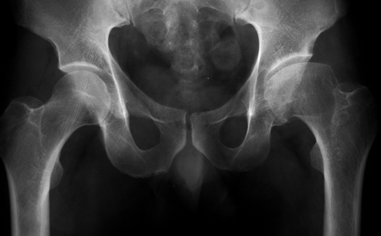
Stages of radiological changes in Perthe's disease: cont…
Late Stage–
Coxa magna
High-riding trochanter
Flattened femoral head
Irregular articular surface

Slide 31
Imaging – Radiographic Feature
Widening of the joint space and minor subluxation
Sclerosis
Fragmentation and focal resorption
Loss of height
Metaphyseal cyst formation
Widening of the femoral neck & head (Coxa Magna)
Lateral uncovering of the femoral head
Sagging rope sign
Acetabular remodelling
Notes:
-frog leg= better for crescent sign
-compare films with previous to determine change
-arthrography can show status of cartilage not shown on x-ray, check ROM to r/o hinging abduction
-hinging abduction due to large femoral head extruding laterally & hinging over
edge of acetabulum

Slide 32
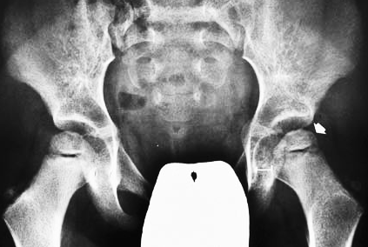
Frog-lateral View Of The Hips

Slide 33
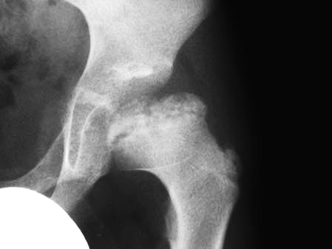
Fragmentation of the femoral capital epiphysis

Slide 34
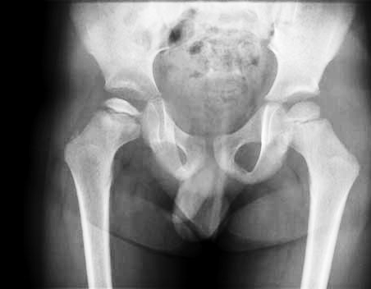
Sclerosis of epiphysis & widening of joint space in the early stages

Slide 35
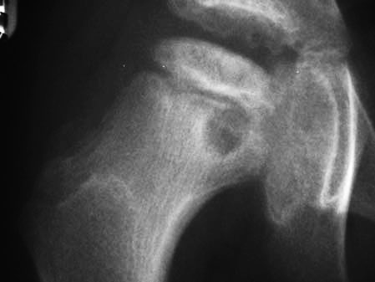
Metaphyseal cyst formation within the femoral neck

Slide 36
Ultrasound features
Effusion, especially if persistent
Synovial thickening
Cartilaginous thickening
Atrophy of the ipsilateral quadriceps muscle
Flattening, fragmentation, irregularity of the femoral head
New bone formation
Revascularisation with contrast enhanced power Doppler

Slide 37
Differential Diagnosis
It is important to rule out infectious etiology (septic arthritis, toxic synovitis)
Others:
Chondrolysis -Neoplasm
JRA -Sickle Cell
Osteomyelitis -Traumatic AVN
Lymphoma -Medication

Slide 38
Differential Diagnosis
D/D unilateral Perthes’ disease:
Transient synovitis
Septic arthritis
Sickle cell disease
D/D bilateral Perthes’ disease:
Hypothyroidism
Multiple epiphyseal dysplasia
Sickle cell disease

Slide 39
Diagnosis
Children with Perthes disease limp and complain of mild to moderate hip pain.
This situation can persist for several weeks.
Clinical examination usually reveals a slight stiff, protective limp.
The ROM of the affected hip is usually restricted, in particular with reduced abduction and internal rotation.

Slide 40
MANAGEMENT
GOALS INCLUDE
Containment of the head in the acetabular socket during healing
Hip ROM exercises to prevent contractures
Muscle strengthening of the hip musclesa

Slide 41
Treatment: Two main choices
Conservative
Pain control
Gentle exercises
Regular re-assessment
Avoid sport and strenous activities
Containment
Hold hips widely abducted in cast/brace >1yr
Operation
Varus osteotomy of femur
Innominate osteotomy of pelvis
Both

Slide 42
PERTHES EXERCISES
Static Stretching Parameters –
2 minutes of stretching/day/muscle group
30 second hold time
4 repetitions per muscle group
If not tolerated, may do 10 to 30 second hold time with repetitions adjusted to meet 2 minute requirement
e.g. if holding 15 seconds, would do 8 stretches

Slide 43
ROM cont…
Dynamic Stretch Parameters –
5 second hold
24 repetitions per muscle group per day to meet 2 minute stretching time required
Done if patient does not tolerate static stretch

Slide 44
Strengthening Exercises
Isometric Ex -> Isotonic Ex in gravity lessened -> Isotonic Ex against gravity.
It is appropriate to include concentric and eccentric contractions.
Begin with 2 sets of 10 to 15 rep of each ex, progression to 3 sets of each exs.
Note: If the patient is unable to perform 2 sets of 10 rep, the difficulty of the ex is to be decreased either through weight or type of ex.

Slide 45
Strengthening Ex Prescription
Special attention should be given to:
Hip abductors (especially gluteus medius)
Hip internal rotators
Hip external rotators
Hip flexors
Hip extensors

Slide 46
Weight Relief
The load on the hip can basically be relieved by the following methods:
Bed rest
Wheelchair
Walking with crutches,
Bracing devices (Thomas splint , Mainz orthosis, etc.).

Slide 47
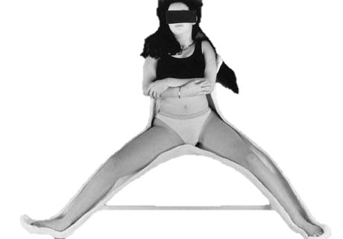
Petrie Cast

Slide 48
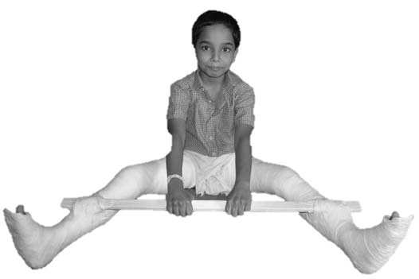
Broomstick Cast

Slide 49
Bracing

Slide 50
Herring Guidelines to treatment
Children <6years
Symptomatic treatment
Children >6years; bone age more imp than chronological age
Bone age at or <6yrs
Lateral pillar A or B/ caterall I and II
Symptomatic treatment
Lateral pillar C/ Caterall III and IV
Bone over 6years
Herring A and B/Caterall I and II
Abduction brace or osteotomy
Herring C/Caterall III and IV
Outcome unaffected by treatment
Children 9yrs and older
Except in very mild cases, operative containment is the treatment of choice

Slide 52
Prognosis
60% of kids do well without Rx
AGE is key prognostic factor:
<6y – good outcome regardless of Rx
6-8y – not always good results with just containment
>9y – containment option is questionable, poorer prognosis, significant residual defect
Notes:
-Catterral 1 and usually 2 do well without treatment

Slide 53
Operative Tx
If non-op Rx cannot maintain containment
Surgically ideal pt:
6-9yo
Catterral II-III
Good ROM
<12mos sx
In collapsing phase

Slide 54
Surgical Tx
Surgical options:
Excise lateral extruding head portion to stop hinging abduction
Acetabular osteotomy to cover head
Varus femoral osteotomy
Arthrodesis

Slide 55
Varus Osteotomy

Slide 56
Head at risk signs
Clinical features:
Progressive loss of movement
Adduction contractures
Flexion in abduction
Heavy child
Radiological features:
Lateral subluxation of the femoral head (head partially uncovered)
Entire femoral head involved
Calcification lateral to the epiphysis
Metaphyseal cysts
Gage's sign

Slide 57
Prognostic features
Age
<6yrs; good regardless of treatment
6-9years; not always satisfactory with containment
>10yrs; questionable benefit from containment, poor prognosis
Gender
Girls have worse prognosis
Classification grade
Herrings lateral pillar classification
Salter and thompson grade B worse prognosis
Caterral classification grade
Caterral “head-at-risk” signs
The five signs carry worse prognosis
Others
Body weight, decreased ROM

