Slide 1
PHARMACOKINETICS
DRUG MOVEMENT ACROSS CELL MEMBRANES

Slide 2
Introduction
Pharmacokinetics is the process whereby drug concentrations at effecter sites are achieved, maintained and diminished; that is, the study of the absorption, distribution, metabolism and excretion of drugs in the intact animal or human.
The quantitative study of drug movement in, through and out of the body.

Slide 3
Importance
Pharmacokinetics quantifies the component parts of drug disposition to determine:
  Absorption
  Distribution
  Metabolism
  Elimination

Slide 4
Importance
It helps to know the:
  Optimum routes
  Absorption rates
  Timing of drug administration
Regimes of drug administration are determined from pharmacokinetic studies.

Slide 5
Importance…
Pharmacokinetics is concerned with the rate at which drug molecules cross cell membranes to enter the body, to distribute within it and to leave the body, as well as with the structural changes (metabolism) to which they are subject within it.

Slide 6
Drug movement across cell membranes
Pharmacokinetics

Slide 7
Learning objectives
Describe the components of a cell membrane
Explain how passage across cell membranes affects drug use
Describe the processes through which drugs cross cell membranes
Describe the physicochemical classification of drugs and explain its relationship to drug passage across cell membranes
Explain the clinical relevance of drug passage across cell membranes

Slide 8
Structure of cell membrane
Cell membranes are essentially bilayers of lipid molecules with ‘islands’ of protein.
The hydrophilic ends of the lipids orientate themselves at both the inner and outer surfaces, while the hydrophobic portions occupy the center of the membrane.

Slide 9
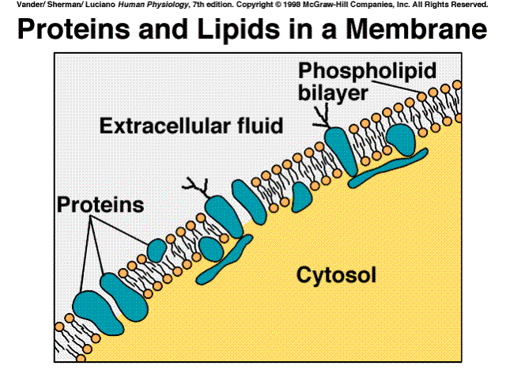
Cell membrane…

Slide 10
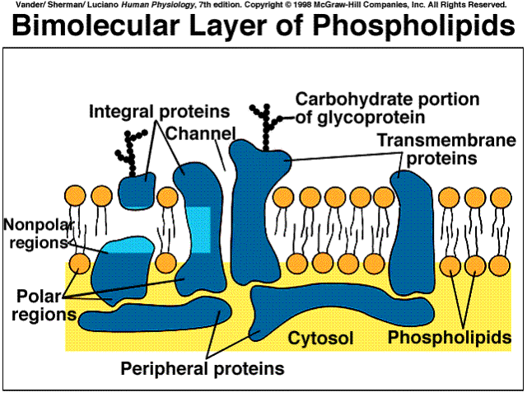
Cell membrane…

Slide 11
Cell membrane structure…
Integral proteins extend the full length of the membrane and show a predominance of either hydrophilic or hydrophobic groups at their surfaces – contiguous to the corresponding lipids according to their depth within the membrane.
Peripheral proteins are attached either to integral proteins at the inner side of the membrane and are predominantly hydrophilic or to the hydrophilic ends of lipids at either surface.

Slide 12
Cell membrane structure…
Some of the integral proteins, which extend through the full thickness of the membrane, surround fine aqueous pores.
Carbohydrates – glycoproteins or glycolipids are formed on the outer surface of the membrane by the attachment of different polymeric arrangements of monosaccharides.

Slide 13
Relationship with drug use
The extent to which a drug can cross epithelia is fundamental to its clinical use.
It is the major factor that determines whether a drug can be taken orally for systemic effect and whether within the glomerular filtrate it will be reabsorbed or excreted in the urine.
Lipid-soluble substances diffuse readily into cells and therefore throughout body tissues.

Slide 14
Relationship with drug use
Adjacent epithelial or endothelial cells are joined by tight junctions, some of which contain water-filled channels through which water-soluble substances of small molecular size may filter.
The jejunum and proximal renal tubules contain many such channels and are called leaky epithelia.
The tight junctions in the stomach and urinary bladder do not have these channels and water cannot pass; they are termed tight epithelia.
Special protein molecules within the lipid bilayer allow specific substances to enter or leave the cell preferentially (carrier proteins)

Slide 15
Processes through which drugs pass across membranes
The passage of drugs across cell membranes is determined by the natural processes of:
  Filtration
  Carrier-mediated transport
  Diffusion

Slide 16
Filtration
Aqueous channels in the tight junctions between adjacent epithelial cells (paracellular spaces) allow the passage of some water-soluble substances.
Filtration is mainly important in drug excretion by glomerular filtration.
Capillaries (except those in the brain) have large pores and most drugs filter through these.
Diffusion of drugs through capillaries is dependent on the rate of blood flow through them rather than on lipid solubility or pH.

Slide 17
Filtration…
Drugs may also pass through aqueous pores in the membrane.
Majority of cells (including intestinal mucosa) have very small pores and drugs with molecular weight of more than 100 or 200 are not able to penetrate.

Slide 18
Carrier-mediated transport
This comprises active transport and facilitated diffusion
In carrier transport, the drug combines with a carrier present in the membrane and the complex then translocates from one face of the membrane to the other.
The carriers for polar molecules appear to form a hydrophobic coating over the hydrophilic groups and thus facilitate passage through the membrane.
Carrier transport is specific, saturable and is competitively inhibited by analogues which utilize the same carrier.

Slide 19
Active transport
This is a specialized process requiring energy and enables some drugs to move into or out of cells against a concentration gradient.
They often require a carrier substance, and the movement is independent of the physical properties of the membrane.
It results in selective accumulation of the substance on one side of the membrane.

Slide 20
Facilitated diffusion
This is carrier mediated transport that does not require energy.
This proceeds more rapidly than simple diffusion and translocates even non-diffusible substrates, but along their concentration gradient.
It, therefore, does not require energy.
Vitamin B12 absorption is an example.

Slide 21
Diffusion
This is the most important means by which a drug enters the tissues and is distributed through them.
Simple diffusion requires:
  A favorable concentration gradient of the drug
  Sufficient lipid-solubility to pass through the membrane.

Slide 22
Diffusion …
In the context of an individual cell, the drug moves passively at a rate proportional to the concentration difference across the cell membrane; that is, it shows first-order kinetics.
Cellular energy is not required, which means that the process does not become saturated and is not inhibited by other substances.

Slide 23
Diffusion…
Drugs exhibit greater or less degrees of lipid solubility according to environmental pH and the structural properties of the molecule.
Broadly, water solubility favored by the possession of alcoholic (-OH), amide (-CO.NH2) or carboxylic (-COOH) groups, and the formation of glucuronide and sulphate conjugates.
Presence of a benzene ring, a hydrocarbon chain, a steroid nucleus or halogen (-Br, -Cl, -F) groups favours lipid solubility.

Slide 24
Physicochemical classification of drugs
Drugs can be classified in a physicochemical sense into:
Those that are variably ionized according to environmental pH (electrolytes). These can either be lipid soluble or water-soluble, depending on the environmental pH.
Those that are incapable of becoming ionized whatever the environmental pH (unionized, non-polar substances). These are lipid soluble.
Those that are permanently ionized whatever the environmental pH (ionized polar substances). These are water-soluble.

Slide 25
Drugs that are variably ionized according to the environmental pH
Many drugs are weak electrolytes, i.e. their structural groups ionize to a greater or lesser extent, according to environmental pH.
Most such elements are present partly in the ionized and partly in the un-ionized state.
The degree of ionization influences lipid solubility (and hence diffusibility) and so affects absorption, distribution and elimination.

Slide 26
Drugs that are variably ionized…
Ionizable groups in a drug molecule tend either to lose a hydrogen ion (acidic groups) or to add a hydrogen ion (basic groups)

Slide 27
Drugs that are variably ionized…
In an acidic environment, i.e. one already containing many hydrogen ions, an acidic group tends not to lose a hydrogen ion and remains un-ionized.
A relative deficit of hydrogen ions, i.e. a basic environment, favors dissociation of the hydrogen ion from an acidic group which thus becomes ionized.
The opposite is the case for a base.

Slide 28
Drugs that are variably ionized…
In summary:
  Acidic groups become less ionized in acidic environment
  Basic drugs become less ionized in a basic (alkaline) environment and vice versa.
  This in turn influences diffusibility since:
  Un-ionized drugs are lipid-soluble and diffusible, and
  Ionized drugs are lipid-insoluble and non-diffusible.

Slide 29
Drugs that are incapable of becoming ionized
These include digoxin and chloramphenicol.
Having no ionizable groups, they are unaffected by the environmental pH, are lipid-soluble and diffuse readily across tissue boundaries.

Slide 30
Drugs that are predominantly ionized
These drugs remain ionized at all values of pH. This is because they carry groups which dissociate so strongly.
Such compounds are called polar, as their groups are either negatively charged (acidic, e.g. heparin) or positively charged (basic, e.g. tubocurarine) and all have very limited capacity to cross cell membranes.
Advantage: heparin is a useful anticoagulant in pregnancy because it does not cross the placenta.
Disadvantage: heparin must be given parenterally as the gut does not absorb it.

Slide 31
The clinical relevance of drug passage across membranes
Blood-brain barrier:
The capillaries of the cerebral circulation lack the channels between endothelial cells through which substances in the blood normally gain access to the extracellular fluid.
There are tight junctions between adjacent capillary endothelial cells, which together with their basement membrane separate the blood from the brain tissue.

Slide 32
Clinical relevance – blood-brain barrier
This blood-brain barrier places constraints on the passage of substances from blood to the brain and CSF.
Compounds that are lipid-insoluble do not cross it readily, e.g. atenolol, compared with propranolol (lipid-soluble), and CNS side effects are prominent with the latter.
Therapy with methotrexate (lipid-insoluble) may have no effect on leukaemic cells in the CNS.

Slide 33
Clinical relevance…
Lipid-soluble substances enter brain tissue with ease.
  thus diazepam (lipid-soluble) given intravenously is effective in one minute for status epilepticus;
  the level of general anaesthesia can be controlled closely by altering the concentration of inhaled anaesthetic gas (lipid-soluble)

Slide 34
The clinical relevance of drug passage across membranes
Placenta:
Chorionic villi, consisting of a layer of trophoblastic cells that enclose foetal capillaries, are bathed in maternal blood.
The large surface area and blood flow (500ml/min.) are essential for gas exchange, uptake of nutrients and elimination of waste products.

Slide 35
The clinical relevance of drug passage across membranes
The fetal and maternal blood streams are therefore separated by a lipid barrier that readily allows the passage of lipid-soluble substances but excludes water-soluble compounds, especially those with molecular weight exceeding 600.
This exclusion is of particular importance with short-term use, e.g. tubocurarine (lipid-insoluble) given as a muscle relaxant during Caesarean section, does not affect the infant.

Slide 36
The end
Thank you.

