Slide 1
PHARMACOLOGY
Baariu Kirimi S.
LECTURER
KMTC-NAIROBI

Slide 2
Lesson 1: Introduction to pharmacology
Objectives
At the end of the lesson, learners will:
Define pharmacology
Explain the concepts of pharmacodynamics and pharmacokinetics
Define a drug

Slide 3
DEFINATION OF TERMS
Pharmacology-:study of substances that interact with living systems through binding to regulatory molecules and activating or inhibiting normal body processes.
Pharmacy- the science and technique of preparing and dispensing drugs
Medical pharmacology:- the science of substances used to prevent, diagnose and prevent disease.
Toxicology- the branch of pharmacology that deals with the undesirable effects of chemicals on living systems

Slide 4
Drug:- any substance that brings about a change in biologic function through it chemical actions.
Poison:- these are drugs that have almost exclusively harmful effects. However, increase in dosage can make any drug harmful. Examples of poisons:
    Lead
    Arsenic
Toxins:- poisons of biologic origin. Examples
    Bortulinum toxin
    Amanita toxin from mushrooms

Slide 5
Drugs names
Chemical…states its chemical composition and molecular structure.
Generic…usually suggested by the manufacturer.
Official…as listed in the Pharmacopoeia. (I.P., B.P., U.S.P.)
Brand…the trade or proprietary name

Slide 6
 | 1,4 benzodiazepine analog
Generic Name | Alprazolam
Chemical Name | Alprazolam, USP
Brand Name | Alprax®

Slide 7
The sources of drugs
Source | example
Mineral Animal Plant Synthetic Micro-organisms Drugs produced by genetic engineering | Liquid paraffin, magnesium sulfate, etc Insulin, Thyroid, etc. Morphine, Quinine etc Aspirin, Sulfonamides, etc. Penicillin & other antibiotics. Human insulin, human growth, hormone etc.

Slide 8
Doses and dosage
Dose: The quantity of drug administered at one time
  500mg of Paracetamol
Dosage: The amount of the drug that should be given over time
  500 mg Paracetamol TID for 3 days

Slide 9
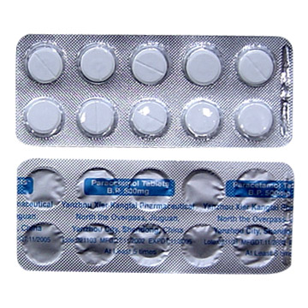
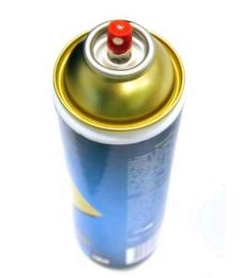
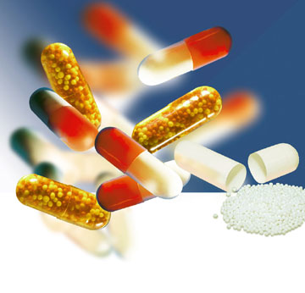
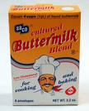
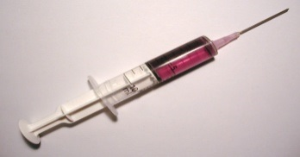

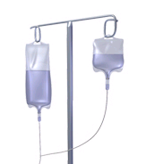
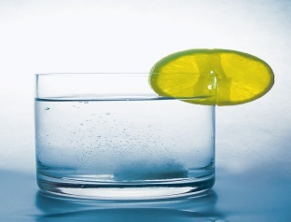
Drug dosage forms
Aerosol
Tablets
Capsule
Suspension
Injection
Solution
Cream
Infusion

Slide 10
Routes of drug administration
How the drug is given
Enteral
Parenteral (injectable)
Topical
Oral
Sublingual
Rectal
1. Intravenous
2. Intramuscular
3. Subcutaneous
Intranasal
Inhalation
Intravaginal

Slide 11
Advantages and disadvantages of various routes of drug administration
            BIOAVAILABILITY
High and Reliable
IV > IM = SC > ORAL
Low &/or Variable
ONSET OF ACTION
Immediate
IV > IM > SC > Oral
Delayed
PATIENT COMPLIANCE
High
Oral > SC > IM > IV
Low
SAFETY
High
Oral > SC > IM > IV
Low
CONVENIENCE
High
Oral > SC > IM > IV
Low
COST
High
IV > IM > SC > ORAL
Low

Slide 12
PHARMACOKINETICS
The study of what the body does to the drug
It is the study of absorption, distribution, metabolism and excretion (ADME) of drugs.
Absorption
  How the drug is moved into blood stream from the site of administration (what affects absorption?)
Distribution
  How much drug is moved to various body tissues / organs ? Depends on blood flow through tissue
Metabolism
  How the drug is altered – broken down ?
Excretion
  How much of the drug is removed from the body ?

Slide 13
bioavailability
Bioavailability is a fraction of administered dose of a drug that reaches the systemic circulation in the unchanged form.
Bioavailability of IV route : 100 %
FACTORS AFFECTING BIOAVAILABITY
  Dosage forms
  Chemical form
  Dissolution & Absorption of drug
  Route of administration
  Presence of food/drugs in GI tract
  First pass effect
  Extent of drug metabolism before reaching systemic circulation

Slide 14
Concept of Critical Threshold
MEC (Minimum Effective Concentration): The minimum level of drug concentration needed for the desired therapeutic effect to be present.
MSC (Maximum Safe Concentration): The maximum level of drug concentration above which toxic effects occurs
MTC (Minimum Toxic Concentration): The minimum level of drug concentration that produces toxic effects.
Maximal Effect: Greatest response that can be produced by a drug, above which no further response can be created (sometimes called “peak effect”)
Onset: How long before a drug is able to exert a therapeutic effect
Duration: How long a drug effect lasts

Slide 15
DRUG HALF-LIFE (t_{1/2} )
Half life is the time required to reduce the plasma concentration to 50% of its original value
Will determine dosing requirements / how long a drug will remain in the body
Used in determining dosing interval
  1 t1/2 - 50 % drug is eliminated
  2 t1/2 - 50+25 (75 %) drug is eliminated
  3 t1/2 - 50+25 +12.5 (87.5 %) drug is eliminated
  4 t1/2 - 50+25 +12.5+6.25 (93.7 %) drug is eliminated
Thus, nearly complete drug elimination occurs in 4-5 half lives.

Slide 17
DISTRIBUTION
Distribution is a branch of pharmacokinetics which describes the reversible transfer of drug from one location to another within the body.
Dosing
Dosing Interval - How often the drug should be given
Loading dose – Which puts the plasma concentration in the therapeutic range
Maintenance dose - Routine smaller doses to maintain the steady state (Plateau)

Slide 18
METABOLISM
Metabolism = change / biotransformation
The conversion from one chemical form to another
Site of drug biotransformation
    Liver - cytochrome P450 pathways OR microsomal P450 pathways are used to metabolize most agents
    Enzymatic alteration of drug structure
Effect of metabolism
  80% of drugs become inactive
  Inactive drug becomes active: Prodrug
  Some drugs do not get metabolized at all
Other drugs may induce or inhibit metabolism

Slide 19
First Pass Metabolism
The first-pass metabolism (also known as first-pass effect or presystemic metabolism) is a phenomenon of drug metabolism whereby the concentration of a drug is greatly reduced before it reaches the systemic circulation
Systems that affect the first pass effect of the drug,
  Enzymes of the gastro intestinal lumen
  Gut wall enzyme
  Bacterial enzymes
  Hepatic enzymes

Slide 20
Effect of first pass metabolism
  Part of administered dose made inactive
    ↓ bioavailability
  Drug converted into its active form
Nitroglycerin when given orally
  Totally inactivated in the liver
  100% first pass effect
  Always given sublingually

Slide 21
prodrug
Administered in an inactive form
After administration converted into their active form
  usually in liver
Designed to improve bioavailability
Examples
  Enalapril – Enalaprilate
  Ramipril - Ramiprilate

Slide 22
Elimination of drug
Drugs &/or its metabolites are irreversibly eliminated from the body
Elimination of the drug
  Unchanged (Parent form)
  Metabolites
Routes of excretion
  Kidneys – Urine
  GIT – Stools
  Skin - Perspiration
  Eyes - Tears

Slide 23
PHARMACODYNAMICS
The study of what the drug does to the body
It is the quantitative study of the biological and therapeutic effects of drugs. These are:
Drug actions:
The cellular processes involved in the drug and cell interaction
Drug effect:
The physiologic reaction of the body to the drug

Slide 24
Onset
The time it takes for the drug to elicit a
therapeutic response
Peak
The time it takes for a drug to reach its maximum therapeutic response
Duration
The time a drug concentration is sufficient to elicit therapeutic response

Slide 25
Effects of combining drugs
Addition 1 + 1 = 2
  Response elicited by combined drugs is equal to the combined response of the individual drugs
Synergism 1 + 1 = 3
  Two drugs with the same effect are given together and produce a response greater than the sum of their individual responses
Potentiation 0 + 1 = 2
  A drug which has no effect enhances the effect of a second drug
Antagonism 1 + 1 = 0
  Drug inhibits the effect of another drug. Usually, the antagonist has no inherent activity

Slide 26
Factors affecting drug response
Pharmacological
  Dose & Route of administration
  Duration of treatment
  Co-administration of other drugs
Individual
  Age & Weight
  Gender
  Pathology
  Diet

Slide 27
Indication & Contraindication
Indication:
A clinical circumstance indicating that the use of a particular intervention would be appropriate
Contraindication:
Any condition which renders a particular line of treatment improper or undesirable

Slide 28
Adverse drug reactions
Side Effect
  Unavoidable unintended pharmacodynamic effects that occur at a therapeutic dose
    Dryness of mouth with Atropine
Toxic effects
  Result of excessive pharmacological action of the drug due to over dosage or prolonged use
    Hepatic necrosis from paracetamol over dosage
Drug intolerance
  Toxic effects of a drug in an individual at therapeutic doses
    Vomiting with a single dose of salicylate
Drug tolerance
  Decreased response to the same amount of drug after repeated administration

Slide 29
Adverse drug reactions
Cross Tolerance
  Tolerance for a drug that develops after administration of a different drug
Tachyphylaxis
  Rapidly occurring tolerance to a drug.
Cumulative effect
  Increased effectiveness when a drug is given in several doses.
Drug dependence
  The patient becomes accustomed to the drug’s presence in his
  body.

Slide 30
Adverse drug reactions
Idiosyncrasy
    Drug effect unique to an individual,
    A. a toxic reaction
    B. an allergic reaction
    C. a reaction peculiar to the patient
    D. an anaphylactic reaction
Drug allergy
  Immunologically mediated reaction
  Symptoms unrelated to pharmacodynamic profile of drug
  Independent of dosage
  E.g. Penicillin
Drug withdrawal symptoms
  Functional disturbances induced by a drug Persists even after offending drug has been withdrawn
  E.g. Peptic ulcer by salicylates

Slide 31
Adverse drug reactions
Teratogenecity – induce birth defect
  Capacity of a drug to cause foetal abnormalities
    Thalidomide
Mutagenic Effect
  Mutagenesis involves alteration of the genotype by modification of the DNA
  Mutation is carried to the next generations
Photosensitivity
  Cutaneous reaction resulting from drug induced sensitization of the skin to UV radiation
  Quinolones

Slide 32
Pregnancy Considerations
Increased maternal HR, CO and blood volume
  May affect absorption, distribution, effectiveness
Drugs may cross placenta
Drugs may cross into breast milk
Teratatogens

Slide 33
Pregnancy Categories
A: controlled studies in pregnancy (<1 %).
B: animal studies show no risk; Inadequate human data.
C: animal studies show risk, inadequate human data.
D: human data show risk, benefit may outweigh risk.
X: animal or human data positive for risk. Use unwarranted.

Slide 34
Pediatric Considerations
⇓ Oral absorption
Thinner skin (⇑ topical absorption)
⇓ Plasma protein concentration
  ⇑ Free protein-bound drug availability
⇑ Extracellular fluid in neonate
Altered metabolic rates
⇓ Elimination/metabolism
BSA/weight based dosing important!

Slide 35
Geriatric Considerations
⇓ Oral absorption
⇓ Plasma protein concentration
⇓ Muscle mass, ⇑ body fat
⇓ Liver/renal function
Multiple drugs
Multiple diseases

Slide 36
FUNDAMENTALS OF PHARMACOLOGY
The rational pharmacological treatment of any patient requires adequate knowledge about :
The disease process,
Pharmacodynamic properties of the drug(s) selected, and
The individual’s handling of the drug(s) [pharmacokinetics].

Slide 37
Drugs act by affecting biochemical or physiological process in the body. Most drugs act at specific receptors.
The action of a drug is characterized by two variables:
The magnitude of the response and
The concentration required to produce the response.

Slide 38
A specific drug acts only at one receptor but may produce multiple effects due to the location of the receptor in various organs.
A selective drug acts on one receptor in a particular tissue at concentrations that produce little effect on the receptor in other organs.
Most drugs have multiple actions and it is usually preferable to use more specific or more selective agents

Slide 39
ANTI-INFECTIVE AGENTS

Slide 40
ANTIBACTERIALS

Slide 41
antibacterials
Antibacterials/antimicrobial drugs - Substances that inhibit the growth of or kill bacteria or other microorganisms (microscopic organisms = bacteria, viruses, fungi, protozoa)
Bacteriostatic = Inhibits growth of bacteria
Bactericidal = Kills bacteria
Peaks & Troughs = Serum antibacterial levels for drugs w/ a narrow therapeutic index
- Too high = drug toxicity (Peak - 1 hr. after drug infused)
- Too low = therapeutic range (Trough - before dose)

Slide 42
antibacterials
Mechanism of Action:
  1. Inhibition of cell wall synthesis - Bactericidal
  2. Alteration in membrane permeability - ‘Cidal’ or ‘Static’
  3. Inhibition protein synthesis - ‘Cidal’ or ‘Static’
  4. Inhibition of bacterial RNA & DNA - Inhibits synthesis of RNA & DNA
  5. Interferes with metabolism in the cell - ‘Static’

Slide 43
antibacterials
Pharmacodynamics -
- Concentration at site or exposure time for drug plays an important role in bacteria eradication
- Duration of time for use of antibacterial varies according to type of pathogen, site of infection & condition of host
- With some severe infections - continuous infusion more effective than intermittent
- Body defense & drugs work together to stop infectious process
- Effect = drug & host’s defense mechanisms

Slide 44
antibacterials
Bacterial Resistance - result naturally or may be acquired
* Natural (inherent) = w/o previous exposure to antibiotic
ie. pseudomonas resistant to Penicillin G
* Acquired = prior exposure to antibacterial
ie. staph aureus was sensitive to PCN G, now it’s not
Nosocomial infections - infections acquired while clients are in the hosp. Many are mutant strains resistant to many antibacterials.
Antibacterial resistance occurs when antibiotics are used frequently

Slide 45
antibacterials
Culture & Sensitivity - Bld test done to determine effect drugs have on a specific organism
Culture = organisms responsible
Sensitivity = what antibiotic will work best
Narrow & Broad Spectrum
Narrow - primarily effective against 1 type of organism
Broad - effective against both gram + & gram - organisms
* Used before isolating organism through C & S
* Not as effective as narrow spectrum against those single organisms

Slide 46
PENICILINS
From mold genus Penicillium - ‘miracle drug’ from WWII
A beta-lactum structure (beta-lactum ring) interferes w/ bacterial cell wall synthesis by inhibiting the bacterial enzyme necessary for cell division & synthesis
Bacteria die of cell lysis (breakdown)
Both ‘static’ & ‘cidal’ in nature
Mainly referred to as beta-lactum antibiotics (enzymes produced by bacteria that can inactivate PCN - Penicillinases = beta-lactamases which attack PCN

Slide 47
Antibacterials
Penicillins
Natural Penicillins
Penicillin G, Penicillin V, Procaine, Bicillin
- Good gram +, fair gram - , good anaerobic action.
- PCN G = more effective IV or IM, but painful d/t aqueous solution
- PCN V = PO; peak 2 - 4 hrs

Slide 48
Antibacterials
Penicillins
Aminopenicillins (Broad Spectrum)
Amoxicillin (Amoxil), Ampicillin, Bacampicillin HCL (Spectrobid)
- effective against both Gram + & Gram - bacteria
- Costlier
- Inactivated by beta-lactamases = ineffective against Staphylococcus aureus (staph. A)
- Amoxicillin = most prescribed PCN derivative for adults & children

Slide 49
Antibacterials
Penicillins
Penicillinase - Resistant Penicillins
Methicillin (Staphcillin), Nafcillin (Unipen), Oxacillin (Bactocil)
- Used to treat penicillinase-producing Staph A.
- Gram + , not effective against Gram -
- IV & PO

Slide 50
Antibacterials
Penicillins
Extended - Spectrum Penicillins
Carbenicillin (PO), Mezlocillin, Piperacillin, Ticarcillin, Ticarcillin-clavulanate (Timentin) - IM & IV
- Broad spectrum - good gram (-), fair gram (+)
- Good against Pseudomonas aeruginosa
- Not penicillinase resistant

Slide 51
Antibacterials
Penicillins
SE & adverse reactions of Penicillins
1. Hypersensitivity - mild or severe
Mild = rash, pruritus, & hives - Rx w/ antihistamines
Severe = anaphylactic shock - occurs w/ in 20 min. - Rx w/ epinephrine
2. Superinfection - secondary infection when normal microbial flora of the body disturbed during antibiotic Rx
Mouth, resp. tract, GI, GU or skin - usually fungus
3. Organ toxicity - esp. liver & kidneys where drugs metabolized & excreted (aminoglycosides)

Slide 52
Antibacterials
Cephalosporins
From a fungus Cephalosperium acremonium
- Gram (+) & gram (-)
- Resistant to beta - lactamase
- Bactericidal - action similar to PCN’s
- 4 groups (generations) - each effective against a broader spectrum of bacteria
- about 10% of people allergic to PCN also to allergic to cephalosporins
- Action - inhibits bacterial cell wall synthesis
- IM & IV - onset = almost immediate

Slide 53
Antibacterials
Cephalosporins
1st Generation Cephalosporins - cefadroxil (Duricef) & cephalexin (Keflex) - PO; Cefazolin (Ancef) & cephalothin (Keflin) - IM
- Gram (+), & gram (-)
- Esp. used for skin/skin structure infections
- Keflin used for resp, GI, GU, bone, & joint infections

Slide 54
Antibacterials
Cephalosporins
2nd Generation Cephalosporins - cefaclor (ceclor) - PO, cefoxitin (Mefoxin), cefuroxime (Zinacef), cefotetan (Cefotan) - IM & IV
- Gram (+), slightly boarder gram (-) effect than 1st generation
- for harder to treat infections

Slide 55
Antibacterials
Cephalosporins
3rd Generation Cephalosporins - cefotaxime (Claforan), ceftazidime (Fortaz), ceftriaxone (Rocephin), cefixime (Suprax) - IM or IV
- More effective against gram (-), less effective against gram (+)
- for harder yet to treat infections
4th Generation Cephalosporins - cefepime (Maxipime) - IV or IM
- Resistant to most beta-lactamase bacteria
- greater gram (+) coverage than 3rd generation

Slide 56
MACROLIDES
Erythromycin is a naturally-occurring macrolide derived from Streptomyces erythreus – problems with acid lability, narrow spectrum, poor GI intolerance, short elimination half-life
Structural derivatives include clarithromycin and azithromycin:
  Broader spectrum of activity
  Improved PK properties – better bioavailability, better tissue penetration, prolonged half-lives
  Improved tolerability

Slide 57
Mechanism of Action
  Inhibits protein synthesis by reversibly binding to the 50S ribosomal subunit
    Suppression of RNA-dependent protein synthesis
  Macrolides typically display bacteriostatic activity, but may be bactericidal when present at high concentrations against very susceptible organisms
  Time-dependent activity

Slide 58
Macrolides
Pharmacology
Absorption
  Erythromycin – variable absorption (15-45%); food may decrease the absorption
    Base: destroyed by gastric acid; enteric coated
    Esters and ester salts: more acid stable
  Clarithromycin – acid stable and well-absorbed, 55% bioavailable regardless of presence of food
  Azithromycin –acid stable; 38% bioavailable; food decreases absorption of capsules

Slide 59
Macrolides
Pharmacology
Distribution
  Extensive tissue and cellular distribution – clarithromycin and azithromycin with extensive penetration
  Minimal CSF penetration
Elimination
  Clarithromycin is the only macrolide partially eliminated by the kidney (18% of parent and all metabolites); requires dose adjustment when CrCl < 30 ml/min
  Hepatically eliminated: ALL
  NONE of the macrolides are removed during hemodialysis!
  Variable elimination half-lives (1.4 hours for erythro; 3 to 7 hours for clarithro; 68 hours for azithro)

Slide 60
Macrolides
Adverse Effects
Gastrointestinal – up to 33 %
  Nausea, vomiting, diarrhea, dyspepsia
  Most common with erythro; less with new agents
Cholestatic hepatitis - rare
  > 1 to 2 weeks of erythromycin estolate
Thrombophlebitis – IV Erythro and Azithro
  Dilution of dose; slow administration
Other: ototoxicity (high dose erythro in patients with RI); QTc prolongation; allergy

Slide 61
Macrolides
Drug Interactions
Erythromycin and Clarithromycin ONLY– are inhibitors of cytochrome p450 system in the liver; may increase concentrations of:
  Theophylline Digoxin, Disopyramide
  Carbamazepine Valproic acid
  Cyclosporine Terfenadine, Astemizole
  Phenytoin Cisapride
  Warfarin Ergot alkaloids

Slide 62
Macrolide Spectrum of Activity
Gram-Positive Aerobes – erythromycin and clarithromycin display the best activity
(Clarithro>Erythro>Azithro)
    Methicillin-susceptible Staphylococcus aureus
    Streptococcus pneumoniae (only PSSP) – resistance is developing
    Group A/B/C/G and viridans streptococci
    Bacillus sp., Corynebacterium sp.

Slide 63
Macrolide Spectrum of Activity
Gram-Negative Aerobes – newer macrolides with enhanced activity (Azithro>Clarithro>Erythro)
  H. influenzae (not erythro), M. catarrhalis, Neisseria sp., Campylobacter jejuni, Bordetella pertussis
  Do NOT have activity against any Enterobacteriaceae or Pseudomonas

Slide 64
Macrolide Spectrum of Activity
Anaerobes – activity against upper airway anaerobes
Atypical Bacteria – all macrolides have excellent activity against atypical bacteria including:
    Legionella pneumophila - DOC
    Chlamydia sp.
    Mycoplasma sp.
    Ureaplasma urealyticum
Other Bacteria – Mycobacterium avium complex (MAC – only A and C), Treponema pallidum, Campylobacter, Borrelia, Bordetella, Brucella. Pasteurella

Slide 65
Antibacterials
Fluoroquinolones (Quinolones)
Ciproflaxacin (Cipro), Levofloxacin (Levaquin), Ofloxacin (Floxin), Norfloxacin (Noroxin) - IV or PO
- Interferes w/ synthesis of bacterial DNA
- Bactericidal
- Broad spectrum - gram (-) & gram (+)
- Rx - UTI’s, lower resp. infections, bone & joint infections, GI, skin
- Wide safety margin
- CI - Children < 14 yrs

Slide 66
Antibacterials
Fluoroquinolones (Quinolones)
Gastrointestinal – 5 %
  Nausea, vomiting, diarrhea, dyspepsia
Central Nervous System
  Headache, agitation, insomnia, dizziness, rarely, hallucinations and seizures (elderly)
Hepatotoxicity
  LFT elevation (led to withdrawal of trovafloxacin)
Phototoxicity (uncommon with current FQs)
  More common with older FQs (halogen at position 8)
Cardiac
  Variable prolongation in QTc interval
  Led to withdrawal of grepafloxacin, sparfloxacin

Slide 67
Antibacterials
Fluoroquinolones (Quinolones)
Articular Damage
  Arthopathy including articular cartilage damage, arthralgias, and joint swelling
  Observed in toxicology studies in immature dogs
  Led to contraindication in pediatric patients and pregnant or breastfeeding women
  Risk versus benefit
Other adverse reactions: tendon rupture, dysglycemias, hypersensitivity

Slide 68
Antibacterials
Sulfonamides
One of the oldest - broad spectrum - gram - & gram +
First group of drugs used against bacteria
Bacteriostatic - inhibits bacterial synthesis of folic acid, essential for bacterial growth
Alt. for people allergic to PCN
Use - UTI’s, ear infections, newborn eye prophylaxis
- Not effective against viruses or fungi
PO, sol’n & ointment for ophthalmic use & cream
- Silver sulfadiazine (Silvadene) - for burns

Slide 69
Antibacterials
Sulfonamides
Special consideration - Drink fluids to prevent crystalluria (d/t poor water solubility) & hematuria
SE -
- allergic response - skin rash & itching
- Anaphylaxis not common
- Bld disorders w/ prolonged use & high doses
- GI disturbances
- Photosensitivity

Slide 70
Aminoglycosides
Mechanism of Action
Amikacin (Amikin), Gentamicin (Garamycin), Tobramycin (Nebcin), Netilmicin (Netromycin)
Multifactorial, but ultimately involves inhibition of protein synthesis
Irreversibly bind to 30S ribosomes
  must bind to and diffuse through outer membrane and cytoplasmic membrane and bind to the ribosome
  disrupt the initiation of protein synthesis, decreases overall protein synthesis, and produces misreading of mRNA
Are bactericidal

Slide 71
Aminoglycosides
Spectrum of Activity
Gram-Positive Aerobes
most S. aureus and coagulase-negative staph (but not DOC)
viridans streptococci (in combination with a cell-wall agent)
Enterococcus sp. (only in combination with a cell-wall agent)
Gram-Negative Aerobes (not streptomycin)
E. coli, K. pneumoniae, Proteus sp.
Acinetobacter, Citrobacter, Enterobacter sp.
Morganella, Providencia, Serratia, Salmonella, Shigella
Pseudomonas aeruginosa (amik>tobra>gent)
Mycobacteria
  tuberculosis - streptomycin
  atypical - streptomycin or amikacin

Slide 72
Aminoglycosides
Pharmacology
Absorption - poorly absorbed from gi tract
Distribution
  primarily in extracellular fluid volume; are widely distributed into body fluids but NOT the CSF
  distribute poorly into adipose tissue, use LBW for dosing
Elimination
  eliminated unchanged by the kidney via glomerular filtration; 85-95% of dose
  elimination half-life dependent on renal fxn
    normal renal function - 2.5 to 4 hours
    impaired renal function - prolonged

Slide 73
Aminoglycosides
Adverse Effects
Nephrotoxicity
  nonoliguric azotemia due to proximal tubule damage; increase in BUN and serum Cr; reversible if caught early
  risk factors: prolonged high troughs, long duration of therapy (> 2 weeks), underlying renal dysfunction, elderly, other nephrotoxins
Ototoxicity
  8th cranial nerve damage - vestibular and auditory toxicity; irreversible and saturable
  vestibular: dizziness, vertigo, ataxia
  auditory: tinnitus, decreased hearing
  risk factors: same as for nephrotoxicity

Slide 74
Antibacterials
Tetracyclines
Tetracycline, Doxycycline (Vivbamycin), Minocycline (Minocin)
- Broad spectrum - Gram (+) & gram (-) bacteria
- Bacteriostatic
- Wide safety margin, but many side effects
- Primarily used for skin/skin structure infections
- Also used to treat Helicobacter pylori (H. pylori) - bacterium in stomach that can cause peptic ulcers
- Tetracycline mostly

Slide 75
Antibacterials
Tetracyclines
Considerations
- SE = Photosensitivity - sunburn rxn
- Should not be given to children < 8 yrs or to women in last trimester of pregnancy - Irreversibly discolors permanent teeth
- Tetracycline during 1st trimester of pregnancy can cause birth defects
- Take on an empty stomach - antacids & dairy products prevent absorption of the drug

Slide 76
Antibacterials
Vancomycin
Glycopeptide bactericidal antibiotic - IV
- Use: Drug resistant Staph A., cardiac surgery -
prophylaxis for clients w/ PCN allergies
- SE = Ototoxicity - damage to auditory branch of 8th cranial nerve permanent hearing loss or loss of balance & Nephrotoxicity
- Serum Vanco levels drawn to minimize toxic effects

Slide 77
Vancomycin
Clinical Uses
Infections due to methicillin-resistant staph including bacteremia, empyema, endocarditis, peritonitis, pneumonia, skin and soft tissue infections, osteomyelitis
Serious gram-positive infections in β-lactam allergic patients
Infections caused by multidrug resistant bacteria
Endocarditis or surgical prophylaxis in select cases
Oral vancomycin for refractory C. difficile colitis

Slide 78
Antibacterials
Lincosamides
Clindamycin (Cleosin), Lincomycin (Lincorex) - PO, IM, IV
- Inhibit bacterial protein synthesis
- ‘Static’ & ‘cidal’ actions depending on drug dosage
- effective against most gram (+), no gram (-)
- Clindamycin more effective than lincomycin

Slide 79
Antibiotics and pregnancy
FDA Category | Antibiotics in Category
A
B | Penicillins, Cephalosporins, Carbapenems (except Imipenem), Daptomycin, Vancomycin (oral), Clindamycin, Erythromycin, Azithromycin, Metronidazole (avoid first trimester), Nitrofurantoin, Acyclovir, Amphoterocin B, Ethambutol
C | Quinolones, Chloramphenicol, Clarithromycin, Imipenem, Linezolid, Trimethoprim/Sulfa (D if used near term), Vancomycin (IV), Rifampin, INH, PZA, PAS, Fluconazole, Caspofungin
D | Tetracyclines (Doxy, Tige, Mino), Voriconazole, Aminoglycosides (some put gentamicin as a category C)
X | Ribavarin

Slide 81
Antitubercular Agents

Slide 82
Antitubercular Agents
Tuberculosis, “TB” Caused by Mycobacterium is tuberculosis.
Antitubercular agents treat all forms of mycobacterium infections.
Common TB Infection Sites
  lung (primary site)
  brain
  bone
  liver
  Kidney
  Spine

Slide 83
Mycobacterium Infections
Common Infection Sites
lung (primary site)
brain
bone
liver
kidney

Slide 84
Mycobacterium Infections
Aerobic bacillus
Passed from infected:
  Humans
  Cows (bovine)
  Birds (avian)

Slide 85
Mycobacterium Infections
Tubercle bacilli are conveyed by droplets.
Droplets are expelled by coughing or sneezing,
then gain entry into the body
by inhalation.
Tubercle bacilli then spread to other body organs
via blood and lymphatic systems.
Tubercle bacilli may become dormant, or walled
off by calcified or fibrous tissue.

Slide 86
Antituberculosis Drugs
First-Line Drugs
Second-Line Drugs
Isoniazid
Rifampin
Pyrazinamide
Ethambutol
Rifabutin*
Rifapentine
Streptomycin
Cycloserine
p-Aminosalicylic acid
Ethionamide
Amikacin or kanamycin*
Capreomycin
Levofloxacin*
Moxifloxacin*
Gatifloxacin*
* Not approved by the U.S. Food and Drug Administration for use in the treatment of TB

Slide 87
Drug Abbreviations
Ethambutol EMB
Isoniazid INH
Pyrazinamide PZA
Rifampin RIF
Rifapentine RPT
Streptomycin SM

Slide 88
Antitubercular Agents:
Mechanism of Action
Three Groups
Protein wall synthesis inhibitors streptomycin, kanamycin, capreomycin, rifampin, rifabutin
Cell wall synthesis inhibitors cycloserine, ethionamide, isoniazid
Other mechanisms of action

Slide 89
Antitubercular Agents:
Therapeutic Uses
Used for the prophylaxis
or treatment of TB

Slide 90
Treatment Regimens
Four regimens recommended for treatment of culture-positive TB, with different options for dosing intervals in continuation phase
Initial phase: standard four drug regimens (INH, RIF, PZA, EMB), for 2 months, (except one regimen that excludes PZA)
Continuation phase: additional 4 months or (7 months for some patients)

Slide 91
Why Extend Continuation-Phase Treatment for 3 Months?
Cavitary disease and positive sputum culture at 2 months associated with increased relapse in clinical trials
Extended continuation phase decreased relapses in silicotuberculosis (from 20% to 3%)

Slide 92
When to Extend Continuation-Phase Treatment for 3 Months?
Cavitary pulmonary disease and positive sputum cultures at completion of initial phase
Initial phase excluded PZA
Once-weekly INH and rifapentine started in continuation phase and sputum specimen collected at the end of initial phase is culture positive
HIV-infected with positive 2-month sputum culture

Slide 93
Antitubercular Therapy
Effectiveness depends upon:
Type of infection
Adequate dosing
Sufficient duration of treatment
Drug compliance
Selection of an effective drug combination

Slide 94
Antitubercular Agents: Side Effects
INH
peripheral neuritis, hepatotoxicity
ethambutol
retrobulbar neuritis, blindness
rifampin
hepatitis, discoloration of urine, stools

Slide 95
Antitubercular Agents:
Nursing Implications
Obtain a thorough medical history and assessment.
Perform liver function studies in patients
who are to receive isoniazid or rifampin
(especially in elderly patients or those who use alcohol daily).
Assess for contraindications to the various agents, conditions for cautious use, and potential drug interactions.

Slide 96
Antitubercular Agents:
Nursing Implications
Patient education is CRITICAL:
Therapy may last for up to 24 months.
Take medications exactly as ordered,
at the same time every day.
Emphasize the importance of strict compliance
to regimen for improvement of condition or cure.

Slide 97
Antitubercular Agents:
Nursing Implications
Patient education is CRITICAL:
Remind patients that they are contagious during
the initial period of their illness—instruct in proper hygiene and prevention of the spread of infected droplets.
Emphasize to patients to take care of themselves, including adequate nutrition and rest.

Slide 98
Antitubercular Agents:
Nursing Implications
Patients should not consume alcohol while on these medications nor take other medications, including OTC, unless they check with their physician.
Diabetic patients taking INH should monitor their blood glucose levels because hyperglycemia may occur.
INH and rifampin cause oral contraceptives to become ineffective; another form of birth control
will be needed.

Slide 99
Antitubercular Agents: Nursing Implications
Patients who are taking rifampin should be told that their urine, stool, saliva, sputum, sweat, or tears may become reddish-orange; even contact lenses may be stained.
Vitamin B₆ may is needed to combat peripheral neuritis associated with INH therapy.
Monitor for side effects
Instruct patients on the side effects that should be reported to the physician immediately.
These include fatigue, nausea, vomiting, numbness and tingling of the extremities, fever, loss of appetite, depression, jaundice.

Slide 100
Antitubercular Agents: Nursing Implications
Monitor for therapeutic effects:
Decrease in symptoms of TB, such as cough
and fever
Lab studies (culture and sensitivity tests)
and CXR should confirm clinical findings
Watch for lack of clinical response to therapy, indicating possible drug resistance

Slide 101
rifampicin
Works by inhibiting bacterial DNA-dependent RNA synthesis by inhibiting bacterial DNA-dependent RNA polymerase
Resistance to rifampicin arises from mutations that alter residues of the rifampicin binding site on RNA polymerase, resulting in decreased affinity for rifampicin
used to treat several types of bacterial infections, including tuberculosis, Mycobacterium avium complex, leprosy, Legionnaire and Brucellosis

Slide 102
Rifampicin is well absorbed in the intestines and widely metabolized in the liver.
The elimination is through bile. About 7% is eliminated unchanged in urine
Rifampicin is a potent inducer of cytochrome P450

Slide 103
Side effects
Fever
gastrointestinal disturbances
Rashes
immunological reactions.
Taking rifampicin usually causes certain bodily fluids, such as urine, sweat, and tears, to become orange-red in color,
Liver toxicity—hepatitis, liver failure in severe cases
Respiratory—breathlessness

Slide 104
Cutaneous—flushing, pruritus, rash, hyperpigmentation, redness and watering of eyes
Abdominal — nausea, vomiting, abdominal cramps, diarrhea
Flu-like symptoms—chills, fever, headache, arthralgia, and malaise.
Allergic reaction—rashes, itching, swelling of the tongue or throat, severe dizziness, and trouble breathing

Slide 105
isoniazid
Also known as isonicotinylhydrazide (INH)
It may also be used for atypical types of mycobacteria, such as M. avium, M. kansasii, and M. xenopi
Works by inhibiting formation of the bacteria cell wall
Metabolized in the liver and mostly excreted in bile

Slide 106
Side effects
Peripheral neuropathy
Gastrointestinal reactions include nausea and vomiting.
Aplastic anemia, thrombocytopenia, and agranulocytosis
Hypersensitivity reactions are also common and can present with a maculopapular rash and fever.
Asymptomatic elevation of serum liver enzyme concentrations occurs in 10% to 20% of people taking INH

Slide 107
Symptoms suggestive of liver toxicity include nausea, vomiting, abdominal pain, dark urine, right upper quadrant pain, and loss of
Headache, poor concentration, weight gain, poor memory, insomnia, and depression have all been associated with isoniazid use
Isoniazid is associated with pyridoxine (vitamin B6) deficiency because of its similar structure. Isoniazid is also associated with increased excretion of pyridoxine.

Slide 108
Pyrazinamide
Mechanism of action is poorly understood
Pyrazinamide is well absorbed orally.
It crosses inflamed meninges and is an essential part of the treatment of tuberculous meningitis.
It is metabolized by the liver and the metabolic products are excreted by the kidneys.

Slide 109
Joint pains
The most dangerous side effect of pyrazinamide is hepatotoxicity, which is dose-related.
nausea
vomiting
anorexia
sideroblastic anemia
skin rash
urticaria, pruritus, dysuria, interstitial nephritis, malaise, rarely porphyria, and fever.

Slide 110
Ethambutol
Works by inhibiting synthesis of bacteria cell wall
Effective also against mycobacterium avium complex and mycobacterium kasansii
Well absorbed from GIT and well distributed in body tissues and fluids
50% is excreted unchanged in urine

Slide 111
Side effects
Optic neuritis
Joint pain
Nausea
Headache
Hepatitis
Kidney problems
Red-green colour blindness
Hyperurecemia
Vertical nystagmas

Slide 112
Antiviral agents

Slide 113
ANTIVIRAL AGENTS
Viruses are obligate intracellular parasites and therefore antiviral agents must either inhibit the entry of virus into the cell, prevent replication inside the cell or prevent the exit of virions out of the cell.
In the process of their interfering with the process of viral replication, these agents can interfere with host cell function leading to toxicity

Slide 114
acyclovir
An acyclic guanosine derivative
Works by inhibiting DNA synthesis in two ways:
  Competition with deoxyGTP for the viral DNA polymerase and
  Chain termination following incorporation into the viral DNA.
Acyclovir is cleared by glomerullar filtration and tubal secretion. Accumulation occurs in patients with impaired renal function
Side effects includes nausea, reversible renal or neurologic (delirium, tremors, seizures) headache, diarrhea,

Slide 115
Drugs related to acyclovir and with similar mode of action include
  Valacyclovir - valgancyclovir
  Famcyclovir
  Pencyclovir
  ganciclovir
Clinical use:
  Herpes simplex infections treatment
  Varicella-zoster virus infection treatment
  CMV infections treatment
  Epstein-Barr virus infections treatment

Slide 116
docosanol
It is a 22-carbon saturated aliphatic alcohol.
Works by inhibiting fusion between virus and plasma membrane and thus prevents entry of virus into the cell.
Used in treatment of HSV infections as a topical application

Slide 117
trifluridine
It is a fluorinated nucleoside.
Works by inhibiting viral DNA synthesis
Trifluridine can be incorporated into both host and viral DNA and this prevents its systemic use.
Used in treatment of HSV1 and 2, CMV, vaccinia and adenovirus infections

Slide 118
foscarnet
Phosphonoformic acid that inhibits viral DNA and RNA polymerase and HIV reverse transcriptase.
Used in treatment of HSV, VZV, CMV, EBV, HHV6&8, and HIV 1.
Adverse effects includes renal impairment, hyper or hypocalcaemia, hypo or hypephosphatemia, hypokalemia or hypomagnesemia

Slide 119
cidofovir
It is an acyclic cytosine nucleotide analog.
Works by inhibiting DNA synthesis and becoming incorporated into viral DNA chain.
Has activity against CMV, HSV 1&2, VZV, EBV, HHV-6, HHV-8, adenovirus, poxvirus, and human papilloma virus.
Adverse effects include dose-dependent proximal tube nephrotoxicity, proteinuria, azotemia, metabolic acidosis and Fanconi’s syndrome.

Slide 120
Antiretroviral agents

Slide 121
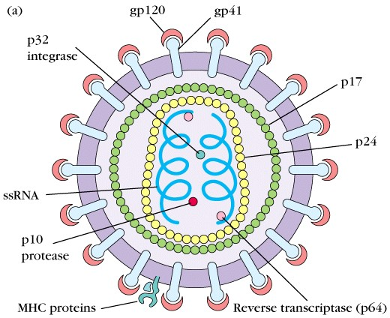

Slide 122
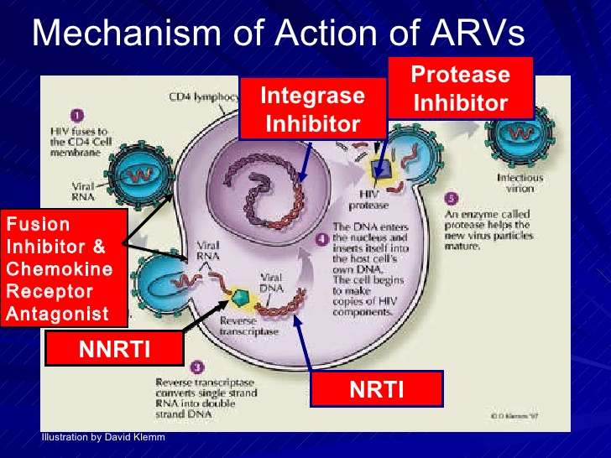

Slide 123
Nucleoside and nucleotide reverse transcriptase inhibitors.
Retrovirus have an enzyme reverse transcriptase, which transcribes viral RNA into a DNA so that the virus can make use of host DNA polymerase to make copies of viral RNA and messenger RNAs for protein synthesis.
Nucleotide and nucleoside reverse transcriptase inhibitors works by getting incorporated into growing viral DNA chain resulting in premature termination.

Slide 124
a) abacavir.
It is a guanosine analog
Hypersensitivity reactions occurs in btn 3-5% patients and presents with symptoms such as fever, malaise, nausea, vomiting, diarrhea, dyspnea, rash and cough.
Should be used with care on patients with existing cardiac risk factors.

Slide 125
b) didanosine
A synthetic analogue of deoxyadenosine.
Drug eliminated by cellular metabolism and renal excretion.
Adverse effects include pancreatitis, peripheral neuropathy, diarrhea, hepatitis, cardiomyopathy, headache, insomnia and irritability.
Contraindicated in patients with increased risk for pancreatitis

Slide 126
c) emtricitabine
This is a fluorinated analog of lamivudine with longer half-life.
Once daily dosing is possible
Common side effects include: headache, diarrhea, nausea and asthenia.
Contraindicated in children, pregnant women, patient with renal or hepatic impairement and those using metronidazole or disulfiram.

Slide 127
d) Lamivudine (3TC)
A cytosine analog.
Shows synergy with zidovudine and stavudine.
Has good oral bioavailability that is not affected by food.
Adverse effects includes headache, dizziness, insomnia and GI discomfort
Its bioavailabity increases when co-adminstered with trimethoprim-sulfamethoxazole.
Shld not be administered together with zalcitabine.(why?)

Slide 128
e) stavudine
A thymidine analog
Has good bioavailability following oral administration which is not affected by food.
Has dose-limiting peripheral sensory neuropathy. This is more pronounced in patients taking other neuropathy inducing drugs and those with advanced immunosupression.
other adverse effects are pancreatitis, arthralgia, lactic acidosis, and hepatic steatosis.

Slide 129
f) tenofovir
An adenosine analog.
Often administered in combination with emtricitabine.
GI complaints are the most common adverse effects but don’t merit discontinuation.

Slide 130
g) zidovudine
A deoxythymidine analog.
Used widely in PMTCT
Shown to decrease the disease progression rate and increase survival rate in HIV infected patients.
Common adverse effects includes; myelosupression, gastrointestinal intolerance, headache and extremity fat loss
NB. READ AND MAKE NOTES ON ZALCITABINE AND DRUGS THAT INTERACTS WTH ZIDOVUDINE

Slide 131
Nonnucleoside reverse transcriptase inhihitors
These agents bind directly to HIV-1 reverse transcriptase, resulting in allosteric inhibition of RNA – and DNA- dependent DNA polymerase.

Slide 132
a) nevirapine
Has excellent oral bioavailability
Metabolized in the liver and excreted in the urine
Used widely in PMTCT
Adverse effects includes rash, elevated liver enzymes, fever, nausea, vomiting, headache and somnolence
Induces enzymes and thus increases metabolism of rifampicin and tipranavir. Fluconazole, ketoconazole and clarithromycin increase serum concentration of nevirapine

Slide 133
b) efavirenz
Has moderate bioavailability PO that increases when taken with fatty food and thus shld be taken on empty stomach to prevent toxicity.
Adverse effects include dizziness, drowsiness, insomnia, headache, depression, mania,and psychosis.
Shld be avoided in pregnancy—risk of abnormalities.

Slide 134
c) delavirdine
Its PO bioavailability reduced by antacids and H2 receptor blockers.
Shld not be used together with rifabutin and fosamprenavir because they decrease the level of delavirdine.
Adverse effects include skin rash, headache, fatigue, nausea, diarrhea, and has been shown to be teratogenic in rats and thus, contraindicated in pregnancy.
NB: READ ON ETRAVIRINE.

Slide 135
PROTEASE INHIBOTORS
Protease is an enzyme that cleaves virion proteins from their precusor molecules.
Protease inhibitors works by preventing the processing of viral proteins into functional conformations.
Protease inhibitors include:
  Atazanavir -Darunavir
  Fosamprenavir -Indinavir
  Lopinavir -Nelfinavir
  Ritonavir -Saquinavir
  tipranavir

Slide 136
Viruses rapidly acquire resistance against these agents and thus monotherapy is contraindicated.
They causes central obesity, buffalo hump, peripheral and facial wasting, breast enlargement and cushingoid syndrome.

Slide 137
ENTRY INHIBITORS
These agents prevents binding of viral glycoprotein gp 160 complex to cellular CD-4 receptor or co-receptors CCR5 and CXCR4
EXAMPLES
Maraviroc- binds on CCR5blocking access of virus to these receptors. Adverse effects include cough, URTIs, muscle and joints pains, diarrhea, sleep disturbance and hepatotoxicity
Enfuvirtide- binds on gp 41 preventing viral fusion with plasma membrane. Adverse effects include eosinophalia, injection site reactions, hypersensitivity.

Slide 138
Ibalizumab
It is a monoclonal antibody that binds CD4, receptor and inhibits HIV from entering cells.
It is a post-attachment inhibitor, blocking HIV from binding to the CCR5 and CXCR4 co-receptors after HIV binds to the CD4 receptor on the surface of a CD4 cell.
The drug is administered intravenously every 14 days
Side effects include immune reconstitution syndrome, Dizziness, diarrhea nausea and rash

Slide 139
Integrase Inhibitors
Works by blocking the action of integrase, a viral enzyme that inserts the viral genome into the DNA of the host cell
Raltegravil is taken per oral and is widely used for post exposure prophylaxis
Common side effects include trouble sleeping, feeling tired, nausea, high blood sugar, and headaches.
Severe side effects may include allergic reactions including Stevens-Johnson syndrome, muscle breakdown, and liver problems.

Slide 140
Dolutegravil
Sold under brand name Tivicay
Used together with other drugs for treatment of HIV infection and other retroviruses
It is also used for post exposure prophylaxis
It is taken per oral

Slide 141
Common side effects include trouble sleeping, feeling tired, diarrhea, high blood sugar, and headache.
Severe side effects may include allergic reactions and liver problems.
There is tentative concerns that use during pregnancy can result in harm to the baby.

Slide 142
Antifungal agents

Slide 143
Systemic antifungal drugs
Amphotericin B
This is an amphoteric polyene macrolide antibiotic produced by Streptomyces nodosus.
It is poorly absorbed PO and thus it is administered intravenously.
Mechanism of action: binds to ergosterol and forms ampotericin-B associated pores that alters permeability of the fungal cells. This causes leakage of intracellular ions and eventual fungal death.

Slide 144
It is used in treatment of infections caused by candida albicans, Cryptococcus neoformans, aspergillus fumigatus, coccidioides immitis, blastomyces dermatitidis etc
Adverse effects
  Infusion-related toxicity- fever, chills, musclespasms, vomiting, headache and hypotension.
  Cumulative toxicity- renal damage, abnormalities of liver function tests.

Slide 145
azoles.
These are sythentic compounds that contain nitrogen on a five-membered azole ring.
They work by unhibiting ergosterol synthesis, a component of fungal cell wall.
The azoles are used in treatment of infections by C. neoformans, blastomycosis, coccidiomycosis, histoplasmosis, dermatophytosis, and appergillosis.

Slide 146
The drugs in this group are:
  Ketoconazole - itraconazole
  Fluconazole - voriconazole
  Posaconazole - miconazole
  Clotrimazole
Fluconazole has good penetration of blood-brain barrier and thus used in treatment of fungal meningitis.

Slide 147
Echinocandins
The drugs in this class includes caspofungin, micafungin and anidulafungin.
Are only available in intravenous formulations.
Works by inhibiting synthesis of fungal beta(1-3)-glucan with eventual disruption of cell wall.
Are well tolerated with few adverse effects that includes GI disturbance, flushing and elevated liver enzymes

Slide 148
Griseofulvin
It is a fungistatic drug that is deposited in newly forming skin cells and thus, prevents their infection.
It is administered for long period (2-6 weeks) to allow replacement of infected structures with new ones.
Adverse effects include serum like sickness and hepatitis.

Slide 149
Nystatin
Nystatin is a polyene macrolide like amphotericin B but it is too toxic to be administered parentally and thus, used topically only.
Mechanism of action similar to amphoterin B.
Indicated for oropharengeal thrush, vaginal candidiasis and intertrigenous fungal infections

Slide 150
allylamines.
Agents in this includes terbinafine and naftifine.
They works by preventing synthesis of fungal cell membrane.
They are used in treatment of mucocutaneous fungal infections.
Common side effects includes GI upset, headache and hepatotoxicity.

Slide 151
Antimalarial, Antiprotozoal, and Antihelmintic Agents

Slide 152
Protozoal Infections
Parasitic protozoa: live in or on humans
malaria
leishmaniasis
amebiasis
giardiasis
trichomoniasis

Slide 153
Malaria
Caused by the plasmodium protozoa.
Four different plasmodium species.
Cause: the bite of an infected adult mosquito.
Can also be transmitted by infected individuals via blood transfusion, congenitally, or via infected needles by drug abusers.

Slide 154
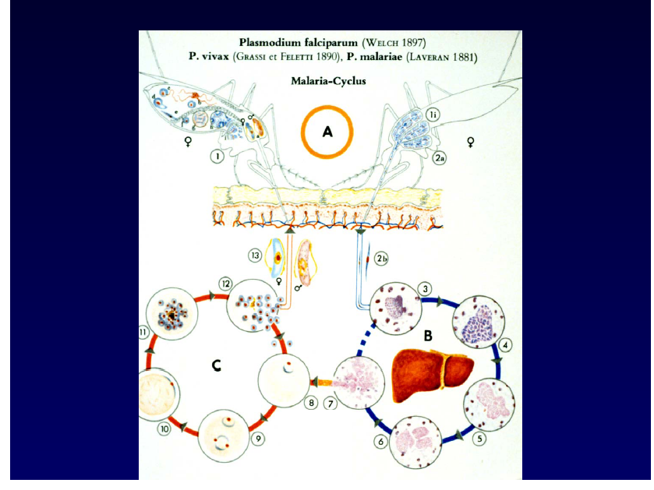

Slide 155
Malarial Parasite (plasmodium)
Two Interdependent Life Cycles
Sexual cycle: in the mosquito
Asexual cycle: in the human
  Knowledge of the life cycles is essential in understanding antimalarial drug treatment.
  Drugs are only effective during the asexual cycle.

Slide 156
Plasmodium Life Cycle
Asexual cycle: two phases
Exoerythrocytic phase: occurs “outside” the erythrocyte
Erythrocytic phase: occurs “inside” the erythrocyte
  Erythrocytes = RBCs

Slide 157
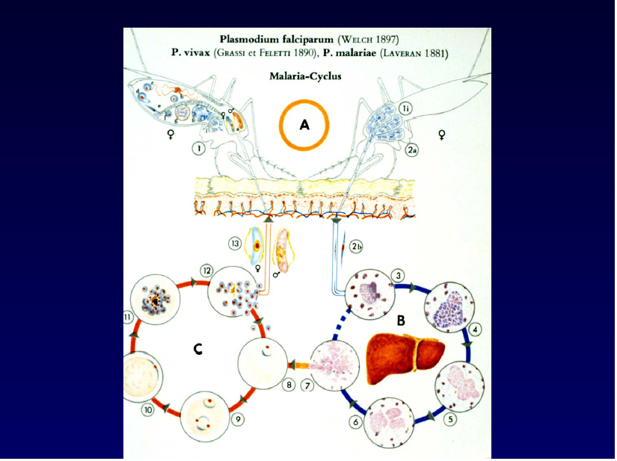

Slide 158
Antimalarial Agents
Attack the parasite during the asexual phase, when it is vulnerable
Erythrocytic phase drugs: chloroquine, hydroxychloroquine, quinine, mefloquine
Exoerythrocytic phase drug: primaquine
May be used together for synergistic or additive killing power.

Slide 159
Antimalarials:
Mechanism of Action
4-aminoquinoline derivatives chloroquine
and hydroxychloroquine
Bind to parasite nucleoproteins and interfere with protein synthesis.
Prevent vital parasite-sustaining substances from being formed.
Alter pH within the parasite.
Interfere with parasite’s ability to metabolize and
use erythrocyte hemoglobin.
Effective only during the erythrocytic phase

Slide 160
Antimalarials: Mechanism of Action
4-aminoquinoline derivatives quinine and mefloquine
Alter pH within the parasite.
Interfere with parasite’s ability to metabolize and use erythrocyte hemoglobin.
Effective only during the erythrocytic phase.

Slide 161
Antimalarials: Mechanism of Action
diaminophyrimidines pyrimethamine and trimethoprim
Inhibit dihydrofolate reductase in the parasite.
This enzyme is needed by the parasite to make essential substances.
Also blocks the synthesis of tetrahydrofolate.
These agents may be used with sulfadoxine or dapsone
for synergistic effects.

Slide 162
Antimalarials: Mechanism of Action
primaquine
Only exoerythrocytic drug.
Binds and alters DNA.
sulfonamides, tetracyclines, clindamycin
Used in combination with antimalarials to increase protozoacidal effects

Slide 163
Antimalarials: Drug Effects
Kill parasitic organisms.
Chloroquine and hydroxychloroquine also have antiinflammatory effects.

Slide 164
Antimalarials: Therapeutic Uses
Used to kill plasmodium organisms, the parasites that cause malaria.
The drugs have varying effectiveness on
the different malaria organisms.
Some agents are used for prophylaxis against malaria.
Chloroquine is also used for rheumatoid arthritis and lupus.

Slide 165
Antimalarials: Side Effects
Many side effects for the various agents
Primarily gastrointestinal: nausea, vomiting, diarrhea, anorexia, and abdominal pain

Slide 166
Antiprotozoals
atovaquone (Mepron)
metronidazole (Flagyl)
pentamidine (Pentam)
iodoquinol (Yodoxin, Di-Quinol)
paromomycin (Humatin)

Slide 167
Protozoal Infections
amebiasis
giardiasis
pneumocystosis
toxoplasmosis
trichomoniasis

Slide 168
Protozoal Infections
Transmission
Person-to-person
Ingestion of contaminated water or food
Direct contact with the parasite
Insect bite (mosquito or tick)

Slide 169
Antiprotozoals: Mechanism of Action and Uses atovaquone (Mepron)
Protozoal energy comes from the mitochondria
Atovaquone: selective inhibition of mitochondrial electron transport
Result: no energy, leading to cellular death
  Used to treat mild to moderate P. carinii

Slide 170
Antiprotozoals: Mechanism of Action and Uses metronidazole
Disruption of DNA synthesis as well as nucleic acid synthesis
Bactericidal, amebicidal, trichomonacidal
  Used for treatment of trichomoniasis, amebiasis, giardiasis, anaerobic infections, and antibiotic-associated pseudomembranous colitis

Slide 171
Antiprotozoals: Mechanism of Action and Uses pentamidine
Inhibits DNA and RNA
Binds to and aggregates ribosomes
Directly lethal to Pneumocystis carinii
Inhibits glucose metabolism, protein and RNA synthesis, and intracellular amino acid transport
  Mainly used to treat P. carinii pneumonia
  and other protozoal infections

Slide 172
Antiprotozoals: Mechanism of Action and Uses iodoquinol (Yodoxin, Di-Quinol)
“Luminal” or “contact” amebicide
Acts primarily in the intestinal lumen of the infected host
Directly kills the protozoa
  Used to treat intestinal amebiasis

Slide 173
Antiprotozoals: Mechanism of Action and Uses paromomycin
“Luminal” or “contact” amebicide
Kills by inhibiting protein synthesis
  Used to treat amebiasis and intestinal protozoal infections, and also adjunct therapy in management of hepatic coma

Slide 174
Antiprotozoals: Side Effects
atovaquone
nausea, vomiting, diarrhea, anorexia
metronidazole
metallic taste, nausea, vomiting, diarrhea,
abdominal cramps
iodoquinol
nausea, vomiting, diarrhea, anorexia, agranulocytosis

Slide 175
Antiprotozoals: Side Effects
pentamidine
bronchospasms, leukopenia, thrombocytopenia, acute pancreatitis, acute renal failure, increased liver function studies
paromomycin
nausea, vomiting, diarrhea, stomach cramps

Slide 176
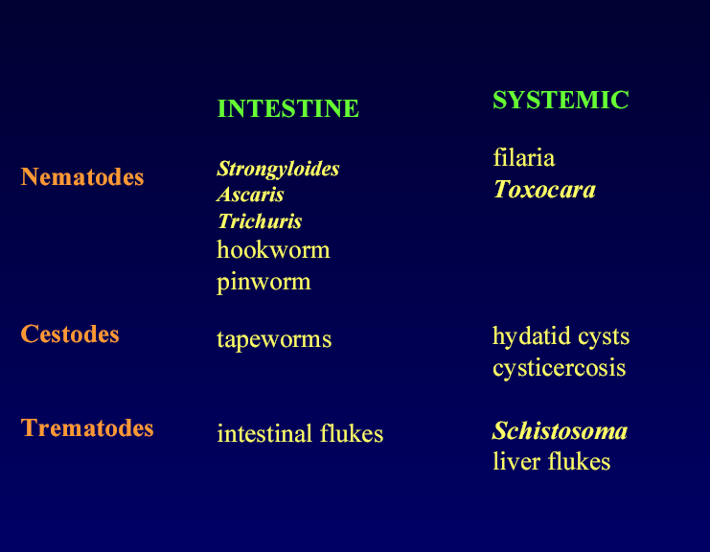
Antihelmintic drugs

Slide 177
Roundworm characteristics
Round in cross section
Digestive system complete – mouth to anus
Acellular cuticle
Four larval stages
Subcuticular layer of muscle
Separate sexes
Terms: egg (ova)
embryo
larva
adult

Slide 178
Antihelmintics
diethylcarbamazine (Hetrazan)
mebendazole (Vermox)
niclosamide (Niclocide)
oxamniquine (Vansil)
piperazine (Vermizine)
praziquantel (Biltricide)
pyrantel (Antiminth)
thiabendazole (Mintezol)

Slide 179
Antihelmintics
Drugs used to treat parasitic worm infections: helmintic infections
Unlike protozoa, helminths are large and have complex cellular structures
Drug treatment is very specific

Slide 180
Antihelmintics
It is VERY IMPORTANT to identify the causative worm
Done by finding the parasite ova or larvae in feces, urine, blood, sputum, or tissue
  cestodes (tapeworms)
  nematodes (roundworms)
  trematodes (flukes)

Slide 181
Antihelmintics: Mechanism of Action and Uses
diethylcarbamazine (Hetrazan)
Inhibits rate of embryogenesis
thiabendazole (Mintezol)
Inhibits the helminth-specific enzyme, fumarate reductase
  Both used for nematodes
  (tissue and some roundworms)

Slide 182
Antihelmintics: Mechanism of Action
piperazine and pyrantel
Blocks acetylcholine at the neuromuscular junction, resulting in paralysis of the worms, which are then expelled through the GI tract
  Used to treat nematodes (giant worm and pinworm)

Slide 183
Antihelmintics: Mechanism of Action
mebendazole (Vermox)
Inhibits uptake of glucose and other nutrients, leading to autolysis and death of the parasitic worm
  Used to treat cestodes and nematodes

Slide 184
Antihelmintics: Mechanism of Action
niclosamide (Niclocide)
Causes the worm to become dislodged
from the GI wall
They are then digested in the intestines
and expelled
  Used to treat cestodes

Slide 185
Antihelmintics: Mechanism of Action
oxamniquine and praziquantel
Cause paralysis of worms’ musculature and immobilization of their suckers
Cause worms to dislodge from mesenteric veins
to the liver, then killed by host tissue reactions
  Used to treat trematodes, cestodes
  (praziquantel only)

Slide 186
Antihelmintics: Side Effects
niclosamide, oxamniquine, praziquantel, thiabendazole, piperazine, pyrantel
nausea, vomiting, diarrhea, dizziness, headache
mebendazole
diarrhea, abdominal pain, tissue necrosis

Slide 187
Antimalarial, Antiprotozoal, Antihelmintic Agents: Nursing Implications
Before beginning therapy, perform a thorough health history and medication history, and assess for allergies.
Check baseline VS.
Check for conditions that may contraindicate use, and for potential drug interactions.

Slide 188
Antimalarial, Antiprotozoal, Antihelmintic Agents: Nursing Implications
Some agents may cause the urine to have an asparagus-like odor, or cause an unusual skin odor, or a metallic taste; be sure to warn the patient ahead of time.
Administer ALL agents as ordered and for the prescribed length of time.
Most agents should be taken with food to reduce GI upset.

Slide 189
Antimalarial Agents:
Nursing Implications
Assess for presence of malarial symptoms.
When used for prophylaxis, these agents should be started 2 weeks before potential exposure to malaria, and for 8 weeks after leaving the area.
Medications are taken weekly, with 8 ounces of water.

Slide 190
Antimalarial Agents:
Nursing Implications
Instruct patient to notify physician immediately if ringing in the ears, hearing decrease, visual difficulties, nausea, vomiting, profuse diarrhea, or abdominal pain occur.
Alert patients to the possible recurrence of the symptoms of malaria so that they will know to seek immediate treatment.

Slide 191
Antimalarial, Antiprotozoal, Antihelmintic Agents: Nursing Implications
Monitor for side effects:
Ensure that patients know the side effects that should be reported.
Monitor for therapeutic effects and adverse effects with long-term therapy.

Slide 192
Cytotoxic drugs
c

Slide 193
Non-steroidal anti-inflammatory drugs

Slide 194
ANTI-INFLAMMATORY DRUGS
A class of drugs that lower inflammation and that includes NSAIDs and DMARDs.

Slide 195
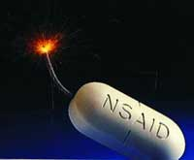
Pharmacokinetic
Oral administration
Most metabolized in liver (oxidation & conjugation)
95% bound to plasma-protein (high bioavailability)
Most NSAIDs are weak acid (absorbed well in stomach and intestinal mucosa)

Slide 196

MECHANISM OF ACTION OF NSAIDS

Slide 197
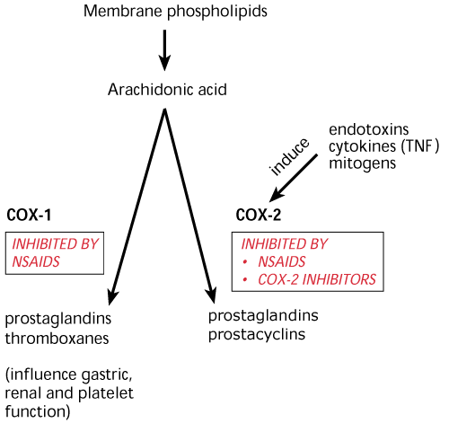

Slide 198
NON- SLECTIVE -NON -STEROIDAL ANTI-INFLAMMATORY DRUGS
Are group of drugs that share in common the capacity to induce:
Analgesic effect.
Antipyretic effect.
Anti-inflammatory effect.
Antiplatelet effect

Slide 199
Mechanism Of Action
Analgesic
Inhibition of COX enzymes in CNS
Anti-Inflammatory action
Antipyretic
Centrally inhibiting Prostaglandins
Inhibit interleukin-1 release
Anti-Inflam.
Peripherally inhibiting Prostaglandins secretion
Stabilization of lysosomes
Inhibits phagocytosis
Anti-oxidant
Peripheral vasodilation
production

Slide 200
Mechanism Of Action ( continue)
Antiplatelet
Inhibition of platelet COX₁ enzyme & TXA₂

Slide 201
NSAIDs
Prostaglandins
pGE2 pGF2
Inflammatory factors
+
Bradrkinin
Histamine
5-HT
Symptoms of inflammation
block prostaglandins production
Sites of action: peripheral tissue
Red, swelling,
Heating, Pain

Slide 202
Anti-inflammatory Effects
Reduced synthesis:
--eicosanoid mediators
Interference:
--kallikrein system mediators
--inhibits granulocyte adherence
--stabilizes lysosomes
--inhibits leukocyte migration
Notes:
Kallikrein [生化][药]激肽释放酶

Slide 203
Systemic effects of NSAIDS
Effect on GIT
Inhibition of PGI₂ & PGE₂ & PGF₂ resulting in gastric upset up to gastric ulceration & bleeding

Slide 204
Continue
Kidney
Inhibit PGE₂ & PGI₂ resulting in salt & water retention , edema , hyperkalemia & interstitial nephritis

Slide 205
Continue
Respiratory system
With aspirin
High dose act directly on respiratory center causing hyperventilation & respiratory alkalosis
Toxic doses causing central respiratory paralysis& respiratory acidosis

Slide 206
COMMON USES AMONGST NSAIDS
Fever.
Analgesic (Type of pain?)
Headache, Migraine,
Dental pain
Common cold.

Slide 207
Continue
Rheumatic / Rheumatoid arthritis
Dysmenorrhea
Muscular pain

Slide 208
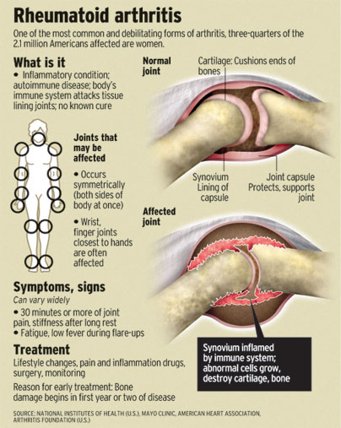

Slide 209
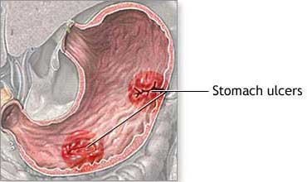
ADVERSE EFFECTS
GIT upsets ( nausea, vomiting)
GIT bleeding & ulceration
Bleeding
Hypersensitivity reaction
Inhibition of uterine
contraction
Salt & water retention

Slide 210
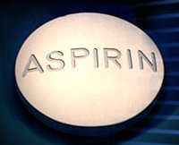

Slide 211
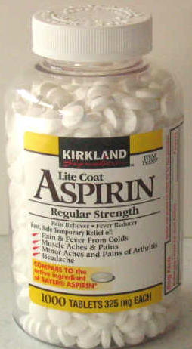
Clinical uses
Acute rheumatic fever
Reducing the risk of myocardial infarction
Prevention of pre-eclampsia

Slide 212
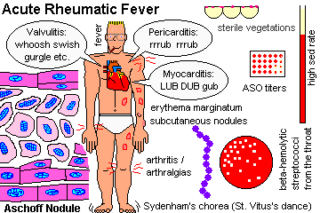

Slide 213
Adverse Effects Related to (A)Therapeutic Doses Of Aspirin
Gastric irritation
Hypersensitivity
( aspirin asthma)
Acute Gouty arthritis
Reye's syndrome

Slide 214
(B) TO high doses &prolonged use of aspirin
Salicylism ( ringing of ears (tinnitus), vertigo)
Hyperthermia
Gastric ulceration & bleeding
Metabolic acidosis

Slide 215
Contraindications
Peptic ulcer
Pregnancy
Hemophilic patients
Patients taking anticoagulants
Children with viral infections
Gout ( small doses )

Slide 216
PARACETAMOL
Also known as acetaminophen
A commonly used analgesic antipyretic instead of aspirin in cases of :
Peptic or gastric ulcers.
Bleeding tendency.
Allergy to aspirin.
Viral infections in children .
Pregnancy.

Slide 217
Adverse Effects
Mainly on liver due to its active metabolites
Therapeutic doses elevate liver enzymes
High doses cause liver & kidney necrosis
Treatment toxicity of paracetamol:
N- acetylcysteine to neutralize the toxic metabolites

Slide 218
Propionic acid derivatives
IBUPROFEN

Slide 219
Clinical uses
Therapeutic uses shared by NS- NSAIDs
Acute gouty arthritis
Patent ductus arteriosus
More potent as an anti-inflammatory than aspirin

Slide 220
Preparations of Ibuprofen
Oral preparations.
Topical cream for osteoarthritis.
A liquid gel for rapid relief of postsurgical dental pain.
Intravenous route as In patent ductus arteriosus

Slide 221
Adverse effects
Adverse effects shared by NS-NSAIDs
(Gastric upset less frequent than aspirin)
Rare hematologic effects (agranulocytosis & aplastic anemia ).
Ocular disturbance

Slide 222
Contraindications
Peptic ulcer
Allergic patients to aspirin
Kidney impairment
Liver diseases
Pregnancy
Haemophilic patients
The concomitant administration of ibuprofen antagonizes the irrevesible platelet inhibition of aspirin( limit cardioprotective effect of aspirin ).

Slide 223
Oxicam derivatives
Piroxicam
Tenoxicam

Slide 224
Piroxicam
Half- Life 45 hours
Given once daily
Adverse effects
Less frequent gastric upset (20%) .
Dizziness
Tinnitus
Headache
Allergy

Slide 225
Acetic acid derivatives
Diclofenac

Slide 226
Preparations of Diclofenac
Diclofenac with misoprostol decreases upper gastrointestinal ulceration ,but result in diarrhea.
Diclofenac with omeprazole to prevent recurrent bleeding.
.1% ophthalmic preparation for postoperative ophthalmic inflammation.
A topical gel 3% for solar keratosis.
Rectal suppository
Oral mouth wash.
Intramuscular preparations.

Slide 227
Clinical uses shared by Ns-NSAIDs
Acute gouty arthritis
Locally to prevent or treat post opthalmic inflammation
A topical gel for solar keratosis

Slide 228
Adverse effects
Adverse effects shared by NS-NSAIDs

Slide 229
Selective COX-2 inhibitors
General advantages :
Potent anti-inflammatory
Antipyretic & analgesic
Lower incidence of gastric upset
No effect on platelet aggregation ( COX-1)

Slide 230
General adverse effects
Renal toxicity
Dyspepsia & heartburn
Allergy
Cardiovascular ( do not offer the cardioprotective effects of non-selective group).

Slide 231
Clinical uses
Postoperative patients undergoing bone repair
Acute gouty arthritis
Acute musculoskeletal pain
Ankylosing spondylitis

Slide 232
Celecoxib
Half-life 11 hours ( Given twice daily)
Food decrease its absorption
Highly bound to plasma proteins
Metabolized in liver to inactive metabolites

Slide 233
Meloxicam
Relatively selective Cox2 inhibitors.
Safer than piroxicam.

Slide 234
Pharmacokinetics
Given orally ,rectally, I.M.,I.V.
Metabolized in liver to inactive metabolites.
Excreted in urine 50% and in feces 50%.
Half-life 20 hours.
Given once daily.

Slide 235
Clinical uses
Shared by selective COX-2 inhibitors

Slide 236
Adverse effects
Shared by selective COX-2 inhibitors

Slide 237
Drug interactions
Cholestyramine increases the clearance of the drug .

Slide 238
Nabumetone
Relatively selective COX-2 inhibitor
Well absorbed orally.
Metabolized in liver to active metabolites.
Half-life 26 hours.
Taken once daily.

Slide 239
Clinical uses
Shared by selective COX-2 inhibitors

Slide 240
Adverse effects
Shared by selective COX-2 inhibitors
Headache
Tinnitus
Photosensitivity

Slide 241
Sedatives-hypnotics
LESSON 2:

Slide 242
Sedatives are medications intended to reduce anxiety and exert calming effects. They are also known as anxiolytics.
Hypnotic drugs are medications that produces drowsiness, induce onset and maintenance of sleep.
Sedative-hypnotics produces dose-dependent depression of central nervous system.

Slide 243
With these drugs, an increase in dose higher than that needed for hypnosis may lead to a state of general anaesthesia or still, depression of vasomotor and respiratory centers leading to coma and death.
There is high risk for tolerance and physiological dependence with these drugs if used for a long period of time

Slide 244
Classes of sedatives-hypnotics
Benzodiazipines
examples
diazepam, chlordiazepoxide, flurazepam, desmethyldiazepam, oxazepam, lorazepam,
nitrazepam, triazolam, alprazolam, midazolam, quazepam, temazepam, estazolam

Slide 245
Barbiturates
phenobarbital, secobarbital, pentobarbital, allobarbital, aprobarbital, alphenal, barbital, brallobarbital.
Glutethimide, meprobamate, chloral hydrate are structurally different from barbiturates but works in the same way

Slide 246
New hypnotics
zolpidem, zaleplon eszopiclone, ramelton a melatonin receptor agonist, hydroxyzine, meprobamate, paraldehyde and buspirone.

Slide 247
pharmacokinetics
The rate of absorption after oral administration differs among these drugs and depends on lipophilicity.
All sedatives hypnotics cross the fetal-placenta barrier.
The sedative-hypnotics are metabolized in the liver.
Excretion of conjugated metabolites is through the kidneys.

Slide 248
pharmacokinetics
Mechanism of action: the sedative-hypnotics work by binding on GABA (Gamma AminoButiric Acid) receptor in the brain.
GABA is the major inhibitory neurotransmitter in the brain. The sedatives-hypnotics do not a substitute GABA on its receptor but rather allosterically potentiates its effects

Slide 249
organic effects of sedatives-hypnotics
Sedation- they exert calming effect with concomitant reduction in anxiety. The anxiolytic effect is accompanied by depression of cognitive and psychomotor function.
Hypnosis- they induce and maintain sleep if high enough doses are given.
Anesthesia- high doses of some sedative-hypnotics depress CNS to the point of stage III of general anesthesia. Benzodiazipines like diazepam, lorazepam and midazolam are used intravenously in combination with other agents in anesthesia

Slide 250
Anticonvulsant effect- they are capable of inhibiting development and spread of epileptiform electrical activity in the brain. Clonazepam, nitrazepam, lorazepam and diazepam are used in treatment of seizures.
Muscle relaxation- carbamate and benzodiazipine groups inhibit polysynaptic reflexes and at higher doses can inhibit transmission at neuromuscular junction.
Effects on respiratory and cardiovascular function- respiratory depression is dose-related. Cardiovascular depression is seen in patients with hypovolumia, heart failure and other states that affect cardiovascular function.

Slide 251
Tolerance and physiological dependency
Tolerance refers to decreased responsiveness to drug following repeated exposure. This means with continued use, dose adjustments are needed to achieve desired relief.
Physiologic dependency describes an altered physiologic state continuous administration of a drug to prevent withdrawal symptoms.
The above are associated with sedatives-hypnotics and thus have increased risk for abuse. These drugs are classified as controlled drugs in kenya

Slide 252
Clinical use of sedative-hypnotics
To relieve anxiety
For sedation and amnesia before and during medical and surgical procedures.
For treatment of epilepsy and seizure states.
as a component of balanced anaesthesia.
For control of ethanol and other sedative-hypnotics withdrawal syndromes
For muscle relaxation in specific neuromuscular disorders
As diagnostic aids or for treatment in psychiatry

Slide 254
Histamine and Antihistamines
Kirimi bs
‘Antihistamines’ means classical H1 receptor antagonists unless otherwise specified

Slide 255
Drug list items
cetirizine (Zyrtec®)
chlorpheniramine (Chlor-Trimeton®)
diphenhydramine (Benadryl®)
disodium cromoglycate (cromolyn, Intal®)**
fexofenadine (Allegra®)
histamine
hydroxyzine (Atarax®)
loratadine (Claritin®)
promethazine (Phenergan®)
scopolamine (Transderm Scop®)**
tripelennamine (PBZ)

Slide 256
Histamine (tissue amine, also ‘enteramine’): another potent biogenic amine
(normally acts locally, an ‘autacoid’)
Synthesized by decarboxylation from an amino acid precursor, histidine
Stored in granules in certain cells (mast cells, basophils, enterocytes)
Released in response to certain stimuli (Ca dependent exocytosis)
Eliminated by oxidative deamination and/or transmethylation

Slide 257
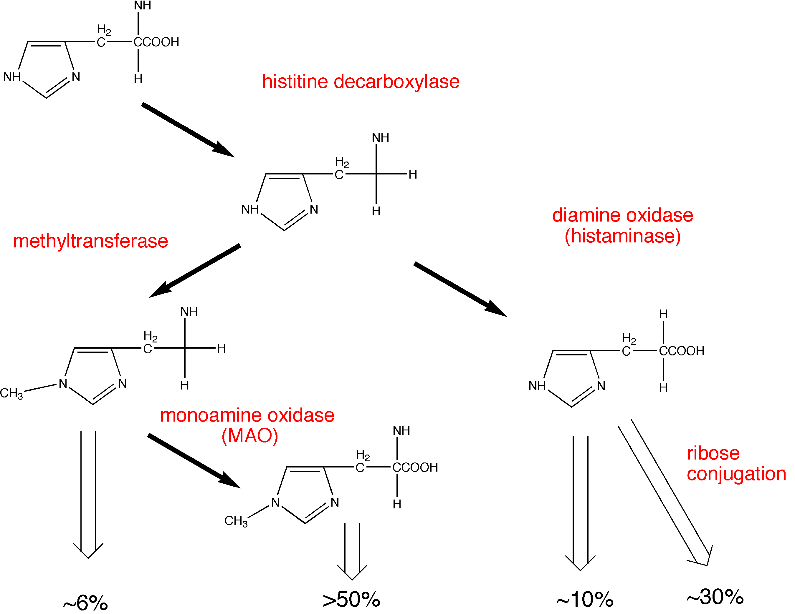
Synthesis and metabolism of histamine

Slide 258
Histamine receptors
H1 - smooth muscle, exocrine glands, vascular endothelium, brain; coupled to phospholipase C, leading to IP3 (inositol triphosphate) and diacylglycerol (DAG)
H2 - parietal cells, heart, vascular smooth muscle, mast cells, brain; coupled to cAMP production
H3 - presynaptic, brain, myenteric plexus
(no therapeutic applications, yet)

Slide 259
Histamine in the skin: the Triple Response of Lewis
Red spot
Flare
Wheal

Slide 260
Effects of histamine
Decreased peripheral vascular resistance (mediated by H1 and H2) ( flushing, headache!)
Increased vascular permeability, especially postcapillaries, local edema (H1)
Stimulation of nerve endings (pain!)

Slide 261
Effects of histamine
Decreased peripheral vascular resistance (mediated by H1 and H2) ( flushing, headache!)
Increased vascular permeability, especially postcapillaries, local edema (H1)
Stimulation of nerve endings (pain!)
Tachycardia, direct (H2) and reflex
Increased gastric acid secretion (H2) and GI motility (H1)

Slide 262
Histamine release: Promoted by many compounds
Therapeutic:
morphine, d-tubocurarine, aminoglycosides (remember “Red neck syndrome” ??)
Experimental:
compound 48/80 (was tested as antihypertensive)
Unknown:
cause of hives is rarely determined
Antigen-antibody reactions

Slide 263
Anaphylaxis
Type I allergic response
(immediate hypersensitivity reaction)
Mediated by IgE antibodies
IgE binds to receptors on mast cells and basophils
Fab portion of antibody binds antigen and causes (moderate to massive) release of:
histamine
leukotrienes
prostaglandins
etc., etc.

Slide 264
Common causes of anaphylactic and anaphylactoid reactions
IgE-mediated
Anaphylaxis
Peanuts, seafood, eggs, milk, grains
Venoms
Foreign proteins
Some exercise-induced bronchospasm
Non-IgE-mediated
Anaphylactoid
NMJ blockers, opioids, plasma expanders
Aminoglycosides
Protamine
Radiocontrast media
Urticaria of cold, heat, sun
Some exercised-induced bronchospasm

Slide 265
Anaphylaxis: Effects and Treatment
(may involve release of mediators in addition to histamine)
Decreased blood pressure
Decreased cardiac output
Bronchoconstriction and increased pulmonary secretions
Pruritis
Treatment: Epinephrine - not initially antihistamines
(epinephrine is a physiological antagonist of histamine, not a pharmacological antagonist)
(alpha-1 vasoconstriction, beta-1 increased HR,
beta-2 bronchodilation)

Slide 266
Three mechanistically different approaches to minimize histamine reactions
Physiological antagonism (e.g., epinephrine)
Inhibit the release of histamine (e.g., cromolyn)
Pharmacological antagonism (antihistamines)

Slide 267
disodium cromoglycate (cromolyn, Intal®)
Decreases histamine release from mast cells
(and decreases release of SRS-A)
Administration: inhalation of nebulized solution
(formerly powder, irritating)
May be useful in prophylaxis of histamine release, but does not antagonize the effects of histamine
Similar mechanism and effects by nedocromil (Tilade®)

Slide 268
Cromolyn (Intal®)
Indications:
  Adjunct in treatment of severe perennial asthma
  Prevention and treatment of allergic rhinitis
  Prevention of exercise induced bronchospasm
  Systemic mastocytosis (mast cell ‘dumping’)
  Allergic ocular disorders
Contraindications
  Acute asthma
  Bronchospasm

Slide 269
Cromolyn: Adverse reactions
Cough
Wheezing
Headache
Rash
Nausea

Slide 270
H1 antihistamines: diverse pharmacological properties
Antagonize H1 receptors (±)
Prophylaxis of motion sickness & vomiting
Inhibition of allergic rhinitis
Useful symptomatic relief
pollinosis, conjunctivitis, urticaria (but do not use topically !)

Slide 271
General properties of first generation
H1 antihistamines
Lipid soluble - CNS penetration and effects
Well absorbed
Metabolized in the liver
Half life about 5-6 hours
Adverse reactions
SEDATION, DROWSINESS
headache, nausea & vomiting
cough
constipation, diarrhea
dry mouth, blurred vision, urinary retention

Slide 272
H1 antihistamines: overdosage
Fever
Excitement
Pupillary dilatation
Hallucinations
Convulsions

Slide 273
H1 antihistamines: overdosage
Fever
Excitement
Pupillary dilatation
Hallucinations
Convulsions
REMEMBER
Hot as a stove…
Red as a beet…
Dry as a bone…
Mad as a hatter

Slide 274
Some second generation (‘non-drowsy’)
H1 antihistamines
terfenadine (Seldane®), the pioneer of this second generation (NOW WITHDRAWN)
astemizole (Hismanal®) (NOW WITHDRAWN)
fexofenadine (Allegra®)
(active metabolite of terfenadine)
cetirizine (Zyrtec®)
loratadine (Claritin®)
Second generation antihistamines are recommended as the first line in treatment of allergic rhinitis by The American College of Allergy Asthma and Immunology (Ann. Allergy Asthma & Immunology, Nov. 1998). Avoids drowsiness of first generation antihistamines and major adverse reactions of injected corticosteroids.

Slide 275
Terfenadine (Seldane®) blocks K channels:
May cause torsades de pointes
There is normally a large first pass effect resulting in creation of carboxy-terfenadine (fexofenadine) by CYP3A4
Erythromycin, ketoconazole and other drugs that inhibit CYP3A4 promote accumulation of unchanged terfenadine and, thus, increased the risk of torsade de pointes - prompting withdrawal of terfenadine (similar effects with astemizole, Hismanal®, also withdrawn)

Slide 276
General properties of second generation
H1 antihistamines
Lipid soluble structure with a highly ionized functional group - less CNS penetration - more selective for peripheral H1 antagonism (less useful in other indications)
Well absorbed
Metabolized in the liver
Half life about 5-6 hours
(Huge potential market,
direct consumer advertising)

Slide 277
Indications for antihistamine examples
First generation
Second generation
promethazine
Rhinitis
Urticaria & angioedema
Allergic conjunctivitis
Anaphylaxis (with EPI)
Pre/post op sedation
Prevention of N&V
Prevention of motion sickness
Adjunct to pain meds (esp. hydroxyzine)
(local anesthetic)
fexofenadine
Seasonal allergic rhinitis
Urticaria, chronic

Slide 278
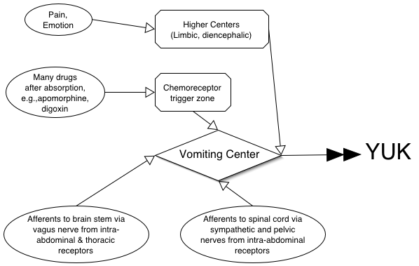
Input and integration of the vomiting reflex

Slide 279
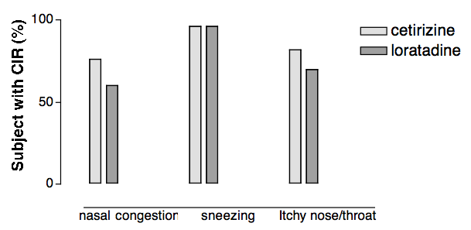
Clinically important relief (CIR) produced by antihistamines in allergic rhinitis
Adapted from Day et al., Annals of Allergy, Asthma and Immunology, 79: 163-171
Financial support from Nordic Merrill Dow, Canada

Slide 280
Worth noting…...
First generation antihistamines are virtually without value in the treatment of asthma; may be relatively contraindicated. The main benefit in pruritis may be sedation……on the other hand, a main cause of driver drowsiness may be traced to antihistamines…….
Second generations antihistamines may be useful (off label)
in some patients with asthma (e.g., 20 mg of cetirizine has a bronchodilator action additive to that of albuterol in subjects with FEV1 of 50-80% of predicted, Spector et al., 1995).

Slide 281
Anti Cancer Chemotherapy
Kirimi shadrack
Lecturer
Kmtc nairobi

Slide 282
Cancer
  Uncontrolled multiplication and spread within the body of abnormal forms of body's own cells
Neoplasm
  A mass of tissue formed as a result of
    Abnormal
    Excessive
    Uncoordinated
    Autonomous and
    purposeless
    Proliferation of cells

Slide 283
Why term chemotherapy
Like infective disease
  Some malignant cells can be cultured
  Some malignancies can be transmitted by innoculation

Slide 284
Cancer chemotherapy not as successful as antimicrobial chemotherapy
Metabolism in parasite differs qualitatively from host cells, while metabolism in cancer cells differ only quantitatively from normal host cells
  Hence target selectivity is more difficult in cancer
  cancer there is no substantial immune response
  Diagnostic complexity: delay in institution of treatment

Slide 285
Cancer chemotherapy can be curative in
Acute Leukemias
Wilm’s Tumour
Ewing’s Sarcoma
Choriocarcinoma
Hodgkin’s Disease
Lymphosarcoma
Burkitts lymphoma
Testicular Teratomas
Seminomas
In children

Slide 286
Chemotherapy can have only Palliative effect in
Breast Cancer
Ovarian Cancer
Endometrial Cancer
Prostatic Cancer
Chronic Lymphatic Leukemia
Chronic Myeloid Leukemia
Head & Neck Cancer
Lung (small cell) Cancer

Slide 287
Chemotherapy is less sensitive in
Colorectal Cancer
Carcinoma Stomach
Carcinoma of esophagus
Renal carcinoma
Hepatoma
Bronchogenic (non small cell) carcinoma
Malignant Melanoma
Sarcoma

Slide 288
Pathogenesis of cancer
Chemicals, viruses, irradiation, etc
Acquired Mutations
Inherited Mutations
Protooncogenes → oncogenes
↓ expression of tumor supressor genes (P53, Rb etc)
Promoters,
co-carcinogen, hormones
Uncontrolled cell proliferation, dedifferentiation
↓ apoptosis, alterations in telomerase
Development of primary tumor

Slide 289
Pathogenesis of cancer
Development of primary tumor
Production of metalloproteinases
Invasion of nearby tissue by tumor cells
Angiogenesis
Metastasis
Development of secondary tumors

Slide 290
Cancer cells differ from normal cells by
Uncontrolled proliferation
De-differentiation & loss of function
Invasiveness
Metastasis

Slide 291
Guiding principles in cancer chemotherapy
To achieve cure a TOTAL CELL KILL must be tried
Early diagnosis and early institution of treatment
Combination chemotherapy
Intermittent regimens
Adjuvant and neoadjuvant chemotherapy occasionally

Slide 292
Total cell kill
Aimed at destroying all the malignant cells, leaving none
This approach ensures
  Early recovery
  Prevents relapse
  Prolongs survival
Pharmacological sancturies

Slide 293
Early diagnosis and early T/t why?
Survival time inversely related to initial number of cells
Aging cancer cells are less susceptible to chemotherapy, because there is
  ↑ cell cycle (division) time
  ↓No of actively dividing cells with more resting cells
  ↑ cell death within tumor
  Overcrowding of cells

Slide 294
Combination chemotherapy?
Heterogenicity of cells remaining in different phase of growth cycle , showing different level of sensitivity
  Nature of drug (with different biochemical site of action)
  Avoid emergence of drug resistance
Monotherapy adequate in Burkitts lymphoma & choriocarcinoma

Slide 295
Why intermittent regimen?
Favours risk –benefit ratio
Allows time for damaged normal host cells to recover
Pulse therapy
  Type of intermittent chemotherapeutic regime employing highest tolerated dose within a short administration period
  Based on principle of drug conc. (C) x duration of exposure (T) = constant

Slide 296
Adjuvant & Neoadjuvant chemotherapy
Adjuvant chemotherapy:
  Chemotherapy given after surgery or irradiation to destroy micrometastasis & prevent development of secondary neoplasm.
Neo-adjuvant chemotherapy:
  Chemotherapy given before surgery or radiotherapy in order to diminish the volume of large primary neoplasm

Slide 297
General toxicity of cytotoxic drugs
Nausea & Vomiting
Bone marrow depression
Alopecia
Gonads: Oligospermia, impotence, ↓ ovulation
Foetus: Abortion, foetal death, teratogenicity
Carcinogenicity
Hyperuricemia
Immunosupression: Fludarabine
Hazards to staff

Slide 298
Alkylating agents
Nitrogen Mustards
  Meclorethamine, Melphalan, Chlorambucil, cyclophosphamide, ifosfamide
Ethyleneimine : Thiotepa
Alkyl Sulfonate: Busulfan
Nitrosureas
  Carmustine,lomustine, streptozocin
Triazines
  Dacarbazine, temozolamide

Slide 299
Antimetabolites
Folate Antagonists
  Methotrexate
Purine Antagonists
  6 Mercaptopurine, 6 Thioguanine, Azathioprine
Pyrimidine antagonists
  5 Fluorouracil, cytarabine, gemcitabine

Slide 300
Natural Products
Antibiotics
  Actinomycin D, Doxorubicin, Daunorubicin, Bleomycin, Mitomycin C
Vinca alkaloids
  Vincristine, Vinblastine, Vinorelbine
Taxanes
  Paclitaxel, docetaxel
Enzymes
  L-Asparginase
Epipodophyllotoxins
  etoposide, tenoposide
Camptothecin analogs
  Topotecan, irinotecan
Biological response modifiers
  Interferons,
  Interleukins

Slide 301
Miscellaneous Agents
Cisplatin
Carboplatin
Hydroxurea
Procarbazine
Mitotane
Imatinib

Slide 302
Hormones & antagonists
Corticosteroids
  Prednisolone
Estrogens
  Ethinyl Estradiol
SERM( selective estrogen receptor modulators)
  Tamoxifene, Toremifene
SERD (selective estrogen receptor downregulators)
  Fulvestrant
Aromatase Inhibitors
  Letrozole, Anastrazole, Exemestane
Progestins
  Hydroxyprogesterone
Anti-androgens
  Flutamide, Bicalutamide
5-α reductase Inhibitors
  finasteride, dutasteride
GnRH analogs
  Naferelin, goserelin, leuoprolide

Slide 303
MOA of some anticancer drugs
Purine/ Pyrimidine antagonists
Purine & Pyrimidine synthesis
Methotrexate
Inhibition of purine ring & dTMP biosynthesis
Ribonucleotides
5 FU inhibits dTMP synthesis
Deoxy ribonucleotides
Cytarabine inhibits DNA chain elongation
DNA
Alkylating agents
Alter structure & function of DNA by cross linking and/or fragmenting DNA
Dactinomycin , Intercalate with DNA disrupt DNA function
RNA
Proteins

Slide 304
Alkylating agents
Nitrogen Mustards (MCI)
  Meclorethamine, Melphalan, Chlorambucil, Cyclophosphamide, Ifosfamide
Ethyleneimine : Thiotepa
Alkyl Sulfonate: Busulfan
Nitrosureas
  Carmustine,lomustine, streptozocin
Triazines
  Dacarbazine, temozolamide

Slide 305
Mechanism of action
Alkylating Agents
Form highly reactive carbonium ion
Transfer alkyl groups to nucleophilic sites on DNA bases
Results in
Cross linkage
Abnormal base pairing
DNA strand breakage
Alkylation also damages RNA and proteins
↓ cell proliferation

Slide 306
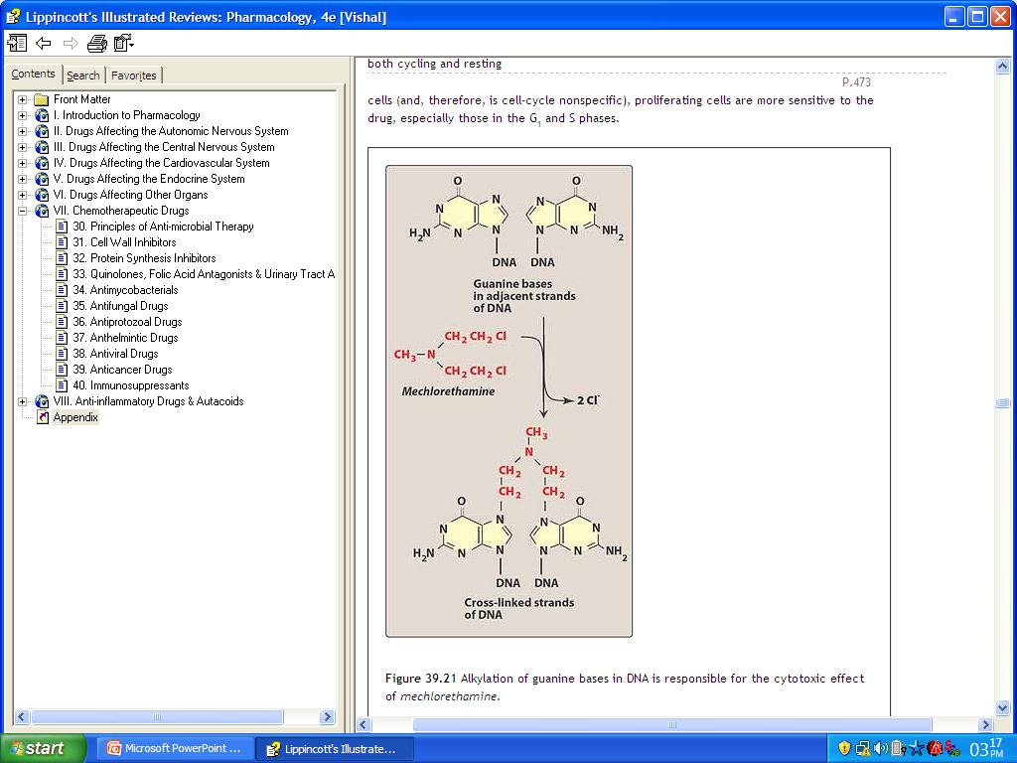

Slide 307
Pharmacological actions
Cytotoxic action
  Hemopoetic system highly susceptible
    Chlorambucil – more against lymphoid series
    Busulfan – more against myeloid series
  Epithelial tissues, hair follicles
  Spermatogenesis , fetopathic effect
Immunosupressant action
Miscellaneous
  Severe nausea & vomiting
Known as radiomimetic drugs

Slide 308
Nitrogen Mustards
Mechlorethamine
Melphalan
Chlorambucil
Cyclophosphamide
Ifosfamide

Slide 309
Mechlorethamine (Mustine)
Very irritant drug
Dose = 0.4 mg/kg single or divided
Uses
  Hematological cancers , lymphomas , solid tumors
  Hodkins as part of MOPP, CML, CLL
Adverse effects
  Anorexia, nausea, vomiting
  Bone marrow depression, aplasia
  Menstrual irregularities
Estramustine

Slide 310
Melphalan
Very effective in MULTIPLE MYELOMA
Less irritant locally , less alopecia
Dose:
0.25 mg/kg daily for 4 days every 4-6 weeks
Adverse Effects :
  Bone marrow Depression
  Infections , diarrhoea and pancreatitis

Slide 311
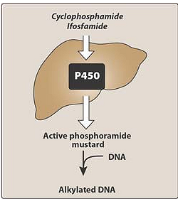
Cyclophosphamide
Most commonly used alkylating agent a prodrug

Slide 312
Cyclophosphamide
Cyclophosphamide
Aldophosphamide
⊗
Phosphoramide mustard
Acrolein
Hemorrhagic cystitis
Cytotoxic effect
Mesna

Slide 313
Uses of cyclophosphamide
Neoplastic conditions
  Hodgkins and non hodgkins lymphoma
  ALL, CLL, Multiple myeloma
  Burkits lymphoma
  Neuroblastoma , retinoblastoma
  Ca breast , adenocarcinoma of ovaries
Non neoplastic conditions
  Control of graft versus host reaction
  Rheumatoid arthritis
  Nephrotic syndrome

Slide 314
Cyclophosphamide
Adverse effects:
  Hemorrhagic cystitis,
  alopecia,
  nausea & vomiting,
  SIADH
  hepatic damage
Dose: 2-3 mg/kg/day oral
10-15 mg/kg IV every 7-10 days
It can be administered IV, IM, IP, intrapleurally, Intraarterialy, directly into tumor

Slide 315
Ifosfamide
Congener of cyclophosphamide
Longer half life than cyclophosphamide
Less alopecia and less emetogenic than cyclophosphamide
Can cause hemorrhagic cystitis and severe neurological toxicity
Used for germ cell testicular tumors and adult sarcomas

Slide 316
Chlorambucil (Leukeran)
Slowest acting and least toxic alkylating agent
Main action on lymphoid series produces marked lympholytic action
Drug of choice for long term maintenance therapy of CLL
Dose: 0.1-0.2 mg/kg daily for 3-6 weeks then 2 mg daily for maintenance

Slide 317
ThioTEPA
Triethylene phosphoramide
Does not require to form active intermediate
Active intravesicular agent can also be used topicaly in superficial bladder cancer
Not well absorbed orally given IV
High toxicity

Slide 318
Busulfan (Myleran)
Depresses bone marrow with selective action on myeloid series
Primarily used in Chronic myelogenous leukemia 2-6 mg/day
Adverse effect:
  Interstitial pulmonary fibrosis
  Venoocclusive disease of liver
  Hyperuricaemia
  Sterility

Slide 319
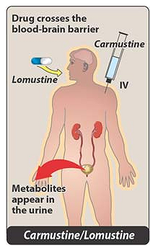
Nitrosureas
Highly lipid soluble, Cross BBB
Uses:
  Meningeal / Brain tumours
Dose :150-200 mg/m2 BSA
every 6 wks (Carmustine)
Adverse Effects:
  Delayed bone marrow
  suppression
  Visceral fibrosis, renal
  damage

Slide 320
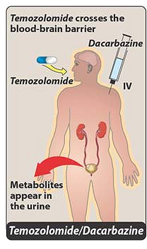
Triazenes
Dacarbazine
  Primary inhibitory action on RNA & protein synthesis
  Used in malignant melanoma
Temozolamide
  New alkylating agent
  Approved for malignant glioma
  Rapidly absorbed after oral absorption & crosses BBB

Slide 321
Mechanisms of resistance of alkylating agents
↓ Influx of drug
↑ Production of nucleophilic substances like glutathione that compete with target DNA for alkylation
↑ Activity of DNA repair enzymes
↑ metabolic inactivation of drugs

Slide 322
Cisplatin
Non cell cycle specific killing
Administered IV
Highly bound to plasma proteins
Gets conc in kidney, intestine, testes
Poorly penetrates BBB
Slowly excreted in urine
Cl
NH₃
Pt
Cl
NH₃
Dose:
20 mg/m2 for 5 days a week
75 – 100 mg/m2 once in 4 weeks to treat ovarian cancer

Slide 323
Mechanism of action of cisplatin
Cisplatin enters cells
Cl⁻
Forms highly reactive platinum complexes
Intra strand & interstrand cross links
DNA damage
Inhibits cell proliferation

Slide 324
Cisplatin uses and adverse effects
Uses
  Testicular cancer (85% - 95 % curative )
  Ovarian cancer
  Other solid tumors: lung, esophagus, gastric
Adverse effects
  Emesis
  Nephrotoxicity
  Peripheral neuropathy
  Ototoxicity

Slide 325
Carboplatin
Better tolerated
Nephrotoxicity , ototoxicity , neurotoxicity low
Less emetogenic
But thrombocytopenia and leukopenia may occur
Less plasma protein binding
Use:
  primarily in ovarian cancer of epithelial origin
  Squamous cell carcinoma of head and neck

Slide 326
Antimetabolites
Folate Antagonists
  Methotrexate
Purine Antagonists
  6 Mercaptopurine, 6 Thioguanine, Azathioprine
Pyrimidine antagonists
  5 Fluorouracil, cytarabine, gemcitabine

Slide 327
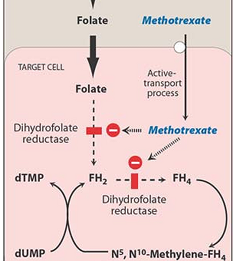
Methotrexate
Folic acid not useful in toxicity
Folinic acid N⁵ formyl FH₄ should be given which is converted to N⁵,N¹⁰-Methylene –FH₄ and bypasses the inhibited reductase
Adenine, guanine, thymidine , methionine, serine

Slide 328
Pharmacological actions
Cytotoxic actions
  Predominant on bone marrow
  Ulceration of intestinal mucosa
  Crosses placenta interferes with embroyogenesis foetal malformations and death
Immunosupressive action
  Prevents clonal expansion of B & T lymphocytes
Anti-Inflammatory action
  Interferes with release of inflammatory cytokines IL-2, IL-6,IL-8 & TNF-α , ↓ Rheumatoid Factor production

Slide 329
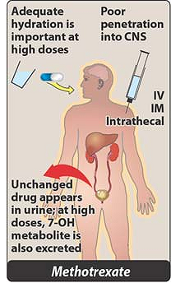
Pharmacokinetics
Absorbed orally, 50 % protein bound
Disappears rapidly from blood , remains in tissue longer than folate thus causes prolonged inhibitory effect
C/I in renal impairment

Slide 330
Adverse effects
Megaloblastic anemia
Thrombocytopenia, leukopenia, aplasia
Oral, intestinal ulcer , diarrhoea
Alopecia , liver damage, nephrpathy
Treatment of methotrexate toxicity
Folinic acid (citrovorum factor, N5 Formyl THF)
IM/IV 8 to 24 hrs after initiation of methotrexate
120 mg in divided doses in first 24 hrs, then 25
mg oral/IM 6 hrly for next 48 hrs

Slide 331
Uses of methotrexate
Antineoplastic
  Choriocarcinoma and tropoblast tumor 15 -30 mg/day orally for 5 days
  Remission of ALL in children 2.5 to 15 mg/day
  Ca breast, head & neck, bladder, ovarian cancer
Immuno-supressive agent
  Rheumatoid arthritis, resistant asthma
  Crohns disease, wegeners granulomatosis
  Prevention of graft versus host reaction
Psoriasis
Medical termination of pregnancy

Slide 332
Purine antagonists
6 Mercaptopurine
6 Thioguanine
Azathioprine
Fludarabine

Slide 333
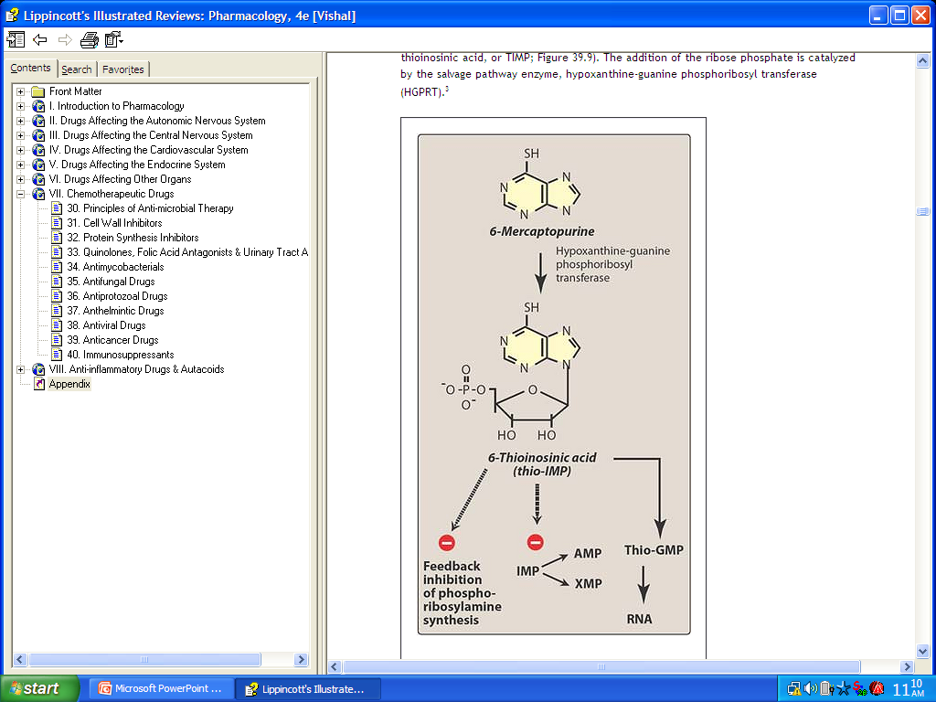
6 Mercaptopurine
HGPRT
Ribonucleotide
(HGPRT):
hypoxanthine-guanine phosphoribosyl transferase

Slide 334
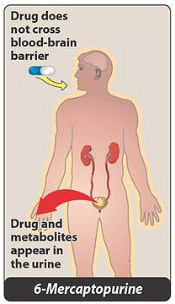
6 Mercaptopurine
Allopurinol
6 MP
TPMT
Xanthine oxidase
6 Thiouric acid
Inactive metabolite

Slide 335
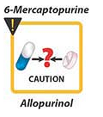
6 Mercaptopurine
Use:
  Acute leukemia (ALL)
  Choriocarcinoma
Adverse Effects:
  Bone marrow & GIT mainly
  Hepatic necrosis rarely
  Hyperuricaemia

Slide 336
Fludarabine
Phosphorylates intracellularly to form triphosphate
Inhibits DNA polymerase and gets incorporated to form dysfunctional DNA
Effective in slow growing tumors: (apoptosis)
Use:
  CLL and non hodgkins recurring after treatment
Adverse events:
  chills, fever, opportunistic infection, myelosupression

Slide 337
Cladirabine
Like fludarabine converted to triphosphate
Incorporated into DNA
Inhibits DNA polymerase α and β thus inhibits DNA synthesis and repair
Used in treatment of Hairy cell leukemia, CLL and low grade lymphomas

Slide 338
Pentostatin
Inhibits adenosine deaminase
Accumulation of adenosine & deoxyadenosine
Inhibits ribonucleotide reductase
Blocks DNA synthesis
S adenosyl homocysteine accumulation
Toxic to lymphocytes
Used in
Hairy cell leukemia

Slide 339
Pyrimidine antagonists
5 fluoruracil
Cytosine arabinoside (Cytarabine)
Gemcitabine

Slide 340
5 fluorouracil
5 FU
FdUMP
FdUMP = fluorodeoxyuridine monophosphate
Thymidilate synthetase
Thymidine Monophosphate
dUMP
Uses : stomach , colon, breast ovaries , liver, skin cancers
DNA Synthesis (Selective failure)

Slide 341
Cytosine arabinoside
Pyrimidine analog considered drug of choice in inducing remission in AML
Phosphorylated in body to triphosphate
Triphosphate of cytarabine inhibits DNA polymerase α & β
Thus inhibit DNA synthesis and repair
Gemcitabine
Drug of choice in adenocarcinoma of pancreas

Slide 342
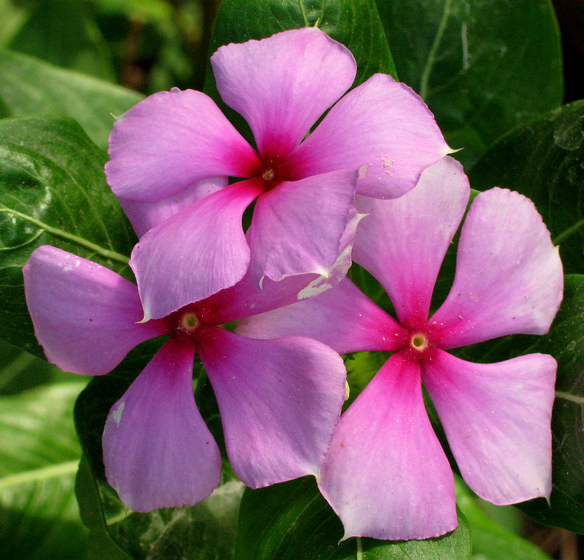
Vinca alkaloids
Obtained from periwinkle plant ( Vinca Rosea)
Vincristine, vinblastine, vindesine, vinorelbine

Slide 343
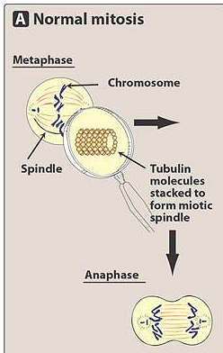
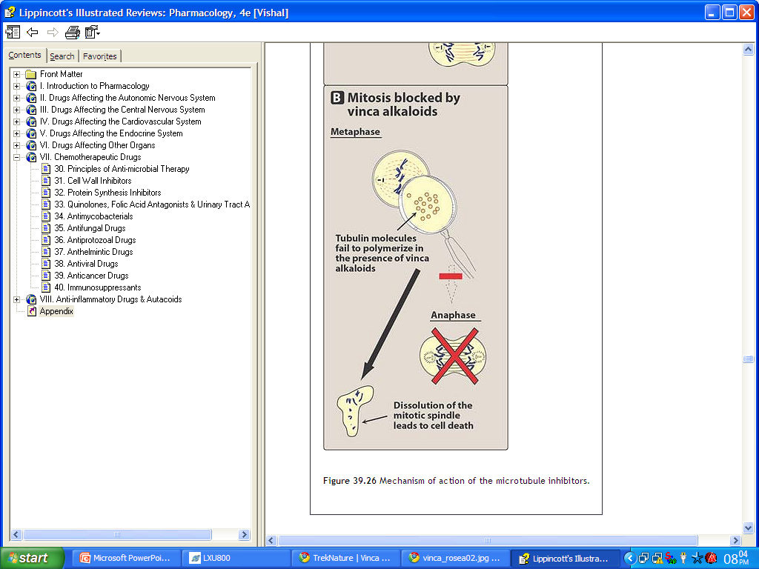
Mechanism of action

Slide 344
Comparison between
Vincristine
Vinblastine
Marrow sparing effect
Alopecia more common
Peripheral & autonomic neuropathy & muscle weakness (CNS)
Constipation
Uses: (Childhood cancers)
  ALL , Hodgkins, lymphosarcoma, Wilms tumor, Ewings sarcoma
Bone marrow supression
Less common
Less common, temp. mental depresssion
Nausea, vomiting, diarrhoea
uses
  Hodgkins disease & other lymphomas , breast cancer, testicular cancer

Slide 345
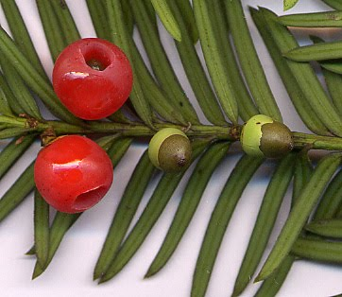

Taxanes
Paclitaxel & docetaxel
Plant product obtained from bark of Pacific Yew ( Taxus Brevifolia) & European Yew (Taxus Buccata)

Slide 346
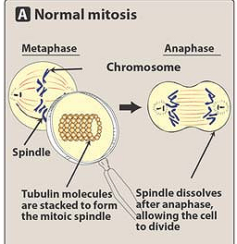

Mechanism of action
Cell cycle arrested in G2 and M phase

Slide 347
Paclitaxel
  Administered IV
  Use: advanced breast & ovarian cancer also lungs, esophagus, prostrate cancer
  Adverse effects:
    Anaphylactoid reaction because of solvent cremaphor
    Myalgia, myelosupression, peripheral neuropathy
Docetaxel
  Oral
  Used in refractory breast & ovarian cancer
  Major toxicity neutropenia may cause aarrhythmias , hypotension

Slide 348
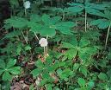
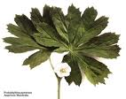
Epipodophyllotoxins
Etoposide & tenoposide
Semisynthetic derivatives of podophyllotoxins podophyllum peltatum (plant glycoside)

Slide 349
Etoposide
Act in S & G2 phase
Inhibit topoisomerase II which results in breakage of DNA strands & cell death
Uses:
  Testicular tumors , squamous cell cancer of lungs

Slide 350
Camptothecin analogs
Derived from camptotheca accuminata
Inhibit Topoisomerase I: No resealing of DNA after strand has untwisted
Topotecan:
  Used in metastatic ovarian cancer
  Major toxicity is bone marrow depression
Irinotecan
  Used in metastatic cancer of colon/rectum
  Toxicity: diarrhoea, neutropenia, thrombocytopenia, cholinergic side effects

Slide 351
Anticancer antibiotics
Cell cycle non specific drugs
Derived from streptomyces species
MOA:
  Intercalation in the DNA between adjoining nucleotide pairs – blocks DNA & RNA synthesis
  Generation of oxygen radicals which mediate single strand scission of DNA
  Action on Topoisomerase II

Slide 352
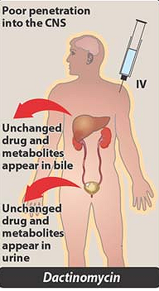
Dactinomycin
Uses:
  Wilms tumor,
  gestational choriocarcinoma
Adverse effects
  bone marrow supression
  Irritant like meclorethamine
  sensitizes to radiation, and inflammation at sites of prior radiation therapy may occur
  Gastrointestinal adverse effects

Slide 353
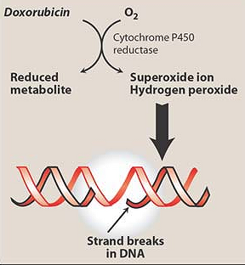
Doxorubicin & Daunorubucin

Slide 354
Doxorubicin:
  Used in acute leukemias, malignant lymphoma and many solid tumors, direct instillation in bladder cancer
Daunorubicin:
  Use limited to ALL and granulocytic leukemias
Toxicity:
  Both cause cardiotoxicity (cardiomyopathy)
  Marrow Depression, Alopecia

Slide 355
Mitoxantrone
  Analog of doxorubicin
  Lower cardiotoxicity
  Uses: Acute leukemia, CML, Non Hodgkin
Mitomycin C
  Highly toxic used only in resistant cancers of stomach, colon, rectum
  Transformed to form which acts like alkylating agent
Mithramycin
  Reduces blood calcium levels by inhibiting osteoclasts
  Used in T/t of hypercalcemia with bone metastasis

Slide 356
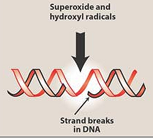
Bleomycin
DNA – bleomycin – Fe²⁺
Reacts with iron, copper & O₂ in presence of CYP -450 reductase
DNA – bleomycin – Fe³⁺
Also can intercalate between DNA strands

Slide 357
Bleomycin
Uses :
  Epidermoid cancers of skin, oral cavity, genitourinary tract, esophagus
  Testicular tumors
  Hodgkins lymphoma
Adverse effects:
  Pneumonitis
  Fatal pulmonary fibrosis
  Hyper pigmentation
  spares bone marrow

Slide 358
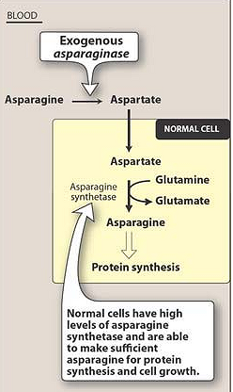
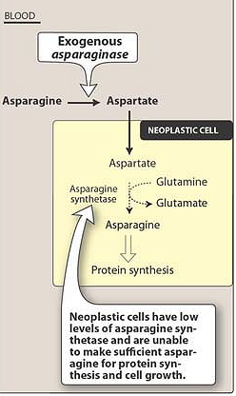
L-asparaginase

Slide 359
L-asparaginase
Isolated from E.coli
Use: Acute Lymphocytic Leukemia (ALL)
Dose :
  6000 to 10000U/kg IV daily for 3-4 weeks
A/E:
  Hepatic damage
  Hypersensitivity , hemorrhage
  Hyperglycemia, headache, hallucinations , confusion, coma

Slide 360
Hydroxyurea
Ribonucleoside diphosphate reductase
Ribonucleotides
Deoxyribonucleotides
Hydroxyurea
Uses:
  CML, Polycythemia, psoriasis
Dose:
  20-30 mg/kg /day orally
Adverse effects
  Myelosuppression (Minimal)
  Hypersensitivity
  Hyperglycemia
  Hypoalbuminemia

Slide 361
Procarbazine
MOA: Depolymerizes DNA & causes chromosomal damage
USES: Hodgkin’s disease ( MOPP regimen)
  Non hodgkins lymphoma
100-200mg daily orally
A/e: MAO inhibitor action & antabuse action

Slide 362
Radio active isotopes
I¹³¹ – Emits beta radiation , half life-8.04 days
use:Follicular Ca- Thyroid
P32 - Emits beta radiation , half life- 14.3 days.
use : Polycythemia vera
198Au – gives low energy beta & gamma radiation, half life- 2.69 days
use :malignant pleural, peritoneal effusion

Slide 363
Hormones & antagonists
Corticosteroids
  Prednisolone
Estrogens
  Ethinyl Estradiol
SERM
  Tamoxifene, Toremifene
SERD
  Fulvestrant
Aromatase Inhibitors
  Letrozole, Anastrazole, Exemestane
Progestins
  Hydroxyprogesterone
Anti-androgens
  Flutamide, Bicalutamide
5-α reductase Inhibitors
  finasteride, dutasteride
GnRH analogs
  Naferelin, goserelin, leuoprolide

Slide 364
Glucocorticoids
Marked lympholytic effect so used in acute leukaemias & lymphomas,
They also
  Have Anti-inflammatory effect
  Increase appetite, prevent anemia
  Produce sense of well being
  Increase body weight
  Supress hypersensitivity reaction
  Control hypercalcemia & bleeding
  Non specific antipyretic effect
  Increase antiemetic effect of ondansetron

Slide 365
Estrogens
Physiological antagonists of androgens
Thus used to antagonize the effects of androgens in androgen dependent prostatic cancer
Fofesterol
  Prodrug , phosphate derivative of stilbesterol
  600-1200mg IV initially later 120-240 mg orally

Slide 366
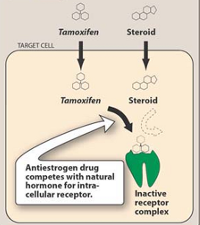
Selective Estrogen Receptor Modulators (SERMs)
Tamoxifen : Non steroidal antiestrogen
Antagonistic:
Breast and blood vessels
Agonistic:
Uterus, bone, liver, pitutary

Slide 367
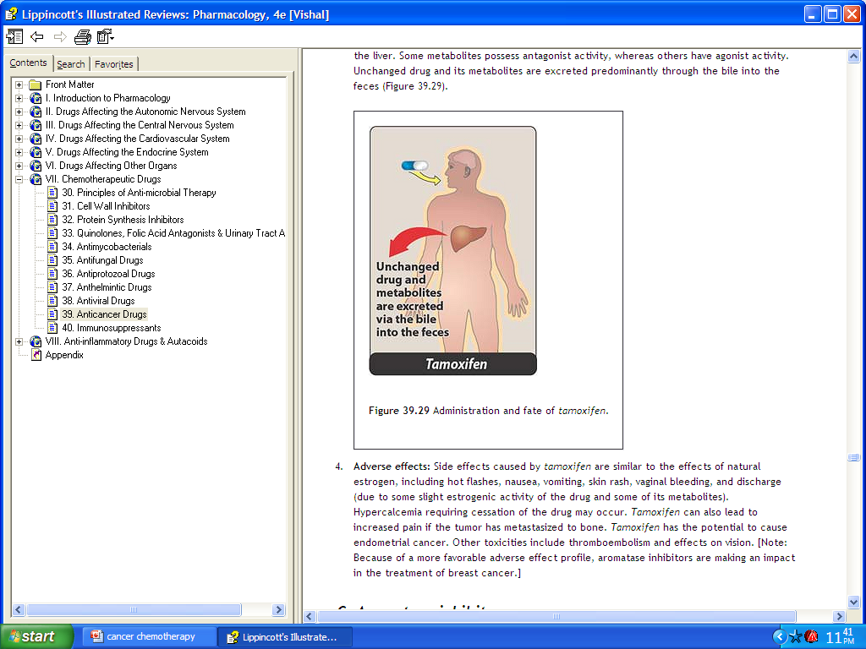
Tamoxifen
DOSE:10-20mg bd
Standard hormonal treatment in breast cancer
Adverse effects:
  Hot flushes , vomiting, vaginal bleeding, menstrual irregularities, venous thromboembolism, dermatitis, rarely endometrial cancer

Slide 368
Selective Estrogen Receptor Down regulator (fulvestrant)
Pure estrogen antagonist
USES: Metastatic ER+ Breast Ca in postmenopausal women
MOA:
  Inhibits ER dimerization & prevents interaction of ER with DNA
  ER is down regulated resulting in more complete supression of ER responsive gene function

Slide 369
Aromatase Inhibitors
Letrozole
  Orally active non steroidal compound
  MOA : Inhibits aromatisation of testosterone & androstenedione to form estrogen.
  Uses : Breast Ca- & adj. to mastectomy
  Dose :2.5mg bd orally
Anastrozole : more potent
  1mg OD in ER+ Breast Ca
  A/E : hot flushes

Slide 370
Anti androgens
FLUTAMIDE & BICALUTAMIDE :
  Androgen Receptor antagonists
  Dose : 250 mg tds, 50mg od resp.
  Palliative effect in metastatic Prostatic Ca
  after orchidectomy

Slide 371
5-α reductase inhibitors
Finasteride
Orally active
DHT levels ↓
Benign prostatic
hyperplasia
Dose: 5mg/day
  Prostate volume
  Symptom score
  Peak urine flow rate
  DHT level in prostate
Also used for prevention of hair loss
Side effects: Loss of libido & impotence in 5 % pts.

Slide 372
GnRH agonists
NAFERELIN : nasal spray / SC inj
↓FSH & LH release from pituitary- ↓ the release of estrogen & testosterone
USE : Breast Ca, Prostatic Ca
PROGESTINS:
Hydroxyprogesterone – used in metastatic endometrial Ca.
A/E: bleeding

Slide 373
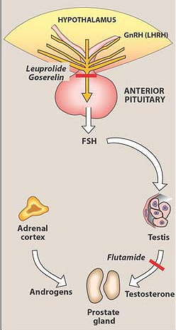

Slide 374
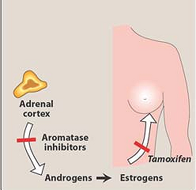

Slide 375
Newer anticancer drugs
Inhibitors of growth factors receptors
  Imatinib: CML (BCR-ABL gene)
  Gefitinib: Non small cell cancer of lungs (EGFR)
  Nilotinib : CML (Tyrosine kinase inhibitor)
  Dasatinib : CML (Tyrosine kinase inhibitor)
  Lapatinib : metastatic breast cancer (HER2/neu)
  Sunitinib : renal cell carcinoma (VEGF)
  Sorafinib : renal cell carcinoma (VEGF)

Slide 376
Newer anticancer drugs
Monoclonal antibodies
  Trastuzumab : breast cancer (HER2/neu)
  Bevacizumab: metastatic colon cancer (VEGF)
  Rituximab : non hodgkins lymphoma (CD-20)
  Panitumumab : metastatic colon cancer (EGFR)
  Alemtuzumab : CLL (CD 52 antigen)
  Iodine tositumonab : Non hodgkins (CD-20)

Slide 377
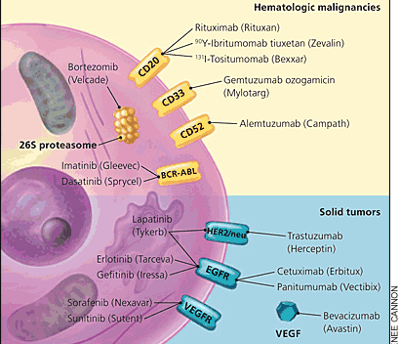

Slide 378
Important drug combinations
REGIMEN | CANCER | DRUGS
MOPP | Hodgkins | Mechlorethamine, oncovin, prednisolone, procarbazine
ABVD | Hodgkins | Doxorubicin, bleomycin, vinblastine, dacarbazine
CMF | Breast | Cyclophosphamide, methotrexate, 5-FU
CAF | Breast | Cyclophosphamide, doxorubicin, 5FU
 | ALL | Vincristine, prednisolone, aspargine, daunorubicin
 | AML | Cytarabine, methotrexate
 | CML | Hydroxyurea, interferon
 | Wilms | Actinomycin, vincristine, doxorubicin

Slide 380
Learning Objectives
Gastrointestinal Pharmacology
Know the major classes of acid-suppressive drugs and their mechanisms of action
Know the common side effects of acid-suppressive drugs
Know the specific treatment of acid-peptic disorders

Slide 381

Peptic Ulcer Disease
Factors that
Increase Acidity
Factors that
Protect Against
Acidity

Slide 382
Peptic Ulcer Disease
Imbalance between defenses and aggressive factors
Defensive factors:
  -Mucus: continually secreted, protective effect
  -Bicarbonate: secreted from endothelial cells
  -Blood flow: good blood flow maintains mucosal integrity
  -Prostaglandins: stimulate secretion of bicarbonate and
  mucus, promote blood flow, suppress secretion of gastric
  acid

Slide 383
Aggressive factors:
  -Helicobacter pylori: gram negative bacteria, can live in stomach and duodenum, may breakdown mucus layer => inflammatory response to presence of the bacteria also produces urease – forms CO2 and ammonia which are toxic to mucosa
  -Gastric Acid: needs to be present for ulcer to form => activates pepsin and injures mucosa
  -Decreased blood flow: causes decrease in mucus production and bicarbonate synthesis, promote gastric acid secretion
  -NSAIDS: inhibit the production of prostaglandins
  -Smoking: nicotine stimulates gastric acid production

Slide 384
Classes of Agents
Proton Pump Inhibitors
Histamine H₂-Receptor Antagonists
Prostaglandin Analogs
Cytoprotectants
Antacids

Slide 385
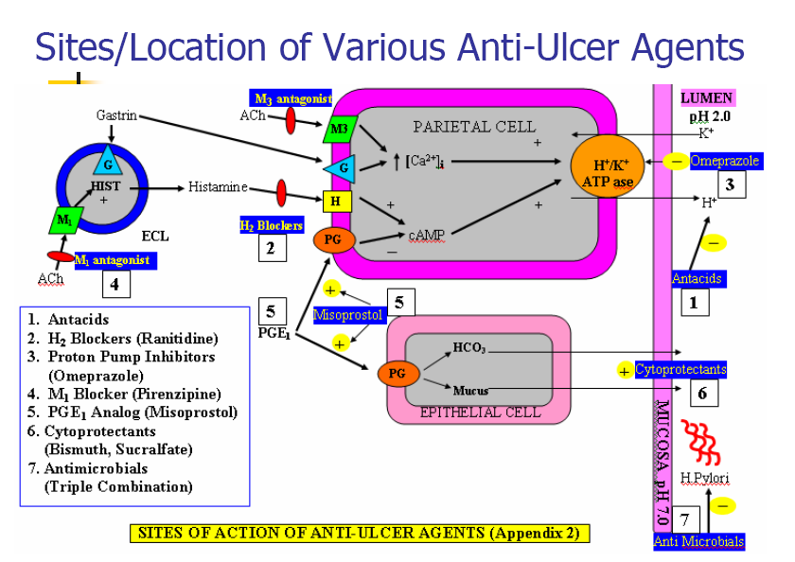

Slide 386
1. Proton Pump Inhibitors (PPI’s)

Slide 387
PPIs
- Most potent suppressors of acid secretion
- 24-48 hr effects on acid suppression
Irreversible inhibitor of proton pump; blocks 98% of
acid secretion in all forms of ulcer and hypersecretory
Zollinger-Ellison syndrome.
The drug is given in gelatin coated capsule to resist
breakdown in stomach acid. It reaches the intestine,
well absorbed, enters blood stream,reaches the
parietal cell.

Slide 388
PPIs
Irreversibly inhibit H⁺/K⁺ATPase function to:
  Block gastric acid secretion
  Decrease pepsin concentration
  Increase gastric pH
Secretion of acid only resumes when new proton pumps are deployed
Steady-state inhibition (affecting 70% of pumps) may take 2-5 days

Slide 389
PPI Pharmacology
Activated only when pH decreases below 4
  Occurs only in parietal cell
  Achieved only when parietal cell activation occurs (after meals)
  Most effective after a prolonged fast when large amounts of active proton pumps are present (i.e. breakfast)

Slide 390
Available PPIs
Esomeprazole (Nexium)
Lansoprazole (Prevacid) (iv)
Omeprazole (Prilosec, generic, OTC)
Pantoprazole (Protonix) (iv)
Rabeprazole (Aciphex)

Slide 391
PPI Metabolism
Rapidly absorbed
Highly protein bound
Extensively metabolized in the liver by the P450 system (CYP2C19 and CYP3A4)
Sulfated metabolites are excreted in the urine or feces
Hepatic disease reduces the clearance of lansoprazole--reduce dose

Slide 392
Common PPI Side Effects
Headache (2.9-6.9%) vs. Placebo (2.5-6.3%)
Diarrhea (3%) vs. Placebo (3.1%)
Abdominal pain (2.4-5.2%) vs. Placebo (3.1-3.3%)
Constipation (1.1-1.5%) vs. Placebo (0-0.8%)

Slide 393
Drug-Drug Interactions
Ketoconazole and Digoxin absorption is decreased due to reduced acidity.
Omeprazole may inhibit coumadin, diazepam and phenytoin metabolism

Slide 394
2. Histamine H₂-Receptor Antagonists (H₂RAs)

Slide 395
H₂RAs
Reversibly compete with histamine for binding to H₂ receptors on the basolateral membrane of parietal cells
Less potent than PPIs but still suppress acid by 70% over 24 hrs

Slide 396
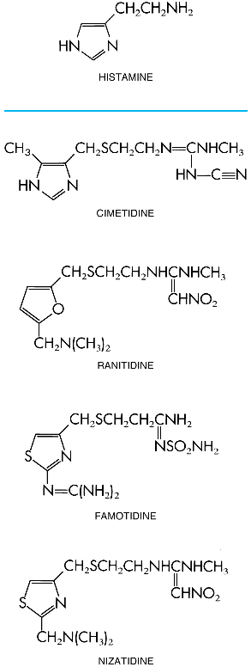
Available H₂RAs
H2 receptor blockers:
Cimetidine (Tagamet®)
  First H2-blocker available
  Inhibits P450 => Drug interaction
Ranitidine (Zantac®)
  Does not inhibit P450 => fewer side effects
Nizatidine (Axid®)
Famotidine (Pepcid®)

Slide 397
Pharmacokinetics
Rapidly absorbed after oral administration
Serum concentrations peak in 1-3 hr
Therapeutic levels maintained up to 12 hrs
Small percentage is protein bound
10% to 35 % metabolized by the liver
Drugs and metabolites primarily excreted by kidneys (**reduce doses in renal disease)

Slide 398
inhibit 90% acid secretion in basal state as well as food-induced and nocturnal acid production.
they are helpful in healing gastric and duodenal ulcers and prevent their recurrence. Have benefits in preventing increased gastric acid secretion in Zollinger-Ellison syndrome.
-Cimetidine Has several side effects, not a choice
now - Under Prescription.

Slide 399
Common H₂RA Side Effects
All less than 3%
  Diarrhea
  Headache
  Drowsiness
  Fatigue
  Muscular pain
  Constipation
Much less common
  Confusion, delirium in the elderly
  Associated with thrombocytopenia
  Cimetidine anti-androgen effects

Slide 400
Drug-Drug Interactions
-Inhibits CyP450: Inhibits the metabolism of various drugs that are concomitantly taken: phenytoin, warfarin, theophylinne, BZD.
-These adverse effects are relatively least with ranitidine and famotidine

Slide 401
3. Prostaglandin Analogs: Misoprostol

Slide 402
Protective Effects of Prostaglandins
PGE₂ and PGI₂ synthesized by gastric mucosa
Acid-reducing effects
  Bind to EP₃ receptors on parietal cells
  Decrease acid production
Cytoprotective effects
  Stimulation of mucin and bicarbonate
  Increase mucosal blood flow
Contrast with NSAIDS which diminish prostaglandin formation by inhibition of cycloxygenase and lead to
ulcer formation

Slide 403
Misoprostol: Cytotec
Synthetic analog of PGE₁
  Enhanced potency
  Increased oral bioavailability
Inhibit basal acid secretion (85-95%)
Inhibit stimulated acid secretion (75-85%)

Slide 404
Pharmacokinetics
Rapidly absorbed
Rapidly de-esterfied to misoprostol acid--the active metabolite
Therapeutic effect peaks at 60-90 minutes
Lasts 3 hours (qid dose required)

Slide 405
Side Effects
Diarrhea ± abdominal cramps as high as 30%
Begins within 2 weeks and often resolves spontaneously in 1 week
Can exacerbate inflammatory bowel disease
Contraindicated during pregnancy

Slide 406
4. Sucralfate: Carafate

Slide 407
Sucralfate
Sulfated polysaccharide
Acid activated
Administered on an empty stomach 1 hr before meals
Stimulates local prostaglandin synthesis, adsorbs pepsin
Binds bile acids
Not absorbed => essentially free of side effects

Slide 408
Common Side Effects
Constipation (2%)
Avoid in renal failure
May impair absorption of other drugs

Slide 409
5. Antacids

Slide 410


Slide 411
Antacids
Sodium bicarbonate
CaCO3
Mg²⁺ hydroxides
Al³⁺ hydroxide

Slide 412
Antacids
Given orally 1-3 hrs after meals and bedtime
Mg⁺² based preparations increase motility
  Diarrhea
Al⁺³ based preparations relax smooth muscle
  Constipation
Ca⁺² based preparations release CO2
  Belching, nausea, distension, and flatulence.

Slide 413
Common Side Effects
Aluminum toxicity with renal disease
  Osteoporosis, enchephalopathy, myopathy
Hypercalcemia
  Phosphate retention
  Calcium precipitation in the kidney
Impair absorption of some drugs
  Take 2 hrs before or after other drugs

Slide 414

Antibiotic ulcer therapy:
Combinations must be used:
-Bismuth (PeptoBismol®) – disrupts cell wall of H. pylori
-Clarithromycin – inhibits protein synthesis
-Amoxicillin – disrupts cell wall
-Tetracyclin – inhibits protein synthesis
-Metronidazole – used often due to bacterial resistance to amoxicillin and tetracyclin, or due to intolerance by
the patient
Standard treatment regimen for peptic ulcer:
Omeprazole + amoxicillin + metronidazole

Slide 415
Laxatives

Slide 416
Constipation
Abnormally infrequent and difficult passage of feces through the lower GI tract
Symptom, not a disease
Disorder of movement through the colon and/or rectum
Can be caused by a variety of diseases
or drugs

Slide 417
Laxatives :
Bulk forming
Emollient
Hyperosmotic
Saline
Stimulant

Slide 418
Laxatives:
Mechanism of Action
Bulk forming
High fiber
Absorbs water to increase bulk
Distends bowel to initiate reflex bowel activity
Examples:
  psyllium (Metamucil)
  methylcellulose (Citrucel)
  polycarbophil

Slide 419
Laxatives:
Mechanism of Action
Emollient
Stool softeners and lubricants
Promote more water and fat in the stools
Lubricate the fecal material and intestinal walls
Examples:
  Stool softeners: docusate salts (Colace, Surfak)
  Lubricants: mineral oil

Slide 420
Laxatives:
Mechanism of Action
Hyperosmotic
Increase fecal water content
Result: bowel distention, increased peristalsis, and evacuation
Examples:
  polyethylene glycol (GoLYTELY)
  sorbitol
  glycerin
  lactulose (Chronulac)

Slide 421
Laxatives:
Mechanism of Action
Saline
Increase osmotic pressure within the intestinal tract, causing more water to enter the intestines
Result: bowel distention, increased peristalsis, and evacuation

Slide 422
Saline laxative examples:
  magnesium sulfate (Epsom salts)
  magnesium hydroxide (MOM)
  magnesium citrate
  sodium phosphate (Fleet Phospho-Soda, Fleet enema)

Slide 423
Laxatives:
Mechanism of Action
Stimulant
Increases peristalsis via intestinal nerve stimulation
Examples:
  castor oil
  senna
  cascara
  bisacodyl

Slide 424
Laxatives: Side Effects
Bulk forming
  Impaction
  Fluid overload
Emollient
  Skin rashes
  Decreased absorption of vitamins
Hyperosmotic
  Abdominal bloating
  Rectal irritation

Slide 425
Laxatives: Side Effects
Saline
  Magnesium toxicity (with renal insufficiency)
  Cramping
  Diarrhea
  Increased thirst
Stimulant
  Nutrient malabsorption
  Skin rashes
  Gastric irritation
  Rectal irritation

Slide 426
Antidiarrheals

Slide 427
Causes of Diarrhea
Acute Diarrhea
Bacterial
Viral
Drug induced
Nutritional
Protozoal
Chronic Diarrhea
Tumors
Diabetes
Addison’s disease
Hyperthyroidism
Irritable bowel syndrome

Slide 428
Antidiarrheals
  Drugs that decrease peristalsis, thereby allowing fluid absorption from the intestinal contents
  Examples:
    Anticholinergics
    Protectants/adsorbents
    Opiate-related agents
    Probiotics
    Metronidazole

Slide 429
Antidiarrheals
  Anticholinergics are used to treat tenemus and vomiting
  Examples:
    Atropine
    Aminopentamide
    Isopropamide
    Propantheline
    Methscopolamine
  Side effects include dry mucous membranes, urine retention, tachycardia, and constipation

Slide 430
Antidiarrheals
  Protectants/adsorbents coat inflamed intestinal mucosa with a protective layer (protectants) or bind bacteria and/or digestive enzymes and/or toxins to protect intestinal mucosa from damaging effects (adsorbents)
  Examples:
    Bismuth subsalicylate (bismuth + aspirin-like product)
    Kaolin/pectin
    Activated charcoal
  Side effects include constipation

Slide 431
Antidiarrheals
  Opiate-related agents control diarrhea by decreasing both intestinal secretions and the flow of feces and increasing segmental contractions
  Examples:
    Diphenoxylate
    Loperamide
    Paregoric
  Side effects include CNS depression, ileus, urine retention, bloat, and constipation

Slide 432
Antidiarrheals
  Probiotics seed the GI tract with beneficial bacteria; use is based on the theory that some forms of diarrhea are caused by disruption of the normal bacterial flora of the GI tract
  Must be refrigerated to maintain the viability of the bacteria
  Examples:
    Plain yogurt with active cultures
    Variety of trade-name products

Slide 433
Antidiarrheals
  A theory regarding the development of diarrhea is that anaerobic bacteria may increase due to disruption of normal GI flora
  One way to treat this is to use an antibiotic effective against anaerobic bacteria
  Metronidazole is an example of an antibiotic used to treat diarrhea

Slide 434
Skeletal muscle relaxants

Slide 435
Classification on basis of site of action and mechanism of action
A) PERIPHERALLY ACTING
Neuromuscular blockers
Non depolarizing agents
Isoquinoline derivatives steriod derivatives
  Tubocurarine Pancuronu ium
  Doxacurium Pipecuronium
  Atracurium Rapacuronium
  Metocurine Rocuronium
  Mivacurium Vecuronium
Depolarizing agents
  Suxamethonium (Succinylcholine)
  Decamethonium

Slide 436


Neuromuscular Junction
1: Cholinergic motor neurone,2: motor end-plate, 3: vesicles, 4: N_{M}R, 5: mitochondrion

Slide 437
Depolarizing agents:
Succinyle choline
These drugs are structural analogue pf acetylcholine .
They either act as antagonists ( non depolarizing)
OR
agonist (depolarizing)
These drugs are used to increase the safety of general anesthetics
These are used parentrally

Slide 438
B) Centrally acting (spasmolytic drugs)
Diazepam ( act through GABA _{A}) receptors)
Baclofen (GABA _{B)} receptors
Dantroline ( act directly by interfering release of calcium from sarcoplasmic reticulum)
Note:
these drugs are used to control spastic muscle tone as in epilesy ,multiple scelerosis ,cerebral palsy, stroke,

Slide 439
Mechanism of Sk. muscle contraction
Initiation of impulse
Release of acetylcholine
Activation of nicotinic receptor at motor end plate
Opening of ion channel, passage of Na⁺ , depolarization of end plate

Slide 440
Mechanism cont’d
Muscle contraction.
Neuromuscular blocking agents used in clinical practice interfere with this process.
Drugs, can block neuromuscular transmission/ or muscle contraction by acting

Slide 441
Presynaptically:
To inhibit acetylcholine synthesis or release (practically not used).
As they may have whole body unspecific nicotinic as well as muscarinic effects
Postsynaptically:
To block the receptor activity.
To block ion channel at the end plate
Clinically these drugs are only used as an adjuvant to general anesthesia, (only when artificial respiration is available.)
They interfere with the post synaptic action of
acetylcholine.

Slide 442
Non depolarizing (majority):
Act by blocking acetylcholine receptors.
In some cases (in higher doses), act by blocking ion channels.
Depolarizing:
act as agonists at acetylcholine receptors

Slide 443
Mechanism of action
(non depolarizing agents)
a) At low doses:
These drugs combine with nicotinic receptors and prevent acetylcholine binding.as they compete with acetycholine for receptor binding they are called competitive blockers
Thus prevent depolarization at end-plate.
Hence inhibit muscle contraction, relaxation of skeletal muscle occurs. Their action can be overcome by increasing conc. of acetylcholine in the synaptic gap(by inhibition of acetyl cholinesterase enzyme)
e.g.: Neostigmine, physostigmine, edrophonium
Anesthetist can apply this strategy to shorten the duration of blockage or over come the overdosage

Slide 444
At high doses
These drugs block ion channels of the end plate.
Leads to further weakening of the transmission and reduces the ability of Ach-esterase inhibitors to reverse the action.
ACTIONS
All the muscles are not equally sensitive to blockade.
Small and rapidly contracting muscles are paralyzed first.
Respiratory muscles are last to be affected and first to recover.

Slide 445
Pharmacokinetics:
Administered intravenously
Cross blood brain barrier poorly
Some are not metabolized in liver, their action is terminated by redistribution and excreted urine unchanged (tubocurarine, mivacurium, metocurine).
Atracurium is degraded spontaneously in plasma by ester hydrolysis releasing histamine and can produce a fall in blood pressure ,flushing and bronchoconstriction. It is also metabolized to laudanosine (which can provoke seizures). Cisatracurium with similar pharmacokinetics is more safer.
non depolarizers are excreted via kidney.

Slide 446
Some (vecuronium, rocuronium) are acetylated in liver.( there clearance can be prolonged in hepatic impairment)
Can also be excreted unchanged in bile.
They differ in onset, duration and recovery
Uses:
  as adjuvant to anesthesia during surgery.
  Control of ventilation (Endotracheal intubation)
  Treatment of convulsion

Slide 447
Drug interactions
Choline esterase inhibitors such as neostigmine, pyridostimine and edrophonium reduces or overcome their activity but with high doses they can cause depolarizing block due to elevated acetylcholine concentration at the end plate.
Halogenated hydrocarbons, aminoglycosides, calcium channel blockers synergize their effect.

Slide 448
Unwanted effects
Fall in arterial pressure chiefly a result to ganglion block , may also be due to histamine release this may give rise to bronchospasm (especially with tubocurarine ,mivacurium ,and atracurium)
Gallamine and pancuronium block, muscarinic receptors also, particularly in heart which may
results in to tachycardia.

Slide 449
DEPOLARIZING AGENTS
DRUGS Suxamethonium ( succinylecholine)
Decamethonium
Mechanism of action:
These drugs act like acetylcholine but persist at the synapse at high concentration and for longer duration and constantly stimulate the receptor.
First, opening of the Na+ channel occurs resulting in depolarization, this leads to transient twitching of the muscle, continued binding of drugs make the receptor incapable to transmit the impulses, paralysis occurs.
The continued depolarization makes the receptor incapable of transmitting further impulses.

Slide 450
Therapeutic uses:
When rapid endotracheal intubations is required.
Electroconvulsive shock therapy.
Pharmacokinetics:
Administered intravenously.
Due to rapid inactivation by plasma cholinestrase, given by continued infusion.

Slide 451
SUCCINYLCHOLINE
It causes paralysis of skeletal muscle.
Sequence of paralysis may be different from that of non depolarizing drugs but respiratory muscles are paralyzed last
It causes maintained depolarization at the end plate, which leads to a loss of electrical excitability.
It has shorter duration of action.

Slide 452
Unwanted effects:
Bradycardia preventable by atropine.
Hyperkalemia in patients with trauma or burns this may cause dysrhythmia or even cardiac arrest.
Increase intraocular pressure due to contracture of extra ocular muscles .
increase intragastric pressure which may lead to emesis and aspiration of gastric content.
Malignant hyperthermia: rare inherited condition probably caused by a mutation of Ca⁺⁺ release channel of sarcoplasmic reticulum, which results muscle spasm and dramatic rise in body temperature. (This is treated by cooling the body and administration of Dantrolene)
Prolonged paralysis: due to factors which reduce the activity of plasma cholinesterase
    genetic variants as abnormal cholinesterase, its severe deficiency.
    anti -cholinesterase drugs
    neonates
    liver disease

Slide 453

Characteristics of neuromuscular-blocking drugs

Slide 454
DANTROLENE
It acts directly
It reduces skeletal muscle strength by interfering with excitation-contraction coupling into the muscle fiber, by inhibiting the release of activator calcium from the sarcoplasmic stores.
It is very useful in the treatment of malignant hyperthermia caused by depolarizing relaxants.
This drug can be administered orally as well as intravenously. Oral absorption is only one third.
Half life of the drug is 8-9 hours.

Slide 455
Baclofen
It acts through GABA B receptors
It causes hyper polarization by increased K+ conductance reducing calcium influx and reduces excitatory transmitter in brain as well as spinal cord
It also reduces pain by inhibitory substance P. in spinal cord
It is rapidly and completely absorbed orally and has a half life of 3- 4 hours
It is less sedative but may increases seizures in epileptics
It is also useful to prevent migraine.

Slide 457





Antiseizure
(antiepileptic)
drugs
Kirimi bs

Slide 458
EPILEPSY affects 5–10‰ of the general population.
It is due to sudden, excessive depolarization of
some or all cerebral neurons. This may be:
localized (focal or partial seizure);
spread to cause a secondary generalized seizure;
may affect all cortical neurons simultaneously
(primary generalized seizure).

Slide 459


Slide 460

EEG
Cortex:
F – frontal
O – occipital
T – temporal
Rang et al.
Pharmacology
– 5th Ed. (2003)
Classification of seizures

Slide 461
HISTORY
Bromides (1857)
Phenobarbital (1912)
Phenytoin (1938)
Later: Ethosiximide, Carbmazepine
New anticonvulsants (in the last 15–20 years):
vigabatrin, gabapentin, lamotrigine, topiramate,
oxcarbazepine, levetiracetam, pregabalin etc.

Slide 462
1. Carboxamides (enzyme inductors – CYP450):
Carbamazepine (+ neuropathic pain – n. trigeminus,
postherpetic pain, etc.), Oxcarbazepine
2. Hydantoins: Phenytoin (enzyme inductor), used in digitalis
intoxication too
3. Barbiturates (Phenobarbital – enzyme inductors) and their
analogues (Primidone – prodrug)
4. Succinimides: Ethosuximide (casp. 250 mg – petit mal)
5. Valproates (enzyme inhibitors): Sodium valproate (Depakin®)
6. Benzodiazepines: Clonazepam, Clorazepate, Diazepam
t_{1/2} 43 h, amp. 10 mg/2 ml i.m./i.v., Lorazepam, Nitrazepam
7. GABA analogues: Gabapentin, Tiagabine
8. Hetereogenic anticonvulsants: Lamotrigine, Levetiracetam,
Pregabalin (partial seizures, peripheral neuropathic pain),
Topiramate, Vigabatrin
ANTISEIZURE DRUGS

Slide 463
MECHANISM OF ACTION OF ANTIEPILEPTIC DRUGS
Antiepileptics inhibit the neuronal discharge or its spread in one or
more of the following ways:
(1) Enhancing GABA synaptic transmission: barbiturates, benzo-
diazepines, gabapentin, levetiracetam, tiagabine, vigabatrin, topira-
mate, valproate; the result is increased permeability to chloride ion,
which reduces neuronal excitability. Valproate and topiramate block
GABA transaminase and tiagabine blocks reuptake of GABA.
(2) Reducing cell membrane permeability to voltage-dependent
sodium channels: carbamazepine, lamotrigine, oxcarbazepine,
phenytoin, topiramate, valproate.
(3) Reducing cell membrane permeability to calcium T-channels:
valproate, ethosuximide; the result is diminishing of the generation
of action potential.
(4) Inhibiting excitory neurotransmitter glutamate: lamotrigine.

Slide 464


GABA
Barbiturates
Benzodiazepines
Gabapentin
Levetiracetam
Tiagabine
Topiramate
Valproate
Vigabatrin
Na⁺
Ca²⁺
Carbamazepine
Lamotrigine
Oxcarbazepine
Phenytoin
Topiramate
Valproate
Ethosuximide
Levetiracetam
Pregabalin
Valproate

Slide 465

Antiseizure drugs
enhanced
GABA
synaptic
transmission
Goodman & Gilman's
The Pharmacologic Basis of
Therapeutics - 11th Ed. (2006)

Slide 466

Antiseizure drugs, enhanced Na⁺ channel inactivation
Goodman & Gilman's The Pharmacologic Basis of Therapeutics - 11th Ed. (2006)

Slide 467

Antiseizure drugs, induced reduction of
current through T-type Ca²⁺ channels.
Goodman & Gilman's The Pharmacologic Basis of Therapeutics - 11th Ed. (2006)

Slide 468

Goodman & Gilman's The Pharmacologic Basis of Therapeutics – 11th Ed. (2006)
Effects of three antiseizure drugs on sustained high-frequency firing of action
potentials by cultured neurons. Intracellular recordings were made from
neurons while depolarizing current pulses, approximately 0.75 s in duration,
were applied (on-off step changes indicated by arrows). In the absence of a
drug, a series of high-frequency repetitive action potentials filled the
entire duration of the current pulse. Phenytoin, carbamazepine, and
sodium valproate all markedly reduced the number of action potentials
elicited by the current pulses.

Slide 469
INDIVIDUAL ANTIEPILEPTICS
▼CARBAMAZEPINE blocks voltage-dependent sodium ion channels,
reducing membrane excitability. The t_{1/2} of the drug falls from 35 to
20 h over the first few weeks of therapy due to the induction of hepatic
enzymes that metabolize it as well as other drugs (including adrenal
corticosteroids, hormonal contraceptives, theophylline and warfarin.

Slide 470
Standard tablets are taken twice a day. Carbamazepine is a drug of first choice for focal and secondary generalized epilepsy but aggravates myoclonic and absence seizure.
It is useful for the treatment of trigeminal neuralgia, postherpetic pains, etc.
Adverse reactions (ARs): reversible blurring of vision, diplopia,
dizziness, ataxia, depression of AV conduction, skin rashes, liver, and
kidney dysfunction.

Slide 471

▼VALPROIC ACID (Sodium valproate) acts by inhibiting GABA
transaminase and increases the concentration of inhibitory neuro-
transmitter GABA at its receptors. Valproic acid has t_{1/2} 13 h and
90% bound to plasma albumin. It is a nonspecific inhibitor of meta-
bolism, and inhibits its own metabolism, and that of lamotrigine,
phenobarbital, phenytoin and carbamazepine. Valproic acid is
effective for treatment of generalized and partial epilepsy, febrile
convulsion and post-traumatic epilepsy.
ARs can be troublesome: weight gain, teratogenicity, polycystic
ovary syndrome, and loss of hair which grows back curly.
Nausea can be a problem, rarely, liver failure (risk maximal at
2–12 weeks). Ketone metabolites may cause confusion in urine
testing in diabetes mellitus.

Slide 472
▼PHENYTOIN (t_{1/2} 6–24 h) has saturation kinetics. It is extensively
hydroxylated in the liver and this process becomes saturated at the
doses needed for therapeutic effect (therapeutic plasma concentration
range is 10–20 mg/L). Phenytoin is a potent inducer of hepatic metabo-
lizing enzymes affecting itself and other drugs (carbamazepine, war-
farin, adrenal and gonadal steroids, thyroxine, tricyclic antidepressant,
doxycycline, vitamin D, folate). Drugs that inhibit phenytoin metabolism
include: valproic acid, cimetidine, co-trimoxazole, isoniazid, chloram-
phenicol, some NSAIDs, disulfiram. Phenytoin is 90% bound to plasma
albumin and small changes in binding will result in a higher concentra-
tion of free active drug. It is used to prevent all types of partial seizure,
generalized seizure, and st. epilepticus. It is not used for absence attacks.
ARs: impairment of cognitive function (which has led many physicians to
prefer carbamazepine and valproate), sedation, hirsutism, skin rashes,
gum hyperplasia (due to the inhibition of collagen metabolism),
hyperglycemia, anaemia, osteomalacia.

Slide 473
Saturation kinetics. Phenytoin is extensively hyd-
roxylated in the liver and this process becomes
saturated at about the doses needed for therapeutic
effect. Thus phenytoin at low doses exhibits first-
order kinetics but saturation or zero-order kinetics
develop as the therapeutic plasma concentration
range (10–20 mg/L) is approached, i.e. the dose
increments of equal size produce disproportional rise
in steady-state plasma concentration.

Slide 474
▼BENZODIAZEPINES
Diazepam given intravenously or rectally is highly effective for
stopping continuous seizure activity, especially generalized tonic-
clonic status epilepticus. The drug is occasionally given orally on
a long-term basis, although it is not considered very effective in
this application, probably because of the rapid development of
tolerance. A rectal gel is available for refractory patients who need
acute control of bouts of seizure activity.
Lorazepam appears in some studies to be more effective and
longer-acting than diazepam in the treatment of status epilepticus
and is preferred by some experts.
Clonazepam (t_{1/2} 25 h) is a benzodiazepine used as a
second line drug for treatment of primary generalized epilepsy
and status epilepticus.

Slide 475
Clonazepam, Clorazepate,
Diazepam, Lorazepam,
Nitrazepam
GABA
BDZs
site
GABA_{A}-
site
GABA_{A}-
benzo-
diazepine
receptor
complex
+
+
Cl⁻
+
Barbitu-
rate sate
Barbiturates
By Bennett and Brown (2003)

Slide 476

▼BARBITURATES (enzyme inducers)
Antiepilepsy members include phenobarbital (phenobarbitone –
( t_{1/2} 100 h), methylphenobarbital and primidone (which is
largely metabolized to phenobarbital, i.e. it is a prodrug). They are
still used for generalized seizures; sedation is usual.
Primidone and its
active metabolites
Basic & Clinical
Pharmacology –
10th Ed. (2007)

Slide 477
▼LAMOTRIGINE (t_{1/2} 6–24 h) inhibits excitory neurotransmitter
glutamate. Lamotrigine is effective for the treatment of partial and
secondarily generalized tonic-clonic seizure. It is generally well
tolerated but may cause serious ARs of the skin, including
Stevens–Johnson syndrome and toxic epidermal necrolysis.
▼TOPIRAMATE (t_{1/2} 21 h) is used as adjunctive treatment for
partial seizure, with or without secondary generalization. ARs:
sedation, weight loss, acute myopia, raised intraocular pressure.
▼ETHOSUXIMIDE (t_{1/2} 55 h) blocks T-type calcium ion
channels. It is active in absence seizures (petit mal).
ARs: gastric upset, CNS effects and allergic reactions.

Slide 478
PRINCIPLES OF MANAGEMENT
(Clinical Parmacology – 9th Ed., 2003)
Any causative factor must be treated (cerebral neoplasm etc).
Educate the patient about the disease, duration of treatment
and need for compliance.
Avoid precipitating factor (alcohol, sleep deprivation, emotional
stress, and caffeine).
Anticipate natural variation: fits may occur around menstrual
periods in women – catamenial (monthly) epilepsy.
Give antiepileptics only if seizure type and frequency require it
(e.g. more than one fit every 6–12 months).

Slide 479



MAIN INDICATIONS OF ANTIEPILEPTIC DRUGS

Slide 480
Anticonvulsive drugs of choice
Grand mal: I choice – valproate or Lamotrigine
Alternative – Carbamazepine, Topiramate or Phenytoin
Petit mal: I choice – Ehosuximide or valproate
Alternative – Clonazepam or Lamotrigine
Partial seizures: I choice – Carbamazepine or
valproate
Alternative – Phenytoin, Lamotrigine, Vigabatrin, Topiramate
Status epilepticus: I choice – Diazepam or Lorazepam (i.v.)
Alternative – Phenobarbital (i.m./i/v.)

Slide 481


Treatment of status epilepticus in adults
Patient in opisthotonus (grand mal)

Slide 482
GENERAL GUIDE TO ANTIEPILEPSY PHARMACOTHERAPY
(1) The decision whether or not to initiate drug therapy after a
single seizure remains controversial since approximately 25%
of patients may not have another seizure.
(2) Therapy should start with a single drug (70% of patients can
be controlled on one drug (monotherapy).
(3) Anticonvulsant drug therapy should be appropriate to the type
of seizure.
(4) The choice of drugs is also determined by the patient’s age
and sex.
(5) If the attempt to control epilepsy by use of a single drug is
unsuccessful, it should be withdrawn and replaced by a second
line drug, though these are effective in only 10% of patients.

Slide 483
There is little evidence that 2 or 3 drugs are better than one,
but more drugs often mean more ARs.
(6) Effective therapy must never be stopped suddenly,
only gradually.
(7) After a period of at least 2–3 years free from seizures, with-
drawal of anticonvulsants can be considered. In general, dis-
continuing the antiepileptic drug therapy is associated with
about 20% relapse during withdrawal and a further 20% relapse
over the following 5 years. It is recommended that the antiepi-
leptic drug be withdrawn over a period of 6 months. If a fit
occurs during this time, full therapy must begin again until the
patient has been free from seizure for a further 2–3 years.

Slide 484
Alternative methods
for treatment of epilepsy:
  Neurosurgery +
  laser therapy

Slide 485




Antihypertensive Drugs

Slide 486
Introduction
Hypertension
Systolic Blood
Pressure (SBP)
Diastolic Blood
Pressure (DBP)
> 140 mmHg
> 90 mmHg
****************************************************

Slide 487
Types of
Hypertension
Essential
A disorder of unknown origin affecting the
Blood Pressure regulating mechanisms
Secondary
Secondary to other disease processes
****************************************************
Environmental
Factors
Stress
Na+ Intake
Obesity
Smoking

Slide 488
Treatment – Why?
Symptomatic treatment is Mandatory:
  Damage to the vascular epithelium, paving the path for atherosclerosis (IHD, CVA) or nephropathy due to high intra-glomerular pressure
  Increased load on heart due to high BP can cause CHF
  Hypertension, even asymptomatic needs treatment

Slide 489

Normal Blood Pressure Regulation
Hydraulic equation:
Blood Pressure = Cardiac output (CO) X Resistance to passage of blood through precapillary arterioles (PVR)
Physiologically CO and PVR is maintained minute to minute by – arterioles (1) postcapillary venules (2) and Heart (3)
Kidney is the fourth site – volume of intravascular fluid
Baroreflex, humoral mechanism and renin-angiotensin- aldosterone system regulates the above 4 sites
Local agents like Nitric oxide
In hypertensives – Baroreflex and renal blood-volume control system – set at higher level
All antihypertensives act via interfering with normal mechanisms

Slide 490
Baroreceptor reflex arc
Postural baroreflex:
Notes:
Baroreflexes are responsible for minute to minute regulation of BP. Central sympathetic neurones in vasomotor area are tonically active. When there is stretch in the vessel wall brought about by rise in pressure, baroreceptor stimulation occurs and inhibits sympathetic discharge. On the other hand reduction in stretch, increases baroreceptor activity. Therefore, there will be increase in PVR (constriction of arterioles), and increase in CO (increase in venous return due to constriction of capacitance venules and direct stimulation of heart – thereby restoring normal blood pressure. Acts in vasodilators and shock.

Slide 491
The Renal response
Long-term blood pressure control – by controlling blood volume
Reduction in renal pressure - intrarenal redistribution of pressure and increased absorption of salt and water
Decreased pressure in renal arterioles and sympathetic activity – renin production – angiotensin II production
Angiotensin II:
  Causes direct constriction of renal arterioles
  Stimulation of aldosterone synthesis – sodium absorption and increase in intravascular blood volume

Slide 492
Antihypertensive Drugs
Diuretics:
  Thiazides: Hydrochlorothiazide, chlorthalidone
  High ceiling: Furosemide
  K+ sparing: Spironolactone, triamterene and amiloride
MOA: Acts on Kidneys to increase excretion of Na and H2O – decrease in blood volume – decreased BP
Angiotensin-converting Enzyme (ACE) inhibitors:
  Captopril, lisinopril., enalapril, ramipril and fosinopril
MOA: Inhibit synthesis of Angiotensin II – decrease in peripheral resistance and blood volume
Angiotensin (AT1) blockers:
  Losartan, candesartan, valsartan and telmisartan
MOA: Blocks binding of Angiotensin II to its receptors

Slide 493
Antihypertensive Drugs
Centrally acting:
  Clonidine, methyldopa
MOA: Act on central α2A receptors to decrease sympathetic outflow – fall in BP
ß-adrenergic blockers:
  Non selective: Propranolol (others: nadolol, timolol, pindolol, labetolol)
  Cardioselective: Metoprolol (others: atenolol, esmolol, betaxolol)
MOA: Bind to beta adrenergic receptors and blocks the activity
ß and α – adrenergic blockers:
  Labetolol and carvedilol
α – adrenergic blockers:
  Prazosin, terazosin, doxazosin, phenoxybenzamine and phentolamine
MOA: Blocking of alpha adrenergic receptors in smooth muscles - vasodilatation

Slide 494
Antihypertensive Drugs –
Calcium Channel Blockers (CCB):
  Verapamil, diltiazem, nifedipine, felodipine, amlodipine, nimodipine etc.
MOA: Blocks influx of Ca++ in smooth muscle cells – relaxation of SMCs – decrease BP
K+ Channel activators:
  Diazoxide, minoxidil, pinacidil and nicorandil
MOA: Leaking of K+ due to opening – hyper polarization of SMCs – relaxation of SMCs
Vasodilators:
  Arteriolar – Hydralazine (also CCBs and K+ channel activators)
  Arterio-venular: Sodium Nitroprusside

Slide 495
Diuretics
Drugs causing net loss of Na+ and water in urine
Mechanism of antihypertensive action:
  Initially: diuresis – depletion of Na+ and body fluid volume – decrease in cardiac output
  Subsequently after 4 - 6 weeks, Na+ balance and CO is regained by 95%, but BP remains low!
  Q: Why? Answer: reduction in total peripheral resistance (TPR) due to deficit of little amount of Na+ and water (Na+ causes vascular stiffness)
  Similar effect is seen with sodium restriction (low sodium diet)

Slide 496
Thiazide diuretics – adverse effects
Adverse Effects:
  Hypokalaemia – muscle pain and fatigue
  Hyperglycemia: Inhibition of insulin release due to K+ depletion (proinsulin to insulin) – precipitation of diabetes
  Hyperlipidemia: rise in total LDL level – risk of stroke
  Hyperurecaemia: inhibition of urate excretion
  Sudden cardiac death – tosades de pointes (hypokalaemia)
  All the above metabolic side effects – higher doses (50 – 100 mg per day)
  But, its observed that these adverse effects are minimal with low doses (12.5 to 25 mg) - Average fall in BP is 10 mm of Hg

Slide 497
Thiazide diuretics – current status
Effects of low dose:
  No significant hypokalaemia
  Low incidence of arrhythmia
  Lower incidence of hyperglycaemia, hyperlipidemia and hyperuricaemia
  Reduction in MI incidence
  Reduction in mortality and morbidity
JNC recommendation:
  JNC recommends low dose of thiazide therapy (12.5 – 25 mg per day) in essential hypertension
  Preferably should be used with a potassium sparing diuretic as first choice in elderly
  If therapy fails – another antihypertensive but do not increase the thiazide dose
  Loop diuretics are to be given when there is severe hypertension with retention of body fluids

Slide 498
Diuretics
K+ sparing diuretics:
  Thiazide and K sparing diuretics are combined therapeutically – DITIDE (triamterene + benzthiazide) is popular one
Modified thiazide: indapamide
  Indole derivative and long duration of action (18 Hrs) – orally 2.5 mg dose
  It is a lipid neutral i.e. does not alter blood lipid concentration, but other adverse effects may remain
Loop diuretics:
  Na+ deficient state is temporary, not maintained round –the-clock and t.p.r not reduced
  Used only in complicated cases – CRF, CHF marked fluid retention cases

Slide 499
Angiotensin Converting Enzyme (ACE) Inhibitors
What is Renin - Angiotensin?
(Physiological Background)

Slide 500
RAS - Introduction
Renin is a proteolytic enzyme and also called angiotensinogenase
It is produced by juxtaglomerular cells of kidney
It is secreted in response to:
  Decrease in arterial blood pressure
  Decrease Na+ in macula densa
  Increased sympathetic nervous activity
Renin acts on a plasma protein – Angiotensinogen (a glycoprotein synthesized and secreted into the bloodstream by the liver) and cleaves to produce a decapeptide Angiotensin-I
Angiotensin-I is rapidly converted to Angiotensin-II (octapeptide) by ACE (present in luminal surface of vascular endothelium)
Furthermore degradation of Angiotensin-II by peptidases produce Angiotensin-III
Both Angiotensin-II and Angiotensin-III stimulates Aldosterone secretion from Adrenal Cortex (equipotent)
AT-II has very short half life – 1 min

Slide 501

RAS - Physiology
Increased
Blood Vol.
Rise in BP
Vasoconstriction
Na+ & water
retention
Kidney
(Adrenal cortex)

Slide 502
RAS – actions of Angiotensin-II.
Powerful vasoconstrictor particularly arteriolar – direct action and release of Adr/NA release
  Promotes movement of fluid from vascular to extravascular
  More potent vasopressor agent than NA – promotes Na+ and water reabsorption
  It increases myocardial force of contraction (CA++ influx promotion) and increases heart rate by sympathetic activity, but reflex bradycardia occurs
  Cardiac output is reduced and cardiac work increases
Aldosterone secretion stimulation – retention of Na++ in body
Vasoconstriction of renal arterioles – rise in IGP – glomerular damage
Decreases NO release
Decreases Fibrinolysis in blood
Induces drinking behaviour and ADH release by acting in CNS – increase thirst
Mitogenic effect – cell proliferation

Slide 503
Angiotensin-II
What are the ill effects on chronic ?
  Volume overload and increased t.p.r
    Cardiac hypertrophy and remodeling
    Coronary vascular damage and remodeling
  Hypertension – long standing will cause ventricular hypertrophy
  Myocardial infarction – hypertrophy of non-infarcted area of ventricles
  Renal damage
  Risk of increased CVS related morbidity and mortality
ACE inhibitors reverse cardiac and vascular hypertrophy and remodeling

Slide 504
Angiotensin-II – Pathophysiological Roles
Mineraocorticoid secretion
Electrolyte, blood volume and pressure homeostasis: Renin is released when there is changes in blood volume or pressure or decreased Na+ content
  Intrarenal baroreceptor pathway – reduce tension in the afferent glomerular arterioles by local production of Prostaglandin – intrarenal regulator of blood flow and reabsorption
  Low Na+ conc. in tubular fluid – macula densa pathway – COX-2 and nNOS are induced – release of PGE2 and PGI2 – more renin release
  Baroreceptor stimulation increases sympathetic impulse – via beta-1 pathway – renin release
Renin release – increased Angiotensin II production – vasoconstriction and increased Na+ and water reabsorption
Long term stabilization of BP is achieved – long-loop negative feedback and short-loop negative feedback mechanism
Hypertension
Secondary hyperaldosteronism

Slide 505

ACE inhibitors
Captopril, lisinopril., enalapril, ramipril and fosinopril etc.

Slide 506
ACE inhibitors in Hypertension Captopril
Sulfhydryl containing dipeptide and abolishes pressor action of Angiotensin-I and not Angiotensin-II and does not block AT receptors
Pharmacokinetics:
  Available only orally, 70% - 75% is absorbed
  Partly absorbed and partly excreted unchanged in urine
  Food interferes with its absorption
  Half life: 2 Hrs, but action stays for 6-12 Hrs

Slide 507
Captopril – Pharmacological actions
In Normal:
  Depends on Na+ status – lowers BP marginally on single dose
  When Na+ depletion – marked lowering of BP
In hypertensive:
  Lowers PVR and thereby mean, systolic and diastolic BP
  RAS is overactive in 80% of hypertensive cases and contributes to the maintenance of vascular tone – inhibition causes lowering of BP
  Initially correlates with renin-angiotensin status but chronic administration is independent of renin activity
  Captopril decreases t.p.r on long term – arterioles dilate – fall in systolic and diastolic BP
  No effect on Cardiac output
  Postural hypotension is not a problem - reflex sympathetic stimulation does not occur
  Renal blood flow is maintained – greater dilatation of vessels

Slide 508
Captopril – Adverse effects
Cough – persistent brassy cough in 20% cases – inhibition of bradykinin and substanceP breakdown in lungs
Hyperkalemia in renal failure patients with K+ sparing diuretics, NSAID and beta blockers (routine check of K+ level)
Hypotension – sharp fall may occur – 1st dose
Acute renal failure: CHF and bilateral renal artery stenosis
Angioedema: swelling of lips, mouth, nose etc.
Rashes, urticaria etc
Dysgeusia: loss or alteration of taste
Foetopathic: hypoplasia of organs, growth retardation etc
Neutripenia
Contraindications: Pregnancy, bilateral renal artery stenosis, hypersensitivity and hyperkalaemia

Slide 509
ACE inhibitors - Enalapril
It’s a prodrug – converted to enalaprilate
Advantages over captopril:
  Longer half life – OD (5-20 mg OD)
  Absorption not affected by food
  Rash and loss of taste are less frequent
  Longer onset of action
  Less side effects

Slide 510
ACE inhibitors – Ramipril
It’s a popular ACEI now
It is also a prodrug with long half life
Tissue specific – Protective of heart and kidney
Uses: Diabetes with hypertension, CHF, AMI and cardio protective in angina pectoris
Blacks in USA are resistant to Ramipril – addition of diuretics help
Dose: Start with low dose; 2.5 to 10 mg daily

Slide 511
ACE inhibitors – Lisinopril
It’s a lysine derivative
Not a prodrug
Slow oral absorption – less chance of 1st dose phenomenon
Absorption not affected by food and not metabolized – excrete unchanged in urine
Long duration of action – single daily dose
Doses: available as 1.25, 2.5, 5, 10 1nd 20 mg tab – start with low dose

Slide 512
ACE inhibitors and hypertension
1st line of Drug:
  No postural hypotension or electrolyte imbalance (no fatigue or weakness)
  Safe in asthmatics and diabetics
  Prevention of secondary hyperaldosteronism and K+ loss
  Renal perfusion well maintained
  Reverse the ventricular hypertrophy and increase in lumen size of vessel
  No hyperuraecemia or deleterious effect on plasma lipid profile
  No rebound hypertension
  Minimal worsening of quality of life – general wellbeing, sleep and work performance etc.

Slide 513
ACE inhibitors – other uses
Hypertension
Congestive Heart Failure
Myocardial Infarction
Prophylaxis of high CVS risk subjects
Diabetic Nephropathy
Schleroderma crisis

Slide 514
Angiotensin Receptor Blockers (ARBs) -
Angiotensin Receptors:
Specific angiotensin receptors have been discovered, grouped and abbreviated as – AT1 and AT2
They are present on the surface of the target cells
Most of the physiological actions of angiotensin are mediated via AT1 receptor
Transducer mechanisms of AT1 inhibitors: In different tissues show different mechanisms. For example -
  PhospholipaseC-IP3/DAG-intracellular Ca++ release mechanism – vascular and visceral smooth muscle contraction
  In myocardium and vascular smooth muscles AT1 receptor mediates long term effects by MAP kinase and others
Losartan is the specific AT1 blocker
Notes:
514

Slide 515
Angiotensin Receptor Blockers (ARBs) - Losartan
Competitive antagonist and inverse agonist of AT1 receptor
Does not interfere with other receptors except TXA2
Blocks all the actions of A-II - vasoconstriction, sympathetic stimulation, aldosterone release and renal actions of salt and water reabsorption
No inhibition of ACE

Slide 516
Losartan
Theoretical superiority over ACEIs:
  Cough is rare – no interference with bradykinin and other ACE substrates
  Complete inhibition of AT1 – alternative remains with ACEs
  Result in indirect activation of AT2 – vasodilatation (additional benefit)
  Clinical benefit of ARBs over ACEIs – not known
However, losartan decreases BP in hypertensive which is for long period (24 Hrs)
  heart rate remains unchanged and cvs reflxes are not interfered
  no significant effect in plasma lipid profile, insulin sensitivity and carbohydrate tolerance etc
  Mild uricosuric effect

Slide 517
Losartan
Pharmacokinetic:
  Absorption not affected by food but unlike ACEIs its bioavailability is low
  High first pass metabolism
  Carboxylated to active metabolite E3174
  Highly bound to plasma protein
  Do not enter brain
Adverse effects:
  Foetopathic like ACEIs – not to be administered in pregnancy
  Rare 1st dose effect hypotension
  Low dysgeusia and dry cough
  Lower incidence of angioedema
Available as 25 and 50 mg tablets

Slide 518
Beta-adrenergic blockers
Non selective: Propranolol (others: nadolol, timolol, pindolol, labetolol)
Cardioselective: Metoprolol (others: atenolol, esmolol, betaxolol)
All beta-blockers similar antihypertensive effects – irrespective of additional properties
  Reduction in CO but no change in BP initially but slowly
  Adaptation by resistance vessels to chronically reduced CO – antihypertensive action
  Other mechanisms – decreased renin release from kidney (beta-1 mediated)
  Reduced NA release and central sympathetic outflow reduction
  Non-selective ones – reduction in g.f.r but not with selective ones
  Drugs with intrinsic sympathomimetic activity may cause less reduction in HR and CO

Slide 519
Beta-adrenergic blockers
Advantages:
  No postural hypotension
  No salt and water retention
  Low incidence of side effects
  Low cost
  Once a day regime
  Preferred in young non-obese patients, prevention of sudden cardiac death in post infarction patients and progression of CHF
Drawbacks (side effects):
  Fatigue, lethargy (low CO?) – decreased work capacity
  Loss of libido – impotence
  Cognitive defects – forgetfulness
  Difficult to stop suddenly
  Therefore cardio-selective drugs are preferred now

Slide 520
Beta-adrenergic blockers
Advantages of cardio-selective over non-selective:
  In asthma
  In diabetes mellitus
  In peripheral vascular disease
Current status:
  JNC 7 recommends - 1st line of antihypertensive along with diuretics and ACEIs
  Preferred in young non-obese hypertensive
  Angina pectoris and post angina patients
  Post MI patients – useful in preventing mortality
  In old persons, carvedilol – vasodilatory action can be given

Slide 522
Αlpha-adrenergic blockers
Non selective alpha blockers are not used in chronic essential hypertension (phenoxybenzamine, phentolamine), only used sometimes as in phaechromocytoma
Specific alpha-1 blockers like prazosin, terazosin and doxazosine are used
PRAZOSIN is the prototype of the alpha-blockers
Reduction in t.p.r and mean BP – also reduction in venomotor tone and pooling of blood – reduction in CO
Does not produce tachycardia as presynaptic auto (alpha-2) receptors are not inhibited – autoregulation of NA release remains intact

Slide 523
Αlpha-adrenergic blockers.
Adverse effects:
  Prazosin causes postural hypotension – start 0.5 mg at bed time with increasing dose and upto 10 mg daily
  Fluid retention in monotherapy
  Headache, dry mouth, weakness, dry mouth, blurred vision, rash, drowsiness and failure of ejaculation in males
Current status:
  Several advantages – improvement of carbohydrate metabolism – diabetics, lowers LDL and increases HDL, symptomatic improvement in BHP
  But not used as first line agent, used in addition with other conventional drugs which are failing – diuretic or beta blocker
Doses: Available as 0.5 mg, 1 mg, 2.5 mg, 5 mg etc. dose:1-4 mg thrice daily (Minipress/Prazopress)

Slide 524

Calcium Channel Blockers - Classification

Slide 525
Calcium Channel Blockers – Mechanism of action
Three types Ca+ channels in smooth muscles – Voltage sensitive, receptor operated and leak channel
Voltage sensitive are again 3 types – L-Type, T-Type and N-Type
Normally, L-Type of channels admit Ca+ and causes depolarization – excitation-contraction coupling through phosphorylation of myosin light chain – contraction of vascular smooth muscle – elevation of BP
CCBs block L-Type channel:
  Smooth Muscle relaxation
  Negative chronotropic, ionotropic and chronotropic effects in heart
DHPs have highest smooth muscle relaxation and vasodilator action followed by verapamil and diltiazem
Other actions: DHPs have diuretic action

Slide 526
Calcium Channel Blockers
Advantages:
  Unlike diuretics no adverse metabolic effects but mild adverse effects like – dizziness, fatigue etc.
  Do not compromise haemodynamics – no impairment of work capacity
  No sedation or CNS effect
  Can be given to asthma, angina and PVD patients
  No renal and male sexual function impairment
  No adverse fetal effects and can be given in pregnancy
  Minimal effect on quality of life

Slide 527
Calcium Channel Blockers – current status
As per JNC 7 CCBs are not 1st line of antihypertensive unless indicated – ACEI/diuretics/beta blockers
However its been used as 1st line by many because of excellent tolerability and high efficacy
Preferred in elderly and prevents stroke
CCBs are effective in low Renin hypertension
They are next to ACE inhibitors in inhibition of albuminuria and prevention of diabetic nephropathy
Immediate acting Nifedipine is not encouraged anymore

Slide 528
Calcium Channel Blockers
Contraindications:
  Unstable angina
  Heart failure
  Hypotension
  Post infarct cases
  Severe aortic stenosis
Preparation and dosage:
  Amlodipine – 2.5, 5 and 10 mg tablets (5-10 mg OD) – Stamlo, Amlopres, Amlopin etc.
  Nimodipine – 30 mg tab and 10 mg/50 ml injection – Vasotop, Nimodip, Nimotide etc.

Slide 529
Vasodilators - Hydralazine
Directly acting vasodilator
MOA: hydralazine molecules combine with receptors in the endothelium of arterioles – NO release – relaxation of vascular smooth muscle – fall in BP
Subsequenly fall in BP – stimulation of adrenergic system leading to
  Cardiac stimulation producing palpitation and rise in CO even in IHD and patients – anginal attack
  Tachycardia
  Increased Renin secretion – Na+ retention
  These effects are countered by administration of beta blockers and diuretics
However many do not agree to this theory
Uses: 1) Moderate hypertension when 1st line fails – with beta-blockers and diuretics 2) Hypertension in Pregnancy, Dose 25-50 mg OD

Slide 530
Vasodilators - Minoxidil
Powerful vasodilator, mainly 2 major uses – antihypertensive and alopecia
Prodrug and converted to an active metabolite which acts by hyperpolarization of smooth muscles and thereby relaxation of SM – leading to hydralazine like effects
Rarely indicated in hypertension especially in life threatening ones
More often in alopecia to promote hair growth
Orally not used any more
Topically as 2-5% lotion/gel and takes months to get effects
MOA of hair growth:
  Enhanced microcirculation around hair follicles and also by direct stimulation of follicles
  Alteration of androgen effect of hair follicles

Slide 531
Sodium Nitroprusside
Rapidly and consistently acting vasodilator
Relaxes both resistance and capacitance vessels and reduces t.p.r and CO (decrease in venous return)
Unlike hydralazine it produces decrease in cardiac work and no reflex tachycardia.
Improves ventricular function in heart failure by reducing preload
MOA: RBCs convert nitroprusside to NO – relaxation also by non-enzymatically to NO by glutathione
Uses: Hypertensive Emergencies, 50 mg is added to 500 ml of saline/glucose and infused slowly with 0.02 mg/min initially and later on titrated with response (wrap with black paper)
Adverse effects: All are due release of cyanides (thiocyanate) – palpitation, pain abdomen, disorientation, psychosis, weakness and lactic acidosis.

Slide 532
Centrally acting Drugs
Alpha-Methyldopa: a prodrug
  Precursor of Dopamine and NA
  MOA: Converted to alpha methyl noradrenaline which acts on alpha-2 receptors in brain and causes inhibition of adrenergic discharge in medulla – fall in PVR and fall in BP
  Various adverse effects – cognitive impairement, postural hypotension, positive coomb`s test etc. – Not used therapeutically now except in Hypertension during pregnancy
Clonidine: Imidazoline derivative, partial agonist of central alpha-2 receptor
  Not frequently used now because of tolerance and withdrawal hypertension
  Read it yourself

Slide 533



Treatment of hypertension

Slide 534
Treatment of Hypertension: 7 classification
Categories
Risk factors
BP | Systolic | Diastolic
Normal | >120 | <80
Prehypertension | 120-139 | 80-89
Stage1 | 149-159 | 90-99
Stage2 | >160 | >100
Age above 55 and 65 in Men and Woman respectively
Family History
Smoking
DM and Dyslipidemia
Hypertension
Obesity
Microalbuminuria

Slide 535
Treatment of Hypertension –
7 compelling Indications:
  Heart failure
  Coronary artery disease
  H/o MI
  H/o stroke
  Diabetes
  Chronic Renal failure

Slide 536

Treatment of Hypertension

Slide 537
Treatment of Hypertension – General principles
Stage I:
  Start with a single most appropriate drug with a low dose. Preferably start with Thiazides. Others like beta-blockers, CCBs, ARBs and ACE inhibitors may also be considered. CCB – in case of elderly and stroke prevention. If required increase the dose moderately
  Partial response or no response – add from another group of drug, but remember it should be a low dose combination
  If not controlled – change to another low dose combination
  In case of side effects lower the dose or substitute with other group
Stage 2: Start with 2 drug combination – one should be diuretic

Slide 538
Treatment of Hypertension – combination therapy
In clinical practice a large number of patients require combination therapy – the combination should be rational and from different patterns of haemodynamic effects
  Sympathetic inhibitors (not beta-blockers) and vasodilators + diuretics
  Diuretics, CCBs, ACE inhibitors and vasodilators + beta blockers (blocks renin release)
  Hydralazine and CCBs + beta-blockers (tachycardia countered)
  ACE inhibitors + diuretics
3 (three) Drug combinations: CCB+ACE/ARB+diuretic; CCB+Beta blocker+ diuretic; ACEI/ARB+ beta blocker+diuretic

Slide 539
Treatment of Hypertension.
Never combine:
  Alpha or beta blocker and clonidine - antagonism
  Nifedepine and diuretic synergism
  Hydralazine with DHP or prazosin – same type of action
  Diltiazem and verapamil with beta blocker – bradycardia
  Methyldopa and clonidine
Hypertension and pregnancy:
  No drug is safe in pregnancy
  Avoid diuretics, propranolol, ACE inhibitors, Sodium nitroprusside etc
  Safer drugs: Hydralazine, Methyldopa, cardioselective beta blockers and prazosin

Slide 540
Hypertensive Emergencies
Cerebrovascular accident or head injury with high BP
Left ventricular failure with pulmonary edema due to hypertension
Hypertensive encephalopathy
Angina or MI with raised BP
Acute renal failure with high BP
Eclampsia
Pheochromocytoma, cheese reaction and clonidine withdrawal
Drugs:
  Sodium Nitroprusside (20-300 mcg/min) – dose titration and monitoring
  GTN (5-20 mcg/min) – cardiac surgery, LVF, MI and angina
  Esmolol (0.5 mg/kg bolus) and 50-200mcg/kg/min - useful in reducing cardiac work
  Phentolamine – pheochromocytoma, cheese reaction nd clonidine withdrawal (5-10 mg IV)

Slide 541
Desirable to know/learn
Classification of Antihypertensive
Antihypertensive mechanisms: Diuretics, ACE inhibitors, ARBs, Beta-blockers, alpha-blockers, CCBs, Vasodilators and central sympatholytics
Present status of above mentioned group of Drugs
Common Adverse effects of above groups of Drugs
Pharmacotherapy of Hypertension
Pharmacotherapy of hypertensive emergencies
Preparation and dosage of commonly used drugs of above mentioned groups

