Slide 1
PHARMACOLOGY
J. Obiero
Revised 18/01/2022

Slide 2
Lesson 1: Introduction to pharmacology
Objectives
At the end of the lesson, learners will:
Define pharmacology
Explain the concepts of pharmacodynamics and pharmacokinetics
Define a drug

Slide 3
DEFINATION OF TERMS
Pharmacology-:study of substances that interact with living systems through binding to regulatory molecules and activating or inhibiting normal body processes.
Pharmacy- the science and technique of preparing and dispensing drugs
Medical pharmacology:- the science of substances used to prevent, diagnose and prevent disease.
Toxicology- the branch of pharmacology that deals with the undesirable effects of chemicals on living systems

Slide 4
Drug:- any substance that brings about a change in biologic function through it chemical actions.
Poison:- these are drugs that have almost exclusively harmful effects. However, increase in dosage can make any drug harmful. Examples of poisons:
    Lead
    Arsenic
Toxins:- poisons of biologic origin. Examples
    Bortulinum toxin
    Amanita toxin from mushrooms

Slide 5
Drugs names
Chemical…states its chemical composition and molecular structure.
Generic…usually suggested by the manufacturer.
Official…as listed in the Pharmacopoeia. (I.P., B.P., U.S.P.)
Brand…the trade or proprietary name

Slide 6
 | 1,4 benzodiazepine analog
Generic Name | Alprazolam
Chemical Name | Alprazolam, USP
Brand Name | Alprax®

Slide 7
The sources of drugs
Source | example
Mineral Animal Plant Synthetic Micro-organisms Drugs produced by genetic engineering | Liquid paraffin, magnesium sulfate, etc Insulin, Thyroid, etc. Morphine, Quinine etc Aspirin, Sulfonamides, etc. Penicillin & other antibiotics. Human insulin, human growth, hormone etc.

Slide 8
Doses and dosage
Dose: The quantity of drug administered at one time
  500mg of Paracetamol
Dosage: The amount of the drug that should be given over time
  500 mg Paracetamol TID for 3 days

Slide 9
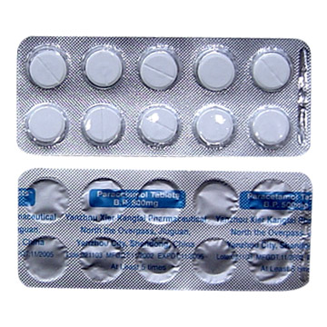
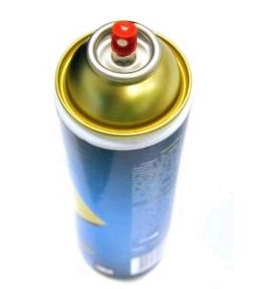
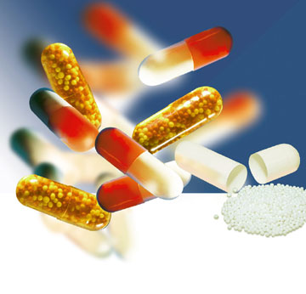
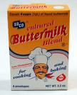
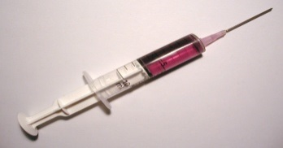
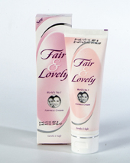
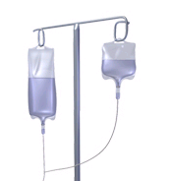
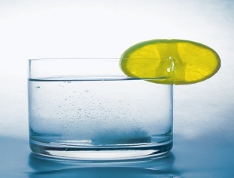
Drug dosage forms
Aerosol
Tablets
Capsule
Suspension
Injection
Solution
Cream
Infusion

Slide 10
Routes of drug administration
How the drug is given
Enteral
Parenteral (injectable)
Topical
Oral
Sublingual
Rectal
1. Intravenous
2. Intramuscular
3. Subcutaneous
Intranasal
Inhalation
Intravaginal

Slide 11
Advantages and disadvantages of various routes of drug administration
            BIOAVAILABILITY
High and Reliable
IV > IM = SC > ORAL
Low &/or Variable
ONSET OF ACTION
Immediate
IV > IM > SC > Oral
Delayed
PATIENT COMPLIANCE
High
Oral > SC > IM > IV
Low
SAFETY
High
Oral > SC > IM > IV
Low
CONVENIENCE
High
Oral > SC > IM > IV
Low
COST
High
IV > IM > SC > ORAL
Low

Slide 12
PHARMACOKINETICS
The study of what the body does to the drug
It is the study of absorption, distribution, metabolism and excretion (ADME) of drugs.
Absorption
  How the drug is moved into blood stream from the site of administration (what affects absorption?)
Distribution
  How much drug is moved to various body tissues / organs ? Depends on blood flow through tissue
Metabolism
  How the drug is altered – broken down ?
Excretion
  How much of the drug is removed from the body ?

Slide 13
bioavailability
Bioavailability is a fraction of administered dose of a drug that reaches the systemic circulation in the unchanged form.
Bioavailability of IV route : 100 %
FACTORS AFFECTING BIOAVAILABITY
  Dosage forms
  Chemical form
  Dissolution & Absorption of drug
  Route of administration
  Presence of food/drugs in GI tract
  First pass effect
  Extent of drug metabolism before reaching systemic circulation

Slide 14
Concept of Critical Threshold
MEC (Minimum Effective Concentration): The minimum level of drug concentration needed for the desired therapeutic effect to be present.
MSC (Maximum Safe Concentration): The maximum level of drug concentration above which toxic effects occurs
MTC (Minimum Toxic Concentration): The minimum level of drug concentration that produces toxic effects.
Maximal Effect: Greatest response that can be produced by a drug, above which no further response can be created (sometimes called “peak effect”)
Onset: How long before a drug is able to exert a therapeutic effect
Duration: How long a drug effect lasts

Slide 15
DRUG HALF-LIFE (t_{1/2} )
Half life is the time required to reduce the plasma concentration to 50% of its original value
Will determine dosing requirements / how long a drug will remain in the body
Used in determining dosing interval
  1 t1/2 - 50 % drug is eliminated
  2 t1/2 - 50+25 (75 %) drug is eliminated
  3 t1/2 - 50+25 +12.5 (87.5 %) drug is eliminated
  4 t1/2 - 50+25 +12.5+6.25 (93.7 %) drug is eliminated
Thus, nearly complete drug elimination occurs in 4-5 half lives.

Slide 17
DISTRIBUTION
Distribution is a branch of pharmacokinetics which describes the reversible transfer of drug from one location to another within the body.
Dosing
Dosing Interval - How often the drug should be given
Loading dose – Which puts the plasma concentration in the therapeutic range
Maintenance dose - Routine smaller doses to maintain the steady state (Plateau)

Slide 18
METABOLISM
Metabolism = change / biotransformation
The conversion from one chemical form to another
Site of drug biotransformation
    Liver - cytochrome P450 pathways OR microsomal P450 pathways are used to metabolize most agents
    Enzymatic alteration of drug structure
Effect of metabolism
  80% of drugs become inactive
  Inactive drug becomes active: Prodrug
  Some drugs do not get metabolized at all
Other drugs may induce or inhibit metabolism

Slide 19
First Pass Metabolism
The first-pass metabolism (also known as first-pass effect or presystemic metabolism) is a phenomenon of drug metabolism whereby the concentration of a drug is greatly reduced before it reaches the systemic circulation
Systems that affect the first pass effect of the drug,
  Enzymes of the gastro intestinal lumen
  Gut wall enzyme
  Bacterial enzymes
  Hepatic enzymes

Slide 20
Effect of first pass metabolism
  Part of administered dose made inactive
    ↓ bioavailability
  Drug converted into its active form
Nitroglycerin when given orally
  Totally inactivated in the liver
  100% first pass effect
  Always given sublingually

Slide 21
prodrug
Administered in an inactive form
After administration converted into their active form
  usually in liver
Designed to improve bioavailability
Examples
  Enalapril – Enalaprilate
  Ramipril - Ramiprilate

Slide 22
Elimination of drug
Drugs &/or its metabolites are irreversibly eliminated from the body
Elimination of the drug
  Unchanged (Parent form)
  Metabolites
Routes of excretion
  Kidneys – Urine
  GIT – Stools
  Skin - Perspiration
  Eyes - Tears

Slide 23
PHARMACODYNAMICS
The study of what the drug does to the body
It is the quantitative study of the biological and therapeutic effects of drugs. These are:
Drug actions:
The cellular processes involved in the drug and cell interaction
Drug effect:
The physiologic reaction of the body to the drug

Slide 24
Onset
The time it takes for the drug to elicit a
therapeutic response
Peak
The time it takes for a drug to reach its maximum therapeutic response
Duration
The time a drug concentration is sufficient to elicit therapeutic response

Slide 25
Effects of combining drugs
Addition 1 + 1 = 2
  Response elicited by combined drugs is equal to the combined response of the individual drugs
Synergism 1 + 1 = 3
  Two drugs with the same effect are given together and produce a response greater than the sum of their individual responses
Potentiation 0 + 1 = 2
  A drug which has no effect enhances the effect of a second drug
Antagonism 1 + 1 = 0
  Drug inhibits the effect of another drug. Usually, the antagonist has no inherent activity

Slide 26
Factors affecting drug response
Pharmacological
  Dose & Route of administration
  Duration of treatment
  Co-administration of other drugs
Individual
  Age & Weight
  Gender
  Pathology
  Diet

Slide 27
Indication & Contraindication
Indication:
A clinical circumstance indicating that the use of a particular intervention would be appropriate
Contraindication:
Any condition which renders a particular line of treatment improper or undesirable

Slide 28
Adverse drug reactions
Side Effect
  Unavoidable unintended pharmacodynamic effects that occur at a therapeutic dose
    Dryness of mouth with Atropine
Toxic effects
  Result of excessive pharmacological action of the drug due to over dosage or prolonged use
    Hepatic necrosis from paracetamol over dosage
Drug intolerance
  Toxic effects of a drug in an individual at therapeutic doses
    Vomiting with a single dose of salicylate
Drug tolerance
  Decreased response to the same amount of drug after repeated administration

Slide 29
Adverse drug reactions
Cross Tolerance
  Tolerance for a drug that develops after administration of a different drug
Tachyphylaxis
  Rapidly occurring tolerance to a drug.
Cumulative effect
  Increased effectiveness when a drug is given in several doses.
Drug dependence
  The patient becomes accustomed to the drug’s presence in his
  body.

Slide 30
Adverse drug reactions
Idiosyncrasy
    Drug effect unique to an individual,
    A. a toxic reaction
    B. an allergic reaction
    C. a reaction peculiar to the patient
    D. an anaphylactic reaction
Drug allergy
  Immunologically mediated reaction
  Symptoms unrelated to pharmacodynamic profile of drug
  Independent of dosage
  E.g. Penicillin
Drug withdrawal symptoms
  Functional disturbances induced by a drug Persists even after offending drug has been withdrawn
  E.g. Peptic ulcer by salicylates

Slide 31
Adverse drug reactions
Teratogenecity – induce birth defect
  Capacity of a drug to cause foetal abnormalities
    Thalidomide
Mutagenic Effect
  Mutagenesis involves alteration of the genotype by modification of the DNA
  Mutation is carried to the next generations
Photosensitivity
  Cutaneous reaction resulting from drug induced sensitization of the skin to UV radiation
  Quinolones

Slide 32
Pregnancy Considerations
Increased maternal HR, CO and blood volume
  May affect absorption, distribution, effectiveness
Drugs may cross placenta
Drugs may cross into breast milk
Teratatogens

Slide 33
Pregnancy Categories
A: controlled studies in pregnancy (<1 %).
B: animal studies show no risk; Inadequate human data.
C: animal studies show risk, inadequate human data.
D: human data show risk, benefit may outweigh risk.
X: animal or human data positive for risk. Use unwarranted.

Slide 34
Pediatric Considerations
⇓ Oral absorption
Thinner skin (⇑ topical absorption)
⇓ Plasma protein concentration
  ⇑ Free protein-bound drug availability
⇑ Extracellular fluid in neonate
Altered metabolic rates
⇓ Elimination/metabolism
BSA/weight based dosing important!

Slide 35
Geriatric Considerations
⇓ Oral absorption
⇓ Plasma protein concentration
⇓ Muscle mass, ⇑ body fat
⇓ Liver/renal function
Multiple drugs
Multiple diseases

Slide 36
FUNDAMENTALS OF PHARMACOLOGY
The rational pharmacological treatment of any patient requires adequate knowledge about :
The disease process,
Pharmacodynamic properties of the drug(s) selected, and
The individual’s handling of the drug(s) [pharmacokinetics].

Slide 37
Drugs act by affecting biochemical or physiological process in the body. Most drugs act at specific receptors.
The action of a drug is characterized by two variables:
The magnitude of the response and
The concentration required to produce the response.

Slide 38
A specific drug acts only at one receptor but may produce multiple effects due to the location of the receptor in various organs.
A selective drug acts on one receptor in a particular tissue at concentrations that produce little effect on the receptor in other organs.
Most drugs have multiple actions and it is usually preferable to use more specific or more selective agents

Slide 39
ANTI-INFECTIVE AGENTS

Slide 40
ANTIBACTERIALS

Slide 41
antibacterials
Antibacterials/antimicrobial drugs - Substances that inhibit the growth of or kill bacteria or other microorganisms (microscopic organisms = bacteria, viruses, fungi, protozoa)
Bacteriostatic = Inhibits growth of bacteria
Bactericidal = Kills bacteria
Peaks & Troughs = Serum antibacterial levels for drugs w/ a narrow therapeutic index
- Too high = drug toxicity (Peak - 1 hr. after drug infused)
- Too low = therapeutic range (Trough - before dose)

Slide 42
antibacterials
Mechanism of Action:
  1. Inhibition of cell wall synthesis - Bactericidal
  2. Alteration in membrane permeability - ‘Cidal’ or ‘Static’
  3. Inhibition protein synthesis - ‘Cidal’ or ‘Static’
  4. Inhibition of bacterial RNA & DNA - Inhibits synthesis of RNA & DNA
  5. Interferes with metabolism in the cell - ‘Static’

Slide 43
antibacterials
Pharmacodynamics -
- Concentration at site or exposure time for drug plays an important role in bacteria eradication
- Duration of time for use of antibacterial varies according to type of pathogen, site of infection & condition of host
- With some severe infections - continuous infusion more effective than intermittent
- Body defense & drugs work together to stop infectious process
- Effect = drug & host’s defense mechanisms

Slide 44
antibacterials
Bacterial Resistance - result naturally or may be acquired
* Natural (inherent) = w/o previous exposure to antibiotic
ie. pseudomonas resistant to Penicillin G
* Acquired = prior exposure to antibacterial
ie. staph aureus was sensitive to PCN G, now it’s not
Nosocomial infections - infections acquired while clients are in the hosp. Many are mutant strains resistant to many antibacterials.
Antibacterial resistance occurs when antibiotics are used frequently

Slide 45
antibacterials
Culture & Sensitivity - Bld test done to determine effect drugs have on a specific organism
Culture = organisms responsible
Sensitivity = what antibiotic will work best
Narrow & Broad Spectrum
Narrow - primarily effective against 1 type of organism
Broad - effective against both gram + & gram - organisms
* Used before isolating organism through C & S
* Not as effective as narrow spectrum against those single organisms

Slide 46
PENICILINS
From mold genus Penicillium - ‘miracle drug’ from WWII
A beta-lactum structure (beta-lactum ring) interferes w/ bacterial cell wall synthesis by inhibiting the bacterial enzyme necessary for cell division & synthesis
Bacteria die of cell lysis (breakdown)
Both ‘static’ & ‘cidal’ in nature
Mainly referred to as beta-lactum antibiotics (enzymes produced by bacteria that can inactivate PCN - Penicillinases = beta-lactamases which attack PCN

Slide 47
Antibacterials
Penicillins
Natural Penicillins
Penicillin G, Penicillin V, Procaine, Bicillin
- Good gram +, fair gram - , good anaerobic action.
- PCN G = more effective IV or IM, but painful d/t aqueous solution
- PCN V = PO; peak 2 - 4 hrs

Slide 48
Antibacterials
Penicillins
Aminopenicillins (Broad Spectrum)
Amoxicillin (Amoxil), Ampicillin, Bacampicillin HCL (Spectrobid)
- effective against both Gram + & Gram - bacteria
- Costlier
- Inactivated by beta-lactamases = ineffective against Staphylococcus aureus (staph. A)
- Amoxicillin = most prescribed PCN derivative for adults & children

Slide 49
Antibacterials
Penicillins
Penicillinase - Resistant Penicillins
Methicillin (Staphcillin), Nafcillin (Unipen), Oxacillin (Bactocil)
- Used to treat penicillinase-producing Staph A.
- Gram + , not effective against Gram -
- IV & PO

Slide 50
Antibacterials
Penicillins
Extended - Spectrum Penicillins
Carbenicillin (PO), Mezlocillin, Piperacillin, Ticarcillin, Ticarcillin-clavulanate (Timentin) - IM & IV
- Broad spectrum - good gram (-), fair gram (+)
- Good against Pseudomonas aeruginosa
- Not penicillinase resistant

Slide 51
Antibacterials
Penicillins
SE & adverse reactions of Penicillins
1. Hypersensitivity - mild or severe
Mild = rash, pruritus, & hives - Rx w/ antihistamines
Severe = anaphylactic shock - occurs w/ in 20 min. - Rx w/ epinephrine
2. Superinfection - secondary infection when normal microbial flora of the body disturbed during antibiotic Rx
Mouth, resp. tract, GI, GU or skin - usually fungus
3. Organ toxicity - esp. liver & kidneys where drugs metabolized & excreted (aminoglycosides)

Slide 52
Antibacterials
Cephalosporins
From a fungus Cephalosperium acremonium
- Gram (+) & gram (-)
- Resistant to beta - lactamase
- Bactericidal - action similar to PCN’s
- 4 groups (generations) - each effective against a broader spectrum of bacteria
- about 10% of people allergic to PCN also to allergic to cephalosporins
- Action - inhibits bacterial cell wall synthesis
- IM & IV - onset = almost immediate

Slide 53
Antibacterials
Cephalosporins
1st Generation Cephalosporins - cefadroxil (Duricef) & cephalexin (Keflex) - PO; Cefazolin (Ancef) & cephalothin (Keflin) - IM
- Gram (+), & gram (-)
- Esp. used for skin/skin structure infections
- Keflin used for resp, GI, GU, bone, & joint infections

Slide 54
Antibacterials
Cephalosporins
2nd Generation Cephalosporins - cefaclor (ceclor) - PO, cefoxitin (Mefoxin), cefuroxime (Zinacef), cefotetan (Cefotan) - IM & IV
- Gram (+), slightly boarder gram (-) effect than 1st generation
- for harder to treat infections

Slide 55
Antibacterials
Cephalosporins
3rd Generation Cephalosporins - cefotaxime (Claforan), ceftazidime (Fortaz), ceftriaxone (Rocephin), cefixime (Suprax) - IM or IV
- More effective against gram (-), less effective against gram (+)
- for harder yet to treat infections
4th Generation Cephalosporins - cefepime (Maxipime) - IV or IM
- Resistant to most beta-lactamase bacteria
- greater gram (+) coverage than 3rd generation

Slide 56
MACROLIDES
Erythromycin is a naturally-occurring macrolide derived from Streptomyces erythreus – problems with acid lability, narrow spectrum, poor GI intolerance, short elimination half-life
Structural derivatives include clarithromycin and azithromycin:
  Broader spectrum of activity
  Improved PK properties – better bioavailability, better tissue penetration, prolonged half-lives
  Improved tolerability

Slide 57
Mechanism of Action
  Inhibits protein synthesis by reversibly binding to the 50S ribosomal subunit
    Suppression of RNA-dependent protein synthesis
  Macrolides typically display bacteriostatic activity, but may be bactericidal when present at high concentrations against very susceptible organisms
  Time-dependent activity

Slide 58
Macrolides
Pharmacology
Absorption
  Erythromycin – variable absorption (15-45%); food may decrease the absorption
    Base: destroyed by gastric acid; enteric coated
    Esters and ester salts: more acid stable
  Clarithromycin – acid stable and well-absorbed, 55% bioavailable regardless of presence of food
  Azithromycin –acid stable; 38% bioavailable; food decreases absorption of capsules

Slide 59
Macrolides
Pharmacology
Distribution
  Extensive tissue and cellular distribution – clarithromycin and azithromycin with extensive penetration
  Minimal CSF penetration
Elimination
  Clarithromycin is the only macrolide partially eliminated by the kidney (18% of parent and all metabolites); requires dose adjustment when CrCl < 30 ml/min
  Hepatically eliminated: ALL
  NONE of the macrolides are removed during hemodialysis!
  Variable elimination half-lives (1.4 hours for erythro; 3 to 7 hours for clarithro; 68 hours for azithro)

Slide 60
Macrolides
Adverse Effects
Gastrointestinal – up to 33 %
  Nausea, vomiting, diarrhea, dyspepsia
  Most common with erythro; less with new agents
Cholestatic hepatitis - rare
  > 1 to 2 weeks of erythromycin estolate
Thrombophlebitis – IV Erythro and Azithro
  Dilution of dose; slow administration
Other: ototoxicity (high dose erythro in patients with RI); QTc prolongation; allergy

Slide 61
Macrolides
Drug Interactions
Erythromycin and Clarithromycin ONLY– are inhibitors of cytochrome p450 system in the liver; may increase concentrations of:
  Theophylline Digoxin, Disopyramide
  Carbamazepine Valproic acid
  Cyclosporine Terfenadine, Astemizole
  Phenytoin Cisapride
  Warfarin Ergot alkaloids

Slide 62
Macrolide Spectrum of Activity
Gram-Positive Aerobes – erythromycin and clarithromycin display the best activity
(Clarithro>Erythro>Azithro)
    Methicillin-susceptible Staphylococcus aureus
    Streptococcus pneumoniae (only PSSP) – resistance is developing
    Group A/B/C/G and viridans streptococci
    Bacillus sp., Corynebacterium sp.

Slide 63
Macrolide Spectrum of Activity
Gram-Negative Aerobes – newer macrolides with enhanced activity (Azithro>Clarithro>Erythro)
  H. influenzae (not erythro), M. catarrhalis, Neisseria sp., Campylobacter jejuni, Bordetella pertussis
  Do NOT have activity against any Enterobacteriaceae or Pseudomonas

Slide 64
Macrolide Spectrum of Activity
Anaerobes – activity against upper airway anaerobes
Atypical Bacteria – all macrolides have excellent activity against atypical bacteria including:
    Legionella pneumophila - DOC
    Chlamydia sp.
    Mycoplasma sp.
    Ureaplasma urealyticum
Other Bacteria – Mycobacterium avium complex (MAC – only A and C), Treponema pallidum, Campylobacter, Borrelia, Bordetella, Brucella. Pasteurella

Slide 65
Antibacterials
Fluoroquinolones (Quinolones)
Ciproflaxacin (Cipro), Levofloxacin (Levaquin), Ofloxacin (Floxin), Norfloxacin (Noroxin) - IV or PO
- Interferes w/ synthesis of bacterial DNA
- Bactericidal
- Broad spectrum - gram (-) & gram (+)
- Rx - UTI’s, lower resp. infections, bone & joint infections, GI, skin
- Wide safety margin
- CI - Children < 14 yrs

Slide 66
Antibacterials
Fluoroquinolones (Quinolones)
Gastrointestinal – 5 %
  Nausea, vomiting, diarrhea, dyspepsia
Central Nervous System
  Headache, agitation, insomnia, dizziness, rarely, hallucinations and seizures (elderly)
Hepatotoxicity
  LFT elevation (led to withdrawal of trovafloxacin)
Phototoxicity (uncommon with current FQs)
  More common with older FQs (halogen at position 8)
Cardiac
  Variable prolongation in QTc interval
  Led to withdrawal of grepafloxacin, sparfloxacin

Slide 67
Antibacterials
Fluoroquinolones (Quinolones)
Articular Damage
  Arthopathy including articular cartilage damage, arthralgias, and joint swelling
  Observed in toxicology studies in immature dogs
  Led to contraindication in pediatric patients and pregnant or breastfeeding women
  Risk versus benefit
Other adverse reactions: tendon rupture, dysglycemias, hypersensitivity

Slide 68
Antibacterials
Sulfonamides
One of the oldest - broad spectrum - gram - & gram +
First group of drugs used against bacteria
Bacteriostatic - inhibits bacterial synthesis of folic acid, essential for bacterial growth
Alt. for people allergic to PCN
Use - UTI’s, ear infections, newborn eye prophylaxis
- Not effective against viruses or fungi
PO, sol’n & ointment for ophthalmic use & cream
- Silver sulfadiazine (Silvadene) - for burns

Slide 69
Antibacterials
Sulfonamides
Special consideration - Drink fluids to prevent crystalluria (d/t poor water solubility) & hematuria
SE -
- allergic response - skin rash & itching
- Anaphylaxis not common
- Bld disorders w/ prolonged use & high doses
- GI disturbances
- Photosensitivity

Slide 70
Aminoglycosides
Mechanism of Action
Amikacin (Amikin), Gentamicin (Garamycin), Tobramycin (Nebcin), Netilmicin (Netromycin)
Multifactorial, but ultimately involves inhibition of protein synthesis
Irreversibly bind to 30S ribosomes
  must bind to and diffuse through outer membrane and cytoplasmic membrane and bind to the ribosome
  disrupt the initiation of protein synthesis, decreases overall protein synthesis, and produces misreading of mRNA
Are bactericidal

Slide 71
Aminoglycosides
Spectrum of Activity
Gram-Positive Aerobes
most S. aureus and coagulase-negative staph (but not DOC)
viridans streptococci (in combination with a cell-wall agent)
Enterococcus sp. (only in combination with a cell-wall agent)
Gram-Negative Aerobes (not streptomycin)
E. coli, K. pneumoniae, Proteus sp.
Acinetobacter, Citrobacter, Enterobacter sp.
Morganella, Providencia, Serratia, Salmonella, Shigella
Pseudomonas aeruginosa (amik>tobra>gent)
Mycobacteria
  tuberculosis - streptomycin
  atypical - streptomycin or amikacin

Slide 72
Aminoglycosides
Pharmacology
Absorption - poorly absorbed from gi tract
Distribution
  primarily in extracellular fluid volume; are widely distributed into body fluids but NOT the CSF
  distribute poorly into adipose tissue, use LBW for dosing
Elimination
  eliminated unchanged by the kidney via glomerular filtration; 85-95% of dose
  elimination half-life dependent on renal fxn
    normal renal function - 2.5 to 4 hours
    impaired renal function - prolonged

Slide 73
Aminoglycosides
Adverse Effects
Nephrotoxicity
  nonoliguric azotemia due to proximal tubule damage; increase in BUN and serum Cr; reversible if caught early
  risk factors: prolonged high troughs, long duration of therapy (> 2 weeks), underlying renal dysfunction, elderly, other nephrotoxins
Ototoxicity
  8th cranial nerve damage - vestibular and auditory toxicity; irreversible and saturable
  vestibular: dizziness, vertigo, ataxia
  auditory: tinnitus, decreased hearing
  risk factors: same as for nephrotoxicity

Slide 74
Antibacterials
Tetracyclines
Tetracycline, Doxycycline (Vivbamycin), Minocycline (Minocin)
- Broad spectrum - Gram (+) & gram (-) bacteria
- Bacteriostatic
- Wide safety margin, but many side effects
- Primarily used for skin/skin structure infections
- Also used to treat Helicobacter pylori (H. pylori) - bacterium in stomach that can cause peptic ulcers
- Tetracycline mostly

Slide 75
Antibacterials
Tetracyclines
Considerations
- SE = Photosensitivity - sunburn rxn
- Should not be given to children < 8 yrs or to women in last trimester of pregnancy - Irreversibly discolors permanent teeth
- Tetracycline during 1st trimester of pregnancy can cause birth defects
- Take on an empty stomach - antacids & dairy products prevent absorption of the drug

Slide 76
Antibacterials
Vancomycin
Glycopeptide bactericidal antibiotic - IV
- Use: Drug resistant Staph A., cardiac surgery -
prophylaxis for clients w/ PCN allergies
- SE = Ototoxicity - damage to auditory branch of 8th cranial nerve permanent hearing loss or loss of balance & Nephrotoxicity
- Serum Vanco levels drawn to minimize toxic effects

Slide 77
Vancomycin
Clinical Uses
Infections due to methicillin-resistant staph including bacteremia, empyema, endocarditis, peritonitis, pneumonia, skin and soft tissue infections, osteomyelitis
Serious gram-positive infections in β-lactam allergic patients
Infections caused by multidrug resistant bacteria
Endocarditis or surgical prophylaxis in select cases
Oral vancomycin for refractory C. difficile colitis

Slide 78
Antibacterials
Lincosamides
Clindamycin (Cleosin), Lincomycin (Lincorex) - PO, IM, IV
- Inhibit bacterial protein synthesis
- ‘Static’ & ‘cidal’ actions depending on drug dosage
- effective against most gram (+), no gram (-)
- Clindamycin more effective than lincomycin

Slide 79
Antibiotics and pregnancy
FDA Category | Antibiotics in Category
A
B | Penicillins, Cephalosporins, Carbapenems (except Imipenem), Daptomycin, Vancomycin (oral), Clindamycin, Erythromycin, Azithromycin, Metronidazole (avoid first trimester), Nitrofurantoin, Acyclovir, Amphoterocin B, Ethambutol
C | Quinolones, Chloramphenicol, Clarithromycin, Imipenem, Linezolid, Trimethoprim/Sulfa (D if used near term), Vancomycin (IV), Rifampin, INH, PZA, PAS, Fluconazole, Caspofungin
D | Tetracyclines (Doxy, Tige, Mino), Voriconazole, Aminoglycosides (some put gentamicin as a category C)
X | Ribavarin

Slide 81
Antitubercular Agents

Slide 82
Antitubercular Agents
Tuberculosis, “TB” Caused by Mycobacterium is tuberculosis.
Antitubercular agents treat all forms of mycobacterium infections.
Common TB Infection Sites
  lung (primary site)
  brain
  bone
  liver
  Kidney
  Spine

Slide 83
Mycobacterium Infections
Common Infection Sites
lung (primary site)
brain
bone
liver
kidney

Slide 84
Mycobacterium Infections
Aerobic bacillus
Passed from infected:
  Humans
  Cows (bovine)
  Birds (avian)

Slide 85
Mycobacterium Infections
Tubercle bacilli are conveyed by droplets.
Droplets are expelled by coughing or sneezing,
then gain entry into the body
by inhalation.
Tubercle bacilli then spread to other body organs
via blood and lymphatic systems.
Tubercle bacilli may become dormant, or walled
off by calcified or fibrous tissue.

Slide 86
Antituberculosis Drugs
First-Line Drugs
Second-Line Drugs
Isoniazid
Rifampin
Pyrazinamide
Ethambutol
Rifabutin*
Rifapentine
Streptomycin
Cycloserine
p-Aminosalicylic acid
Ethionamide
Amikacin or kanamycin*
Capreomycin
Levofloxacin*
Moxifloxacin*
Gatifloxacin*
* Not approved by the U.S. Food and Drug Administration for use in the treatment of TB

Slide 87
Drug Abbreviations
Ethambutol EMB
Isoniazid INH
Pyrazinamide PZA
Rifampin RIF
Rifapentine RPT
Streptomycin SM

Slide 88
Antitubercular Agents:
Mechanism of Action
Three Groups
Protein wall synthesis inhibitors streptomycin, kanamycin, capreomycin, rifampin, rifabutin
Cell wall synthesis inhibitors cycloserine, ethionamide, isoniazid
Other mechanisms of action

Slide 89
Antitubercular Agents:
Therapeutic Uses
Used for the prophylaxis
or treatment of TB

Slide 90
Treatment Regimens
Four regimens recommended for treatment of culture-positive TB, with different options for dosing intervals in continuation phase
Initial phase: standard four drug regimens (INH, RIF, PZA, EMB), for 2 months, (except one regimen that excludes PZA)
Continuation phase: additional 4 months or (7 months for some patients)

Slide 91
Why Extend Continuation-Phase Treatment for 3 Months?
Cavitary disease and positive sputum culture at 2 months associated with increased relapse in clinical trials
Extended continuation phase decreased relapses in silicotuberculosis (from 20% to 3%)

Slide 92
When to Extend Continuation-Phase Treatment for 3 Months?
Cavitary pulmonary disease and positive sputum cultures at completion of initial phase
Initial phase excluded PZA
Once-weekly INH and rifapentine started in continuation phase and sputum specimen collected at the end of initial phase is culture positive
HIV-infected with positive 2-month sputum culture

Slide 93
Antitubercular Therapy
Effectiveness depends upon:
Type of infection
Adequate dosing
Sufficient duration of treatment
Drug compliance
Selection of an effective drug combination

Slide 94
Antitubercular Agents: Side Effects
INH
peripheral neuritis, hepatotoxicity
ethambutol
retrobulbar neuritis, blindness
rifampin
hepatitis, discoloration of urine, stools

Slide 95
Antitubercular Agents:
Nursing Implications
Obtain a thorough medical history and assessment.
Perform liver function studies in patients
who are to receive isoniazid or rifampin
(especially in elderly patients or those who use alcohol daily).
Assess for contraindications to the various agents, conditions for cautious use, and potential drug interactions.

Slide 96
Antitubercular Agents:
Nursing Implications
Patient education is CRITICAL:
Therapy may last for up to 24 months.
Take medications exactly as ordered,
at the same time every day.
Emphasize the importance of strict compliance
to regimen for improvement of condition or cure.

Slide 97
Antitubercular Agents:
Nursing Implications
Patient education is CRITICAL:
Remind patients that they are contagious during
the initial period of their illness—instruct in proper hygiene and prevention of the spread of infected droplets.
Emphasize to patients to take care of themselves, including adequate nutrition and rest.

Slide 98
Antitubercular Agents:
Nursing Implications
Patients should not consume alcohol while on these medications nor take other medications, including OTC, unless they check with their physician.
Diabetic patients taking INH should monitor their blood glucose levels because hyperglycemia may occur.
INH and rifampin cause oral contraceptives to become ineffective; another form of birth control
will be needed.

Slide 99
Antitubercular Agents: Nursing Implications
Patients who are taking rifampin should be told that their urine, stool, saliva, sputum, sweat, or tears may become reddish-orange; even contact lenses may be stained.
Vitamin B₆ may is needed to combat peripheral neuritis associated with INH therapy.
Monitor for side effects
Instruct patients on the side effects that should be reported to the physician immediately.
These include fatigue, nausea, vomiting, numbness and tingling of the extremities, fever, loss of appetite, depression, jaundice.

Slide 100
Antitubercular Agents: Nursing Implications
Monitor for therapeutic effects:
Decrease in symptoms of TB, such as cough
and fever
Lab studies (culture and sensitivity tests)
and CXR should confirm clinical findings
Watch for lack of clinical response to therapy, indicating possible drug resistance

Slide 101
Antiviral agents

Slide 102
ANTIVIRAL AGENTS
Viruses are obligate intracellular parasites and therefore antiviral agents must either inhibit the entry of virus into the cell, prevent replication inside the cell or prevent the exit of virions out of the sale.
In the process of their interfering with the process of viral replication, these agents can interfere with host cell function leading to toxicity

Slide 103
acyclovir
An acyclic guanosine derivative
Works by inhibiting DNA synthesis in two ways:
  Competition with deoxyGTP for the viral DNA polymerase and
  Chain termination following incorporation into the viral DNA.
Acyclovir is cleared by glomerullar filtration and tubal secretion. Accumulation occurs in patients with impaired renal function
Side effects includes nausea, reversible renal or neurologic (delirium, tremors, seizures) headache, diarrhea,

Slide 104
Drugs related to acyclovir and with similar mode of action include
  Valacyclovir - valgancyclovir
  Famcyclovir
  Pencyclovir
  ganciclovir
Clinical use:
  Herpes simplex infections treatment
  Varicella-zoster virus infection treatment
  CMV infections treatment
  Epstein-Barr virus infections treatment

Slide 105
docosanol
It is a 22-carbon saturated aliphatic alcohol.
Works by inhibiting fusion between virus and plasma membrane and thus prevents entry of virus into the cell.
Used in treatment of HSV infections as a topical application

Slide 106
trifluridine
It is a fluorinated nucleoside.
Works by inhibiting viral DNA synthesis
Trifluridine can be incorporated into both host and viral DNA and this prevents its systemic use.
Used in treatment of HSV1 and 2, CMV, vaccinia and adenovirus infections

Slide 107
foscarnet
Phosphonoformic acid that inhibits viral DNA and RNA polymerase and HIV reverse transcriptase.
Used in treatment of HSV, VZV, CMV, EBV, HHV6&8, and HIV 1.
Adverse effects includes renal impairment, hyper or hypocalcaemia, hypo or hypephosphatemia, hypokalemia or hypomagnesemia

Slide 108
cidofovir
It is an acyclic cytosine nucleotide analog.
Works by inhibiting DNA synthesis and becoming incorporated into viral DNA chain.
Has activity against CMV, HSV 1&2, VZV, EBV, HHV-6, HHV-8, adenovirus, poxvirus, and human papilloma virus.
Adverse effects include dose-dependent proximal tube nephrotoxicity, proteinuria, azotemia, metabolic acidosis and Fanconi’s syndrome.

Slide 110
Antiretroviral agents

Slide 111
Nucleoside and nucleotide reverse transcriptase inhibitors.
Retrovirus have an enzyme reverse transcriptase, which transcribes viral RNA into a DNA so that the virus can make use of host DNA polymerase to make copies of viral RNA and messenger RNAs for protein synthesis.
Nucleotide and nucleoside reverse transcriptase inhibitors works by getting incorporated into growing viral DNA chain resulting in premature termination.

Slide 112
a) abacavir.
It is a guanosine analog
Hypersensitivity reactions occurs in btn 3-5% patients and presents with symptoms such as fever, malaise, nausea, vomiting, diarrhea, dyspnea, rash and cough.
Should be used with care on patients with existing cardiac risk factors.

Slide 113
b) didanosine
A synthetic analogue of deoxyadenosine.
Drug eliminated by cellular metabolism and renal excretion.
Adverse effects include pancreatitis, peripheral neuropathy, diarrhea, hepatitis, cardiomyopathy, headache, insomnia and irritability.
Contraindicated in patients with increased risk for pancreatitis

Slide 114
c) emtricitabine
This is a fluorinated analog of lamivudine with longer half-life.
Once daily dosing is possible
Common side effects include: headache, diarrhea, nausea and asthenia.
Contraindicated in children, pregnant women, patient with renal or hepatic impairement and those using metronidazole or disulfiram.

Slide 115
d) Lamivudine (3TC)
A cytosine analog.
Shows synergy with zidovudine and stavudine.
Has good oral bioavailability that is not affected by food.
Adverse effects includes headache, dizziness, insomnia and GI discomfort
Its bioavailabity increases when co-adminstered with trimethoprim-sulfamethoxazole.
Shld not be administered together with zalcitabine.(why?)

Slide 116
e) stavudine
A thymidine analog
Has good bioavailability following oral administration which is not affected by food.
Has dose-limiting peripheral sensory neuropathy. This is more pronounced in patients taking other neuropathy inducing drugs and those with advanced immunosupression.
other adverse effects are pancreatitis, arthralgia, lactic acidosis, and hepatic steatosis.

Slide 117
f) tenofovir
An adenosine analog.
Often administered in combination with emtricitabine.
GI complaints are the most common adverse effects but don’t merit discontinuation.

Slide 118
g) zidovudine
A deoxythymidine analog.
Used widely in PMTCT
Shown to decrease the disease progression rate and increase survival rate in HIV infected patients.
Common adverse effects includes; myelosupression, gastrointestinal intolerance, headache and extremity fat loss
NB. READ AND MAKE NOTES ON ZALCITABINE AND DRUGS THAT INTERACTS WTH ZIDOVUDINE

Slide 119
Nonnucleoside reverse transcriptase inhihitors
These agents bind directly to HIV-1 reverse transcriptase, resulting in allosteric inhibition of RNA – and DNA- dependent DNA polymerase.

Slide 120
a) nevirapine
Has excellent oral bioavailability
Metabolized in the liver and excreted in the urine
Used widely in PMTCT
Adverse effects includes rash, elevated liver enzymes, fever, nausea, vomiting, headache and somnolence
Induces enzymes and thus increases metabolism of rifampicin and tipranavir. Fluconazole, ketoconazole and clarithromycin increase serum concentration of nevirapine

Slide 121
b) efavirenz
Has moderate bioavailability PO that increases when taken with fatty food and thus shld be taken on empty stomach to prevent toxicity.
Adverse effects include dizziness, drowsiness, insomnia, headache, depression, mania,and psychosis.
Shld be avoided in pregnancy—risk of abnormalities.

Slide 122
c) delavirdine
Its PO bioavailability reduced by antacids and H2 receptor blockers.
Shld not be used together with rifabutin and fosamprenavir because they decrease the level of delavirdine.
Adverse effects include skin rash, headache, fatigue, nausea, diarrhea, and has been shown to be teratogenic in rats and thus, contraindicated in pregnancy.
NB: READ ON ETRAVIRINE.

Slide 123
PROTEASE INHIBOTORS
Protease is an enzyme that cleaves virion proteins from their precusor molecules.
Protease inhibitors works by preventing the processing of viral proteins into functional conformations.
Protease inhibitors include:
  Atazanavir -Darunavir
  Fosamprenavir -Indinavir
  Lopinavir -Nelfinavir
  Ritonavir -Saquinavir
  tipranavir

Slide 124
Viruses rapidly acquire resistance against these agents and thus monotherapy is contraindicated.
They causes central obesity, buffalo hump, peripheral and facial wasting, breast enlargement and cushingoid syndrome.

Slide 125
ENTRY INHIBITORS
These agents prevents binding of viral glycoprotein gp 160 complex to cellular CD-4 receptor or co-receptors CCR5 and CXCR4
EXAMPLES
Maraviroc- binds on CCR5blocking access of virus to these receptors. Adverse effects include cough, URTIs, muscle and joints pains, diarrhea, sleep disturbance and hepatotoxicity
Enfuvirtide- binds on gp 41 preventing viral fusion with plasma membrane. Adverse effects include eosinophalia, injection site reactions, hypersensitivity.

Slide 126
Antifungal agents

Slide 127
Systemic antifungal drugs
Amphotericin B
This is an amphoteric polyene macrolide antibiotic produced by Streptomyces nodosus.
It is poorly absorbed PO and thus it is administered intravenously.
Mechanism of action: binds to ergosterol and forms ampotericin-B associated pores that alters permeability of the fungal cells. This causes leakage of intracellular ions and eventual fungal death.

Slide 128
It is used in treatment of infections caused by candida albicans, Cryptococcus neoformans, aspergillus fumigatus, coccidioides immitis, blastomyces dermatitidis etc
Adverse effects
  Infusion-related toxicity- fever, chills, musclespasms, vomiting, headache and hypotension.
  Cumulative toxicity- renal damage, abnormalities of liver function tests.

Slide 129
azoles.
These are sythentic compounds that contain nitrogen on a five-membered azole ring.
They work by unhibiting ergosterol synthesis, a component of fungal cell wall.
The azoles are used in treatment of infections by C. neoformans, blastomycosis, coccidiomycosis, histoplasmosis, dermatophytosis, and appergillosis.

Slide 130
The drugs in this group are:
  Ketoconazole - itraconazole
  Fluconazole - voriconazole
  Posaconazole - miconazole
  Clotrimazole
Fluconazole has good penetration of blood-brain barrier and thus used in treatment of fungal meningitis.

Slide 131
Echinocandins
The drugs in this class includes caspofungin, micafungin and anidulafungin.
Are only available in intravenous formulations.
Works by inhibiting synthesis of fungal beta(1-3)-glucan with eventual disruption of cell wall.
Are well tolerated with few adverse effects that includes GI disturbance, flushing and elevated liver enzymes

Slide 132
Griseofulvin
It is a fungistatic drug that is deposited in newly forming skin cells and thus, prevents their infection.
It is administered for long period (2-6 weeks) to allow replacement of infected structures with new ones.
Adverse effects include serum like sickness and hepatitis.

Slide 133
Nystatin
Nystatin is a polyene macrolide like amphotericin B but it is too toxic to be administered parentally and thus, used topically only.
Mechanism of action similar to amphoterin B.
Indicated for oropharengeal thrush, vaginal candidiasis and intertrigenous fungal infections

Slide 134
allylamines.
Agents in this includes terbinafine and naftifine.
They works by preventing synthesis of fungal cell membrane.
They are used in treatment of mucocutaneous fungal infections.
Common side effects includes GI upset, headache and hepatotoxicity.

Slide 136
Antimalarial, Antiprotozoal, and Antihelmintic Agents

Slide 137
Protozoal Infections
Parasitic protozoa: live in or on humans
malaria
leishmaniasis
amebiasis
giardiasis
trichomoniasis

Slide 138
Malaria
Caused by the plasmodium protozoa.
Four different plasmodium species.
Cause: the bite of an infected adult mosquito.
Can also be transmitted by infected individuals via blood transfusion, congenitally, or via infected needles by drug abusers.

Slide 139
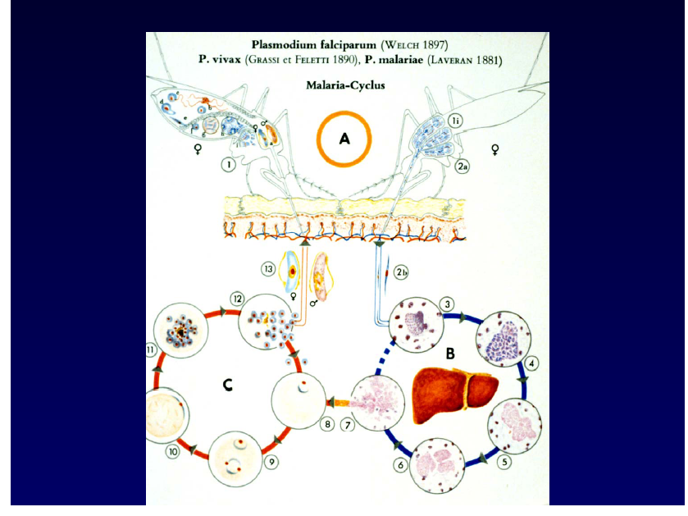

Slide 140
Malarial Parasite (plasmodium)
Two Interdependent Life Cycles
Sexual cycle: in the mosquito
Asexual cycle: in the human
  Knowledge of the life cycles is essential in understanding antimalarial drug treatment.
  Drugs are only effective during the asexual cycle.

Slide 142
Plasmodium Life Cycle
Asexual cycle: two phases
Exoerythrocytic phase: occurs “outside” the erythrocyte
Erythrocytic phase: occurs “inside” the erythrocyte
  Erythrocytes = RBCs

Slide 143
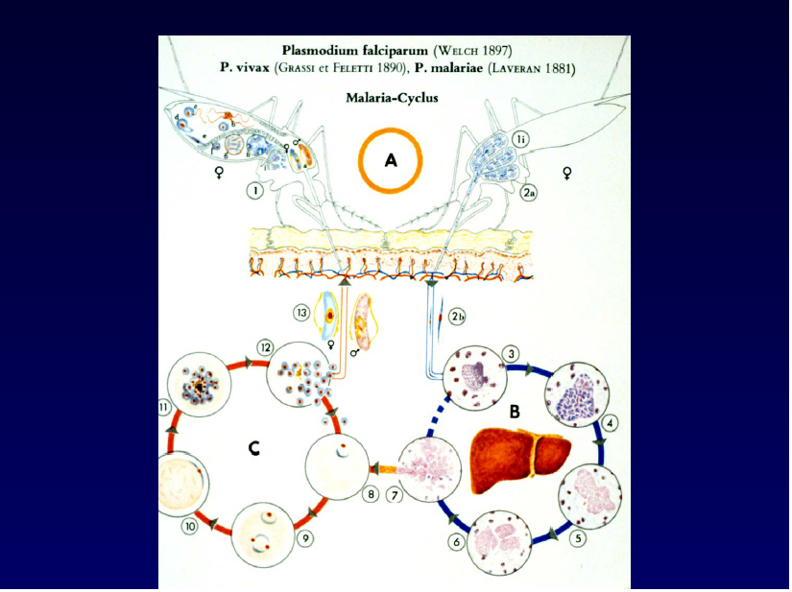

Slide 144
Antimalarial Agents
Attack the parasite during the asexual phase, when it is vulnerable
Erythrocytic phase drugs: chloroquine, hydroxychloroquine, quinine, mefloquine
Exoerythrocytic phase drug: primaquine
May be used together for synergistic or additive killing power.

Slide 145
Antimalarials:
Mechanism of Action
4-aminoquinoline derivatives chloroquine
and hydroxychloroquine
Bind to parasite nucleoproteins and interfere with protein synthesis.
Prevent vital parasite-sustaining substances from being formed.
Alter pH within the parasite.
Interfere with parasite’s ability to metabolize and
use erythrocyte hemoglobin.
Effective only during the erythrocytic phase

Slide 146
Antimalarials: Mechanism of Action
4-aminoquinoline derivatives quinine and mefloquine
Alter pH within the parasite.
Interfere with parasite’s ability to metabolize and use erythrocyte hemoglobin.
Effective only during the erythrocytic phase.

Slide 147
Antimalarials: Mechanism of Action
diaminophyrimidines pyrimethamine and trimethoprim
Inhibit dihydrofolate reductase in the parasite.
This enzyme is needed by the parasite to make essential substances.
Also blocks the synthesis of tetrahydrofolate.
These agents may be used with sulfadoxine or dapsone
for synergistic effects.

Slide 148
Antimalarials: Mechanism of Action
primaquine
Only exoerythrocytic drug.
Binds and alters DNA.
sulfonamides, tetracyclines, clindamycin
Used in combination with antimalarials to increase protozoacidal effects

Slide 149
Antimalarials: Drug Effects
Kill parasitic organisms.
Chloroquine and hydroxychloroquine also have antiinflammatory effects.

Slide 150
Antimalarials: Therapeutic Uses
Used to kill plasmodium organisms, the parasites that cause malaria.
The drugs have varying effectiveness on
the different malaria organisms.
Some agents are used for prophylaxis against malaria.
Chloroquine is also used for rheumatoid arthritis and lupus.

Slide 151
Antimalarials: Side Effects
Many side effects for the various agents
Primarily gastrointestinal: nausea, vomiting, diarrhea, anorexia, and abdominal pain

Slide 152
Antiprotozoals
atovaquone (Mepron)
metronidazole (Flagyl)
pentamidine (Pentam)
iodoquinol (Yodoxin, Di-Quinol)
paromomycin (Humatin)

Slide 153
Protozoal Infections
amebiasis
giardiasis
pneumocystosis
toxoplasmosis
trichomoniasis

Slide 154
Protozoal Infections
Transmission
Person-to-person
Ingestion of contaminated water or food
Direct contact with the parasite
Insect bite (mosquito or tick)

Slide 155
Antiprotozoals: Mechanism of Action and Uses atovaquone (Mepron)
Protozoal energy comes from the mitochondria
Atovaquone: selective inhibition of mitochondrial electron transport
Result: no energy, leading to cellular death
  Used to treat mild to moderate P. carinii

Slide 156
Antiprotozoals: Mechanism of Action and Uses metronidazole
Disruption of DNA synthesis as well as nucleic acid synthesis
Bactericidal, amebicidal, trichomonacidal
  Used for treatment of trichomoniasis, amebiasis, giardiasis, anaerobic infections, and antibiotic-associated pseudomembranous colitis

Slide 157
Antiprotozoals: Mechanism of Action and Uses pentamidine
Inhibits DNA and RNA
Binds to and aggregates ribosomes
Directly lethal to Pneumocystis carinii
Inhibits glucose metabolism, protein and RNA synthesis, and intracellular amino acid transport
  Mainly used to treat P. carinii pneumonia
  and other protozoal infections

Slide 158
Antiprotozoals: Mechanism of Action and Uses iodoquinol (Yodoxin, Di-Quinol)
“Luminal” or “contact” amebicide
Acts primarily in the intestinal lumen of the infected host
Directly kills the protozoa
  Used to treat intestinal amebiasis

Slide 159
Antiprotozoals: Mechanism of Action and Uses paromomycin
“Luminal” or “contact” amebicide
Kills by inhibiting protein synthesis
  Used to treat amebiasis and intestinal protozoal infections, and also adjunct therapy in management of hepatic coma

Slide 160
Antiprotozoals: Side Effects
atovaquone
nausea, vomiting, diarrhea, anorexia
metronidazole
metallic taste, nausea, vomiting, diarrhea,
abdominal cramps
iodoquinol
nausea, vomiting, diarrhea, anorexia, agranulocytosis

Slide 161
Antiprotozoals: Side Effects
pentamidine
bronchospasms, leukopenia, thrombocytopenia, acute pancreatitis, acute renal failure, increased liver function studies
paromomycin
nausea, vomiting, diarrhea, stomach cramps

Slide 162
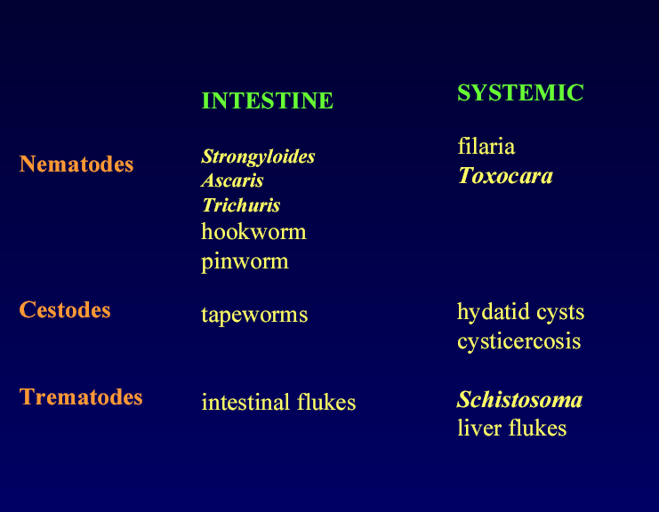
Antihelmintic drugs

Slide 163
Roundworm characteristics
Round in cross section
Digestive system complete – mouth to anus
Acellular cuticle
Four larval stages
Subcuticular layer of muscle
Separate sexes
Terms: egg (ova)
embryo
larva
adult

Slide 164
Antihelmintics
diethylcarbamazine (Hetrazan)
mebendazole (Vermox)
niclosamide (Niclocide)
oxamniquine (Vansil)
piperazine (Vermizine)
praziquantel (Biltricide)
pyrantel (Antiminth)
thiabendazole (Mintezol)

Slide 165
Antihelmintics
Drugs used to treat parasitic worm infections: helmintic infections
Unlike protozoa, helminths are large and have complex cellular structures
Drug treatment is very specific

Slide 166
Antihelmintics
It is VERY IMPORTANT to identify the causative worm
Done by finding the parasite ova or larvae in feces, urine, blood, sputum, or tissue
  cestodes (tapeworms)
  nematodes (roundworms)
  trematodes (flukes)

Slide 167
Antihelmintics: Mechanism of Action and Uses
diethylcarbamazine (Hetrazan)
Inhibits rate of embryogenesis
thiabendazole (Mintezol)
Inhibits the helminth-specific enzyme, fumarate reductase
  Both used for nematodes
  (tissue and some roundworms)

Slide 168
Antihelmintics: Mechanism of Action
piperazine and pyrantel
Blocks acetylcholine at the neuromuscular junction, resulting in paralysis of the worms, which are then expelled through the GI tract
  Used to treat nematodes (giant worm and pinworm)

Slide 169
Antihelmintics: Mechanism of Action
mebendazole (Vermox)
Inhibits uptake of glucose and other nutrients, leading to autolysis and death of the parasitic worm
  Used to treat cestodes and nematodes

Slide 170
Antihelmintics: Mechanism of Action
niclosamide (Niclocide)
Causes the worm to become dislodged
from the GI wall
They are then digested in the intestines
and expelled
  Used to treat cestodes

Slide 171
Antihelmintics: Mechanism of Action
oxamniquine and praziquantel
Cause paralysis of worms’ musculature and immobilization of their suckers
Cause worms to dislodge from mesenteric veins
to the liver, then killed by host tissue reactions
  Used to treat trematodes, cestodes
  (praziquantel only)

Slide 172
Antihelmintics: Side Effects
niclosamide, oxamniquine, praziquantel, thiabendazole, piperazine, pyrantel
nausea, vomiting, diarrhea, dizziness, headache
mebendazole
diarrhea, abdominal pain, tissue necrosis

Slide 173
Antimalarial, Antiprotozoal, Antihelmintic Agents: Nursing Implications
Before beginning therapy, perform a thorough health history and medication history, and assess for allergies.
Check baseline VS.
Check for conditions that may contraindicate use, and for potential drug interactions.

Slide 174
Antimalarial, Antiprotozoal, Antihelmintic Agents: Nursing Implications
Some agents may cause the urine to have an asparagus-like odor, or cause an unusual skin odor, or a metallic taste; be sure to warn the patient ahead of time.
Administer ALL agents as ordered and for the prescribed length of time.
Most agents should be taken with food to reduce GI upset.

Slide 175
Antimalarial Agents:
Nursing Implications
Assess for presence of malarial symptoms.
When used for prophylaxis, these agents should be started 2 weeks before potential exposure to malaria, and for 8 weeks after leaving the area.
Medications are taken weekly, with 8 ounces of water.

Slide 176
Antimalarial Agents:
Nursing Implications
Instruct patient to notify physician immediately if ringing in the ears, hearing decrease, visual difficulties, nausea, vomiting, profuse diarrhea, or abdominal pain occur.
Alert patients to the possible recurrence of the symptoms of malaria so that they will know to seek immediate treatment.

Slide 177
Antimalarial, Antiprotozoal, Antihelmintic Agents: Nursing Implications
Monitor for side effects:
Ensure that patients know the side effects that should be reported.
Monitor for therapeutic effects and adverse effects with long-term therapy.

Slide 178
Cytotoxic drugs
c

Slide 179
Non-steroidal anti-inflammatory drugs

Slide 180
ANTI-INFLAMMATORY DRUGS
A class of drugs that lower inflammation and that includes NSAIDs and DMARDs.

Slide 181
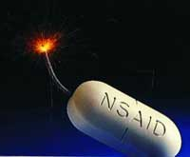
Pharmacokinetic
Oral administration
Most metabolized in liver (oxidation & conjugation)
95% bound to plasma-protein (high bioavailability)
Most NSAIDs are weak acid (absorbed well in stomach and intestinal mucosa)

Slide 182

MECHANISM OF ACTION OF NSAIDS

Slide 183
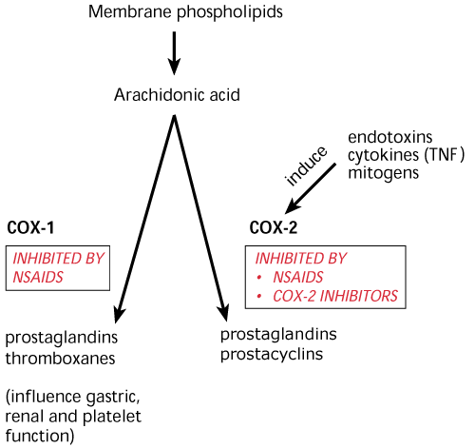

Slide 184
NON- SLECTIVE -NON -STEROIDAL ANTI-INFLAMMATORY DRUGS
Are group of drugs that share in common the capacity to induce:
Analgesic effect.
Antipyretic effect.
Anti-inflammatory effect.
Antiplatelet effect

Slide 185
Mechanism Of Action
Analgesic
Inhibition of COX enzymes in CNS
Anti-Inflammatory action
Antipyretic
Centrally inhibiting Prostaglandins
Inhibit interleukin-1 release
Anti-Inflam.
Peripherally inhibiting Prostaglandins secretion
Stabilization of lysosomes
Inhibits phagocytosis
Anti-oxidant
Peripheral vasodilation
production

Slide 186
Mechanism Of Action ( continue)
Antiplatelet
Inhibition of platelet COX₁ enzyme & TXA₂

Slide 187
NSAIDs
Prostaglandins
pGE2 pGF2
Inflammatory factors
+
Bradrkinin
Histamine
5-HT
Symptoms of inflammation
block prostaglandins production
Sites of action: peripheral tissue
Red, swelling,
Heating, Pain

Slide 188
Anti-inflammatory Effects
Reduced synthesis:
--eicosanoid mediators
Interference:
--kallikrein system mediators
--inhibits granulocyte adherence
--stabilizes lysosomes
--inhibits leukocyte migration
Notes:
Kallikrein [生化][药]激肽释放酶

Slide 189
Systemic effects of NSAIDS
Effect on GIT
Inhibition of PGI₂ & PGE₂ & PGF₂ resulting in gastric upset up to gastric ulceration & bleeding

Slide 190
Continue
Kidney
Inhibit PGE₂ & PGI₂ resulting in salt & water retention , edema , hyperkalemia & interstitial nephritis

Slide 191
Continue
Respiratory system
With aspirin
High dose act directly on respiratory center causing hyperventilation & respiratory alkalosis
Toxic doses causing central respiratory paralysis& respiratory acidosis

Slide 192
COMMON USES AMONGST NSAIDS
Fever.
Analgesic (Type of pain?)
Headache, Migraine,
Dental pain
Common cold.

Slide 193
Continue
Rheumatic / Rheumatoid arthritis
Dysmenorrhea
Muscular pain

Slide 194
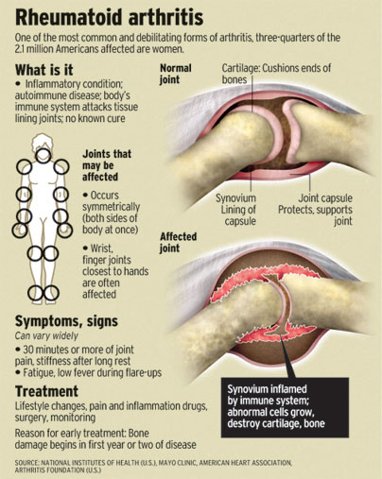

Slide 195
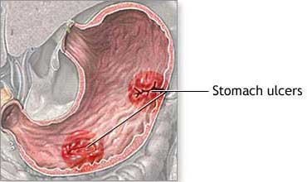
ADVERSE EFFECTS
GIT upsets ( nausea, vomiting)
GIT bleeding & ulceration
Bleeding
Hypersensitivity reaction
Inhibition of uterine
contraction
Salt & water retention

Slide 196
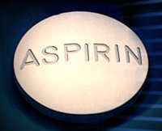

Slide 197
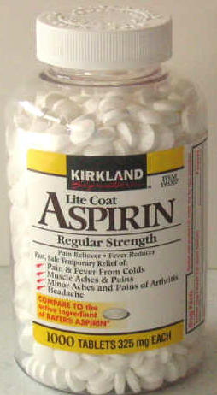
Clinical uses
Acute rheumatic fever
Reducing the risk of myocardial infarction
Prevention of pre-eclampsia

Slide 198
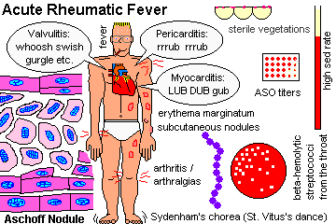

Slide 199
Adverse Effects Related to (A)Therapeutic Doses Of Aspirin
Gastric irritation
Hypersensitivity
( aspirin asthma)
Acute Gouty arthritis
Reye's syndrome

Slide 200
(B) TO high doses &prolonged use of aspirin
Salicylism ( ringing of ears (tinnitus), vertigo)
Hyperthermia
Gastric ulceration & bleeding
Metabolic acidosis

Slide 201
Contraindications
Peptic ulcer
Pregnancy
Hemophilic patients
Patients taking anticoagulants
Children with viral infections
Gout ( small doses )

Slide 202
PARACETAMOL
Also known as acetaminophen
A commonly used analgesic antipyretic instead of aspirin in cases of :
Peptic or gastric ulcers.
Bleeding tendency.
Allergy to aspirin.
Viral infections in children .
Pregnancy.

Slide 203
Adverse Effects
Mainly on liver due to its active metabolites
Therapeutic doses elevate liver enzymes
High doses cause liver & kidney necrosis
Treatment toxicity of paracetamol:
N- acetylcysteine to neutralize the toxic metabolites

Slide 204
Propionic acid derivatives
IBUPROFEN

Slide 205
Clinical uses
Therapeutic uses shared by NS- NSAIDs
Acute gouty arthritis
Patent ductus arteriosus
More potent as an anti-inflammatory than aspirin

Slide 206
Preparations of Ibuprofen
Oral preparations.
Topical cream for osteoarthritis.
A liquid gel for rapid relief of postsurgical dental pain.
Intravenous route as In patent ductus arteriosus

Slide 207
Adverse effects
Adverse effects shared by NS-NSAIDs
(Gastric upset less frequent than aspirin)
Rare hematologic effects (agranulocytosis & aplastic anemia ).
Ocular disturbance

Slide 208
Contraindications
Peptic ulcer
Allergic patients to aspirin
Kidney impairment
Liver diseases
Pregnancy
Haemophilic patients
The concomitant administration of ibuprofen antagonizes the irrevesible platelet inhibition of aspirin( limit cardioprotective effect of aspirin ).

Slide 209
Oxicam derivatives
Piroxicam
Tenoxicam

Slide 210
Piroxicam
Half- Life 45 hours
Given once daily
Adverse effects
Less frequent gastric upset (20%) .
Dizziness
Tinnitus
Headache
Allergy

Slide 211
Acetic acid derivatives
Diclofenac

Slide 212
Preparations of Diclofenac
Diclofenac with misoprostol decreases upper gastrointestinal ulceration ,but result in diarrhea.
Diclofenac with omeprazole to prevent recurrent bleeding.
.1% ophthalmic preparation for postoperative ophthalmic inflammation.
A topical gel 3% for solar keratosis.
Rectal suppository
Oral mouth wash.
Intramuscular preparations.

Slide 213
Clinical uses shared by Ns-NSAIDs
Acute gouty arthritis
Locally to prevent or treat post opthalmic inflammation
A topical gel for solar keratosis

Slide 214
Adverse effects
Adverse effects shared by NS-NSAIDs

Slide 215
Selective COX-2 inhibitors
General advantages :
Potent anti-inflammatory
Antipyretic & analgesic
Lower incidence of gastric upset
No effect on platelet aggregation ( COX-1)

Slide 216
General adverse effects
Renal toxicity
Dyspepsia & heartburn
Allergy
Cardiovascular ( do not offer the cardioprotective effects of non-selective group).

Slide 217
Clinical uses
Postoperative patients undergoing bone repair
Acute gouty arthritis
Acute musculoskeletal pain
Ankylosing spondylitis

Slide 218
Celecoxib
Half-life 11 hours ( Given twice daily)
Food decrease its absorption
Highly bound to plasma proteins
Metabolized in liver to inactive metabolites

Slide 219
Meloxicam
Relatively selective Cox2 inhibitors.
Safer than piroxicam.

Slide 220
Pharmacokinetics
Given orally ,rectally, I.M.,I.V.
Metabolized in liver to inactive metabolites.
Excreted in urine 50% and in feces 50%.
Half-life 20 hours.
Given once daily.

Slide 221
Clinical uses
Shared by selective COX-2 inhibitors

Slide 222
Adverse effects
Shared by selective COX-2 inhibitors

Slide 223
Drug interactions
Cholestyramine increases the clearance of the drug .

Slide 224
Nabumetone
Relatively selective COX-2 inhibitor
Well absorbed orally.
Metabolized in liver to active metabolites.
Half-life 26 hours.
Taken once daily.

Slide 225
Clinical uses
Shared by selective COX-2 inhibitors

Slide 226
Adverse effects
Shared by selective COX-2 inhibitors
Headache
Tinnitus
Photosensitivity

Slide 227
Sedatives-hypnotics
LESSON 2:

Slide 228
Sedatives are medications intended to reduce anxiety and exert calming effects. They are also known as anxiolytics.
Hypnotic drugs are medications that produces drowsiness, induce onset and maintenance of sleep.
Sedative-hypnotics produces dose-dependent depression of central nervous system.

Slide 229
With these drugs, an increase in dose higher than that needed for hypnosis may lead to a state of general anaesthesia or still, depression of vasomotor and respiratory centers leading to coma and death.
There is high risk for tolerance and physiological dependence with these drugs if used for a long period of time

Slide 230
Classes of sedatives-hypnotics
Benzodiazipines
examples
diazepam, chlordiazepoxide, flurazepam, desmethyldiazepam, oxazepam, lorazepam,
nitrazepam, triazolam, alprazolam, midazolam, quazepam, temazepam, estazolam

Slide 231
Barbiturates
phenobarbital, secobarbital, pentobarbital, allobarbital, aprobarbital, alphenal, barbital, brallobarbital.
Glutethimide, meprobamate, chloral hydrate are structurally different from barbiturates but works in the same way

Slide 232
New hypnotics
zolpidem, zaleplon eszopiclone, ramelton a melatonin receptor agonist,hydroxyzine, meprobamate,paraldehyde and buspirone.

Slide 233
pharmacokinetics
The rate of absorption after oral administration differs among these drugs and depends on lipophilicity.
All sedatives hypnotics cross the fetal-placenta barrier.
The sedative-hypnotics are metabolized in the liver.
Excretion of conjugated metabolites is through the kidneys.

Slide 234
pharmacokinetics
Mechanism of action: the sedative-hypnotics work by binding on GABA (Gamma AminoButiric Acid) receptor in the brain.
GABA is the major inhibitory neurotransmitter in the brain. The sedatives-hypnotics do nota substitute GABA on its receptor but rather allosterically potentiates its effects

Slide 235
organic effects of sedatives-hypnotics
Sedation- they exert calming effect with concomitant reduction in anxiety. The anxiolytic effect is accompanied by depression of cognitive and psychomotor function.
Hypnosis- they induce and maintain sleep if high enough doses are given.
Anesthesia- high doses of some sedative-hypnotics depress CNS to the point of stage III of general anesthesia. Benzodiazipines like diazepam, lorazepam and midazolam are used intravenously in combination with other agents in anesthesia

Slide 236
Anticonvulsant effect- they are capable of inhibiting development and spread of epileptiform electrical activity in the brain. Clonazepam, nitrazepam, lorazepam and diazepam are used in treatment of seizures.
Muscle relaxation- carbamate and benzodiazipine groups inhibit polysynaptic reflexes and at higher doses can inhibit transmission at neuromuscular junction.
Effects on respiratory and cardiovascular function- respiratory depression is dose-related. Cardiovascular depression is seen in patients with hypovolumia, heart failure and other states that affect cardiovascular function.

Slide 237
Tolerance and physiological dependency
Tolerance refers to decreased responsiveness to drug following repeated exposure. This means with continued use, dose adjustments are needed to achieve desired relief.
Physiologic dependency describes an altered physiologic state continuous administration of a drug to prevent withdrawal symptoms.
The above are associated with sedatives-hypnotics and thus have increased risk for abuse. These drugs are classified as controlled drugs in kenya

Slide 238
Clinical use of sedative-hypnotics
To relieve anxiety
For sedation and amnesia before and during medical and surgical procedures.
For treatment of epilepsy and seizure states.
as a component of balanced anaesthesia.
For control of ethanol and other sedative-hypnotics withdrawal syndromes
For muscle relaxation in specific neuromuscular disorders
As diagnostic aids or for treatment in psychiatry

Slide 240
Histamine and Antihistamines
Kirimi bs
‘Antihistamines’ means classical H1 receptor antagonists unless otherwise specified

Slide 241
Drug list items
cetirizine (Zyrtec®)
chlorpheniramine (Chlor-Trimeton®)
diphenhydramine (Benadryl®)
disodium cromoglycate (cromolyn, Intal®)**
fexofenadine (Allegra®)
histamine
hydroxyzine (Atarax®)
loratadine (Claritin®)
promethazine (Phenergan®)
scopolamine (Transderm Scop®)**
tripelennamine (PBZ)

Slide 242
Histamine (tissue amine, also ‘enteramine’): another potent biogenic amine
(normally acts locally, an ‘autacoid’)
Synthesized by decarboxylation from an amino acid precursor, histidine
Stored in granules in certain cells (mast cells, basophils, enterocytes)
Released in response to certain stimuli (Ca dependent exocytosis)
Eliminated by oxidative deamination and/or transmethylation

Slide 243
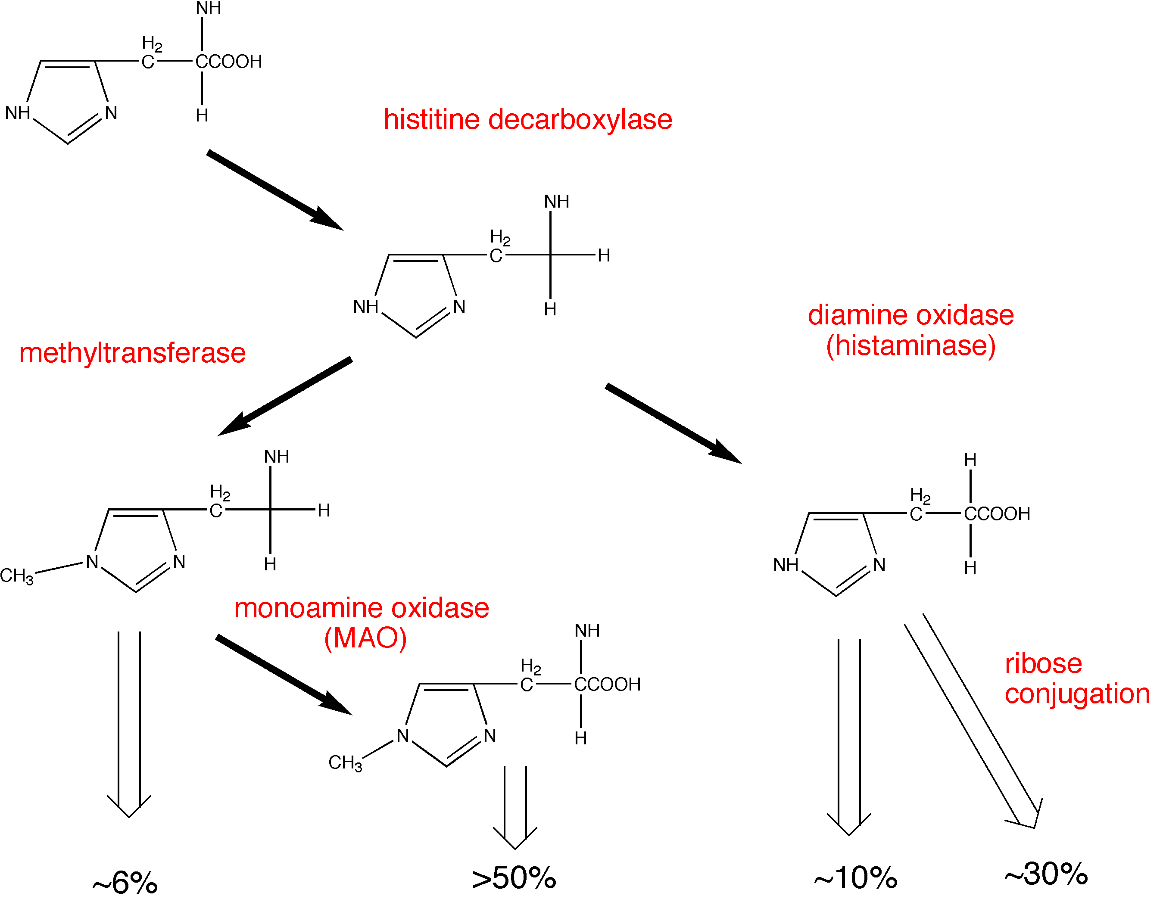
Synthesis and metabolism of histamine

Slide 244
Histamine receptors
H1 - smooth muscle, exocrine glands, vascular endothelium, brain; coupled to phospholipase C, leading to IP3 and diacylglycerol (DAG)
H2 - parietal cells, heart, vascular smooth muscle, mast cells, brain; coupled to cAMP production
H3 - presynaptic, brain, myenteric plexus
(no therapeutic applications, yet)

Slide 245
Histamine in the skin: the Triple Response of Lewis
Red spot
Flare
Wheal

Slide 246
Effects of histamine
Decreased peripheral vascular resistance (mediated by H1 and H2) ( flushing, headache!)
Increased vascular permeability, especially postcapillaries, local edema (H1)
Stimulation of nerve endings (pain!)

Slide 247
Effects of histamine
Decreased peripheral vascular resistance (mediated by H1 and H2) ( flushing, headache!)
Increased vascular permeability, especially postcapillaries, local edema (H1)
Stimulation of nerve endings (pain!)
Tachycardia, direct (H2) and reflex
Increased gastric acid secretion (H2) and GI motility (H1)

Slide 248
Histamine release: Promoted by many compounds
Therapeutic:
morphine, d-tubocurarine, aminoglycosides (remember “Red neck syndrome” ??)
Experimental:
compound 48/80 (was tested as antihypertensive)
Unknown:
cause of hives is rarely determined
Antigen-antibody reactions

Slide 249
Anaphylaxis
Type I allergic response
(immediate hypersensitivity reaction)
Mediated by IgE antibodies
IgE binds to receptors on mast cells and basophils
Fab portion of antibody binds antigen and causes (moderate to massive) release of:
histamine
leukotrienes
prostaglandins
etc., etc.

Slide 250
Common causes of anaphylactic and anaphylactoid reactions
IgE-mediated
Anaphylaxis
Peanuts, seafood, eggs, milk, grains
Venoms
Foreign proteins
Some exercise-induced bronchospasm
Non-IgE-mediated
Anaphylactoid
NMJ blockers, opioids, plasma expanders
Aminoglycosides
Protamine
Radiocontrast media
Urticaria of cold, heat, sun
Some exercised-induced bronchospasm

Slide 251
Anaphylaxis: Effects and Treatment
(may involve release of mediators in addition to histamine)
Decreased blood pressure
Decreased cardiac output
Bronchoconstriction and increased pulmonary secretions
Pruritis
Treatment: Epinephrine - not initially antihistamines
(epinephrine is a physiological antagonist of histamine, not a pharmacological antagonist)
(alpha-1 vasoconstriction, beta-1 increased HR,
beta-2 bronchodilation)

Slide 252
Three mechanistically different approaches to minimize histamine reactions
Physiological antagonism (e.g., epinephrine)
Inhibit the release of histamine (e.g., cromolyn)
Pharmacological antagonism (antihistamines)

Slide 253
disodium cromoglycate (cromolyn, Intal®)
Decreases histamine release from mast cells
(and decreases release of SRS-A)
Administration: inhalation of nebulized solution
(formerly powder, irritating)
May be useful in prophylaxis of histamine release, but does not antagonize the effects of histamine
Similar mechanism and effects by nedocromil (Tilade®)

Slide 254
Cromolyn (Intal®)
Indications:
  Adjunct in treatment of severe perennial asthma
  Prevention and treatment of allergic rhinitis
  Prevention of exercise induced bronchospasm
  Systemic mastocytosis (mast cell ‘dumping’)
  Allergic ocular disorders
Contraindications
  Acute asthma
  Bronchospasm

Slide 255
Cromolyn: Adverse reactions
Cough
Wheezing
Headache
Rash
Nausea

Slide 256
H1 antihistamines: diverse pharmacological properties
Antagonize H1 receptors (±)
Prophylaxis of motion sickness & vomiting
Inhibition of allergic rhinitis
Useful symptomatic relief
pollinosis, conjunctivitis, urticaria (but do not use topically !)

Slide 257
General properties of first generation
H1 antihistamines
Lipid soluble - CNS penetration and effects
Well absorbed
Metabolized in the liver
Half life about 5-6 hours
Adverse reactions
SEDATION, DROWSINESS
headache, nausea & vomiting
cough
constipation, diarrhea
dry mouth, blurred vision, urinary retention

Slide 258
H1 antihistamines: overdosage
Fever
Excitement
Pupillary dilatation
Hallucinations
Convulsions

Slide 259
H1 antihistamines: overdosage
Fever
Excitement
Pupillary dilatation
Hallucinations
Convulsions
REMEMBER
Hot as a stove…
Red as a beet…
Dry as a bone…
Mad as a hatter

Slide 260
Some second generation (‘non-drowsy’)
H1 antihistamines
terfenadine (Seldane®), the pioneer of this second generation (NOW WITHDRAWN)
astemizole (Hismanal®) (NOW WITHDRAWN)
fexofenadine (Allegra®)
(active metabolite of terfenadine)
cetirizine (Zyrtec®)
loratadine (Claritin®)
Second generation antihistamines are recommended as the first line in treatment of allergic rhinitis by The American College of Allergy Asthma and Immunology (Ann. Allergy Asthma & Immunology, Nov. 1998). Avoids drowsiness of first generation antihistamines and major adverse reactions of injected corticosteroids.

Slide 261
Terfenadine (Seldane®) blocks K channels:
May cause torsades de pointes
There is normally a large first pass effect resulting in creation of carboxy-terfenadine (fexofenadine) by CYP3A4
Erythromycin, ketoconazole and other drugs that inhibit CYP3A4 promote accumulation of unchanged terfenadine and, thus, increased the risk of torsade de pointes - prompting withdrawal of terfenadine (similar effects with astemizole, Hismanal®, also withdrawn)

Slide 262
General properties of second generation
H1 antihistamines
Lipid soluble structure with a highly ionized functional group - less CNS penetration - more selective for peripheral H1 antagonism (less useful in other indications)
Well absorbed
Metabolized in the liver
Half life about 5-6 hours
(Huge potential market,
direct consumer advertising)

Slide 263
Indications for antihistamine examples
First generation
Second generation
promethazine
Rhinitis
Urticaria & angioedema
Allergic conjunctivitis
Anaphylaxis (with EPI)
Pre/post op sedation
Prevention of N&V
Prevention of motion sickness
Adjunct to pain meds (esp. hydroxyzine)
(local anesthetic)
fexofenadine
Seasonal allergic rhinitis
Urticaria, chronic

Slide 264
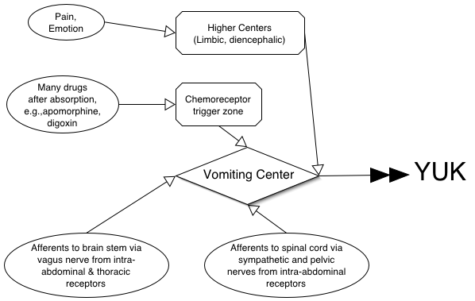
Input and integration of the vomiting reflex

Slide 265
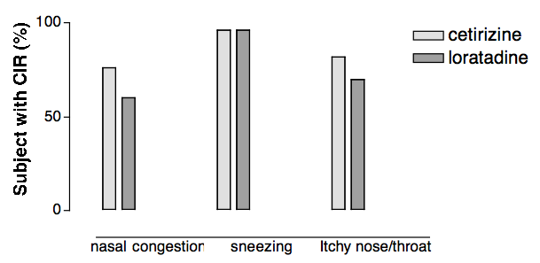
Clinically important relief (CIR) produced by antihistamines in allergic rhinitis
Adapted from Day et al., Annals of Allergy, Asthma and Immunology, 79: 163-171
Financial support from Nordic Merrill Dow, Canada

Slide 266
Worth noting…...
First generation antihistamines are virtually without value in the treatment of asthma; may be relatively contraindicated. The main benefit in pruritis may be sedation……on the other hand, a main cause of driver drowsiness may be traced to antihistamines…….
Second generations antihistamines may be useful (off label)
in some patients with asthma (e.g., 20 mg of cetirizine has a bronchodilator action additive to that of albuterol in subjects with FEV1 of 50-80% of predicted, Spector et al., 1995).

Slide 267
Anti Cancer Chemotherapy
Kirimi shadrack
Lecturer
Kmtc nairobi

Slide 268
Cancer
  Uncontrolled multiplication and spread within the body of abnormal forms of body's own cells
Neoplasm
  A mass of tissue formed as a result of
    Abnormal
    Excessive
    Uncoordinated
    Autonomous and
    purposeless
    Proliferation of cells

Slide 269
Why term chemotherapy
Like infective disease
  Some malignant cells can be cultured
  Some malignancies can be transmitted by innoculation

Slide 270
Cancer chemotherapy not as successful as antimicrobial chemotherapy
Metabolism in parasite differs qualitatively from host cells, while metabolism in cancer cells differ only quantitatively from normal host cells
  Hence target selectivity is more difficult in cancer
  cancer there is no substantial immune response
  Diagnostic complexity: delay in institution of treatment

Slide 271
Cancer chemotherapy can be curative in
Acute Leukemias
Wilm’s Tumour
Ewing’s Sarcoma
Choriocarcinoma
Hodgkin’s Disease
Lymphosarcoma
Burkitts lymphoma
Testicular Teratomas
Seminomas
In children

Slide 272
Chemotherapy can have only Palliative effect in
Breast Cancer
Ovarian Cancer
Endometrial Cancer
Prostatic Cancer
Chronic Lymphatic Leukemia
Chronic Myeloid Leukemia
Head & Neck Cancer
Lung (small cell) Cancer

Slide 273
Chemotherapy is less sensitive in
Colorectal Cancer
Carcinoma Stomach
Carcinoma of esophagus
Renal carcinoma
Hepatoma
Bronchogenic (non small cell) carcinoma
Malignant Melanoma
Sarcoma

Slide 274
Pathogenesis of cancer
Chemicals, viruses, irradiation, etc
Acquired Mutations
Inherited Mutations
Protooncogenes → oncogenes
↓ expression of tumor supressor genes (P53, Rb etc)
Promoters,
co-carcinogen, hormones
Uncontrolled cell proliferation, dedifferentiation
↓ apoptosis, alterations in telomerase
Development of primary tumor

Slide 275
Pathogenesis of cancer
Development of primary tumor
Production of metalloproteinases
Invasion of nearby tissue by tumor cells
Angiogenesis
Metastasis
Development of secondary tumors

Slide 276
Cancer cells differ from normal cells by
Uncontrolled proliferation
De-differentiation & loss of function
Invasiveness
Metastasis

Slide 277
Guiding principles in cancer chemotherapy
To achieve cure a TOTAL CELL KILL must be tried
Early diagnosis and early institution of treatment
Combination chemotherapy
Intermittent regimens
Adjuvant and neoadjuvant chemotherapy occasionally

Slide 278
Total cell kill
Aimed at destroying all the malignant cells, leaving none
This approach ensures
  Early recovery
  Prevents relapse
  Prolongs survival
Pharmacological sancturies

Slide 279
Early diagnosis and early T/t why?
Survival time inversely related to initial number of cells
Aging cancer cells are less susceptible to chemotherapy, because there is
  ↑ cell cycle (division) time
  ↓No of actively dividing cells with more resting cells
  ↑ cell death within tumor
  Overcrowding of cells

Slide 280
Combination chemotherapy?
Heterogenicity of cells remaining in different phase of growth cycle , showing different level of sensitivity
  Nature of drug (with different biochemical site of action)
  Avoid emergence of drug resistance
Monotherapy adequate in Burkitts lymphoma & choriocarcinoma

Slide 281
Why intermittent regimen?
Favours risk –benefit ratio
Allows time for damaged normal host cells to recover
Pulse therapy
  Type of intermittent chemotherapeutic regime employing highest tolerated dose within a short administration period
  Based on principle of drug conc. (C) x duration of exposure (T) = constant

Slide 282
Adjuvant & Neoadjuvant chemotherapy
Adjuvant chemotherapy:
  Chemotherapy given after surgery or irradiation to destroy micrometastasis & prevent development of secondary neoplasm.
Neo-adjuvant chemotherapy:
  Chemotherapy given before surgery or radiotherapy in order to diminish the volume of large primary neoplasm

Slide 283
General toxicity of cytotoxic drugs
Nausea & Vomiting
Bone marrow depression
Alopecia
Gonads: Oligospermia, impotence, ↓ ovulation
Foetus: Abortion, foetal death, teratogenicity
Carcinogenicity
Hyperuricemia
Immunosupression: Fludarabine
Hazards to staff

Slide 284
Alkylating agents
Nitrogen Mustards
  Meclorethamine, Melphalan, Chlorambucil, cyclophosphamide, ifosfamide
Ethyleneimine : Thiotepa
Alkyl Sulfonate: Busulfan
Nitrosureas
  Carmustine,lomustine, streptozocin
Triazines
  Dacarbazine, temozolamide

Slide 285
Antimetabolites
Folate Antagonists
  Methotrexate
Purine Antagonists
  6 Mercaptopurine, 6 Thioguanine, Azathioprine
Pyrimidine antagonists
  5 Fluorouracil, cytarabine, gemcitabine

Slide 286
Natural Products
Antibiotics
  Actinomycin D, Doxorubicin, Daunorubicin, Bleomycin, Mitomycin C
Vinca alkaloids
  Vincristine, Vinblastine, Vinorelbine
Taxanes
  Paclitaxel, docetaxel
Enzymes
  L-Asparginase
Epipodophyllotoxins
  etoposide, tenoposide
Camptothecin analogs
  Topotecan, irinotecan
Biological response modifiers
  Interferons,
  Interleukins

Slide 287
Miscellaneous Agents
Cisplatin
Carboplatin
Hydroxurea
Procarbazine
Mitotane
Imatinib

Slide 288
Hormones & antagonists
Corticosteroids
  Prednisolone
Estrogens
  Ethinyl Estradiol
SERM( selective estrogen receptor modulators)
  Tamoxifene, Toremifene
SERD (selective estrogen receptor downregulators)
  Fulvestrant
Aromatase Inhibitors
  Letrozole, Anastrazole, Exemestane
Progestins
  Hydroxyprogesterone
Anti-androgens
  Flutamide, Bicalutamide
5-α reductase Inhibitors
  finasteride, dutasteride
GnRH analogs
  Naferelin, goserelin, leuoprolide

Slide 289
MOA of some anticancer drugs
Purine/ Pyrimidine antagonists
Purine & Pyrimidine synthesis
Methotrexate
Inhibition of purine ring & dTMP biosynthesis
Ribonucleotides
5 FU inhibits dTMP synthesis
Deoxy ribonucleotides
Cytarabine inhibits DNA chain elongation
DNA
Alkylating agents
Alter structure & function of DNA by cross linking and/or fragmenting DNA
Dactinomycin , Intercalate with DNA disrupt DNA function
RNA
Proteins

Slide 290
Alkylating agents
Nitrogen Mustards (MCI)
  Meclorethamine, Melphalan, Chlorambucil, Cyclophosphamide, Ifosfamide
Ethyleneimine : Thiotepa
Alkyl Sulfonate: Busulfan
Nitrosureas
  Carmustine,lomustine, streptozocin
Triazines
  Dacarbazine, temozolamide

Slide 291
Mechanism of action
Alkylating Agents
Form highly reactive carbonium ion
Transfer alkyl groups to nucleophilic sites on DNA bases
Results in
Cross linkage
Abnormal base pairing
DNA strand breakage
Alkylation also damages RNA and proteins
↓ cell proliferation

Slide 292
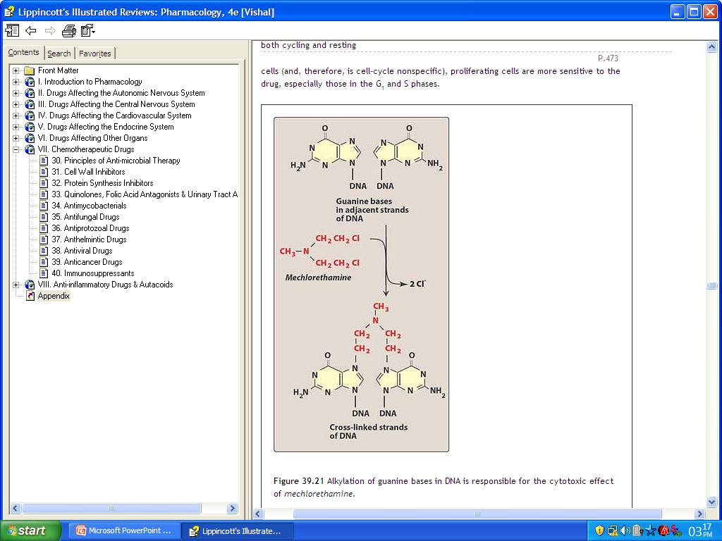

Slide 293
Pharmacological actions
Cytotoxic action
  Hemopoetic system highly susceptible
    Chlorambucil – more against lymphoid series
    Busulfan – more against myeloid series
  Epithelial tissues, hair follicles
  Spermatogenesis , fetopathic effect
Immunosupressant action
Miscellaneous
  Severe nausea & vomiting
Known as radiomimetic drugs

Slide 294
Nitrogen Mustards
Mechlorethamine
Melphalan
Chlorambucil
Cyclophosphamide
Ifosfamide

Slide 295
Mechlorethamine (Mustine)
Very irritant drug
Dose = 0.4 mg/kg single or divided
Uses
  Hematological cancers , lymphomas , solid tumors
  Hodkins as part of MOPP, CML, CLL
Adverse effects
  Anorexia, nausea, vomiting
  Bone marrow depression, aplasia
  Menstrual irregularities
Estramustine

Slide 296
Melphalan
Very effective in MULTIPLE MYELOMA
Less irritant locally , less alopecia
Dose:
0.25 mg/kg daily for 4 days every 4-6 weeks
Adverse Effects :
  Bone marrow Depression
  Infections , diarrhoea and pancreatitis

Slide 297
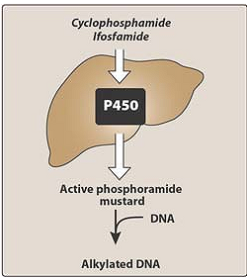
Cyclophosphamide
Most commonly used alkylating agent a prodrug

Slide 298
Cyclophosphamide
Cyclophosphamide
Aldophosphamide
⊗
Phosphoramide mustard
Acrolein
Hemorrhagic cystitis
Cytotoxic effect
Mesna

Slide 299
Uses of cyclophosphamide
Neoplastic conditions
  Hodgkins and non hodgkins lymphoma
  ALL, CLL, Multiple myeloma
  Burkits lymphoma
  Neuroblastoma , retinoblastoma
  Ca breast , adenocarcinoma of ovaries
Non neoplastic conditions
  Control of graft versus host reaction
  Rheumatoid arthritis
  Nephrotic syndrome

Slide 300
Cyclophosphamide
Adverse effects:
  Hemorrhagic cystitis,
  alopecia,
  nausea & vomiting,
  SIADH
  hepatic damage
Dose: 2-3 mg/kg/day oral
10-15 mg/kg IV every 7-10 days
It can be administered IV, IM, IP, intrapleurally, Intraarterialy, directly into tumor

Slide 301
Ifosfamide
Congener of cyclophosphamide
Longer half life than cyclophosphamide
Less alopecia and less emetogenic than cyclophosphamide
Can cause hemorrhagic cystitis and severe neurological toxicity
Used for germ cell testicular tumors and adult sarcomas

Slide 302
Chlorambucil (Leukeran)
Slowest acting and least toxic alkylating agent
Main action on lymphoid series produces marked lympholytic action
Drug of choice for long term maintenance therapy of CLL
Dose: 0.1-0.2 mg/kg daily for 3-6 weeks then 2 mg daily for maintenance

Slide 303
ThioTEPA
Triethylene phosphoramide
Does not require to form active intermediate
Active intravesicular agent can also be used topicaly in superficial bladder cancer
Not well absorbed orally given IV
High toxicity

Slide 304
Busulfan (Myleran)
Depresses bone marrow with selective action on myeloid series
Primarily used in Chronic myelogenous leukemia 2-6 mg/day
Adverse effect:
  Interstitial pulmonary fibrosis
  Venoocclusive disease of liver
  Hyperuricaemia
  Sterility

Slide 305
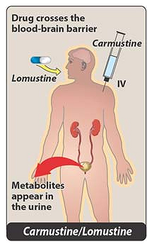
Nitrosureas
Highly lipid soluble, Cross BBB
Uses:
  Meningeal / Brain tumours
Dose :150-200 mg/m2 BSA
every 6 wks (Carmustine)
Adverse Effects:
  Delayed bone marrow
  suppression
  Visceral fibrosis, renal
  damage

Slide 306
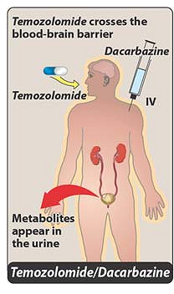
Triazenes
Dacarbazine
  Primary inhibitory action on RNA & protein synthesis
  Used in malignant melanoma
Temozolamide
  New alkylating agent
  Approved for malignant glioma
  Rapidly absorbed after oral absorption & crosses BBB

Slide 307
Mechanisms of resistance of alkylating agents
↓ Influx of drug
↑ Production of nucleophilic substances like glutathione that compete with target DNA for alkylation
↑ Activity of DNA repair enzymes
↑ metabolic inactivation of drugs

Slide 308
Cisplatin
Non cell cycle specific killing
Administered IV
Highly bound to plasma proteins
Gets conc in kidney, intestine, testes
Poorly penetrates BBB
Slowly excreted in urine
Cl
NH₃
Pt
Cl
NH₃
Dose:
20 mg/m2 for 5 days a week
75 – 100 mg/m2 once in 4 weeks to treat ovarian cancer

Slide 309
Mechanism of action of cisplatin
Cisplatin enters cells
Cl⁻
Forms highly reactive platinum complexes
Intra strand & interstrand cross links
DNA damage
Inhibits cell proliferation

Slide 310
Cisplatin uses and adverse effects
Uses
  Testicular cancer (85% - 95 % curative )
  Ovarian cancer
  Other solid tumors: lung, esophagus, gastric
Adverse effects
  Emesis
  Nephrotoxicity
  Peripheral neuropathy
  Ototoxicity

Slide 311
Carboplatin
Better tolerated
Nephrotoxicity , ototoxicity , neurotoxicity low
Less emetogenic
But thrombocytopenia and leukopenia may occur
Less plasma protein binding
Use:
  primarily in ovarian cancer of epithelial origin
  Squamous cell carcinoma of head and neck

Slide 312
Antimetabolites
Folate Antagonists
  Methotrexate
Purine Antagonists
  6 Mercaptopurine, 6 Thioguanine, Azathioprine
Pyrimidine antagonists
  5 Fluorouracil, cytarabine, gemcitabine

Slide 313
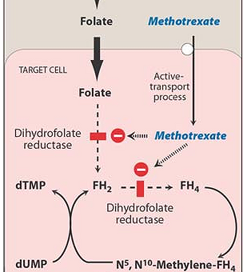
Methotrexate
Folic acid not useful in toxicity
Folinic acid N⁵ formyl FH₄ should be given which is converted to N⁵,N¹⁰-Methylene –FH₄ and bypasses the inhibited reductase
Adenine, guanine, thymidine , methionine, serine

Slide 314
Pharmacological actions
Cytotoxic actions
  Predominant on bone marrow
  Ulceration of intestinal mucosa
  Crosses placenta interferes with embroyogenesis foetal malformations and death
Immunosupressive action
  Prevents clonal expansion of B & T lymphocytes
Anti-Inflammatory action
  Interferes with release of inflammatory cytokines IL-2, IL-6,IL-8 & TNF-α , ↓ Rheumatoid Factor production

Slide 315
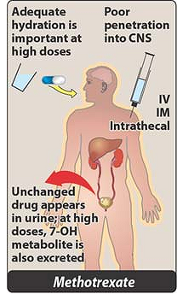
Pharmacokinetics
Absorbed orally, 50 % protein bound
Disappears rapidly from blood , remains in tissue longer than folate thus causes prolonged inhibitory effect
C/I in renal impairment

Slide 316
Adverse effects
Megaloblastic anemia
Thrombocytopenia, leukopenia, aplasia
Oral, intestinal ulcer , diarrhoea
Alopecia , liver damage, nephrpathy
Treatment of methotrexate toxicity
Folinic acid (citrovorum factor, N5 Formyl THF)
IM/IV 8 to 24 hrs after initiation of methotrexate
120 mg in divided doses in first 24 hrs, then 25
mg oral/IM 6 hrly for next 48 hrs

Slide 317
Uses of methotrexate
Antineoplastic
  Choriocarcinoma and tropoblast tumor 15 -30 mg/day orally for 5 days
  Remission of ALL in children 2.5 to 15 mg/day
  Ca breast, head & neck, bladder, ovarian cancer
Immuno-supressive agent
  Rheumatoid arthritis, resistant asthma
  Crohns disease, wegeners granulomatosis
  Prevention of graft versus host reaction
Psoriasis
Medical termination of pregnancy

Slide 318
Purine antagonists
6 Mercaptopurine
6 Thioguanine
Azathioprine
Fludarabine

Slide 319
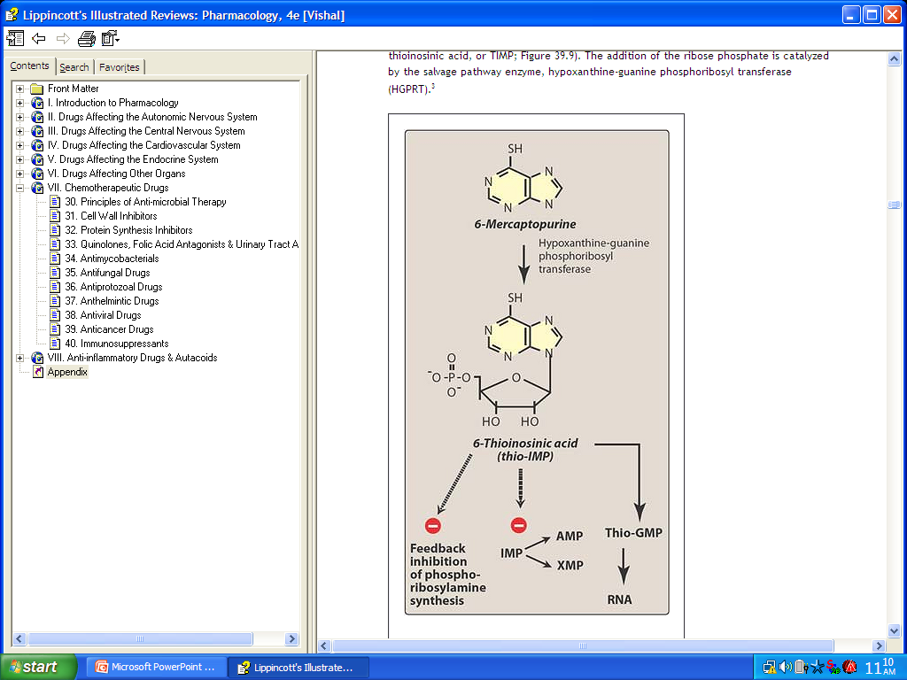
6 Mercaptopurine
HGPRT
Ribonucleotide
(HGPRT):
hypoxanthine-guanine phosphoribosyl transferase

Slide 320
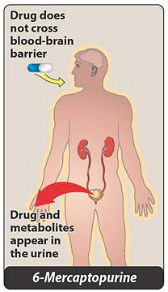
6 Mercaptopurine
Allopurinol
6 MP
TPMT
Xanthine oxidase
6 Thiouric acid
Inactive metabolite

Slide 321
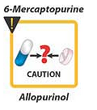
6 Mercaptopurine
Use:
  Acute leukemia (ALL)
  Choriocarcinoma
Adverse Effects:
  Bone marrow & GIT mainly
  Hepatic necrosis rarely
  Hyperuricaemia

Slide 322
Fludarabine
Phosphorylates intracellularly to form triphosphate
Inhibits DNA polymerase and gets incorporated to form dysfunctional DNA
Effective in slow growing tumors: (apoptosis)
Use:
  CLL and non hodgkins recurring after treatment
Adverse events:
  chills, fever, opportunistic infection, myelosupression

Slide 323
Cladirabine
Like fludarabine converted to triphosphate
Incorporated into DNA
Inhibits DNA polymerase α and β thus inhibits DNA synthesis and repair
Used in treatment of Hairy cell leukemia, CLL and low grade lymphomas

Slide 324
Pentostatin
Inhibits adenosine deaminase
Accumulation of adenosine & deoxyadenosine
Inhibits ribonucleotide reductase
Blocks DNA synthesis
S adenosyl homocysteine accumulation
Toxic to lymphocytes
Used in
Hairy cell leukemia

Slide 325
Pyrimidine antagonists
5 fluoruracil
Cytosine arabinoside (Cytarabine)
Gemcitabine

Slide 326
5 fluorouracil
5 FU
FdUMP
FdUMP = fluorodeoxyuridine monophosphate
Thymidilate synthetase
Thymidine Monophosphate
dUMP
Uses : stomach , colon, breast ovaries , liver, skin cancers
DNA Synthesis (Selective failure)

Slide 327
Cytosine arabinoside
Pyrimidine analog considered drug of choice in inducing remission in AML
Phosphorylated in body to triphosphate
Triphosphate of cytarabine inhibits DNA polymerase α & β
Thus inhibit DNA synthesis and repair
Gemcitabine
Drug of choice in adenocarcinoma of pancreas

Slide 328
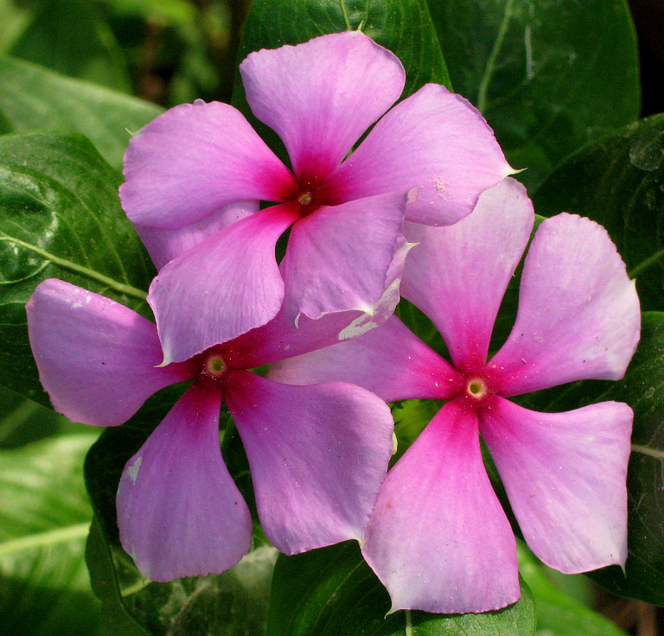
Vinca alkaloids
Obtained from periwinkle plant ( Vinca Rosea)
Vincristine, vinblastine, vindesine, vinorelbine

Slide 329
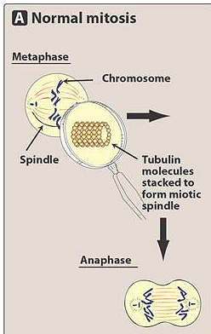
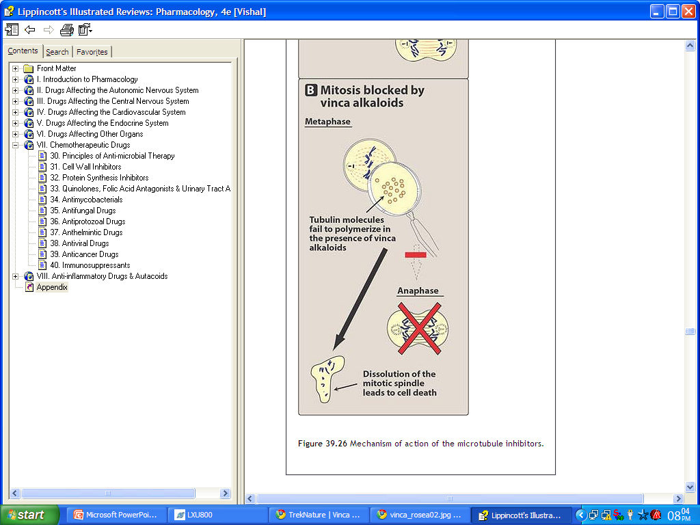
Mechanism of action

Slide 330
Comparison between
Vincristine
Vinblastine
Marrow sparing effect
Alopecia more common
Peripheral & autonomic neuropathy & muscle weakness (CNS)
Constipation
Uses: (Childhood cancers)
  ALL , Hodgkins, lymphosarcoma, Wilms tumor, Ewings sarcoma
Bone marrow supression
Less common
Less common, temp. mental depresssion
Nausea, vomiting, diarrhoea
uses
  Hodgkins disease & other lymphomas , breast cancer, testicular cancer

Slide 331
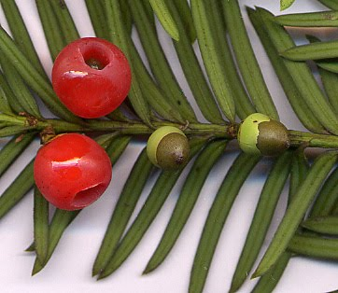

Taxanes
Paclitaxel & docetaxel
Plant product obtained from bark of Pacific Yew ( Taxus Brevifolia) & European Yew (Taxus Buccata)

Slide 332
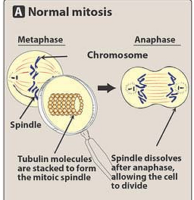

Mechanism of action
Cell cycle arrested in G2 and M phase

Slide 333
Paclitaxel
  Administered IV
  Use: advanced breast & ovarian cancer also lungs, esophagus, prostrate cancer
  Adverse effects:
    Anaphylactoid reaction because of solvent cremaphor
    Myalgia, myelosupression, peripheral neuropathy
Docetaxel
  Oral
  Used in refractory breast & ovarian cancer
  Major toxicity neutropenia may cause aarrhythmias , hypotension

Slide 334
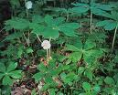
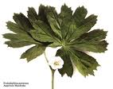
Epipodophyllotoxins
Etoposide & tenoposide
Semisynthetic derivatives of podophyllotoxins podophyllum peltatum (plant glycoside)

Slide 335
Etoposide
Act in S & G2 phase
Inhibit topoisomerase II which results in breakage of DNA strands & cell death
Uses:
  Testicular tumors , squamous cell cancer of lungs

Slide 336
Camptothecin analogs
Derived from camptotheca accuminata
Inhibit Topoisomerase I: No resealing of DNA after strand has untwisted
Topotecan:
  Used in metastatic ovarian cancer
  Major toxicity is bone marrow depression
Irinotecan
  Used in metastatic cancer of colon/rectum
  Toxicity: diarrhoea, neutropenia, thrombocytopenia, cholinergic side effects

