Slide 1
PLATELET DISORDERS IN CHILDREN
KMTC VOI
March 2019.

Slide 2
definitions
Spontaneous bleeding
HEMOSTASIS, THROMBOCYTOPENIA,THROMBOCYTOSIS
Excessive and prolonged bleeding
Petachiae
Papura
Echymosis
Hematoma
Bruises
Occult bleeds
Melena
epistaxis

Slide 3
CONT
HEMOSTASIS is an active process that clots blood in areas of blood vessel injury hence limiting the bleeding.
Over time, the clot is lysed by the fibrinolytic system and normal blood flow is restored
The main components of hemostasis process are;
(NB; Bleeding disorders are grouped into the following)
The vessel wall abnormalities
Platelets
Coagulation disorders
Anticoagulant proteins
Fibrinolytic system

Slide 4
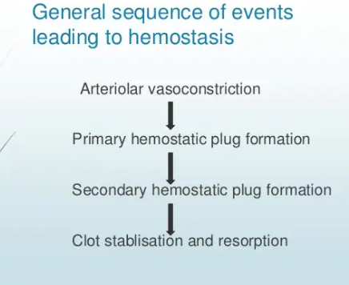

Slide 5
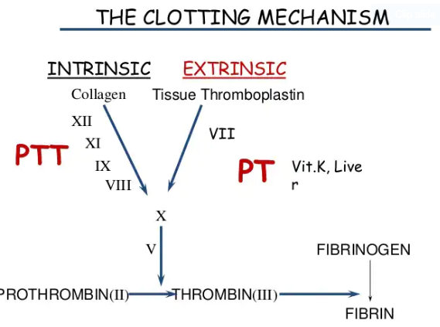
Coagulation cascade

Slide 6
1. Platelets DISORDERS
Platelets are disc shaped anucleate cell fragments
They are shed from megakaryocytes in the bm to the blood stream
Their main regulator of its production is the hormone thrombopoeitin (TPO) which is synthesized in the liver
Normal platelet count = 150000-400000/mm3
They circulate with an average life span of 7-10 days.
Platelet disorders are broadly grouped into Two.
Functional disorders(qualitative)
Disorders in the Number (quantitative)

Slide 7
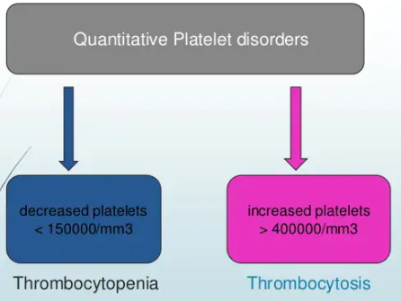

Slide 8
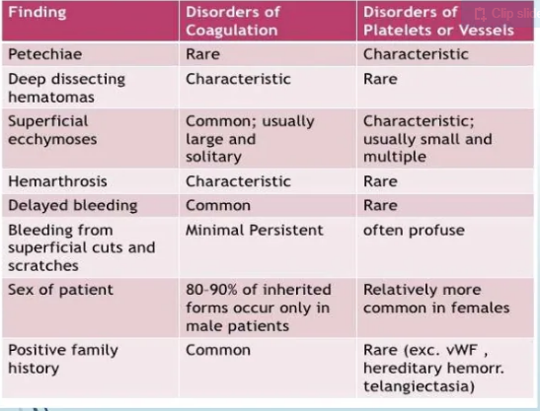

Slide 9
diagnostics
Bleeding time ( 3-12 mins)
Peripheral blood smear-number and morphology
In vitro platelet function analyzer
Platelet aggregation tests
Bone marrow examination

Slide 10
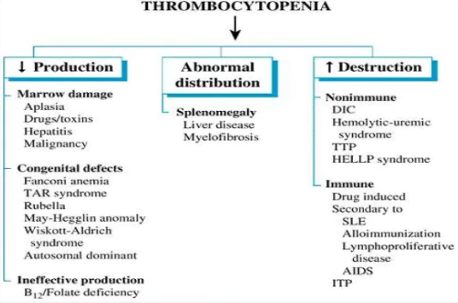

Slide 11
IMMUNE THROMBOCYTOPENIC PAPURA (ITP)
The most common cause of acute onset of thrombocytopenia <100000 in an otherwise well child
Occurs due to production of autoantibodies against the platelet glycoprotein complexes
After binding of the antibody to the platelet surface, circulating antibody-coated platelets are recognized by splenic microphages and are destroyed.
Clinical features
A previously healthy child presents with sudden onset of generalized Petachiae and Papura
Bleeding from the gums and mucous membrane
Usually there is a history of a preceding viral infection 1-4 wks
Rare below ages of 2 years

Slide 12
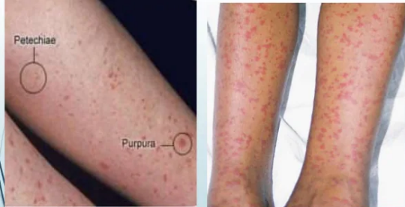

Slide 13
Physical exam
Findings are normal other than Papura and petachia
The presence of abnormal findings such as; hepatospleenomegally,bone and joint pain,lymphadenopathy suggests-leukemia and other syndromes.
Severity;
No symptoms
Mild symptoms-bruising, petachiae, epistaxis-has very little interference with normal living
Moderate; more skin and mucosal lesions and epistaxis
Severe; bleeding episodes, menorrhagia- requiring transfusion.

Slide 14
dx
CBC is sufficient
Large platelets are seen on PBF and increased number of megakaryocytes in BM
Indications for BM biopsy are; abnormal WBC in CBC
Unexplained anemia as well as findings on HX and physical exam
Always rule out and treat infections if the child is febrile.
Treatment;
Majority achieve spontaneous remission
Watch and wait
Platelet transfusion only when life threatening bleeding is present

Slide 15
Emergency treatment
IV methylprednisolone
Or oral prednisolone 1 mg/kg PO for 7 days and tapper down over 3 weeks
Anti D( 50-75mg/kg as single dose.)
Antifibrinolytics such as tranexamic acid 10-15mg/kg IV 6 hourly are useful to control bleeding.
Splenectomy is the definitive treatment when above rx is not working.

Slide 16
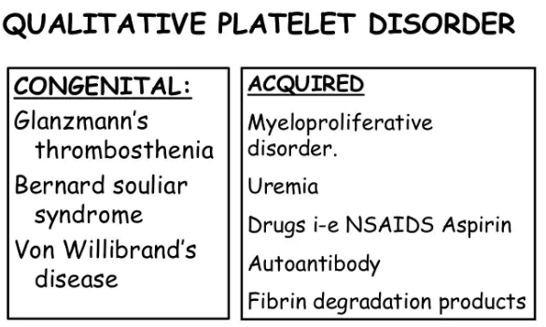

Slide 17
VON WILLIBRAND’S DISEASE
Autosomal dominant (gene for Von willibrands Factor located on chromosome 12)
VWF is synthesized by endothelial cells and megakaryocytes.
It acts as a carrier protein for factor VIII (antihemophilic) by non covalent bond. A defect therefore leads to decreased plasma levels for factor 8.
It forms bridges between platelets and sub endothelium therefore a defect of VWF leads to prolonged bleeding.

Slide 18
Clinical features
Mucosal bleeding which can be mild to severe.
LAB
Reduced level of VWF which is often accomplished by reduction of factor 8 and prolonged BT
RX
Mild hemorrhages;
Desmopressin 0.3micrograms/kg after which VWF raises 3 in 30-90 mins.
Massive hemorrhages;
Factor VIII*

Slide 19
2.Vessel wall abnormalities
Increased vascular fragility
Manifest by petachial hemorrhages of skina nd mucous membrane
Not life threatening
Congenital;
Ehlers - Danlos syndrome
Hereditary hemorrhagic telangiectasia
2. Acquired;
Hypersensitivity vasculitis
Drug reaction; immune complex deposits in vessel wall (thiazide diurectics)
Henoch-schonlein pupura
Scurvy (vit c def)
Lab; BT,PLT ,PT,PTT will be normal

Slide 20
Explanations- vesselwall
EHLERS DANLOS DSE- there is congenital disorder of collagen synthesis-in which capillaries are poorly supported by sub cutaneous collagen
Ecchymosis are commonly seen
HEREDETARY HEMORHAGIC TELANGECTAISIS- dominant inherited condition.
Telangectasis are small aneurysms found on fingertips,face,nasal passages, tongue and GIT.
Few people develop pulmonary A/v malformations
Patients develop recurrent bleeding/epistaxis,occult GIT bleeding that leads to iron def anemia.
RX- iron therapy + foods local laser therapy for single lesions

Slide 21
HENOCH- NSCONLEIN PURPURA (non-thrombocytopenic)
Generalized hypersensitivity vasculitis(immune mediated)
Presentation;
palpable purpura
Colicky abdominal pains
Polyathralgia
Acute glomerulonephritis
RX- Prednisolone for 2-4 weeks

Slide 22
3. COAGULATION DISORDERS
Coagulation factor disorders can either be due to a single factor or multiple.
A congenital deficiency eg in factor VIII results in Hemophilia A or due to multiple factor deficiency, which is an acquired eg secondary to liver disease or warfarin therapy.
Congenital bleeding disorder;
Heamophilia- A ( classic true haemophilia
Heamophilia- B ( christmass disease)
X-linked recessive inheritance.

Slide 23
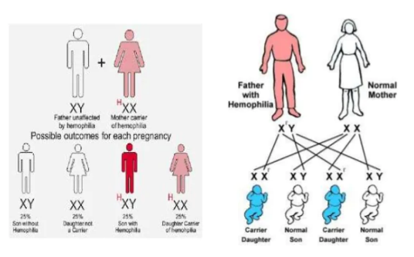

Slide 24
HEAMOPHILIA -A
X LINKED DISORDER DUE TO DEFF OF FACTOR VIII
C/F
BLEEDING OCCURS AS BRUISING AT THE AGE OF 6 MONTHS
Trauma results in excessive bleeding
Recurrent bleedings and hemorrhage in knee,elbow and hip(hemoathrosis)
Mucous membrane/ internal bleeding of mouth,lips and gums
Muscle hematoma
RX- Factor VIII infusion

Slide 25
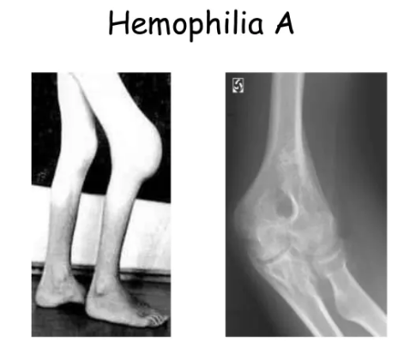

Slide 26
HAEMOPHILIA-B (XMASS DSE)
Due to deficiency of FACTOR IX
SS- SAME AS TYPE A
RX- FACTOR IX INFUSSION
COMPLICATIONS;
Arthropathy
Muscle atrophy due to hematomas
Mononeuropathy due to pressure of hematoma
Antifator viii antibody develops due to therapy
Viral transmission of hepatitis ABCD AND HIV

Slide 27
ACQUIRED BLEEDING DISORDERS
DIC
LIVER DISEASE
RENAL DISEASE
Disseminated intravascular coagulation
DIC is a condition xrised by thrombosis within circulation
DIC can be induced by different mechanisms
Due to endothelial cell damage by endotoxins in G-ve septicaemia resulting in tissue factor release which in turn leads to coagulation cascade activation through extrinsic pathway
The presence of thromboplastin from damaged tissue,placenta and fat embolus (following brain injury and fractures) may activate coagulation.
This results in excessive consumption of platelets and coagulation factors, with secondary activation of fibrinolysis leading to bleeding tendency.

Slide 28
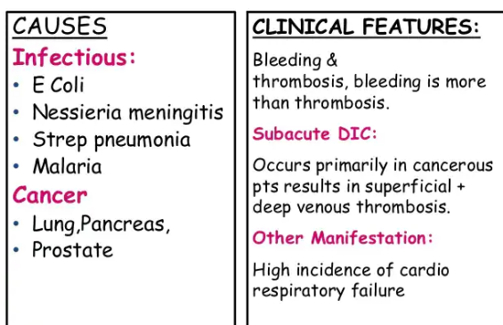

Slide 29
lab
Thrombocytopenia
Prolonged PT
APTT may be normal/increased
Low fibrinogen
Increased level of D-dimmer

Slide 30
treatment
supportive
Treat the underlying cause
Correct dehydration
Renal failure
Acidosis and shock
Specific/replacement
Platelet transfusionFFP
Heparin if there is DVT or pulmonary thrombosis

Slide 31
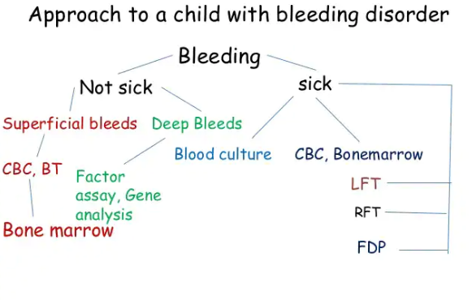

Slide 32
Assignment
Blood and blood components
Blood groups
Transfusion and management of transfusion reactions

