Slide 1

THE KENYA NATIONAL EXAMINATIONS COUNCIL
PORTFOLIO ASSESSMENT
The Kenya National Examinations Council (KNEC)
P. O. Box 73598-00200, Nairobi, Kenya
Email:info@knec.ac.ke

Slide 2
By the end of the session, the participant should be able to;
Define a portfolio
Identify types of portfolios
Describe the stages of portfolio development

Slide 3
Notes:
Divide the participants into groups of 5-6 members.

Slide 4
1.0 PORTFOLIO
  Definition:
It is a purposeful collection of learner’s work that shows;
  learning progress,
  effort,
  achievement towards the attainment of learning outcomes.
  STEPS taken to get there
A portfolio is one of the assessment tools used in educational assessment.

Slide 5
PORTFOLIO ASSESSMENT
Is an evaluation tool used to document evidence of learning through a series of LEARNERS developed
  Artifacts- drawings, mathematical activities, environmental activities, creative & movements activities
  write-ups; literacy,

Slide 6
WHY PORTFOLIO?
Portfolios give learners the opportunity to direct their own learning
Portfolios can be used to determine Learners' level of achievement
Portfolios can be used to understand how learners think, reason, organize, investigate, and communicate
Portfolios can be used to communicate learners efforts, progress toward accomplishing learning goals, and
accomplishments.

Slide 7
WHY PORTFOLIO? Cont..
Portfolios can be used to evaluate and improve curriculum and instructions.

Slide 8
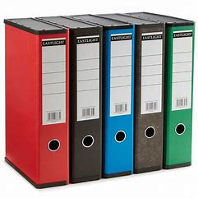
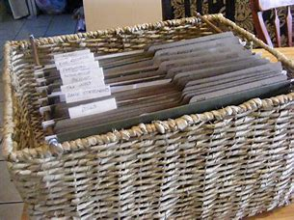
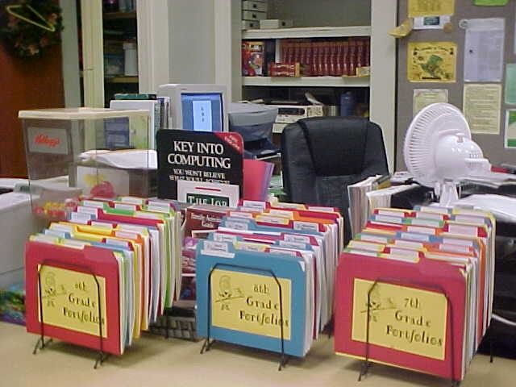

Samples of portfolio designs
FILES
BASKETS

Slide 9
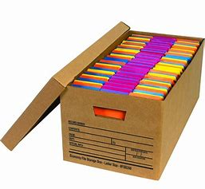
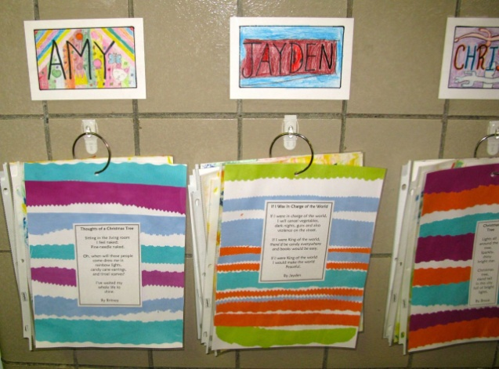
Ways of keeping portfolios
RING BINDERS
CARTONS

Slide 10
1.2 Types of portfolios
1. Working
Portfolio
TYPES OF PORTFOLIOS
2. Showcase
Portfolio
3. Assessment
Portfolio

Slide 11
1. Working Portfolio
This is a collection of work in progress as well as finished samples of work (products).
It contains collection of work guided by learning areas, learning outcomes and core competencies to be developed or individual learner’s areas of interests.
It contains work that can be later selected for showcase and assessment portfolios.
Notes:
It shows
development of one or more products/performances (tracking)
goal-setting
growth or change over time - earlier and later work samples
reflection of progress on set goals
strengths and weaknesses

Slide 12
WORKING PORTFOLIO SHOWS………
(a) Goals set
(c) Reflections of progress on set goals
(b) Development (Growth over time)

Slide 13


Slide 14

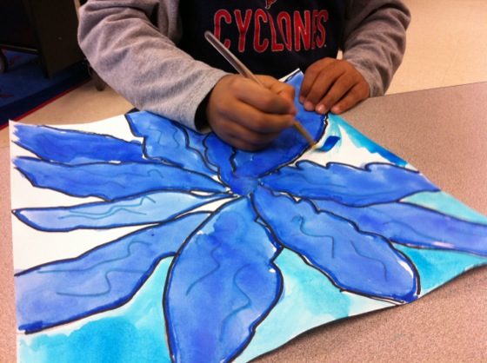

Slide 15
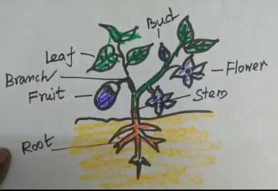
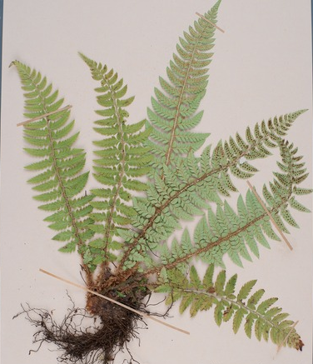
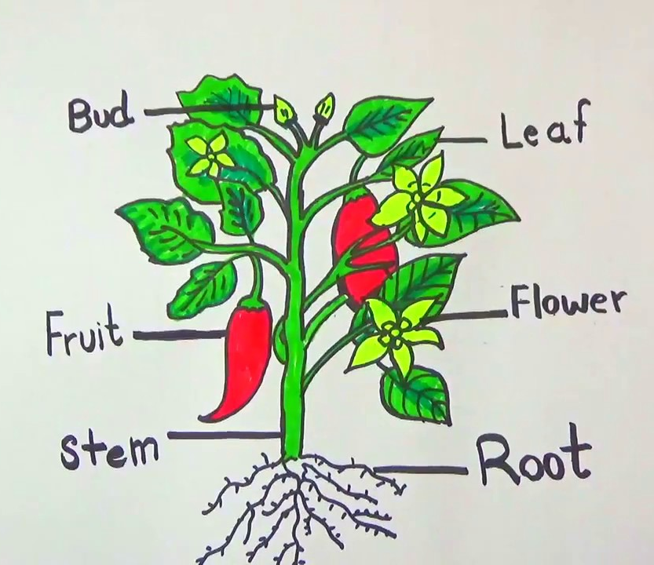

Slide 16
2. Showcase Portfolio
It displays the best of the learners outputs and products.
The content that goes into this type of portfolio is purely selected by a learner in line with their interests and abilities.

Slide 17
SHOWCASE PORTFOLIO shows……
(a) Accomplishments
(c) Learners perception of his/her best or interest
(b) Samples of work for placement

Slide 18
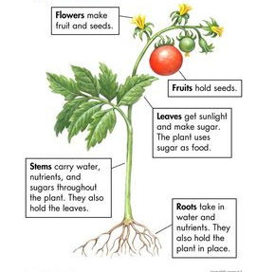
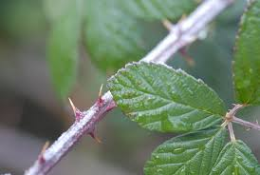
Samples of best works in showcase portfolio
A PLANT
Photograph of a thorny plant
Functions of parts of a plant

Slide 19
3. Assessment Portfolio
This type of portfolio is used to document mastery of skills or competencies in a particular learning area.
The content in this type of portfolio is guided by the competencies specified in the curricular.
Notes:
It is used to
show achievement for grading purposes
document progress towards standards
place learners appropriately.

Slide 20
ASSESSMENT PORTFOLIO SHOWS……….
(a) Achievement for grading
(c) samples of work for learners placement
(b) Progress towards standards

Slide 21
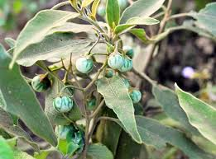


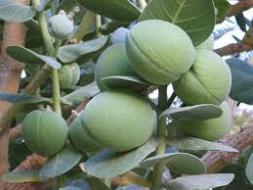

Slide 22
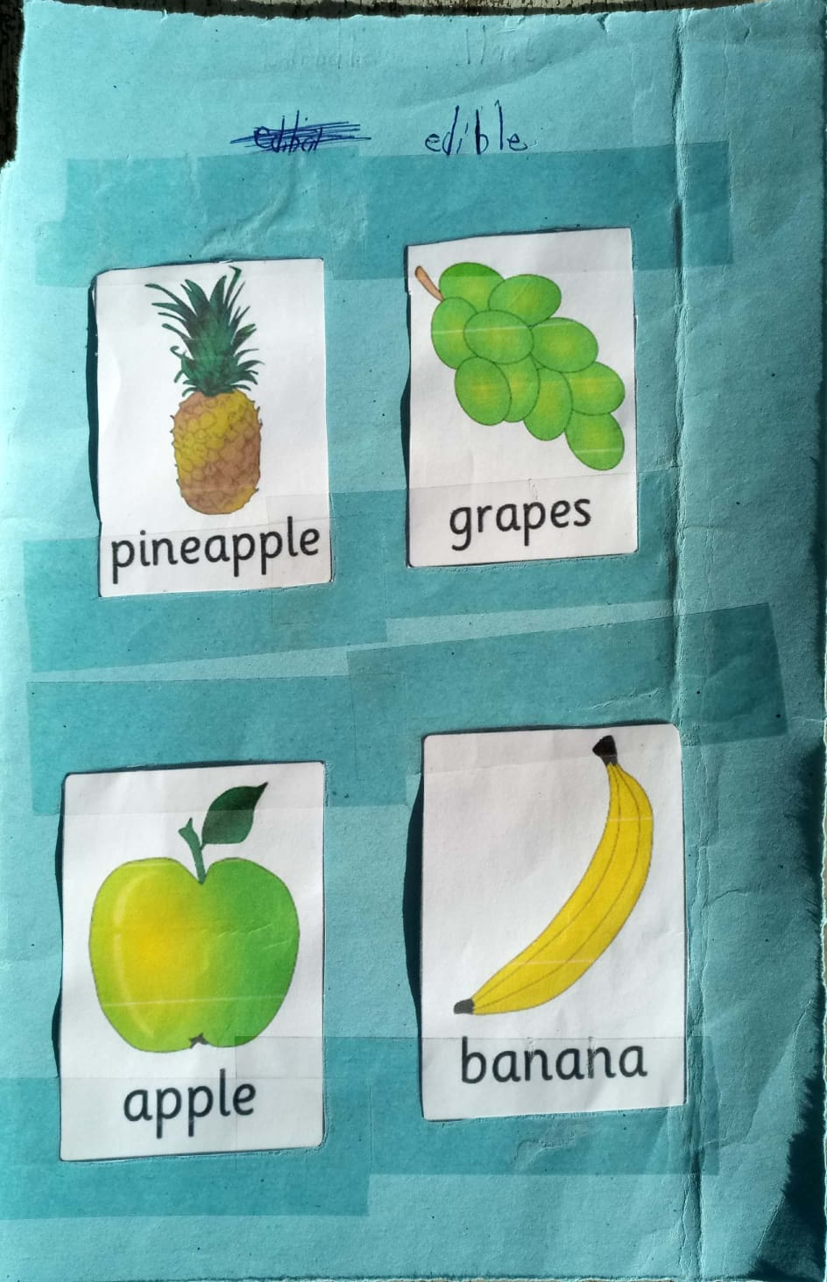

Slide 23

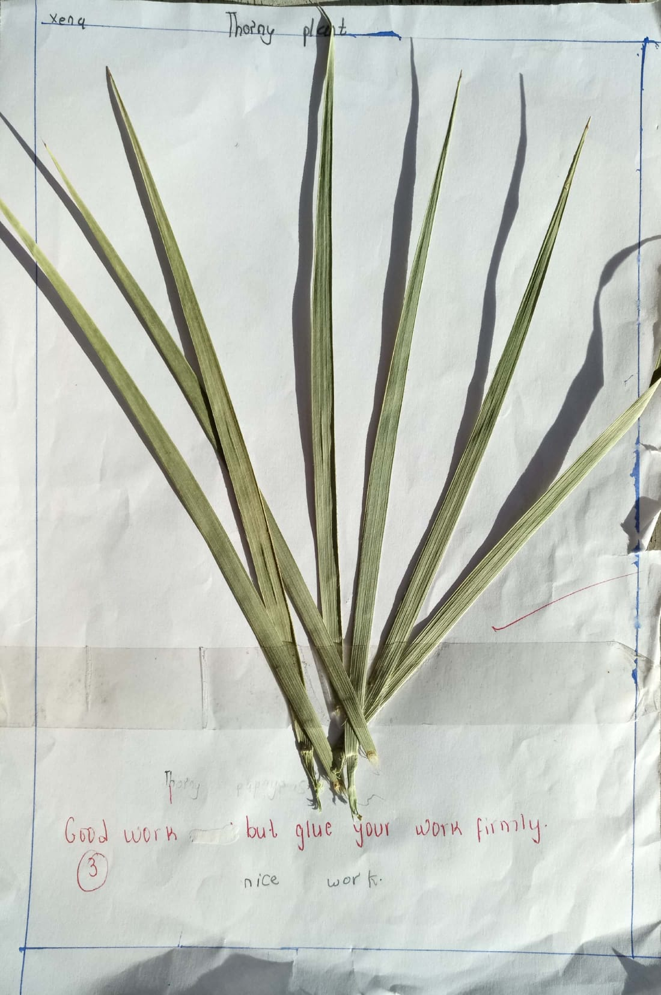


Slide 24
2 STAGES OF PORTFOLIO DEVELOPMENT

Slide 25
Overview
The portfolio development process consists of four basic steps:
collection,
selection,
reflection,
projection.

Slide 26
2. STAGES OF PORTFOLIO DEVELOPMENT
    2.1 Planning
    2.2 Communication
    2.3 Collection of work
    2.4 Selection of work samples
    2.5 Reflection
    2.6 Feedback

Slide 27
Stages of portfolio development
…………..cont.d
  2.1Planning
    The function / purpose- To show learners progress, achievement or mastery of competencies , learner interest or talents.
    Types e.g. working, show case, or assessment
    Audience: the consumers of the portfolio e.g. teachers, parents, school administration
    Design of the portfolio:
        Storage holders.
        Colour codes.

Slide 28
Stages of portfolio development
…………..cont.d
2.2 Communication
The teacher should communicate to the learners, Headteacher, other teachers and parents about the:
    purpose of the portfolio
    Assessment criteria
    Requirements

Slide 29
Stages of portfolio development
…………..cont.d
2.3 Collection of work samples
Learners are guided by the teacher to assemble work that reflects their own progress and mastery of competencies.
The collection should be guided by
    Purpose of the portfolio
    Specified learning outcomes and competencies
    Evaluation criteria
    Personal goals, interests and abilities

Slide 30
Stages of portfolio development
…………..cont.d
2.4 Selection of work samples
This is the decision-making stage where the learner selects the work to be added to the portfolio and how it should be arranged.
The selection is guided by the type and purpose of the portfolio.
Learners should be guided and encouraged to select the best of their own work.

Slide 31
Stages of portfolio development
…………..cont.d
2.5 Reflection
Learners should make a self assessment comment on the work selected for addition to a portfolio, and on their own work.
The reflection statements can be:
    Learners thoughts on their own learning;
    Strengths and weaknesses identified;
    Progress on the specified competency.

Slide 32
Stages of portfolio development
…………..cont.d
  Questions that guide reflection include:
  What did I learn from it?
  What did I do well?
  Why did I choose this item? (Based on the assessment criteria or own interests)
  What do I do to improve on the item?
  How do I feel about my performance?
  What are the problem areas?
  What are others’ opinion about my work?

Slide 33
Stages of portfolio development
…………..cont.d
2.6 Feedback
The work selected for addition into a portfolio should contain feedback from peers, parents and teachers.
Feedback should be positive and focus on the work and not the individual learner
Feedback may be provided after the learners’ reflections on their own work

Slide 34
By the end the session, the participants should be able to
  Identify features of a good portfolio
  Manage portfolio assessment in the classroom
  Engage parents in portfolio assessment
  Explain the importance of portfolio assessment

Slide 35

3. FEATURES OF A GOOD PORTFOLIO
Activity 3 In groups, participants Brainstorm and make presentations on the features/elements of a good portfolio.

Slide 36
ELEMENTS OF A PORTFOLIO
Cover
Table of Contents
Entries
Dates
Drafts
Reflections

Slide 37
Features of a good Portfolio
…… contd
Cover Page
This includes the learner’s personal details;
  Name,
  Age
  Grade,
  Gender
  School.
  It also includes one or two paragraphs that show personal goals and experiences of the learner.

Slide 38



Features of a good Portfolio
…… contd
Samples of portfolio cover page

Slide 39
Features of a good Portfolio
…… contd
Table of contents
This shows what is contained in the portfolio.
The contents can be organized based on
  learning areas,
  tasks or
  core competencies.

Slide 40
Features of a good Portfolio
…… contd
  Entries
  This includes core and optional items.
  Core items are required for each learner to facilitate decision making during assessment.
  Core items provide evidence of performance on the specified learning outcomes or competencies.
  Optional items on the other hand are the items of the learner’s choice

Slide 41
Features of a good Portfolio
…… contd
Dates
All entries must be dated to provide proof of growth over time.
Drafts
These include initial and revised/corrected/ improved versions of learner’s aural/oral and written/constructed products.
Feedback
This could be on the level of performance, progress and feelings about their work.

Slide 42
Activity 4
  In groups, Participants to discuss and
  make presentations on the following:
  Management of portfolio in
  classroom assessment
  Parental engagement in portfolio assessment
  Importance of portfolio assessment

Slide 43
4.0 MANAGEMENT OF PORTFOLIO IN CLASSROOM ASSESSMENT
  The teacher should:
  4.1 Go over the portfolio with the learners at regular intervals to ensure that the selected pieces address the learning outcomes.
  4.2 Ensure limited number of entries for practical reasons. Focus should be on Quality and not Quantity.

Slide 44
Management of portfolio in classroom assessment…………..contd
    4.3 Involve the learners in organizing the portfolio by completing checklists of the assignments done and include the dates on all entries.
    4.4 Organize for the storage of the learners’ portfolios which should be easily accessible.
    4.5 Separate/Colour code portfolios for each class to facilitate their retrieval.
    4.6 Ensure that storage holders for the portfolio are made from manila envelopes, folders, files, or learners can improvise their own using locally available materials

Slide 45
5.0 PARENTAL ENGAGEMENT IN PORTFOLIO ASSESSMENT
5.1 There should be a planned program for parental engagement in portfolio assessment.
5.2 The parents should be informed about
        Portfolio assessment;
        Participation in learner-led portfolio conferences/interactions;
        Provision of feedback to their child;
        Identifying and providing learning opportunities and resources;
        Provision of support for their child’s effort and interest.

Slide 46
IMPORTANCE OF PORTFOLIO ASSESSMENT
6.1 Assessment is integrated in teaching and learning process.
6.2 Instruction goal are set at the beginning and are both clear to the teacher and the learner.
6.3 Provides a clear profile of learners.
6.4 Enables learners to show quality work which is done without pressure and constrains of time in collaboration with others.

Slide 47
Importance of portfolio assessment …………contd
6.5 It allows demonstration of a wide range of competencies.
6.6 It shows the learners effort to improve and develop i.e. it demonstrates progress over time.
6.7 It gives learners opportunity to reflect on their work.

Slide 48
ACTIVITY 5
In groups, participants to develop and present an assessment portfolio using the tasks and evidences developed.
The portfolios should aim at demonstrating the learners progress, achievement and interests in the areas outlined in the rubrics and the core competencies.

Slide 49
PORTFOLIO DEVELOPMENT
Requirements:
Samples of portfolios
Authentic tasks
learners work samples
Score sheets

Slide 50
“Learning should not be all about the
end result, portfolio is one of those
assessment methods which allow
learners to demonstrate more than
the end result – a process orientated
method.”
Chan C.(2009) Assessment: Portfolio, Assessment Resources

Slide 51
THE KENYA NATIONAL EXAMINATIONS COUNCIL
“One big contribution of portfolio is to give the learners the chance to reflect and revisit on their performances overtime”.
THANK YOU

