Slide 1
PSYCHOLOGY 2019
BY
MRS MARGARET JACOB
DPT OF MLS.

Slide 2
INTRODUCTION
Psychology originated from two Greek words i.e., Psyche __________ soul
Logos __________ study
Psychology broke away from philosophy and physiology and emerged as a separate discipline some 100 years ago.
Psychology is the science of human and animal behavior.

Slide 3
Why psychology is a science?
Psychology posses a body of facts which can be supported through universal laws and principles.
It emphasizes the search for truth
It does not believe in hearsay, stereotypes or superstition.
It believes in cause and effect relationships
It adopts the method of objective investigations, systemic and controlled observation and a scientific approach
It also stands for the generalization, verifiability and modification of the observed results or deduced phenomena
Helps in predicting future developments , and
It’s able to turn its theory into practice through application

Slide 4
cont
Psychology posses a body of facts which can be supported through universal laws and principles.
It emphasizes the search for truth
It does not believe in hearsay, stereotypes or superstition.
It believes in cause and effect relationships
It adopts the method of objective investigations, systemic and controlled observation and a scientific approach
It also stands for the generalization, verifiability and modification of the observed results or deduced phenomena
Helps in predicting future developments , and
It’s able to turn its theory into practice through application

Slide 5
cont
What is behavior?
Behavior In its broader sense includes all types of human activities.
Behavior is both mental and bodily. 
Mental behaviors are thinking, reasoning, imagination and other mental experiences or processes.
 Bodily behavior refers to the movements and actions of the body in response to a situation.

Slide 6
cont
Behavior is the reaction of an individual to a particular environment.
The environment exerts influence on individuals.
That influence is called stimulus.
The stimulus in turn arouses an activity from the individual and this is called the response.
A man may be admitted to a hospital for a surgical operation (stimulus)
The man feels frightened and worries because he is uncertain what may happen next (response)
This stimulus response combination constitutes the behavior of an individual.
The human behavior consists of physical responses, feelings, emotions and tensions, and all intellectual responses, perceiving, thinking, recalling, and reasoning.

Slide 7
cont
Psychology as a science studies how behavior grows and develops from infancy to old age and also studies behavioral differences between people.
In general there are four major facts proposed in relation to the nature of behavior.
These are:
 Behavior has a bodily basis 
Behavior is dynamic
 Behavior varies from person to person 
Behavior is social

Slide 8
Importance of psychology
1. It helps to understand oneself.
 Helps to make rational decisions on becoming a health professional;
 To fulfill the need for economic self- sufficiency;
 Helps to assess ones own abilities and limitations; 
Enables to control situations in the college and attain goal through self-discipline.
2. It assists in understanding other people. 
The health professional works with patients, families, other nurses, doctors and administrative staffs. 
Equipped with the knowledge of psychology, the health professional will achieve greater success in interpersonal relationships. 

Slide 9
cont
Psychology helps the health professional to learn why others differ from him/her in their preferences, customs and beliefs or cultural patterns.
3. It enlightens to appreciate the necessity of changing the environment and how to bring it about.
 By changing the environment, the health professional can bring about change in the patient’s life. Example: introducing eyeglasses and hearing devices into the environment can help people with visual or auditory impairments.

Slide 10
Scope of psychology
Psychology studies different subject matters and its scope is diverse. It is related with other disciplines.
Psychology and politics
Many political problems consist psychological problem.
The political battle can be effectively carried on at all, in so far as it can be supported by a scientific psychology.
2. Psychology and Economics
The solution and clarification of an economic problem such as poverty, for example, requires the full understanding of the psychological needs of the human being: which is an essential concept in the theory of personality.

Slide 11
cont
3. Psychology and Health
The relationship is well articulated in so many health related books. It is also clearly stated in the WHO’s preamble as follows:
“Health is a state of complete physical, mental and social well-being, and not merely the absence of disease or infirmity.” The scope of psychology changed through time.

Slide 12
cont
Its expansion has brought changes both in subject matter and methodology.
Among the most important issues and questions that are addressed by psychology at different historical periods are:
 Nature (heredity) versus Nurture (environment); 
Conscious versus unconscious determination of behavior; 
Observable behavior versus internal mental processes; 
Freedom of choice versus determination;  Individual difference versus universal principles.
Though there is a problem in clearly defining the scope and elaborating the methodology, psychology is attractive, important and tantalizing.

Slide 13
Goals of Psychology
Describe – what is the nature of this behaviour?
The first goal is to observe behavior and describe, often in as much detail as possible, what was observed as objectively as possible.
Through describing the behavior of humans and other animals, we are able to understand it and gain a better perspective on what is considered normal and abnormal

Slide 14
cont
Explain –why does it occur?
While descriptions come from observable data, psychologists must go beyond what is obvious and explain their observations. In other words, why did the subject do what he or she did?

Slide 15
cont
Predict –
Another primary goal of psychology is to make predictions.
Once we know what happens, and why it happens, we can begin to speculate what will happen in the future. There’s an old saying, which very often holds true: "the best predictor of future behavior is past behavior."

Slide 16
cont
Control –The fourth goal of psychology is to control, modify or change the existing behavior. Influencing behavior in a helpful manner.
Once we know what happens, why it happens and what is likely to happen in the future, we can expect control over it.
In other words, if we know you choose abusive partners because your father wasabusive, we can assume you will choose another abusive partner, and can therefore intervene to change this negative behavior.

Slide 17
cont
NB:Improve –
Not only do psychologists attempt to control behavior, they want to do so in a positive manner, they want to improve a person’s life, not make it worse.
This is not always the case, but it should always be the intention.

Slide 18
summary
Goals of psychology
observe
describe
explain
predict
control

Slide 19
significance of psychology in nursing
Helps in establishing patient-nurse relationship
Enhances therapeutic relations with patients
Facilitates relationship among health care professionals

Slide 20
Branches of psychology
Educational psychology - It is about Ways and methods of educating people.
2. Developmental psychology - Deals with aspects of human development over the entire span of life. Span of life covers from conception to death.
♦ Aspects of human development are the following: ▪ Physical ▪ Mental ▪ Social

Slide 21
cont
3 Social psychology
It is the study of how people’s thoughts, feelings and actions are affected by others
Social psychologists study aggressive behaviors (example: violence, rape, alcoholism in the community)
Social psychologists study conflict between groups, communities, and ethnic groups and methods of solving it.

Slide 22
cont
4 Behavioral psychology
It is about the role of environment in developing behavior
It is about ways of learning new knowledge and skills
5 Clinical psychology
It is about Psychological disorders and their treatment.
It is about how to change the environment to prevent the prevalence of psychological disorders.
6 Health psychology
Emphasizes the preventive aspect of health than the curative aspect
Health is not merely the absence of illness. Health is a state of physical, mental and social well-being

Slide 23
Major perspectives in the historical development of psychology
Psychology broke away from philosophy and physiology and emerged as a separate discipline over 100 years ago.
In the last century, this young and fertile discipline went through a series of changes and expansions in both subject matter and research methods.

Slide 24
Early perspectives of psychology
Structuralism  -Formal research in psychology began at the university of Leipzig Germany where Wilhelm Wundt founded the first psychological laboratory in 1879.
 Wundt is considered as the first psychologist and father of experimental psychology. 
He limited the subject matter of psychology to the study of conscious experience.
The elements of conscious experience were considered to be of two kinds.
These are:
Sensations: sights, sounds, tastes, smells and touch, which arise from stimulation of the sense organs;

Slide 25
cont
b. Feelings: love, fear, joy, and so on  He believed that all conscious experiences are merely intricate combinations of elemental sensations i.e. sensory knowledge is the building block of our intellect.
Sensations combine to become conscious experiences as basic elements are composed to form complex substances in chemistry.
For example, an experience such as meeting and recognizing an old friend in the street was thought to be composed of many independent sensations, feelings and images, which were drawn together and synthesized by the mind.

Slide 26
cont
Its method of study was introspection. 
In introspection people are taught, trained to observe and report the 'content' or 'elements' of awareness in a particular situation.
For example; people are presented with stimulus such as a sentence on a card and asked to describe in their own words their own experiences. 
Introspection is detailed description and how people perceive things in the world.

Slide 27
2. Functionalism
The American psychologist William James pioneered functionalism.
Functionalism was strongly influenced by biology.
The work and ideas of Charles Darwin had a great impact on the emergence of functional psychology.
According to Darwin’s theory of evolution, living organisms change and develop over time through a process of natural selection.

Slide 28
cont
Organisms whose characteristics were best suited to their environment survived and reproduced.
While organisms whose characteristics were less adaptable died out.
Survivors would transmit to the next generation those characteristics that enabled them to survive. 
William James was greatly influenced by Darwin.
James held that the function of consciousness was to enable humans to behave in ways that would act survival through adaptation to the environment.

Slide 29
Gestalt psychology
 The leading proponents of the Gestalt view were the German psychologists Max Wertheimer, Kurt Kafka and Wolfgang Kohler.  Instead of considering separate parts that make up thinking, Gestalt psychologists concentrated on the ‘whole’.
Their slogan is ‘the whole is greater than the sum of its parts’. Gestalt means shape, form or configuration. 
Their belief was that the whole is different from the sum of its parts. In order to understand our environment we have to perceive it in its totality not in its individuality.

Slide 30
cont
Max werthiemer said that ‘it is a mistake to analyze psychological events into pieces, or elements, as the strtucturalists did.’ 
Further research by the Gestalt psychologists led to the development of a set of principles of perceptual organization.

Slide 31
cont
Such organizations arose through the brains innate ability to structure and organize the
perceptual field into meaningful patterns rather than perceiving the separate elements.
For some of the main Gestalt principles of organization, see the chapter ‘sensation and perception.’

Slide 32
Psychoanalysis
The Viennese neurologist and psychologist Sigmund Freud (1856-1939) pioneered the psychoanalytic perspective. 
Freud said that conscious experiences are only the tip of the Iceberg.
Beneath the conscious experience is Primitive biological urges that seek expression but which are in conflict with the norms and morality of the society. 
These unconscious motivations and conflicts have powerful influences on our conscious thoughts and actions.
Therefore they are responsible for much of human behavior including physiological problems.
According to Freud, all behavior whether normal or abnormal is influenced by the unconscious mind.
This belief is called psychic determinism.
 They cannot be directly studied through introspection.

Slide 33
Freud methods of studying unconscious mind
According to Freud the methods of studying the unconscious mind are:
Free association 
In this method the psychoanalyst gives the client a word and asks to reply with the first word that comes to mind be it nonsense or irrelevant.
The psychoanalyst makes associations and meanings between ideas, words, and thought.
 It is a projective technique to explore the client’s unconscious thoughts.

Slide 34
b. Dream

The contents of dreams are analyzed for underlying or hidden motivations. 
Dreams are viewed as indication of what a person is truly feeling within the conscious mind.
Freud said dreams are ‘the royal road to the understanding of the unconscious.’
Remember the old proverb, which says. " Pigs dream about corn and geese dream about maize."

Slide 35
Behaviorism 
John Watson (1878-1958) revolutionized psychology by changing the subject matter of psychology from the study of conscious experience to the study of behavior. 
Watson believed that the study of psychology should be about observable behavior and its aim should be to describe, predict, understand and control behavior. 
He contended that psychologists should never use the terms consciousness, mental states, introspection, imagery and the like.

Slide 36
cont
 Followers of behaviorism did not reject the existence of mind and consciousness.
Rather, they viewed these concepts as impossible to observe and contributing little to a scientific approach to psychology. 
Watson’s focus on the study of observable behavior enabled to formulate clear hypotheses, which could be tested by experimentation. 

Slide 37
cont
Watson’s view of learning relied to a great extent on Pavlov’s account of classical conditioning. Accordingly, it is possible to break down and analyze a certain behavior into stimulus-response units. 
Much of the behaviorists’ research into learning was carried out on animals, rather than humans; partly because animals were easy to obtain and greater control could be exercised over their environment, and partly because they accepted the idea that humans and animals are related both physiologically and behaviorally. 

Slide 38
cont
The work of John Watson contributed much to the use of more objective and systematic
methods to the study of human behavior.

Slide 39
Recent perspectives
The biological perspective
It states that behavior has a biological basis.
The behavior of both people and animals should be considered in terms of biological functioning.
2. The cognitive perspective 
It focuses on the process that helps people to know, understand, and think about the world. 
This perspective explains how information in the memory is processed at different stages and how our thinking about the world influences our behavior. Example: Can a medical student watch television and study at the same time?

Slide 40
3. The behavioral perspective
 The 1904 Nobel Prize winner, the Russian physiologist and psychologist, Ivan Pavlov opened a new way of thinking for psychological investigations. 
His experiment on dogs enabled psychologists to explain certain behavior and certain differences among individuals as the result of learning. 
Following the works of Pavlov, Thorn dike and Watson behaviorism got strength. Through time, its principles and methods of study became an integral part of psychology.

Slide 41
CONT
By the middle of the twentieth century, it was widely accepted that psychology was about the study of behavior rather than conscious experience. 
The American psychologist B.F.Skinner refined and popularized behaviorism.
He showed that the consequences of behavior provide the basic mechanism for predicting and shaping future behavior.
Contribution: Skinner’s theory inspired certain techniques of toilet training how to loose weight, quit smoking and learn new skills.
His theory helped to develop techniques for the treatment of various psychological disorders, the resolution of sexual problems and even the halting of drug addiction.

Slide 42
4. The humanistic perspective
 It is a psychological approach that suggests that people are in control of their lives 
This perspective assumes that people are naturally endowed with the capacity to make decisions about their lives and to control their behavior.
 Humanistic psychologists claim that everyone has the capacity to develop to higher levels of maturity and realize his/her full potential if given the opportunity.


Slide 43
CONT`
The human being has free will to make decisions about his/her own life, rather than depending on societal standards.
For example, if a person chooses to lead an average life, it cannot be considered as worse compared to a person who has higher aspirations

Slide 44
PERSONALITY
Personality is the total quality of an individual’s behavior as it is shown in his habits of thinking, in his attitudes, interests, his manner of acting and his personal philosophy of life.
It is the totality of his being. It includes his physical, mental, emotional and temperamental makeup and how it shows itself in behavior. 
These various components of personality do not stand apart from each other. They are interconnected and as a result of this integration gave rise to a characteristic behavior pattern or quality called personality.

Slide 45
CONT
There are three basic factors, which have to be considered in describing personality.
These are:
The internal aspects: these are feelings, the physiological systems, glands and inherently determined physical features.
2. The social situation: they include the influence of the family and other groups to which one belongs, the influence of customs, traditions and culture.
3. The reactions or behavior; they are results from the interaction of the individual and the stimuli from the environment.

Slide 46
CONT
Personality is a dynamic growing thing.
It grows in a social setup, through social experiences and continual adjustment to the environment. T
here are three main factors that contribute to differences in personality

Slide 47
Factors causing differences in personality
The physiological factors. These include: 
The physique of the individual (his size, strength, looks);
Physical appearances and deficiencies and how other people react to these characteristics; 
Endocrine glands production of hormones; Example: excess insulin secretion may make the individual fatigued or anxious.
Hypothyroidism may cause sluggishness, inertia or dullness, slowness or stupidity.
Hyperthyroidism may cause nervous tension, excitement and over activity.

Slide 48
cont
2. The environmental or social factors  Reactions of other people and reactions to other people; Example:
relationships in the home and the family, the influence of school 
An atmosphere of peace, love, mutual understanding at home develops self- confidence and security; 
Repressive home atmosphere will result in rebellious or dependence as personality traits; 
Personality of the teacher, richness of the curriculum, the presence or absence of co curricula activities, methods of teaching affect the child’s personality.

Slide 49
3. Mental or psychological factors include  Motives, interests, activities, will and character, intellectual capacities, reasoning, attention, perception and imagination.

Slide 50
Theories of personality development
When we study the field of personality psychology, in general, four areas are observed.
These are theory, structure, development and dynamics.
Theory- It is a body of knowledge, which psychologists use to explain complex concepts in the study of personality.
Psychologists consider a number of approaches to the study of personality.

Slide 51
a. Structure - It is anatomy of personality with basic dispositions and interrelationships of different elements of personality.
These personality structures are enduring and stable aspects of personality.
b. Development- Individuals’ are different from each other even at birth, in physical appearance or temperament.
The differences become more complex with increasing age and interaction with the environment.
c. Dynamics - The dynamic aspect of personality is concerned with the meaning and function of behavior.
It looks for the purpose or the objective of an act, why the individual behaves the way he/ she does.

Slide 52
Psychoanalytic theory
It is general and best-known theory of personality. 
The greatest figure in psychoanalytic theory is Sigmund Freud (1856-1939).
All psychoanalytic theories have two themes in common.
They are concerned with powerful but largely unconscious motivations believed to exist in every human being
Human personality is governed by conflict between opposing forces i.e.; anxiety over unacceptable motives and defense mechanisms that develop to prevent anxiety from becoming too great.

Slide 53
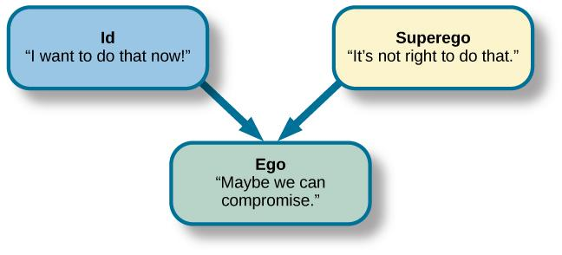
Components of personality

Slide 54
1. The Id
 It is the reservoir of psychic energy.
 It is the storehouse of biological drives that arise from our needs for food, water, warmth, sexual gratification and avoidance of pain etc. 
It is inborn.  It is governed by the pleasure principle the principle of hedonism.
 The id has no link to objective reality  It looks for immediate discharge of tension arising from biological drives, without regard for logic or reason, reality or morality.
 The id is like a demanding, selfish child. It looks only its own pleasure. 
The id has no way of determining which meanness of doing things (strategy) is safe and which are dangerous.
Goal setting is not realistic.
 In the absence of external goal satisfaction, internal mental acts (Example: dream about accomplishment, achievement desire, daydream of attacking some one in order to gratify aggressive needs) are used to fulfill wishes.

Slide 55
2. The Ego
 It begins to develop soon after birth, but does not become apparent until the age of about six months. 
It serves as a mediator between the id impulse and reality.  Unlike the id, the ego is conscious. 
It operates according to the reality principle.
Satisfaction of biological needs is not given up; but reality is taken into account to satisfy these biological needs. 
Takes into consideration past experiences  To obtain the most pleasure, it looks for the best time with the least pain or damage to the self. 
The ego cannot totally reject the id impulse.
Rather like a patient parent, it attempts to control, divert and protect the id.

Slide 56
The ego is partially conscious (preconscious): because it also uses temporary ways of resolving the contradiction between the biological drives and the reality.

Slide 57
3. The Superego
It represents the ideals and moral standards of society as passed to the child by his or her parents in the process of socialization. 
Through the socialization process the child learns the entire dos and don’ts.  Like the id, the superego is not attentive to reality, nor does it differentiate between desires and actions.
 It constantly commands that sexual and other biological urges should be stopped and pleasure is postponed according to the ideals and morality of society. 
The super ego has two main functions based on reinforcement processes.

Slide 58
cont
These are:
a. For good behavior - The super ego rewards Consequence - feeling of pride and self-esteem
b. For bad behavior - The super ego uses punishment Consequence - feeling of guilt and inferiority.
According to Freud the superego is harsh and punitive taskmaster.
It wants the person to be perfect.
It doesn't take into account individual capabilities and circumstances in the environment

Slide 59
Integration of the three personality structures
Ego executive agency (highest) structure in a person mediates to satisfy the constant demands of id but bound by the constraints of reality and moderate the ideals of superego. The following hypothetical example illustrates how the three personality structures operate in real life situation.
A six-year-old child Bereket spots his favorite candy in a supermarket. The id shouts - "I want it now! Take it!" The super ego - "Thou shall not steal." The ego - "I could ask my father Girma to buy it for me, but he might say no."

Slide 60
Anxiety and defense mechanisms
How does the ego then try to reconcile, moderate the opposing goals of the id and the superego? When the ego loses its energy to resolve the divergent demands of the id, anxiety is signaled.
Anxiety is a feeling of apprehension or tension that hinders our daily functioning. Anxiety arises when: 
Ego realizes that expression of an id impulse will lead to some kind of harm to the personality. 

Slide 61
cont
The superego is making an impossible demand to the satisfaction of the biological needs.
Anxiety as an alarm signal tells ego that something must be done to resolve the conflict and to protect the personality from danger.
The ego, therefore, uses defense mechanism, a mental strategy to block the harmful forces while at the same time reducing anxiety. It protects the individual from overwhelming anxiety, punishment of the superego and other unpleasant experiences.
There are varieties of defense mechanisms. The most common defense mechanisms are described below

Slide 62
1. Compensation
 When the individual tries to overcome a failure or deficiency in one area through achieving
recognition in another area, the adjustment is called compensation. 
This enables the individual to enhance his self- esteem.

Slide 63
2. Rationalization
 The individual who has been frustrated or who cannot solve the problem successfully feels discomforted and restless.
To lessen his feelings of anxiety, he gives reasons other than true reasons. Example- A student who cannot do well academically, often satisfies himself by saying “It is not rewarding to work hard in this college”

Slide 64
3. Projection 
When a person attributes his shortcomings, moral defects to others as a means of lessening a sense of guilt or inadequacy it is called projection. 
Projection is deflection of the attention of others from our own shortcomings. Example- A student nurse who has cheated in an examination may satisfy herself by saying that others also have cheated.
A medical student who is criticized for poor work on the wards by his/her professor may retaliate by finding many weaknesses in his/ her profession

Slide 65
4. Displacement
 It is a specific form of projection
Example- The ward sister has scolded a student nurse for showing carelessness on duty.
The student nurse instead of showing her anger towards the ward sister, the student nurse may show aggressive feelings on a patient.

Slide 66
5. Identification
 It is an adjustment mechanism, which enables a person to achieve satisfaction from the success of other people, groups or organization.
Example- Boys identify themselves with their fathers, and girls with their mothers.
Students identify themselves with their favorite teachers. A businessman who has not yet achieved success in business may identify himself with a well-known businessman.
If we assume the attitudes or behavior characteristics of another person with whom we identify, again and again the danger is that we may thereby, lose our own identity

Slide 67
6. Substitution
 It is an adjustment mechanism in which original goals or others substitute desires.
The original goals are difficult to achieve and an attempt at achieving them may end in failure. 
The individual tries to lessen the effects of failure by selecting a new goal or a new situation, which is easier to attain.
Example- A student who has not been accepted for admission by a medical school may satisfy herself/himself by becoming a nurse.
A student who cannot go to the medical college for lack of money takes evening courses in x- ray technology.

Slide 68
7. Sublimation
 It is a form of substitution in which our unacceptable desires or activities are redirected into social desirable channels.
 We cannot give direct expression to our sexual, or aggressive impulses due to many social restrictions, laws and regulations. 
These impulses have to be repressed and the energy associated with them may produce maladjustment. Example- An unmarried woman interested in children may give expression to her repressed maternal need by engaging herself in orphanage work or in any child welfare institution.

Slide 69
 Unsatisfied sexual needs may be redirected in useful artistic and literary works.

Slide 70
8. Negativism
 Some individuals react to frustrating situation by becoming negative. 
They refuse to attack the problem. 
They become uncooperative and do the opposite of what should be done.
Example- patients, who have developed negativism, will not cooperate in the treatment planned for them.
Children who are treated unfairly and discriminately are likely to develop disobedience, tepertantrum.

Slide 71
9. Sympathies
 The individual avoids the necessity of solving his problems by obtaining the sympathy of others. 
The individual tries to get attention and concern of others.
Example- a student nurse is not doing well in her/his studies.
Instead of finding out the cause realistically and making effort to improve herself, she/he may evoke by telling others how difficult things are for her, how her family is in great trouble

Slide 72
Psychosexual stages and how personality develops
Sexual impulses undergo five developmental stages.
These are;-
oral
anal
phallic
latency
genital.
At each stage in a child's life, the drive for pleasure centers around a particular area of the body i.e. mouth, anus, and finally the genitals.
Freud believed that adult personality is shaped by the way in which the conflicts between early id urges and the requirements imposed by society, like for example in weaning, toilet training, prohibitions against masturbation are resolved at each of the psychosexual stages.

Slide 73
cont
Adult emotional problems can be traced to specific disturbances during the four stages of psychosexual stages of development.
When the individual is not able to resolve the conflicting demands of the id impulses and the restrictions of superego, development will be tied up at a certain stage.
It is called Fixation.
The greater the fixation at a certain stage, the lesser mental energy the person has for mature social and emotional relationships with his environment.

Slide 74
1. The oral stage
 Sexual pleasure focuses on the mouth.
 Sucking is an important activity at this stage not only to obtain food to satisfy hunger, but also a source of intense pleasure for the child.
This is why babies suck, lick, bite, and chew anything they can get.
Fixation at the oral stage can occur for the following reasons.
a. When babies repeatedly experience anxiety over whether food will be given or not given.
b. When they come to learn that they are totally dependent on others.

Slide 75
Consequences

Passive, over dependent, un enterprising adult. 
A child who experienced strong oral fixation, due to the birth of a sibling may revert to thumb sucking and exaggerated dependency. It is a form of regression.

Slide 76

Oral stage

Slide 77
2. The anal stage
It occurs during the second year of life, when children begin to develop voluntary control over bowel movements.
 Holding in and expelling feces gives great sensual pleasure to the child.
The demands of toilet training by parents are imposed at this stage. 
Toilet training, according to Freud, is a crucial event because it is the first big conflict between the child's id impulses and society's rules.
.

Slide 78
cont
Fixation at this stage can occur due to strict and punitive toilet training.
Consequences - The child may resist completely the urge to defecate in a free and enjoyable manner.
 May result in extreme orderliness during adulthood. 
May result in excessive neatness during adulthood

Slide 79
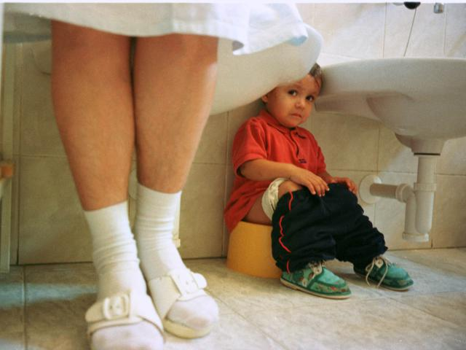

Slide 80
3. The phallic stage
It covers the years from about three to five or six years. 
Pleasure focuses on masturbation (self-manipulation) of the genitals.
 It is the period when the Oedipal and Electra conflicts occurs

Slide 81
The concept of Oedipal and electra complex
At five or six, sexual behavior is directed to mother.
The child sees his father as rival.
This is the rise of Oedipal conflict. But the boy fears to retaliate his father.
Freud called this castration anxiety.
Castration anxiety is the earliest form of subsequent anxieties.
In girls it is called Electra complex.

Slide 82


Slide 83
cont
The girl being jealous of her mother maintains relationship with her father.
But ultimately both boys and girls identify with parents of opposite sex with her mother.
Resolution of the Oedipal conflict 
The boy or the girl recognizes that he or she can never biologically possess the characteristics of the opposite sex parent. 
By means of identification the boy or the girl tries to adopt the attitudes, behaviors, and moral values of the same-sex parent

Slide 84
4. The Latency stage
The resolution of the Oedipal complex brings about a latency period lasting from about age six to eleven. 
During this stage the sexual and aggressive drives, which produced crises at earlier periods, are temporarily dormant.
There is no sexual zone for this state. 
This doesn’t mean that the child’s life at this time is entirely conflict-free. For example, the birth of a sibling may rouse intense jealousy.

Slide 85
5. The genital stage
The stability of the latency period, however, does not last long. As Erickson says, ‘It is only a lull before the storm of puberty’. At puberty sexual energy becomes high.
Once again, Oedipal feelings threaten to break into consciousness, and now the young person is big enough to carry them out in reality.

Slide 86
cont
Freud said that from puberty onward the individual’s great task is freeing himself from the parents.
For the son, this means releasing his tie to the mother and finding a woman of his own.
The boy must also resolve his rivalry with his father and free himself of his father’s domination of him.
For the daughter, the tasks are the same; she too must separate from the parents and establish a life of her own. Freud noted, however, that independence never comes easily.

Slide 87
cont
Over the years we have built strong dependence upon our parents, and it is painful to separate ourselves emotionally from them.
Successful resolution of the Oedipal complex may result in: 
The formation of deep and mature love relationships with the opposite sex. 
Enabling the personality to assumes a place in the world as a fully independent matured adult.

Slide 88


Slide 89
Eric Erickson developed the theory of psycho- social development.
1. trust versus mistrust stage (birth to 11/2 years).
At this stage Infants develop feelings of trust if their physical requirements and psychological needs for attachment are consistently satisfied.
Inconsistent care and unpleasant interactions with others can lead to the development of mistrust.

Slide 90
2. autonomy versus shame and doubt stage (11/2 to 3 years)
In this stage Independence and autonomy develop when there is freedom of environmental exploration  Overly restriction and protection by adults may enhance shame, self-doubt and unhappiness.

Slide 91
3. the initiative versus guilt stage of psychosocial development (ages 3 to 6 years).
At this stage the challenge is between the child’s desire to initiate activities independently and the guilt that may result from unexpected consequences from such activities. 
Parents are expected to react positively to the Child’s attempts so that the child could solve the contradiction at this stage. 
Helping children to plan activities within their limits and encouraging them not to give up their plans is essential for positive psychosocial development

Slide 92
4. industry versus inferiority stage (ages 6 to 12 years)
There is an increase in competence in academic, social and psychomotor skills.
 Children enter into the wider culture and learn basic social skills and start to appreciate societal values.  Peer influence is dominant at this stage. 
To avoid feelings of failure and inadequacy, parents and school administration need to create a supportive environment.

Slide 93
5. intimacy versus isolation stage
The psycho- social development stage during adolescence is named as the identity versus confusion stage.
During this stage:  The adolescence raises the identity question (who am I?)  External pressures are due to: * Physical change * Societal expectation changes (they consider themselves as adults, yet they are economically dependent on their parents)
There is decline in reliance on adults for information with a shift toward using the peer group as source of social judgment.
To avoid role confusion appropriate role model formation is important.

Slide 94
Intimacy versus isolation stage
According to Erickson the stage of social development during early adult hood is termed as intimacy versus isolation stage.
Young adults feel a need for intimacy in their life.
After establishing a stable identity, a person is prepared to share meaningful love or deep friendship with others.
By intimacy we mean an ability to care about others and to share experiences with them.

Slide 95
cont
One research showed that 75% of college -age men and women ranked a good marriage and family life as important adult goals.
Failure to establish intimacy with others leads to a deep sense of isolation (feeling alone and uncared for in life).
Once two people have established some degree of intimacy, their interest begins to expand beyond just the two of them. They become concerned with raising the next generation

Slide 96
g. Generativity versus stagnation
Generativity refers to the creation and care for children.
Parents must do more than giving birth to children.
They must adequately care for and guide children for future life.
But people can achieve a sense of generativity without having children of their own.

Slide 97
cont
Nuns and priests, for example, can still guide and care for the next generation by working with other people’s children or helping to create a better world for them.
When generativity is lacking, the result is stagnation and impoverishment of the personality.
In such case people often become too exclusively involved in their interest and neglect the responsibility of caring for others.

Slide 98
The Humanistic theory of motivation
Humanistic theory is based upon the idea that everyone has the potential to make a contribution to society and be a good and likeable person – if their needs are fulfilled.
Abraham Maslow and Carl Rogers led the humanistic theory movement and it was Maslow who developed the “pyramid of needs”.

Slide 99
Each individual has a unique potential
♦ Self esteem (having positive or negative regard for oneself) is important in shaping ones personality.
Over estimating and under estimating ones own capabilities may result in social and psychological problems like superiority and inferiority complexes.
♦ Individual needs (need for recognition) have an effect on ones personality

Slide 100
The first four needs (physiological; safety and security; belongingness and love; and esteem) are often referred to as deficiency needs because they motivate people to act only when they are unmet to some degree.
Self-actualization, by contrast, is often called a growth need because people constantly strive to satisfy it.
Basically, self-actualization refers to the need for self-fulfillment -- the need to develop all of one's potential talents and capabilities

Slide 101
Specific examples of these types are given below, in both the work and home context.
self-actualization
education, religion, hobbies, personal growth
training, advancement, growth, creativity
esteem
approval of family, friends, community
recognition, high status, responsibilities

Slide 102
cont
Maslow originally felt that self-actualization needs would automatically be activated as soon as esteem needs were met, but he changed his mind when he encountered individuals whose behavior did not fit this pattern.
He concluded that individuals whose self-actualization needs became activated held in high regard such values as truth, goodness, beauty, justice, autonomy, and humor (Feist, 1990).

Slide 103
Characteristics of self actualizers
Accept themselves others and nature
Like simple things
Problem centred
Like privacy and detachment
Have profound interpersonal relationship

Slide 104
CONT
He elaborates on this basic principle by proposing a five-level hierarchy of needs.
Physiological needs are at the bottom of the hierarchy, followed in ascending order by safety and security, belongingness and love, esteem, and self-actualization needs.
This order reflects differences in the relative strength of each need.

Slide 105
cont
The lower a need is in the hierarchy, the greater is its strength because when a lower-level need is activated (as in the case of extreme hunger or fear for one's physical safety), people will stop trying to satisfy a higher-level need (such as esteem or self-actualization) and focus on satisfying the currently active lower-level need (Maslow, 1987).

Slide 106
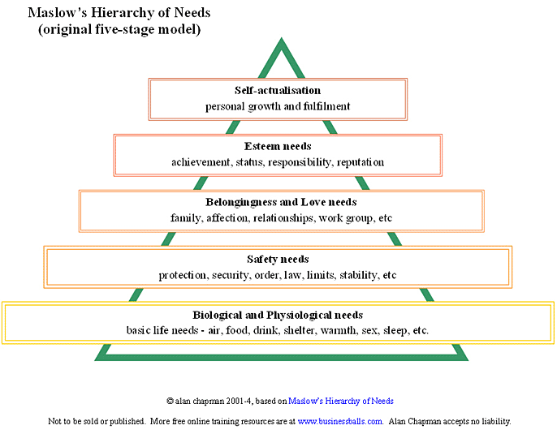

Slide 107
Social cognitive theory
Social and personality development in infancy (birth –1 ½ years)
♦ Consistently meeting the physical and social needs of the newborn baby (when cold, wet, hungry, affection) is very important for healthy social and personality development.
♦ Positive interaction and attachment with caregivers develops trust and self-confidence.
♦ Eye to eye interaction between an infant and care givers (mother, father or any other adult person) is important for emotional development

Slide 108
cont
2. Social and personality development in childhood
♦ From 1 ½- 3 years
▪ It is time to explore the environment.
▪ If children are restricted and controlled they are unable to develop self-control.
▪ Too little control may result in an over demanding behavior
♦ From 3- 6 years
▪ Children start to plan and set goals, act independently.
Adults should react positively to the Child's attempts.

Slide 109
cont
How can the child be protected from failure and other unwanted consequences in his activity?
By easing autonomy (not to be authoritative)
Permitting children to participate in decision- making at home.
Encouraging children not to give up their plans.
♦ From 6-12 years
• The child shows competency in all areas.
• Social interaction widens (influence of peer groups is great)
• Academic skills develop.
• Enters into the wider culture

Slide 110
3. Social and personality development in adolescent (13-19 years)
♦ The adolescent raises the identity question (who am I?)
♦ Pressure due to:
• Physical change (primary and secondary sex characters develop)
• Societal expectation changes (they consider themselves as adults, yet they are dependent on their parents)
♦ To avoid confusion appropriate role model formation is important

Slide 111
cont
4. Social and personality development in adult hood.
♦Formation of close relationship with others.
♦Relationship could be on physical, intellectual or emotional level. Example: marriage, becoming member of professional associations.
♦ Contribution to the family, community and his country becomes great during this period

Slide 112
Human behavior and interractions

Slide 113
CONT
3. Social and personality development in adolescent (13-19 years)
♦ The adolescent raises the identity question (who am I?)
♦ Pressure due to:
• Physical change (primary and secondary sex characters develop)
• Societal expectation changes (they consider themselves as adults, yet they are dependent on their parents)
♦ To avoid confusion appropriate role model formation is important
4. Social and personality development in adult hood.
♦Formation of close relationship with others.
♦Relationship could be on physical, intellectual or emotional level. Example: marriage, becoming member of professional associations.
♦ Contribution to the family, community and his country becomes great during this period.

Slide 114
LEARNING
Definition-
Learning is a relatively permanent change in behavior as a result of practice and experience.
The above definition contains the following components  One has to distinguish between performance due to maturation and changes brought about by experience; 
One has to distinguish between short-term changes in behavior due to fatigue,; tension, stimulants and changes that are due to actual learning. 
The changes in behavior could be for worse or better;  Learning is not directly observed but manifested in the changed activities of the individual

Slide 115
Modes of learning
In learning a new thing, we follow different ways. There are three main ways of learning.
Learning by trial and error
 It is a random attempt to learn a new problem.  Some of these attempts may result in success but others may not. 
The right response to a situation is arrived at by chance, by constant trial and by making repeated errors. 
It is very common mode of learning in animals.  Trial and error learning is slow, wasteful and unintelligent

Slide 116
2. Learning by conditioning
 It is the simplest form of learning. 
It is a process in which a response or action due to some original stimulus becomes transferred to another stimulus which occurs at the same time or shortly after the original stimulus

Slide 117
3. Learning by observation and insight
 It involves mental exploration and understanding of what is being learned.
 It requires the ability to find out relationships. 
The learner uses his past experiences and his ability to generate new ideas.

Slide 118
Factors for effective learning
Motivation 
The stronger and clearer the motives in learning a course in health sciences, the greater are the effort and interest shown by the learner in learning the course. 
When the motives of learning are high, the learner becomes enthusiastic.
2. Intelligence 
It enables us to understand things
It enables us to see the relationships between things 
It enables us to reason and judge correctly and critically.

Slide 119
3. Maturation 
Neuro-muscular coordination is important for learning a given task.
Example- The child has to be physically mature before he is able to walk or run.
4. Physical condition of the learner
The learner should be in a good health status. Example- Sensory defects, malnutrition, toxic conditions of the body, loss of sleep and fatigue hinder effective learning.

Slide 120
5. Abiliy to Associate things
Example- All related facts and understandings from a previously learned course should be brought to new learning.
While learning a nursing procedure a student nurse could see its connection with anatomy, chemistry, and psychology.
6. Length of the working period  Learning periods should neither be too short nor too long. 
Long learning time sets fatigue and reduce effectiveness in learning.

Slide 121
7.Good working conditions
Example- Fresh air, light, comfortable surrounding, moderate temperature, absence of distractions like noise, aid in learning efficiently.
8. Mental health of the learner Example- Worries, fears, feelings of loneliness and inferiority hinders learning. Self-respect, self-reliance, and self-confidence are necessary for effective learning.

Slide 122
Theories of learning
There are four major theories of learning. These are: 1. Behaviorist learning theory;
2. Cognitive learning theory;
3. Social cognitive learning theory;
4. Psychodynamic learning theory;
5. Humanistic learning theory.

Slide 123
Theories of learning
Behaviorist learning theories
Behaviorism is a worldview that operates on a principle of “stimulus-response.”
All behavior caused by external stimuli (operant conditioning).
All behavior can be explained without the need to consider internal mental states or consciousness.
Contributors: John B. Watson, Ivan Pavlov, B.F. Skinner, E. L. Thorndike (connectionism), Bandura, Tolman (moving toward cognitivism)

Slide 124
cont
Behaviorism is a worldview that assumes a learner is essentially passive, responding to environmental stimuli.
The learner starts off as a clean slate (i.e. tabula rasa) and behavior is shaped through positive reinforcement or negative reinforcement.
Both positive reinforcement and negative reinforcement increase the probability that the antecedent behavior will happen again

Slide 125
In contrast, punishment (both positive and negative) decreases the likelihood that the antecedent behavior will happen again.
Positive indicates the application of a stimulus;
Negative indicates the withholding of a stimulus.
Lots of (early) behaviorist work was done with animals (e.g. Pavlov’s dogs) and generalized to humans.

Slide 126
cont
e.g. of behavioral theorists are BF Skinner who suggested that learning will occur and behavioral will be shaped in the direction that teacher wants if the behavior is rewarded.
To maintain that kind of learning behavior, reinforcements or rewards are necessary

Slide 127
The two basic models of learning in behaviorism are:-
classical conditioning model
operant (instrumental) conditioning models.
Both models of learning take place when a stimulus becomes associated with another stimulus or with particular consequences.
For example: a baby learns to associate the sight of a feeding bottle with a milk.

Slide 128
Classical conditioning model of learning
The theory of classical conditioning aims to account for the way in which reflex behavior may become associated with a new stimulus that does not naturally activate that behavior. 
It emphasizes the importance of stimulus conditions and the associations formed in the learning process. 
According to this model of learning, a neutral stimulus (NS), a stimulus that has no particular value or meaning to the learner is paired with a naturally occurring unconditioned or unlearned stimulus (UCS) and unconditioned response (UCR).

Slide 129
cont
After a few such pairings, the neutral stimulus alone, elicits the same response. 
Pavlov (1927), the Russian physiologist, was studying the salivary reflex in dogs.
When he observed that the dogs salivated not only at the sight and smell of food, a natural response, but also at the sight of the food container alone. 
Through a series of experiments, he demonstrated that dogs could be conditioned to salivate to other unnatural stimuli such as a buzzer being sounded slightly before the presentation of food.
Such a pairing caused an association to be formed between the buzzer and the food subsequently between the buzzer and the salivation response.

Slide 130
EXAMPLE
Through a series of experiments, he demonstrated that dogs could be conditioned to salivate to other unnatural stimuli such as a buzzer being sounded slightly before the presentation of food.
Such a pairing caused an association to be formed between the buzzer and the food subsequently between the buzzer and the salivation response. Figure one illustrates the process of classical conditioning and the terminology associated with it.

Slide 131
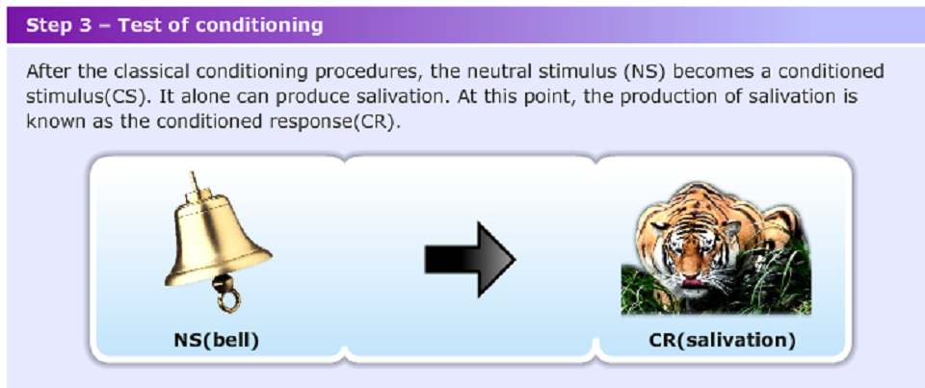

Slide 132
Because the response is now conditioned to a new stimulus, it becomes a conditioned response
There are 3 common phenomena in classical conditioning, they are generalization, discrimination, and extinction

Slide 133
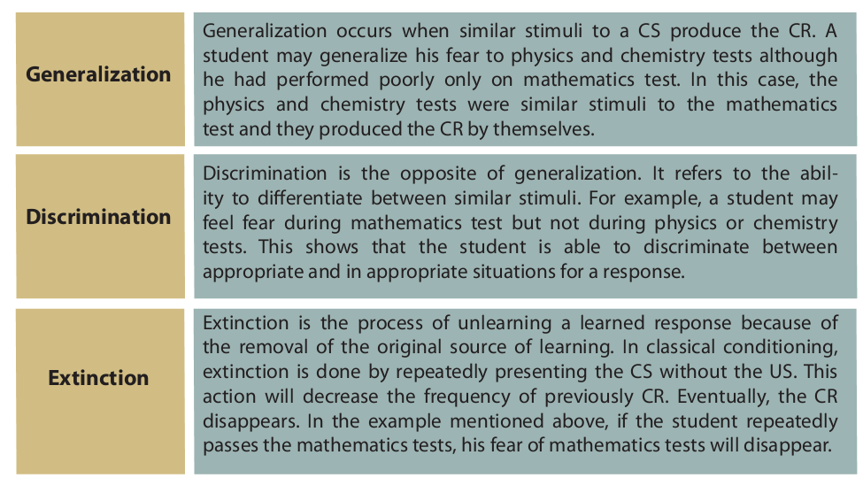
cont

Slide 134
operant conditioning,
Definition-It describes learning as strengthening or weakening voluntary response, depending on its positive or negative consequences.
It is a deliberate form of learning in which the organism actively attempts to change its environment to produce a desirable outcome.
The model focuses on the behavior of the organism and the reinforcement that occurs after the response.
B.F. Skinner has largely developed and popularized the model.
Example-1. Working industriously can bring about a raise in salary or bonus.
Example-2. Studying hard in college results in good academic grades.

Slide 135
cont
Example-3. A patient moans and groans as he attempts to get up and walk for the first time after an operation.
Praise and encouragement for his efforts will improve the chances that he will continue struggling toward independence.

Slide 136
Basic steps followed by Skinner in operant conditioning
A hungry animal (a cat, a rat, a pigeon) is placed in a laboratory setting (example- Skinner box)
2. The animal will wander in the box, exploring its environment in a random way.
3. The animal will press a lever by chance, which enables it to receive food from the food container.
4. The first time the response occurred, the animal will not learn the connection between lever pressing and the stimulus (food)
5. As the frequency of lever pressing increases, the animal learns that the receipt of food is dependent on lever pressing behavior.

Slide 137
Basic features in operant conditioning
Shaping: It is the process of teaching behavior by rewarding closer and closer approximation of the desired behavior.
In shaping, the behavior that is similar to the expected behavior is reinforced first.
Therefore, we use reinforcement selectively to convert simple behaviors into more complex patterns of responding.
The process is sometimes called successive approximation

Slide 138
cont
b. Chaining: It refers to the linking together of a behavior.
The initial response in the chain provides a set of cues which becomes associated with and thus elicits the next succeeding response and so forth so that the full sequence is chained off.
c. Stimulus discrimination: A behavior is reinforced in the presence of a specific stimulus but not in its absence.
A discriminative stimulus signals the likelihood that reinforcement will follow a response.
Example: we borrow a certain material from our friend after we recognize that our friend is in a good mood.

Slide 139
This was a random, unintentional interaction with their environment, leading to a rewarding consequence.
In each subsequent trial, the cat became more and more efficient at activating the latch – until eventually it was activated with little or no hesitation.
Thorndike described this as “learning by trial and accidental success

Slide 140
cont
d. Stimulus generalizations: It is a condition in which an organism learns a response to one stimulus and then applies it to other stimuli.
Example: if a nurse has learned that being polite to the physician produces recognition, it is likely to show similar behavioral pattern to other medical staffs in the ward.
e, Extinction: If reinforcement is discontinued, extinction of the operant response will occur.
Compared to classical conditioning, in operant conditioning extinction takes place after longer period of time

Slide 141
cont
f. Reinforcement: It is the process whereby a reinforcer increases the likely hood of a response.
The whole process that led the experimental animal to press the lever is called reinforcement.
The food that increases the probability of lever pressing is called reinforcer.
Skinner identified two kinds of rein forcers
A primary rein forcer satisfies some biological need. It is not based on past experience or learning. Example- Food, Water, Cessation of pain
2. A secondary rein forcer is a stimulus that becomes a reinforcer because of its association with a primary rein forcer. Example- Money; money enables us to buy basic necessities and luxuries which have survival importance.

Slide 142
cont
Rein forcers can also be labeled in terms of reward.
Positive reinforcer: it is a stimulus when added to the environment brings about an increase to the preceding response.
It is an application of a pleasant stimulus following an organism’s response.
2. Negative reinforcer: it is a stimulus that removes something unpleasant from the environment, leading to an
increase in the probability that a preceding response will occur again in the future.
Example- lowering the volume of the radio when you study prevents attention distraction

Slide 143
Negative reinforcers
Negative reinforcers work in two forms
a. Escape conditioning: the learner makes a response to bring about an end to an aversive situation. Example-1. A college student takes a day to escape from a workload. Example-
2. Suppose an instructor chastises a young student nurse. She says something humorous, and her instructor stops criticizing and laughs. Because the use of humor has allowed the student to escape an unpleasant situation, she will employ humor again to alleviate a stressful encounter.

Slide 144
cont
Avoidance conditioning: when the learner responds to a signal that marks the coming (onset) of unpleasant event with the aim of avoiding the evasion. Example:. The pretension of some people to look ill in order to escape from doing something that they do not want to do. 
If a person becomes truly ill when fearful events are anticipated, sickness is the behavior that has been increased through negative reinforcement

Slide 145
Punishment:
Punishment refers to unpleasant stimulus that decreases the probability of the occurrence of a preceding behavior.
It weakens the response and makes it less likely to recur.
Skinner believed that just as reinforcement (positive and negative) can be used to strengthen a response and makes it less likely to happen again.
However, he suggested that punishment is not a suitable technique for controlling behavior.
Studies with rats showed that punishment appeared only to diminish lever-pressing behavior for a short time, but did not weaken it in the long term.

Slide 146
The pros of punishment
It often is the quickest way to change behavior. 
Special instances like the behavior of autistic children can be suppressed temporarily until to buy time to use positive reinforcement techniques.
The cons of punishment 
t is ineffective if the punishment is not delivered shortly after the individual exhibits the unwanted behavior. 
It is ineffective if the punishment is delivered out of the setting in which the unwanted behavior is exhibited.
One of the important rules of operant conditioning is to punish the behavior, not the person. 
Punishment should not be prolonged.

Slide 147
cont
Example- Bringing up old grievances or complaining about misbehavior at every opportunity is not acceptable.
It may convey to the recipient the idea that physical aggression is desirable.

Slide 148
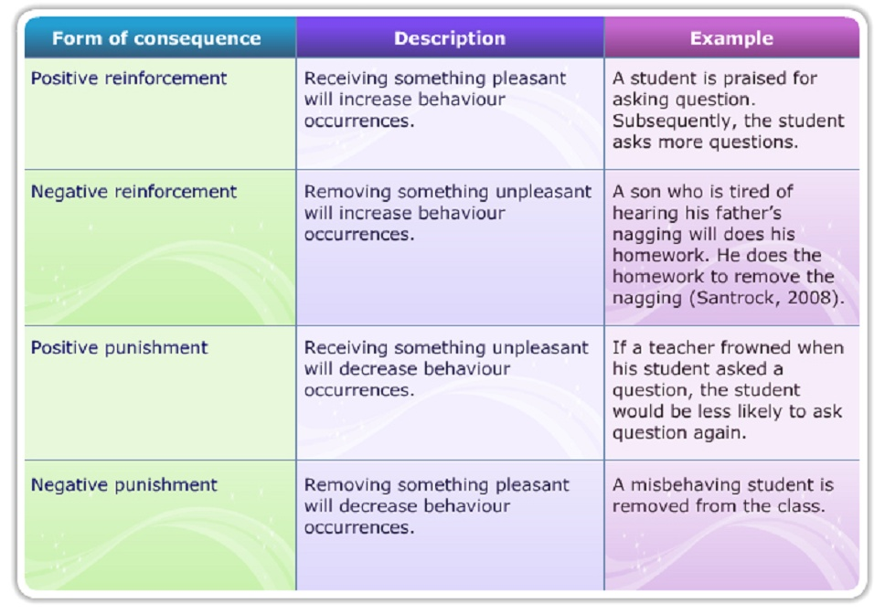

Slide 149
2. Social Learning Theories
This process is called modeling or observational learning.
Most of the principles of the social learning theory were developed by Bandura (Papalia, Olds & Feldman, 2007)
Social learning theory believes that students learn by observing or watching and imitating other people.
This process is called modeling or observational learning. Social learning theory extends behaviorism.

Slide 150
The social learning theory focuses on how people learn by observing and imitating others
Application
Use high-achieving and successful peers as models.
Model positive behaviors himself.
Use vicarious reinforcement, that is, make sure people see that positive behaviors will lead to positive consequences.
Demonstrate and teach good behaviors

Slide 151
3. Humanistic theories
Abraham Maslow (1921–1970) was an American psychologist who studied the needs or motivations of the individual
Humanism focuses on a person’s positive qualities, his or her capacity to change (human potential), and the promotion of self-esteem.
Humanists do consider the person’s past experiences, but they direct more attention toward the present and future.

Slide 152
Abraham Maslow (1954) formulated the hierarchy of needs, in which he used a pyramid to arrange and illustrate the basic drives or needs that motivate people.
The most basic needs—the physiological needs of food, water, sleep, shelter, sexual expression, and freedom from pain—must be met first

Slide 153
Maslow hypothesized that the basic needs at the bottom of the pyramid would dominate the person’s behavior until those needs were met, at which time the next level of needs would become dominant.
For example, if needs for food and shelter are not met, they become the overriding concern in life: the hungry person risks danger and social ostracism to find food.

Slide 154
Maslow used the term self-actualization to describe a person who has achieved all the needs of the hierarchy and has developed his or her fullest potential in life.
Few people ever become fully self-actualized.
Maslow’s theory explains individual differences in terms of a person’s motivation, which is not necessarily stable throughout life

Slide 155
cont
Traumatic life circumstances or compromised health can cause a person to regress to a lower level of motivation.
For example, if a 35-year-old woman who is functioning at the “love and belonging” level discovers she has cancer, she may regress to the “safety” level to undergo treatment for the cancer and preserve her own health.
This theory helps healthworkers understand how clients’ motivations and behaviors change during life crises

Slide 156
Cognitive learning theories
The theory stresses on the importance of what goes on inside the learner. Accordingly, the key to learning and changing in behaviour is the individual’s cognition (perception, thought, memory, and ways of processing and structuring information).

Slide 157
Cognitive learning theories originated from a group of scholars who studied the ways in which knowledge is acquired, stored, correlated and retrieved.
Cognitive theorists believe that knowing is a mental process that results in one being aware of a situation or project.
German Psychologist (1900’s); J. Gestalt postulated that patterns or configurations emphasize perceptions, interpreting, learning in terms of perception, principles of organization and belief that people respond to whole situations rather than parts.
Other cognitive learning theorists are S. Bloom, D. P. Ausubel and J. Bruner.

Slide 158
The three domains of learning
Benjamin, S. Bloom; proposed the following three domains of learning:-
1. Affective domain- which is concerned with attitudes
2. Cognitive domain- which is concerned with knowledge
3. Psychomotor domain- which is concerned with muscular and mental activities
According to bloom, there are levels of learning that a learner must go through starting from the basic existing knowledge to the highest level possible i.e. from simple to complex.
The teacher should cater for the relevant levels of the learner.
Learning skills involve a certain amount of knowledge and appropriate attitudes for the proper performance.

Slide 159
D. P. Ausubel; emphasized learning should start from known to unknown or simple to complex.
That new information fits into existing knowledge like a key fits into a lock. Take an example of preparing porridge versus preparing ‘ugali’. Translate this knowledge into a clinical procedure giving several examples.
Bruner; recommended discovery learning where he proposed that the teacher provide problems for the learners to work out the answers on their own.
The teacher also reminds the learner that in problem solving, there are many ways to approach a situation.

Slide 160
d. Piaget; cognitive constructivism is based on the work of Swiss developmental psychologist Jean Piaget whose theory has two major parts: "ages and stages“.
Component that predicts what children can and cannot understand at different ages, and theory of development that describes how children develop cognitive abilities.

Slide 161
Learning involves:
 Perceiving information; 
Interpreting the information based on what is already known; 
Reorganizing information into new insights or understanding

Slide 162
MOTIVATION
Motivation: It is the factor that directs and energizes the behavior of humans and other organisms.
The study of motivation answers the following questions.
Why do people behave as they do?
Why does behavior take one form and not another? .
What makes people behave differently or similarly?
How can we motivate people to behave in particular ways, such as eating certain foods, quitting smoking, or engaging in safer sex practices?

Slide 163
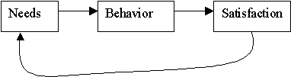
Overall, the basic perspective on motivation looks something like this:

Slide 164
Theories of motivation
The instinct approaches to motivation
This theory states that motivation is the result of an inborn, biologically determined pattern of behavior.
According to this approach, people and animals are born with programmed sets of behavior essential to their survival.
Example:
Sex------------- instinct for reproduction.

Slide 165
cont
Comments on instinct approach ;
 There is a problem of clearly identifying the primary instincts because of their variety and complexities. 
Much of human behavior is learned not instinctual

Slide 166
2. Drive reduction approach to motivation (DRT)
 This theory suggests that when people lack some basic biological requirements such as water and food, a drive to obtain these requirements is produced.
 A drive is tension, arousal that pushes behavior in order to fulfill some need.
Primary drives are related to biological needs of the body. Example: hunger, thirst, sleepiness, and sex.

Slide 167
 Secondary drives are related to prior experience and learning without the fulfillment of any biological needs.
Example: Motivation for academic achievement
An organism tries to maintain an internal biological balance, which is called homeostasis.
Example: except sexual behavior, most of the basic needs of life are to maintain balance.
Comment on drive reduction approach:
We show some kind of behavior simply for curiosity.
The behavior may not be related to biological balance. Example: Many of us spend the whole day in solving puzzles, which are not directly related to the satisfaction of biological drives.

Slide 168
3. Arousal approaches to motivation
According to this approach, each of us tries to maintain a certain level of stimulation and anxiety.  In DRT---if the arousal is too high, we try to reduce them  In arousal approaches ---if the level of stimulation and activity are too low, we will try to increase them by seeking stimulation
People differ in their optimal level of arousal.

Slide 169
4. Incentive approaches to motivation
. This approach attempts to explain motivation in terms of the nature of the external stimuli;
incentives that direct and energize behavior.
According to this view, properties of external stimuli are major causes for a person’s motivation.
Example: after eating our meal, we choose to eat a sweet cake.
Such behavior is motivated by the desert itself but not to satisfy internal drives.
Comment on incentive approach:  Drives (push factor) and incentives (pull factor) work together in motivating behavior

Slide 170
Cognitive approaches to motivation
This approach focuses on the role of our thought, expectations, and understanding of the world. Example:
The degree to which we are motivated to study hard depends upon our expectations for good grades and the value we place on getting good grades.

Slide 171
5. Cognitive approaches to motivation
This approach focuses on the role of our thought, expectations, and understanding of the world.
Example: The degree to which we are motivated to study hard depends upon our expectations for good grades and the value we place on getting good grades.
If both expectations and value are high, we will be motivated to study hard; but if either one is low, our motivation to study will be relatively lower.
In line with this approach, there are two forms of motivations.

Slide 172
Intrinsic motivation:
It is motivation by which people participate in an activity for their own enjoyment, not for the reward it will bring.
It enables to work hard, produce higher quality work and be perseverant.
Some psychologists argue that providing rewards for desirable behavior may cause intrinsic motivation to decline.
b. Extrinsic motivation:
It causes us to do something for a tangible reward.
Offering children monetary rewards for scoring good results at school, or Reminding children on the importance of learning would bring desirable behavioral change.

Slide 173
6. Maslow’s motivational theory
Basic assumptions of the theory  Different motivational needs are arranged in a hierarchy in a pyramidal shape. 
The more basic needs are at the bottom and the higher level needs are at the top. 
Before higher ordered needs are satisfied in the hierarchy, the primary needs must be satisfied.

Slide 174
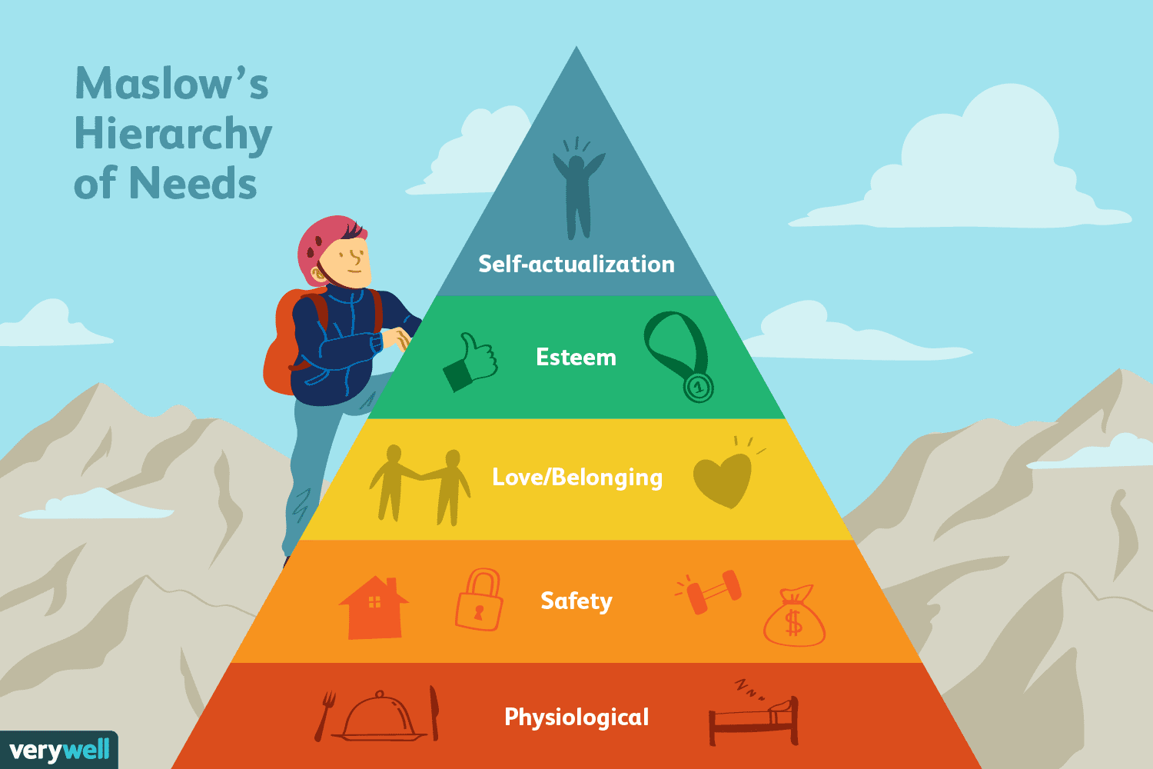
Abraham Maslow’s hierarchy of needs

Slide 175
Deficiency Needs vs. Growth Needs
Maslow believed that these needs are similar to instincts and play a major role in motivating behavior.
Physiological, security, social, and esteem needs are deficiency needs, which arise due to deprivation.
Satisfying these lower-level needs is important in order to avoid unpleasant feelings or consequences.
Maslow termed the highest level of the pyramid as growth needs. These needs don't stem from a lack of something, but rather from a desire to grow as a person.
While the theory is generally portrayed as a fairly rigid hierarchy, Maslow noted that the order in which these needs are fulfilled does not always follow this standard progression.
For example, he noted that for some individuals, the need for self-esteem is more important than the need for love.
For others, the need for creative fulfillment may supersede even the most basic needs.

Slide 176
Physiological Needs
The basic physiological needs are probably fairly apparent—these include the things that are vital to our survival. Some examples of the physiological needs include:
Food
Water
Breathing
Homeostasis
In addition to the basic requirements of nutrition, air and temperature regulation, the physiological needs also include such things as shelter and clothing.
Maslow also included sexual reproduction in this level of the hierarchy of needs since it is essential to the survival and propagation of the species.

Slide 177
Security and Safety Needs
As we move up to the second level of Maslow’s hierarchy of needs, the requirements start to become a bit more complex.
At this level, the needs for security and safety become primary. People want control and order in their lives, so this need for safety and security contributes largely to behaviors at this level.
Some of the basic security and safety needs include:
Financial security
Heath and wellness
Safety against accidents and injury
Finding a job, obtaining health insurance and health care, contributing money to a savings account, and moving into a safer neighborhood are all examples of actions motivated by the security and safety needs.
Together, the safety and physiological levels of the hierarchy make up what is often referred to as the basic needs.

Slide 178
Social Needs
The social needs in Maslow’s hierarchy include such things as love, acceptance, and belonging.
At this level, the need for emotional relationships drives human behavior. Some of the things that satisfy this need include:
Friendships
Romantic attachments
Family
Social groups
Community groups
Churches and religious organizations
In order to avoid problems such as loneliness, depression, and anxiety, it is important for people to feel loved and accepted by other people.
Personal relationships with friends, family, and lovers play an important role, as does involvement in other groups that might include religious groups, sports teams, book clubs, and other group activities.

Slide 179
cont
The concept of self- actualization is applicable not only to few well-known individuals.
In its broader sense it can happen to:  A parent with excellent nurturing skills;  A teacher that maximizes students’ opportunities for success; 
A health professional who works hard to alleviate health problems of the country.

Slide 180
Esteem Needs
At the fourth level in Maslow’s hierarchy is the need for appreciation and respect.
When the needs at the bottom three levels have been satisfied, the esteem needs begin to play a more prominent role in motivating behavior.
At this point, it becomes increasingly important to gain the respect and appreciation of others.
People have a need to accomplish things and then have their efforts recognized.
In addition to the need for feelings of accomplishment and prestige, the esteem needs include such things as self-esteem and personal worth.

Slide 181
People need to sense that they are valued and by others and feel that they are making a contribution to the world.
Participation in professional activities, academic accomplishments, athletic or team participation, and personal hobbies can all play a role in fulfilling the esteem needs.
People who are able to satisfy the esteem needs by achieving good self-esteem and the recognition of others tend to feel confident in their abilities.
Those who lack self-esteem and the respect of others can develop feelings of inferiority.
Together, the esteem and social levels make up what is known as the psychological needs of the hierarchy.

Slide 182
Self-Actualization Needs
At the very peak of Maslow’s hierarchy are the self-actualization needs. "What a man can be, he must be," Maslow explained, referring to the need people have to achieve their full potential as human beings.
According to Maslow’s definition of self-actualization:
"It may be loosely described as the full use and exploitation of talents, capabilities, potentialities, etc. Such people seem to be fulfilling themselves and to be doing the best that they are capable of doing...
They are people who have developed or are developing to the full stature of which they capable."
Self-actualizing people are self-aware, concerned with personal growth, less concerned with the opinions of others, and interested fulfilling their potential.

Slide 183
7. Achievement motivation theory
It is a stable, learned characteristic in which satisfaction is obtained by striving for and attaining a level of excellence. 
People with high achievement motivation tend to compete against some standards and prove themselves successful. 
They tend to choose tasks that are of intermediate difficulty.
 People with low achievement motivation tend to be motivated primarily by a desire to avoid failure.
As a result they choose easy tasks.  The outcome of high achievement motivation is generally positive.
Research shows that high achievement motivation is associated with future economic and occupational success.

Slide 184
Theory x-y (McGregor)
Theory x and theory y represents two sets of assumptions about human nature and human behaviour that are relevant to the need of motivation
Theory x represents a negative view of human nature where as theory y denotes a positive view of human nature

Slide 185
cont
And he is not interested in achievement
Most people have little aptitude for creativity in solving organizational problems.
Motivation occurs only at the physiological and security levels of maslows needs hierachy
Most people are self centred .
As they must be closely controlled and often coerced to achieve organizational objectives

Slide 186
Conclusion on the different approaches to motivation 
The different approaches are complementary rather than contradictory. 
It is useful to employ different approaches simultaneously in order to understand and explain the motivational aspects of beha

Slide 187
Stress and Health
Stress refers to experiencing events that are perceived as endangering one’s physical or psychological well-being.
These events are usually referred to as stressors, and people’s reactions to them are referred to as responses.
Traumatic events are events outside the normal range of people’s experience that are highly distressing.
Trauma such as rape can lead to a wide range of emotional and physical problems.

Slide 188
Health
Health is defined as the physical, mental, psychological, spiritual and social wellbeing and not necessarily the absence of disease or infirmity (WHO), similarly health can also be described from social scientific approach as the ability of one to perform his/her expected role and functions in the event that he/she is not, then he/she is in the state of dysfunction, or sickness

Slide 189
Sources of stress
Death
Loss of employment
Sickness
Change in school
Change in financial states

Slide 190
Stressful situations
One in which harm or loss has occurred
One that is threatening, in that harm or loss is anticipated, and
One that is challenging, in that some opportunity or gain is anticipated.

Slide 191
characteristics of a mentally healthy individual
A mentally healthy individual can realistically assess weaknesses and strengths.
2. His self-esteem is high. He has a sense of personal worth.
3. A mentally healthy person feels that he is wanted and loved by others and can give affection to others.
4. A mentally healthy person has the capacity to face reality rationally and objectively.
5. A mentally healthy person is able to regulate his emotions and expresses them in a socially desirable manner

Slide 192
TYPES OF STRESORS
1. Cataclysmic events : These are strong stressors that occur suddenly affecting many people at once. Example: Natural disaster
2. Post traumatic stress disorder (PTSD)  -It is a phenomenon in which victims of major catastrophes re-experience the original stress event and associated feelings in vivid flashbacks or dreams. Example: sexually raped individuals usually experience posttraumatic stress disorder.
3. Personal stressors - These are major life events such as the death of a family member. They have immediate negative consequences, which generally fade with time.  Holmes and Rahe conducted research and identified stimuli that place a strain on a person’s physical or psychological capacity to adjust

Slide 193
cont
Prevention of disease through a healthy life style, for example, educating people about weight control, smoking cessation, nutrition and exercise can optimize prevention, curing and

Slide 194
TYPES OF STESS
Stress factors broadly fall into four types or categories:
physical stress
psychological stress
psychosocial stress
psycho spiritual stress.

Slide 195
Physical stress:
trauma (injury, infection, surgery), intense physical labor/over-exertion, environmental pollution (pesticides, herbicides, toxins, heavy metals, inadequate light, radiation, noise, electromagnetic fields), illness (viral, bacterial, or fungal agents), fatigue, inadequate oxygen supply, hypoglycemia I(low blood sugar), hormonal and/or biochemical imbalances, dietary stress (nutritional deficiencies, food allergies and sensitivities, unhealthy eating habits), dehydration, substance abuse, dental challenges, and musculoskeletal misalignments/imbalances.

Slide 196
Psychological stress:
emotional stress
(resentments, fears, frustration, sadness, anger, grief/bereavement), cognitive stres (information overload, accelerated sense of time, worry, guilt, shame, jealousy, resistance, attachments, self-criticism, self-loathing, unworkable perfectionism, anxiety, panic attacks, not feeling like yourself, not feeling like things are real, and a sense of being out of control/not being in control), and perceptual stress (beliefs, roles, stories, attitudes, world view).

Slide 197
Psychosocial stress
relationship/marriage difficulties (partner, siblings, children, family, employer, co-workers, employer),
lack of social support, lack of resources for adequate survival, loss of employment/investments/savings, loss of loved ones, bankruptcy, home foreclosure, and isolation

Slide 198
Psycho-spiritual stress:
A crisis of values, meaning, and purpose; joyless striving (instead of productive, satisfying, meaningful and fulfilling work; and a misalignment within one’s core spiritual beliefs.

Slide 199
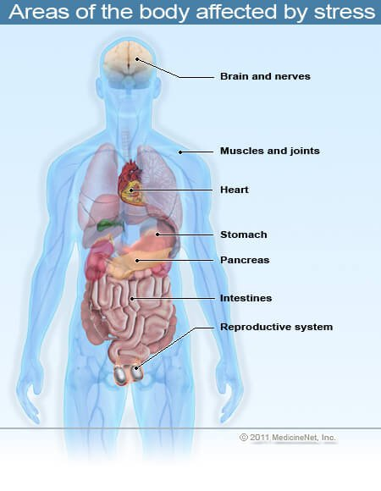

Slide 200
steps to prevent stress in your life
Set realistic goals and limits for yourself.
Put things into perspective and try not to get upset about insignificant or relatively unimportant matters.
Take stress-management, time-management, or anger-management classes.
Find activities that you enjoy and set aside time to participate in them on a regular basis.
Participate in regular physical exercise.

Slide 201
cont
Consume a healthy diet.
Avoid or reducing alcohol and caffeine intake.
Maintain a positive outlook.
Set goals and break them into easily achievable tasks.
Reward yourself for the good things that you do each day

Slide 202
The coping process and coping strategies
Coping refers to the way the mind responds to events that are challenging or threatening.
It is important to be aware that an occurrence perceived as threatening by one person may be a challenge to another; and be perceived by a third person as normal.
Effective coping is the ability to manage internal or environmental stressors.
Adequate physical, psychological, behavioral, or cognitive resources aid effective coping..

Slide 203
coping strategies
Emotional focused coping  -It is a coping style in which a person experiencing stress attempts to relieve it by changing his or her internal reactions to environmental stressors.
Example: talking to oneself to reduce worry. Having lunch with friend and talking about the stress.
Using food or drink to reduce tension. NB. These thoughts or actions do not change the external event.
They change the internal emotional reaction to the event.

Slide 204
2. Problem focused coping.

It is a coping style in which a person experiencing stress seeks to change the external event that is causing the internal stress reaction.
Example: making an appointment with a teacher when a student is having difficulty with a course.  Sitting down with a family member to attempt to resolve a problem when there is stress occurring within the family. 
Studying with another student before an exam.
Coping responses are not the same for all people. Coping is the result of the interplay between:  Perception of stressful events 
The psychological meaning attributed to them and  The physiological response associated with that meaning.

Slide 205
3. Appraisal focused coping
The mind is monitoring external and internal events that cause distress.
It is engaged in active conscious problem solving about the distress.
When the solutions work, we call it coping devices. The mind also modifies the steps that make up the coping process.
The mind constantly monitors the environment in order to provide safety. This monitoring process is called appraisal.
The three steps in process appraisal are:

Slide 206
Primary appraisal  -The event is unimportant and can be ignored.  The event is good and contains no threat.  The event is potentially or already threatening causing harm to self-esteem, relationship, and physical health.
Secondary appraisal  -The mind decides whether it is all right or in trouble.  The mind considers the events as problem, and then it uses defense mechanism.  The individual asks himself “what can I do to help myself”
Reappraisal - The mind is continually evaluating the outcome of its coping efforts.  The mind develops new strategies.

Slide 207
4. Defense Mechanisms
. These are mental strategies we use when we do not wish to face reality. Examples: avoidance, denial, repression
Mal- adaptive coping methods Example: taking drugs, heavy alcohol, and other stimulants to cover the problem for only a limited time
Time management: It includes wise usage of time, planning, and prioritizing of activities
7. Assertiveness: It is to say no when there is imposition.
It is a means of developing self-esteem.
8. Relaxation technique: included are focused attention, physical exercise and appropriate diet

Slide 208
The general adaptive syndrome (GAS)
When coping efforts are not successful and defense mechanisms are not able to reduce the effects of stress, the result is a subjective feeling of anxiety and concurrent physiological symptoms created by the stressors.
Hans Sely, known as the father of stress research describes the physiological response to stress in a concept called the general adaptive syndrome (GAS). The GAS includes the following three stages.

Slide 209
1. The alarm reaction: The body responds to a stressor with a strong defensive response stimulated by hormones from the adrenal cortex. If the stressor is not withdrawn, the body moves to the next step.
The stage of resistance: The body maintains resistance to the stressor until it disappears. If the stressor does not disappear the body moves to the next stage.
3. The stage of exhaustion: The effects of the continuing stressor cause the body’s resistance ability to fail. Ultimately, without intervention, it may lead to death.

Slide 210
General responses to stress
Cognitive: Anxious thoughts, fearful anticipation, poor concentration, difficulty with memory.
Emotional: Feelings of tension, irritability, restlessness, worries, inability to relax, Anxiety,  Depression
 Feelings of worthlessness
Self criticism 
Jealousy
suspiciousness,
angry outbursts 
Spiritual response 
Decreased interest 
Decreased hope 
Decreased connectedness with others/isolation
.

Slide 211
cont
Behavioral: Avoidance of tasks; sleep problems; difficulty in completing work assignments; fidgeting; tremors; strained face; clenching fists; crying; changes in drinking, eating, or smoking behavior
Physiological: Stiff or tense muscles, grinding teeth, sweating, tension headaches, faint feelings, choking feeling, difficulty in swallowing, stomachache, nausea, vomiting, loosening of bowels, constipation, frequency and urgency of urination, loss of interest in sex, tiredness, shakiness or tremors, weight loss or gain, awareness of heart beat.
Social: Some people in stressful times tend to seek out others to be with. Other people withdraw under stress. Also, the quality of relationships can change when a person is under stress.

Slide 212
GROWTH AND DEVELOPMENT
Definition of terms
Development- It is the sequence of changes over the full life span of an organism. It is an irreversible sequence of stages that regularly follow one upon the other.
Example: The motor development during infancy. Raise head (2m), hand-eye coordination (4--7m), sitting erect (7m), crawling (10m), walking (1yr)
 Development is a progressive change leading to higher levels of differentiation and organization. 
It is an increase in effectiveness of function, maturity, sophistication, richness and complexity

Slide 213
cont
Growth- :It is a gradual and progressive increase in size such as height and weight of an individual or its parts.  It is an increase in effectiveness or competence of a function.
 Growth is differentiation and refinement of parts and/or functions.

Slide 214
Maturation
It is the developmental process leading toward the goal of maturity.
It refers to innately determined sequence of growth or bodily changes that are relatively independent of environmental events.
Maturation is genetically programmed, naturally occurring changes over time. Natural capacities common to human races such as sitting, crawling, walking, etc are the results of maturation.
The origin of the word is from the Latin word meaning ripeness.
It is mostly used with prefix . Example: sexual maturity, intellectual maturity, emotional maturity

Slide 215
Heredity (nature) Vs environment (nurture) issue in developmental psychology
The transition from infancy to adulthood is an orderly sequence common to all normal members of the human species.
It is governed by the combined action of heredity and environment.
The nature-nurture issue in developmental psychology is a fundamental issue.
It has philosophical roots.
The English philosopher John Locke said that the newborn baby is a Tabular Rasa (blank slate).

Slide 216
cont
The French philosopher Jean Jacques Roseau considered genetic factors as most influential.
The question nowadays has changed from which influences behavior to how and to what extent environment and heredity affect development.
Because no one grows up without being influenced by heredity and environment.
Developmental psychologists take an interactionist position.
They consider the combined influence of heredity and environment.

Slide 217
Principles of developmental process
1. Continuity
One’s life is a never ending process, life starts with conception and ends with death.
The changes however small and gradual continue to take place in all dimensions of one’s personality.
2. Lack of uniformity in the development rate
Development, though continuous, does not exhibit steadiness and uniformity in terms of the rate of development in various dimensions of personality or in the developmental periods and stages of life.
3. Individual difference
Every organism is a distinct creation in itself, therefore the development which it undergoes in terms of the rate and outcome in various dimensions is quite unique and specific.

Slide 218
cont
4. Uniformity of pattern
Although there seems to be a clear lack of uniformity in terms of rate of development and also there are distinct individual differences with regard to the processes and outcome of the various
stages of development, yet it follows a definite pattern which is uniform and universal with respect to the members of the same species.
5. Proceeding from general to specific response
While developing in relation to any aspect of personality, the child first picks up or exhibits general responses and learns to show specific and goal-directed responses afterwards.
6. Integration
By observing the principle of proceeding from the general to the specific or from the whole to the parts, it does not mean that only the specific responses are aimed for the ultimate consequences of one’s development, rather its sort of integration that is ultimately desired.

Slide 219
7. Interrelation
The various aspects or dimensions of one’s growth and development are interrelated.
8. Interaction
The process of development involves active interaction between the forces within the individual and the forces belonging to his environment.

Slide 220
9. Development proceeds from general to specific responses
In all phases of child development, general activity proceeds specific activity , the responses are of a general sort before they become specific.,
10. Developmental is predictable
With the help of the rate of growth and development of a child it is possible for us to predict the range within which his nature of development us going to fall.
11. Principle of development direction
By cephalo-caudal development proceeds in the direction of longitudinal axis (head to foot). First the child gains control over his head and arm and then his legs so that he can stand

Slide 221
12.Growth and development proceeds in orderly sequence
Growth in height occurs in only one sequence . From smaller to longer. Development also proceeds in a predictable order.
13. Spiral versus linear advancement
The path followed in development by the child is not straight and linear and development at any stage never takes place with a constant or steady pace.

Slide 222
FACTORS INFLUENCING GROWTH AND DEVELOPMENT
Genetic factors
Nutritional factors
Environmental factors

Slide 223
GENETIC FACTORS
These factors include
Hereditary
The hereditary of man and woman determnes their children. Hereditary determines the size and shape of the body , hence family member bear resemblance . The characteristics are transmitted through genes which are responsible for family illness.
b. Sex
Sex is determined at conception . After birth the male infant is both longer and heavier than female. Boys maintain this superiority until about 11 years of age. Girls mature earlier , reach the period of accelerated growth earlier than boys and are taller than boys on the average

Slide 224
c. race
Distinguishing characteristics called racial or sub racial developed in prehistoric humans. Similar physical characteristics are seen in people belonging to the same race.
in terms of height, tallness and shortness are examples which exist among all races and sub races. Intermarriages have produced mixed racial types.

Slide 225
NUTRITIONAL FACORS
Poor nutrition
Nutrition plays a vital role in susceptibility to diseases .
Poor nutrition limits the body's ability to resist infection
Poor nutrition also plays a vital role in the development o chronic illnesses
Growth and development suffering from protein-energy malnutrition anemic and vitamin deficiency states are retarded

Slide 226
cont
b. Maternal nutrition
Intrauterine growth retardation and consequently small size of fetus occur due to nutritional deficiency in mothers, infection and drugs used during pregnancy

Slide 227
ENVIRONMENTAL FACTORS
Physical environment
Environmental forces act upon the individual.
It is the exploding force of an individual potentially to different forces . The physical environment include food , temperature , climate resources etc
b. Mental environment
it includes the intellectual atmosphere of the school, home . libraries , recreation rooms labs etc.
c. Social environment
It includes social association the child gets from the beginning . It also includes cultural atmosphere of the society eg religion, folklore, literature. Art, music, etc. the rich the environment, the better the scope for developing an individual into healthy human being

Slide 228
cont
d. socio-economic level
A child born into the family of low socio economic means may not receive adequate health supervision.
Could leave a child without immunization against measles or other childhood illnesses and thus vulnerable to disease that could cause permanent neurologic damage.
e. Cultural influence
Groups of human beings create their own cultures whereas each individual is influenced or shaped by culture of which he or she is part.. The effects of a particular culture on child begin before birth because of the manner in which culture views and treat the members of the pregnant women's family

Slide 229
cont
f. Internal influences
Three is evidence that all the hormones in the body affect growth in some manner.
Deficiency of growth hormone retards growth while overproduction results in gigantism
g. Characteristics of parents
Parents with high intelligence quotient are more likely to have children with higher level of inherent intelligence.

Slide 230
Characteristics of growth and development
Individual differences
Each child has an individual rate of growth but the pattern of growth shows less variability. Eg an infant will be able to sit before standing alone. As noted the age at which an individual child achieves these skills may occur at any point over a range f time.
2. Readiness for certain task (critical period)
This is the period during which certain behaviors are learned.
3. Rate of development
During the period of growth and development of the body , growth is sometimes rapid and at other times slow.
Rapid growth occurs during gestation and during infancy and slow down during the school days.

Slide 231
cont
4. Sequence of growth and development
Growth and development follows a certain sequence.
5. Interrelatedness of growth and development
Although growth and development is physical, mental, social, emotional, sexual and spiritual proceed at different rates, they are also interrelated in the majority of children that the results a progressive development of the whole child, from infancy to adult.

Slide 232
DEVELOPMENTAL STAGES
PRENATAL DEVELOPMENT
Prenatal refers to the period before birth.
It begins from the time of conception and ends when the baby is born.
Prenatal period is the earliest and the most important stage because the foundations for future development are laid during this stage.

Slide 233
Prenatal life
Prenatal development is divided into the following basic periods.
The germinal period 
After fertilization, the egg begins the process of cell division. 
At first the multiplying cells are all identical. Nerve, muscle, bone, and blood cells can't be distinguished from one another. 
By the end of the first two weeks, the cells have begun to differentiate into three layers that will form the various tissues and organs.
Each layer produces different body systems.

Slide 234
cont
The outer layer is called ectoderm which will develop as the outer layer of the skin, the hair and the nails, parts of teeth, skin glands, sensory cells and nervous system.
The middle layer is called mesoderm from which will develop as the inner skin layers, the muscles, skeleton and the circulatory and excretory organs
The inner layer is called endoderm from which will develop lining of the entire gastro intestinal tract, trachea, bronchi, lungs, liver, pancreas, salivary gland thyroid gland and thymus.

Slide 235
cont
2. The embryonic period
 Four weeks after conception, the embryo is one-fifth of an inch and 10,000 times larger than the original fertilized egg. 
It has developed a spinal cord and a two-lobe.  Many of the major organs have formed, as well as indentation in the head region that will eventually become jaws, eyes and ears.
 Six weeks, the embryo responds reflexively, moving its upper trunk and neck when the mouth area is stroked with a fine hair. 
About the eighth week, the embryo is almost an inch.

Slide 236
cont
3. The fetal period 
Until birth, the developing organism is known as a fetus. 
Nine weeks, it bends its fingers and curls or straightens its toes in response to touches on the palm of the hand or the sole of the foot.
 Diffuse responses narrow, so that when the mouth is touched only reflexes above the mouth moves instead of the entire upper body. 
Sixteen weeks is 6 inches long, hair may appear on the head and facial features approximate their finished appearance. 


Slide 237
cont
Major internal organs have attained their typical shape, although they couldn't keep the fetus alive outside the uterus. 
Cortex has grown back over the lower parts of the brain.  16-20 weeks, all 100 billion neurons have developed.
 The mother can feel movement during this time. 
By twenty-three weeks, the fetus has become quite active, sleeping and waking.

Slide 238
Studies of prematurely delivered fetuses have shown that by twenty-four weeks a fetus can cry, open and close eyes, and look up, down and sideways.
It also developed a grasping reflex and it may even hiccup. 
During the final weeks in the uterus, fat forms over the entire body.
Its function is smoothing out the wrinkled skin. 
Usually the fetus gains about half pound weight every week during the last eight or nine weeks, so that at birth the average baby is about twenty inches long and weighs a little more than seven pounds.

Slide 239
Post-natal Development (after birth
The new born
Human babies are born with good motor coordination and highly acute sensory capabilities.
They are born completely helpless, totally dependent on their parents.
Though human infants are the most helpless and immature when they come to this world, their sensory development is mature and well integrated even before birth.
Human infants may not be able to direct their course of movement in their environment at birth.
But they can perceive and be influenced by that environment from the moment of birth.
Different kinds of reflexes and motor activities help newborn babies to survive after birth.

Slide 240
Motor skills and reflexes
Pupillary reflex- it may elicited by shining a strong light such as a flash light on the eye
Rooting reflex- if new bourns cheek is brushed or stroked near the corner of the mouth, the child will turn the head in that direction. This reflex disappears at about 6th week of life.
Glabellar reflex- it is elicited by striking the tip of the finger in space between eye brow the baby blinks
Sucking reflex- when a new borns lips, the baby makes a sucking motion. The sucking reflex begins to diminish at about six months of age.

Slide 241
cont
Swallowing reflex- the swallowing reflex in the newborn is the same as in the adult. Food that reaches the posterior portion of the tongue is automatically swallowed
Extrusion reflex- a new born will extrude any substance that is placed on anterior part of the tongue. This protective reflex prevents the swallowing of incredible substance disappearing at about 4 months
Palmer grasp reflex- new born will grasp any object placed on their palm by closing their fingers in it. It is a primitive reflex apparently from a time new born cling to their mother for safety. The reflex disappears at about age 6weeks to 3 months.

Slide 242
Step(walk) in place reflex- newborn who are held in vertical position with their feet touching a hard surface will take a new alternating steps. This reflex disappears by 3 months of age
Placing reflex- it is similar to step in place reflex except its elicited by touching the anterior surface of newborns leg against the age of a table.
Plantar grasp reflex- When an object touches the sole of a newborns foot at the base of the toes, the toes grasp in the same manner as the finger do. The reflex disappears in about 8-9months of age on preparation for walking

Slide 243
Tonic neck reflex- when newborns lies on their backs, their hands usually turn to one side or the other. The arm and the leg on the side to which the hand turns extend and the opposite arm and leg contract. This called a boxer or fencing reflex because the newborns position stimulates that of someone preparing to box or fence
Moro reflex- elicit by placing the infant in supine position, holding the neck and the head under the palm of the right hand by lifting the child from the surface to 30 degrees angle and dropping the head back on the other hand. child shoes armband legs extends and abducts , fingers fanning open, thumb and fore finger shows “c “ position.

Slide 244
cont
Babinski reflex- when the side of the sole of the foot is stroke in an inverted J curve from the heel upward , the baby fans the toes. this reflex remains for 3 months.
Magnet reflex- if pressure is applied on the soles of the feet of newborn laying in a supine position he pushes back against the pressure . This is a test of the spinal cord integrity.
Landau reflex-
Deep tendon reflex
Crossed extension reflex
Trunk incurvation reflex

Slide 245
Swimming reflex-a baby only a few weeks old moves both arms and legs in a coordinated pattern when placed in a pool of water.
It soon disappears and reappears at the beginning of the second year. This again disappears and children are taught the skill of swimming at age six. Why do the reflexes appear and disappear in a different form?

Slide 246
Early Childhood
In line with biological development, children progress from immature stages of mental development to complex stages of mental development.
This developmental aspect is called cognitive development
Cognitive development is the process by which a child’s understanding of the environment changes as a function of age and experience.

Slide 247
cont
The Swiss psychologist Jean Piaget (1970) suggested that children throughout the world pass through a series of four stages in their cognitive development. During the initial stage of childhood is the sensory motor stage (birth to two years).
This stage is characterized by:  The child has little capacity in representing objects that are not directly in front of him using images, language or symbols.  For the child at this stage, objects and people do not exist when they are out of sight.
It means children lack what Piaget called object permanence

Slide 248
Late Childhood
At about the time children begin school, they enter the stage of concrete operational stage (7 to 12 years) This stage of cognitive development is marked by mastery of the principle of conservation.
They can think logically though their thought process is limited to the concrete.
They can understand simple transformation, like for example, reversing a ball of clay into a sausage shape and back to a ball shape.

Slide 250
There is an increase in competence in academic, social and psychomotor skills.
 Children enter into the wider culture and learn basic social skills and start to appreciate societal values. 
Peer influence is dominant at this stage.
To avoid feelings of failure and inadequacy, parents and school administration need to create a supportive environment

Slide 251
cont
. Although peer influence contributes a lot, child-rearing practices also shape social competence.
Despite cultural differences, in general parental style can be categorized into three broad categories.
These are authoritarian leadership style, permissive leadership style and authoritative leadership style.
Children whose parents are authoritarian are likely to be unsociable.
Children whose parents are permissive are likely to be immature and moody.
Children whose parents are authoritative are likely to have good social skills.

Slide 252
Adolescence
: Adolescence is the development stage between childhood and adult hood during which many physical, cognitive, and social changes take place. Most dramatic biological changes occur during this stage.
Major physical and sexual changes and their corresponding average range of ages for both sexes are shown below.

Slide 253
Male-sexual changes | changes Average range of age | Major-sexual changes | Average range of age
Heig spurt | 12-16 | Height spurt | 11-14
Penis growth | 13-15 | Onset of menarche | 11.5-13.5
First ejaculation | 12-16 | Breast development | 11.5- 13.5
Pubic hair | 12-18 | Pubic hair | 11-14

Slide 254
Puberty
It is the period during which maturation of the sexual organs occur. For girls 11 or 12 years For boys 13 or 14 years However, there are wide cultural variations depending on quality of nutrition and access to health services.
Early maturation has an advantage and disadvantage for both sexes.
Early maturing boys may do better in athletics and are generally more popular with peers.
This enhances self-concept.
Early maturation in girls may expose them to untimely sexual practices and sexually transmitted diseases.
impact of early and late maturation is related to the specific reactions and attitudes of the society.

Slide 255
Adolescence is the first phase of life in which individuals begin to think carefully about themselves, their role in life, and their plans.
Unlike the younger children, adolescents are often concerned with the meaning of their past and the direction of their future.
The psycho- social development stage during adolescence is named as the identity versus confusion stage.
During this stage:  The adolescence raises the identity question (who am I?)  External pressures are due to: * Physical change * Societal expectation changes (they consider themselves as adults, yet they are economically dependent on their parents)

Slide 256
There is decline in reliance on adults for information with a shift toward using the peer group as source of social judgment.
To avoid role confusion appropriate role model formation is important

Slide 257
Adulthood
 It includes the years from 20-60 but usually 20- 40.  Physical changes during this period are less apparent and occur more gradually than the preceding stages.
 Although physical strength and status of health are great at early adulthood period, gradually they decrease. The body begins to operate less efficiently and immune system decreases. 
At about late forties and early fifties, women stop menstruating (Menopause) Menopause was once considered as having strong association with psychological symptoms including depression and memory loss.
However, recent investigations show that a society’s attitude and women’s’ perceived reactions to menopause are important variables than the physiological changes of menopause.

Slide 258
An increase in IQ is observed at this stage.
They perform better on any learning or memory task.
They find it easy to accept new ideas and they can readily shift their strategies for solving different problems.

Slide 259
Typical life goals and concerns during adult stage
Stages in adult hood Typical concerns related to | Typical goals are related to | Typical concerns related to
Young adult (17- 45 | Education and family | Relationship and friends
Middle ages (40- 65) | Children’s lives and personal property | Occupational worries
Elderly (60 on wards) | Good health, retirement, leisure, community | Health fears

Slide 260
Old age
Physical changes brought about by the aging process include skin wrinkling and folding, slight loss of height due to decrease in the size of disks between vertebrates in the spines. Sensory activities i.e. Vision, hearing, smell and taste decrease.
The major theoretical explanations or reasons for physical decline are:

Slide 261
Genetic programming theories of aging
 1. The theory suggests that there is built in time limit to the reproduction of human cells. 
Some cells are genetically programmed and become harmful and self destructive to the internal biology of the body.
2. Wear and tear theories of aging  The theory suggests that as time goes on functioning of the body stop working efficiently. 
Waste-by- products eventually accumulate and in effect creates problem on cells reproduction.

Slide 262
cont
The disengagement theory of aging sees aging as a gradual withdrawal from the world on physical, psychological and social skills.
Physically less physical activity
Psychologically focus shifts from others to the self Socially less interaction and participation in the society

Slide 263
APPLCATION OF THEORIES OF PERSONALITY IN GROWTH AND DEVELOPMENT
Cognitive development: (Early childhood)
Definition: Cognitive development is the process by which a child’s understanding of the environment changes as a function of age and experience.
The Swiss psychologist Jean Piaget (1970) suggested that children throughout the world pass through a series of four stages in their cognitive development.
During the initial stage of childhood is the sensory motor stage (birth to two years).
This stage is characterized by:  The child has little capacity in representing objects that are not directly in front of him using images, language or symbols.

Slide 264
 For the child at this stage, objects and people do not exist when they are out of sight.
It means children lack what Piaget called object permanence. Example: Hide a play object under the blanket when the child is playing and observe his reaction. 
Children discover that symbols can stand for objects and words.
They rapidly acquire language.
As a result the ability to communicate expands. 
They begin to acquire many cognitive skills.

Slide 265
. According to Piaget the period from 2 to 7 years of age is the preoperational stage.
It is characterized by:  The use of language.  By the use of language children at this stage are able to represent objects, people, events and feelings that are not directly in front of them. 
They pretend in plays like, for example, they push a chair across the floor symbolizing it for a car. 
The concept of a number appears as early as the third year of life.
They can count a group of small number of objects in many ways, starting with a different object each time.

Slide 266
Social development during early childhood begins as a result of a positive emotional bond between a child and a particular caregiver.
It is called attachment. Strong attachment is due to the responsiveness of the caregivers to the signal babies provide such as cries, smiles, reaching and clinging.
In trying to understand social development, it is important to consider how society and culture present challenges to the child’s development.
In line with this idea, the psychologist Eric Erickson developed the theory of psycho- social development

Slide 267
CONT
. The first stage of psychosocial development is trust versus mistrust stage (birth to 11/2 years).
At this stage Infants develop feelings of trust if their physical requirements and psychological needs for attachment are consistently satisfied.
Inconsistent care and unpleasant interactions with others can lead to the development of mistrust.
The second stage in social development is the autonomy versus shame and doubt stage (11/2 to 3 years).
In this stage:  Independence and autonomy develop when there is freedom of environmental exploration  Overly restriction and protection by adults may enhance shame, self-doubt and unhappiness.

Slide 268
Late Childhood
At about the time children begin school, they enter the stage of concrete operational stage (7 to 12 years)
This stage of cognitive development is marked by mastery of the principle of conservation.
They can think logically though their thought process is limited to the concrete.
They can understand simple transformation, like for example, reversing a ball of clay into a sausage shape and back to a ball shape.

Slide 269
CONT
Roughly during the middle childhood period, children enter into the initiative versus guilt stage of psychosocial development (ages 3 to 6 years).
At this stage:  The challenge is between the child’s desire to initiate activities independently and the guilt that may result from unexpected consequences from such activities. 
Parents are expected to react positively to the Child’s attempts so that the child could solve the contradiction at this stage. 
Helping children to plan activities within their limits and encouraging them not to give up their plans is essential for positive psychosocial development.

Slide 270
Late childhood is the stage of industry versus inferiority stage (ages 6 to 12 years).
During this stage:  There is an increase in competence in academic, social and psychomotor skills.
Children enter into the wider culture and learn basic social skills and start to appreciate societal values.  Peer influence is dominant at this stage. 
To avoid feelings of failure and inadequacy, parents and school administration need to create a supportive environment

Slide 271
Although peer influence contributes a lot, child-rearing practices also shape social competence.
Despite cultural differences, in general parental style can be categorized into three broad categories.
These are authoritarian leadership style, permissive leadership style and authoritative leadership style.
Children whose parents are authoritarian are likely to be unsociable.
Children whose parents are permissive are likely to be immature and moody.
Children whose parents are authoritative are likely to have good social skills.

Slide 272
Adolescence
Adolescence is the development stage between childhood and adult hood during which many physical, cognitive, and social changes take place. Most dramatic biological changes occur during this stage
The psycho- social development stage during adolescence is named as the identity versus confusion stage.

Slide 273
CONT
During this stage:  The adolescence raises the identity question (who am I?)  External pressures are due to: * Physical change * Societal expectation changes (they consider themselves as adults, yet they are economically dependent on their parents) There is decline in reliance on adults for information with a shift toward using the peer group as source of social judgment.
To avoid role confusion appropriate role model formation is important.

Slide 274
Adulthood
According to Erickson the stage of social development during early adult hood is termed as intimacy versus isolation stage. Young adults feel a need for intimacy in their life. After establishing a stable identity, a person is prepared to share meaningful love or deep friendship with others. By intimacy we mean an ability to care about others and to share experiences with them. One research showed that 75% of college -age men and women ranked a good marriage and family life as important adult goals. Failure to establish intimacy with others leads to a deep sense of isolation (feeling alone and uncared for in life).

Slide 275
CONT
Once two people have established some degree of intimacy, their interest begins to expand beyond just the two of them.
They become concerned with rising the next generation. They enter the stage of generativity versus stagnation. Generativity refers to the creation and care for children. Parents must do more than giving birth to children. They must adequately care for and guide children for future life.
But people can achieve a sense of generativity without having children of their own.
Nuns and priests, for example, can still guide and care for the next generation by working with other people’s children or helping to create a better world for them

Slide 276
CONT
When generativity is lacking, the result is stagnation and impoverishment of the personality. In such case people often become too exclusively involved in their interest and neglect the responsibility of caring for others.

Slide 277
Old age
The elderly must make physical and social adjustments. These adjustments are more of inner struggles. Older people look back and review their lives.
According to Erickson they enter the stage of ego integrity versus despair stage.
Ego integrity is the acceptance and satisfaction of ones past life.
The person who has lived richly and responsibly develops a sense of integrity.

Slide 278
cont
This allows the person to face aging and death with dignity.
Despair comes due to the feeling that life was not what it should have been.
If previous life events are reviewed with regret, the elderly person experiences despair (heartache and remorse).
The person feels like a failure and knows it is too late to reverse what has been done.
Aging and the threat of death then become source of fear and depression.

