Slide 1
PULMONARY NURSING
By. Emily Kengo
WELCOME ALL

Slide 2
ANATOMY AND PHYSIOLOGY
REVIEW
Composed of upper and lower respiratory system
Together the two are responsible for ventilation
External respiration is responsible for exchange of gases between blood and the lungs
Internal respiration involves exchange of gases between cells and blood

Slide 3
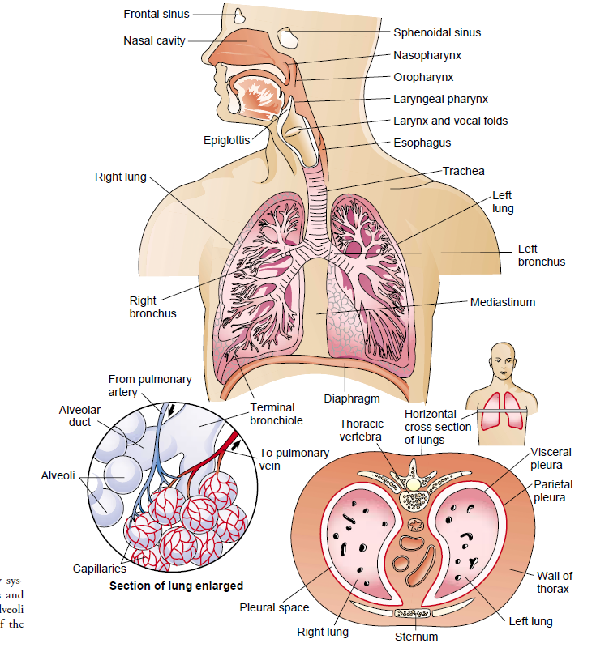

Slide 4
FUNCTIONS OF THE RESPIRATORY SYSTEM
Ventilation
Movement of air in and out of the airways
Respiration
This whole process of gas exchange between the atmospheric air and the blood and between the blood and cells of the body
Oxygen Transport
Oxygen is supplied to, and carbon dioxide is removed from, cells by way of the circulating blood.
Oxygen diffuses from the capillary through the capillary wall to the interstitial ﬂuid.
The movement of carbon dioxide occurs by diffusion from cell to blood.

Slide 5
Muscles of respiration
Inspiration and expiration occurs as a result of muscular activity,
Partly voluntary and partly involuntary.
Muscles of respiration in normal quiet breathing are the
intercostal muscles and
the diaphragm.
During difficult or deep breathing they are assisted by the muscles of the neck, shoulders and abdomen….accessory muscles

Slide 6
UPPER RESPIRATORY TRACT
FUNCTIONS
Protect respiratory system from infection and from foreign body inhalation through sneezing, coughing and spasm
Warms and filters inspired air so that lower respiratory tract accomplishes gas exchange
Humidification of air
Passage way of air into the lower respiratory system

Slide 7
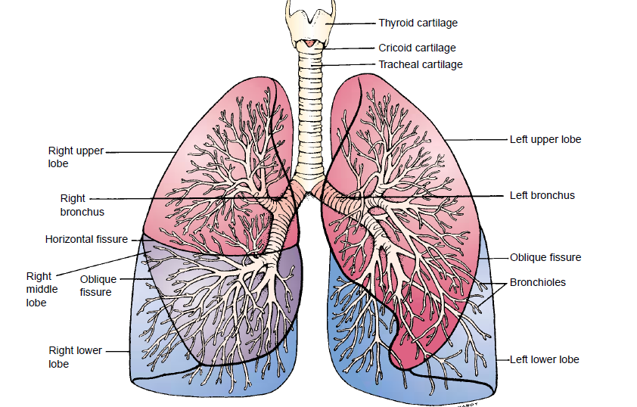

Slide 8
MAJOR SYMPTOMS OF THE RESPIRATORY DISEASE
1. DYSPNEA
Difficult or labored breathing, shortness of breath.
Its’ a symptom common to many pulmonary and cardiac disorders
Particularly in decreased lung compliance or increased airway resistance.
It may also be associated with neurologic or neuromuscular disorders such as myasthenia gravis, Guillain-Barré syndrome, or muscular dystrophys, asthma .

Slide 9
Clinical Signiﬁcance
Acute diseases of the lungs produce a more severe grade of dyspnea than do chronic diseases.
Sudden dyspnea in a healthy person may indicate pneumothorax , acute respiratory obstruction, or Acute Respiratory distress syndrome (ARDS)
In immobilized patients, sudden dyspnea may denote pulmonary embolism.

Slide 10
Cont..
Orthopnea may be found in patients with heart disease and occasionally in patients with (COPD)
Dyspnea with an expiratory wheeze occurs with COPD…(chronic obstructive pulmonary disease)
Noisy breathing may result from a narrowing of the airway.

Slide 11
2. COUGH
Results from irritation of the mucous membranes anywhere in the respiratory tract.
By smoke, smog, dust, or a gas, fluid (droplet) solid.
The cough is the patient’s chief protection against the accumulation of secretions in the bronchi and bronchioles

Slide 12
Clinical Signiﬁcance
Cough may indicate serious pulmonary disease.
It may be described as dry, hacking, wheezing productive, non productive or severe.
A dry, irritative cough is characteristic of an upper respiratory tract infection of viral origin

Slide 13
Cont..
Laryngotracheitis (croup) causes an irritative, high-pitched cough.
A severe or changing cough may indicate bronchogenic carcinoma
Pleuritic chest pain accompanying coughing may indicate pleural or chest involvement
Cough in the morning with sputum indicate bronchitis
Cough after food or drinks may indicate aspiration in the tracheal bronchial tree

Slide 14
3. SPUTUM PRODUCTION
Sputum production is the reaction of the lungs to any constantly recurring irritant.
It also may be associated with a nasal discharge.
Clinical Signiﬁcance
A profuse amount of purulent sputum or a change in color of the sputum probably indicates a bacterial infection.

Slide 15
Cont..
Thin, mucoid sputum frequently results from viral bronchitis.
A gradual increase of sputum over time may indicate the presence of chronic bronchitis or bronchiectasis.(widening of the bronchi)
Pink-tinged mucoid sputum suggest lung tumor
Foul smelling sputum indicate lung abcess, bronchiectasis

Slide 16
4. CHEST PAIN
May be associated with pulmonary or cardiac disease.
Chest pain associated with pulmonary conditions may be sharp, stabbing and intermittent, or it may be dull, aching, and persistent.
The pain usually is felt on the side where the pathologic process is located, but it may be referred elsewhere—for example, to the neck, back, or abdomen

Slide 17
Clinical Signiﬁcance
Chest pain may occur with pneumonia, pulmonary embolism with lung infarction and pleurisy.
It also may be a late symptom of bronchogenic carcinoma.
Pleuritic pain is sharp and intensify on inspiration.
Lung infarction……lung cells death

Slide 18
5. WHEEZING
It is often the major ﬁnding in a patient with bronchoconstriction or airway narrowing.
It is a high- pitched, musical sound heard mainly on expiration.
Relief Measures.
Oral or inhalant bronchodilator medications reverse wheezing in most instances.

Slide 19
6. CLUBBING OF THE FINGERS
It is a sign of lung disease found in patients with;
Chronic hypoxic conditions,
Chronic lung infections and
Malignancies of the lung.
It is manifested initially as loss of the nail bed angle

Slide 20
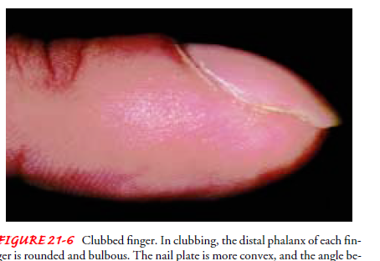

Slide 21
7. HEMOPTYSIS
Expectoration of blood from the respiratory tract
It is a symptom of both pulmonary and cardiac disorders
The most common causes are:
Pulmonary infection
Carcinoma of the lung *
Abnormalities of the heart or blood vessels
Pulmonary artery or vein abnormalities
Pulmonary emboli and infarction
Chest trauma

Slide 22
8. CYANOSIS
It is bluish coloration of the skin
It is a very late indicator of hypoxia (deficiency in O2 reaching the tissues)
The presence or absence of cyanosis is determined by the amount of unoxygenated hemoglobin in the blood.
Appears when there is 5 g/dL of unoxygenated hemoglobin.
Anaemic patient rarely manifests cyanosis and a polycythemic patient may appear cyanotic even if adequately oxygenated

Slide 23
Cont..
Therefore, cyanosis is not a reliable sign of hypoxia.
Central cyanosis is assessed by observing the color of the tongue and lips.
Peripheral cyanosis results from decreased blood ﬂow to a certain area of the body especially the extremeties due to vasoconstriction.
It does not indicate central systemic problem

Slide 24
ASTHMA
Is a chronic inﬂammatory disease of the airways that causes
airway hyperresponsiveness,
mucosal edema and
mucus production
It differs from other obstructive disease in that it is highly reversible either spontaneously or with drugs

Slide 25
Pathophysiology
Exposure to predisposing, causal and contributing factors cause inﬂammation which leads to obstruction from the following:
mucosal edema,
reduced airway diameter,
bronchospasm (contraction of the smooth muscles), causing further narrowing and increased mucus production,

Slide 26
This causes airflow limitation thus resulting in symptoms of wheezing, Dyspnea and chest tightness
Cell that play key role in inflammation of asthma are
Mast cells,
Neutrophils,
Eosinophils and lymphocytes
They perpetuate inflammatory response

Slide 27
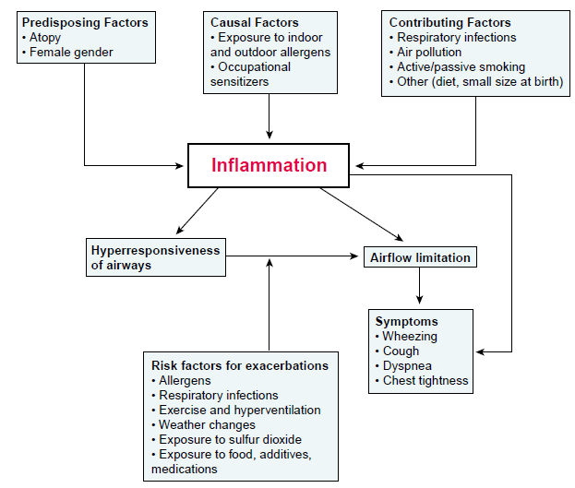
CONT…..

Slide 28
RISK FACTORS
Allergens-- strongest predisposing factor e. g weed, pollen, dust, animal fur, mold
Chronic exposure to airway irritant i.e smoke, dust.
stress
Family history
Risk factors for exacerbations/triggers
Allergens i.e dust, strong odours
Respiratory infections
Exercise and hyperventilation
Weather changes i.e cold season
Exposure to food additives, medications

Slide 29
Symptoms
Wheezing on expiration and inspiration
Cough with or without mucus production
Dyspnea
Chest tightness and air hunger
Tachycardia
Lethargy
Expiration requires efforts
Slow labored breathing with excessive use of accessory muscles
As exercabation continues, there maybe tachycardia, diaphoresis, widened pulse pressure hypoxemia and central cyanosis

Slide 30
Medical Management
Administer bronchodilators to reduce bronchospasms
corticosteroids.
Anticholinergics e.g atrovent.
Combination of inhalers.
Oxygen to increase oxygen saturation and correct hypoxia
Antibiotics for infection

Slide 31
Nursing Management
Obtain history to identify medication patient is currently on
Assess the severity of the respiratory symptoms
Manage for CAB by administering oxygen due to circulatory compromise and hypoxemia
Ensure patent airway by nebulising with salbutamol (ventolin), or combivent
if no improvement suction to remove secretions (but not always indicated)

Slide 32
Maintain good breathing pattern by positioning patient in a semifowlers position
Continue with nebulisation after every 15 minutes and oxygen therapy until there is improvement in breathing and respiration
Ensure bed rest to prevent fatigue and overexertion

Slide 33
Cont…
Ensure frequent monitoring of the respirations, airway, breathing pattern, pulse oximetry and the vital signs
Monitor vitals signs and respiratory activity to identify any change of condition and dyspnoea
Nurse the patient in a well humidified environment free from irritants

Slide 34
Reassure the patient to allay anxiety and to promote quick recovery
Ensure adequate fluid intake and nutrition
On discharge teach the patient on common triggers of asthma and avoiding them, drug compliance, use of inhalor

Slide 35
Prevention
Patients with recurrent asthma should undergo tests to identify the substances that precipitate the symptoms
Instruct patient to avoid causative agent as much as possible.
Complications of asthma
Status asthmaticus,
Respiratory failure,
Pneumonia, and atelectasis.
Airway obstruction, particularly during acute asthmatic episodes, often results in hypoxemia,
dehydration from hyperventilation

Slide 36
STATUS ASTHMATICUS
Is severe and persistent asthma that does not respond to conventional therapy and lasts more than 24 hours
Causes include infection that is not resolved, anxiety, dehydration, increased adrenergic blockage, and nonspeciﬁc irritants.
An acute episode may be precipitated by hypersensitivity to aspirin

Slide 37
Clinical Manifestations
They are the same as those seen in severe asthma:
Labored breathing,
Persistent shortness of breath
Prolonged exhalation,
Engorged neck veins, and wheezing
Chest tightness
Cyanosis
Agitation and confusion
Inability to speak in full sentences

Slide 38
Medical Management
Nebulize with salbutamol.
Give im hydrocortisone.
Give aminophylline in normal saline to restore bronchial reactivity.
Antibiotics to treat infection or for prophylaxis
Administer oxygen at 3-4litres/min to treat dyspnoea and cyanosis.
Intravenous fluids for rehydration.
If symptoms improves maintain patient on oral prednisone

Slide 39
Nursing management
Constantly monitor the patient for the ﬁrst 12 to 24 hours, or until status asthmaticus is under control.
Assess the patient’s skin turgor to identify signs of dehydration
Teach the patient how to use inhaler
Fluid intake is essential to combat dehydration, to loosen secretions, and to facilitate expectoration.

Slide 40
The nurse administers intravenous ﬂuids as prescribed, up to 3 to 4 L/day.
The patient’s energy needs to be conserved by bed rest
The room should be quiet and free of respiratory irritants, including flowers, tobacco smoke, perfumes, or odors of cleaning agents.

Slide 41
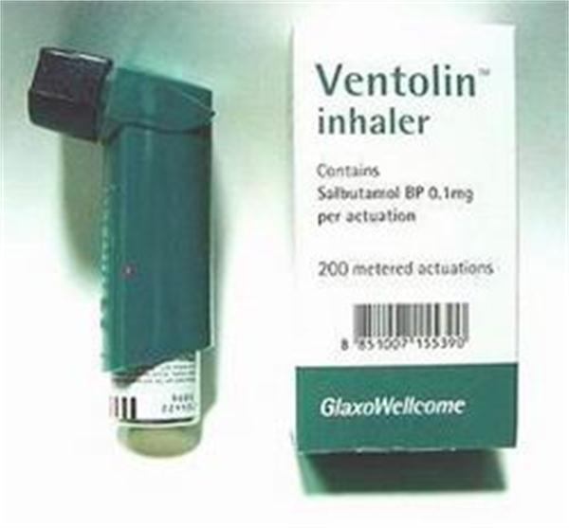

Slide 42
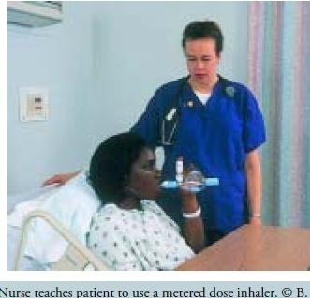

Slide 43
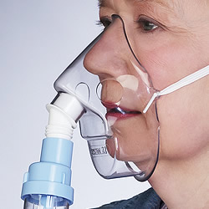

Slide 44
b. BRONCHIECTASIS
is a chronic, irreversible dilation of the bronchi and bronchioles
CAUSES
Chronic Airway obstruction
Diffuse airway injury
Pulmonary infections and obstruction of the bronchus or complications of long-term pulmonary infections
Genetic disorders such as cystic ﬁbrosis
Abnormal host defense (eg,humoral immunodeﬁciency)
Idiopathic causes

Slide 45
Predisposing factors
Recurrent respiratory infections in early childhood eg measles, inﬂuenza, whooping cough
Lung infections i.e tuberculosis
Immunodeﬁciency disorders.

Slide 46
Pathophysiology
The inﬂammatory process associated with pulmonary infections damages the bronchial wall
It causes loss of its supporting structure
Resulting in thick sputum that ultimately obstructs the bronchi.
The walls become permanently distended and distorted, impairing mucociliary clearance.
This results in retained secretions and subsequent obstruction that cause the alveoli distal to the obstruction to collapse.
Inﬂammatory scarring or ﬁbrosis replaces functioning lung tissue.

Slide 47
Medical management
Different types of antibiotics may be prescribed, with different intervals
Patients should be vaccinated against inﬂuenza and pneumococcal pneumonia.
Bronchodilators, may also assist with secretion management.

Slide 48
Nursing Management
Focuses on alleviating symptoms
Assisting the patient to clear pulmonary secretions.
Teaching on smoking cesation.
The patient and family are taught to perform postural drainage……positions
Teach patient on strategies to conserve energy while maintaining as active lifestyle as possible

Slide 49
Cont…
Teach patient about early signs of respiratory infection and the progression of the disorder
The patient’s nutritional status is assessed and strategies are implemented to ensure an adequate diet.

Slide 50
Chronic Obstructive Pulmonary Disease (COPD)
(COPD) is a disease state characterized by airﬂow limitation that is not fully reversible.
It includes emphysema and bronchitis
Pathophysiology
Airﬂow limitation is both progressive
It is associated with an abnormal inﬂammatory response of the lungs to noxious(harmful) particles or gases.

Slide 51
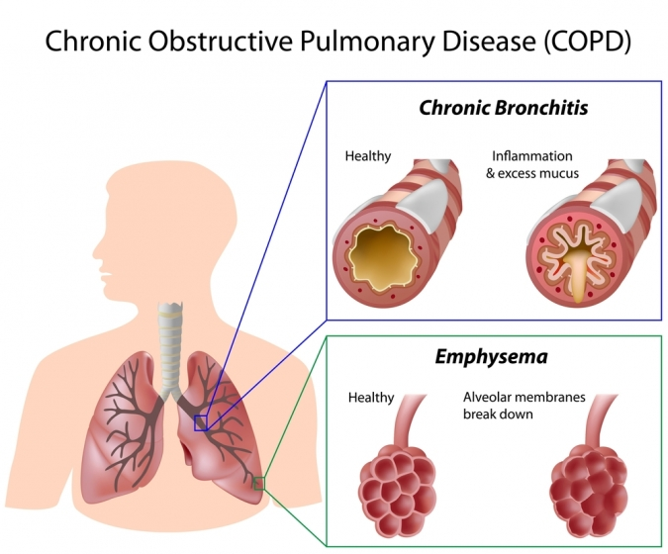

Slide 52
Patho ct…..
The inﬂammatory response occurs throughout the airways, parenchyma, and pulmonary vasculature
Because of the chronic inﬂammation and the body’s attempts to repair it, narrowing occurs in the small peripheral airways.
Over time, this injury and repair process causes scar tissue formation and narrowing of the airway lumen.

Slide 53
CAUSES
Exposure to cigarette smoke
Chronic respiratory infections
Process related to proteinases and antiproteinases in the lung.
  These are proteins produced as a result of inflammation which causes damage to the lung parenchyma
Release of anti-inflammatory mediators
Allergic reactions

Slide 54
Medical management
Risk reduction: smoking cessation,
Pharmacotherapy: bronchodilators using an inhaler eg albuterol, salbutamol
Corticosteroids--- ant-inflammatory
Oxygen therapy

Slide 55
a. Emphysema
Is a pathological term that describes an abnormal distention of the air spaces beyond the terminal bronchioles
Destruction of the distended walls of the alveoli results in impaired gas exchange
It is the end stage of a process that has progressed slowly for many years.

Slide 56
As the walls of the alveoli are destroyed, the alveolar surface area in direct contact with the pulmonary capillaries continually decreases,
Causes an increase in dead space and impaired oxygen diffusion
Leads to hypoxemia
In the later stages of the disease, carbon dioxide elimination is impaired,
Results in hypercapnia and causing respiratory acidosis

Slide 57
Risk Factors
Cigarette smoking. Pipe, cigar, and other types of tobacco smoking.
Passive smoking….
A deﬁciency of alphar1 anti- trypsin, an enzyme inhibitor that protects the lung parenchyma from injury … from the liver (rare condition)
Rupture of the lung thro stab wounds or accident
Prolonged exposure to occupational dust and chemical
Air pollution

Slide 58
Clinical manifestations
Dyspnea
Chronic cough
Sputum production
Fatigue
Wheezing
Hyper inflated(barrel) chest
Diminished breath sound with crackles and prolonged expiration
Weight loss, weakness
Hypercapnia and hypoxemia

Slide 59
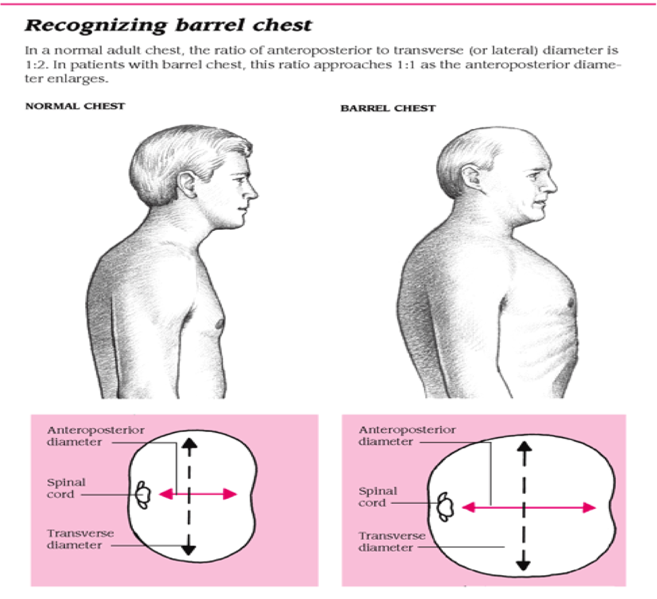

Slide 60
MEDICAL MANAGEMENT
Bronchodilators to reduce bronchospasm and airway obstruction.
Use of corticosteroids
Antibiotics for treatment of infections e.g amoxillin and benzyl penicillin
Oxygen therapy incase of dyspnoea
Chest physiotherapy to aid in removal of secretions

Slide 61
Nursing management
Major focus is on pulmonary rehabilitation that include
  PATIENT EDUCATION includes a broad variety of topics such as:
  normal anatomy and physiology of the lung
  pathophysiology and changes with COPD,
  medications and home oxygen therapy
  nutrition, respiratory therapy treatments,
  symptom alleviation,
  smoking cessation, coping with chronic disease,

Slide 62
  Breathing Exercises.-use of diaphragmatic breathing
  Inspiratory Muscle Training to strengthen the muscle
Activity Pacing to avoid overexertion and fatigue
Nutritional Therapy thorough assessment on caloric needs and food supplementation

Slide 63
lifestyle and home remedies
Stop smoking
Avoid other respiratory irritants
Exercise regularly
Protect yourself from cold air
Prevent respiratory infections.
Get pneumonia vaccinations as advised by your doctor

Slide 64
Complications
Respiratory insufficiency and failure
Right sided heart failure
Atelectasis
Pulmonary arterial hypertension
Pneumothorax

Slide 65
PNEUMONIA
Inflammatory process resulting in edema of the parenchymal lung tissue
Primarily affects terminal gas-exchanging portions of the lung
It is commonly caused by infectious agents

Slide 66
Caused by
bacteria, viruses, fungi, protozoa, parasites
Inhaled into lungs or transported via the bloodstream

Slide 67
Classification of pneumonia
  Classified by causal agent, distribution, setting (hospital -HAP or community - CAP)
a. According to causes
Bacterial (the most common cause of pneumonia)
Viral pneumonia
Fungal pneumonia
Chemical pneumonia (ingestion of kerosene, or inhalation of irritating substance)
Inhalation pneumonia (aspiration pneumonia)

Slide 68
b. According to areas involved (distribution)
Lobar pneumonia;
it is characterized by acute inflammation of the entire lobe or lung
Broncho-pneumonia:
Characterised by patchy consolidation (pus in many alveoli and adjacent air spaces) scattered in one or more lobes of one or both lungs

Slide 69
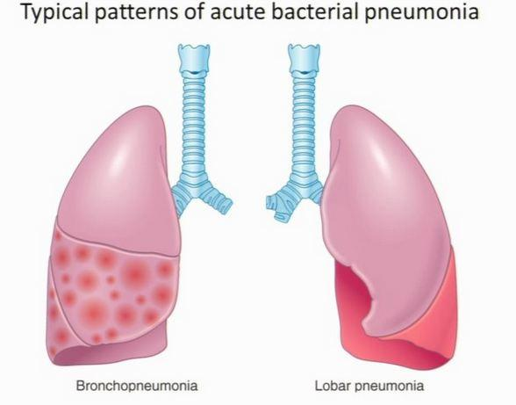
Cont……

Slide 70
c. According to where it is acquired
1. Community-acquired pneumonia(CAP)
Occurs either in the community setting or within the ﬁrst 48 hours of hospitalization.
Mostly caused by Streptococcus pneumoniae
2. Hospital-acquired pneumonia ( nosocomial pneumonia)
Is the onset of pneumonia symptoms more than 48 hours after admission to the hospital.

Slide 71
3. Pneumonia in the immuno- compromised host
Immuno compromised states occur with
  The use of immunosuppressive agents e.g corticosteroids.
  chemotherapy
  nutritional depletion
  use of broad-spectrum antimicrobial agents
  AIDS

Slide 72
MICRO-ORGANISMS RESPONSIBLE FOR PNEUMONIA
a. COMMUNITY ACQUIRED
Streptococcus pneumoniae (pneumococcal), Haemophilus inﬂuenzae
Legionnaires’ pneumophila
Mycoplasma pneumoniae,
Viral pneumonia,
Chlamydia pneumoniae

Slide 73
b. HOSPITAL-ACQUIRED PNEUMONIA.
Staphylococcal pneumonia,
Klebsiella pneumonia, Pseudomonas aeruginosa
c. IMMUNOCOMPROMISED HOST
Pneumocystis carinii pneumonia(PCP) caused by Pneumocystis carinii ,
Fungal pneumonia, caused by Aspergillus fumigatus,
Tuberculosis, caused by Mycobacterium tuberculosis

Slide 74
Mode of transmission
Bacteria and viruses living in the nose, sinuses, or mouth may spread to the lungs… normal flora
Breathing some of these bacteria directly into the lungs (droplets infection).
Aspiration of food, liquids, vomitus, or fluids from the mouth into the lungs (aspiration pneumonia).

Slide 75
Predisposing factors
Immuno-suppresed patients
Cigarette smoking
Difficult swallowing (due to stroke, parkinsons disease, or other neurological conditions)
Impaired consciousness (loss of brain function due to dementia, stroke, or other neurological conditions)

Slide 76
Predisposing factors ct….
Chronic lung disease (COPD, bronchioectasis)
Other serious illness such as heart disease, liver cirrhosis, and DM
Recent cold, laryngitis or flu
Exposure to irritants i.e dust, industrial fumes
Depressed cough reflex due to medication, debilitated state and weak respiratory muscles

Slide 77
Cont….
Aspiration of foreign materials into the lungs
Advanced age - reduced immunity
Alcoholism suppress body reflex and lead to aspiration
General anaesthesia (GA)
Prolonged immobility
Nothing-by-mouth (NPO) status; placement of nasogastric,, or endotracheal tube

Slide 78
Pathophysiology of pneumonia
The streptococci reach the alveoli
leads to inflammation and pouring of an exudates into the air spaces.
WBCs migrates to alveoli
The alveoli become more thick due to its filling with pus (consolidation)
Involved areas by inflammation are not adequately ventilated, due to secretions and edema.
This will lead to partial occlusion of alveoli and bronchi

Slide 79
Pathophysiology (cont…)
Causes a decrease in alveolar oxygen content alveolar oxygen tension (PAO2)
Venous blood goes to affected areas without being oxygenated,returns to the heart inadequately oxygenated
This will lead to arterial hypoxemia and even death due to interference with ventilation
Reduced PO2 in the arterial blood
PO2 ---- partial pressure of oxygen in the arterial blood

Slide 80
SIGNS AND SYMPTOMS
Sudden onset of chills, fever 38.5-40-5 ºC
Tachypnea 25-45 bpm due to respiratory distress
Pleuritic chest pain aggravated by deep breathing and coughing
Dyspnea due to the obstructed airway
Orthopnea...difficulty in breathing when lying flat. Patient prefer to be propped up
Cough with and without sputum i.e productive or non productive

Slide 81
S & S ct….
Reduced normal breath sounds, crackles,
Dullness on percussion.
Fatigue, nasal congestion
Headache
Mucoid or mucopurulent sputum after few days
Cyanosis (lips and nails) in severe cases due to poor oxygenation
Loss of appetite, low energy, and fatigue
Retraction of the ribs in severe pneumonia
Use of accessory muscles of breathing.

Slide 82
Diagnostic tests
History taking.
Physical examination.
Chest x-ray patches of consolidation
Blood test: level of wbc if high it means there is presence of infection
Sputum culture… presence of the bacteria?

Slide 83
MEDICAL MANAGEMENT
1. Ventilation improvement
Administer O2 incase of hypoxemia via mask or nasal cannula.
Use the pulse oxymetry to determine oxygen saturation
In severe cases nebulise with combivent, dexamethasone, or salbutamol (ventolin)
In severe case respiratory support is required
i.e endotracheal intubation and mechanical ventilation

Slide 84
Mgt ct…
2. Antibiotic therapy including
Penicillins eg amoxicillin, penicillin G (X-pen) and gentamycin.
cephalosporins e.g ceftriaxone,
Antipyretics and analgesics e.g Paracetamol, diclofenac, ibuprufen
Antihistamines and nasal decongestants may be administered

Slide 85
NURSING MANAGEMENT
Take history and perform physical exam to assess the severity
Assess the CAB...circulation, airway and breathing.
Administer O2 as prescribed via mask or nasal catheter to maintain SPO2 above 93%
Improve airway patency by removing secretions through nebulisation, suctioning and encouraging hydration 2-3L a day.
  It thins and loosens pulmonary secretions

Slide 86
Nursing mgt ct…
Improve breathing pattern by proper positioning in a semi fowlers position
Administer antibiotics i.e benzyl penicillin as prescribed
Continually monitor for signs of improvement
  By assessing respirations rate,
  Breathing patterns,
  Presence of secretions,
  Use of accessory muscles,
  Any abnormalities in VS and auscultations of breath sounds

Slide 87
Nursing mgt ct....
Administer antipyretics incase of fever and analgesics for pain and antihistamines
Ensuring bed rest and avoid overexertion that may aggrevate the symptoms
Administer fluids as prescribed to replace fluid loss imposed by labored breathing and fever
Continually asses for signs of respiratory distress i.e cyanosis and dyspnoea

Slide 88
Nursing mgt ct....
Nurse the patient in a well humidified environment
Teach patient to avoid irritants i.e. Smoke, pollutants, excessive alcohol intake and overexertion
Provide a high calorie, high protein diet of soft foods.
To prevent aspiration during nasogastric tube feedings, check the position of tube, and administer feedings slowly.
To control the spread of infection, dispose secretions properly.

Slide 89
Preventive measures
Frequent turning of bed ridden patients and early ambulation as much as possible.
Deep Coughing and breathing techniques and exercises
Sterilization of respiratory therapy equipment e g the suctioning equipment
Suctioning of secretion in the unconscious who have poor cough and swallowing reflexes

Slide 90
Prognosis
With treatment, most patients will improve within 2 weeks
Elderly or very sick patients may need longer treatment

Slide 91
COMPLICATIONS of pneumonia
Atelectasis and pleural effusion
Sepsis, which may lead to organ failure
Meningitis
Lung abscesses
Acute respiratory distress syndrome (ARDS)
Respiratory failure (which requires mechanical ventilator)

Slide 92
LUNG CANCER (BRONCHOGENIC CARCINOMA
Affects primarily those in the sixth or seventh decade of life. Though others are also affected
In approximately 70% of lung cancer patients, the disease has spread to regional lymphatic and other sites by the time of diagnosis.
Evidence indicates that carcinoma tends to arise at sites of previous scarring eg(TB, cystic ﬁbrosis) in the lung.
More than 85% of lung cancers are caused by the inhalation of carcinogenic chemicals, most commonly cigarette smoke

Slide 93
CLASSIFICATION AND STAGING
Most are classified as small cell lung cancer and non-small cell cancer.
Non-small cell is further classified with cell types
Squamous cell cancer usually centrally located and arises more in segmental and sub segmental bronchi
Adenocarcinoma - most prevalent. occurs peripherally and often metastases'

Slide 94
Ct..
Large cell carcinoma- is a fast growing tumour that tend to arise peripherally.
Bronchoalveolar -found in terminal bronchi and alveoli and usually slow growing
Small cell carcinoma
arise in the major bronchi and spread by infiltration along the bronchial wall

Slide 95
Staging
Staged according to tumour size, lymphoid involvement, location, and if metastasized
Staged as STAGE I-IV
Stage I- cancer small and only in one area of the lung
Stage II&III -tumour is larger and may have grown into the surrounding tissue and lymph nodes
Stage IV- cancer has spread into the other body parts (metastasis)

Slide 96
Risk factors
Tobacco smoke
Passive smoking
Environmental and occupational exposure i.e motor vehicle emissions and pollutant from manufacturing plants
Chronic exposure to industrial carcinogens
Family history
Dietary factors i.e smokers who eat diet low in fruits and vegetables
Underlying respiratory disease

Slide 97
Clinical manifestations
It develops gradually and asymptomatic until late in the course.
They includes:
Chronic cough that starts as dry persistent to productive cough
Dyspnea
Haemoptysis
Chest or shoulder pain indicate pleural involvement

Slide 98
Cont…..
Repeated unresolved URTI
Wheezing due to bronchial obstruction
Chest pain, tightness, hoarseness, dysphagia, neck edema and symptoms of pleural effusion if tumour has spread to adjacent structures
Non specific symptoms- weakness, anorexia and weight loss

Slide 99
MEDICAL MANAGEMENT
Treatment depend on the cell type, stage of the disease and physiologic status
a) Surgical resection is the preferred method of treating patients with
Localized non-small cell tumors,
No evidence of metastatic spread, and
Adequate cardiopulmonary function

Slide 100
Cont….
to relieve the pressure of the tumor on vital structures.
It can control symptoms of spinal cord metastasis and superior vena cava compression

Slide 101
c) Chemotherapy is used to
alter tumor growth patterns,
to treat patients with distant metastases or small cell cancer of the lung,
as an adjunct to surgery or radiation therapy
d) Palliative therapy may include pain management and other comfort measures.
Evaluation and referral to hospice is essential

Slide 102
Nursing management
RELIEVING BREATHING PROBLEMS
Maintain airway patency through the removal of excess secretions
This may be accomplished through
deep-breathing exercises
chest physiotherapy
suctioning

Slide 103
Cont…
Bronchodilator medications prescribed to promote bronchial dilation.
supplemental oxygen to treat impaired gaseous exchange .
positions that promote lung expansion, breathing exercises for lung expansion and relaxation
Educate the patient on energy conservation and airway clearance techniques
Assess patient respiratory rate, breath sounds and pulse oximetry
Refer for pulmonary rehabilitation

Slide 104
Cont….
Managing symptoms
Administer strong analgesics eg tramadol im, diclofenac, pethidine to relieve pain
Position in a comfortable position to relieve pain i.e semi fowlers
Instruct patient and assess on the side effects of specific treatment and manage them promptly

Slide 105
Cont…
Reducing fatigue
Assess patient level of fatigue and identify treatable causes and validate with the patient that fatigue is a real symptom
Educate the patient about energy conservation
technique and guided exercise as possible
Refer to physical and occupational therapy as possible

Slide 106
Cont…
Providing psychological support
Help patient and family deal with progress of disease and poor prognosis
Assess psychological aspects and assist patient to cope with the disease process
Assist patient and family with informed decision making regarding treatment options
Support patient and family in end of life decision and treatment
Involve a counsellor

Slide 107
CHEST TRAUMA
Two types-
a) Blunt
b) Penetrating chest trauma
a) BLUNT TRAUMA
Results from sudden compression or pressure inflicted on the chest
CAUSES
Motor vehicle crashes (trauma due to steering wheel, seat belt)
Falls,
Bicycle crashes (trauma due to handlebars)

Slide 108
MECHANISM OF BLUNT CHEST TRAUMA
Acceleration- (moving object hitting the patient or patient being thrown into an object)
Deceleration- sudden decrease in the rate of speed
Shearing-stretching forces to the areas of the chest causing tears and raptures
Compression-direct blow to the chest

Slide 109
PATHOLOGIC EFFECTS
• Hypoxemia from disruption of the airwaydue to:
  injury to the lung parenchyma,
  rib cage, and respiratory musculature;
  massive hemorrhage; collapsed lung; and
  pneumothorax
• Hypovolemia from massive ﬂuid loss from the great vessels, cardiac rupture, or hemothorax (blood accumulates in the pleural cavity)

Slide 110
Cont..
Cardiac failure from cardiac tamponade, cardiac contusion, or increased intrathoracic pressure
Cardiac tamponade ---pressure on the heart when fluid filled pericardial space compresses the heart

Slide 111
FLAIL CHEST
It usually occurs when three or more adjacent ribs (multiple contiguous ribs) are fractured at two or more sites,
This results into a free ﬂoating rib segments.
It may also result as a combination fracture of ribs and costal cartilages or sternum .

Slide 112
Pathophysiology
During inspiration, as the chest expands,
The detached part of the rib segment (ﬂail segment) moves in a paradoxical manner movement
It is pulled inward during inspiration,
Reducing the amount of air that can be drawn into the lungs.
On expiration, because the intrathoracic pressure exceeds atmospheric pressure
The ﬂail segment bulges outward, impairing the patient’s ability to exhale.
The mediastinum then shifts back to the affected side.

Slide 113
Cont…
This paradoxical action results in
increased dead space,
a reduction in alveolar ventilation
decreased compliance…(ability of the lung to expand and stretch)

Slide 114
Clinical manifestations
Hypoxemia, if gas exchange is greatly compromised
Respiratory acidosis develops as a result of CO2 retention
Hypotension, due to inadequate tissue
perfusion
Metabolic acidosis due to paradoxical motion of the mediastinum decreases cardiac output and CO2 exhalation

Slide 115
Medical management
Treatment of ﬂail chest is usually supportive.
Management includes
  providing ventilatory support
  clearing secretions from the lungs
  controlling pain.
The speciﬁc management depends on the degree of respiratory dysfunction.

Slide 116
Cont…
If only a small segment of the chest is involved, the objectives are to clear the airway through blocks.
positioning,
coughing,
deep breathing, and
suctioning to aid in the expansion of the lung, and
to relieve pain by intercostal nerve block using anaesthetic drugs eg lignocane

Slide 117
Cont…
For mild to moderate ﬂail chest injuries, appropriate ﬂuid replacement, while at the same time relieving chest pain.
Pulmonary physiotherapy focusing on lung volume expansion.
The patient is closely monitored for further respiratory compromise.
When a severe ﬂail chest injury is encountered, endotracheal intubation and mechanical ventilation is done

Slide 118
Pulmonary Contusion
It is damage to the lung tissues resulting in hemorrhage and localized edema.
It is associated with chest trauma when there is rapid compression and decompression to the chest wall

Slide 119
PATHOPHYSIOLOGY
Injury to the lung parenchyma and its capillary network
Results in a leakage of serum protein and plasma.
The leaking serum protein exerts an osmotic pressure that enhances loss of ﬂuid from the capillaries.

Slide 120
Cont….
Blood and cellular debris enters the lung and accumulate in the bronchioles and alveolar surface
These interfere with gas exchange.
An increase in pulmonary vascular resistance and pulmonary artery pressure occurs.
The patient has hypoxemia and Hypercapnia

Slide 121
CLINICAL MANIFESTATIONS
Tachypnea, tachycardia, pleuritic chest pain,
hypoxemia, and blood-tinged secretions,
Crackles, frank bleeding, severe hypoxemia, and respiratory acidosis.
Patient with moderate pulmonary contusion has a large amount of
mucus, serum, and frank blood in the tracheobronchial tree.

Slide 122
Cont…
A patient with severe pulmonary contusion has the signs and symptoms of ARDS;
these may include
central cyanosis, (tongue and lips)
agitation,
productive cough with frothy, bloody secretions

Slide 123
MEDICAL MANAGEMENT
Treatment priorities include
maintaining the airway,
providing adequate oxygenation, and
controlling pain.
Supplemental oxygen is usually given by mask or cannula for 24 to 36 h.

Slide 124
Cont….
In mild pulmonary contusion, adequate hydration via intravenous ﬂuids and oral intake is important to mobilize secretions.
However, must be closely monitored to avoid hypervolemia.
Postural drainage, physiotherapy including coughing, and endotracheal suctioning are used to remove the secretions.

Slide 125
Cont….
Pain is managed by intercostal nerve blocks or by opioids analgesics eg morphine
Antimicrobial therapy is administered because the damaged lung is susceptible to infection.
Intubation and mechanical ventilation to maintain the pressure and keep the lungs inﬂated

Slide 126
Cont..
Diuretics may be given to reduce edema.
A nasogastric tube is inserted to relieve gastrointestinal distention
Severe contusion require aggressive treatment with endotracheal intubation and ventilatory support, diuretics, and ﬂuid restriction.
Colloids and crystalloid solutions may be used to treat hypovolemia.

Slide 127
B. PENETRATING TRAUMA
Occurs when a foreign object penetrates into the chest wall
Causes
Gun shot and stab wound
Stab wounds are of low velocity and thus destroy small area
Gunshot may be of low, medium or high velocity depending with distance, calibre of gun and bullet

Slide 128
Management
Objective management is to restore and maintain cardiopulmonary function
Adequate airway and ventilation is established and maintained
Assess for shock and treated simultaneously with colloid, crystacolloid solution or blood as indicated by patient condition

Slide 129
Cont…
Diagnostic investigations are done
i.e chest x-ray, arterial blood gases, pulse oximetry and ECG, blood grouping and cross matching
Chest tube inserted for pleural drainage
Surgical intervention in penetrating wound of the heart, great vessels.

Slide 130
PNEUMOTHORAX
Occurs when the parietal or visceral pleura is breached and the pleural space is exposed to positive atmospheric pressure
Negative pressure is required to maintain lung inﬂation.
When either pleura is breached, air enters the pleural space, and the lung or a portion of it collapses!!!!!!!!!!!!!!!!!!!!!!!!!!
Types of pneumothorax include simple, traumatic and tension pneumothorax.

Slide 131
a) Simple(spontaneous) Pneumothorax
This occurs as air enters the pleural space through a bronchopleural ﬁstula.
A spontaneous pneumothorax may occur in an apparently healthy person.
It may be associated with diffuse interstitial lung disease and severe emphysema.

Slide 132
b) Traumatic Pneumothorax
Occurs when air escapes from a laceration in the lung itself and enters the pleural space or
enters the pleural space through a wound in the chest wall.
Causes
Blunt trauma (eg, rib fractures) or penetrating chest trauma.
Abdominal trauma (eg, stab wounds or gun- shot wounds to the abdomen) and from diaphragmatic tears.
Invasive thoracic procedures (ie, thoracentesis, transbronchial lung biopsy, insertion of subclavian line

Slide 133
Cont….
Traumatic pneumothorax is often accompanied by
Hemothorax (collection of blood in the pleural space resulting from torn intercostal blood vessels, lacerations of the great vessels, and lacerations of the lungs).
Hemopneumothorax Often both blood and air are found in the chest cavity.

Slide 134
Hemothorax
Hemothorax is a specific type of pleural effusion in which there is blood in the pleural cavity.
Bleeding may be the result of chest injury, a complication of chest surgery, malignancies, or rupture of a great vessel such as an aortic aneurysm.
Hemothorax may be classified as minimal, moderate, or large.

Slide 135
Cont…
A minimal hemothorax involves the presence of 300 to 500 mL of blood in the pleural space
Small amounts of blood usually are absorbed from the pleural space, and the hemothorax usually clears in 10 to14 days without complication.
A moderate hemothorax (500 to 1000 mL of blood) fills approximately one third of the pleural space

Slide 136
Cont…
May produce signs of lung compression and loss of intravascular volume.
It requires immediate drainage and replacement of intravascular fluids.
A large/massive hemothorax fills one half or more of one side of the chest;
it indicates the presence of 1000 mL or more of blood in the thorax.

Slide 137
Open pneumothorax
A type of traumatic pneumothorax
It occurs when a wound in the chest wall is large enough to allow air to pass freely in and out of the thoracic cavity with each attempted respiration.
Because the rush of air through the hole in the chest wall produces a sucking chest wounds sucking sound, such injuries are termed.

Slide 138
Cont..
In such patients, not only does the lung collapse, but the structures of the mediastinum (heart and great vessels) also shift toward the uninjured side with each inspiration and in the opposite direction with expiration.
This is termed mediastinal ﬂutter or swing, and it produces serious circulatory problems.

Slide 139
c) Tension Pneumothorax
Occurs when air is drawn into the pleural space from a lacerated lung or through a small hole in the chest wall.
It may be a complication of other types of pneumothorax.
Air that enters the chest cavity with each inspiration is trapped;
It cannot be expelled during expiration through the air passages or the hole in the chest wall.

Slide 140
Cont..
With each breath, tension (positive pressure) is increased within the affected pleural space.
This causes the lung to collapse and the heart, the great vessels, and the trachea to shift toward the unaffected side of the chest (mediastinal shift).
Relief considered a medical emergency

Slide 141
Clinical Manifestations
Simple pneumothorax
Pain is usually sudden and may be pleuritic
minimal respiratory distress with slight chest discomfort and tachypnea with a small simple or uncomplicated pneumothorax
Large pneumothorax,
acute respiratory distress.
The patient is anxious,
dyspnea and air hunger,

Slide 142
Cont…
Increased use of the accessory muscles
May develop central cyanosis from severe hypoxemia
Tachypnea,
Decreased movement of the affected side of the thorax,
A tympanic sound on percussion of the chest wall
Decreased or absent breath sounds
Decreased tactile fremitus on the affected side

Slide 143
Cont…
Tension pneumothorax clinical features
air hunger,
agitation,
increasing hypoxemia,
central cyanosis,
hypotension,
tachycardia, and
profuse diaphoresis.

Slide 144
Medical management
Management depends on its cause and severity.
The goal of treatment is to evacuate the air or blood from the pleural space.
If a tension pneumothorax is suspected, the patient should
immediately be given a high concentration of supplemental oxygen to treat the hypoxemia,
pulse oximetry should be used to monitor oxygen saturation.

Slide 145
Cont…
In an emergency situation, a tension pneumothorax can be de-compressed or quickly converted to a simple pneumothorax by
inserting a large-bore needle (14-gauge) at the second intercostal space mid clavicular line on the affected side

Slide 146
Cont…
Chest tube is inserted to drain the ﬂuid and air.
Opiod analgesics administered to relieve chest pain
Antibiotics usually are prescribed to combat infection from contamination.
An emergency thoracotomy may also be performed in the emergency department if there is suggested cardiovascular injury

Slide 147
Chest tube drainage
Indications
Re-expand the lung
Remove excess air fluid and blood from the pleural space
Treatment of pneumothorax, pleural effusion, Emphyema
Chest drainage systems have a
  suction source,
  a collection chamber for pleural drainage, and
  a mechanism to prevent air from reentering the chest with inhalation.

Slide 148
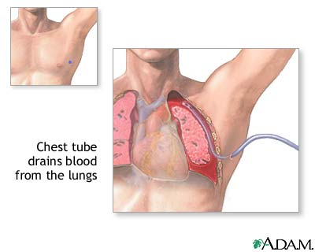
Sites for chest tube insertion

Slide 149
Sites for insertion
Hemothorax -chest tube is inserted between the fourth to sixth intercostal space at the midaxillary line
Pneumothorax- tube will be inserted into the second intercostal space in the anterior chest at the midclavicular line.

Slide 150
Chest Tube Drainage system
Three basic Principles
  Gravity
    Causes air to flow from higher to lower level
  Positive pressure
    Positive pressure created by the air or fluid will seek to relieve itself to a lower pressure under the water
  Suction
    Sub-atmospheric pressure is reduced promoting air or fluid to move from higher to lower pressure rapidly

Slide 151
Cont…
Drainage collection chamber
  Receives fluid and air from chest cavity
Water- seal chamber
  Acts as one way valve
Suction control chamber
  Amount of suction is regulated by the depth of the water not the amount of suction applied to the system

Slide 152
GUIDELINES FOR MANAGING CHEST DRAINAGE SYSTEMS
Verify that all connection tubes are patent and connected securely.
2. Assess that the water seal is intact
3. Monitor characteristics of drainage including color, amount, and consistency.
Assess for signiﬁcant increases or decreases in drainage output.
4. Note ﬂuctuations in the water seal chamber for wet suction systems.

Slide 153
Cont….
5. Keep system below the patient’s chest level.
6. Keep suction at level as ordered.
7. Maintain appropriate ﬂuid in water seal for wet suction systems.
8. Ensure that the drainage tubing does not kink, loop, or interfere with the patient’s movements.

Slide 154
Cont…
. Encourage the patient to assume a comfortable position with good body alignment…high fowlers position
10. Assist patient with ROM exercises on the affected arm
11. Observe for air leaks in the drainage system; they are indicated by constant bubbling in the water seal chamber

Slide 155
Cont..
12. Observe and immediately report rapid and shallow breathing, cyanosis, symptoms of hemorrhage, or signiﬁcant changes in vital signs.
13. Encourage and assist the patient to turn, cough, and take deep breaths.
14. Maintain aseptic technique when changing dressings

Slide 156
Cont….
15. Clamp tubes only for special procedures as changing drainage, air leaks or before removal of chest tubes
16. If drainage system breaks, place distal end of tubing in sterile water container at 2 cm level
Monitor fluid drainage and evacuate
  no more than 1 L to 1500 ml of pleural fluid grossly bloody drainage x24 hours
If more than 1.5 litres of fluid are drained off, fluid shifts can cause haemodynamic instability or pulmonary oedema

Slide 157
Removal of chest tubes
Indications
  Fluid drainage ceased
  Lung re-expansion
Nursing role
  Monitor for tension pneumothorax
  Have pt do a valsalva maneuver as CT is removed
  Apply airtight dressing
  Observe for drainage & reinforce if necessary
  Observe for respiratory distress & pneumothorax

Slide 158
1. PLEURISY (pleuritis)
Refers to inﬂammation of both layers of the pleurae (parietal and visceral).
When the inﬂammed pleural membranes rub together during respiration (intensiﬁed on inspiration)
The result is severe, sharp, knifelike pain.
NB: associated with inspiration and expiration

Slide 159
May develop in conjunction with
Pneumonia or an upper respiratory tract infection,
TB,
After trauma to the chest,
Pulmonary infarction, or pulmonary embolism;
In patients with primary and metastatic cancer; and
After thoracotomy,
Rheumatoid arthritis,
Pneumothorax, pancreatitis

Slide 160
Clinical Manifestations
a. The key characteristic of pleuritic pain is its relationship to respiratory movement.
Taking a deep breath, coughing, or sneezing worsens the pain.
Sharp knife like pain (stabbing)
Pleuritic pain is restricted in distribution rather than diffuse;
It usually occurs only on one side that is affected

Slide 161
The pain may become minimal or absent when the breath is held
Sometimes chest pain may extend to the shoulder
b. Decreased movement on the involved wall
c. Rapid or shallow breathing related to pain

Slide 162
Medical Management
The objectives of treatment are
To discover the underlying condition causing the pleurisy and
To relieve the pain.
Monitor for signs and symptoms of pleural effusion, such as shortness of breath and pain

Slide 163
Cont…
Administer Prescribed analgesics i.e.
Indocid,(indomethacin) (NSAID)
topical applications of heat or cold provide symptomatic relief
b) If the pain is severe, an intercostal nerve block may be required.

Slide 164
Nursing Management
a) The patient has considerable pain on inspiration
The nurse can offer suggestions to enhance comfort, such as turning frequently onto the affected side to splint the chest wall
It reduces the stretching of the pleurae.
b) Teach the patient to use the hands or a pillow to splint the rib cage while coughing.
c) Assumption of a position that decreases pain and decreased chest wall excursion….(movement)

Slide 165
THANK YOU ALL!!
GOD BLESS YOU

