Slide 1
PULMONARY NURSING
By. Emily Kengo
WELCOME ALL

Slide 2
ANATOMY AND PHYSIOLOGY
REVIEW
Composed of upper and lower respiratory system
Together the two are responsible for ventilation
External respiration is responsible for exchange of gases between blood and the lungs
Internal respiration involves exchange of gases between cells and blood

Slide 3
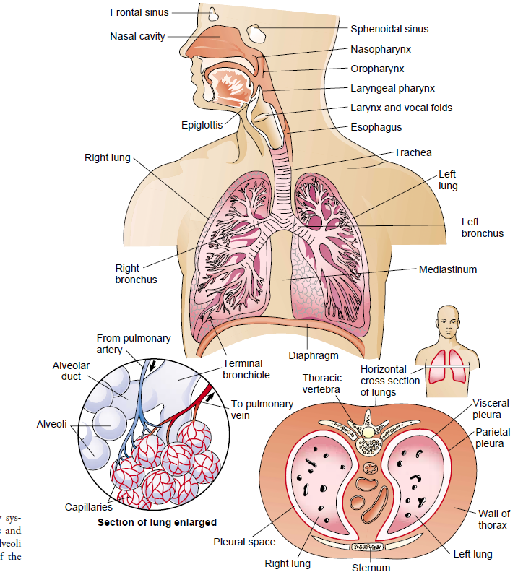

Slide 4
FUNCTIONS OF THE RESPIRATORY SYSTEM
Ventilation
Movement of air in and out of the airways
Respiration
This whole process of gas exchange between the atmospheric air and the blood and between the blood and cells of the body
Oxygen Transport
Oxygen is supplied to, and carbon dioxide is removed from, cells by way of the circulating blood.
Oxygen diffuses from the capillary through the capillary wall to the interstitial ﬂuid.
The movement of carbon dioxide occurs by diffusion from cell to blood.

Slide 5
Muscles of respiration
Inspiration and expiration occurs as a result of muscular activity,
Partly voluntary and partly involuntary.
Muscles of respiration in normal quiet breathing are the
intercostal muscles and
the diaphragm.
During difficult or deep breathing they are assisted by the muscles of the neck, shoulders and abdomen….accessory muscles

Slide 6
UPPER RESPIRATORY TRACT
FUNCTIONS
Protect respiratory system from infection and from foreign body inhalation through sneezing, coughing and spasm
Warms and filters inspired air so that lower respiratory tract accomplishes gas exchange
Humidification of air
Passage way of air into the lower respiratory system

Slide 7
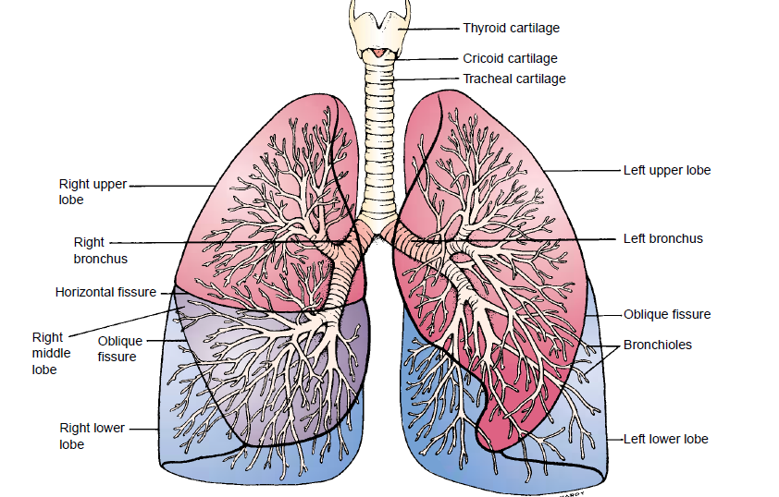

Slide 9
ASTHMA
Is a chronic inﬂammatory disease of the airways that causes
airway hyperresponsiveness,
mucosal edema and
mucus production
It differs from other obstructive disease in that it is highly reversible either spontaneously or with drugs

Slide 10
Pathophysiology
Exposure to predisposing, causal and contributing factors cause inﬂammation which leads to obstruction from the following:
mucosal edema,
reduced airway diameter,
bronchospasm (contraction of the smooth muscles), causing further narrowing and increased mucus production,

Slide 11
This causes airflow limitation thus resulting in symptoms of wheezing, Dyspnea and chest tightness
Cell that play key role in inflammation of asthma are
Mast cells,
Neutrophils,
Eosinophils and lymphocytes
They perpetuate inflammatory response

Slide 12
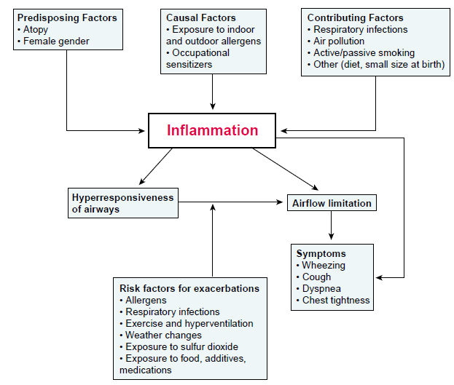
CONT…..

Slide 13
RISK FACTORS
Allergens-- strongest predisposing factor e. g weed, pollen, dust, animal fur, mold
Chronic exposure to airway irritant i.e smoke, dust.
stress
Family history
Risk factors for exacerbations/triggers
Allergens i.e dust, strong odours
Respiratory infections
Exercise and hyperventilation
Weather changes i.e cold season
Exposure to food additives, medications

Slide 14
Symptoms
Wheezing on expiration and inspiration
Cough with or without mucus production
Dyspnea
Chest tightness and air hunger
Tachycardia
Lethargy
Expiration requires efforts
Slow labored breathing with excessive use of accessory muscles
As exercabation continues, there maybe tachycardia, diaphoresis, widened pulse pressure hypoxemia and central cyanosis

Slide 15
Medical Management
Administer bronchodilators to reduce bronchospasms
corticosteroids.
Anticholinergics e.g atrovent.
Combination of inhalers.
Oxygen to increase oxygen saturation and correct hypoxia
Antibiotics for infection

Slide 16
Nursing Management
Obtain history to identify medication patient is currently on
Assess the severity of the respiratory symptoms
Manage for CAB by administering oxygen due to circulatory compromise and hypoxemia
Ensure patent airway by nebulising with salbutamol (ventolin), or combivent
if no improvement suction to remove secretions (but not always indicated)

Slide 17
Maintain good breathing pattern by positioning patient in a semifowlers position
Continue with nebulisation after every 15 minutes and oxygen therapy until there is improvement in breathing and respiration
Ensure bed rest to prevent fatigue and overexertion

Slide 18
Cont…
Ensure frequent monitoring of the respirations, airway, breathing pattern, pulse oximetry and the vital signs
Monitor vitals signs and respiratory activity to identify any change of condition and dyspnoea
Nurse the patient in a well humidified environment free from irritants

Slide 19
Reassure the patient to allay anxiety and to promote quick recovery
Ensure adequate fluid intake and nutrition
On discharge teach the patient on common triggers of asthma and avoiding them, drug compliance, use of inhalor

Slide 20
Prevention
Patients with recurrent asthma should undergo tests to identify the substances that precipitate the symptoms
Instruct patient to avoid causative agent as much as possible.
Complications of asthma
Status asthmaticus,
Respiratory failure,
Pneumonia, and atelectasis.
Airway obstruction, particularly during acute asthmatic episodes, often results in hypoxemia,
dehydration from hyperventilation

Slide 21
STATUS ASTHMATICUS
Is severe and persistent asthma that does not respond to conventional therapy and lasts more than 24 hours
Causes include infection that is not resolved, anxiety, dehydration, increased adrenergic blockage, and nonspeciﬁc irritants.
An acute episode may be precipitated by hypersensitivity to aspirin

Slide 22
Clinical Manifestations
They are the same as those seen in severe asthma:
Labored breathing,
Persistent shortness of breath
Prolonged exhalation,
Engorged neck veins, and wheezing
Chest tightness
Cyanosis
Agitation and confusion
Inability to speak in full sentences

Slide 23
Medical Management
Nebulize with salbutamol.
Give im hydrocortisone.
Give aminophylline in normal saline to restore bronchial reactivity.
Antibiotics to treat infection or for prophylaxis
Administer oxygen at 3-4litres/min to treat dyspnoea and cyanosis.
Intravenous fluids for rehydration.
If symptoms improves maintain patient on oral prednisone

Slide 24
Nursing management
Constantly monitor the patient for the ﬁrst 12 to 24 hours, or until status asthmaticus is under control.
Assess the patient’s skin turgor to identify signs of dehydration
Teach the patient how to use inhaler
Fluid intake is essential to combat dehydration, to loosen secretions, and to facilitate expectoration.

Slide 25
The nurse administers intravenous ﬂuids as prescribed, up to 3 to 4 L/day.
The patient’s energy needs to be conserved by bed rest
The room should be quiet and free of respiratory irritants, including flowers, tobacco smoke, perfumes, or odors of cleaning agents.

Slide 26
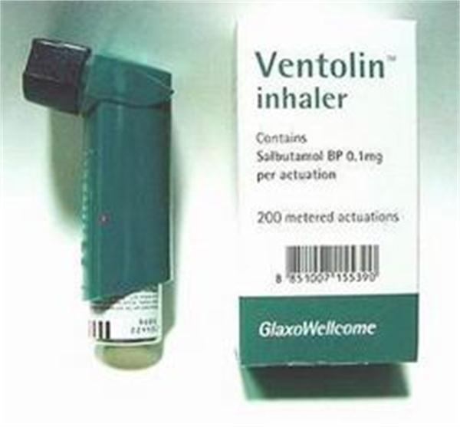

Slide 27
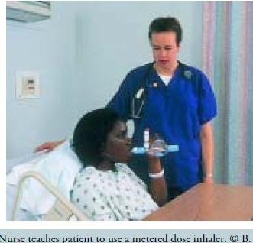

Slide 28
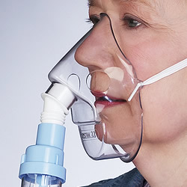

Slide 29
b. BRONCHIECTASIS
is a chronic, irreversible dilation of the bronchi and bronchioles
CAUSES
Chronic Airway obstruction
Diffuse airway injury
Pulmonary infections and obstruction of the bronchus or complications of long-term pulmonary infections
Genetic disorders such as cystic ﬁbrosis
Abnormal host defense (eg,humoral immunodeﬁciency)
Idiopathic causes

Slide 30
Predisposing factors
Recurrent respiratory infections in early childhood eg measles, inﬂuenza, whooping cough
Lung infections i.e tuberculosis
Immunodeﬁciency disorders.

Slide 31
Pathophysiology
The inﬂammatory process associated with pulmonary infections damages the bronchial wall
It causes loss of its supporting structure
Resulting in thick sputum that ultimately obstructs the bronchi.
The walls become permanently distended and distorted, impairing mucociliary clearance.
This results in retained secretions and subsequent obstruction that cause the alveoli distal to the obstruction to collapse.
Inﬂammatory scarring or ﬁbrosis replaces functioning lung tissue.

Slide 32
Medical management
Different types of antibiotics may be prescribed, with different intervals
Patients should be vaccinated against inﬂuenza and pneumococcal pneumonia.
Bronchodilators, may also assist with secretion management.

Slide 33
Nursing Management
Focuses on alleviating symptoms
Assisting the patient to clear pulmonary secretions.
Teaching on smoking cesation.
The patient and family are taught to perform postural drainage……positions
Teach patient on strategies to conserve energy while maintaining as active lifestyle as possible

Slide 34
Cont…
Teach patient about early signs of respiratory infection and the progression of the disorder
The patient’s nutritional status is assessed and strategies are implemented to ensure an adequate diet.

Slide 35
Chronic Obstructive Pulmonary Disease (COPD)
(COPD) is a disease state characterized by airﬂow limitation that is not fully reversible.
It includes emphysema and bronchitis
Pathophysiology
Airﬂow limitation is both progressive
It is associated with an abnormal inﬂammatory response of the lungs to noxious(harmful) particles or gases.

Slide 36
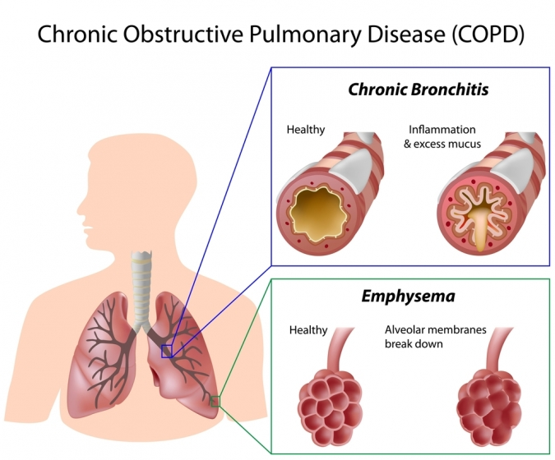

Slide 37
Patho ct…..
The inﬂammatory response occurs throughout the airways, parenchyma, and pulmonary vasculature
Because of the chronic inﬂammation and the body’s attempts to repair it, narrowing occurs in the small peripheral airways.
Over time, this injury and repair process causes scar tissue formation and narrowing of the airway lumen.

Slide 38
CAUSES
Exposure to cigarette smoke
Chronic respiratory infections
Process related to proteinases and antiproteinases in the lung.
  These are proteins produced as a result of inflammation which causes damage to the lung parenchyma
Release of anti-inflammatory mediators
Allergic reactions

Slide 39
Medical management
Risk reduction: smoking cessation,
Pharmacotherapy: bronchodilators using an inhaler eg albuterol, salbutamol
Corticosteroids--- ant-inflammatory
Oxygen therapy

Slide 40
a. Emphysema
Is a pathological term that describes an abnormal distention of the air spaces beyond the terminal bronchioles
Destruction of the distended walls of the alveoli results in impaired gas exchange
It is the end stage of a process that has progressed slowly for many years.

Slide 41
As the walls of the alveoli are destroyed, the alveolar surface area in direct contact with the pulmonary capillaries continually decreases,
Causes an increase in dead space and impaired oxygen diffusion
Leads to hypoxemia
In the later stages of the disease, carbon dioxide elimination is impaired,
Results in hypercapnia and causing respiratory acidosis

Slide 42
Risk Factors
Cigarette smoking. Pipe, cigar, and other types of tobacco smoking.
Passive smoking….
A deﬁciency of alphar1 anti- trypsin, an enzyme inhibitor that protects the lung parenchyma from injury … from the liver (rare condition)
Rupture of the lung thro stab wounds or accident
Prolonged exposure to occupational dust and chemical
Air pollution

Slide 43
Clinical manifestations
Dyspnea
Chronic cough
Sputum production
Fatigue
Wheezing
Hyper inflated(barrel) chest
Diminished breath sound with crackles and prolonged expiration
Weight loss, weakness
Hypercapnia and hypoxemia

Slide 44
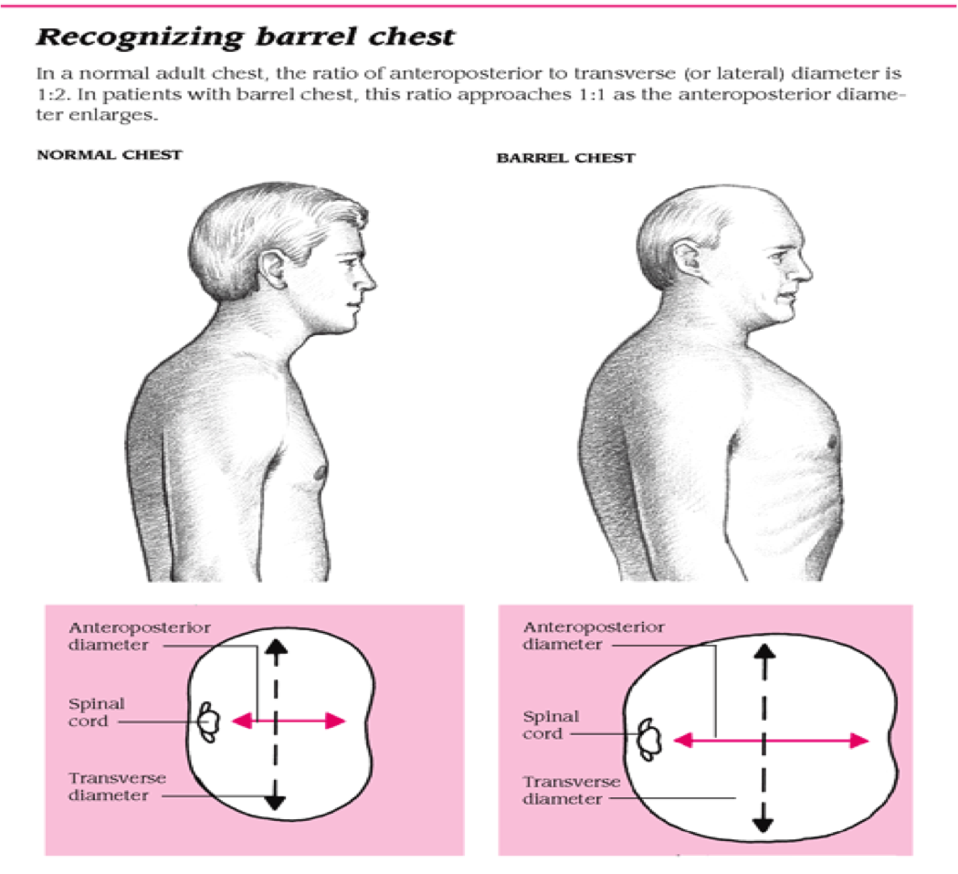

Slide 45
MEDICAL MANAGEMENT
Bronchodilators to reduce bronchospasm and airway obstruction.
Use of corticosteroids
Antibiotics for treatment of infections e.g amoxillin and benzyl penicillin
Oxygen therapy incase of dyspnoea
Chest physiotherapy to aid in removal of secretions

Slide 46
Nursing management
Major focus is on pulmonary rehabilitation that include
  PATIENT EDUCATION includes a broad variety of topics such as:
  normal anatomy and physiology of the lung
  pathophysiology and changes with COPD,
  medications and home oxygen therapy
  nutrition, respiratory therapy treatments,
  symptom alleviation,
  smoking cessation, coping with chronic disease,

Slide 47
  Breathing Exercises.-use of diaphragmatic breathing
  Inspiratory Muscle Training to strengthen the muscle
Activity Pacing to avoid overexertion and fatigue
Nutritional Therapy thorough assessment on caloric needs and food supplementation

Slide 48
lifestyle and home remedies
Stop smoking
Avoid other respiratory irritants
Exercise regularly
Protect yourself from cold air
Prevent respiratory infections.
Get pneumonia vaccinations as advised by your doctor

Slide 49
Complications
Respiratory insufficiency and failure
Right sided heart failure
Atelectasis
Pulmonary arterial hypertension
Pneumothorax

