Slide 1
PULMONARY NURSING(10HRS)
A. SAMBU

Slide 2
MODULE OUTCOMES.
BY THE END OF THE MODULE THE LEARNER SHOULD:
1. MANAGE PATIENTS WITH RESTRICTIVE RESPIRATORY DISORDERS USING THE NURSING PROCESS.
2. MANAGE PATIENTS WITH OBTRUCTIVE RESPIRATORY DISORDERS USING THE NURSING PROCESS.

Slide 3
Intro.
The cells of the human body require a constant stream of oxygen to stay alive. The respiratory system provides oxygen to the body’s cells while removing carbon dioxide, a waste product that can be lethal if allowed to accumulate.

Slide 4
Intro.
There are 3 major parts of the respiratory system: the airway, the lungs, and the muscles of respiration. The airway, which includes the nose, mouth, pharynx, larynx, trachea, bronchi, and bronchioles, carries air between the lungs and the body’s exterior.

Slide 5
Intro.
The lungs act as the functional units of the respiratory system by passing oxygen into the body and carbon dioxide out of the body. Finally, the muscles of respiration, including the diaphragm and intercostal muscles, work together to act as a pump, pushing air into and out of the lungs during breathing.

Slide 6
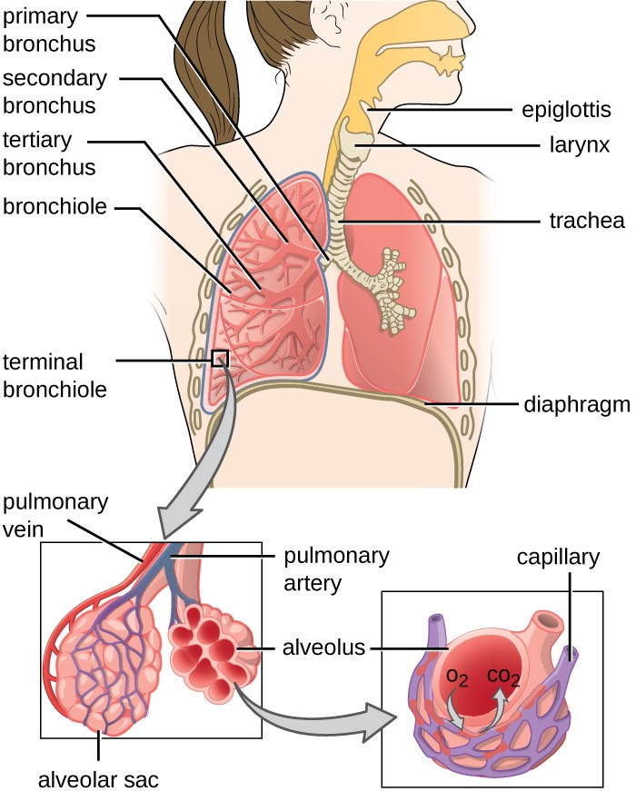

Slide 7
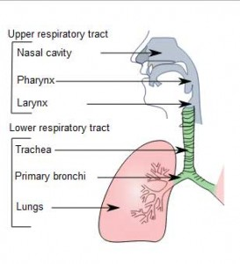

Slide 8
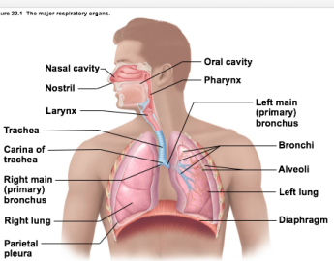

Slide 9
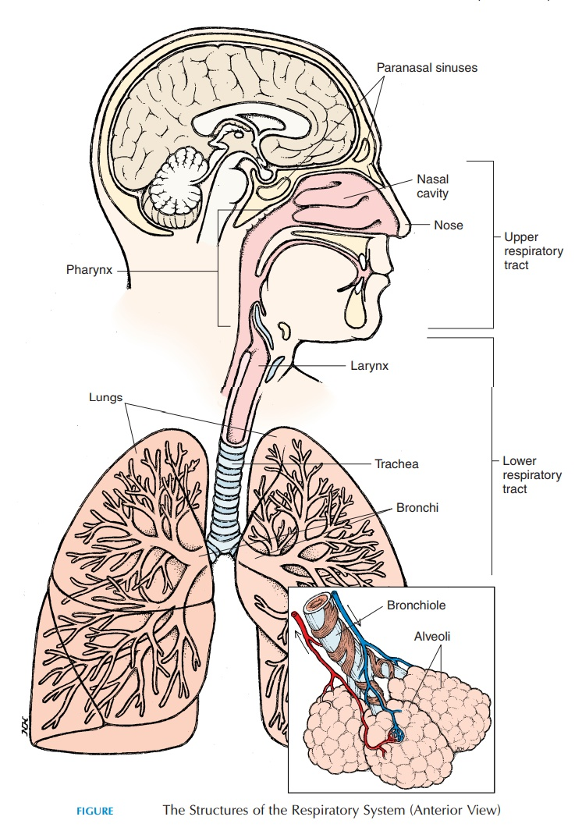

Slide 10
PNEUMONIA.
Pneumonia is an inﬂammation of the lung parenchyma caused by various microorganisms, including bacteria, mycobacteria, fungi, and viruses. Pneumonias are classiﬁed as community acquired pneumonia (CAP), hospital-acquired (nosocomial) pneumonia (HAP), pneumonia in the immunocompromised host, and aspiration pneumonia.

Slide 11
Cont.
Those at risk for pneumonia often have chronic underlying disorders, severe acute illness, a suppressed immune system from disease or medications, immobility, and other factors that interfere with normal lung protective mechanisms. The elderly are also at high risk.

Slide 12
Pathophysiology
An inﬂammatory reaction can occur in the alveoli, producing an exudate that interferes with the diffusion of oxygen and carbon dioxide; bronchospasm may also occur if the patient has reactive airway disease.

Slide 13
Cont.
Bronchopneumonia, the most common form, is distributed in a patchy fashion extending from the bronchi to surrounding lung parenchyma. Lobar pneumonia is the term used if a substantial part of one or more lobes is involved.

Slide 14
Cont.
Pneumonias are caused by a variety of microbial agents in the various settings. Common organisms include Pseudomonas aeruginosa and Klebsiella species; Staphylococcus aureus; Haemophilus inﬂuenzae; Staphylococcus pneumoniae; and enteric Gram-negative bacilli, fungi, and viruses (most common in children).

Slide 15
Clinical Manifestations
Clinical features vary depending on the causative organism and the patient’s disease.
Sudden chills and rapidly rising fever (38.5C to 40.5C [101F to 105F]).
Pleuritic chest pain aggravated by respiration and coughing.
Severely ill patient has marked tachypnea (25 to 45 breaths/min) and dyspnea; orthopnea when not propped up.

Slide 16
Cont.
Pulse rapid and bounding; may increase 10 beats/min per degree of temperature elevation (Celsius).
A relative bradycardia for the amount of fever suggests viral infection, mycoplasma infection, or infection with a Legionella organism.

Slide 17
Cont.
Other signs: upper respiratory tract infection, headache, low-grade fever, pleuritic pain, myalgia, rash, and pharyngitis; after a few days, mucoid or mucopurulent sputum is expectorated.
Sputum purulent, rusty, blood-tinged, viscous, or green depending on etiologic agent.
Appetite is poor, and the patient is diaphoretic and tires easily.

Slide 18
Diagnostic Methods
•Primarily history, physical examination
•Chest x-rays, blood and sputum cultures, Gram stain

Slide 19
Medical Management.
•Antibiotics are prescribed on the basis of Gram stain results and antibiotic guidelines.
Supportive treatment includes hydration, antipyretics, antitussive medications, antihistamines, or nasal decongestants.
•Bed rest is recommended until infection shows signs of clearing.
•Oxygen therapy is given for hypoxemia.

Slide 20
Cont.
•Respiratory support includes high inspiratory oxygen concentrations, endotracheal intubation, and mechanical ventilation.
•Treatment of atelectasis, pleural effusion, shock, respiratory failure, or superinfection is instituted, if needed.
•For groups at high risk for CAP, pneumococcal vaccination is advised.

Slide 21
Possible nursing diagnoses.
• Ineffective airway clearance related to copious tracheobronchial secretions
• Activity intolerance related to impaired respiratory function
• Risk for deﬁcient ﬂuid volume related to fever and a rapid respiratory rate
• Imbalanced nutrition: less than body requirements
• Deﬁcient knowledge about treatment regimen and preventive health measures

Slide 22
Nursing Interventions
1. IMPROVING AIRWAY PATENCY
• Encourage hydration: ﬂuid intake (2 to 3 L/day) to loosen secretions.
• Provide humidiﬁed air using high-humidity face mask.
• Encourage patient to cough effectively, and provide correct positioning, chest physiotherapy, and incentive spirometry.

Slide 23
Cont.
• Provide nasotracheal suctioning if necessary.
• Provide appropriate method of oxygen therapy.
• Monitor effectiveness of oxygen therapy.

Slide 24
Cont.
2. PROMOTING REST AND CONSERVING ENERGY
• Encourage the debilitated patient to rest and avoid overexertion and possible exacerbation of symptoms.
• Patient should assume a comfortable position to promote rest and breathing (eg, semi-Fowler’s position).

Slide 25
Cont.
Instruct outpatients not to overexert themselves and to engage in only moderate activity during the initial phases of treatment.
3. PROMOTING FLUID INTAKE AND MAINTAINING NUTRITION
• Encourage ﬂuids (2 L/day minimum with electrolytes and calories).
• Administer IV ﬂuids and nutrients, if necessary.

Slide 26
Cont.
4. PROMOTING PATIENTS’ KNOWLEDGE
• Instruct on cause of pneumonia, management of symptoms, signs and symptoms that should be reported to the physician or nurse, and the need for follow-up.
• Explain treatments in simple manner and using appropriate language
• Repeat instructions and explanations as needed.

Slide 27
Cont.
Monitoring and Preventing Potential Complications: Shock
• Respiratory failure
• Atelectasis
• Pleural effusion

Slide 28
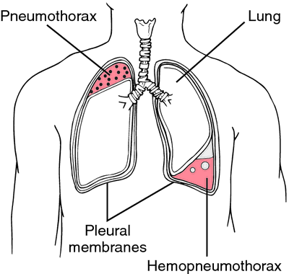
PNEUMOTHORAX AND HEMOTHORAX.

Slide 29
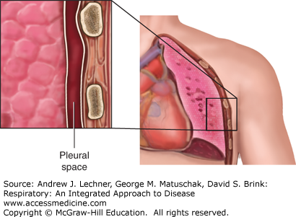

Slide 30
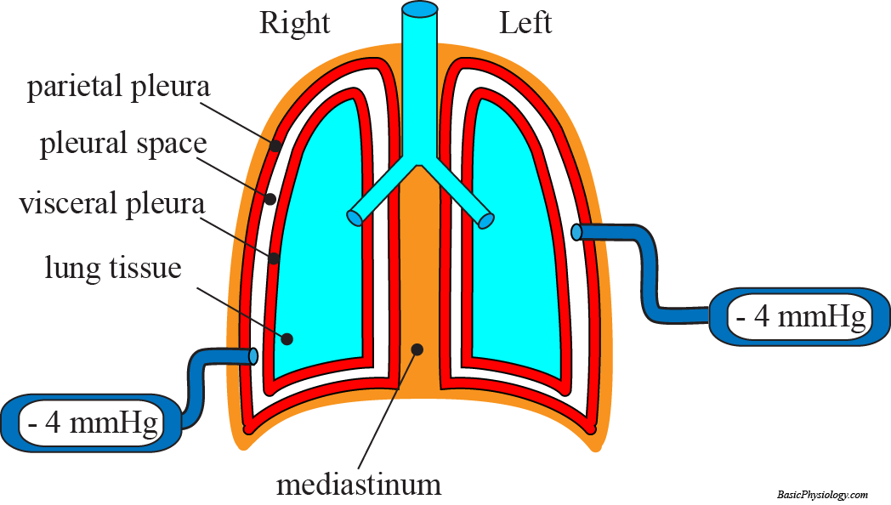

Slide 31
Cont.
Pneumothorax occurs when the parietal or visceral pleura is breached and the pleural space is exposed to positive atmospheric pressure. Normally the pressure in the pleural space is negative or subatmospheric; this negative pressure is required to maintain lung inﬂation.

Slide 32
Cont.
When either pleura is breached, air enters the pleural space, and the lung or a portion of it collapses. Hemothorax is the collection of blood in the chest cavity because of torn intercostal vessels or laceration of the lungs injured through trauma. Often both blood and air are found in the chest cavity (hemopneumothorax).

Slide 33
Types of Pneumothorax
Simple Pneumothorax
A simple, or spontaneous, pneumothorax occurs when air enters the pleural space through a breach of either the parietal or visceral pleura. Most commonly this occurs as air enters the pleural space through the rupture of a bleb or a bronchopleural ﬁstula.

Slide 34
Cont.
A spontaneous pneumothorax may occur in an apparently healthy person in the absence of trauma due to rupture of an air-ﬁlled bleb, or blister, on the surface of the lung, allowing air from the airways to enter the pleural cavity. It may be associated with diffuse interstitial lung disease and severe emphysema.

Slide 35
Traumatic Pneumothorax
A traumatic pneumothorax occurs when air escapes from a laceration in the lung itself and enters the pleural space or from a wound in the chest wall. It may result from blunt trauma (eg, rib fractures), penetrating chest or abdominal trauma (eg, stab wounds or gunshot wounds), or diaphragmatic tears.

Slide 36
Cont.
Traumatic pneumothorax may occur during invasive thoracic procedures (ie, thoracentesis, transbronchial lung biopsy, insertion of a subclavian line) in which the pleura is inadvertently punctured, or with barotrauma from mechanical ventilation. A traumatic pneumothorax resulting from major injury to the chest is often accompanied by hemothorax.

Slide 37
Cont.
Open pneumothorax is one form of traumatic pneumothorax. It occurs when a wound in the chest wall is large enough to allow air to pass freely in and out of the thoracic cavity with each attempted respiration.

Slide 38
Tension Pneumothorax
A tension pneumothorax occurs when air is drawn into the pleural space and is trapped with each breath. Tension builds up in the pleural space, causing lung collapse. Mediastinal shift (shift of the heart and great vessels and trachea toward the unaffected side of the chest) is a life-threatening medical emergency. Both respiratory and circulatory functions are compromised.

Slide 39
Clinical Manifestations
Signs and symptoms associated with pneumothorax depend on its size and cause:
• Pleuritic pain of sudden onset.
•Minimal respiratory distress with small pneumothorax; acute respiratory distress if large.
•Anxiety, dyspnea, air hunger, use of accessory muscles, and central cyanosis (with severe hypoxemia).

Slide 40
Cont.
•In a simple pneumothorax, the trachea is midline, expansion of the chest is decreased, breath sounds may be diminished, and percussion of the chest may reveal normal sounds or hyperresonance depending on the size of the pneumothorax.

Slide 41
Cont.
In a tension pneumothorax, the trachea is shifted away from the affected side, chest expansion may be decreased or ﬁxed in a hyperexpansion state, breath sounds are diminished or absent, and percussion to the affected side is hyperresonant. The clinical picture is one of air hunger, agitation, increasing hypoxemia, central cyanosis, hypotension, tachycardia, and profuse diaphoresis.

Slide 42
Medical Management
The goal is evacuation of air or blood from the pleural space.
• A small chest tube is inserted near the second intercostal space for a pneumothorax.
•A large-diameter chest tube is inserted, usually in the fourth or ﬁfth intercostal space, for hemothorax.
•Autotransfusion is begun if excessive bleeding from chest tube occurs.

Slide 43
Cont.
Traumatic open pneumothorax is plugged (petroleum gauze); patient is asked to inhale and strain against a closed glottis to eject air from the thorax until the chest tube is inserted, with water-seal drainage.

Slide 44
Cont.
Antibiotics are usually prescribed to combat infection from contamination.
The chest wall is opened surgically (thoracotomy) if more than 1,500 mL of blood is aspirated initially by thoracentesis (or is the initial chest tube output) or if chest tube output continues at greater than 200 mL/h. Urgency is determined by the degree of respiratory compromise.

Slide 45
Cont.
An emergency thoracotomy may also be performed in the emergency department if a cardiovascular injury secondary to chest or penetrating trauma is suspected.
The patient with a possible tension pneumothorax should immediately be given a high concentration of supplemental oxygen to treat the hypoxemia, and pulse oximetry should be used to monitor oxygen saturation.

Slide 46
Cont.
In an emergency situation, a tension pneumothorax can be decompressed or quickly converted to a simple pneumothorax by inserting a large-bore needle (14-gauge) at the second intercostal space, midclavicular line on the affected side. A chest tube is then inserted and connected to suction to remove the remaining air and ﬂuid, reestablish the negative pressure, and reexpand the lung.

Slide 47
Nursing Management
Promote early detection through assessment and identiﬁcation of high-risk population; report symptoms.
Assist in chest tube insertion; maintain chest drainage or water-seal.

Slide 48
Cont.
Monitor respiratory status and re-expansion of lung, with interventions (pulmonary support) performed in collaboration with other health care professionals (e.g, physician, respiratory therapist, physical therapist).
Provide information and emotional support to patient and family.

Slide 49
CHEST INJURY
A chest injury, also known as chest trauma, is any form of physical injury to the chest including the ribs, heart and lungs. Chest injuries account for 25% of all deaths from traumatic injury. Typically chest injuries are caused by blunt mechanisms such as motor vehicle collisions or penetrating mechanisms such as stabbings

Slide 50
Cont.
Chest injuries can be classified as blunt or penetrating. Blunt and penetrating injuries have different pathophysiologies and clinical courses.
Specific types of injuries include:

Slide 51
Cont.
Specific types of injuries include:
1. Injuries to the chest wall
  Chest wall contusions or hematomas.
  Rib fractures
  Flail chest
  Sternal fractures
  Fractures of the shoulder girdle

Slide 52
Cont.
2.Pulmonary injury (injury to the lung) and injuries involving the pleural space
Pulmonary contusion
Pulmonary laceration
Pneumothorax
Hemothorax
Hemopneumothorax

Slide 53
Cont.
3.Injury to the airways
Tracheobronchial tear
4.Cardiac injury
Pericardial tamponade
Myocardial contusion
Traumatic arrest
Hemopericardium

Slide 54
Cont.
5.Blood vessel injuries
Traumatic aortic rupture
Thoracic aorta injury
Aortic dissection
6.And injuries to other structures within the torso
Esophageal injury (Boerhaave syndrome)
Diaphragm injury

Slide 55
Clinical manifestations.
The injured area is usually tender or painful. Pain is worse when people inhale. The chest may be bruised. Sometimes people are short of breath. If the injury is severe, they may feel very short of breath, drowsy, or confused, and the skin may be cold, sweaty, or blue. Such symptoms may develop when the lungs malfunction severely (respiratory failure) or people are in shock.

Slide 56
Cont.
People in shock typically have dangerously low blood pressure and feel as if their heart is racing.
Other symptoms depend on the specific chest injury. For example, sometimes air accumulates under the skin in people with pneumothorax. Affected skin feels crackly and makes a crackling sound when touched.

Slide 57
Cont.
The veins in the neck are sometimes enlarged if blood or fluid accumulates in the sac around the heart and interferes with the heart's ability to pump blood (called cardiac tamponade) or if tension pneumothorax develops.

Slide 58
Diagnosis.
Most blunt injuries are managed with relatively simple interventions like tracheal intubation and mechanical ventilation and chest tube insertion. Diagnosis of blunt injuries may be more difficult and require additional investigations such as CT scanning.

Slide 59
Cont.
Penetrating injuries often require surgery, and complex investigations are usually not needed to come to a diagnosis. Patients with penetrating trauma may deteriorate rapidly, but may also recover much faster than patients with blunt injury.

Slide 60
Treatment.
The goal is to:
Support of breathing and circulation
Treatment of the specific injury
Injuries that are immediately life threatening are treated as quickly as possible. The specific treatment depends on the injury.

Slide 61
Cont.
For all injuries, doctors take measures to support breathing and circulation if necessary. People may be given oxygen (for example, by nasal prongs, by face mask, or through a breathing tube) and intravenous fluids or sometimes blood transfusions. People with severe chest injuries are admitted to the hospital.

Slide 62
Cont.
People may be given pain relievers (analgesics) to lessen pain.
For some injuries, a tube must be inserted into the chest (thoracostomy, or chest tube insertion) to drain blood (in hemothorax) or air (in pneumothorax) from the chest. This procedure helps collapsed lungs reinflate. Insertion can usually be done using only local anesthesia.

Slide 63
CARCINOMA OF THE LUNGS.
Lung cancers arise from a single transformed epithelial cell in the tracheobronchial airways. A carcinogen (cigarette smoke, radon gas, other occupational and environmental agents) damages the cell, causing abnormal growth and development into a malignant tumor.

Slide 64
Cont.
Most lung cancers are classiﬁed into one of two major categories: small cell lung cancer (15% to 20% of tumors) and non–small cell lung cancer (NSCLC; approximately 80% of tumors).

Slide 65
Cont.
Risk factors include tobacco smoke, second-hand (passive) smoke, environmental and occupational exposures, gender, genetics, and dietary deficits. Other factors that have been associated with lung cancer include genetic predisposition and underlying respiratory diseases, such as chronic obstructive pulmonary disease (COPD) and tuberculosis (TB).

Slide 66
Clinical Manifestations
•Lung cancer often develops insidiously and is asymptomatic until late in its course.
•Signs and symptoms depend on location, tumor size, degree of obstruction, and existence of metastases to regional or distant sites.
•Most common symptom is cough or change in a chronic cough.

Slide 67
Cont.
•Dyspnea may occur early in the disease.
•Hemoptysis or blood-tinged sputum may be expectorated.
•Chest pain or shoulder pain may indicate chest wall or pleural involvement. Pain is a late symptom and may be related to bone metastasis.
•Recurring fever may be an early symptom.

Slide 68
Cont.
Chest pain, tightness, hoarseness, dysphagia, head and neck edema, and symptoms of pleural or pericardial infusion exist if the tumor spreads to adjacent structures and lymph nodes.
•Common sites of metastases are lymph nodes, bone, brain, contralateral lung, adrenal glands, and liver.
•Weakness, anorexia, and weight loss may appear.

Slide 69
Assessment and Diagnostic Methods
Chest x-ray, CT scans, bone scans, abdominal scans, PET scans, liver ultrasound, and MRI.
•Sputum examinations, ﬁberoptic bronchoscopy, transthoracic ﬁne-needle aspiration, endoscopy with esophageal ultrasound, mediastinoscopy or mediastinotomy, and biopsy.
•Pulmonary function tests, ABG analysis scans, and exercise testing.

Slide 70
Medical Management
The objective of management is to provide a cure if possible. Treatment depends on cell type, stage of the disease, and physiologic status.
Treatment may involve surgery (preferred), radiation therapy, or chemotherapy—or a combination of these. Newer and more speciﬁc therapies to modulate the immune system (gene therapy, therapy with deﬁned tumor antigens) are under study and show promise.

Slide 71
Assignment.
Review nursing management of a cancer patient.

Slide 72
PLEURISY
Pleurisy refers to inﬂammation of both the visceral and parietal pleurae. When inﬂamed, pleural membranes rub together, the result is severe, sharp, knifelike pain with breathing that is intensiﬁed on inspiration.

Slide 73
Cont.
Pleurisy may develop in conjunction with pneumonia or an upper respiratory tract infection, TB, or collagen disease; after trauma to the chest, pulmonary infarction, or pulmonary embolism (PE); in patients with primary or metastatic cancer; and after thoracotomy.

Slide 74
Clinical Manifestations.
Pain usually occurs on one side and worsens with deep breaths, coughing, or sneezing.
Pain is decreased when the breath is held. Pain is localized or radiates to the shoulder or abdomen.
As pleural ﬂuid develops, pain lessens. A friction rub can be auscultated but disappears as ﬂuid accumulates.

Slide 75
Assessment and Diagnostic Methods
•Auscultation for pleural friction rub
•Chest x-rays
•Sputum culture
•Thoracentesis for pleural ﬂuid examination, pleural biopsy (less common)

Slide 76
Medical Management
Objectives of management are to discover the underlying condition causing the pleurisy and to relieve the pain.
Patient is monitored for signs and symptoms of pleural effusion: shortness of breath, pain, assumption of a position that decreases pain, and decreased chest wall excursion.

Slide 77
Cont.
•Prescribed analgesics, such as NSAIDs, are given to relieve pain and allow effective coughing.
•Applications of heat or cold are provided for symptomatic relief.
•An intercostal nerve block is done for severe pain.

Slide 78
Nursing Management
•Enhance comfort by turning patient frequently on affected side to splint chest wall.
• Teach patient to use hands or pillow to splint rib cage while coughing.
See “Nursing Management” under “Pneumonia” for additional information.

Slide 79
CHRONIC OBSTRUCTIVE PULMONARY DISEASE(COPD)
COPD is a disease characterized by airﬂow limitation that is not fully reversible. The airﬂow limitation is usually progressive and associated with an abnormal inﬂammatory response of the lung to noxious particles or gases, resulting in narrowing of airways, hypersecretion of mucus, and changes in the pulmonary vasculature.

Slide 80
Cont.
Other diseases such as cystic ﬁbrosis, bronchiectasis, and asthma that were previously classiﬁed as types of COPD are now classiﬁed as chronic pulmonary disorders, although symptoms may overlap with those of COPD. Cigarette smoking, air pollution, and occupational exposure (coal, cotton, grain) are important risk factors that contribute to COPD development, which may occur over a 20- to 30year span.

Slide 81
Cont.
Complications of COPD vary but include respiratory insufﬁciency and failure (major complications) as well as pneumonia, atelectasis, and pneumothorax.

Slide 82
Clinical Manifestations
•COPD is characterized by chronic cough, sputum production, and dyspnea on exertion; often worsen over time.
•Weight loss is common.
•Symptoms are speciﬁc to the disease. See “Clinical Manifestations” under “Asthma,” “Bronchiectasis,” “Bronchitis,” and “Emphysema.”

Slide 83
Medical Management
•Smoking cessation, if appropriate.
•Bronchodilators, corticosteroids, and other drugs (eg, alpha1-antitrypsin augmentation therapy, antibiotic agents, mucolytic agents, antitussive agents, vasodilators, narcotics). Vaccines may also be effective.
•Oxygen therapy, including nighttime oxygen.

Slide 84
Cont.
•Varied treatments speciﬁc to disease. See “Medical Management” under “Asthma,” “Bronchiectasis,” “Bronchitis,” and “Emphysema.”
•Surgery: bullectomy to reduce dyspnea; lung volume reduction to improve lobar elasticity and function; lung transplantation.

Slide 85
Nursing management.
1. Achieving Airway Clearance
•Monitor the patient for dyspnea and hypoxemia.
•If bronchodilators or corticosteroids are prescribed, administer the medications properly and be alert for potential side effects.

Slide 86
Cont.
Encourage patient to eliminate or reduce all pulmonary irritants, particularly cigarette smoking.
•Instruct the patient in directed or controlled coughing.
•Chest physiotherapy with postural drainage, intermittent positive-pressure breathing, increased ﬂuid intake, and bland aerosol mists (with normal saline solution or water) may be useful for some patients with COPD.

Slide 87
2.Improving Breathing Patterns
•Inspiratory muscle training and breathing retraining may help improve breathing patterns.
•Training in diaphragmatic breathing reduces the respiratory rate, increases alveolar ventilation, and sometimes helps expel as much air as possible during expiration.

Slide 88
Cont.
•Pursed-lip breathing helps slow expiration, prevent collapse of small airways, and control the rate and depth of respiration; it also promotes relaxation.

Slide 89
3.Improving Activity Tolerance
•Evaluate the patient’s activity tolerance and limitations and use teaching strategies to promote independent activities of daily living.
•Determine if patient is a candidate for exercise training to strengthen the muscles of the upper and lower extremities and to improve exercise tolerance and endurance.

Slide 90
Cont.
•Recommend use of walking aids, if appropriate, to improve activity levels and ambulation.
•Consult with other health care professionals (rehabilitation therapist, occupational therapist, physical therapist) as needed.

Slide 91
4.Monitoring and Managing Complications
•Assess patient for complications (respiratory insufﬁciency and failure, respiratory infection, and atelectasis).
•Monitor for cognitive changes, increasing dyspnea, tachypnea, and tachycardia.
•Monitor pulse oximetry values and administer oxygen as prescribed.

Slide 92
Cont.
•Instruct patient and family about signs and symptoms of infection or other complications and to report changes in physical or cognitive status.
•Encourage patient to be immunized against inﬂuenza and Streptococcus pneumonia.

Slide 93
Cont.
•Caution patient to avoid going outdoors if the pollen count is high or if there is signiﬁcant air pollution and to avoid exposure to high outdoor temperatures with high humidity.

Slide 94
Cont.
•If a rapid onset of shortness of breath occurs, quickly evaluate the patient for potential pneumothorax by assessing the symmetry of chest movement, differences in breath sounds, and pulse oximetry.

Slide 95
BRONCHITIS, CHRONIC
Chronic bronchitis, a disease of the airways, is defined as the presence of cough and sputum production for at least 3 months in each of two consecutive years. Although, chronic bronchitis is a clinically and epidemiologically useful term, it does not reflect the major impact of airflow limitation on morbidity and mortality in COPD.

Slide 96
Cont.
In many cases, smoke or other environmental pollutants irritate the airways, resulting in inflammation and hypersecretion of mucus. Constant irritation causes the mucus-secreting glands and goblet cells to increase in number, leading to increased mucus production.

Slide 97
Cont.
Mucus plugging of the airway reduces ciliary function. Bronchial walls also become thickened, further narrowing the bronchial lumen. Alveoli adjacent to the bronchioles may become damaged and fibrosed, resulting in altered function of the alveolar macrophages.

Slide 98
Cont.
This is significant because the macrophages play an important role in destroying foreign particles, including bacteria. As a result, the patient becomes more susceptible to respiratory infection.

Slide 99
Cont.
A wide range of viral, bacterial, and mycoplasmal infections can produce acute episodes of bronchitis. Exacerbations of chronic bronchitis are most likely to occur during the winter when viral and bacterial infections are more prevalent.

Slide 100
Nursing Management
Management, see under management of COPD

Slide 101
EMPHYSEMA, PULMONARY
In emphysema, impaired oxygen and carbon dioxide exchange results from destruction of the walls of over distended alveoli. “Emphysema” is a pathologic term that describes an abnormal distention of the air spaces beyond the terminal bronchioles and destruction of the walls of the alveoli.

Slide 102
Cont.
This is the end stage of a process that progresses slowly for many years. As the walls of the alveoli are destroyed (a process accelerated by recurrent infections), the alveolar surface area in direct contact with the pulmonary capillaries continually decreases. This causes an increase in dead space (lung area where no gas exchange can occur) and impaired oxygen diffusion, which leads to hypoxemia.

Slide 103
Cont.
In the later stages of disease, carbon dioxide elimination is impaired, resulting in increased carbon dioxide tension in arterial blood (hypercapnia) leading to respiratory acidosis. As the alveolar walls continue to break down, the pulmonary capillary bed is reduced in size. Consequently, resistance to pulmonary blood ﬂow is increased, forcing the right ventricle to maintain a higher blood pressure in the pulmonary artery.

Slide 104
Cont.
Hypoxemia may further increase pulmonary artery pressures. For this reason, right-sided heart failure (cor pulmonale) is one of the complications of emphysema. Congestion, dependent edema, distended neck veins, or pain in the region of the liver suggests the development of cardiac failure.

Slide 105
Cont.
There are two main types of emphysema, based on the changes taking place in the lung. Both types may occur in the same patient. In the panlobular (panacinar) type of emphysema, there is destruction of the respiratory bronchiole, alveolar duct, and alveolus.

Slide 106
Cont.
All air spaces within the lobule are essentially enlarged, but there is little inﬂammatory disease. A hyperinﬂated (hyperexpanded) chest, marked dyspnea on exertion, and weight loss typically occur. To move air into and out of the lungs, negative pressure is required during inspiration, and an adequate level of positive pressure must be attained and maintained during expiration.

Slide 107
Cont.
Instead of being an involuntary passive act, expiration becomes active and requires muscular effort. In the centrilobular (centroacinar) form, pathologic changes take place mainly in the center of the secondary lobule, preserving the peripheral portions of the acinus.

Slide 108
Cont.
Frequently, there is a derangement of ventilation–perfusion ratios, producing chronic hypoxemia, hypercapnia, polycythemia, and episodes of right-sided heart failure. This leads to central cyanosis and respiratory failure. The patient also develops peripheral edema, which is treated with diuretic therapy.

Slide 109
Nursing Management
See “Nursing Management” under “Chronic Obstructive Pulmonary Disease” for additional information.

Slide 110
ASTHMA
Asthma is a chronic inﬂammatory disease of the airways characterized by hyperresponsiveness, mucosal edema, and mucus production. This inﬂammation ultimately leads to recurrent episodes of asthma symptoms: cough, chest tightness, wheezing, and dyspnea.

Slide 111
Cont.
Patients with asthma may experience symptom-free periods alternating with acute exacerbations that last from minutes to hours or days. Asthma, the most common chronic disease of childhood, can begin at any age.

Slide 112
Cont.
Risk factors for asthma include family history, allergy (strongest factor), and chronic exposure to airway irritants or allergens (eg, grass, weed pollens, mold, dust, or animals). Common triggers for asthma symptoms and exacerbations include airway irritants (eg, pollutants, cold, heat, strong odors, smoke, perfumes),

Slide 113
Cont.
exercise, stress or emotional upset, rhinosinusitis with postnasal drip, medications, viral respiratory tract infections, and gastroesophageal reﬂux.

Slide 114
Clinical Manifestations
•Most common symptoms of asthma are cough (with or without mucus production), dyspnea, and wheezing (ﬁrst on expiration, then possibly during inspiration as well).
•Asthma attacks frequently occur at night or in the early morning.
•An asthma exacerbation is frequently preceded by increasing symptoms over days, but it may begin abruptly.

Slide 115
Cont.
•Chest tightness and dyspnea occur.
•Expiration requires effort and becomes prolonged.
•As exacerbation progresses, central cyanosis secondary to severe hypoxia may occur.
•Additional symptoms, such as diaphoresis, tachycardia, and a widened pulse pressure, may occur.

Slide 116
Cont.
•Exercise-induced asthma: maximal symptoms during exercise, absence of nocturnal symptoms, and sometimes only a description of a “choking” sensation during exercise.
•A severe, continuous reaction, status asthmaticus, may occur. It is life-threatening.
•Eczema, rashes, and temporary edema are allergic reactions that may be noted with asthma.

Slide 117
Assessment and Diagnostic Methods
•Family, environment, and occupational history is essential.
•During acute episodes, sputum and blood test, pulse oximetry, ABGs, hypocapnia and respiratory alkalosis, and pulmonary function (forced expiratory volume [FEV] and forced vital capacity [FVC] decreased) tests are performed.

Slide 118
Medical Management
Pharmacologic Therapy
There are two classes of medications—long-acting control and quick-relief medications—as well as combination products.

Slide 119
Cont.
• Short-acting beta2-adrenergic agonists-e.g salbutamol
•Anticholinergics-e.g ipratropium (Atrovent), and atropine
•Corticosteroids: metered-dose inhaler (MDI) e.g Prednisone and hydrocortisone

Slide 120
Cont.
•Leukotriene modiﬁers inhibitors/antileukotrienes
•Methylxanthines

Slide 121
Nursing Management
The immediate nursing care of patients with asthma depends on the severity of symptoms. The patient and family are often frightened and anxious because of the patient’s dyspnea. Therefore, a calm approach is an important aspect of care.

Slide 122
Cont.
• Assess the patient’s respiratory status by monitoring the severity of symptoms, breath sounds, peak ﬂow, pulse oximetry, and vital signs.
•Obtain a history of allergic reactions to medications before administering medications.

Slide 123
Cont.
•Identify medications the patient is currently taking.
•Administer medications as prescribed and monitor the patient’s responses to those medications; medications may include an antibiotic if the patient has an underlying respiratory infection.

Slide 124
Cont.
•Administer ﬂuids if the patient is dehydrated.
•Assist with intubation procedure, if required.

Slide 125
Cont.
•Teach patient and family about asthma (chronic inﬂammatory), purpose and action of medications, triggers to avoid and how to do so, and proper inhalation technique.
•Instruct patient and family about peak-ﬂow monitoring.

Slide 126
Cont.
•Refer patient to community support groups.
•Remind patients and families about the importance of health promotion strategies and recommended health screening.

Slide 127
ASTHMA: STATUS ASTHMATICUS
Status asthmaticus is severe and persistent asthma that does not respond to conventional therapy; attacks can occur with little or no warning and can progress rapidly to asphyxiation. Infection, anxiety, nebulizer abuse, dehydration, increased adrenergic blockage, and nonspeciﬁc irritants may contribute to these episodes.

Slide 128
Cont.
An acute episode may be precipitated by hypersensitivity to aspirin. Two predominant pathologic problems occur: a decrease in bronchial diameter and a ventilation–perfusion abnormality.

Slide 129
Clinical Manifestations
•Same as those in severe asthma.
•No correlation between severity of attack and number of wheezes; with greater obstruction, wheezing may disappear, possibly signaling impending respiratory failure.

Slide 130
Assessment and Diagnostic Findings
•Primarily pulmonary function studies and ABG analysis
•Respiratory alkalosis most common ﬁnding

Slide 131
Medical Management
•Initial treatment: beta2-adrenergic agonists, corticosteroids, supplemental oxygen and IV ﬂuids to hydrate patient. Sedatives are contraindicated.
•High-ﬂow supplemental oxygen is best delivered using a partial or complete non-rebreather mask (PaO2 at a minimum of 92 mm Hg or O2 saturation greater than 95%).

Slide 132
Cont.
•Magnesium sulfate, a calcium antagonist, may be administered to induce smooth muscle relaxation.
•Hospitalization if no response to repeated treatments or if blood gas levels deteriorate or pulmonary function scores are low.
•Mechanical ventilation if patient is tiring or in respiratory failure or if condition does not respond to treatment.

Slide 133
Nursing Management
The main focus of nursing management is to actively assess the airway and the patient’s response to treatment. The nurse should be prepared for the next intervention if the patient does not respond to treatment.

Slide 134
Cont.
• Constantly monitor the patient for the ﬁrst 12 to 24 hours, or until status asthmaticus is under control. Blood pressure and cardiac rhythm should be monitored continuously during the acute phase and until the patient stabilizes and responds to therapy.

Slide 135
Cont.
•Assess the patient’s skin turgor for signs of dehydration; ﬂuid intake is essential to combat dehydration, to loosen secretions, and to facilitate expectoration.
•Administer IV ﬂuids as prescribed, up to 3 to 4 L/day, unless contraindicated.

Slide 136
Cont.
•Encourage the patient to conserve energy.
•Ensure patient’s room is quiet and free of respiratory irritants (eg, ﬂowers, tobacco smoke, perfumes, or odors of cleaning agents); nonallergenic pillows should be used.

Slide 137
BRONCHIECTASIS
Bronchiectasis is a condition where the bronchial tubes of your lungs are permanently damaged, widened, and thickened. These damaged air passages allow bacteria and mucus to build up and pool in your lungs. This results in frequent infections and blockages of the airways.

Slide 138
Cont.
Bronchiectasis may be caused by a variety of conditions, including airway obstruction, diffuse airway injury, pulmonary infections and obstruction of the bronchus or complications of long-term pulmonary infections, genetic disorders (eg, cystic ﬁbrosis), abnormal host defense (eg, ciliary dyskinesia or humoral immunodeﬁciency), and idiopathic causes.

Slide 139
Cont.
Bronchiectasis is usually localized, affecting a segment or lobe of a lung, most frequently the lower lobes. People may be predisposed to bronchiectasis as a result of recurrent respiratory infections in early childhood, measles, inﬂuenza, tuberculosis, or immunodeﬁciency disorders.

Slide 140
Clinical Manifestations
•Chronic cough and production of copious purulent sputum
•Hemoptysis, clubbing of the ﬁngers, and repeated episodes of pulmonary infection

Slide 141
Assessment and Diagnostic Findings
•Deﬁnite diagnostic clue is prolonged history of productive cough, with sputum consistently negative for tubercle bacilli.
•Diagnosis is established on the basis of CT scan.

Slide 142
Medical Management
•Treatment objectives are to promote bronchial drainage to clear excessive secretions from the affected portion of the lungs and to prevent or control infection.
•Chest physiotherapy with percussion; postural drainage, expectorants, or bronchoscopy to remove bronchial secretions.

Slide 143
Cont.
•Antimicrobial therapy guided by sputum sensitivity studies.
•Year-round regimen of antibiotics, alternating types of drugs at intervals.
•Vaccination against inﬂuenza and pneumococcal pneumonia
•Bronchodilators.
•Smoking cessation.

Slide 144
Cont.
•Surgical intervention (segmental resection of lobe or lung removal), used infrequently.
•In preparation for surgery: vigorous postural drainage, suction through bronchoscope, and antibacterial therapy.

Slide 145
Nursing Management
See “Nursing Management and Patient Education” under “Chronic Obstructive Pulmonary Disease” in Chapter C and “Preoperative and Postoperative Nursing Management” in Chapter P for additional information.

Slide 146
BRONCHIOLITIS
Bronchiolitis is a common lung infection in young children and infants. It causes inflammation and congestion in the small airways (bronchioles) of the lung. Bronchiolitis is almost always caused by a virus. Typically, the peak time for bronchiolitis is during the winter months.

Slide 147
Cont.
Bronchiolitis starts out with symptoms similar to those of a common cold but then progresses to coughing, wheezing and sometimes difficulty breathing. Symptoms of bronchiolitis can last for several days to weeks, even a month.
Most children get better with care at home. A very small percentage of children require hospitalization.

Slide 148
Clinical manifestation
For the first few days, the signs and symptoms of bronchiolitis are similar to those of a cold:
Runny nose
Stuffy nose
Cough
Slight fever (not always present)

Slide 149
Cont.
After this, there may be a week or more of difficulty breathing or a whistling noise when the child breathes out (wheezing).
Many infants will also have an ear infection (otitis media).

Slide 150
Causes
Bronchiolitis occurs when a virus infects the bronchioles, which are the smallest airways in your lungs. The infection makes the bronchioles swell and become inflamed. Mucus collects in these airways, which makes it difficult for air to flow freely in and out of the lungs.

Slide 151
Cont.
Most cases of bronchiolitis are caused by the respiratory syncytial virus (RSV). RSV is a common virus that infects just about every child by the age of 2. Outbreaks of the RSV infection occur every winter. Bronchiolitis can also be caused by other viruses, including those that cause the flu or the common cold. Infants can be reinfected with RSV because at least two strains exist.

Slide 152
Diagnosis
Tests and X-rays are not usually needed to diagnose bronchiolitis. The doctor can usually identify the problem by observing your child and listening to his or her lungs with a stethoscope. However, it may take more than one or two visits to distinguish the condition from a cold or the flu.

Slide 153
Cont.
If your child is at risk of severe bronchiolitis, if symptoms are worsening or if another problem is suspected, your doctor may order tests, including:
Chest X-ray. Your doctor may request a chest X-ray to look for signs of pneumonia

Slide 154
Cont.
Viral testing. Your doctor may collect a sample of mucus from your child to test for the virus causing bronchiolitis. This is done using a swab that's gently inserted into the nose.

Slide 155
Cont.
Blood tests. Occasionally, blood tests might be used to check your child's white blood cell count. An increase in white blood cells is usually a sign that the body is fighting an infection. A blood test can also determine whether the level of oxygen has decreased in your child's bloodstream.

Slide 156
Treatment.
Bronchiolitis typically lasts for two to three weeks. The majority of children with bronchiolitis can be cared for at home with supportive care. It's important to be alert for changes in breathing difficulty, such as struggling for each breath, being unable to speak or cry because of difficulty breathing, or making grunting noises with each breath.

Slide 157
Cont.
Because viruses cause bronchiolitis, antibiotics — which are used to treat infections caused by bacteria — aren't effective against it. If your child has an associated bacterial infection, such as pneumonia, your doctor may prescribe an antibiotic for that.

Slide 158
Cont.
Oral corticosteroid medications and pounding on the chest to loosen mucus (chest physiotherapy) have not been shown to be effective treatments for bronchiolitis and are not recommended.

Slide 159
Cont.
A tiny percentage of children need hospital care to manage their condition. At the hospital, your child may receive humidified oxygen to maintain sufficient oxygen in the blood, and perhaps fluids through a vein (intravenously) to prevent dehydration.

Slide 160
Cont.
Maintain a smoke-free environment. Smoke can aggravate symptoms of respiratory infections. If a family member smokes, ask him or her to smoke outside of the house and outside of the car.

