Slide 1
PULMONARY NURSING
DR. KABANYA

Slide 2
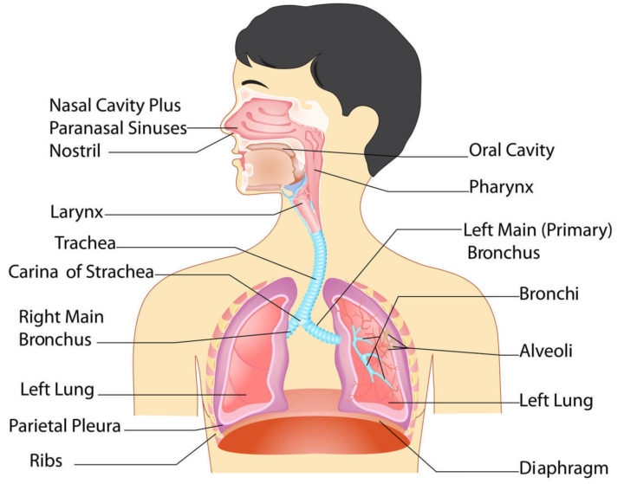

Slide 3
PULMONARY NURSING
MODULE COMPUTENCE
Diagnose, manage and rehabilitate patients with respiratory conditions
MODULE OUTCOMES
By the end of the module the learner should:
Manage patients with restrictive respiratory disorders using the nursing process
Manage patients with obstructive respiratory disorders using the nursing process

Slide 4
RESTRICTIVE DISORDERS
PNEUMONIA
Definition: It is an acute infective inflammatory condition of the lung tissue. Anatomically it is divided into two types; - Broncho and Lobar pneumonia.
Lobar pneumonia
It is the inflammation of lung tissues. Usually, parts affected are one or more lobes of lung segments.

Slide 5
Bronco pneumonia
Definition: Bronco pneumonia is a condition where by pneumonic process originates from bronchi and spread to adjacent lung tissue infection is bilateral. Both lungs are affected by small patches

Slide 6
Causes
Staphylococcus pyogenes
Streptococcus pneumonia
Klebsiella pneumonia
Streptococcus influenza
Pneumonia is classified according to the types of germs that cause it and where you got the infection.
Community-acquired pneumonia
Community-acquired pneumonia is the most common type of pneumonia. It occurs outside of hospitals or other health care facilities. It may be caused by:

Slide 7
Hospital-acquired pneumonia
Some people catch pneumonia during a hospital stay for another illness. Hospital-acquired pneumonia can be serious because the bacteria causing it may be more resistant to antibiotics and because the people who get it are already sick.
Aspiration pneumonia Aspiration pneumonia occurs when one inhales food, drink, vomit or saliva into the lungs.

Slide 8
Predisposing factors
Lowered resistance to infections
Upper respiratory tract infections
Chronic infection of the airway such as chronic bronchitis emphysema lung cancer or bronchiectasis
Impairment of bronchial drainage when there is an obstruction e.g. bronchial carcinoma or inhaled foreign body the drainage is obstructed. Also where there are fractured limbs these inhibit mechanism of breathing.
Inhalation of infected material e.g. mucous from upper airway esp. chronic sinusitis. Inhalation of ingested material or vomitus in oesophageal obstruction.

Slide 9
Occurrence
The disease occurs in all ages but broncho pneumonia occurs in children and very old people while lumbar occurs in young and Middle Ages. Highest incidences are cold weather.
Signs and symptoms
The onset is sudden occasionally following upper respiratory tract infection. Respirations are rapid due to pain on the diseased part of the lungs, pyrexia of above 40 °C, rigors, rapid pulse.

Slide 10
Signs and symptoms cont.
Difficulty in breathing where respiration is shallow, rapid and nostrils dilate with each respiration. Stabbing chest pain which shows there is inflammation of pleura.
Patient is restless and has delirium, low blood pressure, short painful cough dry at first but productive later and may even be blood stained.
Severe pneumonia may be accompanied by cyanosis. The patient looks very ill, with general malaise, anorexia and lose of weight

Slide 11
Management
Prop up the patient in comfortable position and encourage coughing. If breathing is difficult and there is cyanosis oxygen therapy is given. Tepid sponging and bed rest is maintained till temperature subsides. Physiotherapy and postural drainage is done.
Light diet and plenty of oral fluids are given. Oral and personal hygiene, observations of vital signs 4 hourly or depending on patient’s condition.
Chest exercises are done to prevent chest problems.
Drug: Penicillins are given. They best respond to crystalline penicillin dose 1-2 meg 6 hourly. Caugh sedations and expectorants. Analgesics to relieve pain. Antipyretics to lower temperature. I.V. fluids where patient doesn’t feed orally.

Slide 12
Complications
Infection can spread to other lobes.
Pneumococco septiceamia
Menengitis due to pneumocco meningitis
Carditis due to toxic effects
Otitis media
Acidosis
Peritonitis
Lung abscess
Peripheral circulatory failure
Pleural effusion
Collapse of the lung. (Atelectasis)
emphysema.

Slide 13
Prognosis
It is good if early and adequate Rx is commenced. Sometimes surgery is considered.
Prevention
Prompt and adequate treatment of respiratory conditions. Keeping warm during cold weather. Very sick and elderly patients should not be left for long without exercises, frequent suction of secretion from patients who cannot expectorate
Vaccination and immunization of the under five.

Slide 14
Pneumothorax (collapsed lung)
Pneumothorax is a collection of free air in the chest cavity (thoracic cavity) that causes the lung to collapse.
Causes
Pneumothorax may occur on its own in the absence of underlying disease; this is termed spontaneous pneumothorax.
Pneumothorax may also occur because of an injury or underlying lung disease.
• cystic fibrosis,
• chronic obstructive pulmonary disease (COPD),
• lung cancer, asthma, and
• infections of the lungs.

Slide 15
Signs and symtoms of pneumothorax
Symptoms of a pneumothorax include
The pain is sharp and may lead to feelings of tightness in the chest.
Shortness of breath,
rapid heart rate,
chest pain that usually has a sudden onset.
rapid breathing,
cough,
and fatigue are other symptoms of pneumothorax.
The skin may develop a bluish color (termed cyanosis) due to decreases in blood oxygen levels.

Slide 16
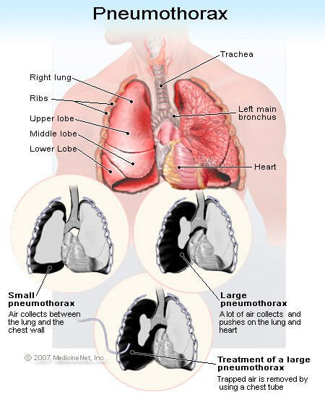

Slide 17
Types of pneumothorax
A spontaneous pneumothorax, also referred to as a primary pneumothorax, occurs in the absence of a traumatic injury to the chest or a known lung disease.
A secondary (also termed complicated) pneumothorax occurs due to an underlying condition.
Spontaneous pneumothorax is more common in men. Smoking has been shown to increase the risk for spontaneous pneumothorax.

Slide 18
Diagnoses of spontaneous pneumothorax
Examination of the chest with a stethoscope reveals decreased or absent breath sounds over the affected lung.
The diagnosis is confirmed by chest X-ray.

Slide 19
Treatment for pneumothorax
Pneumothorax without underlying lung disease may resolve on its own in one to two weeks.
A larger pneumothorax and a pneumothorax associated with underlying lung disease often require aspiration of the free air and/or placement of a chest tube to evacuate the air.

Slide 20
complications
. Possible complications of chest tube insertion include
pain,
infection of the space between the lung and chest wall (the pleural space),
hemorrhage (bleeding),
fluid accumulation in the lung, and
low blood pressure (hypotension).
In some cases, the leak does not close on its own. This is called a bronchopleural fistula (punctured lung), and may require chest surgery to repair the hole in the lung.

Slide 21
Prognosis for pneumothorax
The outcome of pneumothorax depends upon the extent and type of pneumothorax.
A small spontaneous pneumothorax will generally resolve on its own without treatment.
A secondary pneumothorax (even when small) associated with underlying disease is much more serious and has a significant death rate. A secondary pneumothorax requires urgent and immediate treatment.
Having one pneumothorax increases the risk of developing the condition again. Most recurrences occur within the first year.

Slide 22
CARCINOMA OF THE LUNGS
Malignancy disease of the lungs.
Incidences
Common in people who are above 50 years
It is more common in men and mostly cigarette smokers
The disease occurrence rate is higher in urban than rural areas or polluted atmosphere.

Slide 23
Predisposing factors
Heavy smoking
Asbestos dust
Metastasis
Arsenic
Uranium
Beryllium
Vinyl chloride
Nickel
Gasoline

Slide 24
Pathology
The tumor arises from bronchial epithelium or mucous glands and at an early stage it may occur at the bronchial lumen.
There may be involvement of the pleura either directly or by lymphatic spread.

Slide 25
Clinical features
Onset is usually gradual with a persistent cough as earliest symptom (dry cough). Later the cough becomes productive, yellowish in color and may contain blood.
There is progressive loss of weight, energy and appetite associated with cough and anaemia.
As toxic effect of the carcinoma there may be such evidence as mental and endocrine disorder before any detectable signs.
Dysprea
Pleural effusion accompanied by chest pains (severe).

Slide 26
Diagnosis
It is difficult to diagnose in the early stage of the disease.
History of long smoking
X-ray of chest
Sputum can be sent for cystology
Investigation
Bronchoscopy
Biopsy
Paracentesis – send to lab

Slide 27
Treatment
Surgical treatment in the early stages and where it is localized to one area
For advanced cases radiotherapy and cytotoxic drugs are given for palliative
NB: Best results in surgery are when radiotherapy is given before operation.
Management nursing
It is the nursing care for all patients with chest condition and surgery to the chest. See post-operative care.
Management of patients who are dying.

Slide 28
PLEURISY AND EMPYEMA
Pleurisy
Inflammation of the pleural membrane
Pleural effusion
Accumulation of serous fluid in pleural cavity
Pleural empyema
Collection of pus in the pleural cavity which comes as a result of infected pleural or infected pleural effusion.

Slide 29
Causes
Chest infections and chest conditions e.g. pneumonia, TB, bronchitis, lung abscess, cancer of the lungs, trauma in the chest following chest surgery.
Signs and symptoms
There is cough followed by unilateral cough movements
Chest pain
Dyspnea
Poor appetite – loss of weight
A grating sound can be heard with stethoscope on inspiration

Slide 30
Diagnosis
Chest x-ray shows pleural secretions
Examination of pleural fluids
White blood count is raised.

Slide 31
Management
Rx Thoracentasis (chest aspiration) to relieve pressure
Antibiotics
Treat the cause
Sedate the patient
Chest surgery and underwater seal drainage is left to drain the pus.
Nursing management as is for any other patient with chest condition before surgery.
Keen observations should be done during thoracentasis

Slide 32
PULMONARY EMPHYSEMA
Trapping of air in the lung tissues due to destruction of the alveolar wall by repeated infections.
Types of pulmonary emphysema;
Surgical due to trauma esp fractured limbs
Medical due to chronic infections or irritants

Slide 33
Signs and symptoms
Onset is gradual and affects patients who are over 40 years of age. Starts with shortness of breath followed by fatigue, wheezing respirations.
They may experience cyanosis and patient shows signs of heart failure.
Patient has fixed diaphragm and presents with purse-lip.
Patient is thin and has barrel shaped (fixed ribs and rigid chest).

Slide 34
SIGNS AND SYMPTOMS CONT.
NB: Cough and sputum production are not striking symptoms unless there is an accompanying infection.
Pulmonary function studies reveals;
Decreased expiratory flow rate
Increased residual volume
Reduced vital capacity.

Slide 35
Management
Drugs
Antibiotics,
bronchial dilators

Slide 36
Under water seal drainage

Slide 37
Water seal drainage
water seal drainage
Definition
▪ Indication
▪ Purposes
▪ Site for chest tube insertion
▪ Type of water seal drainage system
▪ FUNCTION OF PLEURAL DRAINAGE SYSTEM
▪ PRINCIPLES OF THE CHEST TUBE
▪ Nursing Responsibilities

Slide 39
Water seal drainage
Definition
Water seal drainage system is a closed chest drainage system used to allow air and fluid to escape from the plural space with each exhalation and to prevent their return flow with each inhalation.

Slide 40
Water seal drainage
Water seal means that the water in the bottle seals off the atmospheric air thus prevents the entering of air or fluid back into the pleural space.

Slide 41
Indication
1. Traumatic pneumothorax
2. Hemopneumothorax
3. Spontaneous pneumothorax
4. Iatrogenic pneumothorax
5. Broncho-pleural fistula
6. Emphysema
7. Malignancy 8.
Pleural effusion
9. Thoracic or thoraco-abdominal surgeries

Slide 42
Water seal drainage
Purposes
To permit drainage of air and fluid from the pleural cavity
To establish normal negative pressure in the pleural cavity for lung expansion
To equalize pressure on both sides of the thoracic cavity
To provide continuous suction to prevent tension pneumothorax

Slide 43
Water seal drainage
Site for chest tube insertion
1. Thoracic surgery.
2 chest tube are inserted – Anterior chest tube
-Posterior chest tube

Slide 44
Site for chest tube insertion
Anterior chest :
Upper/anterior chest wall
Inserted in the 2nd Intercostal space to remove the air arising from the pleural cavity
Posterior chest tube :
Placed at the posterior chest in the 8th or 9th Intercostal space at the mid-Axillary line.
Indication to remove sero-sangeneous fluid at the lower area of pleural cavity
Diameter of tube in the lower section is wider or longer compare to the upper tube.

Slide 46
Water seal drainage

Slide 47
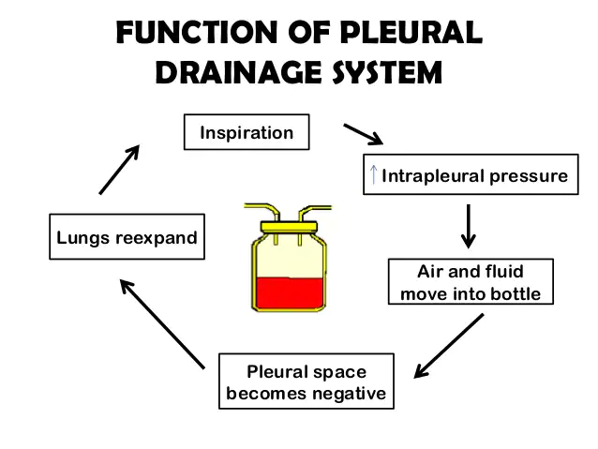

Slide 51
3. Suction
Is a pull force
MUST be in another bottle
Purpose for the suction is, when :
i. - gravity drainage is not enough.
ii. - patient’s respiration and cough are too weak
iii. - air leak is fast into the pleural space
iv. - need to speed up removal from pleural space

Slide 56
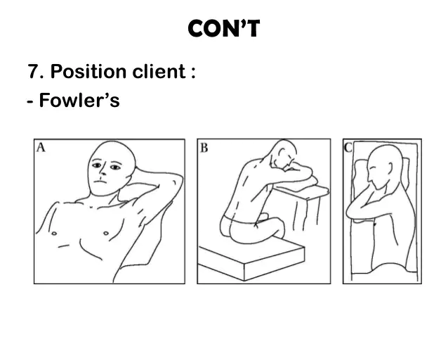

Slide 63
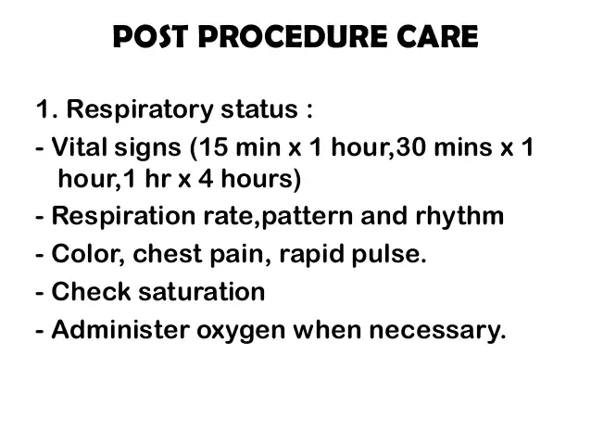

Slide 64
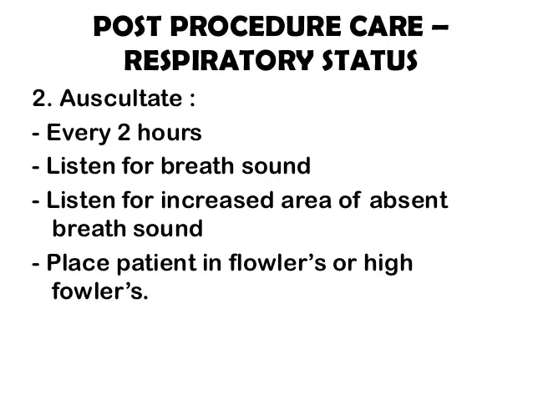

Slide 69
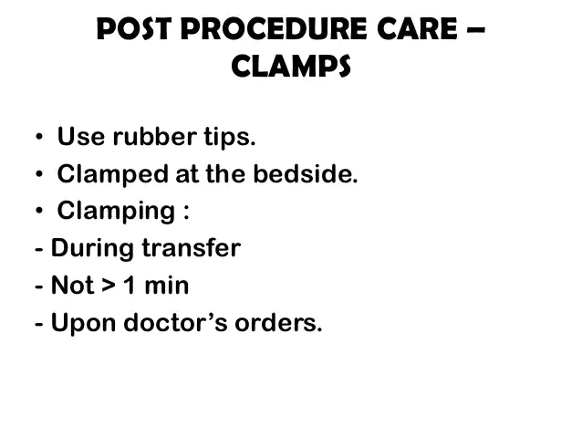

Slide 87
CHEST INJURIES
Define chest injuries
Explain causes of chest injuries
Explain classification of chest injuries
List causes of chest injuries
Discuses pathophysiology
Explain management on chest injuries

Slide 88
Introduction
Chest is a large exposed portion of the body that is vulnerable to impact injuries.
Because chest houses the lungs, heart and great vessels, chest trauma is frequently life threatening,
Injuries to thoracic cage and its content can restrict the hearts ability to pump blood or lungs ability to exchange blood and oxygenated blood.

Slide 89
INTRODUCTION CONT.
The danger with chest injuries is internal bleeding and organ puncture.
Chest injury is any form of physical injury to the chest including the ribs, chest and lungs. Chest injuries may occur alone or with other injuries.

Slide 90
Chest injury cont.
The most important chest injuries include the following:
Aortic disruption.
Blunt cardiac injury.
Cardiac tamponade.
Flail chest.
Hemothorax.
Pneumothorax (traumatic pneumothorax, open pneumothorax, and tension pneumothorax)
Pulmonary contusion.

Slide 91
CLASSIFICATION OF CHEST INJURY
Blunt injuries
Rib fractures
Sternum fracture
Frail chest
Pulmonary contusion
Penetrating injuries
Gun shot
Stab wounds
Pulmonary injuries
Pneumothorax
Haemothorax
Cardiac temponid

Slide 92
CAUSES
Stab wounds
Chest compression
Crash injuries
MECHANISM OF CHEST INJURIES
Blunt trauma: This occurs when a body is struck by a blunt object such as a steering wheel. The external injury may appear minor but the impact may cause severe life threatening internal injuries such as raptured spleen.
It is difficult to identify the extent of damage because the symptoms may be generalized.

Slide 93
ETIOGY
Motor vehicle accident
Explosion fall
Assault with blunt object
Crash injury

Slide 94
PATHIPHYSIOLOGY
Occurs from motor vehicle accident, fall from heights leading to blunt chect injuries, hypoxia occurs due to disruption of the airway, injuries to lung parenchyma, rib cage and respiratory muscle.
Hypovolemia from massive fluid loss from great vessels, cardiac vessel, cardiac raprure and haemothorax.
These pathogenic states frequently cause impaired ventilation and perfusion leading to acute renal failure and hypovolemic shock and at last death if not treated properly.

Slide 95
DIAGNOSIS
History taking
Physical examination – inspection of airway, thorax, neck veins, breathing difficulty.
Chect X-ray
Oxygen saturation – arterial blood gas analysis

Slide 96
CLINICAL FEATURES
Rapid shallow respirations
Tarchycardia
Movement of thorax is Asymetrix and uncoordinated
During respiration the affected portion is sucked in and during expiration it bulges out.
Chest pain
Dyspnea

Slide 97
MEDICAL MANAGEMENT
Establish airway with oxygen support and in some cases intubation and ventilatory support.
Re-establish fluid volume and negative intrapleural pressure and draining interpleural fluid and blood.
Fractured rib are generally treated conservatively with good pulmonary physiotherapy, rapid mobilization and pain management.
Analgesics are used to relieve pain and allow deep breathing and coughing.

Slide 98
Management cont.
Drugs used to relive pain include an intercostals nerve block and ice over the fracture sire e.g. deep freeze.
Pain relives within 5-7 days. Most of the ribs fractures heal in 3-6 weeks.
Mechanical ventilation when patient is sedated to prevent pain
Clear the secreations from lungs through sanctioning.

Slide 99
Management cont.
Pulmonary physiotherapy
Surgery may be required in patients who are difficult to ventilate.
Observations of pulse, temperatures, respirations and blood pressure hourly.
Blood gas analysis.
Pulmonary function monitoring.

Slide 100
Surgical management
A chest tube is inserted into pleural cavity of most patients with penetrating wound of the chest to achieve continuing re-expansion of the lungs
The chest tube results in complte evacuation of blood and air (underwater seal and drainage)
Shock is treated with colloid solution, crystralloids, or blood as indicated by patients condition.

Slide 101
EMERGENCY MANAGEMENT IN CHEST INJURIES
Ensure patient airway
Position the semi fowler position
Administer high flow oxygen to patient
Administer IV fluids
Remove clothing to injury
Covering sucking injury with non- porous dressing to prevent air entry

Slide 102
Emergency management cont.
Stabilize frail rib segment with hard followed by application of large pieces of tape horizontal across the frail segment.
Monitor vital signs, level of consciousness, oxygen saturation, respiratory status and circulatory status (BP)
Anticipate intubation for respiratory distress.

Slide 103
NURSING MANAGEMENT
Assessment: Asses patient for respiratory system i.e.
Dyspnoea
Respiratory distress
Cyanosis of mouth, face, nail beds
Decreased breath sounds on the side of injury
Decreased oxygen saturation
Frothy secretions

Slide 104
Cardiovascular system
Decreased blood pressure
Distended neck veins
Chest pain
Dysrhythmias
Rapid thread pulse

Slide 105
Surface findings
Bruising
Abrasion
Open chest wound
Asymmetric chest movement

Slide 106
1. NURSING DIAGNOSIS
1. Impaired gas exchange related to air or fluid collection in the pleural space and lungs as evidenced by draining from chest tube, decreased breath sounds and abnormal pulse oximetry.
Expected outcome
To maintain gas exchange and breathing pattern

Slide 107
Interventions
Provide oxygen therapy to the patient to treat hypoxia
Position patient in semi-fowlers position to prevent dyspnoea
Monitor respiratory and oxygenation status of the patient.
Ensure under seal drainage tubes are well connected
Maintain intake output of the patients.
Keep drainage bottle below chest level to prevent tension pneumothorax

Slide 108
2. Inneffective breathing pattern related to pain and position as evidenced by shortness of breath and shallow respirations
Expected outcome
To maintain normal respiratory pattern of the patient.
Interventions
Assess respirations for rate, rhythm and depth of respirations
Provide suction if needed
Provide proper position to treat dyspnoea
Provide oxygen to patient
Give analgesics to prevent pain and promote deep breathing and coughing

Slide 109
3. Acute pain related to trouma as evidenced by facial expressions of the patient.
Expected outcome
To relieve pain of the patient
Interventions
Asses level of pain
Position patient in a comfortable position
Provide analgesics to the patient if prescribed by the doctor

Slide 110
4. Immobility related to pain as evidenced by inability to move purposefully within physical environment.
Expected outcome
Patient performs physical activity independently or with assistive devices as needed.
Interventions
Assess patients independency level
Encourage and facilitate early ambulation
Allow patients to perform tasks at his own pace
Turn and position patient every two hours as needed
Assist patient in accepting limitations
Teach passive exercises

Slide 111
5. Risk of infection related to inadequate primary defences: broken skin, injured tissue, body fluid stasis.
Expected outcome
Patient remains free of infection as evidenced by normal vital signs and absence of pus drainage from wound.
Interventions
Infection prevention measures
Maintain aseptic techniques during dressing
Encourage intake of diet rich in proteins and vitamins
Give antimicrobial drugs as ordered
Encourage patient to perform coughing and deep breathing exercises

Slide 112
6. Self-care deficit related to inability to perform bathing and grooming of self independently.
Expected outcome
Patient will safely perform self-care activities
Interventions
Assist patient in accepting necessary amount of dependence
Set short term goals with the patient
Encourage independence but intervene when patient can not perform
Provide adequate time to patient to perform tasks
Provide positive reinforcement.

Slide 113
OBSTRUCTIVE CONDITIONS
BRONCHITIS
Definition: This is the inflammation of the bronchi and at times the trachea.
Types: Acute and chronic
Acute
Causative Streptococci pneumococci influenza pyogenes. Streptococci aureas.
Predisposing factors
Damp climate, polluted environment like dust, fumes, sprays e.t.c. Also, infectious fevers such as measles, influenza and whooping cough.
It is an extension of upper respiratory tract infection. Smoking is commonest.

Slide 114
Occurrence
It is common in elderly people and children.
Clinical features
Irritating and productive cough on the 1st and 2nd day.
Dry irritating cough and tightness with pain underneath the sternum.
General malaise, headache, anorexia, pyrexia.
There is dyspnea and cyanosis in severe cases and respiration is increased. There may be soreness of the throat and hoarseness of the voice.
On chest examination, alterations of normal sound (crepitations) are heard.

Slide 115
Management
Management
Maintain complete bed rest in a warm well ventilated atmosphere and place the patient in the most comfortable way possible until temperature goes down.
Encourage light diet and plenty of fluids about 3000-4000 mls in 24 hrs.
Where there is a dry cough steam inhalation or humidified room should be provided by the nurse for the patient.

Slide 116
Drugs
Sedatives may be given.
Tetracycline and ampicillin are the best dose 500 mg 6 hourly for 7 days.
If the airway is obstructed, bronchodilator drugs can be given e.g. Aminopheline, Ventolin or Bricanyl.
Oxygen therapy can be given. Breathing exercises are taught and pastural drainage can also be done.
Prognosis
With prompt and adequate treatment, the prognosis is always good. However repeated attacks lead to chronic bronchitis.

Slide 117
CHRONIC BRONCHITIS
Definition: This is a gradual inflammation of the trachea and bronchi which develops due to continued or repeated attacks of acute bronchitis.
Causes
Heavy smoking
Repeated attacks of bronchitis
Infection such as tuberculosis

Slide 118
Pathology
Mucous membrane becomes inflamed and this affects the smooth action of the cilia due to over activity of the mucous secreting glands and the goblet cells in the bronchi and the bronchioles their sizes increase and envelops.
The vast excess of mucous produced coats the bronchial wall and blocks them.
Clinical features
Recurrent attacks of acute bronchitis, persistent cough and mucoid or muco pulurent sputum worse in the morning. Dyspnea

Slide 119
Treatment
Antibiotics - these are effective for bacterial infections, but not for viral infections.
They may also prevent secondary infections.
Cough medicine - one must be careful not to completely suppress the cough, for it is an important way to bring up mucus and remove irritants from the lungs.
Bronchodilators - these open the bronchial tubes and clear out mucus.

Slide 120
Treament cont.
Mucolytics - these thin or loosen mucus in the airways, making it easier to cough up sputum.
Anti-inflammatory medicines and glucocorticoid steroids - these are for more persistent symptoms.
Pulmonary rehabilitation program - this includes work with a respiratory therapist to help breathing.

Slide 121
Nursing Diagnosis
Ineffective breathing pattern related to shortness breathing ,mucus or broncho constriction.
Ineffective airway clearence related to broncho constriction.
Self care deficit related to fatigue secondary to increased effort for breathing.
Activity intolerence due to fatigue and inffective breathing patterns 

Slide 122
Nursing management
Assess The Condition Of Patient.
Assess The Vital Signs
Provide Comfortable Position.
Change The Position Periodically.
Maintain Personal Hygiene.
Use pulse oximetry & Suction.
Deep Breathing Exercise Learn To Patient.
Refer To Physiotherapist(if Need).

Slide 123
Nursing care cont.
9. Provide Oxygen According To Physician Order.
10.Provide Psychological Support To Patient.
11. Provide Knowledge About Chronic Bronchitis.
12. administer medication according to physician order. Bronchodilators,antibiotics,mucolytics

Slide 124
Health Education
Avoiding tobacco smoke and exposure to second hand smoke
Quitting smoking
Avoiding people who are sick with colds or the flu
Getting a yearly flu vaccine
Getting a pneumonia vaccine (especially for those over 60 years of age)
Washing hands regularly
Avoiding cold, damp locations or areas with a lot of air pollution
Wearing a mask around people who are coughing and sneezing

Slide 125
Complication
CCF
Pneumonia
Lung collapse (emphysema)
Bronchiectasis
Asthma

Slide 126
Prevention
Prevention is by;
Abandonment of smoking
Prompt treatment of URTI
Control of atmospheric pollution especially in urban areas.
Good diet.

Slide 128
Chronic obstructive pulmonary disorders COPD
Chronic obstructive pulmonary disease (COPD)is a disease state characterized by airflow limitation that is not fully reversible.
COPD may include diseases that cause airflow obstruction (e.g., emphysema, chronic bronchitis) or a combination of these disorders.

Slide 130
COPD cont.
COPD includes chronic bronchitis and emphysema.
Asthma is not considered part of COP due its reversibility.
1. Chronic bronchitis: is a chronic inflammation of the lower respiratory tract characterized by excessive mucous secretion, cough, & dyspnea associated with recurrent infections of the lower respiratory tract.
2. Emphysema: is a complex lung disease characterized by damage to the gas- exchanging surfaces of the lungs ( alveoli)

Slide 131
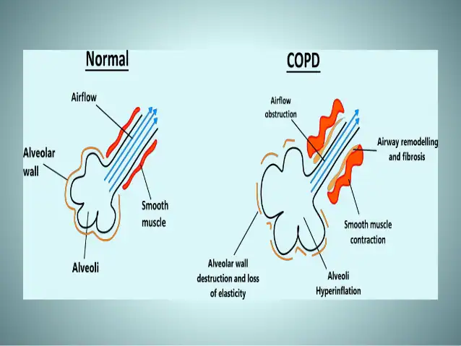

Slide 132
Risk Factors for COPD
1. Exposure to tobacco smoke accounts for an estimated 80% to 90% of COPD cases. ( smoking)
2. Passive smoking
3. Occupational exposure
4. Ambient air pollution
5. Genetic abnormalities, including a deficiency of alpha1-antitrypsin enzyme.

Slide 133
Clinical Manifestations
• COPD is characterized by three primary symptoms:
1. Cough
2. Sputum production and
3. Dyspnea on exertion (DOE) Dyspnea may be severe and often interferes with the patient’s activities. Weight loss is common because dyspnea interferes with eating.

Slide 134
Assessment and Diagnostic Findings
1. History collection (The nurse should obtain a thorough health history for a patient with known or potential COPD).

Slide 135
Key Factors to Assess in the COPD Patient’s Health History
1. Exposure to risk factors—types, intensity, duration.
2. Past medical history—respirator diseases/problems, including asthma, allergy, sinusitis, nasal polyps, history of respiratory Infections.
3. Family history of COPD or other chronic respiratory diseases.
4. Pattern of symptom development.
5. History of exacerbations or previous hospitalizations for respiratory problems.

Slide 136
6. Presence of comorbidities
7. Appropriateness of current medical treatments
8. Impact of the disease on quality of life
9. Available social and family support for patient
10. Potential for reducing risk factors (e.g., smoking cessation).

Slide 137
2. Pulmonary function studies are used to help confirm the diagnosis of COPD, determine disease severity, and follow disease progression.
3. Spirometry is used to evaluate airflow obstruction.
4. Arterial blood gas (ABGs) measurements may also be obtained to assess baseline oxygenation and gas exchange.
5. Chest x-ray
6. alpha1antitrypsin deficiency screening may be performed for patients under age 45 or for those with a strong family history of COPD.

Slide 138
Complications
1. Respiratory insufficiency and Respiratory failure are major life-threatening complications of COPD.
2. Pneumonia & respiratory infection
3. Right-sided heart failure
4. Pulmonary hypertension
5. Pneumothorax
6. Skeletal muscle dysfunction
7. Depression and anxiety disorders

Slide 139
The objective of Management of client with COPD
The main objectives of COPD management are theFollowing:
1. Relieve symptoms
2. Prevent disease progression
3. Reduce mortality & improve exercise tolerance
4. Prevent and treat complications

Slide 140
Medical Management
1. Risk reduction: Smoking cessation is the single most effective intervention to prevent COPD or slow its progression. ( smoking cessation is major essential to reduce disease progression and improve survival rate)
Nurses play a key role in promoting smoking cessation and educating patients about ways to do so. Patients diagnosed with COPD who continue to smoke must be encouraged and assisted to quit.

Slide 142
PHARMACOLOGIC THERAPY
• Bronchodilators: Bronchodilators relieve bronchospasm and reduce airway obstruction by allowing increased oxygen distribution throughout the lungs and improving alveolar ventilation.
• These medications, which are central in the management of COPD are delivered through a metered-dose inhaler (MDI) by nebulization, or via the oral route in pill or liquid form.

Slide 145
Corticosteroids
• Corticosteroids. Inhaled and systemic corticosteroids (oral or intravenous) may also be used in COPD but are used more frequently in asthma.
• Although it has been shown that corticosteroids do not slow the decline in lung function, these medications may improve symptoms.
Other Medications including Patients should receive a yearly influenza vaccine and the pneumococcal vaccine every 5 to 7 years as preventive measures.

Slide 146
MANAGEMENT OF EXACERBATION
An exacerbation of COPD is difficult to diagnose, but signs and symptoms may include;
increased dyspnea,
increased sputum production and purulence,
respiratory failure,
changes in mental status,
or worsening blood gas abnormalities.
Primary causes for an acute exacerbation include tracheobronchial infection and air pollution.

Slide 147
OXYGEN THERAPY
Oxygen therapy can be administered as long- term continuous therapy, during exercise, or to prevent acute dyspnea.
Long-term oxygen therapy has been shown to improve the patient’s quality of life and survival.

Slide 148
PULMONARY REHABILITATION
The primary goal of rehabilitation is to restore patients to the highest level of independent function possible and to improve their quality of life.
A successful rehabilitation program is individualized for each patient, is multidisciplinary, and attends to both the physiologic and emotional needs of the patient.

Slide 149
Nursing Management client with COPD
1. Assess the Client status ask detail about smoking (pack per year history), occupational exposure history, positive family history of respiratory disease etc.)
2. Note amount, color and consistency of sputum.
3. The nurse should be inspect for use of accessory muscles during respiration and use of abdominal muscles during expirations.
4. The nurse plays a key role in identifying potential candidates for pulmonary rehabilitation and in facilitating and reinforcing the material learned in the rehabilitation program.

Slide 150
Nursing Management client with COPD
• The nurse should teach to patient and family as well as facilitating specific services for the patient (e.g., respiratory therapy education, physical therapy for exercise and breathing retraining, occupational therapy, medications using e.g. MDI, Nebulization for conserving energy during activities of daily living, and nutritional counseling)

Slide 151
PATIENT EDUCATION
• Patient education is a major component of pulmonary rehabilitation and includes a broad variety of topics.
• Depending on the length and setting of the program, topics may include normal anatomy and physiology of the lung, pathophysiology and changes with COPD, medications and home oxygen therapy, nutrition, respiratory therapy treatments, symptom alleviation, smoking.

Slide 152
Breathing Exercise
Inspiratory muscle training is defined as a course of therapy consisting of a series of breathing exercises that aim to strengthen the bodies' respiratory muscles making it easier for people to breathe.
Inspiratory muscle training is normally aimed at people who suffer from asthma, bronchitis, emphysema and COPD

Slide 153
Self-Care Activities
.As gas exchange, airway clearance, & the breathing pattern improve, the patient is encouraged to assume increasing participation in self-care activities.
Oxygen Therapy. Oxygen supplied to the home comes in compressed gas, liquid, or concentrator systems. Portable oxygen systems allow the patient to exercise, work, and travel.
Nutritional Therapy. Nutritional assessment and counseling are important aspects in the rehabilitation process for the patient with COPD.

Slide 154
Nursing diagnosis
1. Ineffective breathing pattern related to chronic airflow limitation.
2. Ineffective airway clearance related to bronchoconstriction, increased mucus production, ineffective cough, possible bronchopulmonary infection.
3. Risk for infection related to compromised pulmonary function, retained secretions and compromised defense mechanisms.

Slide 155
Nursing diagnosis cont.
4. Imbalanced nutrition: less than body requirements related to increased work of breasting, presenting dyspnea & drug effects.
5. Deficient knowledge of self-care strategies to be performed at home.

Slide 156
Bronchial asthma

Slide 157
OBJECTIVES
Define Bronchial Asthma and status asthmatics.
Enlist triggers of bronchial Asthma
Discuss the clinical manifestations
Describe assessment, diagnostic findings, complications, prevention, medical and nursing management of patients with asthma and status asthmatics

Slide 158
Introduction
Asthma can occur at any age and is the most common chronic disease of childhood.
Despite increased knowledge regarding the pathology of asthma and the development of better medications and management plans, the death rate from asthma continues to increase.

Slide 159
Allergy is the strongest predisposing factor for asthma. Chronic exposure to airway irritants or allergens also increases the risk for developing asthma.
Common allergens can be seasonal (e.g., grass, tree, and weed pollens) or perennial (e.g., mold, dust, roaches, or animal dander).

Slide 160
Bronchial asthma
▪ Asthma is a chronic inflammatory disease of the airways that causes airway hyper responsiveness, mucosal edema, and mucus production. This inflammation ultimately leads to recurrent episodes of asthma symptoms: cough, chest tightness, wheezing, and dyspnea
.

Slide 161
Definition of Bronchial asthma
▪ Bronchial asthma is a chronic , inflammatory disease of the airways, characterized by airflow obstruction, bronchial hyperactivity, and a mucous production

Slide 163
Risk factors for asthma
Positive family history
Allergy ( strongest risk factor)
Chronic exposure to airway irritants or allergens

Slide 164
Triggers of bronchial asthma
▪ Allergens
▪ Exercise ( Exercise induced asthma) EIA
▪ Respiratory Infections
▪ Nose and Sinus problems
▪ Drugs and Food Additives
▪ GERD ( Gastro esophageal disorder)
▪ Emotional Stress

Slide 165
Clinical Manifestations
▪ The three most common symptoms of asthma are Cough ( esp. at night) Dyspnea, and Wheezing. In some instances, cough may be the only symptom. Asthma attacks often occur at night or early in the morning, possibly due to circadian variations (biological processes) that influence airway receptor thresholds.

Slide 166
Asthma symptoms
1. shortness of breath
Cough
Wheezing
Chest tightness

Slide 167
Assessment and Diagnostic Findings
History collection (A complete family, environmental, and occupational history is essential. To establish the diagnosis)
Occupation related to chemicals and compounds
Sputum culture
Arterial blood gas analysis ( ABGs)
Pulse oximetry
Pulmonary functions test (PFT)
Peak flow monitoring (peak expiratory flow test or PEF)
Incentive spirometer

