Slide 1
PALLIATIVE CARE
ANN WARUI
KRCHN, BScN

Slide 2
Objectives: Broad
To equip students with appropriate knowledge, skills and attitudes on palliative care that will enable them to provide quality, holistic services to patients, families and communities faced with cancer, HIV & AIDS and other Life threatening illnesses.
Specifically:-
Define Palliative care
Principles and care
Pillars of palliative care
Explain the History of palliative care in Kenya
Assess the need for palliative care
State and explain the components of PC

Slide 3
- Describe the interdisciplinary team approach in Palliative Care
- State Ethical Legal Issues in Palliative Care
- Explain the benefits of the Service User, patient and Public involvement in Palliative care

Slide 4
History of palliative care
Understanding palliative care begins with the story of hospice.
‘Hospice’ comes from a Latin word hospitium, meaning hospitality, and was used in the Middle Ages in Europe and Mediterranean regions to describe a place of rest for travelers, the dying and pilgrims managed by religious orders. They later disappeared.
by Dr Cecily Saunders, later Dame Cecily Saunders (1918 – 2005). The modern use of the term hospice dates from 1967 with the opening of St Christopher’s Hospice, London, established
At that time there was a growing awareness that 20th century medical advances, while offering a cure for many illnesses, also resulted in the health system ignoring those people who could not be cured.
Cecily Saunders, originally a nurse, then a social worker (almoner), finally studied medicine to meet this challenge, the neglect of the suffering of the terminally ill. Her work in building St Christopher’s Hospice and her approach to pain and symptom management, recognizing the multi-dimensional nature of suffering and the need for emotional, psychological and spiritual support for both the terminally ill patient and their family was the foundation for modern hospice and palliative care practice.

Slide 5
The term ‘palliative care’ was first used in 1975 by Canadian surgeon Balfour Mount, an early Saunders pupil.
Returning to French speaking Quebec, he needed to avoid the word hospice because of the poor reputation, particularly the connotation of destitution, associated with these institutions in France
Mount developed a comprehensive hospital-based service at the Royal Victoria Hospital, Montreal that included an in-patient ward, consultation service, home care program, and bereavement support service under the name Palliative Care service by which he meant non-curative therapy aimed at improving the quality of life.
Cecily Saunders introduced the idea of specialized care for the dying to the United States during a 1963 visit with Yale University.
Her lecture, given to medical students, nurses, social workers, and chaplains about the concept of holistic hospice care, included photos of terminally ill cancer patients and their families, showing the dramatic differences before and after the symptom control care.

Slide 6
HISTORY OF PALLIATIVE CARE IN KENYA
The first palliative care service and teaching program commenced in 1990 at Nairobi Hospice.
The vision came from Ruth Woodridge the wife of a BBC correspondent and a Nurse herself.
Jane Moore a Kenyan Nurse
Professor Edward Kasili
The Nairobi Hospice not only delivered services to patients and relatives but also focused on advocacy and training of both health care professionals and non health care providers.
This resulted to establishment of Hospices and palliative care units across the country.
This improved access to palliative care services to patients and families.

Slide 7
Nursing care of terminally ill patients
1. Psychosocial issue
Education about illnesses and patient’s life with the illness
Value clarification
Treatment decision making
End of life closure
Nurses should try and understand the illness from the patient's point of view.
An honest discussion about death should be held giving the patient information on illness, end of life choices, open discussion about death.
At the same time the nurses should be culturally aware and sensitive in their approaches to communication about death to patient and relatives and how much information they can handle.
Patient’s should be allowed to communicate their wishes about the end of their life e.g. about the use of or non-use of medical treatment; authorizing other people to make decisions for them.
2. Communication
General guidelines
Deliver and interpret the technical information necessary for making decisions without hiding behind medical terminology
Realize that the best time for the patient to talk may be when it is least convenient for you.
Being fully present during any opportunity for communication is often the most helpful form of communication.
Allow the patient and family to set the agenda regarding the depth of the conversation.

Slide 8
Key to effective listening
Resist the impulse to fill the empty space in communication with a talk.
Allow the patient and family sufficient time to reflect and respond after asking a question.
Prompt gently, do you need more time to think about this?
Avoid distraction/interruptions
Avoid impulse to give advice
Avoid canned response e.g. I know just how you feel.
Ask questions
Assess understanding; your own and the patient by restating, summarizing and reviewing.

Slide 9
9. Spiritual care
Mnemonic SPIRIT
S- spiritual belief system
P- person spirituality
I- integration and involvement with others in a spiritual community
R- ritualized practices and restriction
I- implication of medical care
T – terminal events planning
10. Hope
11. Realistic initial assessment of the threat
12. Envisioning alternative and setting goals
13. Bracing for negative outcomes
14. Realistic assessment of resources
15. Solicitation of mutually supportive relationship.
16. Continuous evaluation of signs reinforcing the goals.
17. Determination to endure

Slide 10
Nursing intervention to improve or support hope
Listening attentively
Encouraging sharing of feelings
Providing accurate information
Encouraging and supporting the patient’s control over his or her circumstances, choices and environment whenever possible.
Assisting patients to explore ways of finding meaning in their lives.
Encouraging realistic goals
Facilitating effective communication within families
Making referrals for psychological and spiritual counseling
Assisting with development of supports in the home or community when none exist

Slide 11
HOSPICE CARE
A program of care that provides special care for people who are near the end of life and their families.
A program of medical, nursing and emotional care for the terminally ill, designed to provide comfort and support to patients and their families when a life limiting illness no longer respond to curative treatment.
Hospice care: care concerned with end of life focusing on realistic social, emotional, spiritual and financial preparation for death.
It addresses the whole person including physical, social and spiritual aspect in life threatening illness.
Hospice care can be defined as provided to terminally ill person’s and their families in the last 6 months of the patient's life.
Hospice care began as a response in gaps in care e.g.
Between treating the disease and treating the person
Between technological research and psychological support
Between the general denial of the facts of death in the society and acceptance of death by those who face it.

Slide 12
Principles of hospice care
Death must be accepted
The patient’s total care is best managed by an interdisciplinary team whose members communicate regularly with each other.
Pain and other symptoms of terminal illness must be managed.
The patient and family should be viewed as a single unit of care.
Home care of the dying is necessary
Bereavement care must be provided to family.
Research and education should be ongoing.

Slide 13
Eligibility criteria
Patient must have progressive irreversible illness
Limited life expectancy
Client must have opted for palliative care
It does not only serve cancer patients but any patient with life-limiting illness.
Presence of a family member or other caregiver continuously in the home when the patient is no longer able to safely care for him/herself.
Types of care offered
routine home care
Continuous care
General in-patient care
In-patient respite care

Slide 14
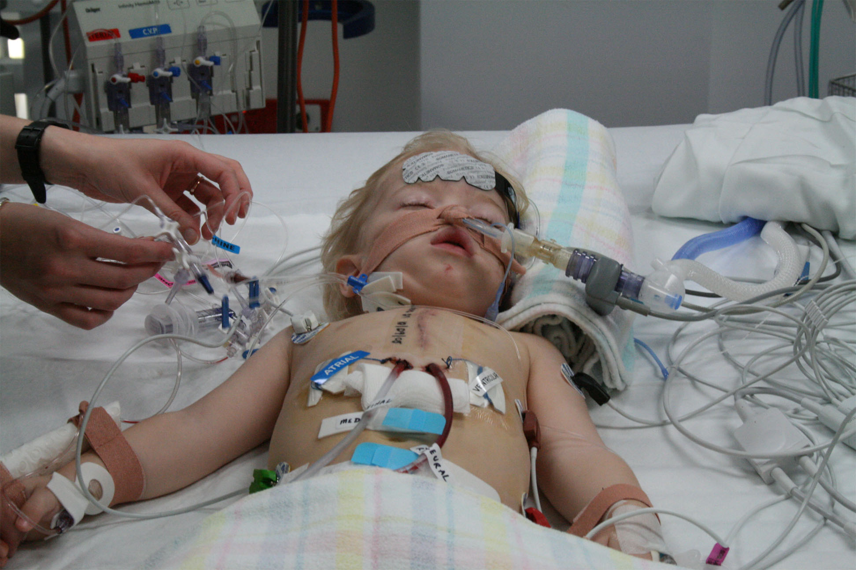
Definition of Palliative care
Palliative care is an approach that improves the quality of life of patients and their families facing the problem associated with life threatening illness, through the prevention and relief of suffering by means of early identification and impeccable assessment and treatment of pain and other problems physical, psycho social and spiritual. ( WHO 2002)
Palliative care for children is the active total care of the child’s body mind and spirit and also involves giving support to the family.
(WHO 2002)

Slide 15
Key features of palliative care
Integrated team work
Management of pain and symptoms
Holistic care
Caring, compassionate and skilled providers
Timely and responsive care
Patient and family preparedness

Slide 16
Models of palliative care
Hospice care-a well established program to provide patients with a prognosis of six months or less
Palliative care program-institutional based programs in the hospital or nursing home to serve patient with life threatening or life limiting illnesses
Provide services to patients anywhere along the disease continuum between initial diagnosis and death
Outpatient palliative care program-occour in ambulatory care settings to provide continuity of care for patients with serious or life threatening illnesses
Community palliative care programs-occur in communities as consultative teams collaborate wit hospices to support seriously ill patient who have not yet accessed hospice

Slide 17
Domains of quality palliative care
Domain 1:structure and processes care
Interdisciplinary team assessment based on patient/family goals of care
Domain 2:physical aspects of care
Pain,dyspnea,nausea and vomiting, fatigue, constipation, medical diagnosis and medication
Domain 3:psychological aspects of care
Anxiety, depression, delirium, stress, anticipatory grief, bereavement
Domain 4:social aspect of care
Family/friend communication, interaction, support, care giver crisis
Domain 5:spiritual aspects of care
Spiritual, religious, fear, forgiveness
Domain 6:cultural aspects of care
Language, ritual
Domain 7:care of imminently dying
Presences, recognitionand communication to patient/family about prognosis
Domain 8:ethicall legal issues
Decision maker, advance directives

Slide 18
Benefits of palliative care
Puts the patient desires goal and decision
Support the patient and family
Helps the patient and family understand the treatment plan
Improves the quality of life
Focuses on body mind and spirit
Reduce unnecessary hospital visits
Provides pain and symptoms control

Slide 19
Elements of palliative care
Primary goal :prevent and relieve suffering imposed by disease and their treatment
Patient population: patients of all ages experiencing a debilitating threating illness.
Patient and family centered: the uniqueness of each family is respected.
Timing of palliative care: it ideally begins at the time of diagnosis of life threating and continues until cure or death
Comprehensive care: it employs multidisciplinary assessment to identify and relieve suffering through the prevention or alleviation of physical distress
Interdisciplinary team: it require the expertise of various providers in order to adequately assess and treat the complex needs of seriously ill patient and the families
Communication skills: it includes appropriate and effective sharing of information of goals and preferences
Skills in care of dying and bereaved: team must be knowledgeable and skilled in providing care for the dying
Continuity of care across setting: is integral to all health care delivery system settings.
Equitable access: it work towards equitable access to palliative across all ages and patients populations
Quality improvement: its committed to pursuit of excellence and high quality of care which enhance quality of life

Slide 20
PRINCIPLES OF PALLIATIVE CARE
Communication-Setting goals, discussing realistic goals and how to achieve
Pain control-diagnosis, analgesics ladder, routes of administration
Emotional care-causes of distress, diagnosis and pharmacological approaches
Social issues-diagnosis, management approaches
Spiritual/existential issues-expression of fear and doubt
Grief and bereavement-preparation for counselling
Ethical issues
Emergencies encountered in palliative care

Slide 21
COMPONENTS OF PALLIATIVE CARE
Physical- Nursing, treating, prescribing
Psychological- Listening, counseling, being there
Social- help with finances, housing, family support
Spiritual- prayer, counseling, carrying out rituals rites

Slide 22
STAGES OF PALLIATIVE CARE
STAGE 1:Creating a plan: current and future treatment plan, expected progression of your illness, conversation around your wishes
STAGE 2:Preparing emotionally: depending on care agreed the counsellor the spiritual leader will work together to support.
STAGE 3:Early stage care: all aspect of care to stay independent
STAGE 4:Late stage care: care team help you plan more permanent, last stage care.at this stage end of life care begin
Stage 5: supporting your loved ones with bereavement over 12 months

Slide 23
Palliative care importance
Provides relief from pain and other distressing symptoms
Affirms life and regards dying as a normal process
Intends neither to hasten nor postpone death
Integrates the psychological and spiritual aspects of care
Offers a support system to help patients live as actively as possible till death
Offers a support system to help the family cope during the patients illness and in bereavement
Uses a team approach to address the needs of patients and families including bereavement counseling if indicated .
Will enhance quality of life and may also influence positively the course of the illness
Is applicable early in the course of illness in conjunction with other therapies that are intended to prolong life like chemotherapy, ARVs, radiotherapy and includes those investigations needed to better understand and manage distressing clinical complications

Slide 24
What does palliative care do?
Pain and symptom control
Communication and coordination
Emotional support
Family/caregiver support
What would a patient expect
To have more control over his or her care
A comfortable and supportive atmosphere that reduces anxiety and stress
Relief from distressing symptoms like pain, fatigue, vomiting, lack of sleep, constipation etc
Improve his ability to go through medical treatments Better understand his condition and his choices for medical care
Best possible quality of life

Slide 25
Interdisciplinary Team approach in palliative care
The provision of comprehensive palliative care requires the input of many people ranging from family members to health care professionals and community members.
In settings where palliative care is well established and well resourced it is often carried out by a interdisciplinary team which may consist of Doctors, nurses, counselors, spiritual leaders ,social workers and others.
There is an need to build a team because one cannot provide palliative care on his/her own. An interdisciplinary team involves care that is
Physical – The role of health care professionals
Psychological- The role of a counselor
Social – The role of a social worker (to help in finances, housing, family support etc)
Spiritual -The role of a spiritual leader
Volunteers- who help the patient with basic needs like assisted walking, feeding and improve patient’s comfort.

Slide 26
Ethical legal issues in palliative care
In recognizing the importance of human rights within the health field, the Kenyan patient’s rights Charter 2013 states that every patient has a right to;
access quality health care
A healthy and safe environment
Participate in decision making
Knowledge of ones own insurance/medical scheme Choice of health services
Be treated by a qualified and certified health care provider
Entitled to confidentiality and privacy
Informed consent
Refuse treatment
Be referred for a second opinion
Continuity of care
Complain about health services

Slide 27
Ethical principles in Palliative care
Autonomy- Is about a patient’s right to make decisions concerning their care. Promotes the development of a trusting relationship between a health worker and a patient. Patient becomes an active member of the management team which restores a sense of control in the face of an illness that has deprived that person of control.
Beneficence- To “do good” health professionals should reflect on patient care decisions with this question in mind. ‘Will this treatment benefit the patient’ This require considering risks versus benefits and deciding whether the benefits outweigh the risks.
Non-malefince-To do no harm; a health worker needs to have adequate education and knowledge to ensure that the treatment they offer will not harm or endanger a patient. Many treatment carry some risk of harm and it is up to the health worker to weigh the risk versus benefits.
Justice is concerned with the correct use of resources and this is particularly pertinent when working in resource poor settings. for example if a family has very limited resources should the terminally ill patient be prescribed expensive treatment that will cause financial hardship for the rest of the family.

Slide 28
Difference between palliative care and Hospice care
Palliative care is for any one with a serious illness. You can have it at any stage of the illness. You can have it alongside curative treatment.
Hospice is an important medical care that provides palliative care for terminally ill patients who may have only a few months to live. People who receive hospice care are no longer receiving curative treatment for their underlying disease.

Slide 29
Nutrition and hydration at the end of life
1. Anorexia
Anorexia and cachexia are very common symptoms of any serious illness. This is usually characterized by:
disturbance in carbohydrates, proteins, and fat metabolism
Dysfunction of the endocrine system
Anemia; can be exacerbated by situation such as inability to have meals with the progression of the disease
Management
Use of pharmacological agents to stimulate appetite e.g. dexamethasone, megestrol acetate, dronabinol. They give temporary weight gain. They should be tapered after 4 to 8 weeks if no response.

Slide 30
2. Cachexia
Def: Severe muscle wasting and weight loss associated with illness.
Tips to promote nutrition for terminal illness patients.
Offer small portions of favorite food
Do not be overly concerned about a balanced diet.
Cool foods may be better tolerated than hot foods.
Offer cheese, eggs, peanut butter, fish, chicken (meat may taste bitter and unpleasant)
Add milkshakes, milk
Place nutritious food at the bedside, fruits and juices
Schedule for meals when relatives are around.
Avoid argument at meal times
Help on oral care
Allow patient to refuse food and fluids
Treatment of pain and other symptoms

Slide 31
PAIN ASSESSMENT AND MANAGEMENT IN LIFE LIMITING ILLNESSES.

Slide 34
Pain definitions

Slide 35
PAIN CONTROL IS OF UTMOST IMPORTANCE
To tolerate the effects of diagnosis and management.
Simply allows them to live their final days in peace and dignity.
To enhance comfort and improve quality of life.

Slide 36
1. Pain
Pain is usually many of the end of life illnesses e.g. cancer.
Poor management of pain affects psychological, emotional, social and financial well being of the patient.
Patients on analgesic for pain should continue receiving those medications and inability to complain should not be mistaken for absence of pain. If patient is unable to swallow oral analgesic, drugs can be administered per rectal or sublingually.
Drugs to combat constipation should also be administered with opioid medication.
Relatives should be taught how to continue offering comfort at home.
Drug duration should be altered with pain increase 3 to 4 hours continuously.

Slide 37
2. Dyspnoea
Where possible treatment, of the underlying cause e.g. anemia
Assessment of dyspnoea
Symptoms intensity, distress and interference with activities.
Auscultation of lung sounds
Assessment of fluid balance
Measurement of dependent oedema (circumference of lower extremities)
Measurement of abdominal girth
Temperature
Skin color
Sputum quantity and character
cough

Slide 38
CAUSES OF CANCER PAIN
Typically classified according to reasonably well-defined pain syndromes.
There are many causes of cancer pain; those related to the disease itself, treatment or psychosocial factors.
Careful investigation and source of the pain may enable the physician to treat the underlying cause and at least choose the most appropriate analgesic.
Obstruction of hollow viscera or of the ductal systems of solid organs produces characteristic colicky or diffuse visceral pain
Occlusion of blood vessels and lymphatics may cause edema or ischemia; involvement of mucous membranes causes severe burning pain.

Slide 39
CAUSES OF PAIN
NEOPLASTIC PROCESS
The most common cause is directly related to the neoplastic process;
Within this group, tumor invasion of bone, either locally or by distant metastases, is most frequent, followed by infiltration or compression of nerves by tumor growth.
PSYCHOLOGICAL FACTORS
Must not be ignored.
Anxiety, fear, depression, and feelings of uncertainty and isolation can profoundly lower the patient's pain threshold and alter his or her perception of pain.
Patients may perceive far more discomfort from stimuli that in other circumstances would be of little consequence.
For many patients, pain was the presenting symptom of cancer, and recurrence of pain may represent to them recurrence or progression of disease.
Psychological factors may play an even greater role in patients who have had chronic pain from a preexisting, noncancerous condition.

Slide 40
Impact of Pain on the Patient
Reduced quality of life
Induce depression
Exacerbated anxiety
Interfere with social performance and impair the quality of relationships
Impact negatively on physical capability
Prevent work and reduce income

Slide 41
TYPES OF PHYSICAL PAIN
NOCICEPTIVE PAIN.
Its caused by potential harmful stimuli being detected by nociceptors around the body.
e.g. bruises, burns, fractures
When activated by stimuli nociceptors notify the brain about the injury with electrical signals sent via peripheral and CNS. when the brain receive signals, it has perception of pain that being felt
(a)Somatic-It happens pain receptor in your tissue are activated
Constant or intermittent.
Usually gnawing, aching.
Occasionally cramping.
Well localized, headaches and cuts
Mechanism: activation of nociception receptors, e.g., bone metastasis, or muscle/soft tissue tumor infiltration.
(b) Visceral pain.-it happens when internal organs such as involuntary muscles in the heart are injured or inflamed
Its described as aching
Constant.
Aching, squeezing, cramping.
Poorly localized, occasionally referred.
Occasionally well localized.
Mechanism: activation of nociceptors, e.g., intra-abdominal metastases, liver metastases.

Slide 42
NEUROPATHIC PAIN.
Mechanism: Destruction, infiltration, compression of nerve tissue. Neuropathic cancer pain can have two main clinical manifestations.
Sharp, shooting pain, e.g. trigeminal neuralgia.
CAUSES
DISEASE-C
(a)Dysesthetic pain (deafferentation)
Constant burning.
Occasionally radiates, e.g. post hepatic pain.
(b)Neuropathic pain.
Paroxysms of excruciating pain.

Slide 43
Perception of pain is influenced by:
Sleep pattern
Psychological Personality Variables
Age
Social Support
Marital/sexual Relationship
Spiritual Meaning of disease
Fear of dying
Involvement with Religion activities(spiritual well being)
Cultures.

Slide 45
-Onset
-Nature
-Radiation
-Relieving factors
-Aggravating factors

Slide 48
Numeric scale

Slide 49
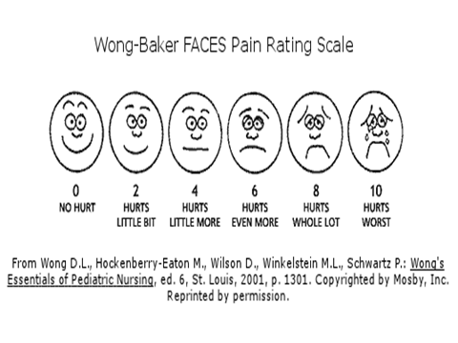

Slide 50
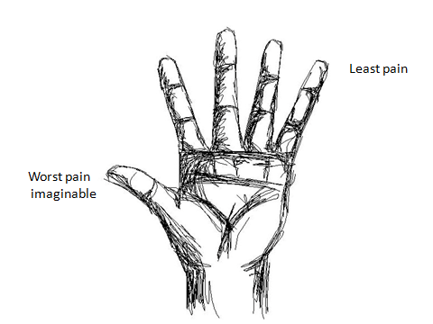
Five finger scale

Slide 51
Wong baker and Five finger scale

Slide 52
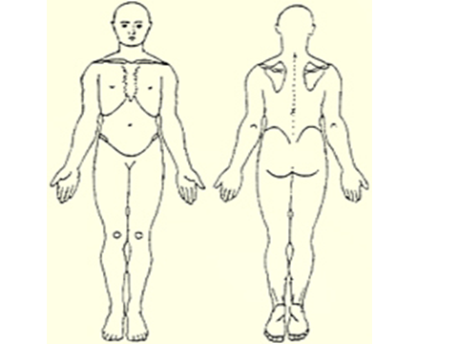
Where is the pain?
Shade where the pain is
Located.

Slide 53
TOTAL PAIN DIAGRAM
PHYSICAL
(Drugs, dressings etc)
SPIRITUAL
(Involve spiritual leader)
SOCIAL
(Involves social worker)
PAIN
PSYCHOLOGICAL
(Counseling)
POOR COMMUNICATION
(Improve skills)
Notes:
53

Slide 54
PAIN MANAGEMENT
Commonly used analgesics for cancer patients are generally classified as;
Non narcotic,non opioids analgesics
Narcotic (or opioid).
3. Adjuvant analgesics.
The WHO advocates the use of an "analgesic ladder". a stepwise approach to the use of analgesics in patients with cancer pain.

Slide 55
WHO ANALGESIC LADDER
Strong opiods + Co-analgesic. (Step three.)
Morphine
Diamorphine
Oxycodone
Weak opiods + co analgesic. (Step two.)
Codeine phosphate
DF 118
Non opiods + co analgesic. (Step one)
Aspirin,Paracetamol etc

Slide 56
NON -NARCOTIC ANALGESICS/NON OPIOIDS
A drug that has analgesics, antipyretic, and anti inflammatory.
They do not bind to opioids receptor
These include aspirin, acetaminophen and the non-steroidal anti-inflammatory drugs(NSAIDS).like ibuprofen, diclofenac, indomethacin
Non-narcotic analgesics are typically the first-line treatment for mild to moderate cancer pain.
SIDE EFFECTS OF NON NARCOICS
The side effects of aspirin are well known, particularly gastrointestinal ulceration, inhibition of platelet aggregation and aspirin hypersensitivity.
Conversely, acetaminophen is usually safe and free of side effects when given in dosages under 4 g per day. Hepatotoxicity may occur at a higher dosage, but this is a rare complication.

Slide 57
NARCOTIC ANALGESICS
Opioids are substances that act on opioids receptors to produce morphine like effects like codeine,methadone,tramadol,fentanyl,heroine
They are used for pain relief including anesthesia other medical uses suppression of diarrhea, suppressing cough, reversing opioids overdose
The narcotic agents remain the gold standard for analgesia.
These agents produce a much greater analgesic effect than the non-narcotic analgesics.
Mode of action
It has actions on two site, the presynaptic nerve and post synaptic nerve.
The post synaptic actions of opioids are usually inhibitory.
The presynaptic action of opioids is to inhibit neurotransmitter release.
They work by activating opioids receptor in CNS and PNS, this reduces neuronal activity, it reducing transmission of pain receptors
Opioids dull pain perception and increases feelings of pleasure

Slide 58
ADJUVANT
They are medications whose primary indication is the management of medical conditions with secondary effects of analgesia.
They are not designed as analgesic but may help in certain kinds of pain alongside standard analgesics.
They can be started at any step of the analgesic ladder.
Corticosteroids;
E.g. dexamethasone 1mg,prednisolone 7mg.
They help relieve pain from severe swelling or inflammation.
Cancer causes local inflammation and swelling. When it spreads to an area of the body where there is very little room for this swelling, it may result in considerable pain e.g. increased intracranial pressure, spinal cord compression and opportunistic infections in HIV e.g. severe candidiasis.
Tricyclic antidepressants;
E.g. laroxyl and imipramine. Used in pain as a result of nerve damage[neuropathic pain]
Anticonvulsants;
E.g. tegretol, sodium valproate. Used in pain as a result of nerve damage.
Damaged nerves causes great pain than you would expect for the extent of injury.
It is difficult to treat with opioids and NSAIDS alone.eg nerve compression, severe damage and severe diabetes causing neuropathy.
The pain is burning, shooting or like an electric shock.
The area of the skin near the site of the pain is either numb or very sensitive to light touch or clothes.

Slide 59
Benzodiazepines;
E.g. Diazepam. .
Used in skeletal muscle spasm.
Anticholinergics ;
E.g. buscopan
.Help in smooth muscle spasm,eg abdominal colic. Painful muscle spasm
can occur in neurogical and in bed-ridden patients.
N/B Ensure patient is not constipated when using buscopan as it will make this worse
.
Like the narcotic analgesics, corticosteroids pose little threat of long-term sequelae in patients with advanced cancer.
Fluid retention, hyperglycemia and proximal myopathy can occur relatively quickly in the debilitated patient, and the clinician must be alert to these potential complications.

Slide 60
Non Pharmacological Pain Management
Gentle Massage
Relaxation technique
Physical therapy
Music therapy
Use of tens (trans-cutaneous electric nerve stimulation)

Slide 61
TRANSCUTANEUS ELECTRICAL NERVE STIMULATION (TENS)
It stimulates skin mechanoreceptors producing a pre-synaptic spiral inhibition of pain transmission.
There has been little research into the use of tens in cancer pain, but reports suggest it can be helpful.
Many cancer patients have muscular-skeletal pains (cervical spondylosis, for example is a common condition for which TENS can be helpful .
Electrode location needs to be precise and is most effective when anatomical acupuncture points are used
Small electrodes are more effective how frequency TENS should be used for only 15 to 20 minutes to prevent habituation (the nervous system tunes out a repetitive signal). The last effect can last for hours or days
Contraindications
Cardiac Pacemaker
Inflamed or Infected skin

Slide 62
TENS

Slide 63
-Palliative Radiotherapy
-Palliative Physiotherapy
-Psychological techniques e.g simple relaxation, hypnosis, cognitive behavior therapies and biofeedback which train the patient to use coping strategies and behavioral techniques. This is more relevant in non-malignant pain
Stimulation therapies
Acupuncture causes release of endorphins(endogenous analgesics) within the spinal cord.
A study showed that CSF from a rabbit receiving acupuncture when injected into the brain of another rabbit increased pain threshold.

Slide 64
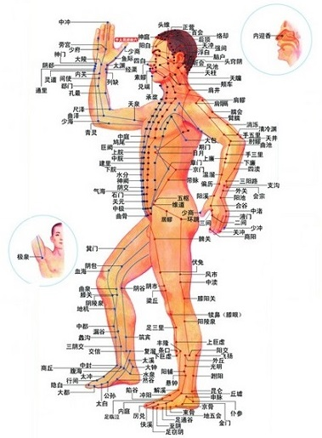

Slide 65
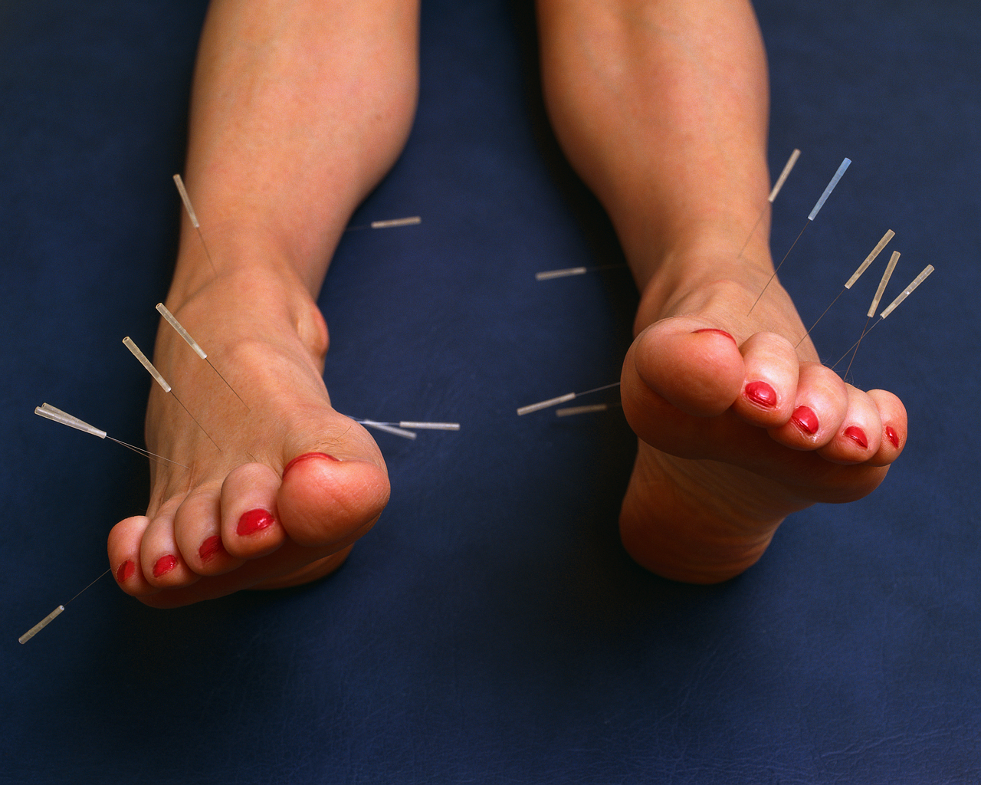

Slide 66
Massage: Combines physical relaxation with therapeutic touch and reduces stress by reducing muscular tension and feelings of isolation..

Slide 68
Many patients regress and need more physical touch. It also conveys empathy and encourages trust and the ventilation of feelings.
Aromatherapy: Nice smells from oils for relaxation.
Visualization: Regular imagining of the desired outcome e.g a shrank tumor. Done 3-4 times a day for 15-20min. Helps the patient to have feelings of control, reduces helplessness.
Muscular relaxation: Contracting and relaxing different groups of muscles.
Biofeedback: Skin resistance(sweating), pulse rate and muscle tension.
Breathing exercises: To focus on full expiration, lowering the shoulders and using the diaphragm when inhaling so the abdomen rises. Encouraged in times of panic especially.

Slide 69
Meditation: Reduces arousal level by means of focused attention using a visual image, a repeated sound or a physical activity e.g breathing. Indices deep relaxation.
Reflexology: Massage of the feet. Based on the theory that there are 10 zones of energy flow running the length of the body and that massage can remove congestion and energy blocks from the pathways and normalize the function of internal organs.
Faith healing: Combines touch, positive thinking and listening. A supernatural power may be invoked.
Hypnosis: use of imagination. Mental imagery is very powerful. For example, a patient with ulcerative colitis may be asked to imagine what his/her distressed colon looks like, then encouraged in hypnosis (and in self-hypnosis) to imagine this image changing to a healthy one. A second basic hypnotic method is to present ideas or suggestions to the patient. In a state of concentrated attention, ideas and suggestions that are compatible with what the patient wants seem to have a more powerful impact on the mind.
Art/music therapy: Reduces stress, provides a sense of purpose and improves self esteem.

Slide 70
CONCLUSION.
Pain must be controlled before other problems can be addressed and treated.
Good pain control requires accurate and detailed assessment of every different pain experienced and documentation.
Pain control requires knowledge of the different types of pain.

Slide 71
Types of loss
Real loss e.g. of a loved one, property or relationship which can be shared by others.
Perceived loss: that is felt by the individual alone and not shared by others e.g. loss of feminity following a major operation e.g. mastectomy or hysterectomy
NB: Any situation which cause change can be identified as loss. Failure either real or perceived can be viewed as loss. Loss or anticipated loss can trigger a grief response. The period of grief is known as mourning which is a normal response characterized by sadness, guilt, anger, helplessness and despair.

Slide 72
END OF LIFE CARE
MANIFESTATION OF IMPENDING DEATH
Difficulty talking or swallowing
Nausea, flatus, abdominal distention
Urinary and/or bowel incontinence, constipation
Decreased sensation, taste, and smell
Weak, slow, and/or irregular pulse

Slide 73
Decreasing blood pressure
Decreased, irregular, or Cheyne-Stokes respirations
Changes in level of consciousness
Restlessness, agitation
Coolness, mottling,(spotting) and cyanosis of the extremities

Slide 74
Stages of death by Kubler Ross 1969
1. Denial and isolation: it is very difficult for any individual to face the fact that death is to be faced soon. The most common reaction is to isolate oneself until defences are achieved.
Denial permits hope to exist but most patients are ready to accept the fact that they are dying but families continue to express denial.
Denial delay, communication of concerns with the patient stopping denial and isolation by thinking about unfinished business e.g. personal affairs, finances, arrangement for spouse, children and others.
2. Anger: the person experiences anger with the person asking the question; why me? The patient is difficult to nurse as nothing seems to please him or her. The person wants to express their outrage and helplessness. After expressing their anger they move on.

Slide 75
3. Bargaining: third phase of dying when the person attempts to negotiate and trade. It usually involves a deal with God; the physician or the nurse. E.g. If I can live long enough to attend my son’s wedding I will be ready to die. If possible patients should be granted their request.
4. Depression: the patient is now aware that death is inevitable. Defense mechanism are no longer effective. Sadness and anguish are felt and expressed.
The patient may organize to gain support from loved one’s and nurses.
The resolution leads to final stage.

Slide 76
5. Acceptance: it’s a time of relative peace. The patient wants to review the past and think about the unknown future. Patient may not talk a lot about but he/she wants other people nearby. With pain relieve the person accepts death and wants to be comforted by having significant others nearby.
Nursing intervention
To give maximum help to the dying by examining the own feeling about death.
Patient is an individual and should be treated with respect and dignity regardless of background or condition.
Social values may affect reaction to the dying person e.g. age, attractiveness, socio-economic status, former accomplishment. These may affect whether the person is cared for or abandoned while dying.
Nurses usually become the most important link with life for the dying person.
The nurse provides physical comfort and emotional support. It is an emotional stress to the nurse assigned to people who are dying and these need to share their feelings and reactions with others to obtain support.

Slide 77
Bill of rights for a dying person
I have a right to be treated as a living human being until I die
I have a right to maintain a sense of hopefulness, however changing its focus may be.
I have the right to be cared for by those who can maintain a sense of hopefulness, however changing this may be.
I have a right to express my feelings and emotions and my approaching death in my own way.
I have a right to participate in decision concerning my care.
I have a right to expect continuing medical and nursing attention even though “cure” goals must be changed to comfort goals.
I have a right not to die alone.
I have a right to be free from pain.
I have a right to have my questions answered honestly.

Slide 78
10. I have a right not to be deceived
11. I have a right to help from and for my family in accepting my death.
12. I have the right to die in peace and with dignity
13. I have the right to retain my individuality and not to be judged by my decision, which may be contrary to the believes of others.
14. I have the right to discuss and enlarge my religious and spiritual experience, regardless of what they mean to others.
15. I have the right to expect that the sanctity of the human body will be respected after death.
16. I have the right to be cared for by caring, sensitive and knowledgeable people who will attempt to understand my needs and will be able to gain some satisfaction in helping me face my death.

Slide 79
Bereavement
Def: refers to a state of loss resulting from death of a significant person. It produces stress and major symptoms in the affected person.
The person who has suffered bereavement may have physical, psychological changes due to grief.
STAGES OF BEREAVEMENT
1. Numbness and denial: a person has a sense of emptiness as if life has stood still. There is also denial; a feeling that it cannot happen to the individual.
2.Yearning and pinning: the person is pre-occupied with images of the dead person. The person feels that they have seen, talked or heard the dead person.
3 .Despair and depression: stage of acceptance that the person may get disorganized and some people may find it difficult to cope with daily task of life and work. The bereaved person often experiences despair and depression
4.Reality and organization: the bereaved person realizes that life must go on without the dead person. Loss is painful but the survivor begins to move on with life.

Slide 80
GRIEF
It’s the response to loss particularly to the loss of someone or some living things that has died.
TYPES OF GRIEF
1. ANTICIPATORY GRIEF
It is the initiation and actual process of grieving that takes place when anticipating a significant loss before it takes place.
Stages of grieving are similar to those of normal loss with a difference that conventional grief tends to reduce in intensity as time passes.
Anticipatory grief increases in intensity as expected loss becomes more imminent.
Disadvantages
If family members complete the process of grieving then attachment from the dying person occurs prematurely.
The person experiences loneliness, isolation as well as psychological pain of imminent death without family support.
There may be problem of re-establishing prior relationship after grieving if death does not occur.

Slide 81
2. Prolonged grief
Grief is considered prolonged if activities of normal living are not resumed after a period of 4 to 6 weeks.
If grief is associated with self-blame; difficulties accepting loss, sudden untimely loss, history of dependence on the dead person.
Signs and symptoms
Development of physical symptoms experienced by the dead person
Progressive social withdrawal
Poor interpersonal relationships with friends and relatives
Participation in activities detrimental to one’s social or economic existence.

Slide 82
3. Exaggerated grief
Signs and symptoms of normal grieving process are exaggerated.
Feeling of sadness, helplessness, hopelessness, anger and guilt are accompanied by other somatic complaints.
This leads to overwhelming behavior without progression toward completion of the grieving process.
Individual is fixed in anger stage and blames others or self for the loss which leads to depression.

Slide 83
Factors that influence outcomes of grief
The importance of the lost object or person as a source of support
The degree of dependency on relation with lost object or person.
The number and nature of other meaningful relationship the mourner has.
The degree of ambivalence felt towards the lost person or object.
The number and nature of previous grief experiences e.g. grief which can be cumulative especially when the previous grief has not been resolved.
The age of the lost person e.g. child, adult or elderly person.
Health of the mourner at the time of loss. Status of physical, psychological condition and coping capacity for stress.
The degree of preparation for the loss.

Slide 84
STAGES OF GRIEF
SHOCK & DENIAL- The person reacts to learning of the loss with numbed disbelief. He deny the reality of the loss at some level, in order to avoid the pain. Shock provides emotional protection from being overwhelmed all at once. This may last for weeks.
2. PAIN & GUILT- As the shock wears off, it is replaced with the suffering of unbelievable pain. Although excruciating and almost unbearable, it is important that you experience the pain fully, and not hide it, avoid it or escape from it with alcohol or drugs. He/she may have guilty feelings or remorse over things he/she did or didn't do with your loved one. Life feels chaotic and scary during this phase.

Slide 85
3. ANGER & BARGAINING- Frustration gives way to anger, and one may lash out and lay unwarranted blame for the death on someone else. This is a time for the release of bottled up emotion.
One may rail against fate, questioning "Why me?“ one may also try to bargain in vain with the powers that be for a way out of his/her despair ("I will never drink again if you just bring him back").
4. "DEPRESSION", REFLECTION, LONELINESS- Just when one’s friends may think he/she should be getting on with life, a long period of sad reflection will likely overtake him/her. This is a normal stage of grief and one should not be "talked out of it" by well-meaning outsiders. Encouragement from others is not helpful during this stage of grieving.
During this time, one finally realizes the true magnitude of his/her loss, and it depresses him/her. One may isolate self on purpose, reflect on things he/she did with his/her lost one, and focus on memories of the past. One may sense feelings of emptiness or despair.

Slide 86
5. THE UPWARD TURN- As one starts to adjust to life without his/her dear one, his/her life becomes a little calmer and more organized. One’s physical symptoms lessen, & "depression" begins to lift slightly.
6. RECONSTRUCTION & WORKING THROUGH- As one becomes more functional, his/her mind starts working again, and you will find yourself seeking realistic solutions to problems posed by life without your loved one. You will start to work on practical and financial problems and reconstructing yourself and your life without him or her.
7. ACCEPTANCE & HOPE- One learns to accept and deal with the reality of his/her situation. Acceptance does not necessarily mean instant happiness. Given the pain and turmoil one has experienced, one can never return to the carefree, untroubled self that existed before this tragedy.

Slide 87
Nurses' Grief
The nurse develops close relationship with the client who has died may experience strong feelings of grief.
Crying with families (at one time considered unprofessional) is now recognized as simply an expression of empathy and caring.
Sharing grief with the family after the death of a loved one helps both the nurse and family to cope with their feelings about the loss.

Slide 88
FINALLY
Death should simply become a discrete but dignified exit of a peaceful person from a helpful society….. Without pain or suffering and ultimately without fear.
Philippe Aries,1977 (The Hour of our death)

Slide 89
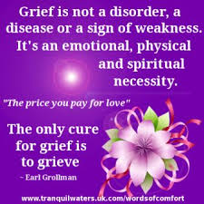

Slide 90
To cure sometimes
to relive often
to comfort always!

Slide 91
Group discussions
Group 1-types of pain nociceptive pain
Group 1neuropathic pain
Group 2-pain assessment
Group 3 –pain management non narcotic
Group 4-narcotic and adjuvant analgesics
Group 5-non pharmacological pain management

Slide 92
END

