Slide 1
PARATHYROID DISORDERS

Slide 2
HYPERPARATHYROIDISM

Slide 4
Definition
Over activity of the parathyroid glands
Produces too much PTH resulting in hypercalcemia and hypophosphatemia.
Excess calcium is reabsorbed by the kidneys and may result in kidney stones

Slide 5
Cont…
Parathyroid tumors are usually benign.
Can be classified as primary or secondary hyperparathyroidism
Primary hyperparathyroidism - due to a single benign tumor known as a parathyroid adenoma.
Secondary hyperparathyroidism - occurs due to vitamin D deficiency, chronic kidney disease, or other causes of low blood calcium.

Slide 6
Pathophysiology
There is hypersecretion of parathyroid hormone (PTH) leading to hypercalcemia and relative hypophosphatemia.
PTH hypersecretion can lead to bony demineralization, nephrolithiasis, and hypercalcemic crisis.
It may also be associated with mental disturbances, neuromuscular disease, hypertension, and glucose intolerance.
Notes:
Nephrolithiasis – kidney stones.
Glucose intolerance is cause by biochemical abnormalities like hypercalcemia, hypophosphatemia and elevated PTH which will sustain a form of insulin resistance

Slide 7
Causes
Neoplasms
Hyperplasia
Radiation treatment to the neck area
Cancer of the parathyroid gland

Slide 8
Clinical manifestations
Ataxia
Hypertension
Lethargy, muscle weakness
Nausea
Depression
Loss of appetite
Constipation
Reduced kidney function (severe cases)
Osteoporosis
Notes:
Ataxia is a term for a group of disorders that affect co-ordination, balance and speech.

Slide 9
Clinical manifestations
Bone pain or fracture as a result of excreting calcium from bone
Flank pain - Kidney stones
Frequent urination as a result of increased calcium in the urine (hypercalciuria)

Slide 10
Diagnosis
Serum calcium.
Serum PTH.
Serum phosphate.
Urine calcium.
Presence of kidney stones on ultrasound.
Fine needle biopsy of the parathyroid tumor.
Serum Vitamin D level
Bone density

Slide 11
Complications
Acute hypercalcemic crisis can occur with extreme elevation of serum calcium levels.
Serum calcium levels higher than 15 mg/dL (3.7 mmol/L) result in neurologic, cardiovascular, and renal symptoms that can be life-threatening.

Slide 12
Treatment includes rehydration with large volumes of intravenous fluids, diuretic agents to promote renal excretion of excess calcium, and phosphate therapy to correct hypophosphatemia and decrease serum calcium levels by promoting calcium deposit in bone and reducing the gastrointestinal absorption of calcium.
Cytotoxic agents (mithramycin), calcitonin, and dialysis may be used in emergency situations to decrease serum calcium levels quickly

Slide 13
Management
Fluid replacement - IV normal saline to dilute serum calcium
Drugs – Calcitonin, Plicamycin
Surgical removal of the parathyroid tumor.
Administer bisphosphonates to lower serum calcium by increasing calcium absorption in the bone..
Diuretic such as furosemide to excrete excess calcium in the urine.
Notes:
Because kidney involvement is possible, patients with hyperparathyroidism are at risk for renal calculi. Therefore, a fluid intake of 2,000 mL or more is encouraged to help prevent calculus formation.
Thiazide diuretics are avoided because they decrease the renal excretion of calcium and further elevate serum calcium levels. Because of the risk of hypercalcemic crisis, the patient is instructed to avoid dehydration and to seek immediate health care if conditions that commonly produce dehydration

Slide 14
Read on the nursing management of hyperparathyroidism

Slide 15
HYPOPARATHYROIDISM

Slide 16
Definition
Hypoparathyroidism is diminished functioning of the parathyroid glands
leads to low levels of PTH
Causes hypocalcemia.
Notes:
The most common cause of hypoparathyroidism is inadequate secretion of parathyroid hormone after interruption of the blood supply or surgical removal of parathyroid gland tissue during thyroidectomy, parathyroidectomy, or radical neck dissection. Atrophy of the parathyroid glands of unknown cause is a less common cause of hypoparathyroidism.

Slide 17
Pathophysiology
Notes:
Symptoms of hypoparathyroidism are caused by a deficiency of parathormone that results in elevated blood phosphate (hyperphosphatemia) and decreased blood calcium (hypocalcemia) levels. In the absence of parathormone, there is decreased intestinal absorption of dietary calcium and decreased resorption of calcium from bone and through the renal tubules. Decreased renal excretion of phosphate causes hypophosphaturia, and low serum calcium levels result in hypocalciuria.

Slide 18
Causes
Injury to or removal of the parathyroid glands.
Surgical removal of parathyroid glands
Genetics.
Autoimmune disease.
Cancer radiation treatments.
Low magnesium levels.

Slide 19
Signs and symptoms
Tetany (muscle irritability) due to abnormal levels of calcium
Tingling of periorbital area, hands, and feet from abnormal calcium levels
Lethargy due to low levels of parathyroid hormone
Cataract development
Convulsions due to acute low calcium levels
Notes:
Tetany is a general muscle hypertonia, with tremor and spasmodic or uncoordinated contractions occurring with or without efforts to make voluntary movements. Symptoms of latent tetany are numbness, tingling, and cramps in the extremities, and the patient complains of stiffness in the hands and feet. In overt tetany, the signs include bronchospasm, laryngeal spasm, carpopedal spasm (flexion of the elbows and wrists and extension of the carpophalangeal joints), dysphagia, photophobia, cardiac dysrhythmias, and seizures.

Slide 20
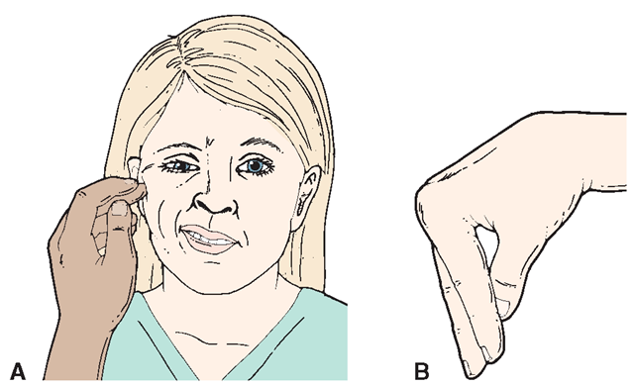
Cont…
A positive Chvostek’s sign
A positive trousseau’s sign
Hypotension
Osteomalacia
Cardiac insufficiency

Slide 21
Diagnosis
Serum calcium due to low levels of PTH.
Serum phosphate due to low levels of PTH.
Serum PTH from diminished secretion from the parathyroid glands.
Urinary calcium levels
Positive Chvostek’s sign due to decreased calcium levels.
Positive Trousseau’s sign due to decreased calcium levels.

Slide 22
Management
Administer calcium gluconate by slow IV drip for acute hypocalcemia.
Oral calcium—calcium gluconate, lactate, carbonate
Large doses of vitamin D (calciferol) to help absorption of calcium.
Aluminum hydroxide to decrease phosphate levels.

Slide 23
Nursing care
Assignment:
What kind of nursing care would you offer this patient?
Formulate two nursing diagnoses and two interventions for each for such a patient

