Slide 1
Jaundice
ChristaMayienga

Slide 2
Jaundice
Jaundice is a yellowish discoloration of the skin, sclerae, mucous membranes and nails due to excessive accumulation of bilirubin in the blood(Hyperbilirubinemia).
It is Clinically apparent when bilirubin levels reach 2-3 mg/dL (34-51 mmol/L)- Normal levels are 0.3-1.2mg/dl
May be the earliest sign of liver dysfunction and therefore needs urgent evaluation.
Rate of bilirubin production should equal hepatic uptake, conjugation and excretion. Jaundice occurs when equilibrium btn production and excretion is disturbed.

Slide 3
Bilirubin Metabolism
Bilirubin is the final product of haem catabolism, which is mostly derived from haemoglobin (75% ) and (25% ) from breakdown of other proteins such as myoglobin, cytochromes, and nitric oxide synthases.
In RES, haem is further catabolised by haem oxygenase to biliverdin.
This is acted upon by biliverdin reductase to form bilirubin.
Bilirubin is then bound to serum albumin in the plasma and is transported to the liver.

Slide 4
Bilirubin Metabolism
It dissociates from albumin, and is taken up into the hepatocytes where it is conjugated by the uridine diphosphoglucuronyl transferase (UDPGT) enzyme.
It is then excreted from Hepatocytes into the bile canaliculi then into the intestines where its converted to urobilinogen by bacterial action.
Some urobilinogen is absorbed back to the blood stream and into the liver(enterohepatic circulation) and some is excreted in the urine.
The bilirubin in the intestines is excreted in the feces as stercobilin giving stool its characteristic colour.

Slide 5
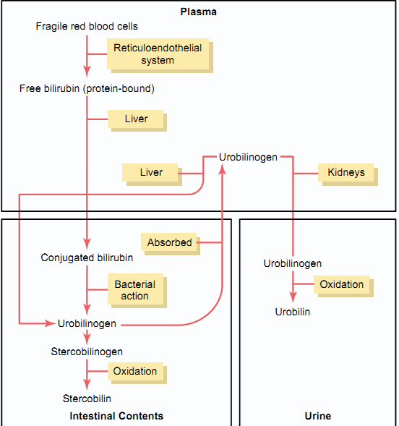

Slide 6
Bilirubin exists in two main forms in serum
Unconjugated Bilirubin
Tightly compounded to serum albumin
Normally very small amount is present as albumin free
Insoluble in water can not be excreted in urine
Toxic
Conjugated Bilirubin
Non toxic
Water soluble
Loosely bound to albumin. Delta fraction

Slide 7
Causes of Jaundice
Excessive extra hepatic production of bilirubin
Reduced hepatic uptake
Impaired conjugation
Decreased hepatocellular excretion
Impaired bile flow
Classification:
Prehepatic- Hemolytic
Hepatic- Liver disease
Post hepatic- obstructive

Slide 8
Causes of unconjugated hyperbilirubinemia
1. Excess production of bilirubin like in Hemolysis, Resorption of blood from internal hemorrhage Like in GI bleeding, hematomas and Ineffective erythropoiesis like in pernicious anemia, thalassemia, SCD.
2. Reduced hepatic uptake like in Drug interference with membrane carrier systems and Some cases of Gilbert syndrome
3. Impaired bilirubin conjugation
Physiologic jaundice of the newborn (decreased UGT1A1 activity, decreased excretion)
Breast milk jaundice (β-glucuronidases in milk)
Genetic deficiency of UGT1A1 activity (Crigler-Najjar syndrome types I & II)
Gilbert syndrome
Diffuse hepatocellular disease (e.g., viral or drug-induced hepatitis, cirrhosis)

Slide 9
Hereditary Hyperbilirubinemias

Slide 10
Causes of Jaundice
Causes of Conjugated Hyperbilirubinemia.
Deficiency of canalicular membrane transporters (Dubin-Johnson syndrome, Rotor syndrome)
Impaired bile flow like in billiary stone or cancers
Assignment: What are the Diagnostic Differences Between Hemolytic and Obstructive Jaundice.

