Slide 1
Portal Hypertention
ChristaMayienga

Slide 2
Portal hypertension is characterized by a pathologic increase in portal venous pressure( from 5MMHG to > 12MMHG)
This leads to the formation of extensive network of porto-systemic collaterals diverting a large fraction of portal blood to the systemic circulation, bypassing the liver.
As the PHTN progresses, formation of collateral vessels and arterial vasodilation progress Eventually causing a hyperdynamic circulatory syndrome that manifests as esophageal varices, ascites, and other stigmata

Slide 3
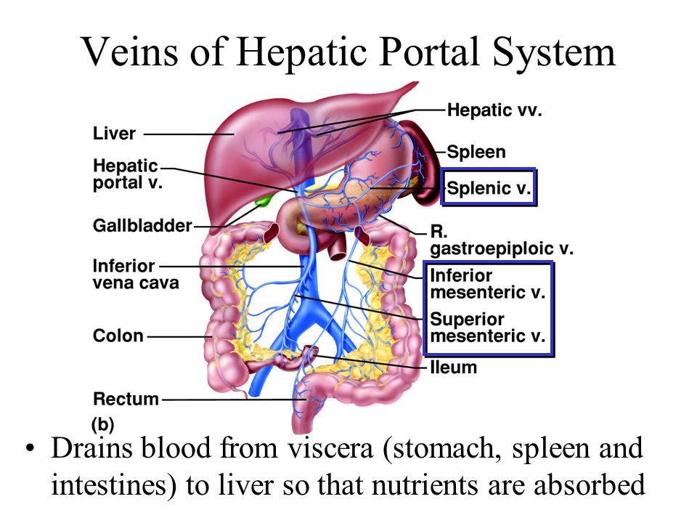

Slide 4
The portal system
The portal system drains the GIT from the esophagus to the upper 1/3 of the rectum.
The flow is under very low pressures -5mmHG
Branches-
Left gastric vein drains the lower part of the esophagus
Spleenic vein drains the spleen pancrease and part of the stomach
Superior mesenteric vein drain the ileum and upper part of the colon
Inferior mesenteric vein drains the later parts of the colon and upper rectum

Slide 5
Causes of PHTN
Prehepatic causes-Congenital abnormalities like atresia, obstructive thrombosis, narrowing of the portal vein before it ramifies within the liver, massive splenomegaly with increased splenic vein blood flow or Wilms tumor pressing on the portal vein.
post-hepatic causes- Severe RHF, constrictive pericarditis, hepatic vein outflow obstruction, Budd-Chiary syndrome or blocked IVC

Slide 6
Causes of PHTN
Intrahepatic cause-Mainly cirrhosis, accounting for most cases, schistosomiasis, massive fatty change, diffuse fibrosing granulomatous disease such as sarcoidosis, Drugs, polycystic liver disease, congenital liver fibrosis, malignant liver disease and diseases affecting the portal microcirculation such as nodular regenerative hyperplasia

Slide 7
Pathophysiology
involves two phenomena
1) Increase in resistance to portal flow at the level of sinusoids.
The increased resistance to portal flow at the level of the sinusoids is caused by scarring and the formation of parenchymal nodules.
Sinusoidal remodeling & anastomosis btn the arterial & portal system in the fibrous septa contribute to PHTN by imposing arterial pressures on the low pressure portal venous system.
Sinusoidal remodeling and intrahepatic shunts also interfere with the metabolic exchange between sinusoidal blood and hepatocytes.

Slide 8
pathophysiology
2) Increase in portal blood flow caused by hyperdynamic circulation.
This is caused by arterial vasodilation, primarily in the splanchnic circulation.
The increased splanchnic arterial blood flow in turn leads to increased venous efflux into the portal venous system.
Vasodilation is caused majorly by NO produced by gut bacteria
The two phenomena cause congestion and pooling of blood in the portal system-> PHTN

Slide 9
Effects of PHTN
Esophegeal varices- Dilated esophegeal veins. The left gastric vein which drains the esophagus into the portal system anastomoses with the azygous & Hemiazygous vein at the level of lower esophagus. Portal congestion and elevated pressure causes backflow through the left gastric vein into the azygous & Hemiazygous vein then to the IVC. The varices may bleed and it is a major cause of death.

Slide 10
Effects of PHTN
Rectal Varices-Dilated superior rectal veins. The inferior mesenteric vein which drains the upper and middle portion of the rectum into the portal system anastomoses with cutenous veins at the level of the rectum. Due to congestion and elevated pressure in the portal system, blood reverses and backflows through the inferior mesenteric causing congestion of rectal veins.

Slide 12
Effects of PHTN
Caput Medusae- Dilated paraumbilical veins. The portal blood avoids the high resistance liver and follow the umbilical vein which has subcutenous branches to drain into the illiacs.
Spleenomegally-Backflow and congestion through the spleenic vein. This causes hyperspleenism manifesting as pancytopenia.
Jaundice-Intrahepatic obstruction of bile flow causes accumulation and signs of obstrucive J.

Slide 13
Effects of PHTN
Ascites- pooling and high intravascular pressure in the portal system causes fluid to move from intravascular spaces to the abdominal cavity.
Pooling-> low RBF-> activation of RAAS-> salt and fluid retention.

Slide 14
Effects of PHTN
Hepatic encephalopathy-poor or no detoxification of Ammonia intoxicates the brain causing neurological symptoms.
Hepato-Pulmonary Syndrome- not fully understood but postulations indicate that release of endothiline and NO from fibrosed hepatocytes causes vasodilation of pulmonary capillaries leading to high blood flow and build up of pressure that causes dyspnoea.

Slide 15
Effects of PHTN
Hepato-renal syndrome- due to pooling of blood in the portal system, there is low RBF-> low GFR -> accumulation of nitrogenous wastes, salt and water retention.
Hepatocellullar carcinoma due to abnormal multiplication of hepatocytes.

Slide 16
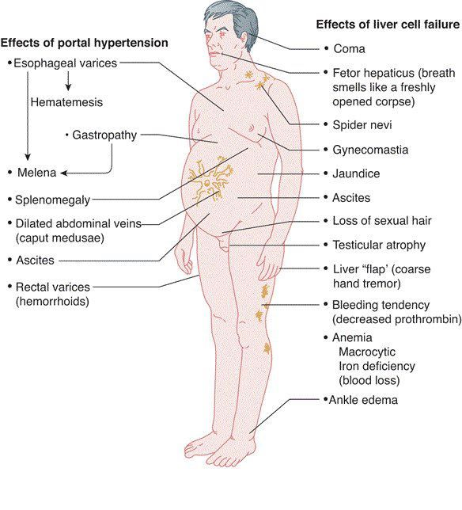

Slide 17
Clinical Features
Four major clinical consequences of portal hypertension are
1) Ascites,
2) Formation of portosystemic venous shunts,
3) congestive splenomegaly.
4) hepatic encephalopathy

Slide 18
Investigations
Imaging- Abdominal ultrasound, Ct scan and MRI. Can identify the cause and measure the extend of damage.
FHGM
Esophageal endoscopy.

Slide 19
