Slide 1
Cholelithiasis, Cholecystitis, choledocolithiasis and cholangitis
Gall Bladder Pathology

Slide 2
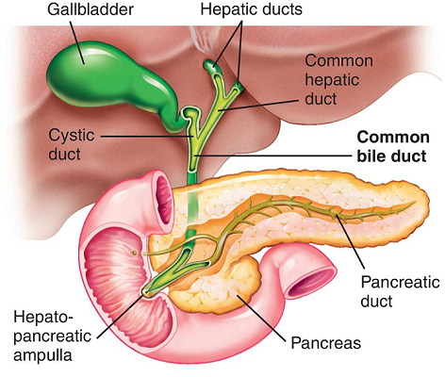

Slide 3
The gall bladder
1 L of bile is secreted by the liver per day.
Between meals bile is stored in the gallbladder, where it is concentrated.
The adult gallbladder has a capacity of about 50 mL. The organ is not essential for biliary function, since humans do not suffer from indigestion or malabsorption of fat after cholecystectomy.
Bile Emulsifys fat and makes it easy to absorb

Slide 4
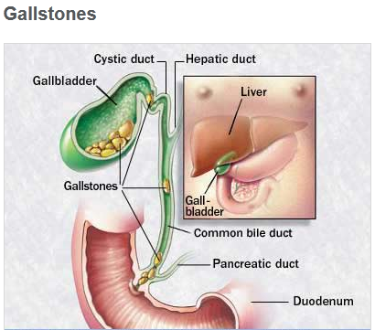

Slide 5
Cholelithiasis
Over 95% of biliary tract disease is attributable to cholelithiasis (gallstones).
Majority of gallstones (>80%) are “silent,” and most individuals
Most are cholesterol stones, containing more than 50% of crystalline cholesterol monohydrate. The rest are composed of bilirubin calcium salts.( Pigmented stones)

Slide 6
Risk Factors
Cholesteral stones:
Demography: northern Europeans, North and South Americans, Native Americans, Mexican-Americans
Advancing age
Female gender-Estrogen increases cholesteral presipitation
Oral contraceptives
Pregnancy
Obesity and metabolic syndrome
Rapid weight reduction
Gallbladder stasis
Inborn disorders of bile acid metabolism

Slide 7
Risk Factors
Pigmented Stones:
Demography: Asians more than Westerners, rural more than urban
Chronic hemolytic syndromes
Biliary infection
Gastrointestinal disorders: ileal disease (e.g., Crohn disease), ileal resection or bypass, cystic fibrosis with pancreatic insufficiency

Slide 8
Pathogenesis of Cholesterol stones
Cholesterol is kept soluble in bile by aggregation with water-soluble bile salts and water-insoluble lecithins.
When cholesterol concentrations exceed the solubilizing capacity of bile (supersaturation), it nucleates into solid cholesterol crystals.
Cholesteral stones are radiolucent unless mixed with calcium ions. (Which is in most cases)

Slide 9
Pathogenesis of Cholesterol stones
3 Conditions contribute to formation of stones;
1. Supersaturation of cholesteral in bile so it precipitates and forms a stone.
2. Less/lack of bile salts and acids or phospholipids that keep cholesteral in solution
3. Bile stasis-> precipitation and stone formation.

Slide 10
Pathogenesis of Bilirubin/pigmented stones
They are complex mixtures of abnormal insoluble calcium salts of unconjugated bilirubin along with inorganic calcium salts.
Disorders that are associated with elevated levels of unconjugated bilirubin in bile such as hemolytic syndromes, severe ileal dysfunction (or bypass), and bacterial contamination of the biliary tree, increase the risk of developing pigment stones.
Infection of the biliary tract with Escherichia coli, Ascaris lumbricoides, or the liver fluke O. sinensis, the increases risk

Slide 11
Pathogenesis of Bilirubin/pigmented stones
They are black or brown in colour
Formed when there is excess bilirubin in bile.
Bilirubin combines with calcium to form calcium Bilirubinate.
Mostly made of unconjugated bilirubin.
They are radio-opaque.

Slide 12
Clinical features
Asymptomatic.
Excruciating or colicky or dull RUQ pain as a result of the obstructive nature of gallstones in the biliary tree gallbladder itself.
Pain is worse with fatty foods
Abd. U/S- demonstrates the stone
ERCP- diagnosis and can remove the stone.

Slide 13
Complications
cholecystitis,
Cholangitis
Pancreatitis
intestinal obstruction

Slide 14
Cholecystitis
Def: Inflamation of the gall bladder caused by obstruction of the cystic duct by a gall stone.
It is a complication of cholelithiasis and choledocholithiasis.
May be acute, chronic, or acute superimposed on chronic.

Slide 15
Acute cholecystitis
Acute inflammation of the gallbladder, precipitated 90% of the time by obstruction of the neck or cystic duct.
Pathogenesis
Due to the blocked cystic duct, there is cholestasis and a chemical irritation on the walls of the G.B.
The normally protective glycoprotein mucus layer is disrupted, exposing the mucosal epithelium to the direct detergent action of bile salts.
The G.B starts to secrete prostaglandins, enzymes and more mucous which cause inflammation.

Slide 16
Acute cholecystitis -Pathogenesis
Inflammation, edema and accumulation of bile cause distention and pressure build up.
Bile stasis creates media for bacterial growth.
Bacteria-E. coli, Enterococci, bacteroids fragilis and clostridium.
They may invade through the walls of the GB to the peritoneum to cause peritonitis.

Slide 17
Acute cholecystitis -Pathogenesis
Gallbladder dysmotility develops; distention and increased intraluminal pressure compromise blood flow to the mucosa -> ischemia, gangrene->rupture and bile seeding the gut-> chemical peritonitis.
Bacteria in the bile may get into the blood vessels ->septicemia

Slide 18
Clinical features
RUQ pain that radiates to the back.
Fever, Nausea, vomiting
Jaundice (+ or -)
+ve Murphy’s sign
Elevated WBCs

Slide 19
Investigations
LFTs-----Elevated ALP
FBC----Elevated WBC
Imaging-Abdominal ultrasound with a special scan called Hida scan. Its cholescintigraphy where a contrast scan lights up the biliary tree
Endoscopic retrograde cholangiopancretography (ERCP)
Magnetic Resonance cholangiopancretography (MRCP)

Slide 20
Complications
Chronic cholecystitis
Empyema (Mirizzi’s syndrome) may cause obstruction of the hepatic duct.
Perforation
GB-Duodenal fistula-> gall stones ileus
Cholangitis, choledocolithiasis
Pancretitis
Mucoceal
GB cancer

Slide 21
Chronic Cholecystitis
Caused by frequent/recurrent acute cholecystitis.
Associated with cholelithiasis in more than 90% of cases.
The evolution of chronic cholecystitis is unclear, but its thought that gallstones may play a direct role in the initiation of inflammation or the development of pain.
Rather, supersaturation of bile predisposes to both chronic inflammation and, in most instances, stone formation.
Microorganisms, usually E. coli and enterococci play a role, but obstruction of gallbladder outflow is not a requisite.
Symptoms range from biliary colic to indolent right upper quadrant pain and epigastric distress.

Slide 22
Pathogenesis
Presence of gall stones cause chronic irritation of the GB wall
The GB wall starts to show signs of cellular damage and it may die off.
Reactive proliferation of the mucosa and fusion of the mucosal folds may give rise to buried crypts of epithelium within the gallbladder wall.
Outpouchings of the mucosal epithelium through the wall lead to lesions called Rokitansky-Aschoff sinuses.
Gradual fibrosis, then calcification caused the GB to take up a blue colour called porcelain gallbladder. It’s a risk for development of GB cancer.
Xanthogranulomatous cholecystitis is where the GB has a massively thickened wall, is shrunken, nodular, and chronically inflamed with foci of necrosis and hemorrhage.
Finally, an atrophic, chronically obstructed gallbladder may contain only clear secretions, a condition known as hydrops of the gallbladder.

Slide 23
Clinical Features
Chronic cholecystitis does not have the striking manifestations of the acute forms and is usually characterized by recurrent attacks of either steady or colicky epigastric or RUQ pain. Nausea, vomiting, and intolerance for fatty foods.

Slide 24
Complications
Bacterial superinfection leading to cholangitis or sepsis
Gallbladder perforation and local abscess formation
Gallbladder rupture with diffuse peritonitis
Biliary enteric (cholecystenteric) fistula, with drainage of bile into adjacent organs, entry of air and bacteria into the biliary tree, and potentially, gallstone-induced intestinal obstruction (ileus)
Aggravation of preexisting medical illness, with cardiac, pulmonary, renal, or liver decompensation
Porcelain gallbladder, with increased risk of cancer,

Slide 25
CHOLEDOCHOLITHIASIS
It is obstruction of the common bile duct by a gall
The stones are usually pigmented and associated with biliary tract infections.
There is proximal inflammation, obstructive jaundice and dilated hepatic ducts.
Strongly associated with Cholangitis.

Slide 26
CHOLEDOCHOLITHIASIS
Choledocholithiasis may be asymptomatic or may cause symptoms from:
obstruction, pancreatitis, cholangitis, hepatic abscess, secondary biliary cirrhosis, acute cholecystitis

Slide 27
CHOLANGITIS (ASCENDING CHOLANGITIS)
Cholangitis is inflammation of the entire biliary tree.
Results from any lesion that creates obstruction to bile flow, most commonly choledocholithiasis and biliary strictures.
Less common causes include indwelling stents or catheters, tumors, acute pancreatitis, and rarely, fungi, viruses, or parasites.
Bacteria most likely enter the biliary tract through the sphincter of Oddi;
The bacteria are usually enteric gram-negative aerobes such as E. coli, Klebsiella, Interococcus, or Enterobacter. Clostridium and Bacteroides are usually present as a mixed infection.
Infection of intrahepatic biliary radicles is termed ascending cholangitis.

Slide 28
CHOLANGITIS (ASCENDING CHOLANGITIS)
Cholangitis usually presents with fever, chills, abdominal pain, and jaundice
The most severe form of cholangitis is suppurative cholangitis: purulent bile fills and distends bile ducts.
Since sepsis rather than cholestasis tends to dominate the picture, prompt diagnostic evaluation and intervention are imperative in these seriously ill patients

Slide 29
CHOLANGITIS (ASCENDING CHOLANGITIS)
Diagnosis is by Charcots triad:
Reynods Pentad
Hypotention
Altered mental status
Rx-Emergency ERCP, I.V antibiotics.

