Slide 1
PHARMACOKINETICS
Ms Ireri

Slide 2
Clinical Pharmacokinetics
The science of the rate of movement of drugs within biological systems, as affected by the absorption, distribution, metabolism, and elimination of medications

Slide 3
** Pharmacokinetic process
It is the study of what the body does to a drug
It includes the processes:

Slide 4
Pharmacokinetics of drugs
(ADME)
Are studies of
Absorption
Distribution
Metabolism
Excretion of drugs= Elimination

Slide 5
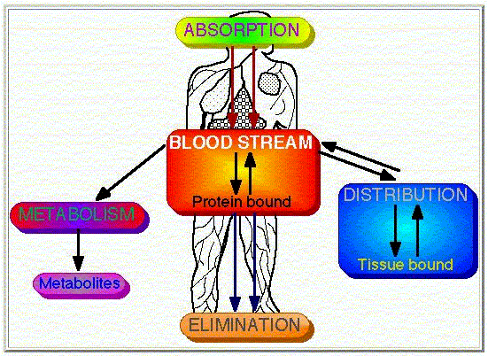

Slide 6
DRUG ABSORPTION
Is the passage of drug through cell membranes to reach its site of action.
Mechanisms of drug absorption
  Simple diffusion = passive diffusion.
  Active transport.
  Facilitated diffusion.
  Pinocytosis (Endocytosis).

Slide 7

Drug absorption
Refers to the route or method by which the drug reaches the blood supply, this depends on how the drug is administered.
The most common and preferred method of administration is the oral route.
It depends on hydrophilic/hydrophobic properties, polarity and ionization of the drug.

Slide 8
N/B
# To be effective a drug must be absorbed - except for topical and IV

Slide 9
Sites of drug absorption:
Oral mucosa (buccal; sublingual tab.)
Stomach (aspirin)
Intestine (iron; vit. B₁₂)
Lungs (general anesthetics)
Rectum (suppositories)
Skin (local preparations)

Slide 10
Drug Absorption of Various
Oral Preparations
Liquids, elixirs, syrups Suspension solutions Powders
Capsules Tablets Coated tablets
Enteric-coated tablets
Fastest
𝗍
𝗍
𝗍
𝗍
𝗍
Slowest
08/23/18
Mr.Dipti S.
Chapter 2-67

Slide 11
Factors That Affect Absorption
Route of administration of the drug
Food or fluids administered with the drug
Dosage formulation of the drug
Status of the absorptive surface- blood supply
Rate of blood flow to the small intestine
Acidity of the stomach (GUT Ph)
Size of the drug (molecular weight)
Status of GI motility (diarrhea, vomiting)
Food-drug interactions
Solubility of the drug

Slide 12
Absorption in the Pediatric Patient
Gastrointestinal pH changes
Gastric emptying
Gastric enzymes
Bile acids & biliary function
Gastrointestinal flora
Formula/food interaction

Slide 13
Drug distribution
Passage of drugs from blood to different tissues (site of action)

Slide 14
Volume of Distribution
Volume of distribution (Vd) relates the amount of drug in the body to the concentration of drug (C) in blood or plasma:
is an apparent volume
Drugs with very high volumes of distribution have much higher concentrations in extravascular tissue than in the vascular compartment, ie, they are not homogeneously distributed.
The units for Volume of Distribution are typically reported in (ml or liter)/kg body weight

Slide 15
Extent of distribution could be measured by a constant known as AVD
Apparent volume of distribution (AVD):
The total volume in which the free form of a given drug distributes in different body compartments at equilibrium
AVD = Dose (mg)/C₀ (mg/L)
C₀ = Concentration of drug in blood at time zero

Slide 16
Drug distribution
Once the drug is absorbed, it is rapidly distributed around the blood supply, then slowly distributed to the various tissues and organs.
Distribution to the interstitial fluid surrounding tissues and organs is rapid if the drug is not bound to plasma proteins .
Some drugs have to enter cells in order to reach their target.
A certain percentage of a drug may be absorbed into fatty tissue (e.g. Barbiturates) and/or bound to macromolecules

Slide 17
Vd
A theoretical volume that the drug would be if all the body had the same concentration as plasma
It gives an idea of how fat soluble the drug is and how well it binds to plasma proteins
Vd approximates extracellular fluid volume (5-30l) for drugs that are ionized( have a charge)
This is because these drugs are not very soluble in fat, and cannot easily cross cell membranes to the intracellular fluid, but can easily diffuse out of the vascular space into the interstitial space thereby occupying the whole extracellular space e.g gentamicin

Slide 18
Vd
Vd is close to total body water (30-45l) for drugs that are highly fat soluble. They are able to cross cell membranes to enter intracellular fluid. E.g. diazepam
Vd is greater than total body water for drugs which enter cells and which bind extensively to tissue proteins e.g. digoxin

Slide 19
Factors affecting drug distribution:
Compartmental selectivity
Organ selectivity
Protein binding ( Major factor)
Size of organ
Solubility
Blood flow
Natural barriers
BBB
Placenta
Mammary glands

Slide 20
Distribution of Drugs
Determinants of Distribution
The distribution of drugs to the tissues depends on the following:
1.Size of the Organ
The size of the organ determines the concentration gradient between blood and the organ. For example, skeletal muscle can take up a large amount of drug because the concentration in the muscle tissue remains low (and the blood–tissue gradient high) even after relatively large amounts of drug have been transferred; this occurs because skeletal muscle is a very large organ. In contrast, because the brain is smaller, distribution of a smaller amount of drug into it will raise the tissue concentration and reduce to zero the blood-tissue concentration gradient, preventing further uptake of drug.

Slide 21
2.Solubility
The solubility of a drug in tissue influences the concentration of the drug in the extracellular fluid surrounding the blood vessels. If the drug is very soluble in the cells, the concentration in the perivascular extracellular space will be lower and diffusion from the vessel into the extravascular tissue space will be facilitated. For example, some organs (including the brain) have a high lipid content and thus dissolve a high concentration of lipid-soluble agents. As a result, a very lipid-soluble anesthetic will transfer out of the blood and into the brain tissue more rapidly and to a greater extent than a drug with low lipid solubility.

Slide 22
3.Blood Flow
Blood flow to the tissue is an important determinant of the rate of uptake, although blood flow may not affect the amount of drug in the tissue at equilibrium. As a result, well-perfused tissues (eg, brain, heart, kidneys, and splanchnic organs) usually achieve high tissue concentrations sooner than poorly perfused tissues (eg, fat, bone). If the drug is rapidly eliminated, the concentration in poorly perfused tissues may never rise significantly.

Slide 23
4.Binding
Binding
Binding of a drug to macromolecules in the blood or a tissue compartment tends to increase the drug's concentration in that compartment. For example, warfarin is strongly bound to plasma albumin, which restricts warfarin's diffusion out of the vascular compartment. Conversely, chloroquine is strongly bound to extravascular tissue proteins, which results in a marked reduction in the plasma concentration of chloroquine.

Slide 24
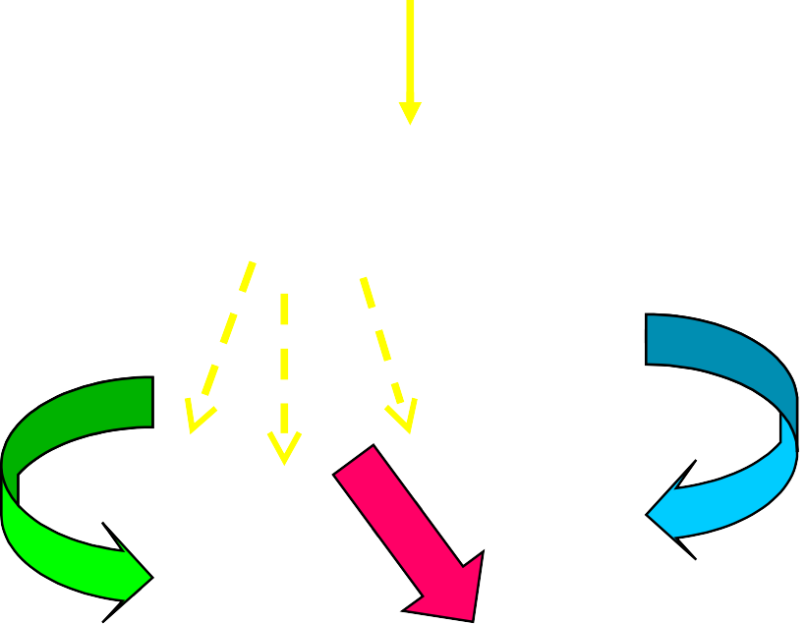
Metabolism
Major organ of metabolism - LIVER
DRUG
Enzyme Pathways
Inactive Metabolites
Metabolites
Unchanged drug
Active Metabolites

Slide 25
Metabolism
Liver is the primary site for metabolism.
Most of the drugs are inactivated by metabolism.
Some drugs may be activated from the inactive compounds (Prodrugs) and others may give rise to active metabolites from the active compound.
Metabolism may occur with help of microsomal or non-microsomal enzymes.
Microsomal enzymes (monooxygenase, cytochrome P450 and glucoronyl transferase) may be induced or inhibited by other drugs whereas non-microsomal enzymes are not subjected to these interactions.

Slide 26
Metabolism
Drugs and toxins are seen as foreign to patients bodies
Body works to convert drugs to less active forms and increase water solubility to enhance elimination

Slide 27
Characteristics of an ideal metabolite:
Water soluble
Pharmacologically inactive
Not to be toxic
Sites of drug metabolism:
Liver (major site)
Intestine
Lungs; brain; kidney; plasma, adrenals...etc

Slide 28
Phases of Drug Metabolism
Phase I (non-synthetic) – in this reaction functional group get attached with drug molecule.
After phase I reaction, drug may become water soluble or lipid soluble.
Phase II (synthetic) – in this reaction a conjugate is attached to drug and make it water soluble.

Slide 29
Phase I reactions
Cytochrome P450 system
Located within the endoplasmic reticulum of hepatocytes
Through electron transport chain, a drug bound to the CYP450 system undergoes oxidation or reduction
Enzyme induction
Drug interactions

Slide 30
Phase I reactions types
Hydrolysis
Oxidation
Reduction
Demethylation
Methylation
Alcohol dehydrogenase metabolism

Slide 31
Phase II reactions
involve the addition of highly polar molecules to a functional group
Polar group is conjugated to the drug
Results in increased polarity of the drug
Types of reactions
  Glycine conjugation
  Glucuronide conjugation
  Sulfate conjugation

Slide 32
Metabolic Reactions
Phase I (non-synthetic) | Phase II (synthetic)
Functional group get attached with drug molecule | Conjugate is attached to drug .
Drug may become water soluble or lipid soluble. | Make it water soluble
Include oxidation, reduction, hydrolysis, cyclization, and decyclization etc. | Include glucuronidation, acetylation, methylation, sulfation,and glycine conjugation etc.

Slide 33
CLINICAL RELEVANCE OF DRUG
METABOLISM
The dose and frequency of administration required to achieve effective therapeutic blood and tissue levels vary in different patients because of individual differences in drug distribution and rates of drug metabolism and elimination.
• These differences are determined by genetic factors and nongenetic variables, such as age, sex, liver size, liver function, circadian rhythm, body temperature, and nutritional and environmental factors such as concomitant exposure to inducers or inhibitors of drug metabolism

Slide 34
Diseases Affecting Drug Metabolism
• Acute or chronic diseases that affect liver architecture or function markedly affect hepatic metabolism of some drugs.
• alcoholic hepatitis, active or inactive alcoholic cirrhosis, hemochromatosis, chronic active hepatitis, biliary cirrhosis, and acute viral or drug induced hepatitis.
• these conditions may significantly impair hepatic drug-metabolizing enzymes, particularly microsomal oxidases, and thereby markedly affect drug elimination

Slide 35
Factors affecting drug metabolism: i.e. compete for enzyme pathways in the liver)
Genetic factors and species differences (major factor) (slow and rapid metabolizers)
Sex
Drug-drug interactions
Age
General health of patients and nutritional status
Dose and frequency of administration

Slide 36
# Other drugs e.g. Cimetidine / Ciproxen
# Smoking
#Enzyme induction/inhibition(CYP450/others) # Some foods
#Liver disease

Slide 37
Diet & Environmental Factors
Diet and environmental factors contribute to individual variations in drug metabolism. Charcoal-broiled foods and cruciferous vegetables are known to induce CYP1A enzymes, whereas grapefruit juice is known to inhibit the CYP3A metabolism of coadministered drug substrates

Slide 38
Age & Sex
Increased susceptibility to the pharmacologic or toxic activity of drugs has been reported in very young and very old patients compared with young adults
Clinical reports suggest that similar sex-dependent differences in drug metabolism also exist in humans for ethanol, propranolol, some benzodiazepines, estrogens, and salicylates.

Slide 39
Enzyme inhibitors
Vitamin | Valproate
K | Ketoconazole
Cannot | Cimetidine
Cause | Ciprofloxacin
Enzyme | Erythromycin
Inhibition | INH

Slide 40
Enzyme inducers
Increases the metabolism of other drugs and reduce their effect.
G | Griseofulvin
P | Phenytoin
R | Rifampicin
S | Smoking
Cell | Carbamazepine
Phone | Phenobarbitone

Slide 41
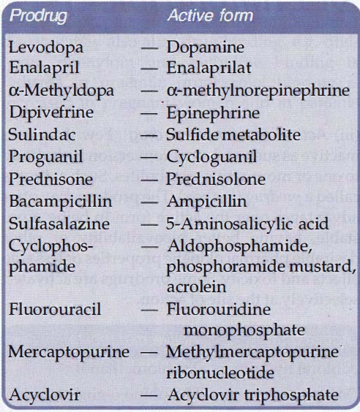
Prodrug
Few drugs are inactive as such and need conversion in the body to one or more active metabolites. Such a drug are called a prodrug .
The prodrug may offer advantages over the active form in being more stable, having better bioavailability or other desirable pharmacokinetic properties or less side effects and toxicity.
Some prodrugs are activated selectively at the site of action.

Slide 42
Drug excretion
A process by which a drug or it’s metabolites are eliminated from the body
Major sites:
Kidney (most drugs)
Liver
gut
Skin, saliva, breast milk
Kidney function (old people)!!!!!

Slide 43
Elimination
=
Metabolism
+
Excretion

Slide 44
Excretion
Kidney is the major route of excretion.
Excretion through kidneys occurs by glomerular filtration, tubular reabsorption and tubular secretion.
Glomerular filtration depend on the plasma protein binding and renal blood flow.
It does not depend on the lipid solubility because all substances (wether water soluble or lipid soluble) can cross fenestrated glomerular membrane.
Tubular reabsorption depends on lipid solubility.
If a drug is lipid soluble, more of it will be reabsorbed and less will be excreted. Opposite is true for lipid insoluble drugs.

Slide 45
Excretion
As lipid solubility depends on ionization, the ionized drug will be excreted by the kidney.
Thus, in acidic drug poisoning (salicylate, barbiturates etc.) urine should be alkalinized with sodium bicarbonate because weak acids are in ionized from in alkaline urine and thus are easily excreted.
Similarly for basic drug poisoning (e.g. morphine, amphetamine etc.), urine should be acidified using ammonium-chloride.

Slide 46
Excretion
Tubular secretion
Does not depend on lipid solubility or plasma protein binding.
In the nephron, separate pumps are present for acidic and basic drugs.
Drugs utilizing the same transporter may show drug interactions e.g. Probenecid decreases the excretion of penicillin and increases the excretion of uric acid.
Remember, exogenous substances e.g. Penicillins are removed whereas endogenous substances like uric acid are retained by these pumps.

Slide 47
## N.B. Patients with renal disease or dysfunction (elderly/heart disease) may require lower doses as the drug will be retained for longer than in ‘normal’ patients

Slide 48
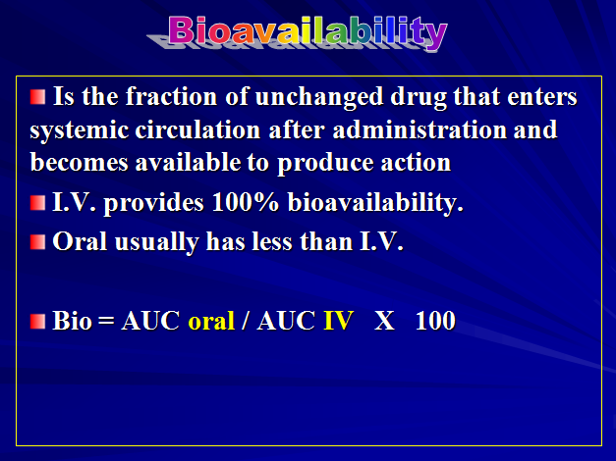

Slide 49
The fraction of an administered dose of drug that reaches the blood stream.
What determines bioavailability?
  Physical properties of the drug (hydrophobicity, pKa, solubility)
  The drug formulation (immediate release, delayed release, etc.)
  If the drug is administered in a fed or fasted state
  Gastric emptying rate
  Interactions with other drugs
  Age
  Diet
  Gender
  Disease state

Slide 50
Factors Affecting Bioavailability
  Molecular weight of drug.
  Drug Formulation (ease of dissolution).
  (solution > suspension > capsule > tablet)
  Solubility of the drug
  Chemical instability in gastric pH
  (Penicillin & insulin )
  First pass metabolism reduces bioavailability

Slide 51
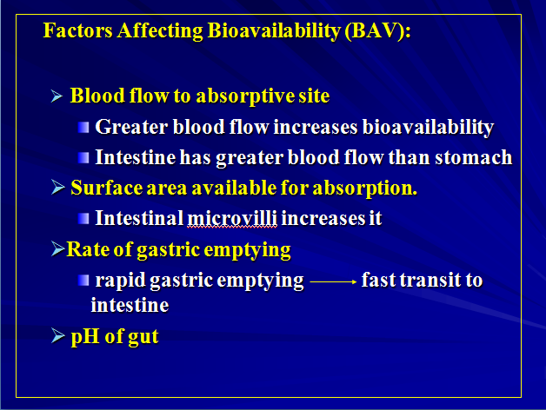

Slide 52
Factors Affecting Bioavailability (BAV)
  Intestinal motility (Transit Time)
    Diarrhea reduce absorption
  Drug interactions
  Food
    slow gastric emptying
    generally slow absorption
    Tetracycline, aspirin, penicillin V

Slide 53
Kinetics Of Elimination
Rate of elimination is the amount of drug eliminated (in units of weight like grams) per unit time.
If it is seen as a function of plasma concentration, we derive an important parameter known as clearance (CL).
Thus clearance is the rate of elimination of a drug divided by its plasma concentration.

Slide 54
Clearance
the factor that predicts the rate of elimination in relation to the drug concentration
Elimination of drug from the body may involve processes occurring in the kidney, the lung, the liver, and other organs
The two major sites of drug elimination are the kidneys and the liver.
Clearance of unchanged drug in the urine represents renal clearance. Within the liver, drug elimination occurs via biotransformation of parent drug to one or more metabolites, or excretion of unchanged drug into the bile, or both

Slide 55
Clearance
the rate of drug elimination is directly proportional to concentration –first order elimination
Capacity-Limited Elimination-dosing rate exceeds elimination capacity, steady state cannot be achieved: The concentration will keep on rising as long as dosing continues
Also known as saturable, dose- or concentration-dependent, nonlinear, and Michaelis-Menten elimination.
Zero order elimination. For drugs that exhibit capacity-limited elimination (eg, phenytoin, ethanol), clearance will vary depending on the concentration of drug that is achieved

Slide 56
First order kinetics
A constant fraction of drug is eliminated per unit of time.
When drug concentration is high, rate of disappearance
is high.

Slide 57
Zero order kinetics
Rate of elimination is constant.
Rate of elimination is independent of drug concentration.
Constant amount eliminated per unit of time.
Example: Alcohol

Slide 58
First Order kinetics (Linear kinetics) | Zero Order kinetics (Non linear kinetics)
Constant fraction of drug is eliminated per unit time. Rate of elimination is proportional to plasma concentration. Clearance remains constant. Half life remain constant. Most of the drugs follow first order kinetics. | Constant amount of the drug is eliminated per unit time. Rate of elimination is independent of plasma concentration. Clearance is more at low concentrations and less at high conc. Half life is less at low conc. and more at high conc. Very few drugs follow pure zero order kinetics e.g. alcohol. Any drug at high conc. (when metabolic or elimination pathway is saturated) May show zero order kinetics.

Slide 59
First Order Elimination
  [drug] decreases exponentially w/ time
  Rate of elimination is proportional to [drug]
  t _{1/2} is constant regardless of [drug]
Zero Order Elimination
  [drug] decreases linearly with time
  Rate of elimination is constant
  No true t _{1/2}

Slide 60
clearance
A drug with a small volume of distribution is cleared fast
The half life will be long if the drug is widely distributed in the body ( large vd) and is excreted slowly by the kidneys and liver ( slow clearance)

Slide 61
Half-life
Refers to the time required for the body to eliminate 50% of the drug.
– It is important in planning the frequency of dosing.
Short half-life (2-4 hours) : needs to be given frequently
Long half life: (21-24 hours): requires less frequent dosing
Note: It takes 5 to 6 half lives to eliminate approximately 98% of a drug from the body
61

Slide 62
Half-Life
Half-life (t1/2) is the time required to change the amount of drug in the body by one-half during elimination (or during a constant infusion).
It is also the time taken for the concentration of the drug in the blood stream to fall to half of its original value, very important in the design of the infusion systems.
Half-life is useful because it indicates the time required to attain 50% of steady state—or to decay 50% from steady-state conditions—after a change in the rate of drug administration.

Slide 63
Half-life
Liver and kidney disease patients may have problems of excreting a drug.
Difficulty in excreting a drug increases the half-life and increases the risk of toxicity.
Implication: may require frequent diagnostic tests and measuring renal and hepatic function.
63

Slide 64
Half Life = ½
# Time in which a measure (concentration effects) declines by one half
# Measured in 3 ways : -
Plasma half life
Biological effect half life
Biological half life

Slide 65
Plasma – Half Life
# The Plasma half-life (t_{1/2}) of a drug is the time taken for its plasma concentration to be reduced to half of its original value.
Time in which the plasma concentration falls by one half
Influenced by various factor – tissue diffusion, protein binding , renal excretion

Slide 66
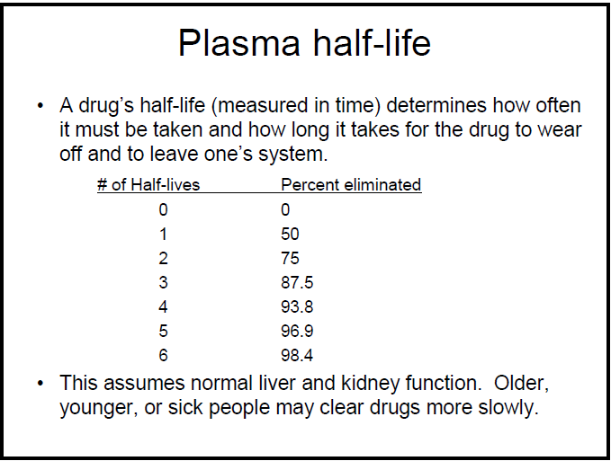

Slide 67
Biological effect half life
# Time in which a the pharmacological effect of the drug, and of any of the active metabolites, has declined by one half
# Eg. For antibiotics, varies with each infection

Slide 68
Biological half life
# Time in which a the total amount of drug in the body after equilibrium of plasma with other compartments (fat, muscle) is halved
# Measured using radioisotopes, rates of excretion

Slide 69
Steady-state Concentration
is the time during which the concentration of the drug in the body stays consistent.
For most drugs, the time to reach steady state is four to five half-lives if the drug is given at regular intervals—no matter the number of doses, the dose size, or the dosing interval.

Slide 70
The time to reach steady state is defined by the elimination half-life of the drug. After 1 half-life, you will have reached 50% of steady state. After 2 half-lives, you will have reached 75% of steady state, and after 3 half-lives you will have reached 87.5% of steady state.

Slide 71
Drugs with short half-life reach steady state rapidly; drugs with long half-life take days to weeks to reach steady state
Important for choosing the right dose and dosing interval to achieve a desired.
Determining how long it will take for therapeutic exposures to be achieved during repeat or continuous dosing, since it might take several doses for a drug to achieve

Slide 72
REMEMBER
No drug produces a single effect!!!

