Slide 1
lear
Orthopedic trauma department
Machakos campus
c.o.t.m
Year One Semester Two
Casting and splinting techniques
single sugar tong and double sugar tong
By
Mercy Iburu

Slide 2
Learning out come
By the end of this topic, learners should be able to demonstrate an understanding of single sugar tong and double sugar tong splinting

Slide 3
learning objectives
Students should be able to
Outline indications and contraindications single sugar tong and double sugar tong
Describe equipments and steps procedure of applying single and double sugar tong splints
outline complications of sugar tongs and splint care

Slide 4
defination
The sugar tongs are small serving utensils used at the table to transfer sugar pieces from the sugar bowl to the tea cups.

Slide 5
Defination
A sugar tong arm splint is a device applied to immobilize the wrist and arm to prevent supination and pronation of the wrist and forearm.
Indications
Distal radius fracture
Distal ulna fracture

Slide 6
Requirements
Stockinet
Orthopedic padding
Plaster or fiberglass splinting material
Strong scissors and/or shears
Elastic bandage
Lukewarm water and bucket or other container
Nonsterile gloves

Slide 7
Positioning the patient
The patient should be positioned so that the operator has appropriate access to the patient's affected hand.
Wrist should be splinted in neutral
to slightly extended position of 10 to 20° degrees
Splint the elbow at 90° flexion.

Slide 8
Steps of the procedure
Wear nonsterile gloves.
Apply stockinet, covering the area from
distal to the MCP joints to the mid-humerus.
Make a hole in the stockinet to allow
protrusion of the thumb.
Wrap the padding from the MCP joint to the mid-humerus;

Slide 9
Steps procedure
overlap each turn by half the width of the padding and periodically tear the wrapping across its width to decrease the risk of tissue compression.
Smooth the padding as necessary. Tear away any areas of excess padding to prevent areas of increased pressure on the skin.
Lay out a length of splint material matching the distance from just proximal to the MCP joints extending around the elbow joints.

Slide 10
Step-by-Step Description of Procedure
Unroll additional splint material, folding it back and forth along the first length until there are 8 to 10 layers (when using single-layer rolls).
Alternatively, if using ready-made splint material, cut a single piece to the above length.
Immerse the splinting material in lukewarm water.
Squeeze excess water from the splinting material (do not wring out plaster).

Slide 11
procedure
Apply the splint material from the volar surface of the MCP joints along the volar surface
of the forearm around the elbow
dorsal surface of the forearm back to the dorsal surface of the MCP joints
In fold the extra stockinette and cotton padding over the edges of the splinting material.
Wrap the elastic wrap over the splinting material
distally to proximally and overlap each revolution by half the width of the elastic wrap.

Slide 12
procedure
Smooth out the splinting material using your palms
Maintain the wrist in neutral position, which is extension at about 10 to 20°
elbow at 90° flexion until the splinting material hardens.
Check distal neurovascular status (eg, capillary refill, distal sensation, finger flexion and extension).

Slide 13
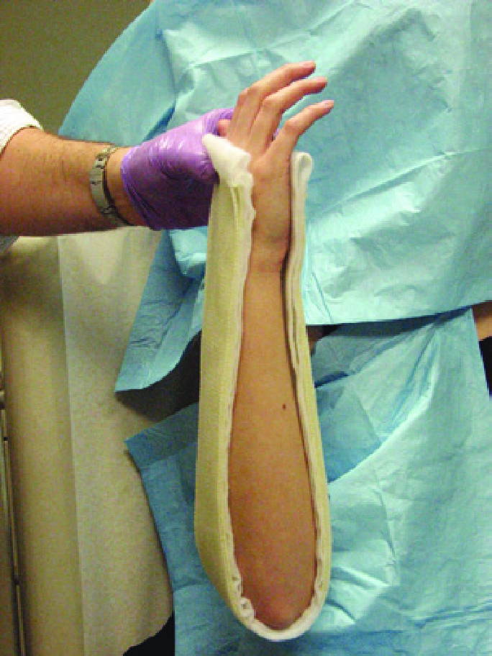
Single sugartong

Slide 14
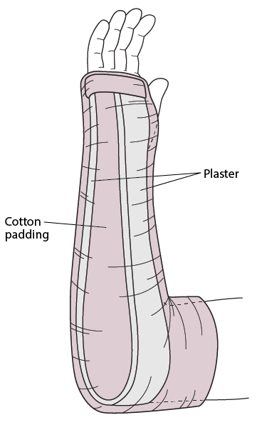
Single sugartong

Slide 15
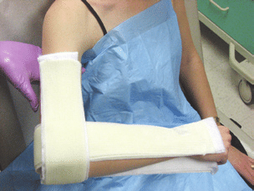
Double sugar tong
fractures to the radius,
ulnar
olecranon process

Slide 16
Double sugar tong
A double sugar-tong splint consists of two U-shaped splints.
Elbow bent at a 90 degree angle,
one of these U-shaped splints fits under the elbow and extends up both sides of the forearm until it reaches the base of the fingers.
The other U-shaped splint is then placed on the upper arm, going under the elbow and extending up the arm until it reaches the bottom of the deltoid (shoulder) muscle

Slide 17
Splinting care
Advise the patient to keep the splint dry.
Arrange or recommend appropriate follow-up.
Instruct the patient to watch for complications
such as worsening pain,numbness, and excessive swelling
Instruct the patient to seek further care if pain cannot be controlled
Not to hang down the limb always use arm sling

Slide 18
Complication of sugar tone splint
Thermal injury (caused by the exothermic reaction between plaster or fiberglass and water)
Pressure sores,
Neurapraxia,
Ischemic injury (caused by excessive pressure)
Compartment syndrome (sometimes caused, in part, by excessive tightness of circumferential wrapping)
Notes:
is a form of traumatic peripheral nerve injury,results from blockage of nerve conduction,ischemic injury occurs when the blood supply to an area of tissues is cut off.

Slide 19
references
Denes, A. E., Goding, R., Tamborlane, J., & Schwartz, E. (2007). Maintenance of reduction of pediatric distal radius fractures with a sugar-tong splint. AMERICAN JOURNAL OF ORTHOPEDICS-BELLE MEAD-, 36(2), 68.
Dittmer, A. J., Molina IV, D., Jacobs, C. A., Walker, J., & Muchow, R. D. (2019). Pediatric forearm fractures are effectively immobilized with a sugar-tong splint following closed reduction. Journal of Pediatric Orthopaedics, 39(4), e245-e247.

Slide 20


