Slide 1
Orthopedic trauma department
Machakos campus
c.o.t.m
Year One Semester Two
Casting and splinting techniques
Thumb Spica and extension block splint
By
Mercy Iburu

Slide 2
learning objectives
Students should be able to
Outline indications and contraindications thumb Spica
Describe indication and contraindication of extension block
outline requirements and procedure of application of thumbspica and extension block

Slide 3
Indication of thumb Spica
Thumb metacarpal fracture
Scaphoid fracture
Lunate fracture
Thumb ulnar collateral ligament injuries
De Quervain's tenosynovitis
Notes:
Painful condition affects the tendons on the thumb side of the wrist

Slide 4
complication
Thermal injury (caused by the exothermic reaction between plaster or fiberglass and water)
Compartment syndrome (sometimes caused, in part, by excessive tightness of circumferential wrapping)

Slide 5
Requirements
Stockinette (one piece to cover the area from MCP joints to mid-forearm and a second piece to cover the thumb from the tip to the base of the metacarpal)
Roll padding (eg, cotton roll) 5-cm (2-inch) width
Plaster or fiberglass splinting material 7.5-cm (3-inch) width—enough to cover from the DIP joint of the thumb to the mid-forearm
Strong scissors and/or shears
Elastic bandage 5 cm (2-inch) width
Lukewarm water and bucket or other container
Nonsterile gloves

Slide 6
Positioning the patient
The patient should be positioned so that the operator has appropriate access to the patient's affected hand.
Maintain the thumb in a slightly flexed and abducted position as if holding a narrow cup or the stem of a wine glass.
Extend the wrist at 10 to 20°.
Unless there is additional injury, the splint should allow unrestricted motion of the 2nd through 4th MCP joints.

Slide 7
How to apply thumb spica
Wear nonsterile gloves.
Apply stockinette to cover the thumb.
Cut a hole in the second stockinette to allow for protrusion of the thumb.
Apply second stockinette to cover the area from the MCP joints to the mid-forearm.
Wrap the padding from the MCP joint to the mid-forearm slightly beyond the area to be covered by the splint material; overlap each turn by half the width of the padding and periodically tear the wrapping across its width to decrease the risk of tissue compression

Slide 8
Wrap the padding around the thumb.
Smooth the padding as necessary. Ensure there are no folds in the padding. Tear away any excess padding to prevent areas of localized pressure on the skin.
Lay out a length of splint material matching the distance from just past the DIP joint of the thumb to the mid-forearm.

Slide 9
Wrap the padding around the thumb.
Smooth the padding as necessary. Ensure there are no folds in the padding. Tear away any excess padding to prevent areas of localized pressure on the skin.
Lay out a length of splint material matching the distance from just past the DIP joint of the thumb to the mid-forearm.

Slide 10
Unroll additional splint material, folding it back and forth along the first length until there are 6 to 8 layers (when using single-layer rolls).
Alternatively, if using ready-made splint material, cut a single piece to the above length.
Immerse the splinting material in lukewarm water.
Squeeze excess water from the splinting material (do not wring out plaster).
Apply the splint material around the thumb and radial side of the forearm.
Fold the extra stockinette and cotton padding to cover all edges of the splinting material

Slide 11
Wrap the elastic wrap over the splinting material distally to proximally and overlap each revolution by half the width of the elastic wrap.
Smooth out the splinting material using your palms rather than your fingertips to conform to the contour of the arm to fill in the interstices in the material.
Maintain the thumb in a slightly flexed and abducted position and the hand and wrist in a position as if holding a narrow cup or the stem of a wine glass until the splinting material hardens (see figure Thumb spica splint).
Check the distal neurovascular status (eg, capillary refill, distal sensation, finger flexion and extension

Slide 12
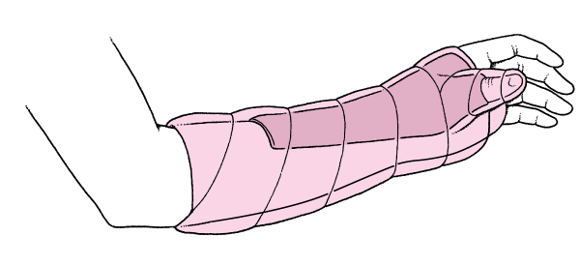

Slide 13
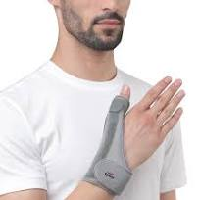
Customized thumb spica

Slide 14
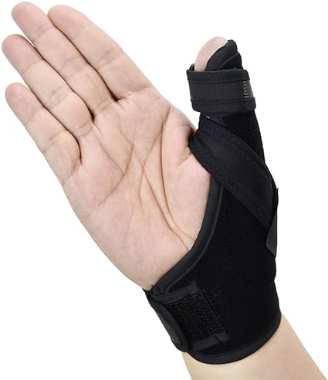

Slide 15
Extension block/burke halter
Definition. Extension block is splinting of the proximal interphalangeal (PIP) joint
splint blocks a specific arc of terminal PIP joint extension while allowing unrestricted flexion.

Slide 16
Extension block/burke halter indication
Fracture proximal phalanx, middle phalanx
Treatment PIP joint fractures and dislocations
Pip subluxation
Tear of the volar plate ligament
post-operative rehabilitation, such as protection of the PIP joint volar plate
Notes:
PIP fracture-subluxations occur when fractures of the middle phalangeal base compromise the buttressing effect of its volar lip resulting in dorsal instability and subluxation of the remaining uninjured middle phalangeal base joint surface relative to the proximal phalangeal head. This injury pattern is a relatively common indication for an extension block splint when the uninjured portion of the joint reduces in PIP joint flexion. PIP joint. fracture-subluxations that do not reduce in flexion or require extreme flexion would be contraindicated for the use of this splinting technique alone and may likely require operative intervention.

Slide 17
REQUIREMENTS
Orthopedic padding(under casting)
Surgical tape (buddy splinting)
Crepe bandage
Pop rolls
Water between 22-25c
mp joint90

Slide 18
Objective
Correction of rotational deformities
Initial displacement and reduction
Application of the extension block splint

Slide 19
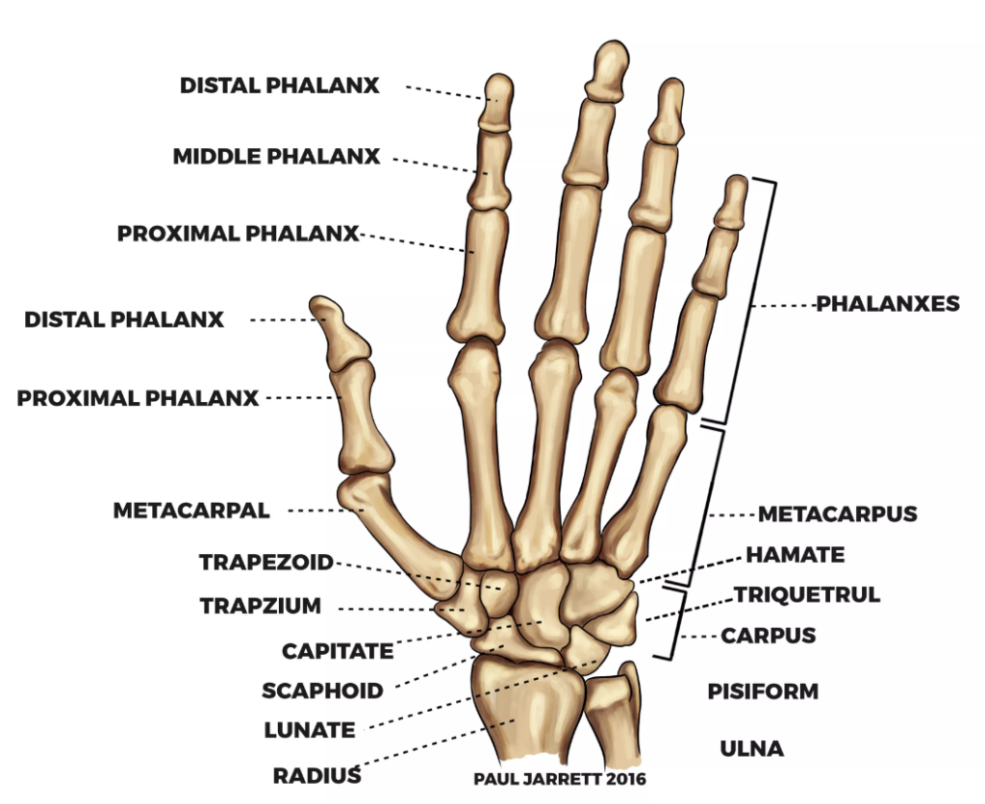
Anatomy of the hand

Slide 20
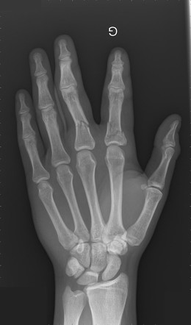
Fractures of the proximal phalanx

