Slide 1
Principles of fracture MANAGEMENT
Introduction to traumatology

Slide 2
Learning objectives
Outline the steps in the initial management of a patient with fracture.
Outline the priorities of management of a patient with multiple injuries
Discuss the three fundamental principles of fracture treatment
Reduction
Immobilization
Rehabilitation

Slide 3
Initial management
First Aid and Clinical Assessment

Slide 4
First Aid
At accident site:
Clear the airway
Control any external bleeding
Cover wounds with clean dressing
Immobilize fractured limbs
Make patient comfortable

Slide 5
First Aid
Moving the patient:
If fracture of long bone, apply traction while the limb is being moved
If spinal column fracture/dislocation is supected, avoid flexion of the spine.
In some cases also avoid extension
Patient should be lifted bodily (straight) on to firm surface
Protect the neck with a cervical collar

Slide 6
First Aid
Temporary immobilization of limbs:
Bandage the two lower limbs together (sound limb acts as a splint)
Bandage arm to chest
Apply a sling for forearm

Slide 7
First Aid
Control haemorrhage:
Apply firm bandage over a pad
Application of tourniquet (if profuse pulsatile bleeding despite pressure)
Time of application must be indicated
Apply firm manual pressure over the main artery at the root of the limb

Slide 8
Clinical assessment
Follow the priorities of management of a multiple injury patient.
Primary survey – ABC
Secondary survey
Re-examine ABC
Investigate as per injury
Physical examination of all systems
Drug treatment (analgesics, antibiotics, tetanus toxoid)

Slide 9
Clinical assessment
Examination of the limb should determine:
Whether there is a wound communicating with the fracture
Evidence of vascular injury
Evidence of nerve injury
Evidence of visceral injury

Slide 10
Resuscitation
Is done during primary survey
Airway
Breathing
Circulation
Many of the severe trauma patients (multiple fractures with visceral injury) have problem with circulation. They are usually in shock.

Slide 11
Resuscitation…
Correction of shock:
Immediate replenishment of circulating blood volume
Electrolytes to establish intravenous infusion
Normal saline
Ringer’s lactate
Plasma expanders (colloids) to replace the lost volume
Dextran – a high molecular weight polysaccharide
Hemacel – a gelatin solution
Transfusion only for severe haemorrhage > 1 liter

Slide 12
Initial management
Priorities of management of a patient with multiple injuries

Slide 13
Advanced trauma life support (ATLS)
Steps in the ATLS philosophy:
Primary survey with simultaneous resuscitation – identify and treat what is killing the patient.
Secondary survey – proceed to identify all other injuries.
Definitive care – develop a definitive management plan.

Slide 14
Priorities … primary survey
On arrival:
Take a brief history
Do Primary survey – ABC
Airway:
The airway must be evaluated first
Check verbal response. If present, the airway is not immediately at risk.
Ensure the airway is clear. Clear the mouth and airway with a large-bore sucker. Inspect for any FBs.
Stabilize the neck to protect the cervical spine.

Slide 15
Primary survey…
Breathing:
Make sure the patient is ventilating and if not, assist (Ambu bag, oxygen)
Give 100% oxygen at high flow
Check for tension pneumothorax
Decompress at once if tension pneumothorax is suspected (needle in the second intercostal space mid-clavicular line)

Slide 16
Priorities… primary survey
Circulation:
Assess consciousness level – compromised cerebral perfusion; Assess skin colour for pallor; Asses the pulse; BP
Secure an intravenous line
Give I.V. fluids to restore blood volume
Stop obvious bleeding
Blood for GXM, Hb, haematocrit, blood gases

Slide 17
Priorities… Secondary survey
Secondary survey involves:
Re-examine ABC
Investigate as per suspected injuries
Skull x-ray
Chest x-ray
Spinal x-ray
Pelvic x-ray
Perform a physical examination of body systems even if you think they are not injured

Slide 18
Priorities… secondary survey
Give analgesics
Administer tetanus toxoid in case of open wounds
Give antibiotics in case of open wounds
Splint the fractures
Admit or refer the patient

Slide 19
Definitive care
There should be as little delay as possible in reaching this stage
A definitive management of the injuries identified is carefully planned and carried out.

Slide 20
TREATMENT OF UNCOMPLICATED FRACTURES
Principles of fracture treatment

Slide 21
Fundamental principles of fracture treatment
Are three:
Reduction
Immobilization
Rehabilitation – preservation of function

Slide 22
Reduction
Reduction is done if necessary
In some cases there is no displacement, or displacement may be immaterial to the final result
Imperfect apposition of the fragments can be accepted, e.g. a loss of contact of half the diameter in fracture femur

Slide 23
Reduction…
Imperfect alignment may not be accepted, e.g. angulation (angular deformity of more than 20 degrees in fracture femur)
Fractures involving joint surfaces must be reduced as accurately as possible.
The articular fragments must always be restored as nearly as possible to normal to lessen the risk of osteoarthritis.

Slide 24
Methods of reduction
Three methods:
Closed manipulation
Manipulative reduction usually under anaesthesia or sedation and strong analgesia.
Mechanical traction (with or without manipulation)
To overcome contraction of large muscles that exert a strong displacing force.
Operative reduction (open reduction)

Slide 25
Immobilization
If necessary
Indications for immobilization:
To prevent displacement or angulation of the fragments – in order to maintain correct alignment
To prevent movement that might interfere with union
To relieve pain

Slide 26
Immobilization
Prevention of displacement or angulation:
Immobilize to prevent displacement or angulation of the fragments – in order to maintain correct alignment

Slide 27
Immobilization
Prevention of movement:
Movement is undesirable when it might shear the delicate capillaries bridging the fracture, e.g. rotation movements.
Fractures that constantly demand immobilization to ensure their union are:
Fracture of the neck of femur
Fracture of the scaphoid bone
Fracture of the shaft of ulna

Slide 28
Immobilization
Fractures that heal well without immobilization include:
Fracture of the ribs
Fracture of the clavicle
Fractures of the scapula
Stable fractures of the pelvic ring
Immobilization may be unnecessary for certain fractures of the humerus, femur, metacarpals, metatarsals and phalanges.
Injured fingers poorly tolerate prolonged immobilization. Leads to stiffness.

Slide 29
Immobilization
Relief of pain:
Relief of pain is an important reason for immobilization
The limb is made comfortable
It is possible to use the limb without causing movement at the fracture site, therefore causing no pain.

Slide 30
Methods of immobilization
Four methods:
Plaster of Paris cast (P.O.P), Dyna cast or other external splint, e.g. cervical collar, malleable strips of aluminium.
Continuous traction
External fixation
Internal fixation

Slide 31
Immobilization by plaster
Assignment:
Write down the requirements and procedure of application of plaster of Paris.
Describe the use of:
Plaster-cutting shears
Powered oscillating plaster saw
Plaster spreader
What complications may follow application of P.O.P, and how do you prevent/manage them?

Slide 32
Padding a limb before application of POP
See the apparatus that acts as an assistant in applying traction and support.

Slide 33
Immobilization by sustained traction
Used mainly for fractures that are difficult or impossible to hold in proper position by plaster or external splint alone. E.g. fractures of shaft of femur.
The fragments are difficult to hold in position particularly when the fracture is oblique or spiral because the elastic pull of muscles tends to draw the distal fragment proximally so that it overlaps the proximal fragment.

Slide 34
Tractions…
The pull of muscles must be balanced by sustained traction upon the distal fragment , by a weight or other mechanical device.
Angular deformity is prevented by use of a splint e.g. Thomas’s splint for femur and Braun’s splint/frame for tibia.

Slide 35
Tractions

Slide 36
Skeletal traction
Traction is applied to pins passed through the bone.
They allow substantial loads to be applied accurately to the bone itself.
Common sites for application:
Upper end of the tibia (tibial tuberosity)
Distal femur
Calcaneum
Olecranon
The skull
Pelvis
Greater trochanter

Slide 37
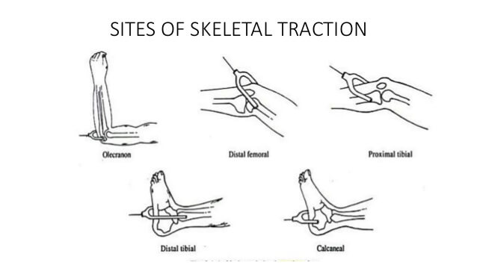
Sites of skeletal traction

Slide 38
Skeletal traction
Types of pin
Two types of pin are in common use:
Steinmann pin
Has a trocar and smooth sides
Easy to insert, but it can slip sideways after being in position for some time
Threaded pins, e.g. Denham pin
Have threads which grip the bone and prevent lateral slippage
Are harder to insert

Slide 39
Denham pin

Slide 40
Steinmann pin with stirrup

Slide 41
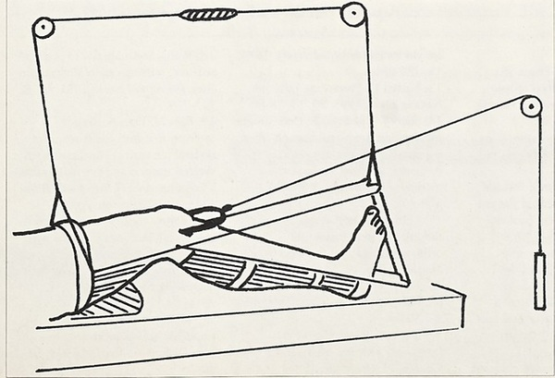
Balanced skeletal traction

Slide 42
Skin traction
Is applied by means of adhesive strapping stuck directly onto the skin.
They pull the bone indirectly through the overlying skin and muscles (soft tissues)
The soft tissues can be disrupted if too much weight is applied.
The usual upper limit is 5 kg (12 lb)
Skin traction is suitable for children and the elderly, and as a temporary measure in adults until definitive treatment is instituted.

Slide 43
Types of traction
Skeletal or skin traction
Fixed or sliding
Fixed traction with a splint e.g. fixed to a Thomas's splint.
Fixed traction using gravity e.g. gallows traction.
Sliding traction uses a system of pulleys and weights. E.g. Hamilton-Russell traction.

Slide 44
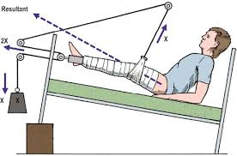
Hamilton-Russel skin traction

Slide 45
Types of traction…
Sliding traction can be balanced or not balanced.
In a balanced traction, one weight applies longitudinal traction and others are applied to the upper and lower ends of the limb so that it ‘floats’ in a gravity-free field.
Most tractions are not of the balanced type.

Slide 46
Complications of traction
Over-distraction
Circulatory embarrassment
Stretched or damaged nerves
Fragments are held apart and do not join
Loss of position
Slipped, angulated or overlapped
Pressure sores
Pin track infection
Allergy to adhesive strapping

Slide 47
Tractions…
Assignment:
Describe the procedure of application of skin traction
State the indications, contraindications, and complications of skin traction
Describe the procedure of application of skeletal traction for fractures of the femur
State the indications, contraindications, and complications of skeletal traction
Name the various traction arrangements ( e.g. Russell's traction) and their indications
Name the various parts of an orthopaedic bed and traction apparatus.

Slide 48
External fixation
Immobilization

Slide 49
Immobilization by external fixation
External fixation implies anchorage of the bone fragments to an external device such as a metal bar through the medium of pins inserted into the proximal and distal fragments of a long bone fracture.
Threaded pins are inserted into the bone from one side.
Two or three pins are inserted into each fragment and the protruding ends of the pins are clamped to the rigid body of the fixator, which lies just clear of the skin surface parallel with the fractured bone.

Slide 50
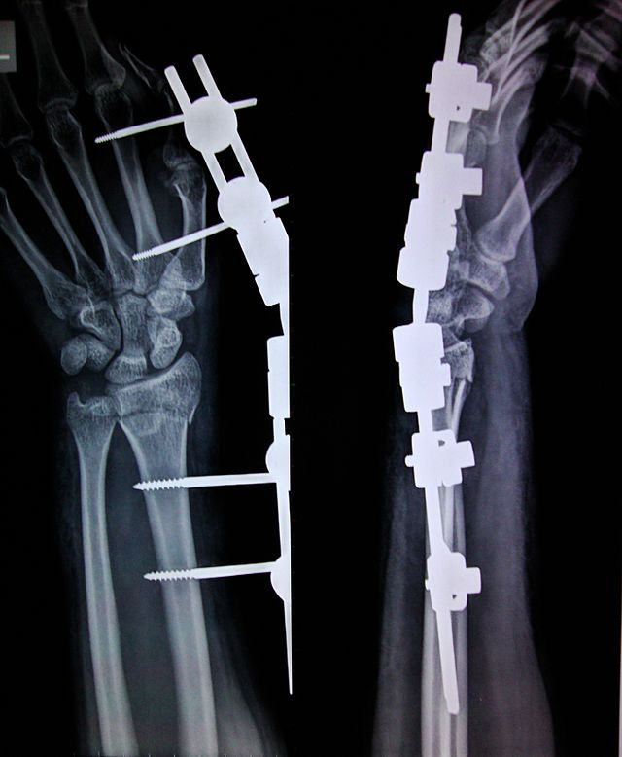
External fixation

Slide 51
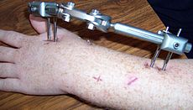
External fixation of radial #

Slide 52
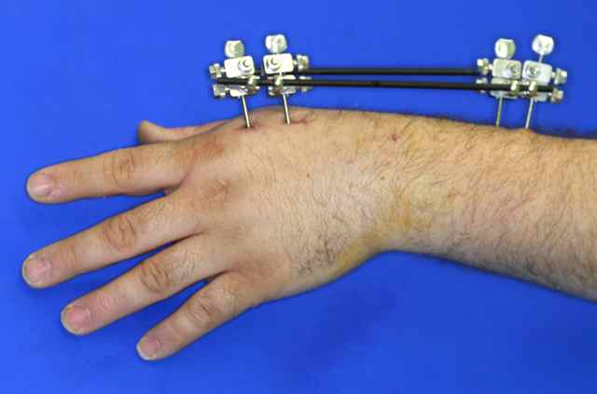
External fixation of distal radius #

Slide 53
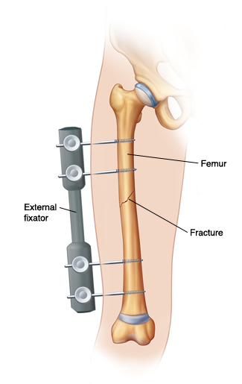
External fixation

Slide 54
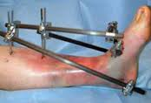
External fixation

Slide 55
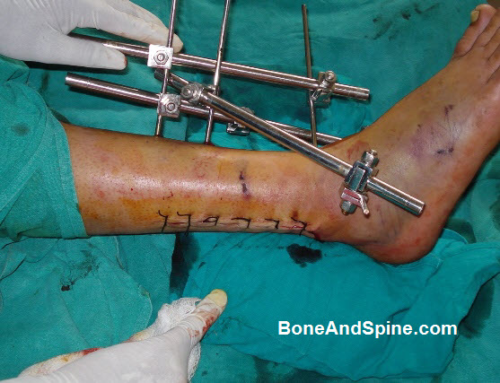
External fixation

Slide 56
External fixation of pelvic fracture

Slide 57
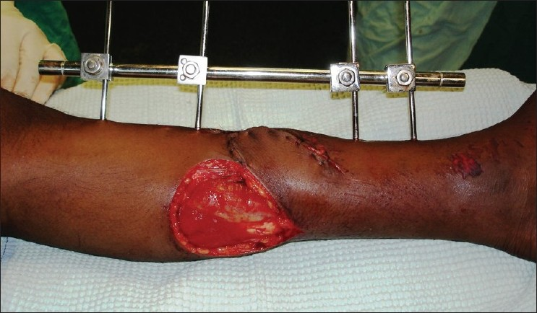
External fixation

Slide 58
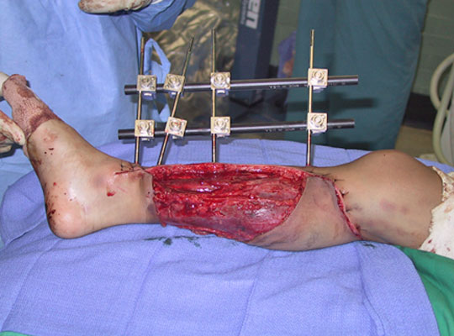
External fixation

Slide 59
External fixators
Indications
Stabilization of severe open fractures
Stabilization of fractures associated with infection or nonunion
Severely comminuted diaphysial and peri-articular fractures
Closed fracture with associated severe soft tissue injuries
Severely comminuted and unstable fractures

Slide 60
External fixators …
Indications: …
Pelvic ring disruptions
Arthrodesis
Fractures that are associated with bony deficits
Limb-lengthening procedures
Osteotomies

Slide 61
Internal fixation
Immobilization

Slide 62
Immobilization by internal fixation
Indications:
To provide early control of limb fractures when conservative methods would interfere with the management of other severe injuries, for instance of the head, thorax or abdomen.
As a method of choice in certain fractures, to secure immobilization of the fracture and to allow early mobility of the patient, e.g. in the elderly patient with trochanteric hip fracture

Slide 63
Internal fixation
Indications:
When it has been necessary to operate upon a fracture to secure adequate reduction
If it is impossible in a closed fracture to maintain an acceptable position by splintage alone.

Slide 64
Indications of internal fixation…
Fractures that cannot be controlled in any other way
Patients with fractures in more than one bone
Fractures in which the blood supply to the limb is jeopardized and the vessels must be protected
Intra-articular, displaced fractures

Slide 65
Methods of internal fixation
Metal plate held by screws or locking plate (with screws fixed to the plate by threaded holes)
Intramedullary nail – plain [e.g. K-nail] or interlocking i.e. with locking screws [e.g. Sign nail]
Dynamic compression screw-plate [dynamic hip screw]
Condylar screw-plate
Tension band wiring
Transfixion screws
Kirschner wire fixation

Slide 66
Dynamic compression plate

Slide 67
Kuntscher nail
See label.

Slide 68
Interlocking nail
See the holes for screws

Slide 69
Metals for internal fixation
Must be resistant to corrosion in the tissues.
A special stainless steel containing chromium, nickel and molybdenum is widely used.
A non-ferrous alloy containing chromium, cobalt and molybdenum has even better resistance to corrosion in the body and is used for all types of internal appliance except wire.
Titanium and its alloys are also resistant to corrosion and are used for the manufacture of prostheses and internal fixation devices.

Slide 70
The place of operative fixation
Operative fixation is accepted as the best routine method of treating fractures of the neck and trochanteric region of the femur in the elderly.
Intramedullary nailing is used for most fractures of the shaft of femur or tibia, and many fractures of the upper limb are also now routinely operated on.

Slide 71
Advantages of internal fixation
Substantial reduction in hospital stay and time away from work
Function of the limb, and particularly of the joints, may be restored earlier
By providing rigid fixation of the fracture, complications such as delayed union and non-union will be reduced.

Slide 72
Rehabilitation
Rehabilitation is always essential
Rehabilitation should begin as soon as the fracture is under definitive treatment
Purpose of rehabilitation:
Preserve function while the fracture is uniting
Restore function to normal when the fracture is united
This purpose is achieved by encouraging the patient to help himself by active use and active exercises
Supervision of a physiotherapist is required.

Slide 73
Assignment
Name and describe the various types of walking aids and other ambulatory aids.
State their uses

Slide 74
THE END
Thank you.

