Slide 1
Properties of Bacteria, Viruses & Fungi

Slide 2
Objectives
Describe the properties/ characteristics of:
Bacteria
Viruses
Fungi
List the common bacterial and viral diseases and their causative microorganisms

Slide 3
Bacteria
Only approx 4% of bacteria are harmful
Bacteria are distinguished by:
Differences in their shape & surface structure
Response to gram stain
Nutritional requirements

Slide 4
Bacterial shapes
There are 3 main shapes:
Cocci- round. Can occur in:
Clumps- called staphylococci
Chains- called streptococci
Pairs- called diplococci
Bacilli- Rods. Bacilli can occur singly or in chains. Some are curved (e.g. Vibrios); some are very short (called coccobacilli)
Spirals- not very common (include spirochetes & spirila)

Slide 5
The bacterial cell wall
The shape of the bacteria is determined by its cell wall, which is made up of a substance called peptidoglycan (a network of amino acids & CHO’s)
A special method of staining cells (called gram stain) is used to distinguish the type of bacteria
The gram stain attaches onto the peptidoglycan layer

Slide 6
The gram –ve & +ve cells
Gram –ve cells have a cell memb’r, a thin layer of peptidoglycan & an outer membrane (made of proteins, phospholipids) & lipopolysaccharrides [gram stained red]
Gram +ve cells have a cell memb’r & a very thick layer of peptidoglycan but no outer memb’r [gram stained blue]

Slide 7
Gram negative cells

Slide 8
Gram positive cells

Slide 9
Naming of Bacteria
Genus and species - Binomial System of Taxonomic Classification
Information usually given:
1. Describes an organism
2. Identifies a habitat
3. Honors a scientist or researcher

Slide 10
Gram positive cocci
Staphylococci
Streptococci
Enterococci

Slide 11
Gram positive bacilli
Clostridium:
C. deficile- severe GE
C. perfringens- Gas gangrene
C. tetani- tetanus
C. botulinum- food poisoning; neurotoxin=paralysis
Corynebacterium diphtheriae
Bacillus anthrasis

Slide 12
Gram negative cocci
Neisseria meningitidis
Neisseria gonorrhoeae

Slide 13
Gram negative bacilli
Escherichia coli
Klebsiella pneumoniae
Proteus species
Salmonella typhi & paratyphi- typhoid
Shigella- bacillary dysentry
Pseudomonas aeruginosa
Mycobacterium tuberculosis & leprae
Bordetella pertussis- whooping cough
Yersinia pestis- plague
Vibrio cholerae
Helicobacter pylori
Hemophilus influenzae

Slide 14
Viruses
.

Slide 15
The viruses
Viruses are simply a piece of genetic material inside a coat of protein
They have no structures for making their own constituents or for metabolism, hence depend entirely on the host cell for their multiplication (“intracellular parasites”)
The living host cell provides the energy, synthetic machinery & materials needed for the synthesis of viral proteins & nucleic acids

Slide 16
The viral structure
A protein coat- called the CAPSID
All viruses have a protein receptor binding site on their surface which reacts with corresponding receptors on the surface of a host cell
Viruses are able to invade only those cells that carry the appropriate receptors on their surface (e.g. the HIV binds to CD4 receptors on the T-helper cell & other immune cells)

Slide 17
Viral structure cont’d….
Inside the capsid is the genetic material of the virus; can either be DNA or RNA; viruses NEVER contain both types of nucleic acid (THIS IS THE MAJOR DIFFERENCE WITH OTHER LIVING CELLS)
Some viruses have an envelope around them (e.g. Herpes virus, Retrovirus, Rabies virus)

Slide 18
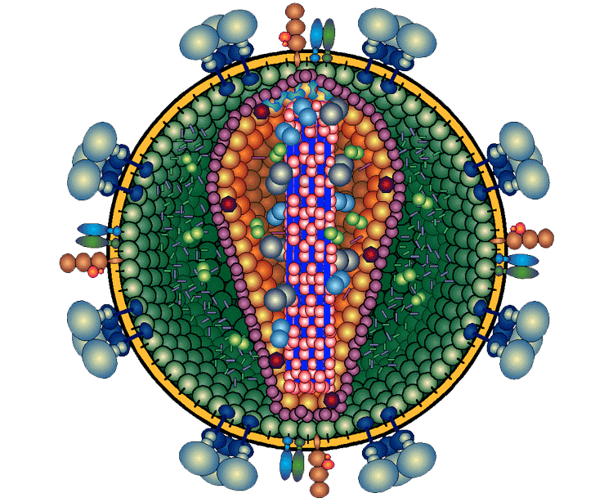
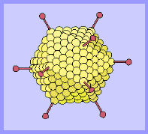
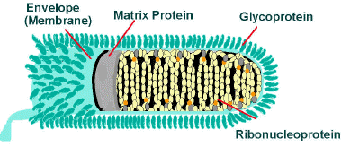
HIV-1 and Other Retroviruses
Adenoviruses
Rhabdoviruses (rabies)

Slide 19
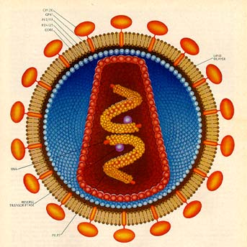
HIV Structure
HIV is composed of three main layers:
Envelope
Viral Matrix
Core
.
2
.

Slide 20
Bacteria
Diseases caused by bacteria include:
anthrax (Bacillus anthracis)
bubonic plague (Yersinia pestis)
cholera (Vibrio cholerae)
diphtheria (Corynebacterium diphtheriae)
gonorrhoea (Neisseria gonorrhoeae)
leprosy (Mycobacteria leprae)
syphilis (Treponema pallidum)
tetanus (Clostridium tetani)
tuberculosis (Mycobacteria tuberculosis)
typhoid (Salmonella typhi)
whooping cough (Bordetella pertussis)

Slide 21
Viruses
Diseases caused by viruses include:
Mumps
Poliomyelitis
Rabies
Smallpox
Rubella (German Measles)
Yellow Fever
AIDS
Chicken Pox
Common Cold
Encephalitis
Herpes
Hepatitis
Influenza
Measles

Slide 22
Fungi
Fungi have cell walls that contain chitin (a polysaccharide similar is structure to cellulose)
Grow by a process called branching/budding
Fungi like other eukaryotes contain membrane-bound nuclei with several DNA.
Fungi have membrane-bound cytoplasmic organelles such as mitochondria and ribosomes.

Slide 24
Human-fungus Interactions
Beneficial Effects of Fungi
Decomposition - nutrient and carbon recycling.
Biosynthetic factories. {Prod’n of drugs, antibiotics, alcohol, acids, food (e.g., fermented products, mushrooms).
Model organisms for biochemical and genetic studies.
Harmful Effects of Fungi
Destruction of food, paper, and cloth.
Animal and human diseases, including allergies.
Plant diseases.

Slide 25
Fungi ……
Saprophytic fungi
Derive food from dead decaying organic matter
Secrete digestive enzymes into dead plant & animal matter which decompose this matter to absorbable nutrients for the fungi & other living organisms (“original recyclers”)
Parasitic fungi
Harmful; derive their nutrients from the host

Slide 26
Fungi …..
Beneficial fungi
Mushrooms
Food production (e.g. cheese, beer, wine)
Medicine prod’n:
The immunosuppressant drug cyclosporine

Slide 27
Examples of Fungi
Microsporidia
Chytridiomycota
Blastocladiomycota
Zoopagomycotina
Glomeromycota
ascomycota

Slide 28
* Diseases caused by fungi
Candidiasis (Candida albicans)
Tinea capitis/ corporis/ pedis
Aspergillosis (resp. d’se)
Blastomycosis (lung/skin d’se - inhalation of spores)
Pneumocystis pneumonia (PCP)
Histoplasmosis (inhaling spores found in droppings of birds & bats- mild resp s/s)

Slide 29
Questions
.

