Slide 1
DISORDERS OF THE LOWER RESPIRATORY TRACT
By
THOMAS JIMBO

Slide 2
Classification of lower reparatory disease
Restrictive airway disease
  Pneumonia (Bronchopneumonia and lobar pneumonia)
  Chest injury
  Pneumothorax
  Carcinoma of the lungs
  Pleurisy

Slide 3
Obstructive airway disease
    Bronchitis
    Chronic obstructive pulmonary disease (chronic bronchitis and emphysema)
    Bronchial asthma
    Status asthmaticus
    bronchiolitis
    Emphysema
    Pneumothorax
    Atelectasis
    Bronchiectasis

Slide 4
OBSTRUCTIVE AIRWAY DISEASES

Slide 5
ACUTE AND CHRONIC BRONCHITIS
Bronchitis is the inflammation of the bronchi. It is an obstructive respiratory disease that may occur in both acute and chronic forms.
Acute bronchitis is commonly a bacterial infection, which responds well to broad-spectrum antibiotics.
Chronic heavy smoking and air pollution contribute to chronic bronchitis.
The inflammation of the bronchi brings about thickening and an increase in mucous secretions, oedema, decrease in ciliated cells and narrowing of the bronchi.

Slide 6
Acute bronchitis
Inflammation of the bronchial passages most commonly caused by infection with bacteria or viruses. It may follow a common cold.
Streptococcus, staphylococcus aureus and H. influenza are commonly associated with acute bronchitis.
Acute bronchitis is generally a self-limiting condition in healthy individuals but can have much more severe consequences in individuals who are weakened with other illness or who are immunocompromised.

Slide 7
Pathophysiology
During an episode of acute bronchitis, the cells of the bronchial-lining tissue are irritated and the mucous membrane becomes hyperemic and edematous, diminishing bronchial mucociliary function.
Consequently, the air passages become clogged by debris and irritation increases.
In response, copious secretion of mucus develops, which causes the characteristic cough of bronchitis.
Acute bronchitis usually lasts approximately 10 days. If the inflammation extends downward to the ends of the bronchial tree, into the small bronchi (bronchioles), and then into the air sacs, bronchopneumonia results.

Slide 8
Symptoms of acute bronchitis
Productive cough,
Dyspnoea
Possible fever.

Slide 9
Chronic bronchitis
Is a chronic obstructive pulmonary disease that is most frequently associated with cigarette smoking.
Chronic bronchitis may also be caused by prolonged exposure to inhaled particulates such as coal dust or other pollutants.’
Pathophysiology
Chronic bronchitis is associated with excessive tracheobronchial mucus production sufficient to cause cough with expectoration for 3 or more months a year for at least 2 consecutive years.
This mucus accumulation can impair function of the ciliated epithelium and lining of the respiratory tract and prevent the clearing of debris and organisms.

Slide 10
The alveolar epithelium is both the target and the initiator of inflammation in chronic bronchitis.
A predominance of neutrophils and the peribronchial distribution of fibrotic changes result from the action of interleukin 8, colony-stimulating factors, and other chemotactic and proinflammatory cytokines.
Airway epithelial cells release these inflammatory mediators in response to toxic, infectious, and inflammatory stimuli, in addition to decreased release of regulatory products such as angiotensin-converting enzyme or neutral endopeptidase.
As a result, patients with chronic bronchitis often suffer repeated bouts of acute respiratory infection.

Slide 11
Manifestations of chronic bronchitis:
• Productive, chronic cough
• Production of purulent sputum
• Frequent acute respiratory infections
• Dyspnea
• Hypoxia, cyanosis
• Symptoms of cor pulmonale
• Fluid accumulation (edema) in later stages

Slide 12
Treatment of chronic bronchitis:
Cessation of smoking or exposure to irritants
Bronchodilators to open airway passages
Expectorants to loosen mucus
Anti - inflammatory to relieve airway inflammation and reduce mucus secretion
Prophylactic antibiotics for respiratory infections
Oxygen therapy
Patient education goes hand in hand with the antibiotics, especially on the importance of completing the dose and recognition of symptoms of complications such as chronic obstructive pulmonary disease.

Slide 13
BRONCHIAL ASTHMA

Slide 14
INTRODUCTION
It is an intermittent, reversible, obstructive airway disease that is characterized by increased responsiveness of the trachea and bronchi to stimuli resulting in the narrowing of the airway.
Asthma is a condition characterized by reversible bronchospasm and chronic inflammation of airway passages.
A key component of asthma appears to be airway “hyperactivity” in affected individuals. Exposure to certain “triggers” can induce marked bronchospasm and airway inflammation in susceptible patients

Slide 15
Clinical Classification of Asthma
Mild intermittent : Attacks occur 2 times per week or less
Mild persistent : Attacks occur more than 2 times per week
Moderate persistent : Attacks occur daily or almost daily and are severe enough to affect activity
Severe persistent : Attacks are very frequent and persist for a long period of time; attacks severely limit activity

Slide 16
Pathophysiology
Exposure of the person to a stimulant causes the initiation of an immunological response which leads to production of antibodies against the allergen and antigen.
Individuals with asthma appear to produce large amounts of the antibody IgE that attach to the mast cells present in many tissues.
Re-exposure to a trigger e.g. pollen results into the antigen binding into the antibodies resulting into the production of cell mediators which include histamine, and prostaglandins.
These mediators cause the muscles of the airway to go into spasms, mucus membrane swelling and hyper production of mucus secretion.

Slide 17
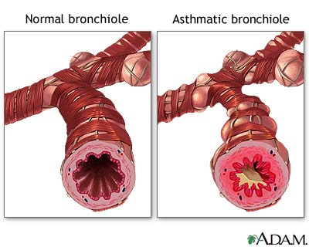
This leads to bronchoconstriction with increased secretion causing further obstruction of the airway.
Breathing in becomes easier with more effort required in expiration due to narrowing of the bronchus and increased secretion.
The secretion produces a sound as air squeezes out of the constricted bronchus. This sound is called a wheeze.

Slide 18
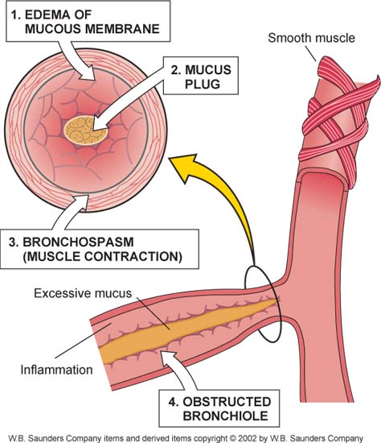
Early phase of asthma:
The early phase of asthma is characterized by:
marked constriction of bronchial airways (bronchospasm)
edema of the airways
production of excess mucus.
The bronchospasm that occurs may be the result of the increased release of certain inflammatory mediators such as histamine, prostaglandins and bradykinin that, in the early stages of asthmatic response, promote bronchoconstriction rather than inflammation.

Slide 19
Late phase of asthma:
The late phase of asthma can occur several hours after the initial onset of symptoms and manifests mainly as an inflammatory response.
The primary mediators of inflammation during the asthmatic response are the white blood cells Eosinophils that stimulate mast cell degranulation and release substances that attract other white cells to the area.
Subsequent infiltration of the airway tissues with white blood cells such as Neutrophils and lymphocytes also contributes to the overall inflammatory response of the late phase of asthma.

Slide 20
Types
Extrinsic asthma
Patients usually have a history of earlier allergic conditions like eczema or allergic rhinitis.
They usually have known allergies like pollens, animals and food. Children with this type of asthma recover with age especially in adolescence.
Intrinsic
This is not related to any allergen.
The attacks become more severe and frequent with time and can progress into chronic bronchitis or emphysema.

Slide 21
Factors associated with intrinsic asthma include environmental pollutants, cold weather, exercise, respiratory tract infection or drugs especially the non steroidal like aspirin.
Mixed
This is the most common and has both the characteristics of the intrinsic and extrinsic type.

Slide 22
Some Potential Asthma Triggers
Allergens — Pollen, pet dander, fungi, dust mites
Cold air
Pollutants
Cigarette smoke
Strong emotions
Exercise
Respiratory tract infections

Slide 23
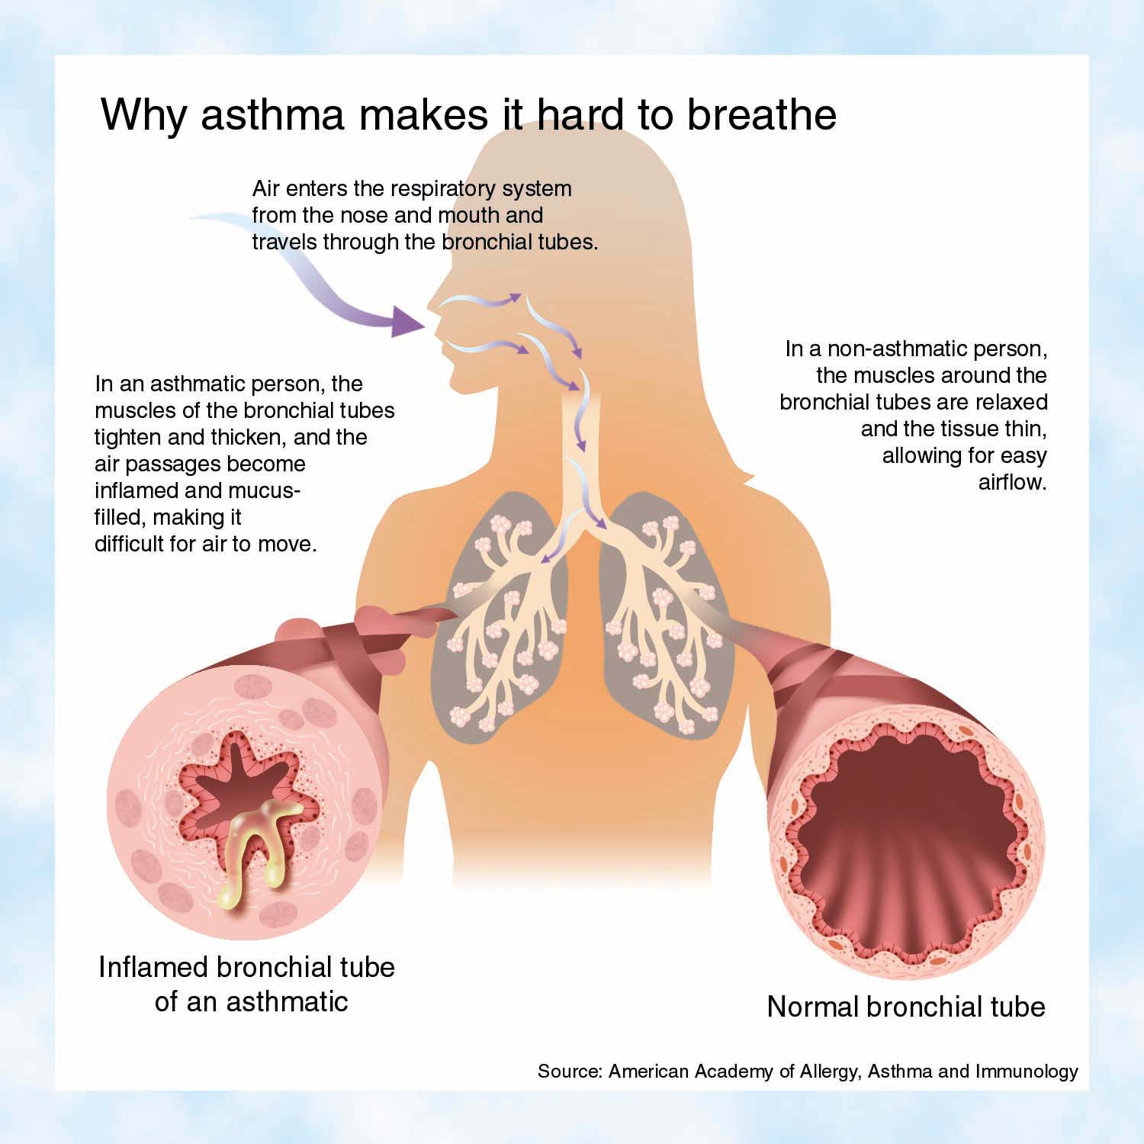

Slide 24
Clinical Features
Cough is present due to production of excessive mucus secretion
Slow laboured breathing with excessive use of accessory muscles
Obstructed airway creates dyspnoea
Profuse sweating, weak pulse and cold extremities is experienced due to fluid loss and dehydration
Occasionally nausea, vomiting and diarrhoea
Air hunger and chest tightness
Wheezing
Increased respiratory rate (tachypnoea)
Significant anxiety

Slide 25
Diagnosis
History of hypersensitivity to known allergen or stimulant
Clinical manifestation
Pulmonary function test, BGAs
Chest x-ray

Slide 26
Management of Asthma
When the patient has ineffective breathing due to bronchospasms, mucosal oedema and increased secretions:
  Provide a comfortable sitting up position to facilitate breathing and use of accessory muscles.
  Give low humidified oxygen to increase oxygen saturation and correct hypoxia.
  Monitor the vital signs and respiratory activity of the patient to identify any change of condition and acute dyspnoea.
  Monitor blood gases with pulse oximetry or blood gases analysis to monitor oxygen saturation.

Slide 27
Auscultate patient's chest, premedicate with bronchodilator, advise deep breathing, coughing and chest physiotherapy to open airway and to allow good sputum removal.
Teach patient deep breathing to increase PaO2 and reduce the respiratory rate.
Administer bronchodilator Beta 2 agonist to reduce bronchospasms.
  Inhaled, nebulized and/or subcutaneous
  Albuterol, terbutaline

Slide 28
Cont’
When the patient has ineffective airway clearance related to bronchospasms, ineffective cough and increased mucus production:
  Ensure absence of possible allergen to reduce the severity of attack.
  Assess patient’s ability to expectorate secretions noting the character, quantity and odour of the secretions to rule out any infection.
  Carry out culture and sensitivity tests and treat with appropriate antibiotics.
When the patient becomes anxious due to difficulty in breathing:
  Give simple, concise explanations to situations and procedures to alleviate anxiety.

Slide 29
  Provide reassurance by staying with the patient and allowing full participation.
When there is risk of infection due to impaired airway clearance:
  Assess for infection, do culture and sensitivity tests and give the appropriate antibiotics
When the patient has a knowledge deficit on the management of asthma:
  Teach patient and relatives about the important aspects of management.
  Enlighten patient on what asthma is, good asthma control, management and medication and their safe use.

Slide 30
Xanthine drugs (example: theophylline) :
Cause bronchodilation and also inhibit the late phase of asthma.
Cromolyn sodium
Anti-inflammatory agent that blocks both the early and late phase of asthma. The mechanism of action is unclear but may involve mast cell function or responsiveness to allergens.
Anti-inflammatory drugs (corticosteroids) :
Used orally or by inhalation to blunt the inflammatory response of asthma.

Slide 31
Leukotrienes modifiers (example: Zafirlukast) :
New class of agents that blocks the synthesis of the key inflammatory mediators, leukotrienes.

Slide 32
Complications of asthma
Severe acute Asthma (status asthmatics), which is a life-threatening condition of prolonged bronchospasm that is often not responsive to drug therapy.
Pneumothorax : is also a possible consequence as a result of lung pressure increases that can result from the extreme difficulty involved in expiration during a prolonged asthma attack.
Respiratory failure: marked hypoxemia and acidosis might occur.

Slide 33
STATUS ASTHMATICUS

Slide 34
Introduction
Status asthmaticus is severe bronchial asthma that is unresponsive to conventional therapy and lasts for more than 24 hours.

Slide 35
Pathophysiology
There is narrowing of bronchus, with bronchospasms and swelling.
Increased mucus production limits air movement and patient ends up with hypoxaemia.
Patient presents with respiratory alkalosis initially and as condition persists progresses to acidosis.

Slide 36
Causes include
Infection that is not resolved
Anxiety
Dehydration
Increased beta block
Non specific irritant
Use of aspirin

Slide 37
Clinical Features
Marked respiratory distress
Cyanosis
Marked wheezing
Absence of breath sounds

Slide 38
Management
Patient is admitted, preferably in a pulmonary ICU.
Intravenous fluids are given to replace lost fluids.
Nebulisation can be attempted if not initially used to cause bronchodilation.
Low humidified oxygen is used where dyspnoea is marked. With poor ventilation, treat with endotrachial intubation and mechanical ventilation.
Intravenous drip of aminophylline is commenced with corticosteroid to restore bronchial reactivity.

Slide 39
Mucolytic may also be used to help in the removal of secretions.
Antibiotics are used for treatment of underlying respiratory infection or prophylactically.
Carry out constant monitoring of the vital signs to identify deviations from normal and also to evaluate the effectiveness of the therapy.

Slide 40
EMPHYSEMA
Pulmonary emphysema is an irreversible distention of the bronchioles, alveolar ducts and alveoli.
This results in increased capacity of the lungs.
In this condition, the alveoli may merge, hence decreasing the surface area.

Slide 41
Pathophysiology
Emphysema is a pathologic diagnosis defined by permanent enlargement of airspaces distal to the terminal bronchioles.
This leads to a dramatic decline in the alveolar surface area available for gas exchange.
Furthermore, loss of alveoli leads to airflow limitation by 2 mechanisms.
First, loss of the alveolar walls results in a decrease in elastic recoil, which leads to airflow limitation.
Second, loss of the alveolar supporting structure leads to airway narrowing, which further limits airflow.

Slide 42
Morphological patterns of Emphysema
Emphysema has 3 morphologic patterns:
  Centriacinar
  Panacinar
  Distal acinar, or paraseptal
Centriacinar emphysema is characterized by focal destruction limited to the respiratory bronchioles and the central portions of the acini. This form of emphysema is associated with cigarette smoking and is typically most severe in the upper lobes.

Slide 43
Panacinar emphysema involves the entire alveolus distal to the terminal bronchiole.
The panacinar type is typically most severe in the lower lung zones and generally develops in patients with homozygous alpha1-antitrypsin (AAT) deficiency.
Distal acinar emphysema, or paraseptal emphysema, is the least common form and involves distal airway structures, alveolar ducts, and sacs.

Slide 44
Predisposing factors: Smoking, acute inflammation, chronic cough and congenital defects that result in deficiency of proteolytic enzyme in the lungs.
Emphysema may also result from rupture of the lung through stab wounds and accidents.
Emphysema can be divided into alveolar or interstitial emphysema.

Slide 45
Management
Treatment of respiratory tract infection if present
Bronchodilators such as anticholinergics, beta-2-adrenergic blockers and corticosteroids
Chest physiotherapy to improve the removal of secretions
Positive end expiratory respiration if the patient is on assisted ventilation, this prevents alveolar collapse
Breathing exercises and retraining
Hydration with at least three litres of fluid per day
Advice on cessation of smoking
Rest as appropriate
Progressive plan of exercises and pulmonary rehabilitation

Slide 46
Complications
Pneumonia – this is an infection of the alveoli and bronchioles.
Collapsed lung – some lungs develop large air pockets (bullae), which may burst, resulting in lung deflation (also called pneumothorax)
Holes in lungs (giant bullae): these large holes make it difficult for your lung to expand. They can also get infected and may lead to a collapsed lung.
Collapsed lung: this is a life-threatening condition for people with emphysema because their lungs are already damaged.
Heart problems: emphysema often increases pressure in the arteries connecting your lungs to your heart.

Slide 47
BRONCHIECTASIS
It is a condition that results from prolonged injury or inflammation of respiratory airways and bronchioles.
It is characterized by abnormal dilation of the bronchus or bronchi. It is most frequently associated with chronic respiratory disease, infections, cystic fibrosis, tumor growth or exposure to respiratory toxins.

Slide 48
Pathophysiology
Its pathophysiology is commonly described as distinct phases of infection and chronic inflammation.
The first stage in the development of bronchiectasis is an initial infective insult to the airways, which triggers a mucociliary response.
Micro-organisms trigger the release of toxins and an inflammatory response within the airways.
This inflammatory response includes the release of neutrophils, lymphocytes and macrophages within the bronchial lumen.

Slide 49
Neutrophils also alter the function of the cilial epithelium, leading to changes in cilial beat frequency and mucous gland hypersecretion.
Both processes compromise mucociliary clearance.
This loss of mucociliary transport renders the airways susceptible to microbial colonization. This encourages further release of inflammatory mediators, which facilitate neutrophil migration to the bronchial lumen and mucosa.
These changes in airway structure further contribute to pooling of mucus, and the self-perpetuating cycle of infection and inflammation, which promotes progressive airway damage and recurrent infections

Slide 50
Signs and symptoms
There is persistent cough to remove mucous retained in the dilated areas, which increases the pressure, worsening the dilation.
Pus may form or bleeding may occur.
Impaired ventilation of the alveoli,
Chronic inflammation and possible fibrosis of the areas.

Slide 51
Management
Pharmacotherapy: bronchodilators, mucolytic agents, expectorants and antibiotics.
Good hydration, to liquefy secretions, must be maintained.
Postural drainage and avoidance of air irritants are also important.

Slide 52
Complications
Pneomonia
Hypoxia
Right sided heart failure.
Lung abscess
Empyema
Emphysema
Cor pulmonale
Septicaemia
Recurrent pleurisy

Slide 53
Atelectasis
Atelectasis refers to the collapse of an alveoli, lobule or lung unit. This could be due to defective expansion of the lungs at birth as a result of obstruction, poorly developed lungs and poor stimulation in the respiratory centre. It may also be acquired as a result of severe lung infection, particularly where there is poor clearance of secretions.
Bronchial carcinoma and bronchiectasis are also common causes. The patient may present with dyspnoea, cyanosis, prostration and chest pain. There is cyanosis and anxiety with dyspnoea.
The affected side or part of chest has little movement with the opposite side experiencing excessive chest movement.

Slide 54
Management
Endoscopic procedures may be performed.
Carry out a radiograph e.g chest x-ray.
Angiograph - study of pulmonary vessels. The goal of management is to increase ventilation and remove the obstruction.
Encourage the patient to cough and do suction where indicated. Chest physiotherapy will also assist in facilitating secretion drainage.
Oxygen therapy will be done to increase oxygen concentration during inhalation.

Slide 55
Restrictive Pulmonary Disorders

Slide 56
PNEUMONIA

Slide 57
Introduction
Pneumonia is an acute respiratory illness, which is either segmental or affecting more than one lobe.
Pneumonia is a condition that involves inflammation of lower lung structures such as the alveoli or interstitial spaces.
It can be community acquired, hospital acquired or occurring due to immunosuppression.
It can also occur as a result of aspiration of contents.
The factors that contribute to this process include damage to the epithelia lining by chronic disease, chronic bronchitis and aspiration of contents from the stomach when drunk or unconscious.

Slide 58
In our setup, the common infectious agents include: streptococcus pneumoniae, klebsiella pneumoniae, haemophilus influenzae and staphylococcus aureus.
In patients with an impaired immune system, the agent pneumocystis carinii commonly causes pneumonia in the immunocompromised.

Slide 59
Most pneumonia occurs when a breakdown in your body's natural defenses allows germs to invade and multiply within your lungs.
It occurs when viruses, bacteria, or fungi cause inflammation and infection in the alveoli (tiny air sacs) in the lungs
To destroy the attacking organisms, white blood cells rapidly accumulate.
Along with bacteria and fungi, they fill the air sacs within your lungs (alveoli).
Bronchopneumonia is a type of pneumonia that causes inflammation in the alveoli hence trouble breathing because their airways are constricted.

Slide 60
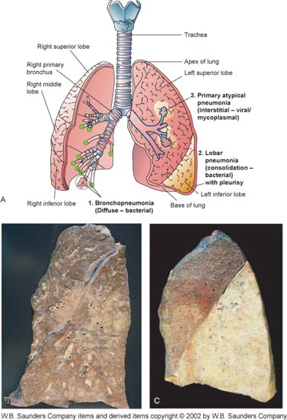

Slide 61
Pathophysiology
Any infectious organisms that reach the alveoli are likely to be highly virulent, as they have already evaded the host’s physical defense mechanisms.
Consequently, they may overwhelm the macrophages, resulting in production of a fibrin-rich exudate that fills the infected and neighbouring alveolar spaces, causing them to stick together, rendering them airless.
The inflammatory response also results in a proliferation of neutrophils.
This can damage lung tissue, leading to fibrosis and pulmonary oedema, which also impairs lung expansion.

Slide 62
The inflammatory response can also lead to the development of a pleural effusion which is thought to complicate up to 40% of cases of pneumonia.
These changes result in reduced gaseous exchange. As a result, vital organs become oxygen deprived and the respiratory effort required with each breath will be increased as a result of the disturbance in normal physiology.

Slide 63
Individuals Most at Risk for Pneumonia
Elderly
Those with viral infection
Chronically ill
AIDS or immunosuppressed patients
Smokers
Patients with chronic respiratory disease e.g. bronchial asthma.

Slide 64
Clinical features
Breathlessness
Cough
Fever
Chest pain,
Tachypnoea and reduced chest movements.
Dyspnoea and fatigue
On x-ray the film may show pulmonary infiltration
Cough could be purulent, or yellow and blood stained, or red
and gelatinous.

Slide 65
Diagnosis
Vital signs and breathing patterns are assessed.
Sputum is collected for culture and sensitivity testing.
Determine the colour, consistency and amount of sputum the patient is producing.

Slide 66
Classification of Pneumonia
Community vs hospital setting
Typical vs atypical pathogens

Slide 67
Community vs Hospital setting
Community acquired pneumonia (CAP)
  Aspiration pneumonia
Hospital acquired pneumonia (HAP)
  Ventilator associated pneumonia (VAP)
  Healthcare associated pneumonia (HCAP)

Slide 68
A second classification scheme for pneumonia is based on the specific structures of the lung that the organisms infect and includes typical and atypical pneumonia.
Typical
Streptococcus pneumoniae
Hemophilus influenzae
Mycobacterium catarrhalis
Klebsiella pneumoniae
Atypical
Chlamydia pneumoniae
Legionella pneumophila
Mycoplasma pneumoniae.

Slide 69
Viruses
Fungi
Less Common pathogens
N. meningitidis
Chlamydia psittaci
B. anthracis
Y. pestis

Slide 70
Typical pneumonia
Usually bacterial in origin.
Organisms replicate in the spaces of the alveoli.
Manifestations:
Inflammation and fluid accumulation are seen in the alveoli.
White cell infiltration and exudation can been seen on chest radiographs.
High fever, chest pain, chills, and malaise are present.
Purulent sputum is present.
Some degree of hypoxemia is present.

Slide 71
Atypical pneumonia
Usually viral in origin.
Organisms replicate in the spaces around the alveoli.
Manifestations:
Milder symptoms than typical pneumonia.
Lack of white cell infiltration in alveoli.
Lack of fluid accumulation in the alveoli.
Not usually evident on radiographs.
May make the patient susceptible to bacterial pneumonia.

Slide 72
Opportunistic organisms
A number of organisms not commonly associated with respiratory illness in otherwise healthy individuals can cause severe respiratory infections and pneumonia in patients with HIV or those who are immunocompromised as a result of immune suppressive therapy.
These organisms include mycobacteria, fungus (Histoplasma) and protozoa (Pneumocystis carinii).
Treatment of these organisms requires specific drug therapy, and, in the case of protozoa and fungi, the organisms are very difficult to kill.

Slide 73
Management
The goals of nursing care for a patient with pneumonia are:
  The patient to have clear breath sounds.
  Normal breathing pattern.
  Normal chest x-ray.
  No complications related to pneumonia.
Interventions:
  To ensure comfort by proper positioning
  Good nutrition
  Fluids and electrolytes
  Patient education on infection prevention and control.

Slide 74
When the patient has ineffective breathing pattern due to pneumonia and pain:
  Monitor respiratory function of a new patient's respiratory response to treatment, this should include blood gas analysis, pulse oximetry, respiratory rate and rhythm.
  Position patient in an upright position to ease breathing and facilitate use of accessory respiratory muscles.
  Give oxygen by mask or nasal cannular depending on the patients need

Slide 75
When the patient has splenic pain:
  Administer analgesia and provide information that can relieve pain
  Observe the pharmacological effects of the drugs
  If the patient is at risk of infection, complications, administer antibiotics and observe their effects to therapy
  Monitor for any signs of hypoxemia
Where there is an ineffective airway clearance due to thick secretions:
  Administer bronchodilators, mucolytics and exercises to facilitate secretions removal
  Maintain input of IV fluids to replace lost fluids and dilute the secretions (reduce the viscosity)

Slide 76
When the patient is at the risk of altered health maintenance:
  Educate the patient on health, self care, and safe use of drugs to prevent recurrent infection
  Educate the patient on safe health practices and discourage unsafe practices like smoking
  Teach the patient about food and nutrition that will help maintain a healthy body
To maintain body temperature:
  To relieve fever to promote comfort you can use antipyretics
  Provide fluid replacement for fever and dehydration

Slide 77
If an activity intolerance exists due to dyspnoea on exertion:
  Administer oxygen and increase oxygen intake dependent on patients needs
  Plan for patient to prevent any unnecessary interruptions in order to decrease lung activity and promote ventilation
  Note signs to evaluate the condition and identify deviation from the normal
  Rehabilitation

Slide 78
Complications of pneumonia
Bacteremia and septic shock.
Lung abscesses.
Pleural effusions, empyema, and pleurisy.
Renal failure.
Respiratory failure.
Lung Collapse
Emphysema
Empyema
Hypoxemia

Slide 79
Pneumothorax
Pneumothorax is the entry of air into the pleural cavity in which the lungs reside.
In order for normal lung expansion to occur, there must be a negative pressure within the pleural cavity with respect to atmospheric pressure outside the pleural cavity. The inside of the pleural cavity is essentially a vacuum and when air enters the pleural cavity the negative pressure is lost and the lungs collapse.
Because each lung sits in a separate pleural cavity, pneumothorax of one plural cavity will not cause collapse of the other lung.

Slide 80
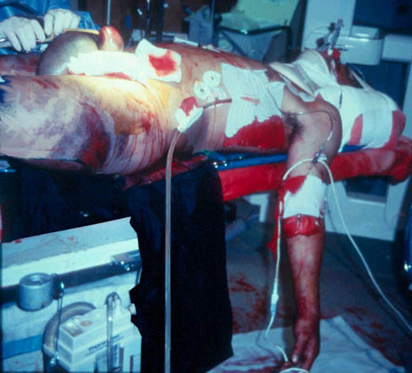

Slide 81
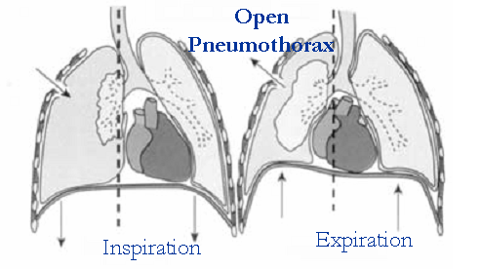
Types of pneumothorax:
1.Open or communicating pneumothorax
  • Usually involves a traumatic chest wound.
  • Air enters the pleural cavity from the atmosphere.
  • The lung collapses due to equilibration of pressure within the pleural cavity with atmospheric pressure.

Slide 82
2. Closed or spontaneous pneumothorax
  Occurs when air “leaks” from the lungs into the pleural cavity.
  May be caused by lung cancer, rupture, pulmonary disease.
  The increased plural pressure prevents lung expansion during inspiration and the lung remains collapsed.

Slide 83
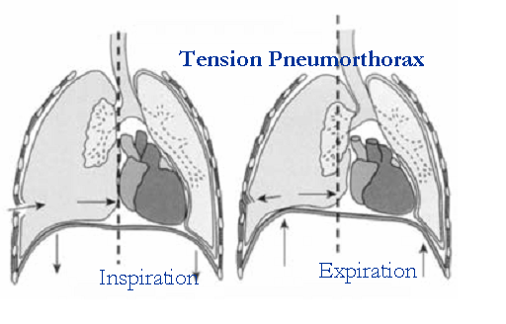
3. Tension pneumothorax
A condition in which there is a one-way movement of air into but not out of the pleural cavity.
May involve a hole or wound to the pleural cavity that allows air to enter and the lung to collapse.
Upon expiration, the hole or opening closes, which prevents the movement of air back out of the pleural cavity.

Slide 84
A life-threatening condition because pressure in the pleural cavity continues to increase and may result in further lung compression or compression of large blood vessels in the thorax or the heart.

Slide 85
Manifestations of pneumothorax:
• Tachypnea,
Dyspnea
• Chest pain
• Possible compression of thoracic blood vessels and heart, especially with tension pneumothorax

Slide 86
Treatment of pneumothorax:
• Removal of air from the pleural cavity with a needle or chest tube
• Repair of trauma and closure of opening into pleural cavity

Slide 87
TUBERCULOSIS

Slide 88
Introduction
Tuberculosis is caused by the bacteria mycobacterium tuberculosis, also referred to as acid-fast bacilli.
These bacteria are spread either by droplet infection or dust contaminated by sputum.
Tuberculosis is divided into primary TB and secondary TB.
Primary TB is infection to the lungs as a result of mycobacterium tuberculosis.
When microbes colonise the lung, macrophages surround the microbes, triggering the body's defense mechanisms.
These macrophages spread to other areas and primary complexes are formed at the Hillary lymph nodes.

Slide 89
Caseous material forms in several areas including the lungs.
Caseous material is basically necrotic (dead) tissue. The disease may then be referred to as pulmonary tuberculosis.
It is called extra pulmonary tuberculosis if it affects areas outside the respiratory system.

Slide 90
Clinical features of pulmonary TB
  Persistent cough for more than four weeks,
  Unexplained weight loss,
  Chest pain,
  Night sweats,
  Poor appetite
  Haemoptysis.

Slide 91
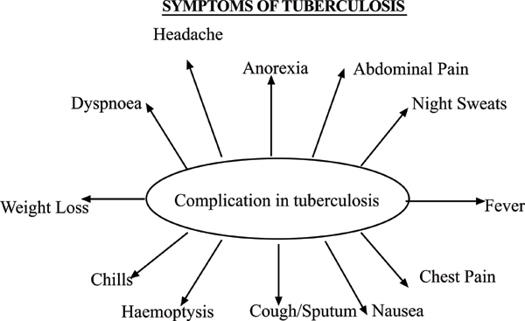

Slide 92
When the disease is extra pulmonary, the manifestations may include:
  Enlarged lymph nodes,
  Pain and swelling in the joints,
  Meningitis
  Paralysis if the spine is involved.
Secondary TB is infection that is due to the caseous material in other organs such as the spinal cord, bone and brain.

Slide 93
Management of Tuberculosis
TB is treated with standard pharmacologic agents. While nursing a patient with tuberculosis, the overall nursing goals are that the patient will:
  Comply with the therapeutic regimen
  Have no recurrence of the disease
  Have normal pulmonary function
  Take appropriate measures to prevent the spread of the disease

Slide 94
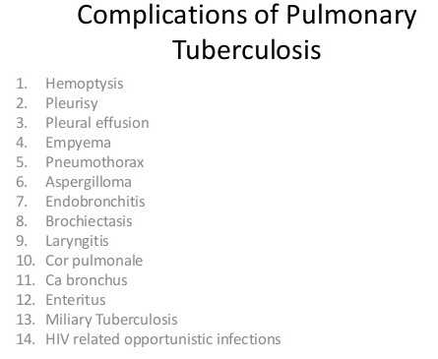

Slide 95
PLEURAL DISEASE

Slide 96
Introduction
The pleura can be inflamed after injury or as a result of introduction of microbes from other processes. Accumulation of air within the pleural cavity results in pneumothorax. Tension pneumothorax is due to stab injury that allows air to enter, but not leave, the pleural space.

Slide 97
Manifestations
Pleural pain,
Dyspnoea,
Chest asymmetry and
hypoxia are common

Slide 98
Pleural Effusion
Pleural effusion refers to accumulation of fluid in the pleural cavity. The fluid may be blood, serous exudates or pus. It can be a complication of diseases such as pulmonary tuberculosis or lung cancer. It can also follow increased pressure due to heart failure, and increased permeability due to inflammation and impaired drainage. The manifestations are almost the same as pneumothorax. However, the percussion note on examination is different (dull).
The note elicited when percussing air filled cavities sounds like
a drum.

Slide 99
Generally, a detailed history and physical assessment must be undertaken to come up with nursing diagnoses.
Other than the medication, teaching on how to avoid spreading the disease, continued follow-up and compliance with the drug regimen and good nutrition must be given.
The involvement of the chest and pleura can be very distressing.
It is important to institute measures to ensure that respiratory function is not compromised.

Slide 100
For pleural fluid to accumulate in disease, there must be increased production from increased hydrostatic pressure, decreased oncotic or pleural pressure, increased microvascular permeability, or peritoneal-pleural movement.

Slide 101
Management of Pleural Disease and Chest Trauma
The emergency management of chest injuries involves:
Establishing and maintaining an airway
Administering high flow oxygen
Establishing IV access
Monitoring vital signs, level of consciousness and
urinary output
Assessing for tension pneumothorax
Dressing a sucking chest wound with nonporous material
Putting the patient in semi-Fowler's position or laying them on the injured side if breathing is easier

Slide 102
A pneumothorax can be aspirated if there is minimal air or fluid in the pleural space
Chest tubes and under water seal drainage are the most definitive treatment modalities
The nursing care for a patient on underwater seal drainage includes the following actions:
Avoid kinks in the tubing
Keep all connections tight
Keep the water seal and suction chambers at appropriate levels by adding sterile water as needed

Slide 103
Mark the drainage levels appropriately
Follow principles of asepsis when emptying the fluid and when changing the bottle
Observe for air bubbles in the water seal chamber and fluctuations in the chest tubes
Air should be bubbling from the chest tube. Check for intermittent bubbling in the water seal
Monitor the patient's status and avoid elevating the drainage system to the level of the patient's chest or above
Encourage the patient to cough

Slide 104
lung scarring,
pneumothorax (collapse of the lung) as a complication of thoracentesis,
empyema (a collection of pus within the pleural space), and.
sepsis (blood infection) sometimes leading to death.

Slide 105
LUNG CANCER

Slide 106
Introduction
The major function of the lungs is respiratory exchange. Inhaled air and potentially dangerous substances are conducted to the alveoli through a network of bronchi and bronchioles.

Slide 107
The putative stem cells of the bronchus are basal cells, which are believed to give rise to the differentiation of ciliated, mucous and neuroendocrine cells.
Lung cancer may arise from all these differentiated and undifferentiated cells, from either the central (small cell lung cancer and squamous cell carcinoma) or the peripheral (adenocarcinoma) airway compartment.
The interaction between inhaled carcinogens and the epithelium of upper and lower airways leads to the formation of DNA adducts: pieces of DNA covalently bound to a cancer-causing chemical.

Slide 108
If DNA adducts persist or are misrepaired, they result in a mutation and can cause genomic alterations.
These are key events in lung cancer pathogenesis, especially if they occur in critical oncogenes and tumour suppressor genes.
Lung cancer pathogenesis is also affected by a genetic component: it relates to the host susceptibility to lung cancer, with or without exposure to carcinogens.

Slide 109
Risk factors for lung cancer:
Smoking
Exposure to secondhand smoke
Exposure to radon gas
Exposure to asbestos and other carcinogens
Family history of lung cancer

Slide 110
Signs and Symptoms
A new cough that doesn't go away
Coughing up blood, even a small amount
Shortness of breath
Chest pain
Hoarseness
Losing weight without trying
Bone pain
Headache

Slide 111
Management
Lung cancer is mainly treated by surgery and radiation therapy.
Make sure that the patient has effective breathing patterns, adequate airway clearance, adequate oxygenation, minimal pain (or none at all), and adherence to treatment regimen.
If one has undergone surgery, postural drainage, airway clearance and an effective breathing pattern are the goals of care.

Slide 112
Prevention
Don't smoke
Stop smoking
Avoid secondhand smoke
Test your home for radon.
Avoid carcinogens at work.
Eat a diet full of fruits and vegetables.
Exercise most days of the week

Slide 113
Complications
Shortness of breath
Coughing up blood.
Pain
Fluid in the chest (pleural effusion).
Cancer that spreads to other parts of the body (metastasis).
Neuropathy
Pain
Pleural effusion

Slide 114
Heart complications: pericardiocentesis and creating a pericardial window
Blocked airways

