Slide 1
REHABILITATION TECHNIQUES (REH-303)
TOM M. NTHIANI BSC PT

Slide 2
BELL’S PALSY
Bell's Palsy, or Bell Palsy, is facial paralysis which is caused by dysfunction of Cranial Nerve VII, the Facial Nerve
Also known as Idiopathic Facial Palsy, it is named after Sir Charles Bell [1774 to 1842], who was a Scottish surgeon, neurologist and anatomist
It results in inability or reduced ability, to move the muscles on the affected side of the face i.e. Facial Palsy

Slide 3
BELL’S PALSY
The facial nerve is damaged by inflammation within the nerve causing it to become enlarged, at the point where the nerve exits the skull through the stylomastoid foramen
Loss of control of the muscles on one side of the face is the main physical presentation
At onset, the paralysis may be complete, or partial (paresis)

Slide 4
BELL’S PALSY
Although it frequently affects all branches of the facial nerve on the affected side, resulting in loss of control of that side of the mouth and the ipsilateral eye, in a few cases only one or two branches of the facial nerve are affected
Bell's Palsy is essentially a diagnosis of exclusion, so once other causes of facial palsy have been eliminated, we call an isolated facial palsy Bell's Palsy, or Idiopathic Facial Palsy

Slide 5
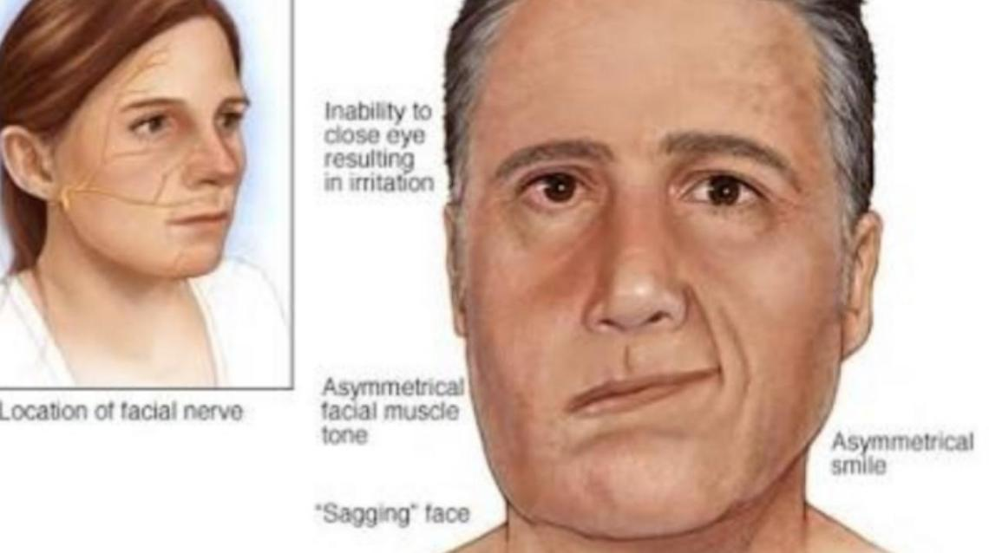
BELL’S PALSY

Slide 6
BELL’S PALSY
Corticosteroids and antiviral medication are generally considered to be the 1st line treatment for Bell's Palsy, providing the best results when treatment starts within 72 hours of the onset of symptoms
It is also important to provide information on care of the eye in order to prevent formation of corneal ulcer

Slide 7
BELL’S PALSY
In the early stages of facial palsy, the most important thing to do is to check that patients are caring for their affected eye in an appropriate way
Other physiotherapy treatments include:-
Neuromuscular retraining (NMR)
Transcutaneous electrical nerve stimulation (TENS)
Electromyography (EMG) and mirror biofeedback

Slide 8
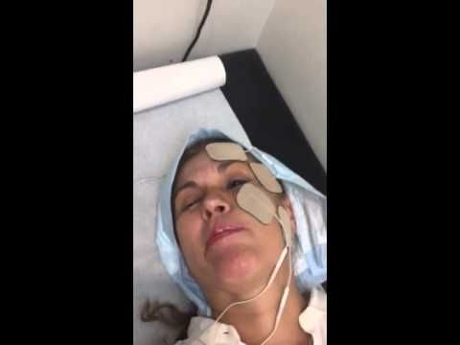
BELL’S PALSY

Slide 9
SATURDAY NIGHT PALSY
The term Saturday night palsy has become synonymous with radial nerve compression in the arm resulting from direct pressure against a firm object
It typically follows deep sleep on the arm, often after alcohol intoxication

Slide 10
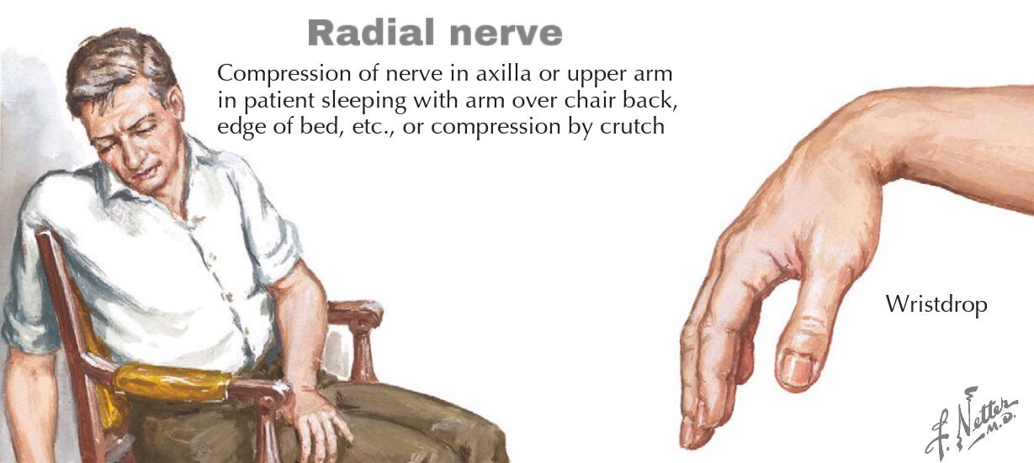
SATURDAY NIGHT PALSY

Slide 11
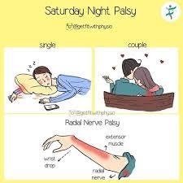
SATURDAY NIGHT PALSY

Slide 12
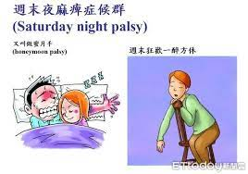
SATURDAY NIGHT PALSY

Slide 13
SATURDAY NIGHT PALSY
Weakness:
Wrist extension- so patient has wrist drop
Abduction of thumb
Diminished sensation:
Back of thumb, index, middle, and 1/2 ring finger
back of forearm

Slide 14
SATURDAY NIGHT PALSY
Treatment for Saturday night palsy is largely focused on physical rehabilitation
Physical therapy involves the use of a soft wrist splint that holds the wrist in extension
Passive stretches are also done to maintain ROM
TENS can also be applied once nerve regeneration has started

Slide 15
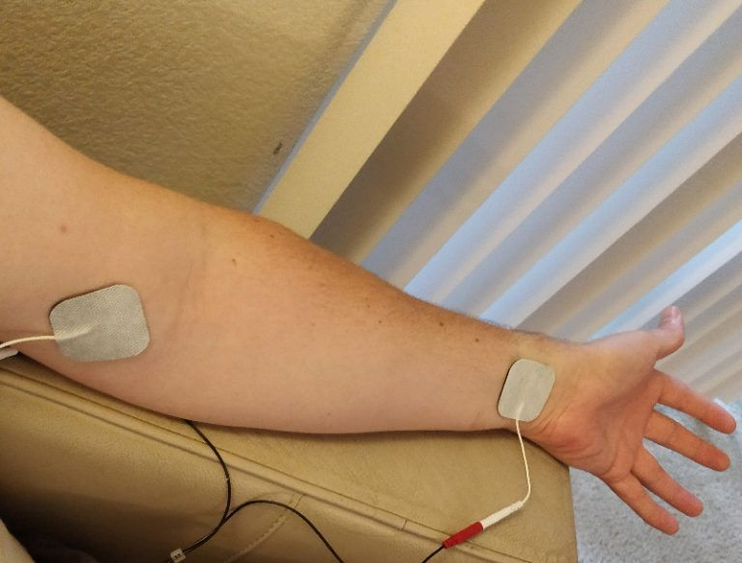
SATURDAY NIGHT PALSY

Slide 16
FOOT DROP
Foot drop is caused by disruption to the common peroneal nerve which controls active dorsiflexion of the ankle leading to a lack of heel strike during gait hence the term foot drop
The common peroneal nerve is in a particularly vulnerable position as it winds around the neck of the fibula

Slide 17
FOOT DROP
It may be damaged at this site by:-
Trauma or injury to the knee
Neurological disorders i.e. stroke
Compression of the fibula head during surgery e.g. tourniquet
Fracture of the fibula
Fracture to tibial plateau

Slide 18
FOOT DROP
Typical presentation of foot drop can be noted when testing the foot and ankle in isolation, however, in a clinical setting, it may be identified initially through gait assessment
Foot drop gait can manifest in different ways varying from patient to patient
Some patients may increase the amount of hip flexion they produce on the effected side therefore, clearing the floor more effectively

Slide 19
FOOT DROP
Rehabilitation of foot drop is:-
One way to improve function while the foot drop resolves is the use of splinting.
A solid ankle-foot orthosis (AFO) or foot-up splint can be used to keep the foot in plantar-grade
These work to increase the amount of dorsiflexion the foot is held in during gait and can prevent falls as the toes do not get caught on the floor

Slide 20
FOOT DROP
Physiotherapy interventions normally are focused on graded exercises to encourage active dorsiflexion and muscle recruitment
Preventing contractures and stiffness is also an important maintenance goal of physiotherapy
Electro-stimulation of the affected muscle groups has also been shown to improve recovery times

Slide 21
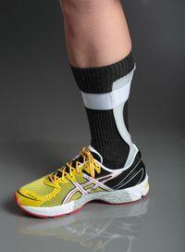
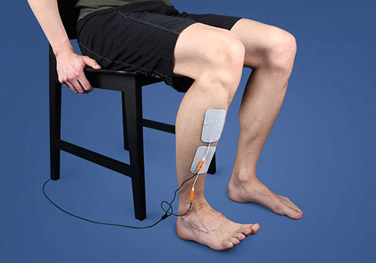
FOOT DROP

Slide 22
SCIATICA
Sciatica is a debilitating condition in which the patient experiences pain and/or paraesthesia in the distribution of the sciatic nerve
Sciatica pain often is worsened with flexion of the lumbar spine, twisting, bending, or coughing
Most cases of sciatica result from an inflammatory condition leading to an irritation of the sciatic nerve
Any condition that may structurally impact or compress the sciatic nerve may cause sciatica symptoms

Slide 23
SCIATICA
The most common cause of sciatica is a herniated or bulging lumbar intervertebral disc
In the older persons, lumbar spinal stenosis may cause these symptoms as well
Spondylolithesis or a relative misalignment of one vertebra relative to another may also result in sciatic symptoms
Lumbar or pelvic muscular spasm and/or inflammation may impinge a lumbar or sacral nerve root causing sciatic symptoms

Slide 24
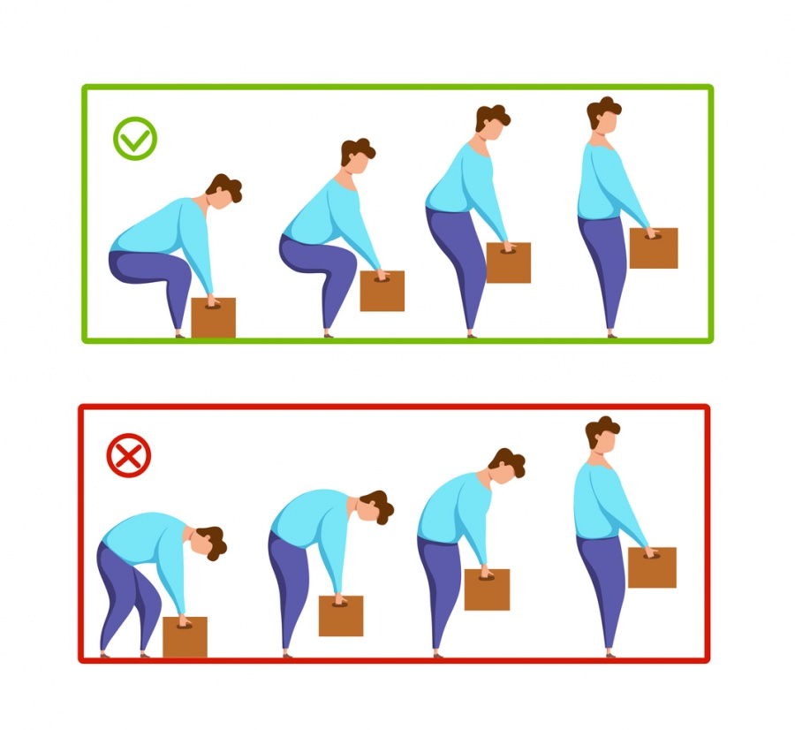
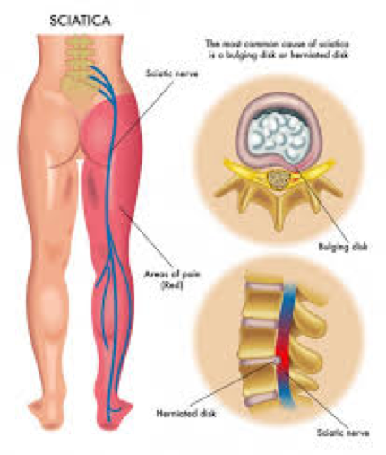
SCIATICA

Slide 25
SCIATICA
Patient with sciatica can present with neurological symptoms such as:-
Pain (intense pain in the buttock)
Lumbosacral radicular leg pain
Numbness
Muscular weakness
Gait dysfunction
Hot and cold or tingling/ burning sensations in the legs

Slide 26
SCIATICA
Physiotherapy management focuses on:-
Use of hot or cold packs
Avoidance of inciting activities or prolonged sitting/standing
Practicing good, erect posture
Engaging in exercises to increase core strength
Gentle stretching of the lumbar spine and hamstrings
Regular light exercises
Use of proper lifting techniques

Slide 27
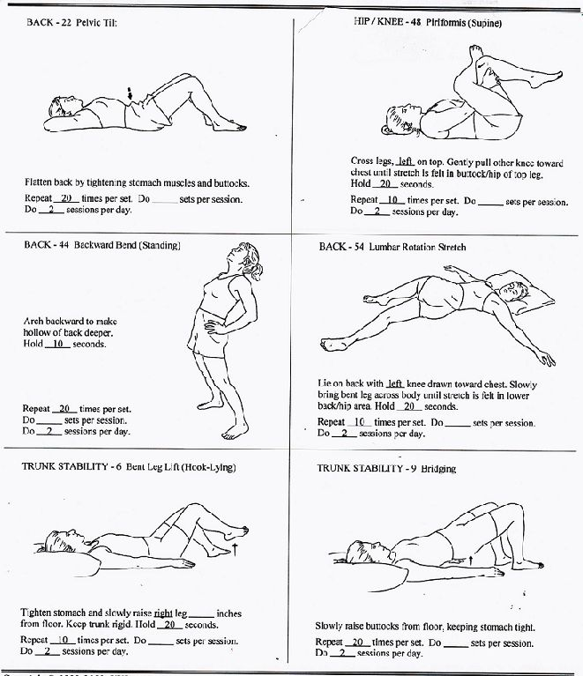
SCIATICA

Slide 28
SCIATICA
Medical management includes:-
A short course of oral NSAIDs
Opioid and nonopioid analgesics
Muscle relaxants
Localized corticosteroid injections

