Slide 1
REHABILITATION TECHNIQUES (REH- 303)
TOM M. NTHIANI BSC PT

Slide 2
COMMUNITY BASED REHABILITATION (CBR)
Community-based rehabilitation (CBR) was initiated by the World Health Organization (WHO) following the Declaration of Alma-Ata in 1978
It was promoted as a strategy to improve access to rehabilitation services for people with disabilities in low-income and middle-income countries, by making optimum use of local resources

Slide 3
CBR
Over the past 30 years through collaboration with other UN organizations, non governmental organizations and disabled people’s organizations, CBR has evolved into a multisectoral strategy to:
Address the broader needs of people with disabilities
Ensuring their participation
Inclusion in society
Enhancing their quality of life

Slide 4
CBR
It has been estimated that at least 10% of the world’s population lives with a disability, the majority in developing countries in conditions of poverty
People with disabilities are among the world’s most vulnerable and least empowered groups
All too often they experience stigma and discrimination with limited access to health care, education and livelihood opportunities

Slide 5
CBR
Is a systematized approach within general community development whereby PWDs are enabled to live a fulfilling life within their own community
It is a strategy within the general community development for the rehabilitation, equalization of opportunities & social inclusion for all PWDs
CBR is implemented through the combined efforts of:-

Slide 6
CBR
The PWDs themselves
Their families
Organizations & communities
Relevant government & non governmental organizations responsible for health, education, vocational & social services

Slide 7
CBR
Mainstreaming & inclusion is seen as an effective way:-
To include PWDs
To give equal opportunities
To provide a non discriminative environment for their growth & development

Slide 8
CBR
The major objectives of CBR are:-
To ensure PWDs are able to maximize their physical & mental abilities
To access regular services & opportunities and become active contributors to the community
To activate communities to promote & protect human rights of PWDs through changes within the community e.g. removing barriers to participation

Slide 9
CBR
Disability is no longer viewed as merely the result of impairment
The social model of disabilities has increased awareness that environmental barriers (e.g. attitude, physical & institutional) to participation impedes the functioning of PWDs
CBR therefore promotes the rights of PWDs as equal citizens within the community

Slide 10
CBR
Through CBR, PWDs are able to fully participate in educational, social, cultural, religious, economic & political activities
There is a strong correlation between disability & poverty
Poverty leads to increased disability & disability leads to increased poverty

Slide 11
BASIC PRINCIPLES OF A CBR PROGRAMME
INCLUSION- is the removal of all kinds of barriers which block PWDs from access to the mainstream
PARTICIPATION- is the involvement of PWDs as active contributors to the CBR program from policy making, implementation & evaluation for the simple reason that they know what's best for them
SUSTAINABILITY- the benefits of the CBR program must be lasting beyond the immediate life of the program itself

Slide 12
BASIC PRINCIPLES OF A CBR PROGRAMME
SELF ADVOCACY- is mobilizing, organizing, representing & creating space for interaction and demands. Its also self determination
EQUITY- is the equality of opportunities and rights
FACILITATION- requires a multi sectoral collaboration to support the community & to address the individual needs of the PWD with the ultimate aim of an inclusive society

Slide 13
BASIC PRINCIPLES OF A CBR PROGRAMME
GENDER SENSITIVITY & SPECIAL NEEDS- is responsive to individuals and groups within the community with special needs
PARTNERSHIP- CBR depends on effective partnerships with community based organizations, government organizations & other organized groups

Slide 14
CBR MATRIX
The CBR matrix consists of 5 key components; health, education, livelihoods, social & empowerment
HEALTH- the elements of the health component are:-
Health promotion- aims to increase control over health & its determinants
Desired outcomes- PWDs and their families are reached by the same health promotion messages as the general population

Slide 15
CBR MATRIX
Prevention- involves primary prevention (avoidance), secondary prevention (early detection & treatment) and tertiary prevention(rehabilitation)
Desired outcomes- PWDs and their families reduce the risk of developing health problems by taking up & maintaining healthy behaviors & lifestyles

Slide 16
CBR MATRIX
Medical care- refers to early identification, assessment & treatment of health conditions and their resulting impairments with the aim of curing or limiting their effects on individuals
Desired outcome- CBR workers are knowledgeable about medical services & able to facilitate referrals
Medical facilities are inclusive & have access for PWDs
Medical care workers have awareness regarding the medical needs of PWDs

Slide 17
CBR MATRIX
Rehabilitation- set of measures that enables PWDs achieve & maintain optimal functioning in their environments
Desired outcomes- PWDs & their families understand the role & purpose of rehabilitation
PWDs can be referred for specialized rehabilitation services
Basic rehabilitation services are available at community level

Slide 18
CBR MATRIX
Assistive devices- are devices that have been designed, made or adapted to assist a person perform a particular task. PWDs benefits from the use of one or more assistive devices
Desired outcomes- CBR workers are knowledgeable about assistive devices including the types, their functions and their suitability
PWDs & their families are knowledgeable about assistive devices so as to make informed decisions about access & usage

Slide 19
CBR MATRIX
PWDs & their families are provided with training, education and follow up to ensure they use & care for assistive devices appropriately
The environmental factors are addressed to enable PWDs use their assistive devices in all locations they are needed

Slide 20
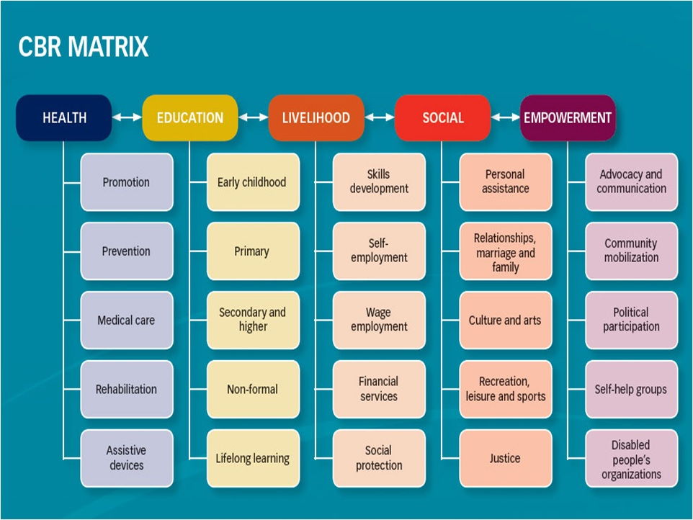
CBR MATRIX

Slide 21
THANKYOU

