Slide 1
REHABILITATION TECHNIQUES (REH-303)
TOM M. NTHIANI BSC PT

Slide 2
POLIOMYELITIS
Poliomyelitis or Polio is a virus infection of cranial nerve nuclei in the brain stem leading to temporary or permanent paralysis of muscles that they activate
The virus affects children under 5 years of age
Mode of transmission is mainly by fecal contamination route and by droplet infection
Poliovirus is an Enterovirus that colonizes the GIT

Slide 3
POLIOMYELITIS
The course of the disease is divided into four stages:
Prodromal Stage or Pre-Paralytic Stage- few hours to a few days and 1 to 3 days is the usual duration
Signs and Symptoms
Headache
Malaise
Slight Cough
Diarrhea
Backache
Joint pains
Pyrexia
Mild neck stiffness
Irritability

Slide 4
POLIOMYELITIS
The course of the disease is divided into four stages:
Prodromal Stage or Pre-Paralytic Stage- few hours to a few days and 1 to 3 days is the usual duration
Signs and Symptoms
Headache
Malaise
Slight Cough
Diarrhea
Backache
Joint pains
Pyrexia
Mild neck stiffness
Irritability

Slide 5
POLIOMYELITIS
Convalescent Stage- Duration 3 months
Signs and Symptoms
Spinal Type-The lower limb muscles are more often involved. Flexion contractures of hip, knee and equinus deformity of the ankle are common
Bulbar Type-The most important sign of Bulbar paralysis is the inability to swallow due oral pharyngeal paralysis
The patient requires urgent ventilatory support for respiration

Slide 6
POLIOMYELITIS
Spinobulbar- This type has a combination of both spinal and bulbar type
Postencephalic- Mental disturbance, coma, paralysis of facial muscles, symptoms similar to meningitis like headache, vomiting, neck stiffness may occur

Slide 7
POLIOMYELITIS
Acute Stage- rehabilitation goals
Correct handling technique- The child should not be lifted by one hand. While carrying the child, they should be held in front and preferably with the Hip in extension without any abduction
Splinting and correct positioning- Splinting of lower limb to be immobilized to prevent further damage to the muscles
Gentle passive movement

Slide 8
POLIOMYELITIS
Convalescent Stage- rehab goals
Continuous Splintage
Muscle strengthening
Stretching of contractures
Stimulation and facilitation technique

Slide 9
POLIOMYELITIS
Stage of recovery- rehabilitation goals
Various strengthening techniques include:-
Sensory integraion
Resisted exercises with springs and pulleys
Hydrotherapy and suspension therapy
Play therapy
Mat Exercises

Slide 10
SPINAL CORD INJURIES
Spinal cord injury is defined as traumatic damage to the spinal cord or nerves at the end of the spinal canal
There are two types:-
Incomplete Lesion:- not all the nerves are severed or the nerves are only slightly damaged. Recovery is possible, but never to the pre-injury level
Complete lesion:- the nerves are severed and there is no motor or sensory function preserved of this point.

Slide 11
SPINAL CORD INJURIES
Causes of spinal cord injuries include:-
Motor Vehicle Accidents
Falls
Sport Injuries
Violence
Self-harm
Work-related Accidents

Slide 12
SPINAL CORD INJURIES
High-Cervical Nerves (C1 – C4)
Most severe of the spinal cord injury levels
Paralysis in arms, hands, trunk and legs
Patient may not be able to breathe on his or her own, cough, or control bowel or bladder movements.
Ability to speak is sometimes impaired or reduced.
When all four limbs are affected, this is called tetraplegia or quadriplegia.

Slide 13
SPINAL CORD INJURIES
Low-Cervical Nerves (C5 – C8)
Corresponding nerves control arms and hands
A person with this level of injury may be able to breathe on their own and speak normally

Slide 14
SPINAL CORD INJURIES
Thoracic Nerves (T1 – T5)
Corresponding nerves affect muscles, upper chest, mid-back and abdominal muscles.
Arm and hand function is usually normal.
Injuries usually affect the trunk and legs(also known as paraplegia)
Most likely use a manual wheelchair

Slide 15
SPINAL CORD INJURIES
Thoracic Nerves (T6 – T12)
Nerves affect muscles of the trunk (abdominal and back muscles) depending on the level of injury
Usually results in paraplegia
Normal upper-body movement
Fair to good ability to control and balance trunk while in the seated position

Slide 16
SPINAL CORD INJURIES
Lumbar Nerves (L1 – L5)
Injuries generally result in some loss of function in the hips and legs
Little or no voluntary control of bowel or bladder, but can manage on their own with special equipment
Depending on strength in the legs, may need a wheelchair and may also walk with braces

Slide 17
SPINAL CORD INJURIES
Sacral Nerves (S1 – S5)
Injuries generally result in some loss of functioning the hips and legs
Little or no voluntary control of bowel or bladder, but can manage on their own with special equipment
Most likely will be able to walk

Slide 18
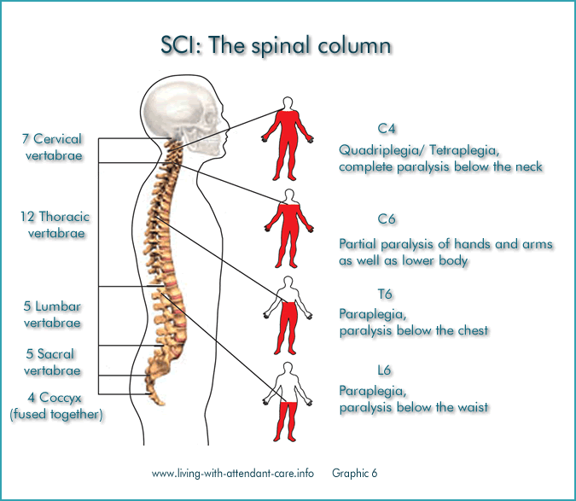
SPINAL CORD INJURIES

Slide 19
SPINAL CORD INJURIES
Rehabilitations depends on the level of injury
For tetraplegics/ quadriplegics, who are fully dependent, rehabilitation focuses on utilization of whatever function that is left to optimize some level of independence
Those with ability to move their fingers can be helped by an electric wheelchair moveable using a joystick

Slide 20
SPINAL CORD INJURIES
Physiotherapy rehabilitation for high level paraplegic is concerned with training the use of a manual wheelchair
The patient is also taught transfers from one surface to another e.g. from bed to wheelchair
The occupational therapists also train them on ADLs & environmental modifications/ adaptations
The orthopedic technologists teaches the patient on usage and care of the wheelchair

Slide 21
SPINAL CORD INJURIES
For low level paraplegics who can use walking braces, the Physiotherapy rehabilitation focuses on balance/ coordination, prescription of crutches & ambulation gait patterns
The occupational therapists also teaches the patient ADLs and environmental modifications
The orthopedic technologists assists the patient in production of both axillary crutches & lower limb braces

Slide 22
SPINAL CORD INJURIES
For patients with sacral injuries whose impairments are bladder/bowel incontinence the role of rehabilitation is bladder/ bowel control

Slide 23
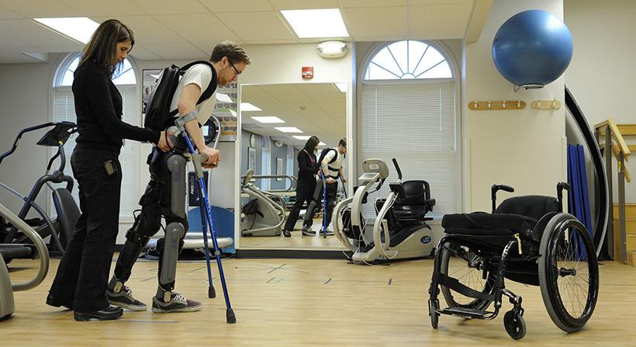
SPINAL CORD INJURIES

Slide 24
TRAUMATIC BRAIN INJURIES
A head injury is any sort of injury to your brain, skull, or scalp
This can range from a mild bump or bruise to a traumatic brain injury
Common head injuries include concussions, skull fractures, and scalp wounds
The consequences and treatments vary greatly, depending on what caused your head injury and how severe it is

Slide 25
TRAUMATIC BRAIN INJURIES
Head injuries may be either closed or open
A closed head injury is any injury that doesn’t break your skull
An open (penetrating) head injury is one in which something breaks your scalp and skull and enters your brain

Slide 26
TRAUMATIC BRAIN INJURIES
In general, head injuries can be divided into two categories based on what causes them
They can either be head injuries due to blows to the head or head injuries due to shaking
Head injuries caused by shaking are most common in infants and small children, but they can occur any time you experience violent shaking

Slide 27
TRAUMATIC BRAIN INJURIES
Head injuries caused by a blow to the head are usually associated with:-
motor vehicle accidents, motorcycle accidents
falls
physical assaults
sports-related accidents

Slide 28
TRAUMATIC BRAIN INJURIES
Brain injuries can result in:-
A hematoma is a collection, or clotting, of blood outside the blood vessels
It can be very serious if a hematoma occurs in the brain
The clotting can lead to pressure building up inside your skull
This can cause you to lose consciousness or result in permanent brain damage

Slide 29
TRAUMATIC BRAIN INJURIES
A hemorrhage is uncontrolled bleeding
There can be bleeding in the space around your brain, called subarachnoid hemorrhage, or bleeding within your brain tissue called intracerebral hemorrhage
A diffuse axonal injury (sheer injury) is an injury to the brain that doesn’t cause bleeding but does damage the brain cells
The damage to the brain cells results in them not being able to function

Slide 30
TRAUMATIC BRAIN INJURIES
A concussion occurs when the impact on the head is severe enough to cause brain injury
It’s thought to be the result of the brain hitting against the hard walls of your skull or the forces of sudden acceleration and deceleration
Generally speaking, the loss of function associated with a concussion is temporary
However, repeated concussions can eventually lead to permanent damage

Slide 31
TRAUMATIC BRAIN INJURIES
Any brain injury can lead to edema, or swelling
Many injuries cause swelling of the surrounding tissues, but it’s more serious when it occurs in your brain
Your skull can’t stretch to accommodate the swelling
This leads to pressure buildup in your brain, causing your brain to press against your skull- intracranial pressure

Slide 32
TRAUMATIC BRAIN INJURIES
Common symptoms of a minor head injury include:
Headache
Lightheadedness
A spinning sensation
Mild confusion
Nausea
Temporary ringing in the ears

Slide 33
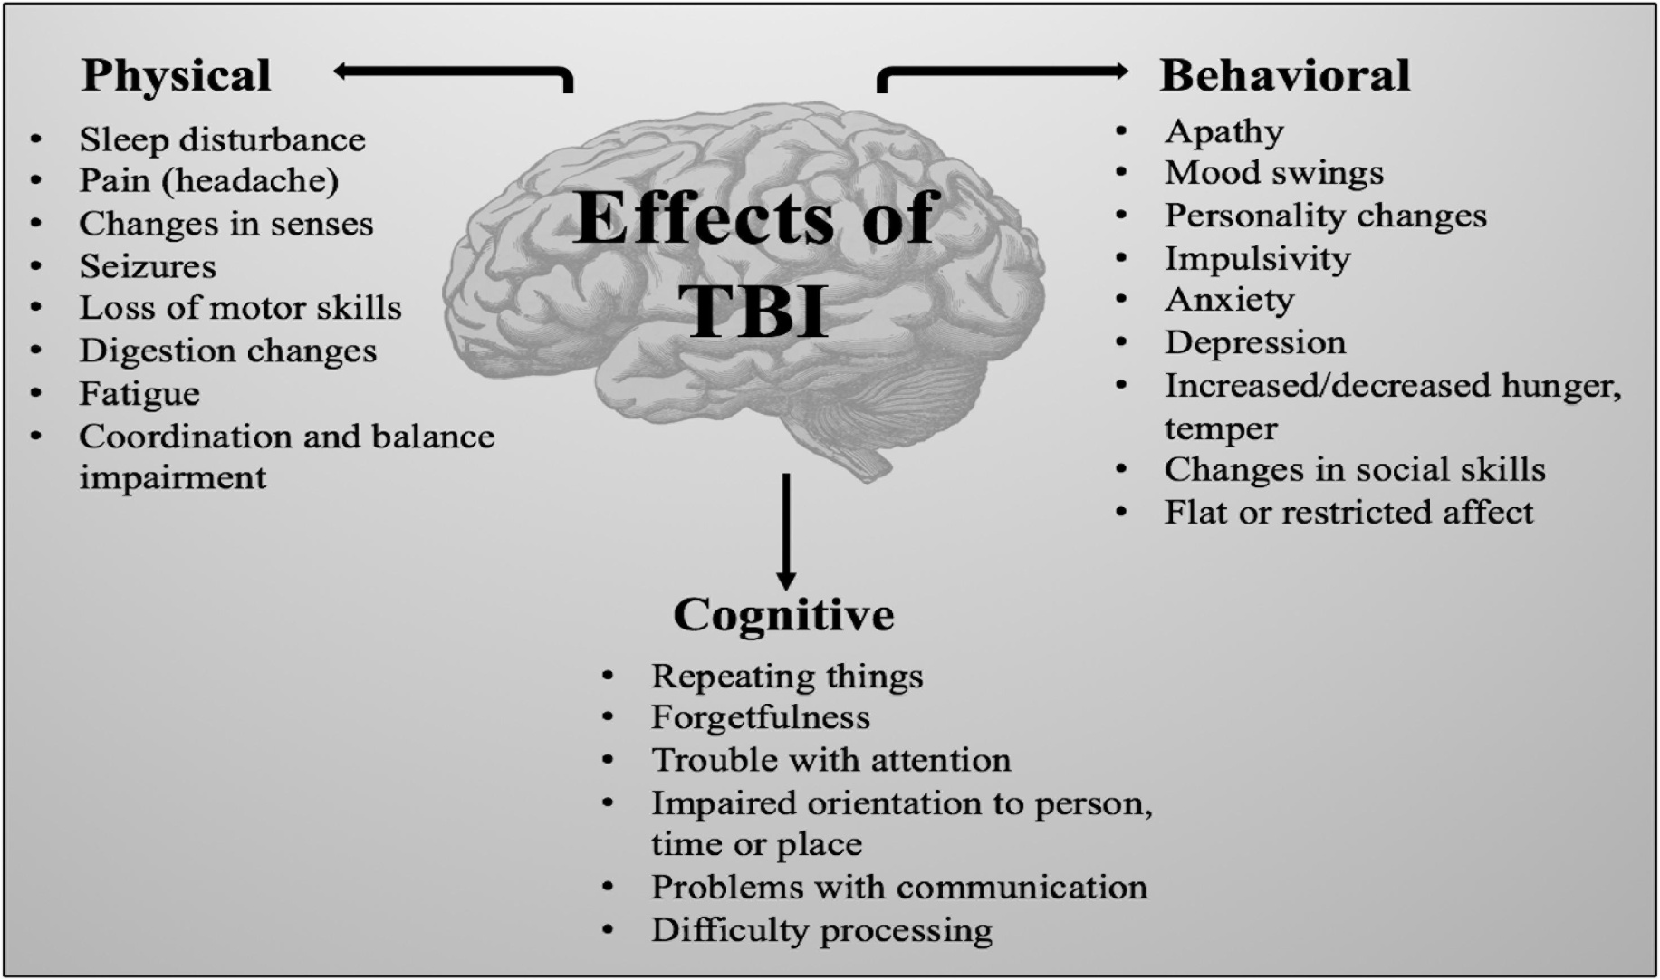
TRAUMATIC BRAIN INJURIES

Slide 34
TRAUMATIC BRAIN INJURIES
The symptoms of a severe head injury include:-
Loss of consciousness
Seizures
Vomiting
Balance or coordination problems
Serious disorientation
Inability to focus the eyes
Abnormal eye movements
Loss of muscle control
Persistent or worsening headache
Leaking of clear fluid from the ear or the nose

Slide 35
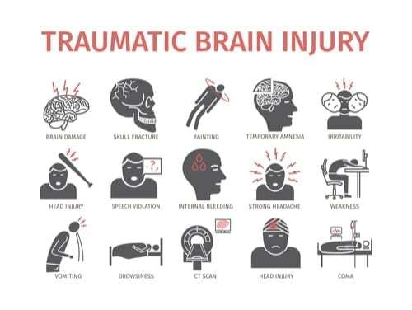
TRAUMATIC BRAIN INJURIES

Slide 36
TRAUMATIC BRAIN INJURIES
One of the first ways your doctor will assess your head injury is with the Glasgow Coma Scale (GCS)- (see next page)
The GCS is a 15-point test that assesses your mental status
A low GCS score indicates severe brain injury
CT Scan/ MRI are other ways of assessment of head injuries( next page- head CT scan of epidural hematoma)

Slide 37
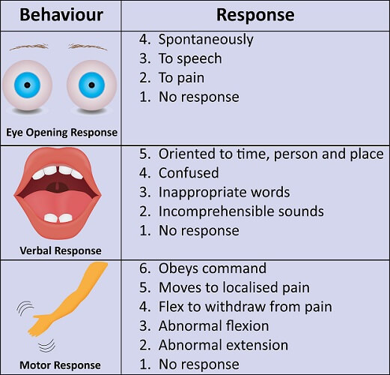
TRAUMATIC BRAIN INJURIES

Slide 38
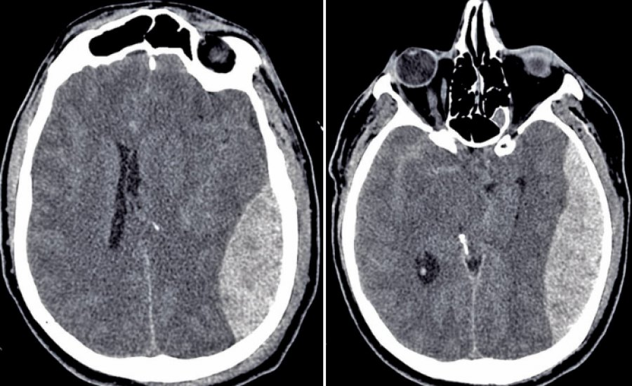
TRAUMATIC BRAIN INJURIES

Slide 39
TRAUMATIC BRAIN INJURIES
It may be necessary to do emergency surgery to prevent further damage to your brain
Doctor may need to operate to:-
remove a hematoma
repair your skull
release some of the pressure in your skull
If you’ve had a severe brain injury, you may be given anti-seizure medication
You’re at risk for seizures in the week following your injury

Slide 40
TRAUMATIC BRAIN INJURIES
If you’ve had a serious brain injury, you’ll most likely need rehabilitation to regain full brain function
The type of rehabilitation you get will depend on what functionality you’ve lost as a result of your injury
People who’ve had a brain injury will often need help regaining mobility and speech

