Slide 1
RENAL AND GENITAL_URINARY DISEASES
BY
VANE KEMUMA

Slide 2
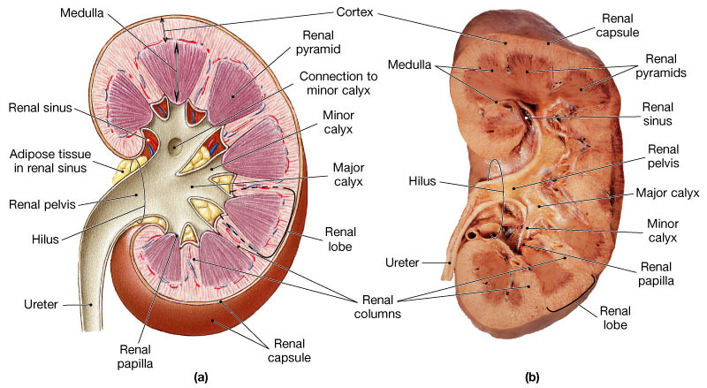
The structure of the kidneys

Slide 3
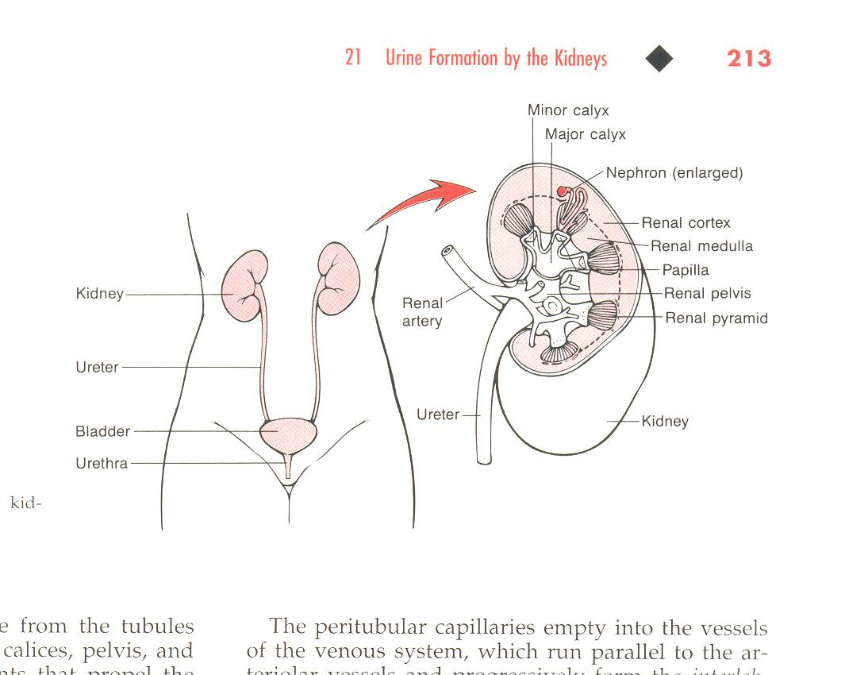
FUNCTIONAL ANATOMY.

Slide 4
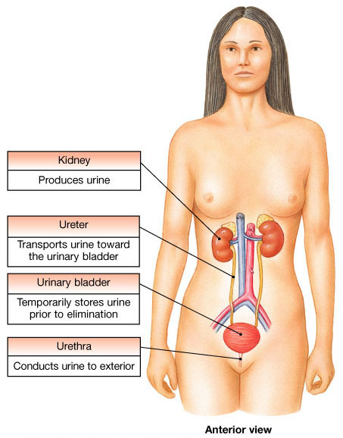

Slide 5
FUNCTIONAL ANATOMY.
Each human kidney has about 1.3million nephons.
Parts of a nephron include: afferent and efferent arteries, glomerular complex, ascending and descending tubules ,loop of Henle and collecting tubes.
Its an invagination of a tuft capillaries into a dilated , blind end of the nepron(Bowman’s capsule).
The capillaries are supplied by afferent arterioles and drained by efferent arterioles.

Slide 6
2 cell layers separate blood in the capillaries and the filtrate in the in Bowman’s capsule, and these layers are separated by a basal lamina.
Stellate cell (Mesangial cells) are located between basal lamina and the endothelium.
These cells are contractile and ,its role is to regulate glomerular filtration. They also secrete various substances, take up immune complexes, and production of glomerular disease.

Slide 7
FUNCTIONS OF THE KIDNEYS
Regulation of :
-water and electrolyte balance
-body fluids osmolarity and electrolyte concentration.
-acid-base balance
-Excretion of metabolic waste products and foreign chemicals.
-Regulation of arterial pressure.
-Secretion of hormones (e.g. erythropoietin,renin, 1,25-Dihydrocholecaciferol ,)

Slide 8
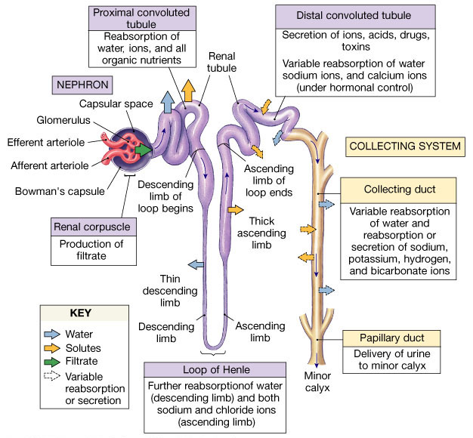
The Nephron.

Slide 9
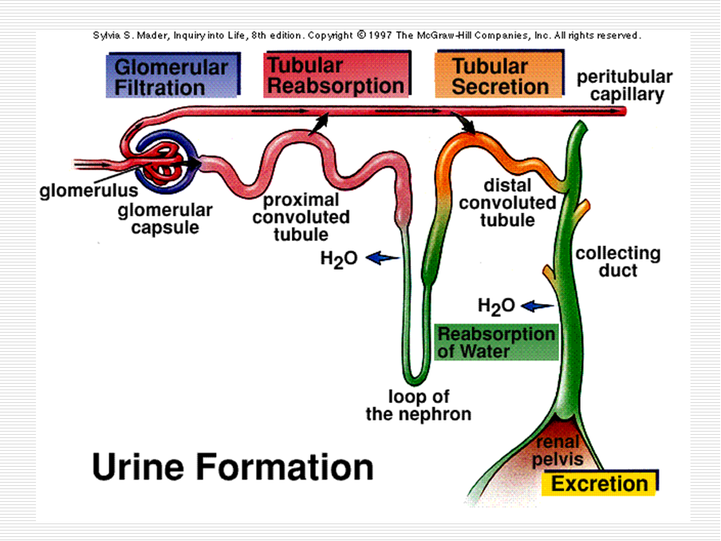
The nephron & Urine formation

Slide 10
Sphincter Muscles on Bladder
1.Internal urethral sphincter:
Smooth muscle
Involuntary control
More superiorly located
2.External Urethral sphincter:
Skeletal muscle
Voluntary control
Posteriorly locate

Slide 11
The Urethra
  Drains urine out of the bladder and body
Male: about 20 cm (8”) long
Female: 3-4 cm (1.5”) long
  Short length is why females have more urinary tract infections than males - ascending bacteria from stool contamination

Slide 12
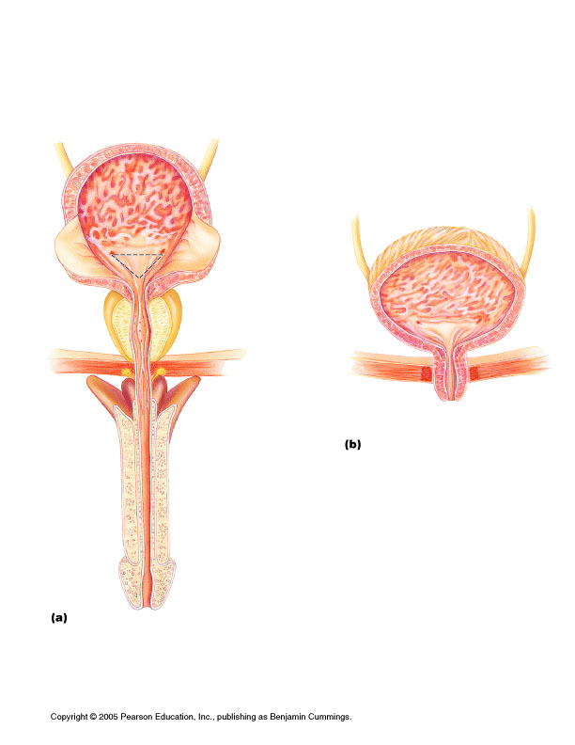
Males: urethra has three regions
female

Slide 13
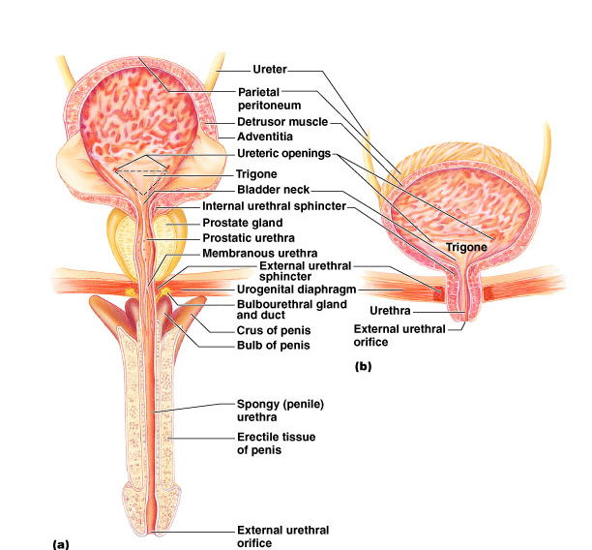

Slide 14
Investigative procedures
Intravenous urography (intravenous pyelography)
Urethrography
Cystogram
Cystoscopy
Urine analysis
Renal biopsy and scan
Renal function tests.

Slide 15
Intravenous urography.
The kidneys do not show up well on an ordinary X-ray of the abdomen.
This is a test that uses X-rays and a special dye to help assess the kidneys, ureters, bladder and urethra.
A contrast dye is injected into a vein. The dye travels in the bloodstream, concentrates in the kidneys, and is passed out into the ureters with urine made in by the kidneys.
There is greater detail of the internal structure.
It is also possible to assess roughly how well each kidney is working.

Slide 16
Urethrography
The radiographic sudy of the urethra using iodinated contrast media and is generally carried out in males.
A urethrogram is usually carried out to show the cause of poor urinary flow thought to be caused by narrowing (a stricture) of the urethra.
The most common cause for narrowing of the urethra in men is benign enlargement of the prostate gland.

Slide 17
Cystogram
Cystography is a diagnostic procedure that uses X-rays to examine the urinary bladder.
Contrast dye is injected into the bladder
May indicate how well the bladder empties during urination and whether any urine backs up into the kidney

Slide 18
Cystoscopy
Cystoscopy is a procedure to see the inside of the bladder and urethra using a telescope.
Cystoscope- A long, thin instrument with an eyepiece on the external end and a tiny lens and a light on the end that is inserted into the bladder.
The small lens magnifies the inner lining of the urethra and bladder, allowing clear visualization.

Slide 19
Urine analysis
Urinalysis is very a useful test in the diagnosis of and screening for many diseases and conditions.
Results of a urinalysis may be helpful in diagnosing :
urinary tract infections (UTIs)
Kidney diseases
Diabetes

Slide 20
Renal biopsy and scan
A renal biopsy is a procedure that involves taking a small sample of tissue from the kidney for laboratory analysis.
The biopsy is taken to:
Diagnose a suspected kidney problem
Determine the severity of kidney disease
Monitor treatment for kidney disease

Slide 21
There are two different ways to perform a renal biopsy.
The most common type of renal biopsy is called a percutaneous biopsy, or a renal needle biopsy. An ultrasound or computed tomography (CT) scan can be used to direct the needle to a specific area of the kidney.
Open biopsy—or surgical biopsy—This allows the physician to look at the kidneys and determine from which area the tissue samples should be taken.

Slide 22
Renal function tests
Kidney function tests are common lab tests used to evaluate how well the kidneys are working.
Such tests include:
BUN
Creatinine - blood
Creatinine clearance
Creatinine - urine

Slide 23
Thank you

Slide 24
Conditions
Pyelonephritis
Acute
chronic
Renal failure
Acute renal failure
Chronic renal failure

Slide 25
PYELONEPHRITIS
Inflammation of the nephron
Occurs when UTI progress to involve the upper urinary system
A potential serious infection that can cause severe septicemia
Almost always curable with antibiotics
Causes
Bacteria or virus
The bacteria can be carried to the kidneys through the blood stream
Can also ascent from the urethra and bladder

Slide 26
Those at Risk.
Those with bladder infection
Those with anatomical problems of the UT
-Enlarged prostate
- Renal stones
- VUR
Women- Short urethra, many sex partners

Slide 27
S&S
Fever
Back , side and groin pain
Nausea and vomiting
Chills Frequent painful urination/Increased urgency
Complications
Permanent renal scars
HTN
Renal failure

Slide 28
DX
Urinalysis
Urine culture
U/S
CT scan
DRE
Voiding cystourethrogram

Slide 29
MGT
Antibiotics
Bed rest
Repeat urine culture after rx
Hydration
Monitor input and output for chronic pyelonephritis
Monitor vital signs

Slide 31
RENAL FAILURE
Occur when kidneys cannot remove the body’s waste or perform their regulatory fn.
A systemic disease and a final common pathway for many different kidney UTIs
NB. There is an increase in the number of deaths from renal failure each year.

Slide 32
Acute Renal failure

Slide 33
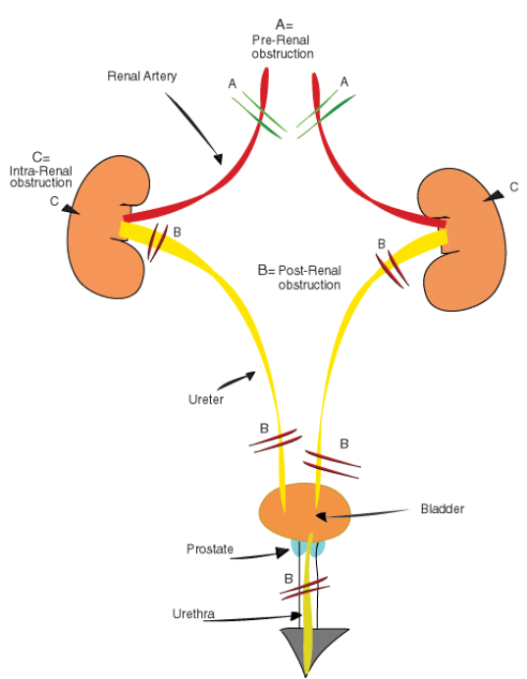

Slide 34
A rapid loss of renal function due to renal damage
RX is aimed at replacing renal function temporarily & reduce potential causes of increased renal injury with the goal of minimizing long term loss of renal function
An accepted criteria for dx ARF is 50% increase in serum creatinine above normal (Normal less that 1.0 mg|dc)

Slide 35
Urine volume may be normal
Possible changes may include;
Oliguria – Less than 500 mls|24 hrs
Anuria – Less than 50 mls
Non-oliguna –Normal vol. but high blood waste

Slide 36
Pathophysiology
Usually there is a specific underlying problem
Some factors may be reversible if identified early & treated promptly e.g hypovolemia, hypertension
Reduced cardiac output / heart failure
Obstruction of the kidneys or lower urinary tract tumor ; blood clot or kidney store
Bilateral obstruction of renal vessels

Slide 37
Types of ARF
Prerenal (hypertension of kidneys) – most common 60-70% of all cases
Intra renal-( Actual damage to the kidneys) eg acute tubular necrosis
Post renal (obstruction of renal flow)- Pressure increase due to back flow and decrease GFR

Slide 38
Acute Tubular Necrosis-Xtised by:
Intra tubular obstruction
Tubular back leak
Vasoconstriction
Changes of glomerular permeability
All these leads to:
Decrease in GFR
Progressive azotemia
Fluid and electrolyte imbalance

Slide 39
Specific caused of ARF
Pre renal failure
Volume depletion – hemorrhage ,renal/ GIT losses
Impaired cardiac efficiency – CCF ,MI , cardiogenic shock
Vasodilation – sepsis ,anaphylaxis ,any medication causing vasodilation

Slide 40
Intrarenal (intrinsic) failure
Prolonged renal ischemia
Occlusion of the renal tubules
Neprotoxic agents e.g. aminoglycoside – gentamycin
Heavy metals e.g. lead ,mercury
NSAIDS e.g. aspirin
ACE inhibitors – captopril , enalapril
Infection processes e.g. Pyelonephritis, AGN
ACE inhibitors

Slide 41
Post renal failure
Due to urinary tract obstruction e.g.
Calculi ,tumors, BPH
Strictures & blood clot

Slide 42
Phases of Acute Renal Failure
4 Phases-Initiation,oliguria,diuresis, recovery
Initiation Phase- starts with the initial insult and ends when oliguria develops
Oliguria phase- Accompanied by increase in blood metabolic waste.
Reduced urine output & hyperkalemia- Life threatening
N/B Some pts have decreased renal fn with normal urine output eg in nephrotoxic exposure

Slide 43
Diuresis phase- Marked with gradual increase in urine output
Laboratory values stabilize and eventually decrease
Although urine output may reach normal, renal fn may be abnormal
When the uremic symptoms are still present the specific medical and nursing mnx continues.
Observe pt for dehydration – may increase uremic symptoms

Slide 44
The recovery Phase
It signals the improvement of renal fn
May take 3-12 months
Lab values return to normal
Usually there is a permanent 1-3% loss in GFR but not clinically significant

Slide 45
Clinical manifestation
Almost all systems are affected with the failure of normal renal regulatory mechanism
Pt may appear critically ill, lethargic, and dehydrated
CNS symptoms-Headache ,drowsiness, twitching, seizures

Slide 46
Assessment & dx
Urine vol varies-scanty to normal
Hematuria
Low specific gravity
Low sodium in the urine
Other investigations
U/S
CT or MRI scan may show evidence of anatomical changes

Slide 47
BUN-Increase depend on degree of protein catabolism, renal perfusion and protein intake
Serum creatinine levels
Hyperkalemia-dysrhythmia and cardiac arrest
Metabolic acidosis-No excretion of any metabolic acid n the buffering mechanism fails- low PH
Calcium levels may be low-No reabsorption from intestines
Anaemia- Reduced erythropoietin production
- Blood loss- haematuria

Slide 48
MNX
Objective-Restore normal chemical balance and prevent complication until repair of renal tissue and restoration of renal fn can occur
Mnx include:
Eliminating the cause
Maintaining fluid balance
Avoiding fluid excess
When indicated provide renal replacement therapy.

Slide 49
Pharmacologic Therapy
Hyperkalemia is the most life threatening
Monitor for potassium elevation
ECG-peaked T-Wave
S&S
Irritability, abdominal cramping, diarrhoea
Paresthesia & generalised muscle weakness
As the levels increase Muscular and cardiac failure occurs- Medical emergency

Slide 50
Mnx of Hyperkalemia:
If there is moderate elevation and no ECG abnormalities, excresion can be enhanced by use of Cation Exchange resin or diuresis
Sodium polystyrene orally
Retention enema
Avoid the source eg intake
In severe hyperkalemia, Discontinue all the exogenous source
Definitive therapy- Dialysis

Slide 51
If patient is haemodynamically unstable-hypotension or QRS waidening, IV 50%D, insulin and calcium replacement may be given to shift potassium back to the cell.
Reduce dosages of drugs since elimination is by the failing kidneys
Monitor arterial blood gasses

Slide 52
Nutritional Therapy
ARF causes nutritional imbalance-nausea vomiting
Weigh pt daily-Loss 0.2-0.5kg –Normal
If pt gains or no loss in wt or develops hypertension, fluid retention is suspected
Protein replacement is individualized-growth and tissue repair only
Carbohydrate is increased
Foods containing potassium are restricted eg bananas, citrus fruits

Slide 53
Nursing Mnx
Monitor complications
Participate in emergency rx of fluid and electrolyte imbalance
Assess pt progress and response to therapy
Provide physical and emotional support
Keep family informed of the progress and provide psychological support
Provide care for the primary disorder

Slide 54
Eliminate any source of potassium
Monitor musculoskeletal and cardiac fn for signs of hyperkalemia
Monitor fluid intake, urine output, edema distension of jungular vein, laboured breathing,
Bed rest-reduce metabolic rate
Treat fever n infection – increase metabolism
Avoid an indwelling catheter-Risk of UTIs
Skin care
Any other supportive care

Slide 55
Chronic Renal Failure

Slide 56
Also called end stage renal disease.
Def: A progressive loss in renal function over a period of months or years
When renal fn decline waste products accumulate.
The greater the buildup of waste the more pronounced the symptoms are

Slide 57
Those At Risk
Those with high blood pressure
or diabetes
Those with a blood relative with chronic kidney disease

Slide 58
Clinical Manifestations
Neurologic
Weakness and fatigue
Confusion
Inability to concentrate
Disorientation
Tremors
Burning sensation of foot
Behaviour changes

Slide 59
Integumentary
Dry flaky skin
Pruritus
Ecchymosis
Thin brittle nails
Coarse thinning hair
CVS
Hypertension, Pericarditis, Pericardial effusion
Pitting edema, Periorbital edema
Engorged neck veins

Slide 60
Pulmonary
Crackles, Thick tenacious sputum, depressed cough reflex, pleuritic pain, Shortness of breath, Tachypnea
GIT
Ammonia breath
Metallic taste, anorexia nausea n vomitting, Hiccups, Mouth ulceration, Bleeding from GIT

Slide 61
Musculoskeletal
Muscle crumps,
Loss of muscle strength,
Bone pain, Bone fractures,
Foot drop.

Slide 62
Assessment and diagnosis
GFR
Sodium and water retention
Acidosis
Anemia
Complications
Hyperkalemia
Hypertension
Anemia
Bone disease

Slide 63
Stages of chronic renal failure
Stage 1 with normal or high GFR (GFR > 90 mL/min)
Stage 2 Mild CKD (GFR = 60-89 mL/min)
Stage 3A Moderate CKD (GFR = 45-59 mL/min)
Stage 3B Moderate CKD (GFR = 30-44 mL/min
Stage 4 Severe CKD (GFR = 15-29 mL/min)
Stage 5 End Stage CKD (GFR <15 mL/min)

Slide 64
MGT
The goal is to maintain kidney fn as long as possible
Pharmacotherapy
Calcium and phosphorus binders
Calcium carbonate
Calcium Acetate
Avoid magnesium antacids to avoid toxicity

Slide 65
Anti hypertensive and cardiovascular agents
Intravascular vol control
Fluid restriction
Low sodium diet
Diuretic agents
Inotropic agents eg digoxin

Slide 66
Antizeizure Agent
Observe for neurological abnormalities eg twitching, headache
Raise side rails
IV diazepam/ Phentoin
Erythropoietin- Epogen
Administered 3 times a week IV or SC

Slide 67
Nutrition
Careful regulation of protein intake, fluid intake and potassium
Adequate caloric intake and vitamin supplements
Eliminate potassium containing foods
Kayexalate for severe hyperkalemia
Dialysis – Hemodialysis
Peritonial dialysis

Slide 68
Nursing management
Asses fluid status
Identify potential source for imbalance
Implement the dietary program
Psychological support
Provide explanation and information on the disease

Slide 69
DIALYSIS
Helps the body to perform the fns of the failing kidneys.
Dialysis is the mechanical process of removing nitrogenous wastes from blood by imitating the function of nephron
Definition
Artificial process that partially replaces renal function
Removes waste products from blood by diffusion (toxin clearance)
Removes excess water by ultrafiltration (maintenance of fluid balance)
Wastes and water pass into a special liquid – dialysis fluid or dialysate

Slide 70
There are two types of dialysis
Hemodialysis uses a machine. (Artificial kidney).
Usually done 3 times a week with treatment duration of 3-4 hours.
2. Peritoneal dialysis uses the lining of the abdomen, the peritoneal membrane, to filter the blood.
Both types filter blood to rid of harmful wastes, extra salt, and water.

Slide 71
Hemodialysis
Hemodialysis is the most common method used to treat advanced and permanent kidney failure.
The blood is allowed to flow, a few mls at a time, through a special filter that removes wastes and extra fluids.
The objective is to extract toxic nitrogenous substances from blood and remove excess water.
The clean blood is then returned to the body.

Slide 72
Removing the harmful wastes and extra salt and fluids helps control the blood pressure and keep the proper balance of chemicals like potassium and sodium in the body.
The blood passes to the dialysis machine, through a filter, and back to the patient.
In the dialysis machine, a solution on the other side of the filter receives the waste products from the patient.

Slide 73
This is therapy involving separation of smaller (diffusible) particles from larger (non diffusible) particles in the blood through a semipermeable membrane
Usually employed when a patient’s kidneys fail to remove these particles from blood.

Slide 74
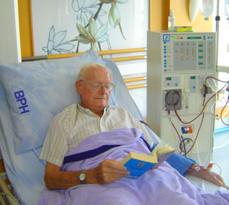

Slide 75
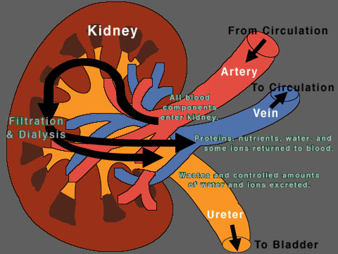

Slide 76
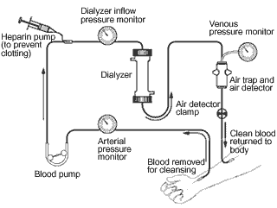
Hemodialysis

Slide 77
Principles of Hemodialysis
The principles of HD are based on the passive transfer of toxins, which is accomplished by diffusion.
When HD is initiated, blood and dialysate flow in opposite directions from their respective sides of an enclosed semi permeable membrane.
The dialysate is a balanced mix of electrolytes and water that closely resembles human plasma.
On the other side of the membrane is the client’s blood, which contains metabolic waste products, excess water, and excess electrolytes.

Slide 78
During HD, the waste products move from the blood into the dialysate because of the difference in their concentrations (diffusion).
Excess water is also removed from the blood into the dialysate (osmosis).
Electrolytes can move in either direction, as needed, and take some fluid with them.
Potassium and sodium typically move out of the plasma.

Slide 79
This process continues as the blood and the dialysate are circulated past the membrane for a preset length of time.
Duration and frequency of HD tx depend on the amt of metabolic waste to be cleared, and the amt of fluid to be removed.

Slide 80
Sites of Access
Internal Jugular Vein
Primary site of choice due to lower associated risk of complication and simplicity of catheter insertion.
Femoral Vein
Patient immobilized, the femoral vein is optimal and constitutes the easiest site for insertion.
Subclavian Vein
The least preferred site given its higher risk of pneumo/hemothorax and its association with central venous stenosis

Slide 81
Vascular Access
Arteriovenous fistula
Arteriovenous shunt
Arteriovenous graft
Subclavian vein catheterization
Femoral vein catheterization

Slide 82
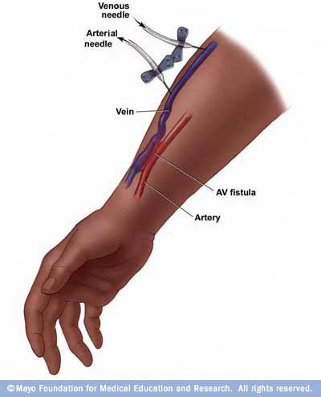

Slide 83
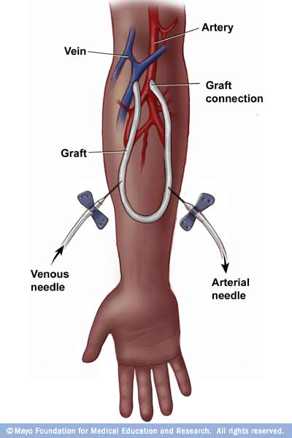

Slide 84
Intratherapy Monitoring
  Blood pressure
  Patency of circuit
  Hemodynamic stability
  Level of consciousness
  Acid/base balance
  Electrolyte balance
  Hematological status
  Infection
  Nutritional status
  Air embolus

Slide 85
Cont…..
  Blood flow rate
  Ultrafiltration flow rate
  Dialysate/replacement flow rate
  Alarms and responses
  Color of ultrafiltrate/filter blood leak

Slide 86
Client Teaching
Care of venous access site
Notifying doctor of any signs of infection
To avoid any pressure or procedure on the arm
Avoid showering or swimming several hours after procedure
Exercises on the arm to promote circulation
If performing dialysis at home then reinforce the teaching of the procedure
Link him/her to patient support Centre

Slide 87
Complications
Anemia
Gastric ulcers
Vomiting
Worsening calcium metabolism

Slide 88
Air embolism
Excessive bleeding
Infections- hepatitis, HIV
Hypotension
Headache
Nausea and vomiting
Malaise
Dizziness
Fever
Muscle cramps
Chronic anemia

Slide 89
Break………… ???

Slide 90
Peritoneal dialysis
Uses the patients own body tissues inside of the belly (abdominal cavity) to act as the filter.
A special fluid is flushed into the abdominal cavity and washes around the intestines.
The intestinal walls act as a filter between this fluid and the blood stream.
By using different types of solutions, waste products and excess water can be removed from the body through this process.

Slide 91
The patient's responsibility is maintaining a clean surface on the abdomen, where treatment is administered, in order to prevent infection.

Slide 92
Uses natural membrane (peritoneum) for dialysis
Access is by PD catheter, a soft plastic tube
Suitability
  Excludes patients with prior peritoneal scarring e.g. peritonitis, laparotomy
  Excludes patients unable to care for self

Slide 93
Is a type of dialysis whereby a sterile solution containing minerals and glucose is run through a tube into the peritoneal cavity, where peritoneal membrane acts as a semi permeable membrane .

Slide 94
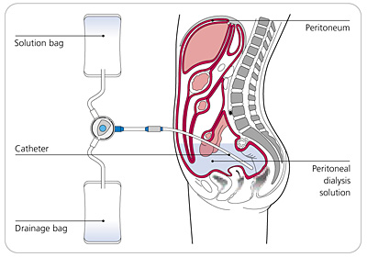

Slide 95
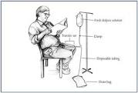

Slide 96
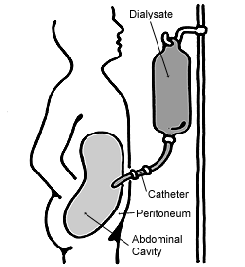

Slide 97
  The dialysate is left for a period of time to absorb waste products, then its drained out through the tube and discarded.
  10 minutes for dialysate to run in, 30 minutes dwell time , and 20 minutes for dialysate to run out.

Slide 98
  Principles of peritoneal dialysis
  Ultrafiltration occurs via diffusion and osmosis. dialysis solution contains high concentration of glucose and the resulting osmotic pressure causes fluid to move from the blood into the dialysate and as a result more fluid is drained than was installed.
  Peritoneal dialysis is less efficient than hemodialysis, but because its carried out for a longer period of time the net effects in terms of removal of waste products are similar to hemodialysis

Slide 99
PD can be carried out at home by the patient, and it can be done while travelling with a minimum of specialized equipment

Slide 100
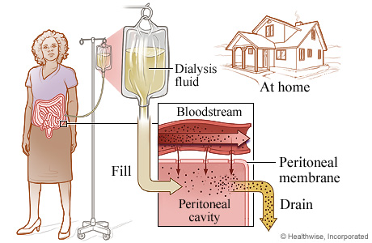

Slide 101
Advantage of PD.
Relatively simple and inexpensive.
Can be performed by unskilled person

Slide 102
Disadvantages
Contraindicated in the presence of abdominal trauma, abdominal sepsis or post abdominal surgery.
Presence of dialysate fluid in the peritoneum can cause abdominal distension and resist diaphragmatic movement.

Slide 103
Can cause uremia especially in catabolic pts.
Proteins can be lost across peritoneum causing difficulty in maintaining positive nitrogen balance.
Increased risk of peritonitis.
Nursing interventions.
Peritoneal dialysate fluid must be warmed prior to infusion to prevent hypothermia.
Monitor blood glucose levels regularly.
Add potassium (2-4mmol) to the dialysate to regulate body potassium.

Slide 104
COMPLICATIONS.
peritonitis.
Leads to weight gain and a change in appearance from distended abdomen.
Diarrhea or constipation.
Pleural effusion leading to difficulty in

Slide 105
Cont……
Intestinal perforation during placement.
Bleeding.
Delayed gastric emptying leading to nausea, vomiting , fullness or discomfort.
Metabolic hypokalemia.

Slide 106
Thank you
????????????????
??????????????????????????????????

Slide 107
TUBERCULOSIS OF THE KIDNEYS
In the kidneys, when multiple granuloma form at the site of metastatic foci, they are typically bilateral, cortical, and adjacent to the glomeruli,
They may remain inactive for decades.
Although both kidneys are seeded, clinically significant disease, which is caused by capillary rupture and delivery of proliferating bacilli into the proximal tubules usually develops in only one kidney.

Slide 108
Growing granuloma may erode into the calyceal system, spreading the bacilli to the renal pelvis, ureters, bladder, and other genitourinary organs.
Depending on the status of the patient's defense mechanisms, fibrosis and strictures may develop with chronic abscess formation.

Slide 109
Extensive lesions can result in nonfunctioning kidneys.
Hypertension in persons with renal tuberculosis (TB) is twice as common as it is in the general population.
Caused by Mycobacterium tuberculosis,

Slide 110
Pathophysiology
It results from hematological spread
Multiple micro-abscess develop forming inactive granulomas and remain quiet for long.
Usually there is a long latency period btn primary infection and clinical presentation which occur with compromised host immunity
The inactive granulomas reactivate, grow and eventually spread to the calyces leading to downstream infection.

Slide 111
Persons with GUTB rarely display the typical symptoms of TB.
GUTB Symptoms are generally chronic, intermittent, and nonspecific.
GUTB often manifests as repeated urinary tract infections that do not respond to the usual antibiotics.

Slide 112
Clinical manifestations
increased frequency of urination
dysuria,
flank pain,
Supra pubic pain,
Blood or pus in the urine
fever.
Urinary urgency is relatively uncommon unless the bladder is extensively involved.

Slide 113
Patients with GUTB may also present with a painful testicular swelling, perianal sinus, or genital ulcer.
N/B Unexplained infertility in both men and women is sometimes attributable to GUTB

Slide 114
MGT
Multi-drug treatment
Nephrectomy

Slide 115
Mgt of extra pulmonary TB
Modern short-course antituberculosis drug regimens are effective in all forms of tuberculosis.
They are based on an initial 2-mo intensive phase of 4 treatment drugs—rifampicin, isoniazid, pyrazinamide, and ethambutol (or streptomycin)—are given (RHZE)
These destroy almost all tubercle bacilli.

Slide 116
This is followed by a 4-mo continuation phase in which only rifampicin and isoniazid are given (RH)
Eliminating the few remaining near-dormant, persisting bacilli.
For success, all doses must be taken,
Failure to comply with therapy is the major cause for treatment failure
The World Health Organization has stressed the importance of direct supervision of therapy. (DOT)

Slide 117
Supportive Care.
Follow up to promote adherence
Monitor for toxic reactions to medications, and to ensure that the tuberculosis is being adequately treated.
Adequate nutrition is important- indicated by wt gain.
Patients should be seen at monthly intervals and should be given just enough medication to last until the next visit.

Slide 118
Monitoring
Adherence
Weight gain
Reduction in temperature
Adverse effects
Symptom assessment

Slide 119


Slide 120
There are different types of kidney stones.
The cause of the problem depends on the type of stone.
Some types run in families.
Stones can form when urine contains too much of certain substances that form crystals.
These crystals can develop into stones over weeks or months.

Slide 121
Chance of recurrence is about 50%
Men are more often affected than women
Calcium stones are most common.
They are most likely to occur in men between ages 20 – 30 years.
Calcium can combine with other substances to form the stone.

Slide 122
Oxalate is the most common of these.
Oxalate is present in certain foods such as spinach.
It's also found in vitamin C supplements.
Diseases of the small intestine increase the risk of these stones.

Slide 123
The biggest risk factor for kidney stones is not drinking enough fluids.
Kidney stones are more likely to occur if you make less than 1 liter of urine a day.

Slide 124
S&S
symptoms may not be present until the stones move down the ureters
Block the flow of urine out of the kidneys.
The main symptom is severe pain that starts suddenly and may go away suddenly:
Pain may be felt in the belly area or side of the back.
Pain may move to groin area (groin pain) or testicles (testicle pain).

Slide 125
Other symptoms can include:
Abnormal urine color
Pain on urination
Pink, red or brown urine
Cloudy or foul-smelling urine
Blood in the urine
Chills
Fever
Nausea
Vomiting
Acute flank pain
Urinary urgency or frequency

Slide 126
DX
History
Physical
Blood tests to check calcium, phosphorus, uric acid, and electrolyte levels
Kidney function tests
Urinalysis to see crystals and look for red blood cells in urine
Examination of the stone to determine the type

Slide 127
DX CONT…….
Stones or a blockage can be seen on:
Abdominal CT scan
Abdominal/kidney MRI
Abdominal x-rays
Intravenous pyelogram (IVP)
Kidney ultrasound
Retrograde pyelogram

Slide 128
RX
Treatment depends on the type of stone and the severity of symptoms.
Kidney stones that are small usually pass through the system on their own.
The urine should be strained so the stone can be saved and tested.
Drink at least 6 - 8 glasses of water per day to produce a large amount of urine. This will help the stone pass.
Over the counter analgesics (e.g. ibuprofen, naproxen), either alone or along with narcotics, can be very effective.
IV fluids may be required.

Slide 129
For some types of stones, some medicines prevent stones from forming or help break down and remove the material that is causing the stone.
Allopurinol (for uric acid stones)
Antibiotics (for struvite stones)
Diuretics
Phosphate solutions
Sodium bicarbonate or sodium citrate
Water pills (thiazide diuretics)

Slide 130
Surgery is often needed if:
The stone is too large to pass on its own.
The stone is growing.
The stone is blocking urine flow and causing an infection or kidney damage.
The pain cannot be controlled.

Slide 131
Lithotripsy is used to remove stones slightly smaller than a half an inch that are located in the kidney or ureter.
It uses sound or shock waves to break up stones. Then, the stone fragments leave the body in the urine.
It is also called extracorporeal shock-wave lithotripsy or ESWL.

Slide 132
Procedures performed by passing a special instrument through a small surgical cut in the skin and into kidney or ureters are used for large stones in or near the kidney.
The stone is removed with a tube (endoscope).
Ureteroscopy may be used for stones in the lower urinary tract.

Slide 133
Prevention
Prevention of kidney stones may include a combination of lifestyle changes and medications.
Drink water throughout the day.
for people with a history of kidney stones, usually recommend passing about 2.5 liters of urine a day.
Eat fewer oxalate-rich foods eg spinach, Swiss chard, sweet potatoes, nuts, tea, chocolate and soy products.

Slide 134
Choose a diet low in salt and animal protein. Reduce the amount of salt and choose nonanimal protein sources, such as legumes.
Continue eating calcium-rich foods, but use caution with calcium supplements.

Slide 136
Renal trauma
Renal trauma may manifest in a dramatic fashion for both the patient and the clinician.
Renal trauma accounts for approximately 3% of all trauma admissions and as many as 10% of patients who sustain abdominal trauma.
At most trauma centers, blunt trauma is more common than penetrating trauma

Slide 137
Classification
renal laceration,
renal contusion,
and renal vascular injury.
All subsets of renal trauma require a high index of clinical awareness and prompt evaluation and management.

Slide 138
Causes
Penetrating eg, gunshot wounds, stab wounds
Blunt - Rapid deceleration eg, motor vehicle crash, fall from heights; direct blow to the flank eg, pedestrian struck, sports injury
Iatrogenic eg, endourologic procedures, extracorporeal shock-wave lithotripsy, renal biopsy, percutaneous renal procedures

Slide 139
Intraoperative eg, diagnostic peritoneal lavage
Other eg, renal transplant rejection, childbirth may cause spontaneous renal lacerations

Slide 140
Presentation
Flank or abdominal pain.
Urinalysis, both gross and microscopic, should be performed in patients who are thought to have renal trauma.
Based on these initial measures, radiographic or operative investigation may follow.

Slide 141
Grading
Renal trauma grading is often done according to depth of damage and involvement of the urinary collecting system and renal vessels:
grade I - contusion or non enlarging subcapsular haematoma, but no laceration
grade II - superficial laceration <1cm depth and does not involve the collecting system; non expanding perirenal haematoma

Slide 142
grade III - laceration >1cm, without extension into the renal pelvis or collecting system and with no evidence of urine extravasation
grade IV
  laceration extends to renal pelvis or urinary extravasation
  vascular : injury to main renal artery or vein with contained haemorrhage
grade V
  shattered kidney

Slide 143
Manifestations
Flank pain (kidney pain),
Bloody urine,
No urine production (anuria),
Decreased urine output (oliguria).

Slide 144
Tests for Renal trauma
A history
Physical exam will be performed.
A CT scan is the most common test used to see kidney injury after trauma.
Tests
Complete blood count (CBC), CT Scan, MRI, Ultrasound and Urinalysis (UA)
Additional tests that may be required
Intravenous pyelography (IVP), angiography,

Slide 145
RX
Nonoperative treatment-
If trauma is not extensive, healing may occur spontaneously
Percutaneous drainage of perinephric fluid collections or urinomas
Endourologic stenting
Surgical Therapy
Urinary extravasation
Incomplete staging
Arterial thrombosis
Penetrating trauma

Slide 146
Complications
Early complications, those that occur within 1 month of injury, include delayed bleeding, urinary fistula, abscess, and hypertension.
Prolonged urinary extravasation is the most common complication after renal trauma

Slide 147
Late complications
hydronephrosis,
arteriovenous fistula,
pyelonephritis,
calculus formation,
delayed hypertension.

Slide 149
BPH
Benign prostatic hyperplasia (BPH) is an increase in size of the prostate gland without malignancy present.
It is so common as to be normal with advancing age
The prostate secretes about 70% of the volume of seminal fluid.
It is a hormone-dependent gland and BPH does not occur in castrated men.

Slide 150
BPH
The prostate is located in front of the rectum and just below the bladder.
The prostate also surrounds the urethra.
One of its main roles is to produce fluid into the urethra as sperm move through during sexual climax.
This fluid energizes the sperm and makes the vaginal canal less acidic.
It is common for the prostate gland to become enlarged as a man ages

Slide 151
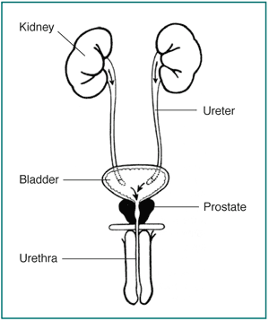
Normal flow of urine

Slide 152
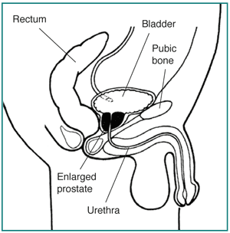
Urine flow with BPH

Slide 153
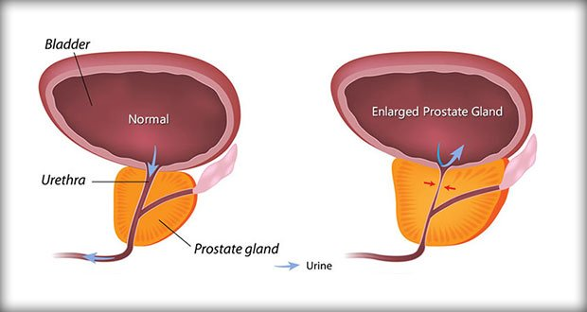

Slide 154
SnS
Urinary frequency is often a presenting symptom.
When enquiring about urinary frequency, it is necessary to distinguish frequent passage of small volumes from polyuria.
Urinary urgency may occur and manifests as a need to pass urine quickly for fear of incontinence.
Hesitancy is when he has to stand at the toilet for a while before he can initiate micturition.
There is usually a poor stream and dribbling too and he may stop during the act.
Incomplete bladder emptying gives the sensation of still having urine in the bladder, no matter how often he goes.
He may even be able to pass more immediately after he has finished.

Slide 155
Nocturia
Hematuria
DX
Hx taking
physical exam

Slide 156
Examination
Abdominal exam includes checking for a palpable bladder.
This may indicate chronic outflow obstruction or a neurogenic bladder.
To exclude the latter, an enquiry about motor or sensory loss along with checking knee and ankle jerks and plantar responses should suffice.
Digital rectal examination (DRE) includes noting the tone of the anal sphincter and the pelvic floor. The size of the prostate is assessed.

Slide 157
Investigation
Urine
Check urine by dipstick and send MSU for microscopy and culture.
Blood
Routine blood tests include:
  U&E and creatinine
  FBC
  LFTs
Abnormal LFTs may indicate other disease. Isolated elevation of alkaline phosphatase can occur:
  If the prostate is malignant and has metastasized to bone.

Slide 158
PSA is elevated with a large, benign prostate. Abdominal ultrasound or intravenous urography may be required.
Residual bladder volume is measured immediately after voiding
Endoscopy may be required.

Slide 159
Management
Immediate catheterization if patient cannot void (an urologist may be consulted if an ordinary catheter cannot be inserted).
A suprapubic cystostomy is sometimes necessary.
“Watchful waiting” to monitor disease progression.

Slide 160
Alpha adrenergic blockers reduce the tone in the muscle of the neck of the bladder.
Surgery is usually reserved for those with a large prostate or failure to respond to an adequate trial of medical therapy.
Surgery is required if there is
Acute urinary retention,
Failed voiding trials,
Recurrent gross haematuria,
UTI, renal insufficiency due to obstruction
Failure of medical treatment.

Slide 161
Nursing Priorities
Relieve acute urinary retention.
Promote comfort.
Prevent complications.
Help patient deal with psychosocial concerns.
Provide information about disease process/prognosis and treatment needs.

Slide 162
Complications^{[3]}
Bladder outlet obstruction can result in:
Urinary retention:
Recurrent UTI, especially with incomplete emptying
Impaired renal function:
Bladder calculi (may present as ongoing recurrent infections).
Haematuria - may be microscopic or macroscopic.

Slide 163
Patients on medical treatment should have symptoms assessed every six months.
Every year PSA and DRE should be repeated.

Slide 164
Discharge Goals post surgery
Voiding pattern normalized.
Pain/discomfort relieved.
Complications prevented/minimized.
Dealing with situation realistically.
Disease process/prognosis and therapeutic regimen understood.
Plan in place to meet needs after discharge.

Slide 165
Hypospadias
Hypospadias is (congenital) defect in which the opening of the urethra is on the underside of the penis.
In males, the opening of the urethra is normally at the end of the penis.
Hypospadias occurs in up to 4 in 1,000 newborn boys. The cause is often unknown.
Sometimes, the condition is passed down through families.

Slide 166
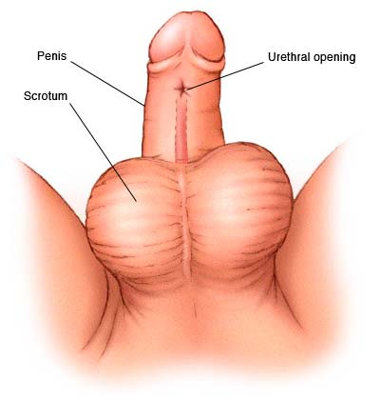

Slide 167
SnS
Symptoms depend on how severe the problem is.
Usually, boys with this condition have the opening of the urethra near the tip of the penis on the underside.
More severe forms of hypospadias occur when the opening is in the middle or base of the penis.
Rarely, the opening is located in or behind the scrotum.
This condition may cause a downward curve of the penis during an erection. Erections are common in infant boys.

Slide 168
Other symptoms include:
Abnormal spraying of urine
Having to sit down to urinate
Foreskin that makes the penis looks like it has a "hood"

Slide 169
Exams and Tests
Diagnosed soon after birth during a physical exam.
Imaging tests may be done to look for other congenital defects.
Treatment
Infants with hypospadias should not be circumcised. The foreskin should be kept for use in later surgical repair.

Slide 170
Surgery is usually done before the child starts school.
Most urologists recommend repair before the child is 18 months old.
During the surgery, the penis is straightened and the opening is corrected using tissue grafts from the foreskin.
The repair may require multiple surgeries.

Slide 171
Risk factors
Family history.
Maternal age over 40.
Exposure to smoking and chemicals.

Slide 172
Epispadia
Epispadias is a rare birth defect located at the opening of the urethra.
In this condition, the urethra does not develop into a full tube and the urine exits the body from an abnormal location.
The causes of epispadias are unknown at this time.
In boys with epispadias, the urethra generally opens on the top or side of the penis rather than the tip.

Slide 173
It is possible for the urethra to be open along the entire length of the penis.
In girls, the opening is usually between the clitoris and the labia, but may be in the belly area.
The condition is usually diagnosed at birth or shortly thereafter.

Slide 174
Symptoms
In males:
Abnormal opening from the joint between the pubic bones to the area above the tip of the penis
Backward flow of urine into the kidney (reflux nephropathy)
Short, widened penis with an abnormal curvature
Urinary tract infections
Widened pubic bone

Slide 175
In females:
Abnormal clitoris and labia
Backward flow of urine into the kidney (reflux nephropathy)
Widened pubic bone
Urinary incontinence
Urinary tract infections

Slide 176
Diagnosis
Blood test to check electrolyte levels
Intravenous pyelogram (IVP), a special x-ray of the kidneys, bladder, and ureters
MRI and CT scans, depending on the condition
Pelvic x-ray
Ultrasound of the urogenital system

Slide 177
Treatment
Surgical repair of epispadias is recommended in patients with more than a mild case.
Leakage of urine (incontinence) may require a second operation.
Surgery generally leads to the ability to control the flow of urine and a good cosmetic outcome.
Upper urinary tract (ureter and kidney) damage and infertility may occur.

Slide 178
Thank you
Have a health urinary system!!!

Slide 179
