Slide 1
REPRODUCTIVE HEALTH AND MIDWIFERY
BY
PIUS KORIR

Slide 2
MALE REPRODUCTIVE SYSTEM
Objectives
Relate the structure (anatomy) and functions (physiology) of male reproductive system.
Elaborate the process of sperm production(spermatogenesis).
Apply concepts of RH in providing quality maternal and newborn care.

Slide 3
MALE REPRODUCTIVE SYSTEM

Slide 4
MALE REPRODUCTIVE SYSTEM
External Male Genitalia
Consists of:
Scrotum (Scrotal Sac)
Scrotum literally means "pouch" or "sac"
It is thin-walled, soft muscular pouch/sac of skin that is incompletely divided into left and right halves. It hangs behind the penis.

Slide 5
MALE REPRODUCTIVE SYSTEM
Each half houses one testis.
The appearance of the scrotum changes with temperature.
At lower temperatures (cold or sexual arousal) , the scrotum appears shorter and quite wrinkled, because Cremaster muscle contracts and pulls it closer to the body for warmth.
At higher temperatures (Heat), the scrotum loosens and the testes hang low because Dartos muscle relaxes to bring down the scrotum away from the body to keep them cool.
It also contains numerous nerves and blood vessels.

Slide 6
MALE REPRODUCTIVE SYSTEM
Function
Suspends the testes outside the body keeping them at a temperature slightly lower than that of the rest of the body.
A temperature of between 34.4 to 36.5 degrees is favorable for viable sperm production. Above 36.7 degrees is damaging to sperm count.

Slide 7
MALE REPRODUCTIVE SYSTEM

Slide 8
MALE REPRODUCTIVE SYSTEM
2. Penis
Copulatory and urinary organ of the external male genitalia.
Two regions; the root and the body (shaft)
Contains 3 compartments of erectile tissue which are covered by a loose layer of skin.
Two "corpora cavernosa"
One "corpus spongiosum" which lies ventrally in the penis and houses the spongy urethra. Expands at the end of the penis into the "glans penis".

Slide 9
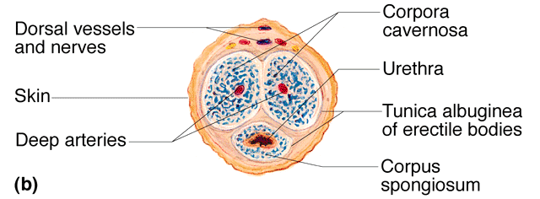
MALE REPRODUCTIVE SYSTEM
When aroused, there is an increase in blood supply into the penis, these compartments fill and expand leading to erect penis – compression of vessels prevents blood flow out.

Slide 10
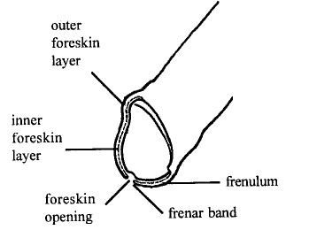
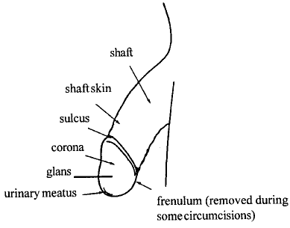
MALE REPRODUCTIVE SYSTEM
In uncircumcised males there is a structure that covers the end of the glans penis called the "prepuce or foreskin".
Its proposed functions include protection, lubrication of glans, part of sexual pleasure system.

Slide 11
MALE REPRODUCTIVE SYSTEM

Slide 12
MALE REPRODUCTIVE SYSTEM
Internal Male Genitalia
Comprises the following organs;
Urethra
Testes
Epididymis
Vas deferens
Seminal vesicles
The ejaculatory duct
Prostate gland
Bulbourethral gland

Slide 13
MALE REPRODUCTIVE SYSTEM
1. Urethra
Tube 18-20 cm long.
Conveys urine and sperm (at different times).
Three regions of urethra;
Prostatic
Membranous and
Spongy (penile) urethra
Contains glands which secrete mucus to aid lubrication during intercourse.

Slide 14
MALE REPRODUCTIVE SYSTEM

Slide 15
MALE REPRODUCTIVE SYSTEM
2. Testes
Testes like the ovaries are components of both the reproductive system and endocrine system.
Each testicles weighs about 25g.
Position
In the last few months of fetal life testicles descend through the abdomen over the pelvic brim and down the inguinal canal into the scrotum outside the body.

Slide 16
MALE REPRODUCTIVE SYSTEM
Structure
Testes are oval shaped about 5cm long and 3cm in diameter.
Are contained within the scrotum.
The testes are each surrounded by three protective coats (or tunics):
Tunica Vasculosa- An inner layer of connective tissue containing a fine network of capillaries.
Tunica Albuginea- A fibrous covering, extends between each of the lobules
Tunica Vaginalis- Outer layer, an extension of peritoneum.

Slide 17
MALE REPRODUCTIVE SYSTEM
Functions
Has seminiferous tubules responsible for the production of spermatozoa (spermatogenesis)
Main source of the male hormone, testosterone (produced by the interstitial cells) which is responsible for the development of secondary sex characteristics.
From here the sperms are carried via efferent ducts to the epididymis.

Slide 18
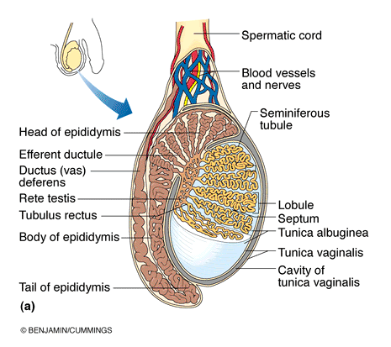
MALE REPRODUCTIVE SYSTEM

Slide 19
MALE REPRODUCTIVE SYSTEM
3. Epididymis
Highly folded duct approximately 6m long, for the passage of sperm from the testis to the vas deferens.
It has 3 divisions:
Head: connected to the testes receiving immature sperm
Body
Tail: continuous with the vas deferens, contains smooth muscle and during ejaculation, contractions of the smooth muscle expel mature sperm into the vas deferens.
Sperm may be stored in the epididymis from 18 hours - 20 days.
During this time the sperm matures, including becoming motile, so they can fertilize an ovum.

Slide 20
MALE REPRODUCTIVE SYSTEM

Slide 21
MALE REPRODUCTIVE SYSTEM
4. Vas (Ductus) deferens
Short, fairly straight tube approximately 45 cm long.
Ascends from the scrotum into the abdomen and passes over the bladder.
Tube cut in vasectomy
Doesn’t affect erection or performance
Supplied by testicular artery and drained by testicular veins
Functions
Stores mature sperms
Carries the sperm to the ejaculatory duct
Notes:
At the posterior wall of the bladder the tubes expand to form "ampulla of the vas deferens" and join a duct from the seminal vesicles to form the "ejaculatory duct".

Slide 22
MALE REPRODUCTIVE SYSTEM

Slide 23
MALE REPRODUCTIVE SYSTEM
5. Seminal Vesicles
2 glands behind prostate gland, size & shape of finger (5cm long)
secretes viscous fluid = 60-70% of seminal fluid (nourish & energize sperm)
Also secrete fructose, citric acid, amino acids and Prostaglandins.

Slide 24
MALE REPRODUCTIVE SYSTEM
6. Ejaculatory ducts
Short tubes that descend through the prostate gland
Function
Carries the spermatozoa and the seminal fluid to the urethra.

Slide 25
MALE REPRODUCTIVE SYSTEM
7. Prostate gland
Chestnut-sized gland below bladder.
Surrounds the ejaculatory duct and part of the urethra.
Secretes a thin liquid that is milky, alkaline and constitutes 30% of the seminal fluid volume
Responsible for raising the pH of the female vagina.
Provides lubrication during coitus

Slide 26
MALE REPRODUCTIVE SYSTEM
8. Cowper’s (Bulbourethral) Glands
The bulbourethral glands, also called Cowper glands, are two small glands located on the sides of the urethra just below the prostate gland.
These glands produce a thick, clear, slippery mucoid fluid before ejaculation (at the tip of the penis) that empties directly into the urethra.
It produces alkaline substance that protects the sperm from acidic vaginal environment.

Slide 27
ASSIGNMENT
DISCUSS THE PROCESS OF SPERMATOGENESIS

Slide 28
FEMALE REPRODUCTIVE SYSTEM

Slide 29
FEMALE REPRODUCTIVE SYSTEM
Objectives
Relate the structure (anatomy) and functions (physiology) of the female reproductive system.
Apply concepts of RH in providing quality maternal and newborn care.

Slide 30
FEMALE REPRODUCTIVE SYSTEM
Mammary glands
Physiology of Lactation
External genitalia (Vulva)
Perineum
Mons pubis
Clitoris
Labias (Minora,Majora)
Urethral Orifice
Hymen
Vestibule
Internal
Vagina
Cervix
Uterus
Fallopian tubes
Ovaries
Physiology of menstruation (menstrual cycle)

Slide 31
FEMALE REPRODUCTIVE SYSTEM
MAMMARY GLANDS
Present in both sexes but only become functional in women
Only of importance functionally after childbirth to produce milk for feeding the baby.
Each mammary gland is contained within a rounded, skin- covered breast.
In the centre of each breast is a slightly hollowed area, darker than skin, called the areola, surrounds the central nipple.
In the areola there are large sebaceous glands that give it a lumpy texture and appearance.
Both the areola and nipple are innervated by the autonomic nervous system and become erect by tactile and sexual stimuli (also cold temperatures)

Slide 32
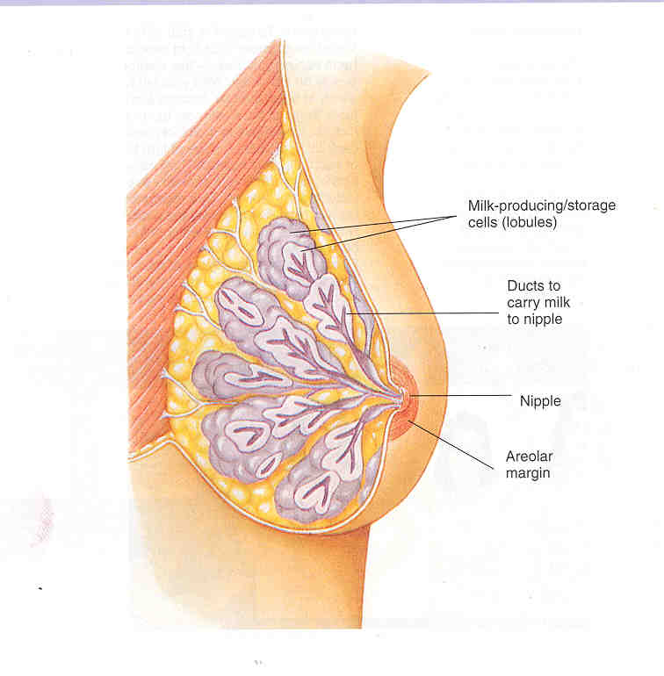

Slide 33
FEMALE REPRODUCTIVE SYSTEM
Internal Structure of Mammary Gland
Each mammary gland is made up or 15-25 lobes that radiate around the nipple
Each lobule is connected by lactiferous ducts that open into the nipples (gets milk to nipple)
Lobes contain
Alveolar glands that produce milk during lactation
Lobes are separated by connective tissue and fat
There are suspensory ligaments in the connective tissue that attach the breasts to the pectoral muscles of the chest

Slide 34
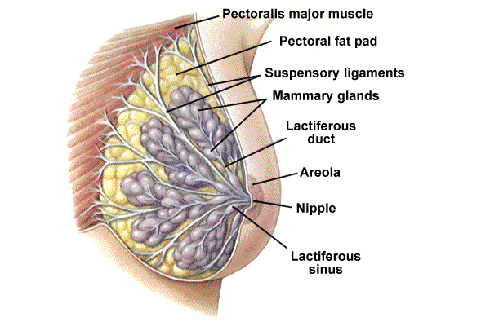

Slide 35
FEMALE REPRODUCTIVE SYSTEM
EXTERNAL GENITALIA
Collectively called the Vulva
Blood supply to vulva
Comes from internal pudental arteries and drains through corresponding veins.
Lymphatic drainage
This is mainly via the inguinal glands
Nerve supply
This is derived from branches of the pudental nerve. The vaginal nerves supply the erectile tissue of the vestibular bulbs and clitoris and their parasympathetic fibres have a vasodilator effect.

Slide 36
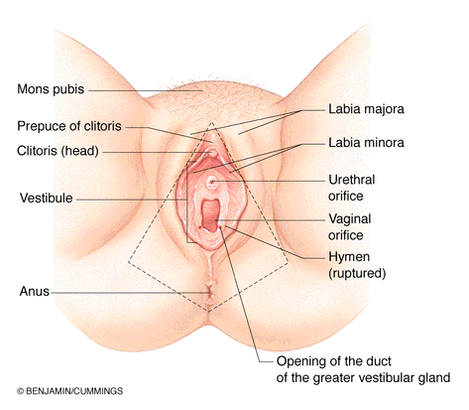
i). Mons Pubis
Fatty, rounded area over the pubic area.
During adolescence sex hormones trigger the growth of pubic hair on the mons pubis.

Slide 37
FEMALE REPRODUCTIVE SYSTEM
ii). Labia Majora
2 fatty skin folds that are homologous with the male scrotum
“Outer lips” – darker pigmentation
Protective covering
Are covered with hair and sebaceous glands
Become flaccid with age and after childbirth
Swell during intercourse

Slide 38
FEMALE REPRODUCTIVE SYSTEM
iii). Labia Minora
“Inner lips”
smaller folds covered with mucosa and richly supplied with sebaceous glands
Made up of erectile, connective tissue that darkens and swells during sexual arousal
Located inside the labia majora
They are more sensitive and responsive to touch than the labia majora
The labia minora tightens during intercourse

Slide 39
FEMALE REPRODUCTIVE SYSTEM
iv). Clitoris
Contains erectile cavernous tissue like the penis
Richly supplied with nerves, and so is one of the most sensitive areas for women
Engorges with blood upon sexual arousal
Housed in a hood of tissue (prepuce) formed by the junction of labia minora
Highly sensitive organ composed of nerves, blood vessels, and erectile tissue
Key to sexual pleasure for most women

Slide 40
FEMALE REPRODUCTIVE SYSTEM
v). Urethral Orifice
Opening located directly below clitoris
Passage of urine
vi). Vaginal Orifice
Opening may be covered by a thin sheath called the hymen
Using the presence of an intact hymen for determining virginity is erroneous
Some women are born without a hymen
The hymen can be perforated by many different events

Slide 41
FEMALE REPRODUCTIVE SYSTEM
Hymen at distal end (external opening) there may be an extension of the mucosa partly or completely covering the vaginal orifice
highly vascular and often bleeds after first sexual intercourse as it is ruptured

Slide 42
FEMALE REPRODUCTIVE SYSTEM
vii). Vestibular Glands
Greater vestibular (Bartholin's)
2, posterior, mucous secreting, can plug and make cysts, reservoir for VD
Lesser vestibular (Skene's)
2, anterior to opening of the vagina, mucous producing

Slide 43
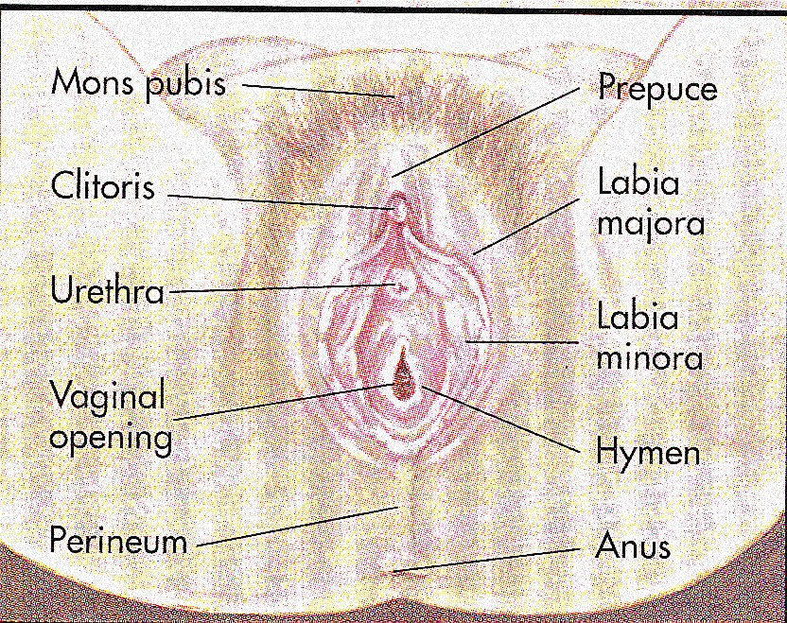

Slide 44
FEMALE REPRODUCTIVE SYSTEM
viii). Perineum
The muscle and tissue located between the vaginal opening and anal canal
It supports and surrounds the lower parts of the urinary and digestive tracts
The perineum contains an abundance of nerve endings that make it sensitive to touch
An episiotomy is an incision of the perinium used during childbirth for widening the vaginal opening

Slide 45
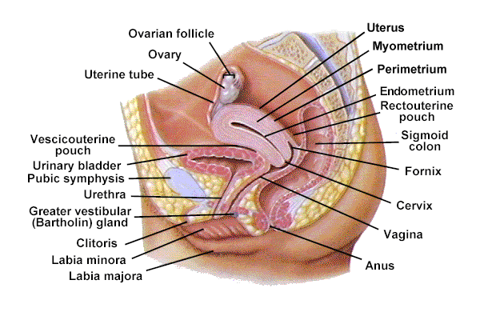

Slide 46
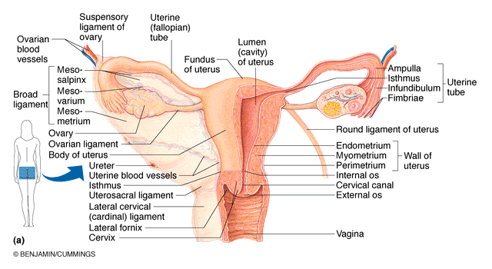
FEMALE REPRODUCTIVE SYSTEM

Slide 47
INTERNAL FEMALE GENITALIA
Internal female genitalia comprises the following;
Vagina
Cervix
Uterus
Fallopian tubes
Ovaries
Notes:
These ligaments work with the Round and Uterosacral ligaments to suspend female reproductive system in the lower abdomen
Significantly different from males where all structures hang

Slide 48
FEMALE REPRODUCTIVE SYSTEM
1. Vagina
Thin-walled, fibromuscular tube, 8-10 cm long
Position
Lies between the bladder (anteriorly) and rectum (posteriorly)
Extends from cervix of uterus to exterior of body (vulva)

Slide 49
FEMALE REPRODUCTIVE SYSTEM
Layers
The vaginal walls are pink in color thrown into small folds called rugae which stretch during intercourse and child birth.
The inner lining is made up of squamous epithelial cells, beneath – a layer of vascular connective tissues
The muscular layer made up of muscular fibres
outside – the pelvic fascia surrounds the vagina forming a layer of connective tissue.

Slide 50
Blood supply
The vaginal artery and descending uterine artery and drains through corresponding veins
Lymphatic drainage – through the inguinal glands
Nerve supply
Derived from pelvic plexus and follows the vaginal arteries to supply the vagina and erectile tissue of vulva.

Slide 51
FEMALE REPRODUCTIVE SYSTEM
Contents
Contains vaginal fluids which are acidic in nature (pH 4.5)
Maintained by glycogen stores that are used by resident normal Flora
Keeps vagina healthy – preventing growth of pathogenic bacteria and parasite infestation.
Low (acidic) pH is hostile to the sperm (High (alkaline) pH of seminal secretions aid to neutralize the acidic pH of the vagina and enhance survival of sperm)

Slide 52
There are normal bacteria/contents called lactobacilli.
Lubrication is through cervical mucus and exudates from blood vessels in the vaginal lining and two Bartholin’s glands (outside vagina)
Functions of the Vagina
Provides exit for fetus during delivery (birth canal)
Allows passage/escape of menses
Receives penis and ejected spermatozoa during sexual intercourse (Female corpulatory organ)

Slide 53
2. Cervix
Neck or narrow outlet of the uterus. It connects the uterus to the vagina.
It has two openings:-
The internal OS (mouth) – opens into the isthmus
The external OS – opens into the vagina
The cervical opening to the vagina is small. This acts as a safety precaution against foreign bodies entering the uterus
During childbirth, the cervix dilates to accommodate the passage of the fetus
This dilation is a sign that labor has begun

Slide 54
FEMALE REPRODUCTIVE SYSTEM
Where the cervix projects into it the vault forms a circular recess that is described as four arches or fornices. Anterior fornix, posterior fornix, lateral fornices
Fornix at proximal end (meets cervix of uterus) there is a fold - this is a potential site for infection in the female reproductive tract.

Slide 55
FEMALE REPRODUCTIVE SYSTEM
3. Uterus
Structure of the Uterus
Hollow, thick-walled organ – womb
It is 7.5cm long, 5 cm wide and 2.5 cm in depth.
Before first pregnancy it is the size and shape of a pear
after first child remains a bit larger
Main function of the uterus is to nourishe the fertilized egg
It prepares for this possibility every month and shades off if pregnancy does not occur.
After pregnancy it expels the uterine contents.

Slide 56
FEMALE REPRODUCTIVE SYSTEM
Position of the Uterus
It is situated in the cavity of true pelvis
Anteriorly- the bladder and uterovesical pouch.
Posteriorly – rectum and recto-uterine pouch of douglas
Laterally– broad ligaments, uterine tubes and ovaries
Superiorly – the intestines
Inferiorly – the vagina
The uterus leans forward (anteversion) and bends forward (anterflexion)

Slide 57
FEMALE REPRODUCTIVE SYSTEM
Uterine/Pelvic Ligaments
Uterus is supported by pelvic floor muscles and maintained in position by several ligaments namely:-
Transverse cervical ligaments Broad ligaments
Uterosacral ligaments Ovarian Ligaments
Pubocervical ligaments Round ligaments
a). Transverse cervical ligaments – from the sides of the cervix to pelvic walls
b). Utero sacral ligaments – Pass backwards from the cervix to the sacrum

Slide 58
FEMALE REPRODUCTIVE SYSTEM
c). Pubocervical ligaments – Pass from cervix, under bladder to the pubic bones.
d). Broad ligaments – spread from the sides of the uterus to the side walls of the pelvis.
e). Ovarian ligaments – Holds the tubes and ovary.
f). Round ligament – Attached to the uterine body below the tubes and broad ligaments and also help to maintain the anteverted position of the uterus.

Slide 59
These ligaments work with the Round and Uterosacral ligaments to suspend female reproductive system in the lower abdomen
Significantly different from males where all structures hang

Slide 60
FEMALE REPRODUCTIVE SYSTEM
Parts of the Uterus
Cervix (neck)
Neck or narrow outlet of the uterus. It projects into the vagina.
It has two openings:-
The internal OS (mouth) – opens into the isthmus
The external OS – opens into the vagina. The cervical canal opens between the two ora and is a continuation of the uterine cavity.
Cervical canal- continuation of the uterine cavity. Lies btn two ostia.
Isthmus
The slightly narrow area between the uterine cavity and cervix (7mm long).
Body or corpus
Major hollow part of the uterus;upper 2/3 of the uterus.

Slide 61
FEMALE REPRODUCTIVE SYSTEM
Parts of the Uterus
Cavity
The potential space between the anterior and posterior walls. Triangular in shape.
Fundus
Rounded region between the insertion of fallopian tubes; the domed upper wall.
Cornua
Upper outer angles where the uterine tubes join

Slide 62
Female Reproductive System

Slide 63
FEMALE REPRODUCTIVE SYSTEM
Three main layers of the uterus include;
Endometrium- Mucosal lining which keeps on changing its thickness during the various stages of the menstrual cycle. Site of implantation for an embryo.
Myometrium – Thick smooth muscle layer – this is the middle layer which is muscular in nature and contracts in childbirth to expel the baby down the cervical os.
Perimetrium - The outermost layer which is a double serous membrane.

Slide 64
Female Reproductive System
Broad ligament helps keep the uterus and fallopian tubes in place.

Slide 65
FEMALE REPRODUCTIVE SYSTEM
Blood supply
The uterus is supplied by uterine arteries and drained via corresponding veins.
The endometrium receives a rich blood supply from a complex network in the myometrium so that it can respond to hormonal changes in the blood
Eg. Pregnancy, stages of menstrual cycle
Lymphatic drainage
Through the internal iliac glands and other pelvic glands.

Slide 66
FEMALE REPRODUCTIVE SYSTEM
4. Fallopian/Uterine Tubes (Oviduct)
Two fine tubes leading from the ovaries to the uterus.
Tubes approx. 10 cm long, 1 cm diameter.
Position
Attached to the uterus by means of ligaments
Fallopian tubes are NOT in direct contact with ovaries
When an oocyte is released from the ovary it moves into the peritoneal cavity.
It must reach the mouth of the fallopian tube to be fertilized.

Slide 67
FEMALE REPRODUCTIVE SYSTEM
Functions of Fallopian tubes
At ovulation, a current draws the oocyte into the fallopian tube through finger-like projections called fimbriae
Receives the spermatozoa as they travel upwards as well as the ruptured oozyte from the ovary.
Provides site for fertilization
They contain cilia and circular smooth muscle lining which propels the fertilized ovum towards the uterus.
Secrets nutritive substances that supplies fertilized ovum with nutrition during its continued journey to the uterus.

Slide 68
FEMALE REPRODUCTIVE SYSTEM
Layers
The lining – inner ciliated epithelium
The muscle layers produce peristaltic movement which aids the ovum in its movement to the uterus
Outer layer – serous membranes conitinuous with the peritoniaum

Slide 69
FEMALE REPRODUCTIVE SYSTEM
Parts of the Fallopian tubes
The isthmus – the narrow part that extends for 2cm from the uterus
The ampulla – the wide part where fertilization occurs. It is 5cm long.
The infundibulum – funnel shaped structure.
Narrows into the ampulla
Constricts further into isthmus as it enters uterus
Fimbriae- finger-like projections

Slide 70
FEMALE REPRODUCTIVE SYSTEM
Tubal ligation, commonly knows as "getting your tubes tied," is a surgical sterilization technique for women.
This procedure closes the fallopian tubes, and stops the egg from traveling to the uterus from the ovary.
It also prevents sperm from reaching the fallopian tube to fertilize an egg.
In a tubal ligation, fallopian tubes are cut, burned, or blocked with rings, bands or clips.
The surgery is effective immediately.
Over 98% effective as birth control.
They do not protect against reproductive tract infections, including HIV/AIDS.

Slide 71
FEMALE REPRODUCTIVE SYSTEM
5. Ovaries
2 almond sized glands, either side of uterus.
Components of the female reproductive system and the endocrine system.
Position, attached to the back of the broad ligaments within the peritoneal cavity.
Relations
Anterior- Broad ligaments
Posterior- Intestines
Lateral- Infundibulopelvic ligaments
Superior- Uterine tubes
Medial- Ovarian ligaments and the uterus.

Slide 72
Functionally, Ovaries;
Produce oocytes. They develop & expel 1 ovum monthly. A woman is born with about 400,000 immature eggs called follicles. During a lifetime a woman releases about 400 to 500 fully matured eggs for fertilization
Produce sex hormones, estrogen and progesterone. These hormones prepare the uterus for implantation of the fertilized egg

Slide 73
Each ovary is covered by 3 layers of epithelial cells – each with different functions:
Nurture developing follicles, secrete hormones, blood vessels and muscles.

Slide 74
FEMALE REPRODUCTIVE SYSTEM
Structure of the ovaries
The ovary is composed of;
The medulla- Supporting framework made of fibrous tissue, the ovarian blood vessels, lymphatics and nerves travel through it.
The cortex- Functioning part of the ovary containing the ovarian follicles surrounded by stroma. The outer layer is formed of fibrous tissue known as the tunica albuginea
Germinal epithelium- Modification of the peritoneum

Slide 75
The ovary contains many sac-like structures called ovarian follicles
Follicle consists of an immature egg (oocyte) surrounded by several follicle cells named according to its stage of development.
Follicle cells support/nourish ova, secrete estrogen.
Primary Follicle - one layer of follicle cells around ovum
Growing Follicle - >1 layer of follicle cells around ovum
Graafian Follicle - mature oocyte, follicle cells have a fluid filled space between them
Corpus Luteum - follicle cells left behind after the ovum has ruptured at ovulation (makes progesterone)

Slide 76
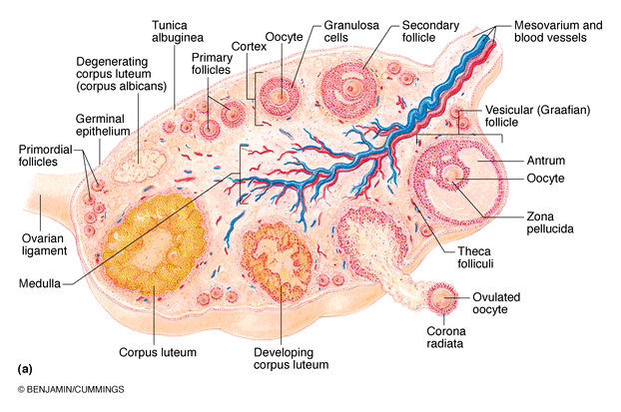
FEMALE REPRODUCTIVE SYSTEM

Slide 77
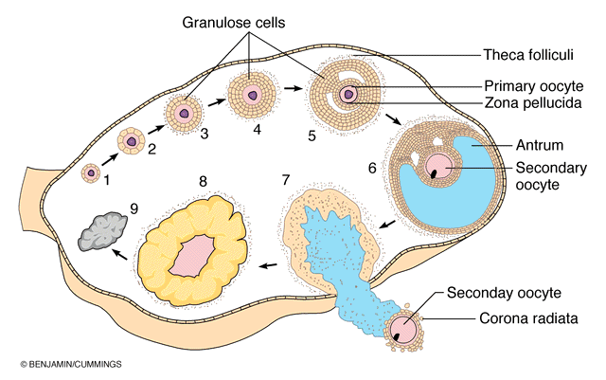
FEMALE REPRODUCTIVE SYSTEM

Slide 78
ASSIGNMENT
Discuss the process of ovulation

