Slide 1
RESEARCH 1
KMTC VOI
MARCH 2020

Slide 5
definitions
Research is a careful investigation or inquiry specifically through search for new facts in any branch of knowledge. It is an original contribution to the existing stock of knowledge making for its advancement.
It’s a task of searching from available data to modify result, theory or facts.

Slide 6
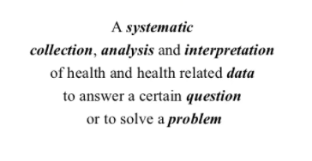
More definitions on the task

Slide 11
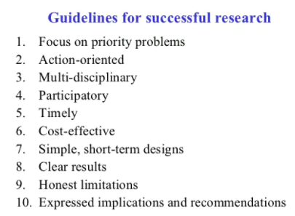

Slide 13
2. TOPIC

Slide 15
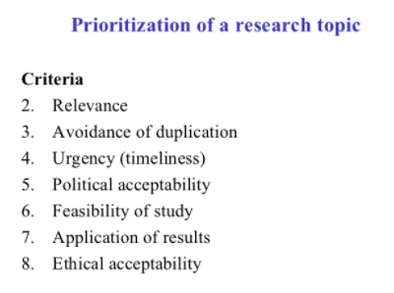

Slide 17
3.ANALYSIS AND STATEMENT OF THE PROBLEM

Slide 21
SNIP BREAK
Q/A SESSION
ASSIGNMENTS
What are some of the types/designs/methods of research
What are the protocols
Literature review
How do we formulate research objectives
Research Methodology

Slide 22
End of introduction

