Slide 1
RESPIRATORY PHYSIOLOGY
HENRY GITONGA

Slide 2
Course outline
Structure of the Respiratory System & thoracic Cavity
Physical Aspects of Ventilation, Intrapulmonary and Intrapleural Pressures, Physical Properties of the Lungs, Surfactant and Respiratory Distress Syndrome
Mechanics of Breathing, Inspiration and Expiration, Pulmonary Function Tests,

Slide 3
…
4. Gas Exchange in the Lungs, Calculation of PO2, Partial Pressures of Gases in Blood, Significance of Blood PO2 and PCO2 Measurements, Pulmonary Circulation and Ventilation/Perfusion Ratios, Disorders Caused by High Partial Pressures of Gases
5. Regulation of Breathing, Brain Stem, Respiratory Centers, Effects of Blood P CO 2 and pH on Ventilation, Effects of Blood P O 2 on Ventilation, Effects of Pulmonary Receptors on Ventilation

Slide 4
..
6. Hemoglobin and Oxygen Transport, Hemoglobin, The Oxyhemoglobin Dissociation Curve, Effect of pH and Temperature on Oxygen Transport, Effect of 2,3-DPG on Oxygen Transport, Inherited Defects in Hemoglobin Structure and Function, Muscle Myoglobin
7. Carbon Dioxide Transport, The Chloride Shift, The Reverse Chloride Shift

Slide 5
..
8. Acid-Base Balance of the Blood, Principles of Acid-Base Balance, Ventilation and Acid-Base Balance
9. Effect of Exercise and High Altitude on Respiratory Function, Ventilation During Exercise, Acclimatization to High Altitude

Slide 6
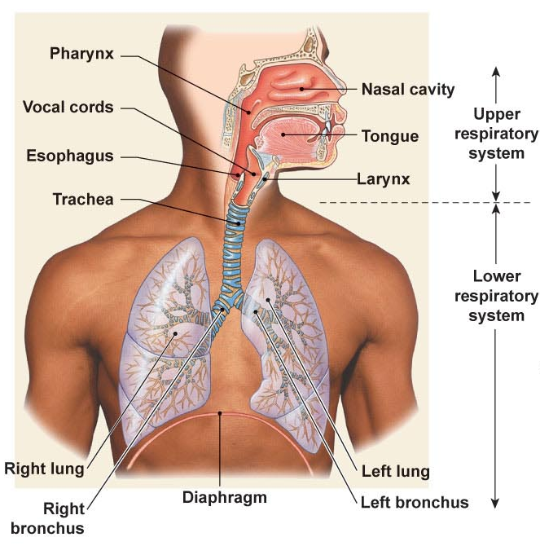
Basics of the Respiratory System
Functional Anatomy
What structural aspects must be considered in the process of respiration?
  The conduction portion
  The exchange portion
  The structures involved with
  ventilation
    Skeletal & musculature
    Pleural membranes
    Neural pathways
All divided into
  Upper respiratory tract
    Entrance to larynx
  Lower respiratory tract
    Larynx to alveoli (trachea
    to lungs)

Slide 7
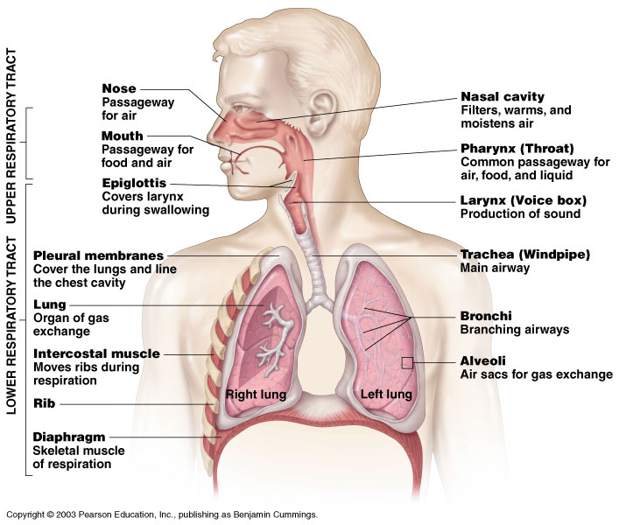
Human Respiratory System
Figure 10.1

Slide 8
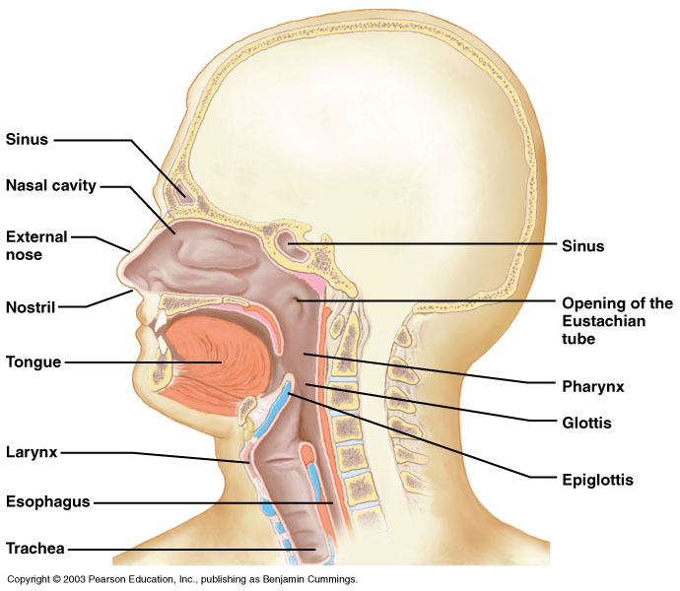
Components of the Upper Respiratory Tract
Figure 10.2

Slide 9
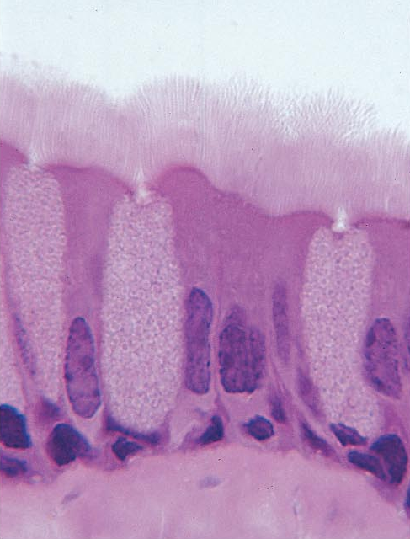
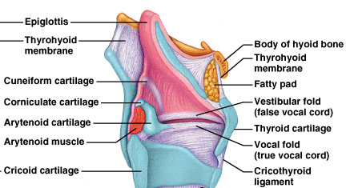
Basics of the Respiratory System
Functional Anatomy
What is the function of the upper respiratory tract?
  Warm
  Humidify
  Filter
  Vocalize
Raises incoming air to 37 Celsius
Forms mucociliary escalator
Raises incoming air to 100% humidity

Slide 10
Upper Respiratory Tract Functions
Passageway for respiration
Receptors for smell
Filters incoming air to filter larger foreign material
Moistens and warms incoming air
Resonating chambers for voice

Slide 11
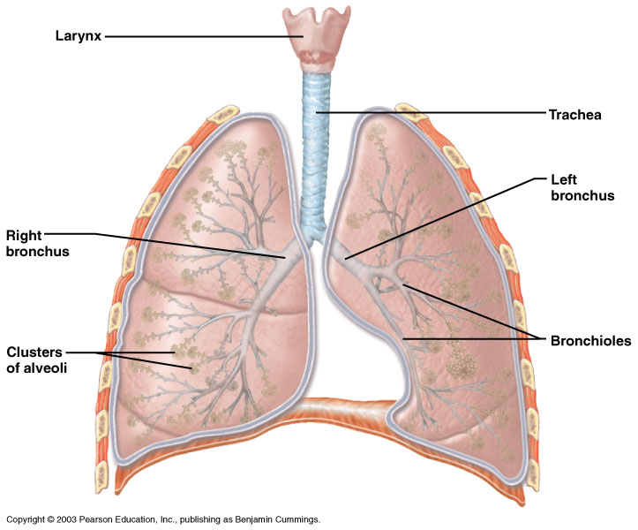
Components of the Lower Respiratory Tract
Figure 10.3

Slide 12
Basics of the Respiratory System
Functional Anatomy
What is the function of the lower respiratory tract?
  Exchange of gases …. Due to
    Huge surface area = 1x10⁵ m² of type I alveolar cells (simple squamous epithelium)
    Associated network of pulmonary capillaries
      80-90% of the space between alveoli is filled with blood in pulmonary capillary networks
    Exchange distance is approx 1 um from alveoli to blood!
  Protection
    Free alveolar macrophages (dust cells)
    Surfactant produced by type II alveolar cells (septal cells)

Slide 13
Lower Respiratory Tract
Functions:
  Larynx: maintains an open airway, routes food and air appropriately, assists in sound production
  Trachea: transports air to and from lungs
  Bronchi: branch into lungs
  Lungs: transport air to alveoli for gas exchange

Slide 14
Organs in the Respiratory System
STRUCTURE | FUNCTION
nose / nasal cavity | warms, moistens, & filters air as it is inhaled
pharynx (throat) | passageway for air, leads to trachea
larynx | the voice box, where vocal chords are located
trachea (windpipe) | keeps the windpipe "open" trachea is lined with fine hairs called cilia which filter air before it reaches the lungs
bronchi | two branches at the end of the trachea, each lead to a lung
bronchioles | a network of smaller branches leading from the bronchi into the lung tissue & ultimately to air sacs
alveoli | the functional respiratory units in the lung where gases are exchanged

Slide 15
DEFINATION
The term respiration includes three separate but related functions:
  ventilation (breathing);
  gas exchange, which occurs between the air and blood in the lungs and between the blood and other tissues of the body; and
  (3) oxygen utilization by the tissues in the energy-liberating reactions of cell respiration.
Ventilation and the exchange of gases (oxygen and carbon dioxide) between the air and blood are collectively called external respiration.
Gas exchange between the blood and other tissues and oxygen utilization by the tissues are collectively known as internal respiration

Slide 16
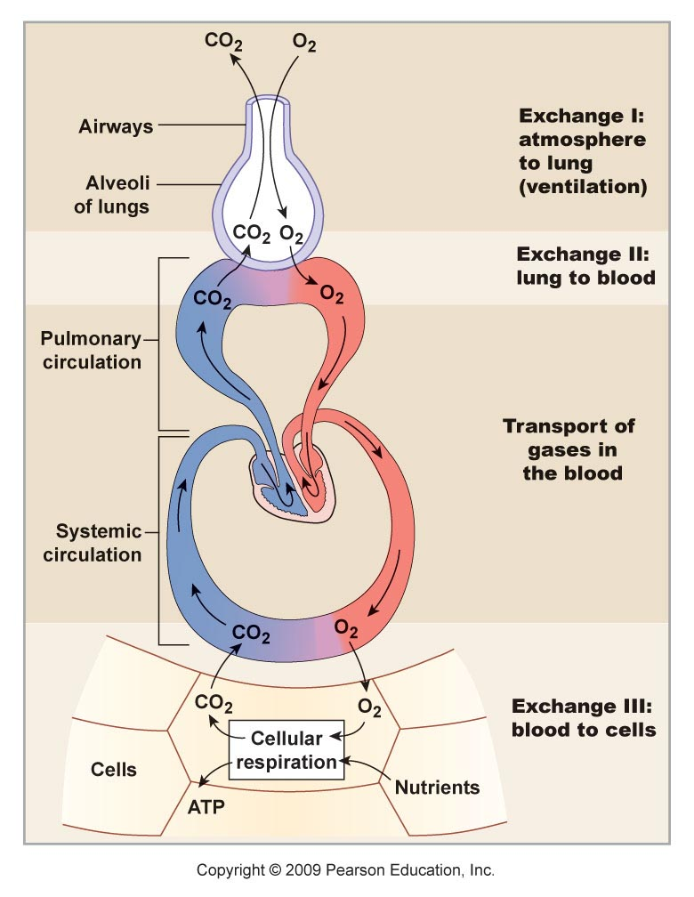
Schematic View of Respiration
External Respiration
Internal Respiration

Slide 17
VENTILATION
Ventilation is the mechanical process that moves air into and out of the lungs. Because the oxygen concentration of air is higher in the lungs than in the blood, oxygen diffuses from air to blood.
Carbon dioxide, conversely, moves from the blood to the air within the lungs by diffusing down its concentration gradient

Slide 18
VENTILATION
blood leaving the lungs (in the pulmonary veins) has a higher oxygen and a lower carbon dioxide concentration than the blood delivered to the lungs in the pulmonary arteries.
Gas exchange between the air and blood occurs entirely by diffusion through lung tissue.
This diffusion occurs very rapidly because of the large surface area within the lungs and the very small diffusion distance between blood and air

Slide 19
Functions of the Respiratory System
Gas Exchange
  O₂, CO₂
Acid-base balance
  CO₂ +H₂O←→ H₂CO₃ ←→ H⁺ + HCO3⁻
Phonation
Pulmonary defense
Pulmonary metabolism and handling of bioactive materials

Slide 20
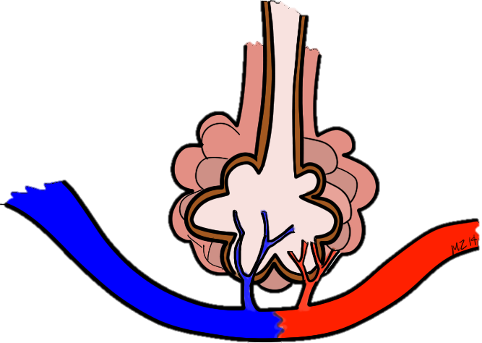
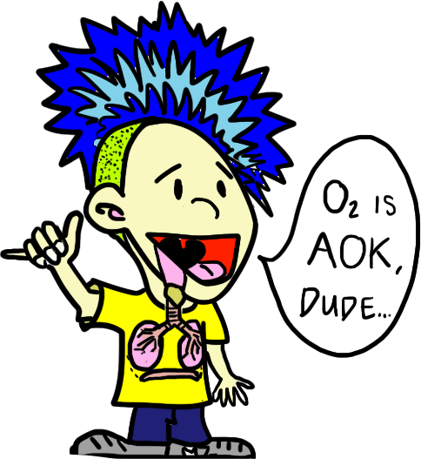
Function: Exchange oxygen and carbon dioxide with the external environment and your internal environment
© 2014 Getting Nerdy, LLC

Slide 21
Structure of the Respiratory
System

Slide 22
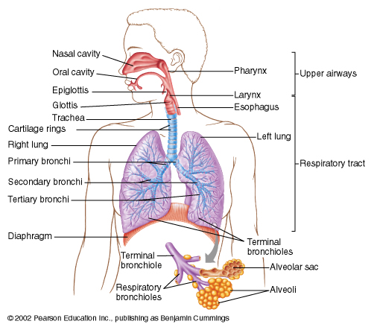
Anatomy of Respiratory Tree

Slide 23
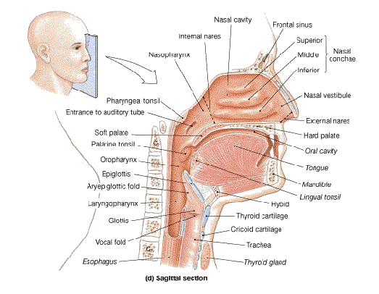
Longitudinal Section

Slide 24
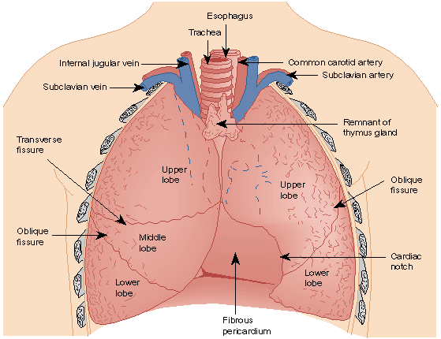
The Thorax and its contents

Slide 25
Functional zones
The respiratory system is divided into:
  1. respiratory zone - site of gas exchange between air and blood. Includes:
      the respiratory bronchioles and
      the terminal alveolar sacs
    2. conducting zone -all of the anatomical structures through which air passes before reaching the respiratory zone.

Slide 26
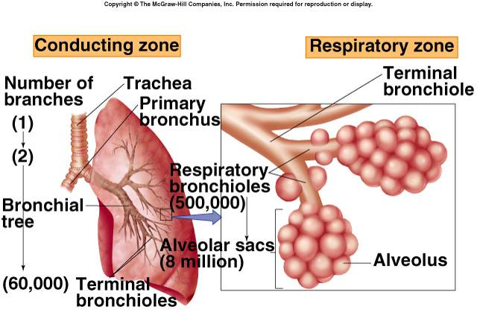
functional Zone

Slide 27
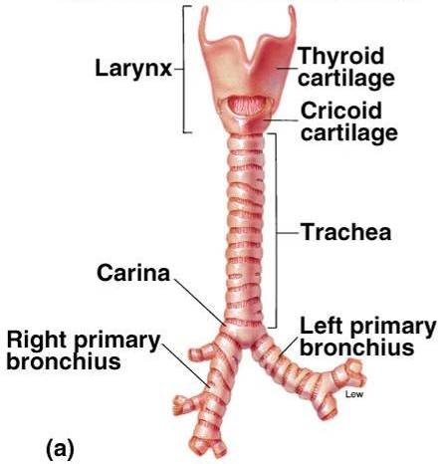
Conducting Zone
Conducting zone:
Includes all the structures that air passes through before reaching the respiratory zone.
Mouth, nose, pharynx, glottis, larynx, trachea, bronchi.

Slide 28
Conducting Airways
Trachea --> right and left main stem bronchi.
Right main stem vulnerable to foreign particles

Slide 29
Conducting zone function..
conducting air into the respiratory zone
warming and humidification of the inspired air, and
filtration and cleaning

Slide 30
..fxns
inspired air reaches the respiratory zone at 37 ° C and saturated with water vapor as it flows over the warm, wet mucous membranes.
Mucus performs a filtration function. This mucus is moved along at a rate of 1 to 2 cm per minute by cilia projecting from the tops of epithelial cells that line the conducting zone.
There are about 300 cilia per cell that beat in a coordinated fashion to move mucus toward the pharynx, where it can either be swallowed or expectorated

Slide 31
….
As a result of this filtration function, particles larger than about 6 μ m do not normally enter the respiratory zone of the lungs.
The importance of this function is evidenced by black lung, a disease that occurs in miners who inhale large amounts of carbon dust from coal, which causes them to develop pulmonary fibrosis.
The alveoli themselves are normally kept clean by the action of resident macrophages.
The cleansing action of cilia and macrophages in the lungs is diminished by cigarette smoke

Slide 32
respiratory Zone

Slide 33
Respiratory Zone
Respiratory zone
Region of gas exchange between air and blood
Respiratory bronchioles
Alveolar ducts, Alveolar Sacs and
Alveoli

Slide 34
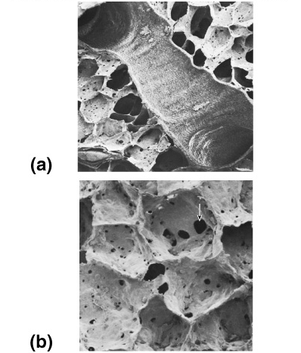
Respiratory Zone
Air duct
Air Sac

Slide 35
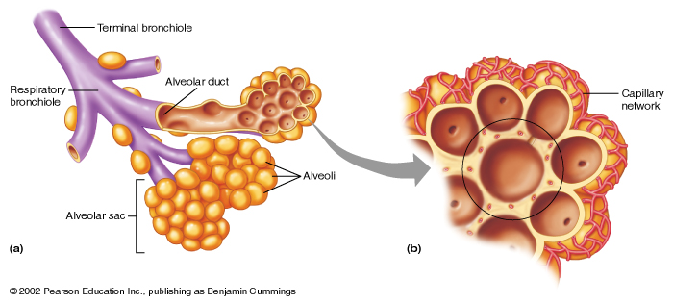
Respiratory Zone

Slide 37
alveoli
Gas exchange in the lungs in alveoli.
Diffusion rate is fast because:
  enormous number (300 million; 0.25 to 0.50 mm in diameter) provides a large surface area (60 to 80 square meters)
  each alveolus is only one cell-layer thick, so that the total “air-blood barrier” is only two cells across (an alveolar cell and a capillary endothelial cell), or about 2 μ m.

Slide 38
..alveolar cells.
There are two types of alveolar cells, designated
type I alveolar cells - structural
type II alveolar cells – secrete surfactant

Slide 39
The type I alveolar cells
comprise 95% to 97% of the total surface area of the lung.
gas exchange occurs primarily through type I alveolar cells
Are very thin because basement membranes of the type I alveolar cells and capillary endothelial cells fuse. the diffusion distance between blood and air can be as little as 0.3 μ m

Slide 40
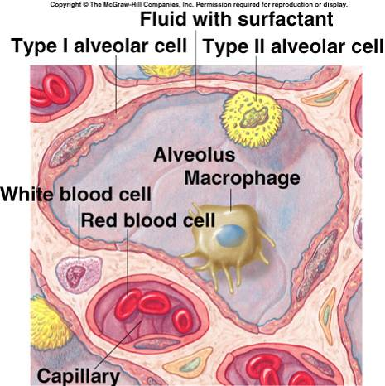

Slide 41
type II alveolar cells
The type II alveolar cells are the cells that secrete pulmonary surfactant and that reabsorb Na + and H 2 O, thereby preventing fluid buildup within the alveoli.

Slide 42
…
Surfactant
produced by alveolar type II cells.
Interspersed among water molecules.
Lowers surface tension.
RDS, respiratory distress syndrome, in preemies.
First breath: big effort to inflate lungs!

Slide 43
NB
Despite all these characteristics, the alveolar wall isn’t fragile but is strong enough to withstand high stress during heavy exercise and high lung inflation.
The great tensile strength of the alveolar wall is provided by the fused basement membranes (composed of type IV collagen proteins) of the blood capillaries and the alveolar walls.

Slide 44
Thoracic Cavity
Diaphragm:
  Sheets of striated muscle divides anterior body cavity into 2 parts.
Above diaphragm: thoracic cavity:
  Contains heart, large blood vessels, trachea, esophagus, thymus, and lungs.
Below diaphragm: abdominopelvic cavity:
  Contains liver, pancreas, GI tract, spleen, and genitourinary tract.

Slide 45
Pleural membranes…
The structures in the central region—or mediastinum —are enveloped by two layers of wet epithelial membrane collectively called the pleural membranes.
The superficial layer, or parietal pleura, lines the inside of the thoracic wall. The deep layer, or visceral pleura, covers the surface of the lungs

Slide 46
Intrapleural space
The lungs normally fill the thoracic cavity so that the visceral pleura covering each lung is pushed against the parietal pleura lining the thoracic wall.
There is thus, under normal conditions, little or no air between the visceral and parietal pleura.
There is, however, a “potential space”—called the intrapleural space —that can become a real space if the visceral and parietal pleurae separate when a lung collapses

Slide 47
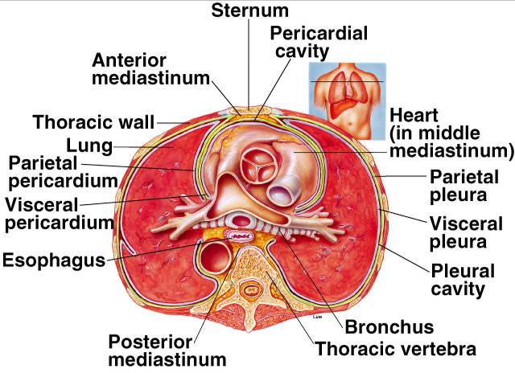
Pleural Layers – Cross Section

Slide 48
Blood Vessels of the Lung
Pulmonary Artery:
  Deoxygenated (venous) cardiac output.
Pulmonary capillaries
  extremely dense
  underground parking garage
Pulmonary Veins:
  Oxygenated (arterial) cardiac output.

Slide 49
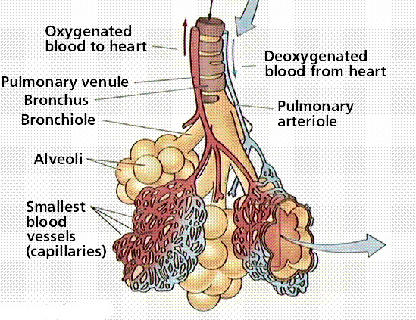
Alveolar capillary interface

Slide 50
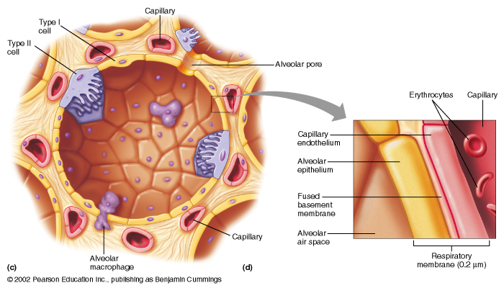
Alveolar capillary interface - schematic

Slide 51
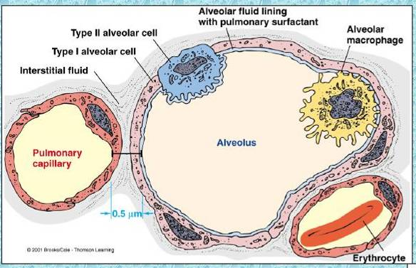
Alveolar capillary interface

Slide 52
THANK YOU

